Slide 1
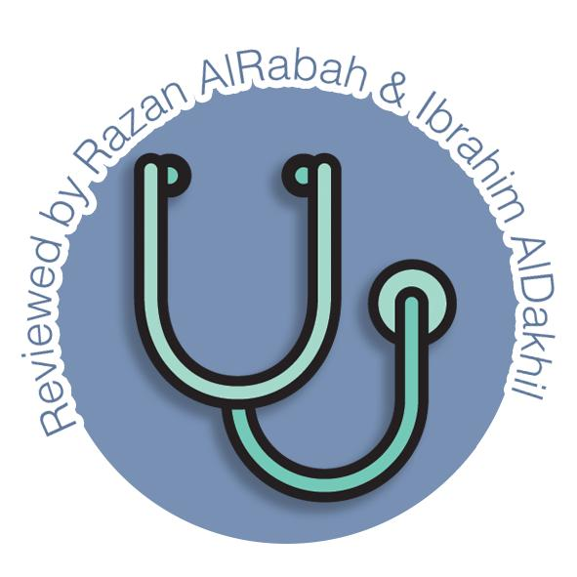
Anatomy of Pancreas
Endocrine block-Anatomy-Lecture 4
Editing file

Slide 2
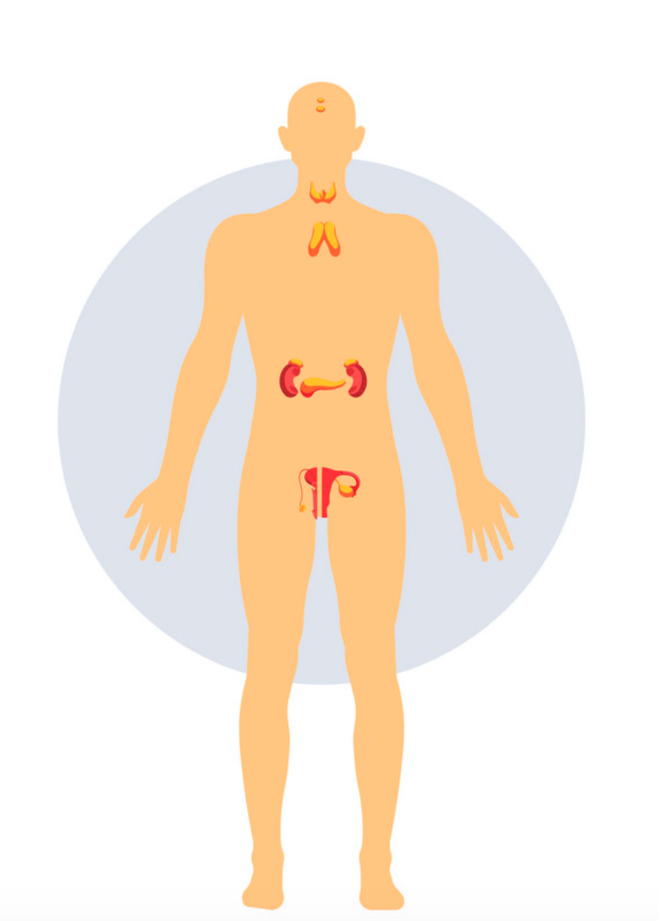
Color guide :
Only in boys slides in Green
Only in girls slides in Purple
important in Red
Notes in Grey
Objectives
At the end of the lecture, students should be able to:
Describe the anatomical view of the pancreas regarding to: location, parts ,relations, ducts
Arterial supply & Venous drainage
Describe the nerve supply and lymph drainage

Slide 3
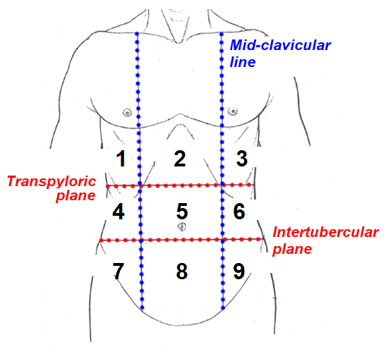
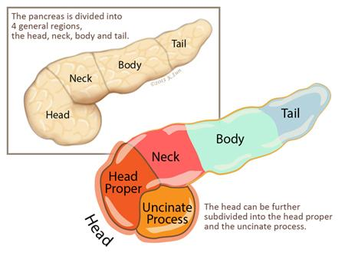
Pancreas
1
Location
The greater part is Retroperitoneal structure, behind the lesser sac.
it lies on the posterior abdominal wall in the Epigastrium & Left upper quadrant of the abdomen.
It extends in a transverse oblique direction at the transpyloric plane (1st lumbar vertebral) from the concavity of the duodenum on the right to the hilum of the spleen on the left. opposite (T12– L3)
because of its oblique direction the tail is higher than the head (at T12).
2
Shape
The pancreas is “J”-shaped or RETORT shaped being set obliquely.
It is Lobulated Because it is surrounded by a fibrous tissue capsule from which septa pass into the gland and divide it into lobes. The lobes are divided into lobules.
3
Size
It is an elongated soft pinkish structure
weight :(60-100) gram
length: (6-10) inch (12–15) cm
4
Parts
It is divided into: •Head •Neck • Body •Tail.

Slide 4
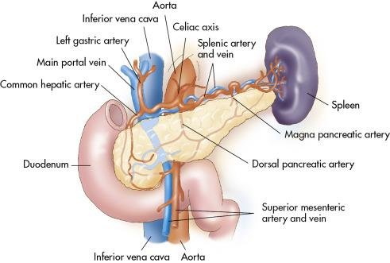
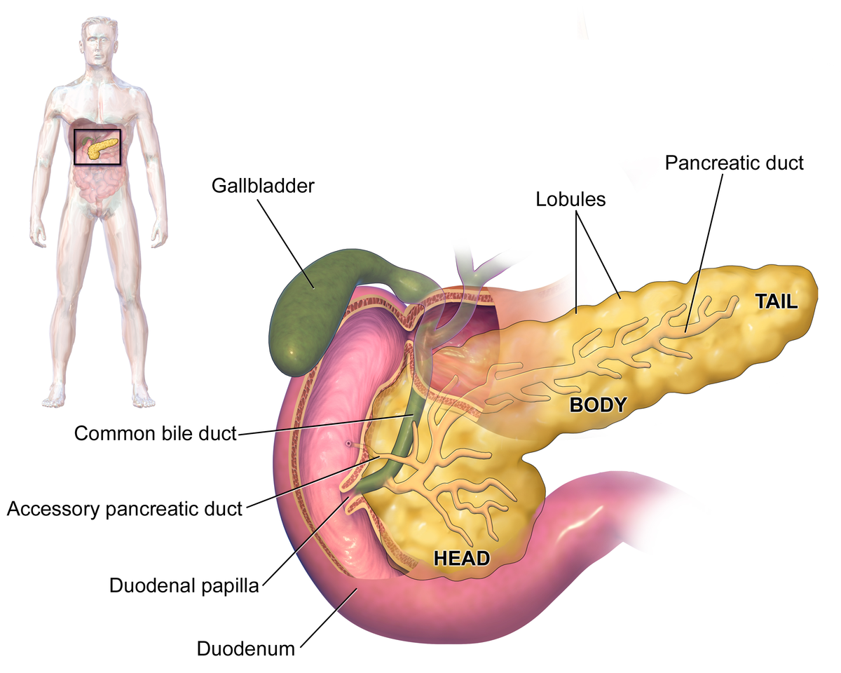
Parts of Pancreas
Head of pancreas
is the enlarged and disc shaped right end of the pancreas with one process called uncinate process
Lies within the concavity of the C-shaped duodenal loop in front of L2)
Related to the 2nd and 3rd portions of the duodenum.
On the left, it emerges into the neck.
On the right, it Includes Uncinate Process ( an extension of the lower part of the head behind the superior mesenteric vessels
Relations
Anterior surface | Posterior surface | Unicate process
The gastroduodenal artery, transverse colon, root of the transverse mesocolon jejunum. | IVC (runs upwards.) left renal vein bile duct (runs downwards and may be embedded in it. (tumor of the head will compression on bile duct lead to obstruction jaundice) right crus of diaphragm | Anterior: superior mesenteric vessels Posterior: abdominal aorta.

Slide 5
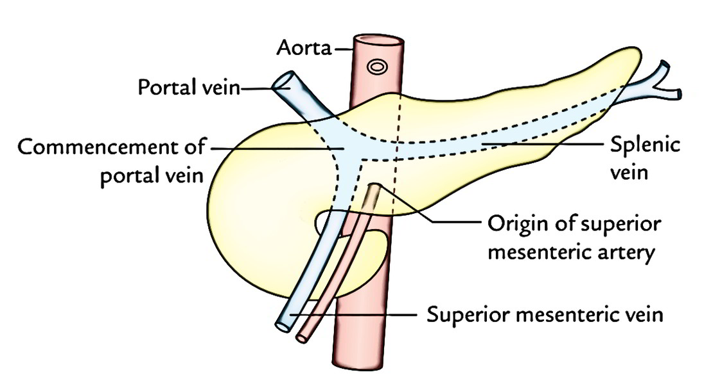
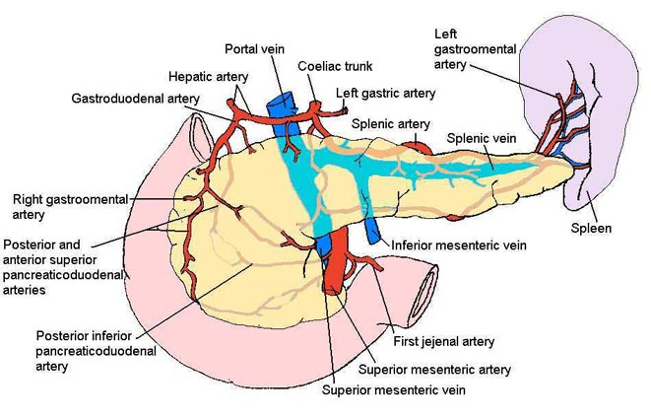
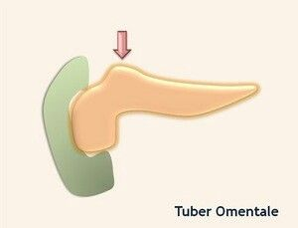
Parts of Pancreas
Neck of pancreas
It is the constricted portion connecting the head & body of pancreas
best defined as “narrow band of pancreatic tissue Lies in front of superior mesenteric and the portal vein”
Relations
Posterior
Aorta
Origin of Superior Mesenteric artery
the confluence of the Portal Vein
Antero-superior: supports the pylorus of the stomach
inferior border: The superior mesenteric vessels emerge
Body of pancreas
It is triangular in cross sections and it runs upward and to the left
lies in front of the vertebral column at or just below the transpyloric plane.
has one process: Tuber omentale ( above the lesser curvature of the stomach and comes in contact with the lesser omentum across the lesser sac).
Relations
Upper border: Splenic Artery runs to the left along the borders
Posterior Surface: Splenic Vein is embedded in it

Slide 6
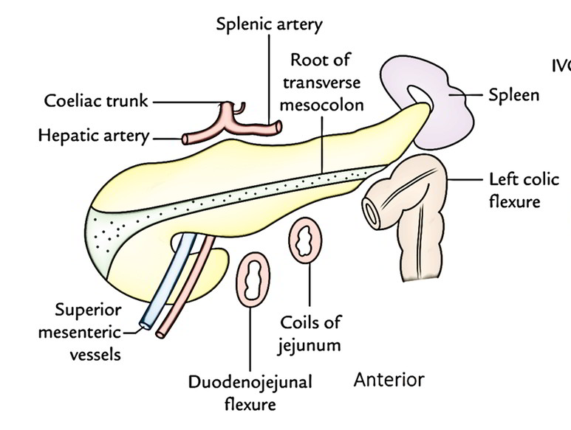
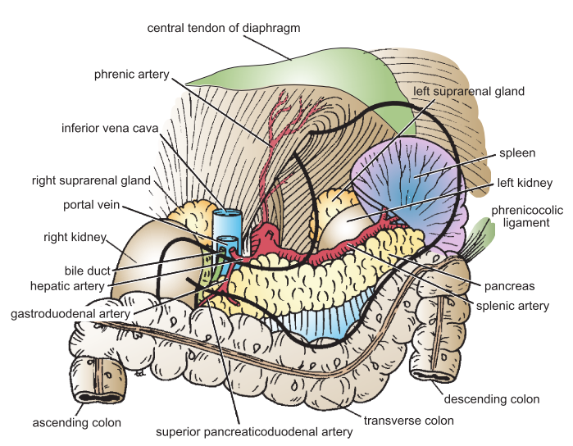
Parts and Relations of Pancreas
Tail of pancreas
A narrow, short segment Ends within the splenic hilum and it It is mobile unlike the other major retroperitoneal parts of the gland.
Lies in the Splenicorenal (lienorenal) ligament (may get injured during splenectomy) along with splenic vessels, at the level of the T12 vertebra
Contains the largest number of islets of Langerhans
Relation
Anteriorly: splenic flexure of colon (May be injured during Splenectomy)
Relations of Pancreas
Anterior (to body and tail) |  | Posterior (to body and tail)
Stomach separated by lesser sac Transverse colon transverse mesocolon |  | Bile duct portal splenic veins, inferior vena cava aorta & origin of superior mesenteric artery.
Left psoas muscle
left renal vessels
left kidney
left adrenal gland
Hilum of the spleen.

Slide 7
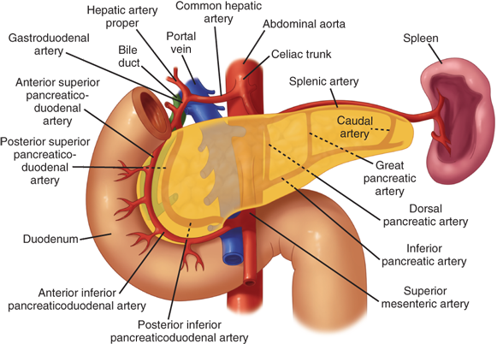
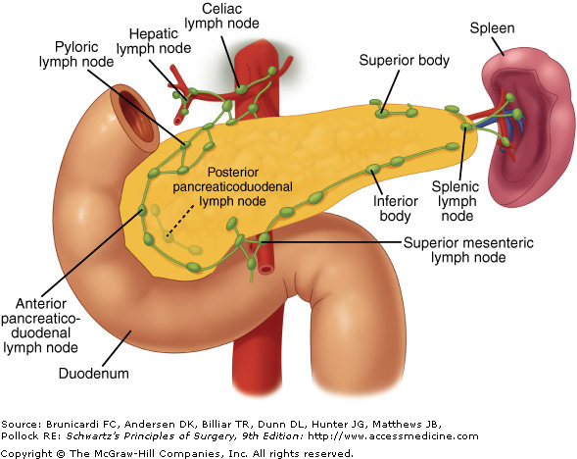
Supply of Pancreas
Arterial supply
Venous drainage
Head and Neck:
Celiac trunk to common hepatic to gastroduodenal to superior pancreaticoduodenal artery
Superior mesenteric to Inferior pancreaticoduodenal
Body and Tail:
Splenic artery (main artery) through about 8-10 branches
Head and neck (body)
Anterior and posterior arcades drain that form superior and inferior pancreaticoduodenal veins
which follow the corresponding arteries
Body and Tail
Splenic vein drains which is a tributary of the portal vein
Lymphatic drainage
Rich network drains into nodes along the upper border of the pancreas called
Pyloric
Hepatic
Splenic nodes
Ultimately the efferent vessels drain into
celiac
superior mesenteric lymph nodes.
Lymph vessels from the region of the Head pass to Superior Mesenteric nodes
Nerve supply
Sympathetic fibers: from the thoracic splanchnic nerves they have a predominantly inhibitory effect.
Parasympathetic fiber: from the Vagus. they stimulate both exocrine and endocrine secretions

Slide 8
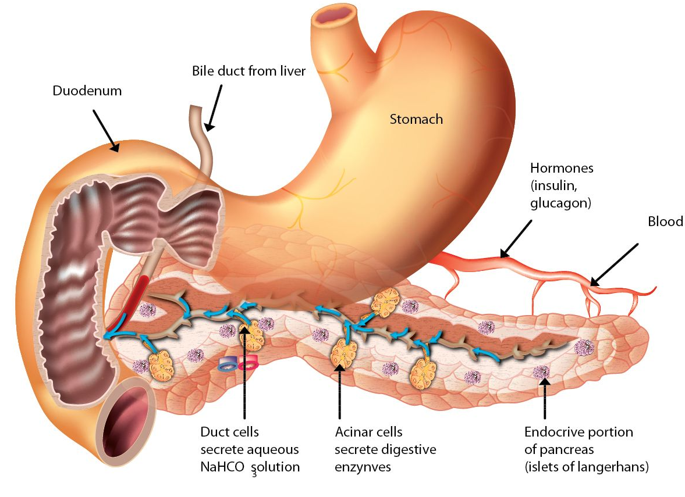
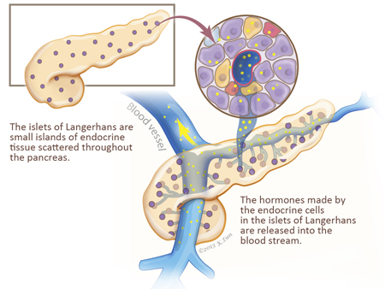
Function of Pancreas
The Exocrine portion
The Endocrine portion
Small ducts arise from the lobules and enter the main pancreatic duct (which begins in the tail), and passes through the body and head where it meets the bile duct.
makes and secretes digestive enzymes into the intestine (Exocrine pancreas)
comprise more than 95% of the pancreatic mass
(Islets of Langerhans) produce insulin, glucagon and somatostatin.
control energy metabolism and storage throughout the body
comprise 1-2% of pancreatic mass
Function

Slide 9
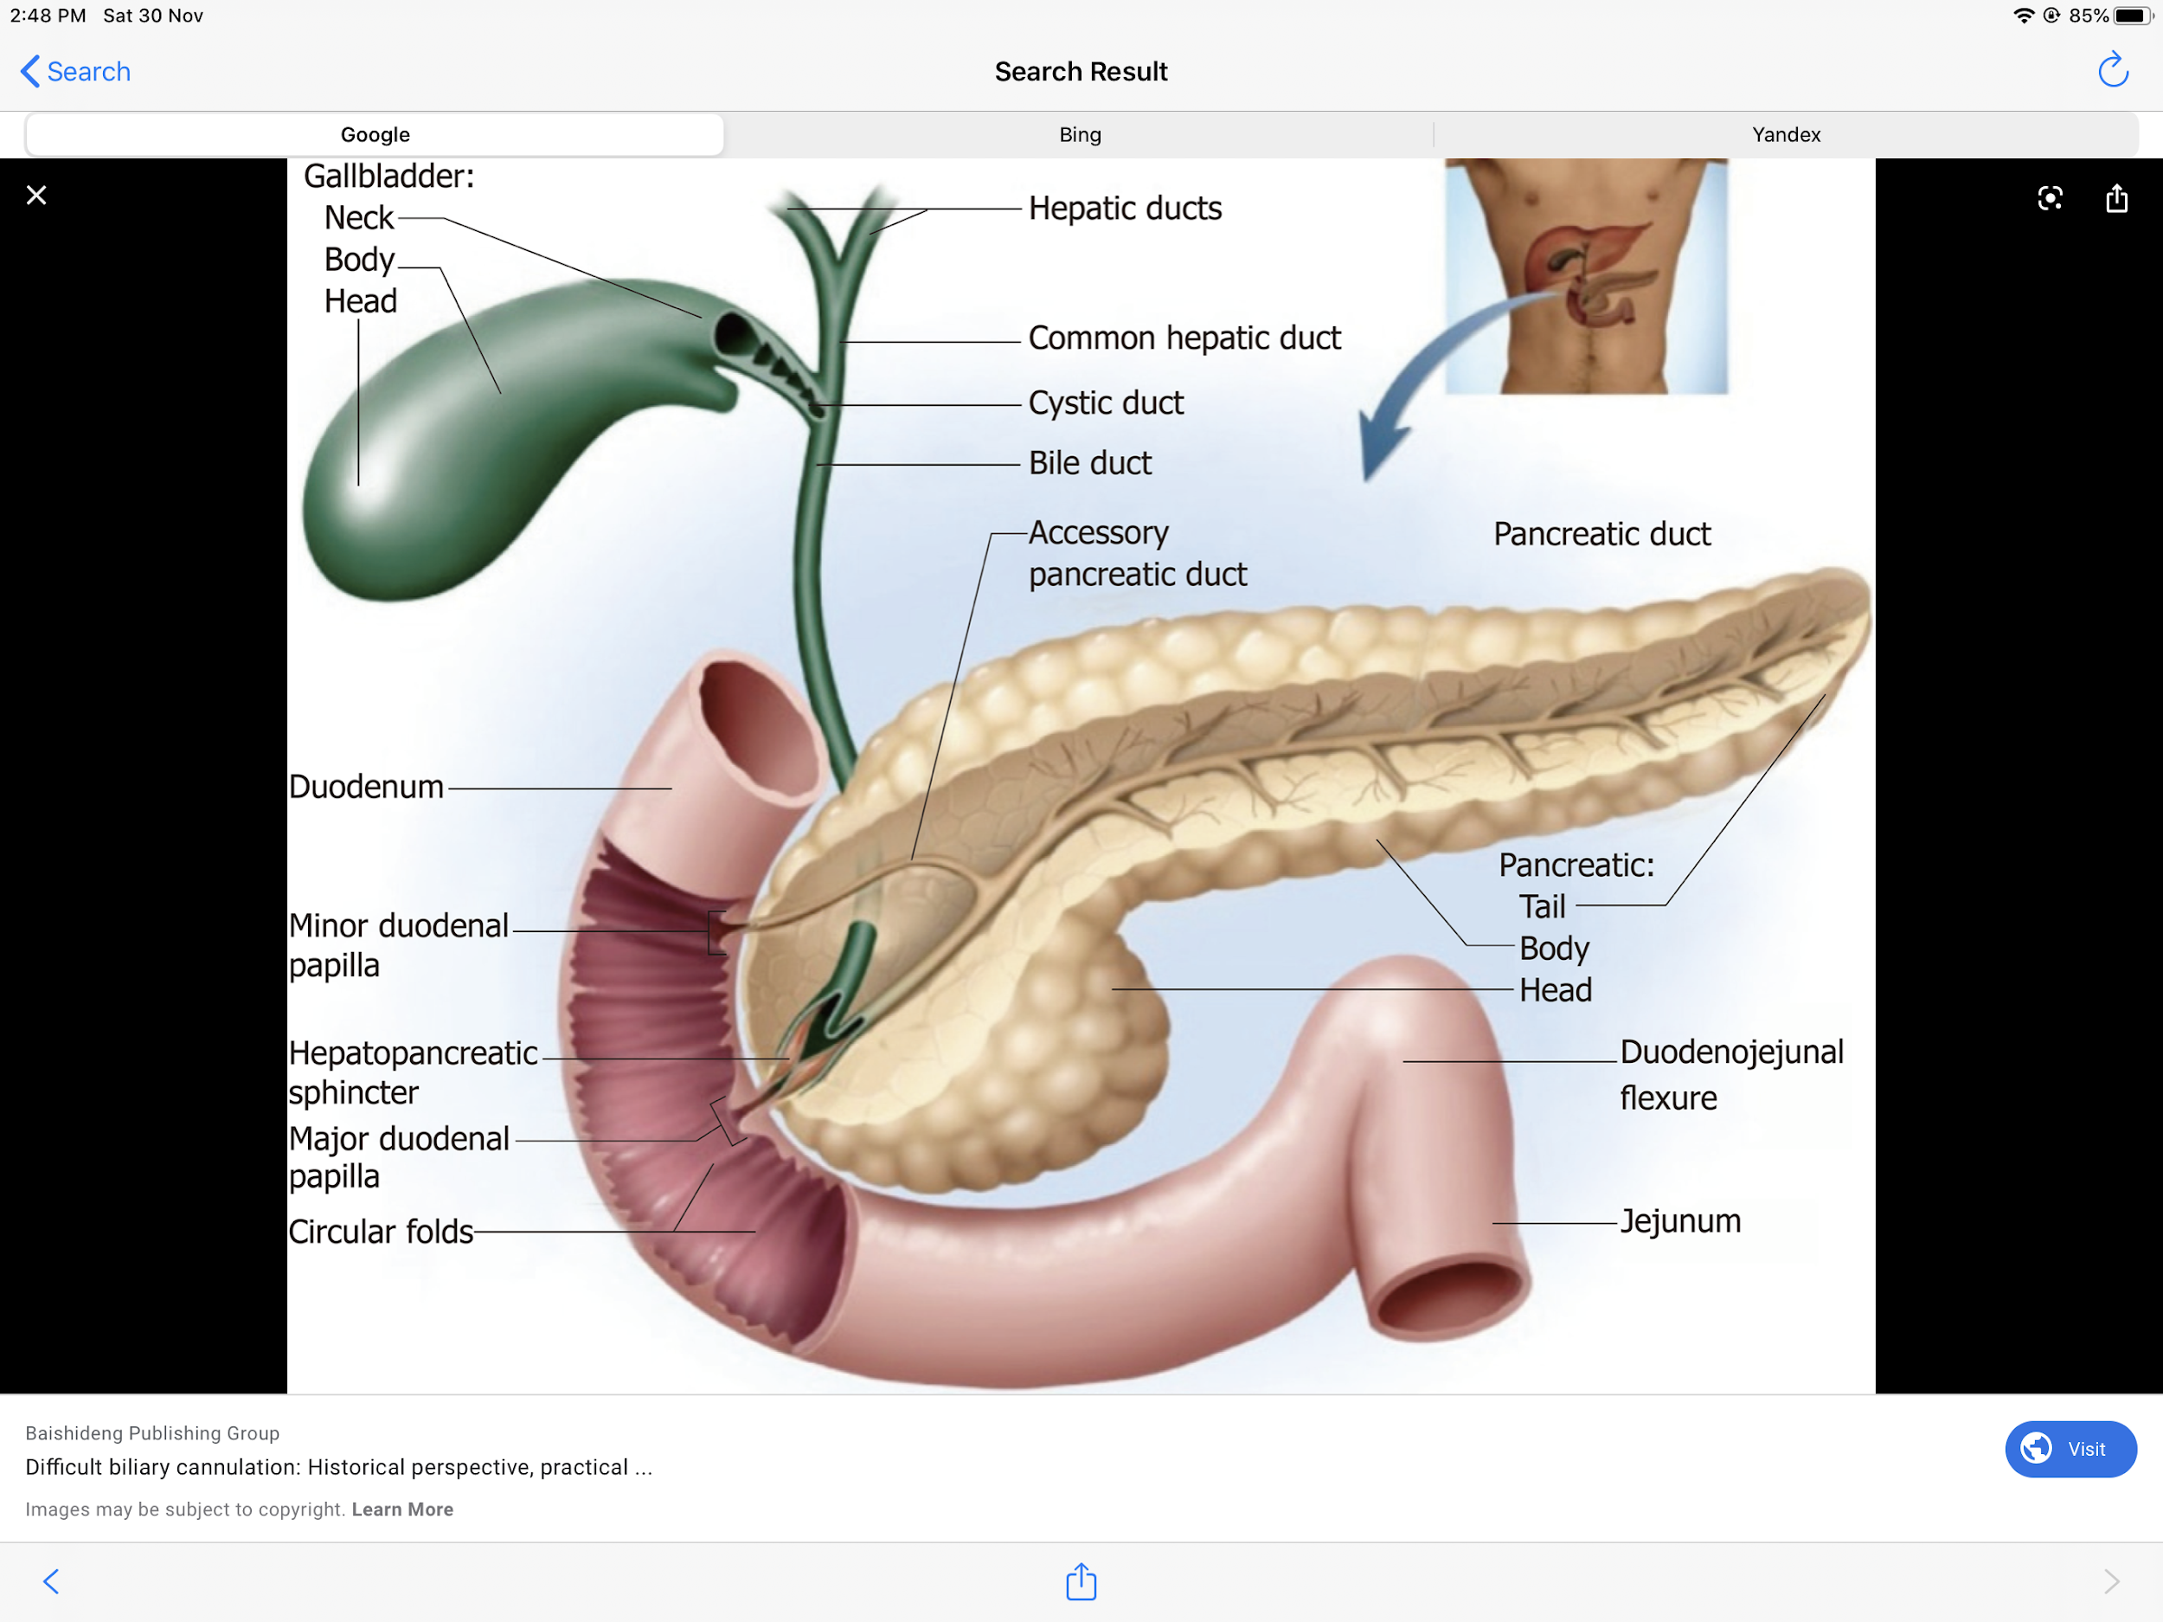
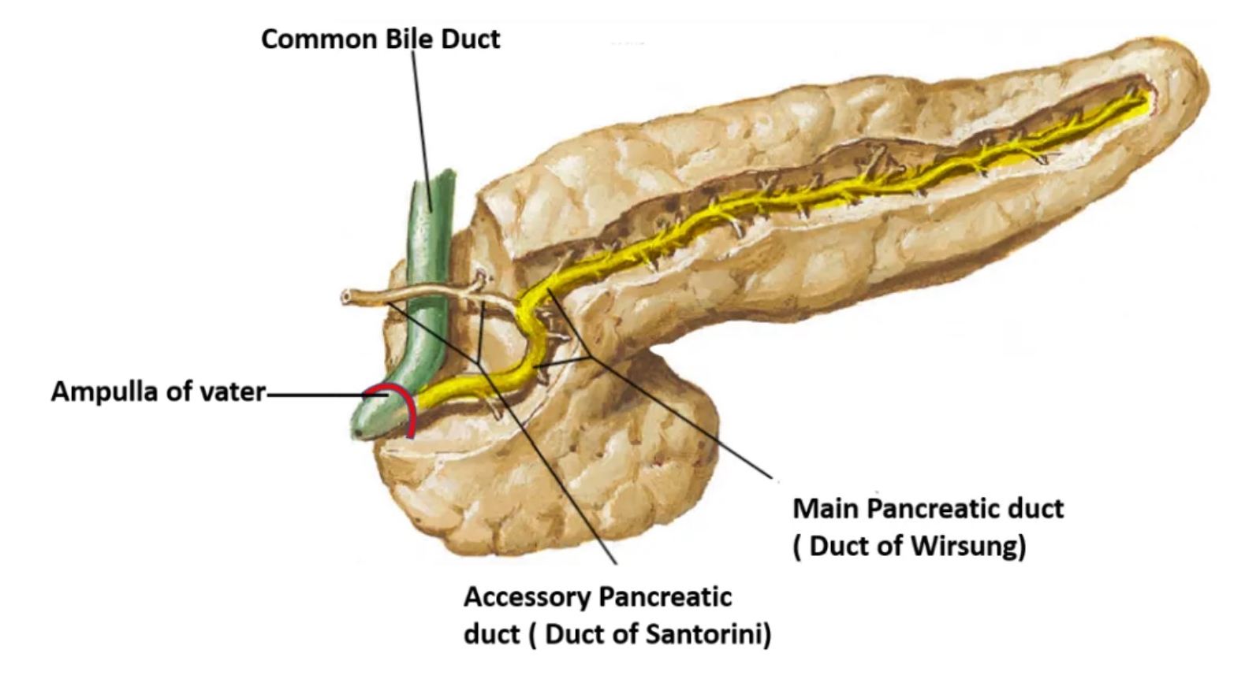
Pancreatic ducts
Main pancreatic duct
(of Wirsung)
runs the entire length of pancreas beginning from the tail.
It drain whole pancreas except upper portion of the head i.e. tail,body, neck, inferior portion of head & uncinate process.
Joins common bile duct & they open into a small hepatopancreatic ampulla in the 2nd part of duodenal wall hepatopancreatic ampulla (Ampulla of Vater).
The ampulla opens by a narrow mouth into the lumen of the duodenum through (Major Duodenal Papilla).
Accessory pancreatic duct
(of Santorini)
Drains superior portion of the head
It empties separately into 2nd portion of duodenum at (minor duodenal papilla) about 2–3 cm above the opening of main pancreatic duct (6–8 cm distal to pylorus)

Slide 10
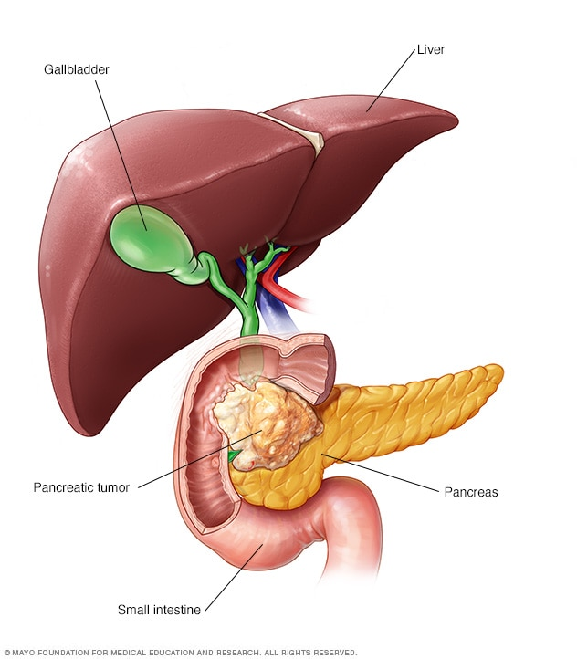
Clinical Anatomy
Only found in male’s slides
Carcinoma of the head of pancreas
Is common.
Compresses the bile duct leading to persistent
obstructive jaundice.
May press the portal vein or may involve the stomach due to close vicinity of these structures to the head of pancreas
Acute pancreatitis
Is the acute inflammation of the pancreas.
Occurs due to obstruction of pancreatic duct, ingestion of alcohol, viral infections (mumps), or trauma.
It is serious condition because activated pancreatic enzymes leak into the substance of pancreas and initiates the autodigestion of the gland.
Clinically, it presents as very severe pain in the epigastric region radiating to the back, fever, nausea, and vomiting.

Slide 11
QUIZ
Q1 | Q2 | Q3 | Q4 | Q5 | Q6 | Q7 | Q8
B | A | C | B | B | D | A | B
Q1: Which part of the pancreas is drained by the splenic vein?
A.Head
B.Body
C. Neck
D. Uncinate Process
Q2: Which of the following structures runs inferior to the neck of the pancreas? A superior mesenteric vessels B. Renal arteries
C. Aorta D. Inferior phrenic
Q3:The tail of the pancreas runs in which of the following structures?
A. Greater omentum
B. Gastrosplenic ligament
C. Splenorenal ligament
D. lesser omentum
Q4: The stomach is separated from the tail of pancreas by which one of the following ?
A. Lesser omentum
B. Lesser sac
C. Greater omentum
D. Splenorenal ligament
Q5: Which part of the pancreas may be injured in a splenectomy procedure?
A. .Body
B. Tail
C. head
D. neck
Q6: The Tuber omentale is an extension of: A. The tail B. The upper part of head
C. The lower part of head
D. The body
Q7: The splenic vein is embedded in which one of the following pancreatic segments?
A. Body
B. Head
C. Neck
D. Tail
Q8: The ampulla of vater opens into the duodenal lumen through:
A. Minor duodenal papilla..
B. Major duodenal papilla.
C. Duct of Santorini.
D. bile duct

Slide 12
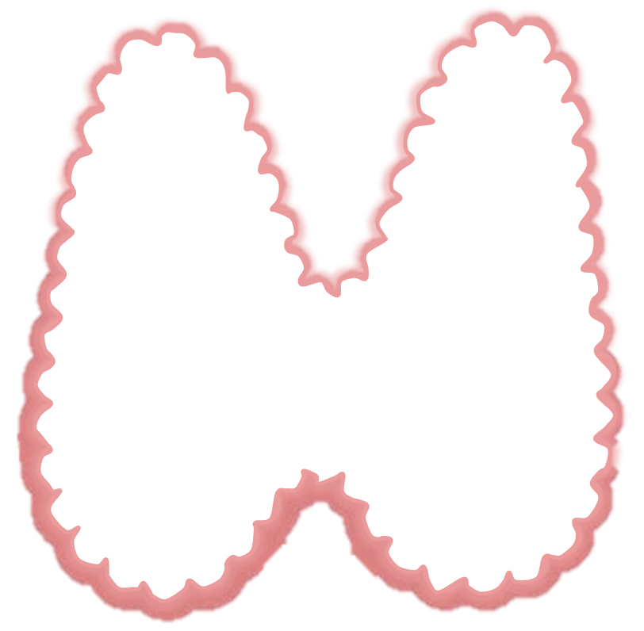
Members board
Team leaders
Abdulrahman Shadid
Ateen Almutairi
Boys team:
Mohammed Al-huqbani
Salman Alagla
Ziyad Al-jofan
Ali Aldawood
Khalid Nagshabandi
Sameh nuser
Abdullah Basamh
Alwaleed Alsaleh
Mohaned Makkawi
Abdullah Alghamdi
Girls team :
Ajeed Al Rashoud
‏Taif Alotaibi
‏Noura Al Turki
‏Amirah Al-Zahrani
‏Alhanouf Al-hilali
‏Sara Al-Abdulkarem
‏Renad Al Haqbani
‏Nouf Al Humaidhi
Jude Al Khalifah
Nouf Al Hussaini
Danah Al Halees
Rema Al Mutawa
Maha Al Nahdi
Razan Al zohaifi
Ghalia Alnufaei
Contact us:
Editing file

