Slide 1
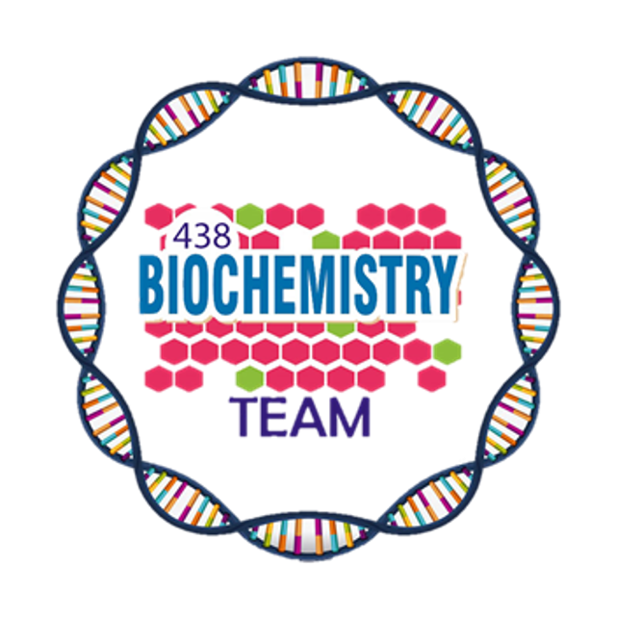
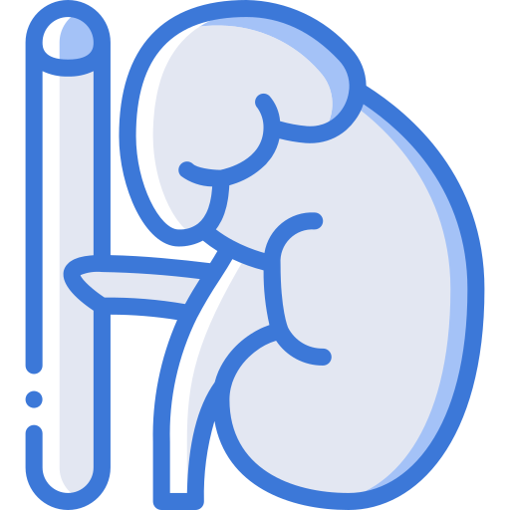
General Mechanisms of Hormone Actions
Color Index:
Main Topic
Main content
Important
Drs’ notes
Extra info
Editing File
Biochemistry teamwork 438 - Endocrine Block

Slide 2
Objectives:
Acquire the knowledge for general consequence of hormone-receptor interaction.
Understand different mechanisms of action of hormones.
Recognize the biomedical importance due to disturbance in the normal mechanisms of hormonal action.
Outlines:
Background
Factors determining the response of a target cell to a hormone
Hormone-receptor interaction
General features of hormone classes, Classification of hormones by mechanism of action and Biomedical importance.

Slide 3
Background
Multicellular organisms depend in their survival on their adaptation to a constantly changing environment
Intercellular communication is necessary for this adaptation to take place
Human body synthesizes many hormones that can act specifically on different cells of the body
More than one hormone can affect a given cell type
Hormones can exert many different effects in one cell or in different cells
A target is any cell in which the hormone (ligand) binds to its receptor
Factors determining the response of a target cell to a hormone:
01
02
03
04
05
The rate of synthesis & secretion of the hormones
The conversion of inactive forms of the hormone into the fully active form
The rate of hormone clearance from plasma (half- life & excretion)
The number, relative activity, and state of occupancy of the specific receptors
Post-receptor factors
E.g. Central dogma if the goal of the hormone was protein synthesis.

Slide 4
Classification of Hormones
The table is very important
 | Group l (Steroid-Thyroid superfamily) | Group ll
Types | Steroid Thyroid Hs(T4,T3) Calcitriol (Active form of Vitamin D, 1,25(OH)₂-D₃) Retinoids (Retinoic acid) | Polypeptides Glycoproteins Catecholamines
Solubility | Lipophilic | Hydrophilic
Transport proteins | Yes | No
Plasma half-life | Long (Hours-Days) | Short (Minutes)
Receptor | Intracellular | Plasma membrane
Mediator | Receptor-hormone complex | cAMP,cGMP,Ca++, Metabolites of complex phosphoinositols, Tyrosine kinase cascade.
Stimulus
1- Hormone release
Group l
Group ll
Lipid soluble
Water soluble
2- Recognition
Hormone/Receptor binding at the target cells
Hormone - Receptor complex
3- Signal generation
Second messengers
4- Effects
Gene transcription
Transporter, Channels
Protein translocation
Protein Modification
Coordinated response to stimulus

Slide 5
Group l
cAMP
Classes
cGMP
Classification of Hormones Based on Mechanism of Action
Group ll
Ca++, PI
Tyrosine kinase
Hormones that bind to intracellular receptors (Steroid-Thyroid superfamily):
Steroid Hormones:
Glucocorticoids
Mineralocorticoids
Sex hormones:
Male sex hormones: Androgens
Female sex hormones: Estrogens & Progestins
Thyroid Hormones (T3 & T4)
Calcitriol (1,25[OH]2-D3)
Retinoic acid
1
Explanation for the PIC:
Each steroid hormone diffuses across the plasma membrane of its target cell and binds to a specific cytosolic or nuclear receptor. These receptor–ligand complexes accumulate in the nucleus, dimerize, and bind to specific regulatory DNA sequences (hormone response elements, HRE) in association with coactivator proteins, thereby causing promoter activation and increased transcription of targeted genes. An HRE is found in the promoter or enhancer element for genes that respond to a specific steroid hormone, thus ensuring coordinated regulation of these genes. Hormone–receptor complexes can also inhibit transcription in association with corepressors.

Slide 6
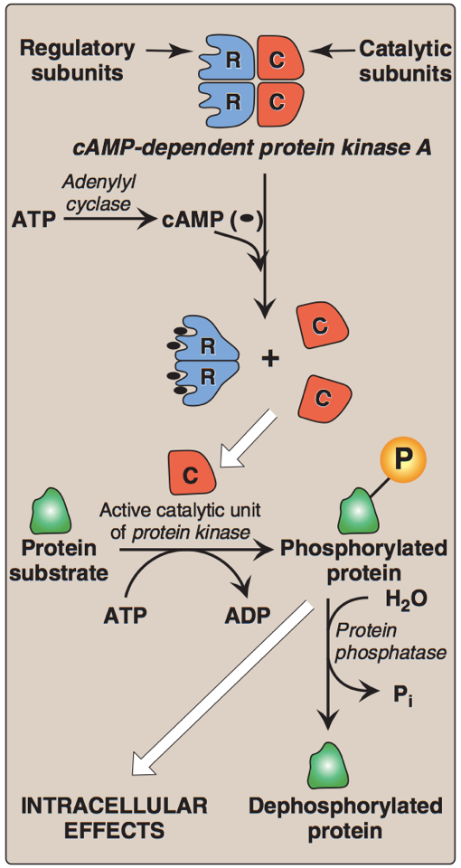
Group l
cAMP
Classes
cGMP
Classification of Hormones Based on Mechanism of Action cont.
Group ll
Ca++, PI
Tyrosine kinase
Hormones that bind to cell surface receptors.
2- Actions of cAMP:
Explanation for the PIC:
Cyclic AMP activates protein kinase A by binding to its two regulatory subunits, causing the release of active catalytic subunits. The active subunits catalyze the transfer of phosphate from ATP to specific serine or threonine residues of protein substrates. The phosphorylated proteins may act directly on the cell’s ion channels, or, if enzymes, may become activated or inhibited. Protein kinase A can also phosphorylate proteins that bind to DNA, causing changes in gene expression. The phosphate groups added to proteins by protein kinases are removed by protein phosphatases. This ensures that changes in protein activity induced by phosphorylation are not permanent.
A- Second messenger: cAMP
Catecholamines (α2- Adrenergic)
Catecholamines (beta- Adrenergic)
Ant. Pituitary: ACTH, FSH, LH & TSH
ADH (Renal V2-receptor)
Calcitonin & PTH
Glucagon
2
Examples are important
Memorize each hormone and its mediators
1- Cascade for formation of cAMP by cell-surface hormones:
Explanation for the PIC:
The effect of the activated, occupied GPCR on second messenger formation is not direct but, rather, is mediated by specialized trimeric proteins (α, β, γ subunits) of the cell membrane. These proteins, referred to as G proteins because they bind guanosine nucleotides (GTP and GDP), form a link in the chain of communication between the receptor and adenylyl cyclase . In the inactive form of a G protein, the α-subunit is bound to GDP, Binding of ligand causes a conformational change in the receptor, triggering replacement of this GDP with GTP. The GTP-bound form of the α subunit dissociates from the βγ subunits and moves to adenylyl cyclase, which is thereby activated and convert ATP into cAMP. Many molecules of active Gα protein are formed by one activated receptor.

Slide 7
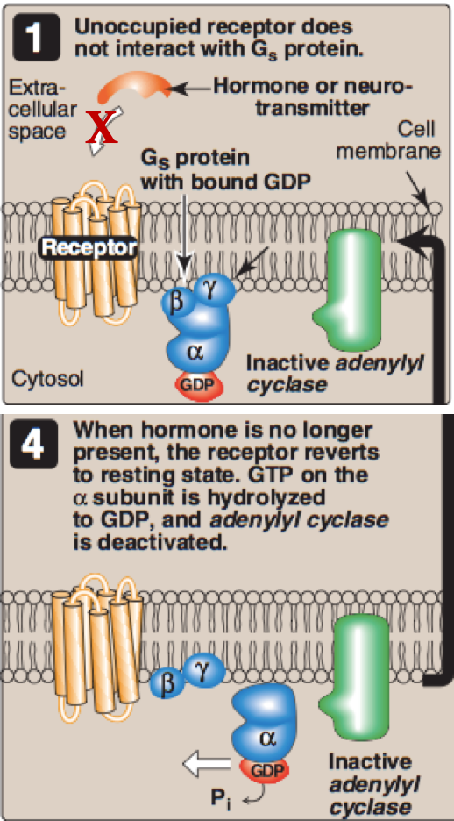
Group l
cAMP
Classes
cGMP
Classification of Hormones Based on Mechanism of Action cont.
Group ll
Ca++, PI
Tyrosine kinase
Hormones that bind to cell surface receptors.
A- Second messenger: cAMP
2
3- Abortion of hormonal stimulus:
1
Release of hormone from its receptor (unbound receptor)
2
Dephosphorylation of protein substrate by phosphatase
3
Degradation of cAMP into AMP by phosphodiesterase
4
Inactivation of protein kinase A by a decrease of cAMP
5
Hydrolysis of GTP into GDP
6
Binding of α-subunit to βγ-subunits
7
Inactivation of adenylyl cyclase

Slide 8
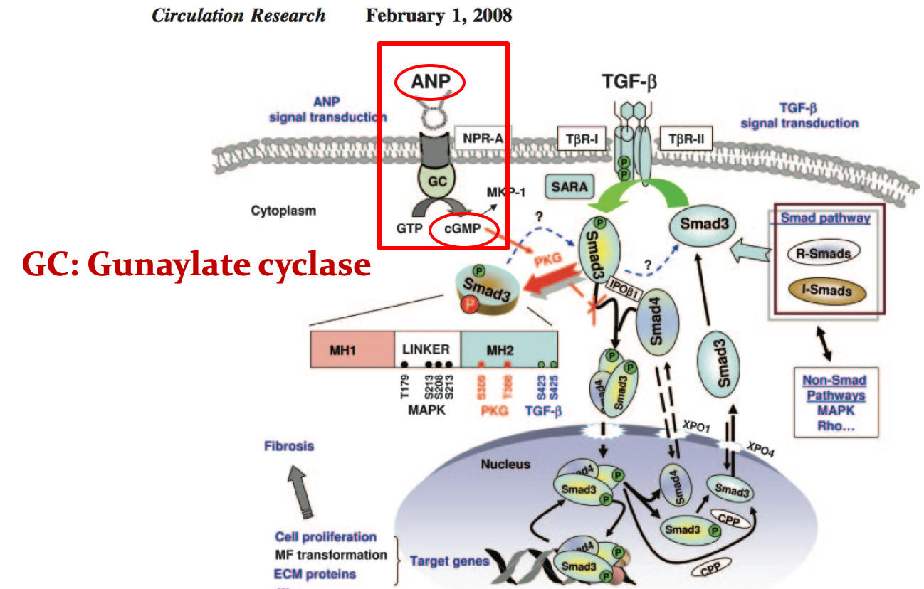
Group l
cAMP
Classes
cGMP
Classification of Hormones Based on Mechanism of Action cont.
Group ll
Ca++, PI
Tyrosine kinase
Hormones that bind to cell surface receptors.
B- Second messenger: cGMP
2
Atrial natriuretic peptide (ANP)
Nitric oxide
Doctor said you only need to know what’s in red, the downstream reactions aren’t important.
Explanation for the PIC:
ANP binds to NPR-A(natriuretic peptide receptor-A) which will activate Guanylate cyclase protein leading to the conversion of GTP into cGMP. cGMP will activate PKG (Protein kinase G) which will phosphorylate Smad3 inhibiting it from upregulating collagen synthesis.
NOTE: Normally when TGF-beta binds to the cell surface receptor it will phosphorylate SMAD3(Has 1 phosphate), then SMAD3 will bind to SMAD4, upregulating the synthesis of Extracellular matrix proteins and myofibroblast transformation leading to fibrosis.

Slide 9
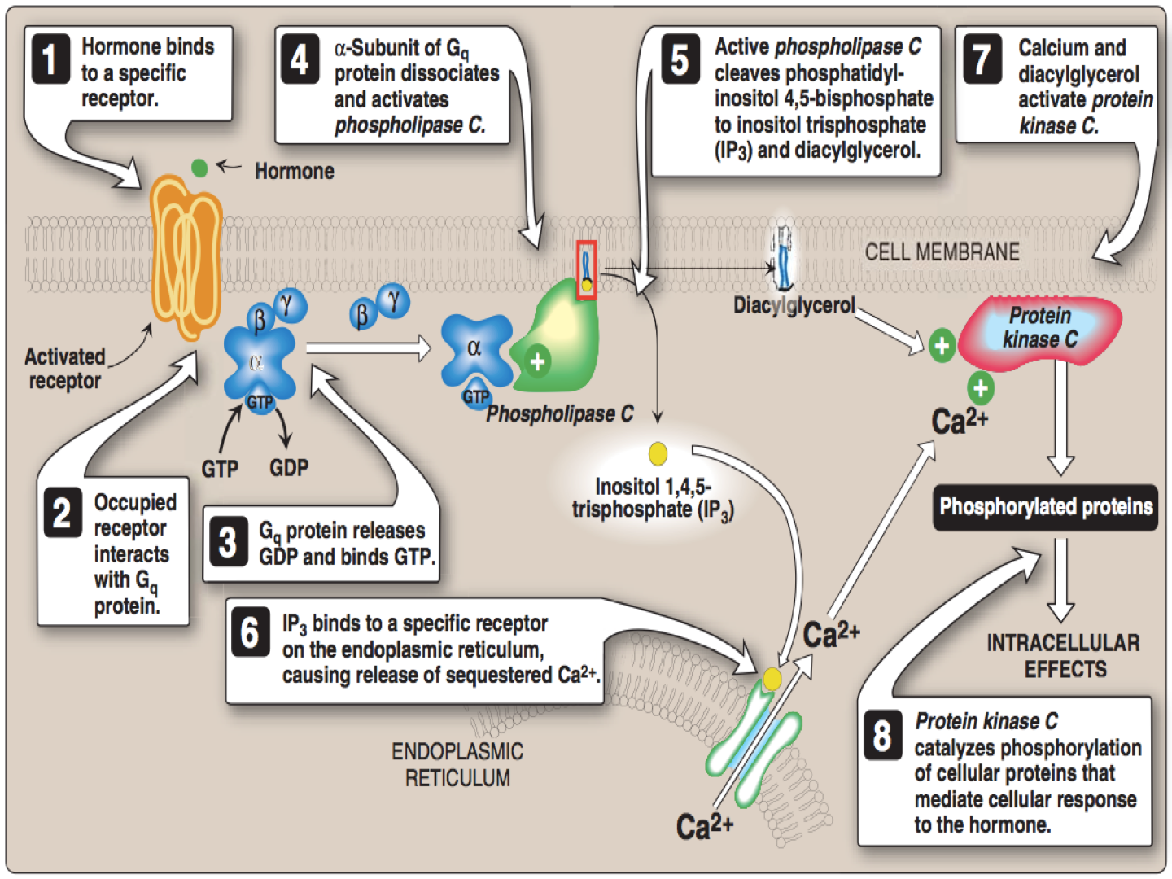
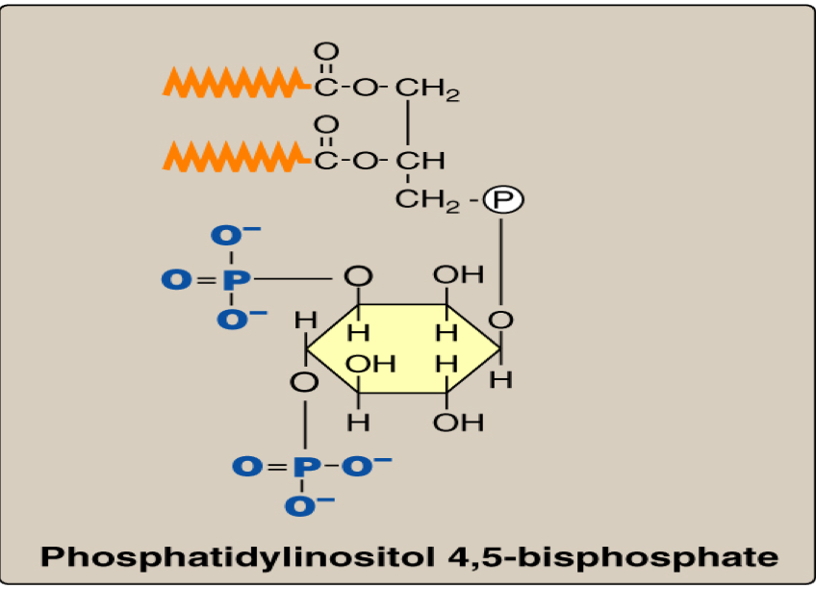
Group l
cAMP
Classes
cGMP
Classification of Hormones Based on Mechanism of Action cont.
Group ll
Ca++, PI
Tyrosine kinase
Hormones that bind to cell surface receptors.
C- Second messenger: calcium or phosphatidylinositol (or both)
2
Acetylcholine (muscarinic)
Catecholamines (α1- Adrenergic)
Angiotensin II
ADH (vasopressin): Extra-renal V1-receptor
Calcium / Phosphatidylinositol System:
Diacylglycerol
(DAG)
Phospholipase C
PIP2 is cleaved by Phospholipase C into DAG and IP3
Inositol Trisphosphate
(IP3)
Don’t skip it, it’s important :)

Slide 10
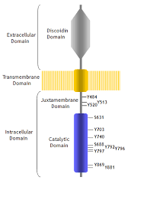
Group l
cAMP
Classes
cGMP
Classification of Hormones Based on Mechanism of Action cont.
Group ll
Ca++, PI
Tyrosine kinase
The figure is important
Hormones that bind to cell surface receptors.
D- Second messenger: Tyrosine kinase cascade
Insulin
GH & Prolactin
Erythropoietin
2
Mechanism of insulin action:
Explanation for the PIC:
The insulin receptor is synthesized as a single polypeptide that is glycosylated and cleaved into α and β subunits, which are then assembled into a tetramer linked by disulfide bonds.
The binding of insulin to the α subunits of the insulin receptor induces conformational changes that are transduced to the β subunits. This promotes a rapid auto phosphorylation of specific tyrosine residues on each β subunit. Autophosphorylation initiates a cascade of cell signaling responses, including phosphorylation of a family of proteins called insulin receptor substrates (IRS). Phosphorylated IRS proteins interact with other signaling molecules through specific domains, activating a number of pathways that affect gene expression, cell metabolism and growth. The actions of insulin are terminated by dephosphorylation of the receptor.
What are the biologic effects of insulin? (Check the figure)

Slide 11
Biomedical importance
Excessive (e.g., hyperthyroidism, Cushing),Deficient (e.g., hypothyroidism, Addison), or inappropriate secretion (e.g., syndrome of inappropriate secretion of ADH “SIADH”) of hormones are major causes of diseases
Pharmacological treatment of these diseases depends on replacement of deficient hormone (hypo-) or use of drugs that interfere with the mechanism of action of the hormones (hyper- or inappropriate)
Take Home Messages
Hormones are involved in responses to a stimulus, using a variety of signaling mechanisms to facilitate cellular adaptive responses.
Group I hormones are lipophilic, while group II are hydrophilic. Other differences exist between both groups.
Hormones can be classified according to their mechanism of action (specific examples of each category were discussed)
Biomedically, studying hormones’ actions in details helps to:
understand consequences of abnormal hormone release- related diseases (excessive, deficient or inappropriate)
design therapeutic approach for such diseases.

Slide 12
 | Group l (Steroid-Thyroid superfamily) | Group ll
Solubility | Lipophilic | Hydrophilic
Transport proteins | Yes | No
Plasma half-life | Long (Hours-Days) | Short (Minutes)
Receptor | Intracellular | Plasma membrane
Summary
Classes
Group l
Steroid Hormones:
Glucocorticoids
Mineralocorticoids
Sex hormones:
Male sex hormones: Androgens
Female sex hormones: Estrogens & Progestins
Thyroid Hormones (T3 & T4)
Calcitriol (1,25[OH]2-D3)
Retinoic acid
Group ll
cAMP
cGMP
Ca++&PI
Tyrosine kinase
Catecholamines (α2- Adrenergic)
Catecholamines (beta- Adrenergic)
Ant. Pituitary: ACTH, FSH, LH & TSH
ADH (Renal V2-receptor)
Calcitonin & PTH
Glucagon
Atrial natriuretic peptide (ANP)
Nitric oxide
Acetylcholine (muscarinic)
Catecholamines (α1- Adrenergic)
Angiotensin II
ADH (vasopressin): Extra-renal V1-receptor
Insulin
GH & Prolactin
Erythropoietin

Slide 13
Quiz
MCQs :
Q1: Which of the following uses cGMP as a second messenger?
a) Insulin b) Glucagon c) Adrenaline d) ANP
Q2: When Angiotensin ll binds to its receptor it will lead to the activation of?
a) Adenylate cyclase b) Phospholipase C
c) Guanylate cyclase d) Hydroxylase
Q3: Which of the following doesn’t require a second messenger for its action?
a) ANP b) AcH c) Estrogen d) Erythropoietin
Q4: Which of the following systems mediates the action of insulin?
a) cAMP b) cGMP c) Tyrosine kinase d) Ca++,PIP2
Q5: Which of the following substance uses Ca++,DAG&IP3 as its 2nd messenger?
a) Catecholamines (α2- Adrenergic) b) Catecholamines (α1- Adrenergic) c) Catecholamines (beta- Adrenergic) d) Retinoic acid
Q6: Which of the following is characteristic of low insulin levels?
a) Increased glycogen synthesis b) Decreased gluconeogenesis from lactate.
c) Decreased Glycogenolysis d) Increased formation of 3-hydroxybutyrate(Ketone body).
SAQs :
Q1: Mention 2 Hormones that utilize cGMP to produce their action.
Q2: Compare between thyroid hormones and glucagon in terms of: Solubility, transport proteins, plasma half-life and receptor location.
Q3: Mention 3 biological effects of insulin.
MCQs Answer key:
1) D 2 B 3) C 4) C 5)B 6) D
SAQs Answer key:
ANP, NO
Apply the table in slide 4
1- Increase glycogen synthesis, 2- Increase fat synthesis , 3- increase protein synthesis.

Slide 14
Team members
We can either walk towards Growth, or stand in Safety
Girls Team:
Boys Team:
Ajeed Al-Rashoud
Alwateen Albalawi
Amira AlDakhilallah
Deema Almaziad
Ghaliah Alnufaei
Haifa Alwaily
Leena Alnassar
Lama Aldakhil
Lamiss Alzahrani
Nouf Alhumaidhi
Noura Alturki
Sarah Alkhalife
Shahd Alsalamah
Taif Alotaibi
Alkassem Binobaid
Fares Aldokhayel
Khayyal Alderaan
Mashal Abaalkhail
Naif Alsolais
Omar Alyabis
Omar Saeed
Rayyan Almousa
Yazen Bajeaifer
Team Leaders
We hear you
Lina Alosaimi
Mohannad Alqarni

