Slide 1
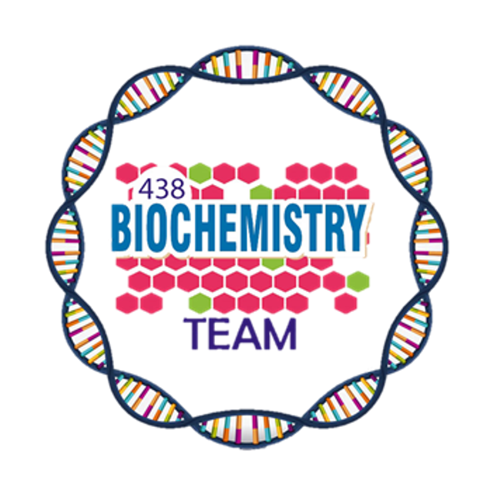
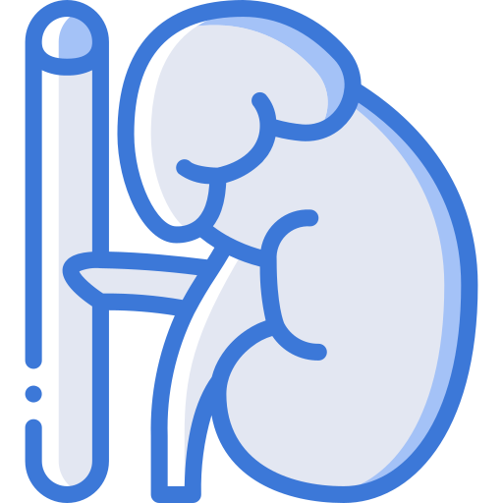
Diabetic Ketoacidosis
Color Index:
Main Topic
Main content
Important
Drs’ notes
Extra info
Editing File
Biochemistry teamwork 438 - Endocrine Block

Slide 2
Lecture’s Outlines:
A case of DKA: (Presentation, Examination, Lab results & their interpretation)
Diabetic Complications
Hyperosmolar hyperglycaemic
state (HHS) = Hypperosmolar
non- - ketotic acidosis (HONK):
Definition
Causes and Mech
anisms
Manifestations
Ketone bodies metabolism
Hypoglycemia:
Causes
Manifestations
Hormonal mechanisms
preventing or correcting
hypoglycemia
Metabolic changes in DKA:
Changes in CHO, protein
and
lipid metabolism
- Changes in water,
electrolytes, and pH
DKA:
Definition
Causes and Mechanisms
Manifestations
Precipitating Factors
3 Diabetic Emergencies
2. Hyperosmolar hyperglycaemic state (HHS)=
Hyperosmolar non-ketotic acidosis (HONK)
1. Diabetic Ketoacidosis (DKA)
3. Hypoglycemia

Slide 3
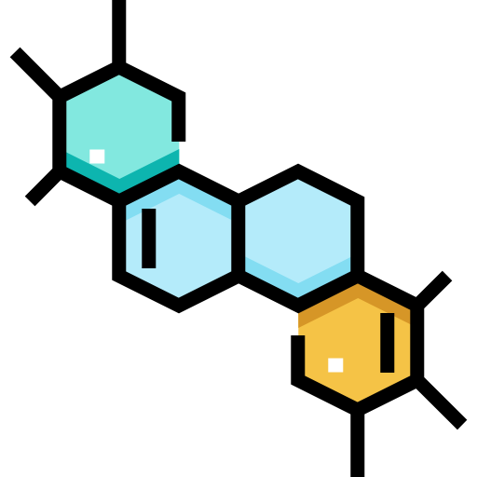
DKA
Diabetic Ketoacidosis (DKA)
Diabetic
HHS=HONK
Hypoglycemia
Hyperglycemia
Characteristically associated with T1 DM
It has become increasingly common in T2 DM
DKA may be the first presentation of T1 DM
Triad of:
Ketonemia
High anion gap metabolic acidosis
Ketone Bodies
2. Acetone
1. Acetoacetate
3. β-Hydroxybutyrate
They are produced by the liver (ketogenesis) and utilized for energy production by peripheral tissues (Ketolysis)

Slide 4
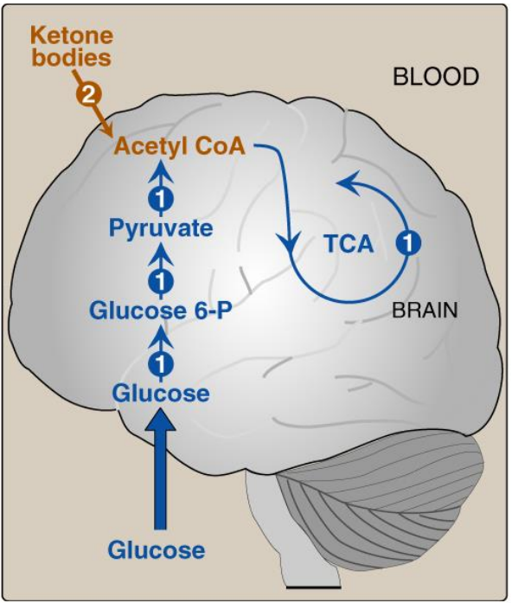
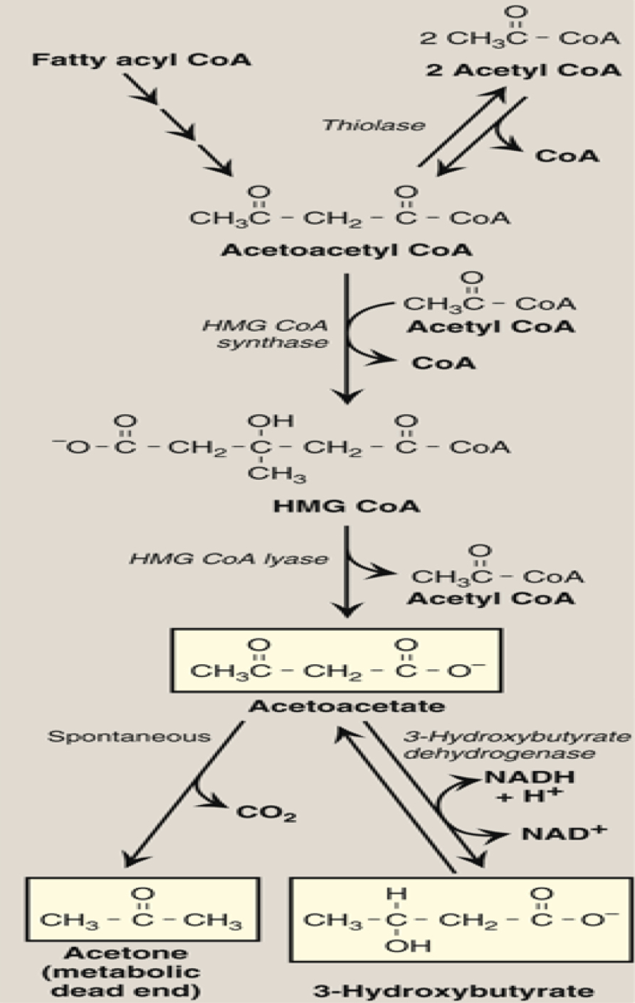
DKA
Brain’s Fuel
Diabetic
HHS=HONK
Hypoglycemia
Normally, glucose is the primary fuel for the brain. It can penetrate the blood brain barrier. The brain’s GLUT is insulin-independent.
If glucose is not available for the brain, the brain can utilize plasma ketone bodies, that can penetrate the blood brain barrier, and serve as fuel molecules.
Ketone Bodies Synthesis (Ketogenesis)
Occurs in hepatocyte mitochondria
1
In uncontrolled DM there is ↑ lipolysis in adipose tissue
2
↑ [FFA] mobilization to liver
3
↑ Hepatic FA oxidation
4
↑ Acetyl CoA which will be channeled into KB synthesis
5
HMG¹ CoA synthase is the rate limiting enzyme.
6
The first KB to be synthesized is acetoacetate
7
Acetoacetate can be:
or
Reduced to β-Hydroxybutyrate
Spontaneously decarboxylated to acetone
1- HMG = hydroxymethylglutaryl CoA
Synthesis of Ketone bodies

Slide 5
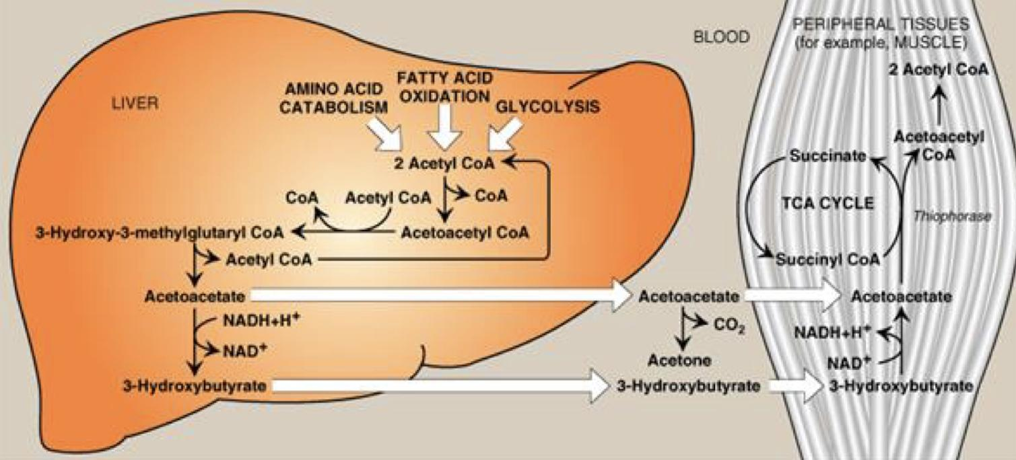
DKA
Ketogenesis
Diabetic
HHS=HONK
Hypoglycemia
1
↑hepatic FA oxidation →↑ acetyl CoA which will be channeled into KB synthesis
2
Acetyl CoA + oxaloacetate (OAA) → Krebs cycle
3
↑ Acetyl CoA production activates pyruvate carboxylase
4
Pyruvate carboxylase converts pyruvic acid into OAA
5
OAA is used for gluconeogenesis (rather than Krebs cycle)
6
Acetyl CoA is channeled into KB synthesis
Synthesis of Ketone bodies
Ketone Bodies Utilization = Ketolysis
Takes place in extrahepatic tissues
Occurs in the mitochondria (so cannot occur in RBCs)
Does not occur in the liver (as the liver lacks the thiophorase enzyme required for ketolysis)
1
β-Hydroxybutyrate is oxidized to acetoacetate
(by a dehydrogenase)
2
Acetoacetate is converted to acetoacetyl CoA
(catalyzed by thiophorase)
3
Acetoacetyl CoA is converted to acetyl CoAs

Slide 6
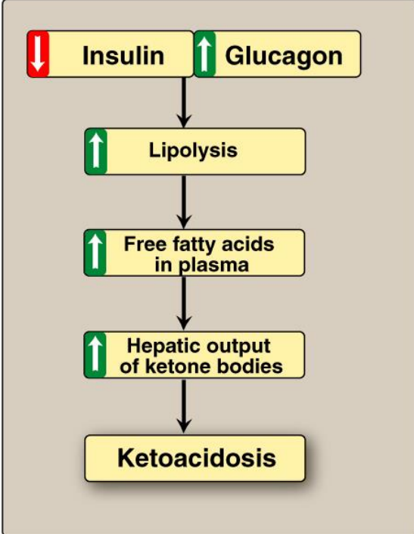
DKA
Mechanisms & Manifestations of DKA
Diabetic
HHS=HONK
Hypoglycemia
In uncontrolled DM there is:
Manifestations of DKA:
Fruity odor on the breath (acetone)
Acidosis (low pH of blood because KBs are acids)
Dehydration (due to glucosuria)
↑ Lipolysis in adipose tissue
In uncontrolled DM The rate of ketogenesis is more than the rate of ketolysis
leading to:
● Ketonemia (↑[KB] in blood)
● Ketonuria (↑[KB] in urine)
↑ [FFA]
↑ Mobilization of FFA to liver
↑ Hepatic FA oxidation
↑ Hepatic acetyl CoA which will be utilized in KB synthesis (ketogenesis)
Ketoacidosis
Precipitating Factors for DKA
Inadequate insulin treatment or noncompliance (20%)
Severe illness e.g.,Myocardial infarction
Trauma
Infection (30-40%)
Drugs : e.g., steroids

Slide 7
DKA
Hyperosmolar hyperglycemic state (HHS)=
Hyperosmolar non-ketotic acidosis (HONK)
Diabetic
HHS=HONK
Hypoglycemia
Features
Manifestation
Mortality
Little or no accumulation of ketone bodies
Serum [glucose] is often >50 mmol/L
Plasma osmolality may reach 380 mosmol/Kg (normal 275-295)
Neurological abnormalities are frequently present
Insulin levels are insufficient to allow appropriate glucose utilization but are adequate to prevent lipolysis and subsequent ketogenesis
Usually occurs in elderly patients with T2DM
Has a substantially higher mortality than DKA (up to 15%)
DKA
Diabetic
HHS=HONK
Hypoglycemia
Hypoglycemia
Manifestations are characterized by:
CNS Symptoms (confusion,
aberrant behavior, or coma)
Common complication of treatment with insulin or oral hypoglycemics
More common in patients with T1DM¹
Low blood [Glucose]
Symptoms resolved within minutes following
the administration of glucose
1- because T1DM is insulin-dependent

Slide 8
DKA
Hypoglycemia
Diabetic
HHS=HONK
Hypoglycemia
Why hypoglycemia is a medical emergency ?
Clinical presentation
The brain has absolute requirement for a continuous supply of glucose
brain death
Symptoms of sympathetic overactivity
(plasma glucose <3.6 mmol/L)
abrupt fall
cerebral
dysfunction
Severe prolonged
Transient
Hypoglycemia occurs due to impaired protective responses to hypoglycemia:
sweating
anxiety
Insulin is supplied exogenously and its
release cannot be turned off
Glucagon & adrenaline response to hypoglycemia becomes impaired later in the course of DM
tremors
palpitation
impaired
Protective
responses
Symptoms of neuroglycopenia
(plasma glucose <2.6 mmol/L)
gradual fall
drowziness
drowziness¹
headache
confusion
ultimately loss of consciousness or seizures¹
at plasma glucose <1.5 mmol/L

Slide 9
DKA
Diabetic
Hypoglycemia
HHS=HONK
Hypoglycemia
Hormonal mechanisms to prevent or correct hypoglycemia:
Don’t skip this picture
^^ ههه مو معناته تسكّبون لذي
Production of insulin
Production of:
Epinephrine & glucagon
Growth hormone
Cortisol
What you have to know from here:
The sequence of which hormones are released in case of hypoglycemia
The adrenergic and neuroglycopenic symptoms and at what level they start
Case study
A 14-year-old girl was admitted to a children’s hospital in coma. Her mother stated that the girl had been in good health until approximately 2 weeks previously, when she developed a sore throat and moderate fever. She subsequently lost her appetite and generally did not feel well Several days before admission she began to complain of undue thirst and also started to get up several times during the night to urinate. However, on the day of admission the girl had started to vomit, had become drowsy and difficult to arouse, and accordingly had been brought to the emergency department

Slide 10
Case study
On examination:
She was dehydrated Her skin was cold She was
breathing in a deep sighing manner (Kussmaul
respiration) Her breath had a fruity odor Her blood
pressure was 90/60 mmHg (N: 120/80) Her pulse rate
115/min. She could not be aroused
Diagnosis
A provisional diagnosis of T1DM with complicating
ketoacidosis and coma (DKA) was made by the intern.
Blood results:
The interpretation of the results in the next slide
 | Result | Normal Range
Glucose | 50 | (3.9-5.6 mmol/L)
Ketoacids | ++++ | (trace)
Bicarbonate | 6 | (3.5-4.5 mmol/L)
Arterial blood pH | 7.07 | (7.35-7.45 mmol/L)
Na+ | 136 | (136-146 mmol/L)
Cl- | 100 | (102-109 mmol/L)
PCO 2 | 2.7 | (4.3-6.0 kPa)
* Anion gap | 35.5 | (7-16 mmol/L)
K+ | 5.5 | (3.5-5.0 mmol/L)
Urea nitrogen | 15 | (2.5-7.1 mmol/L)
Creatinine | 200 | (44-80 mol/L)
Albumin | 50 | (41-53 g/L)
Osmolality | 325 | (275-295 mOsm/kg serum water)
Hematocrit | 0.500 | 0.354-0.444
Urine results:
 | Result | Normal Range
Glucose | ++++ | -
Ketoacids | ++++ | -
* Anion gap (A⁻)= (Na⁺ + K⁺ ) – (HCO₃- + Cl⁻)

Slide 11
Interpretation of the Laboratory findings
↓ Glucose uptake by certain tissues
(adipose tissue & muscle)
↑ Glycogenolysis
↑ Gluconeogenesis
CHO metabolism
Result | Interpretation
Hyperglycemia | Confirm the diagnosis of DKA
Glucosuria
Ketonemia
Ketonuria
↓ pH | Severe metabolic acidosis due to ↑ production of ketone bodies
↓ Bicarbonate and PCO2 | Metabolic acidosis with partial respiratory compensation (the hyperventilation)
↑ Anion gap | Due to ↑ ketone bodies in the blood
↑ Urea & creatinine | 1. Renal impairment (dehydration →↓ blood volume →↓ renal perfusion) 2. Dehydration 3. Degradation of protein (for urea)
↑ K+ | ↓ Uptake of potassium by cells in the absence of insulin
↑ Plasma osmolality | Due to hyperglycemia and fluid loss
↑ Lipolysis
↑ Fatty acid oxidation
↑ Production of Ketone bodies
Lipid metabolism
DM
Metabolic changes in DM and DKA
↓ Protein synthesis
↑ Protein degradation
Protein metabolism
K+, Water
& pH
↓ Entry of K+ into the cells
• Water loss secondary to glycosuria
• Acidosis due to ↑ production of
ketone bodies
DKA

Slide 12
Take Home Messages
Acute complications of DM include: DKA, HHS, and hypoglycemia
DKA is a triad of hyperglycemia, ketonemia and high anion gap
metabolic acidosis, and can be precipitated by several stressful factors.
Ketone bodies (KB) are synthesized in the liver (HMG CoA synthase is the rate limiting enzyme) and utilized by peripheral organs and not the liver (liver lacks thiophorase enzyme)
KB can serve as energy source (this is important for the brain in case of hypoglycemia)

Slide 13
Take Home Messages
In DKA there is excessive ketogenesis (more than ketolysis) (details of the mechanisms and consequences are required)
HHS is a serious condition, usually occurs in elderly with T2DM, and has
high mortality rate.
Hypoglycemia is a medical emergency that might be caused by DM treatment (intensive) and impaired protective mechanisms against hypoglycemia. Its clinical manifestations are due to sympathetic overactivity and neuroglycopenia.
Case presentation, examination of DKA can provide provisional diagnosis, and should be confirmed by comprehensive blood and urine lab investigation including measuring blood glucose, KB, pH, pCO2, electrolytes, osmolality, protein, and kidney function test; anion gap calculation; hematocrit; and urine glucose and KB.

Slide 14
Summary
Diabetic Emergencies
Diabetic Ketoacidosis (DKA)
Hypoglycemia
Hyperosmolar hyperglycaemic state (HHS)=(HONK)
● Associated with T1DM
● Ketone bodies :
Acetoacetate
Acetone
β-Hydroxybutyrate
● Ketogenesis:
○ Occurs in the hepatocyte mitochondria.
○ In uncontrolled DM there is ↑lipolysis in adipose tissue
→ ↑ [FFA] mobilization to liver → ↑hepatic FA
oxidation → ↑ acetyl CoA which will be channeled
into KB synthesis } HMG CoA synthase is the rate
limiting enzyme } The first KB to be synthesized is
acetoacetate.
○ Liver lacks the thiophorase enzyme required for ketolysis.
● Common complication of treatment with insulin or oral
hypoglycemics.
● More common in patients with T1DM.
● Symptoms of sympathetic overactivity (plasma [glucose]
<3.6 mmol/L, abrupt fall): anxiety, tremors, sweating &
palpitation:
● Symptoms of neuroglycopenia (plasma [glucose] < 2.6
mmol/L, gradual fall): headache, confusion, drowsiness
and ultimately loss of consciousness or seizures (at plasma
[glucose] < 1.5 mmol/L)
● Hormonal mechanisms to prevent or correct hypoglycemia:
↓ Production of insulin
↑ production of: 1-Epinephrine, 2-glucagon, 3-Growth
hormone, 4-Cortisol.
● Usually occurs in elderly patients with T2DM
● Serum [glucose] is often >50 mmol/L
● Plasma osmolality may reach 380 mosmol/Kg
● Insulin levels are adequate to prevent lipolysis and
subsequent ketogenesis

Slide 15
Quiz
MCQs :
Q1: Which one of the following is found in a patient with Diabetic ketoacidosis?
a) Dehydration b) Palpitations c) Alkalosis d) Hypo-osmolar
Q2: Where does the ketogenesis occur ?
a) Extrahepatic tissue b) Hepatocyte mitochondria c) Cytoplasm d) Golgi
Q3: Which one of the following ketone bodies is first to be synthesized in ketogenesis ?
a) Acetyl CoA b) Acetone c) B-Hydroxybutyrate d) Acetoacetate
Q4: Which symptom do you expect to see in diabetic patient when plasma glucose <3.6 mmol/L ?
a) confusion b) seizures c) sweating d) diarrhea
Q5: Which of the following components causes ketonemia in DKA?
a) acetoacetate b) glucose c) sodium bicarbonate
Q6: Which one of the following is the cause of production of ketone bodies in patient with DKA?
a) ↓ lipolysis in adipose tissue b) ↑ hepatic glucose output c) ↑ hepatic uptake of FFAs d) ↑ protein degradation in muscle
SAQs :
Q1: What are the triad of DKA?
Q2: What are the Manifestations of DKA?
Q3: Why hypoglycemia is a medical emergency?
Q4: What is the neuroglycopenia symptoms and at which PG level occurs?
MCQs Answer key:
1) A 2) B 3) D 4) C 5) A 6) C
SAQs Answer key:
Ketonemia , Hyperglycemia,High anion gap metabolic acidosis
Fruity odor on the breath (acetone) , acidosis , dehydration
The brain has absolute requirement for a continuous supply of glucose otherwise he will loss his function or die
Headache, Confusion, drowsiness and loss of consciousness or seizure. Lower than 2.6 mol/L.

Slide 16
Team members
We must all suffer one of two things: the pain of discipline or the pain of regret and disappointment
Girls Team:
Boys Team:
Ajeed Al-Rashoud
Alwateen Albalawi
Amira AlDakhilallah
Deema Almaziad
Ghaliah Alnufaei
Haifa Alwaily
Leena Alnassar
Lama Aldakhil
Lamiss Alzahrani
Nouf Alhumaidhi
Noura Alturki
Sarah Alkhalife
Shahd Alsalamah
Taif Alotaibi
Alkassem Binobaid
Fahad Alsultan
Fares Aldokhayel
Khayyal Alderaan
Mashal Abaalkhail
Naif Alsolais
Omar Alyabis
Omar Saeed
Rayyan Almousa
Yazen Bajeaifer
Team Leaders
We hear you
Lina Alosaimi
Mohannad Alqarni

