Slide 1
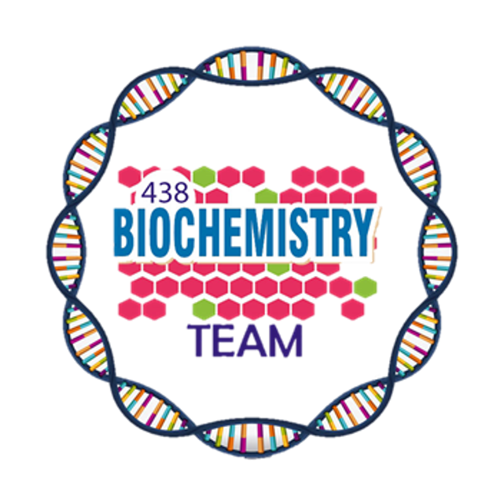
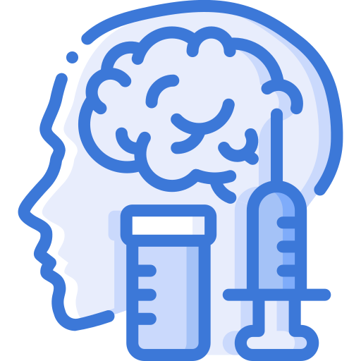
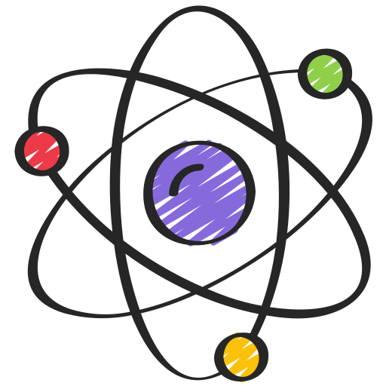
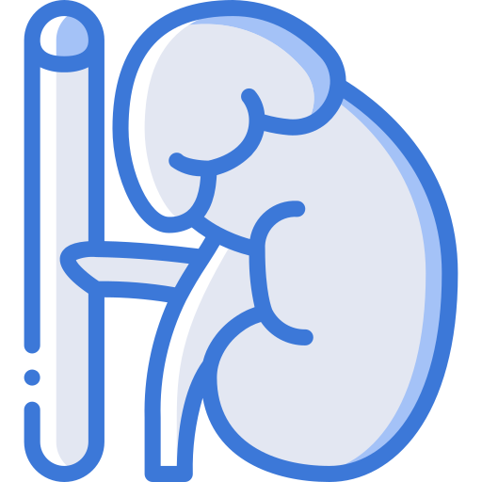
Thyroid Hormones
and Thermogenesis
Color Index:
Main Topic
Main content
Important
Drs’ notes
Extra info
Editing File
Biochemistry teamwork 438 - Endocrine Block

Slide 2
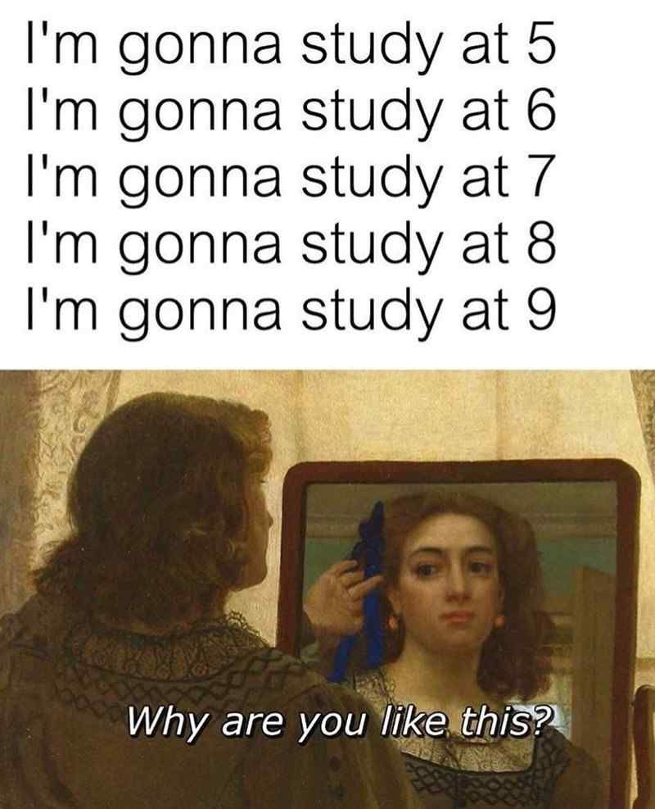
Objectives:
Describe the types and biosynthesis, actions and the regulation of thyroid hormones.
List and interpret the thyroid function tests.
Define goiter and differentiate between hypo- and hyperthyroidism.
Discuss the role of thyroid hormone in thermogenesis.

Slide 3
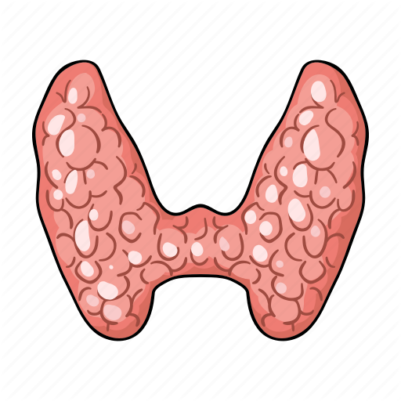
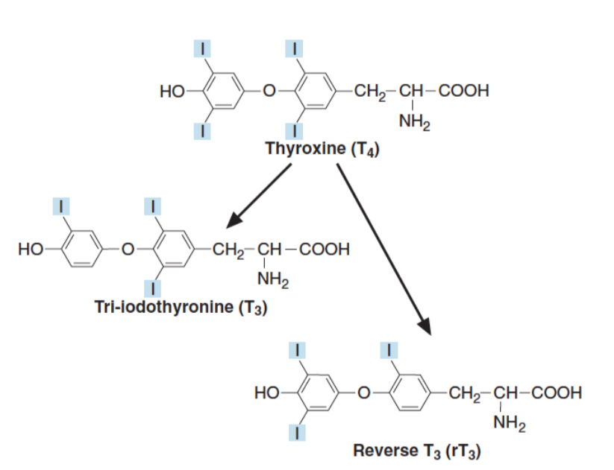
Types and Biosynthesis of
Thyroid Hormones
Types of Thyroid Hormones :
1
Thyroxine ( T₄ )
Major secretion
Tri-iodothyronine ( T₃ )
More biologically active
2
Mostly transported in plasma bound to:
70%
Thyroxin Binding globulin (TBG)
The unbound (free) form of T₃ & T₄ are biologically active
25%
Albumin
5%
Transthyretin (pre-albumin)
Thyroid Gland :
Peripheral tissues (liver, kidney, etc.) :
Synthesize T₃ & T₄
De-iodinate T₄ T₃ or rT₃ (inactive)
Catalyzed by deiodinase enzymes
Iodination
Binding to thyroglobulin (Protein)
Coupling
2 tyrosine molecules
(Inactive form)
Thyroxin Binding globulin
70%
5%
25%
Transthyretin (prealbumin)
Albumin

Slide 4
Thyroid hormone action
Plays an essential role in
maturation of all
body tissues
Involved in thermogenesis
& metabolic regulation
Increases cellular O₂ consumption & stimulates
the metabolic rate
Affects the rate of
protein, carbohydrate
and lipid metabolism
Clinical evidence of the wide spectrum of thyroid hormone action:
Untreated congenital hypothyroidism permanent brain damage

Hypothyroid children have :

Delayed skeletal maturation (short stature)  Delayed puberty
Hypothyroid patients have high serum cholesterol
Why?
liver cells : Down regulation of LDL receptors
Gut : Failure of sterol excretion

Slide 5
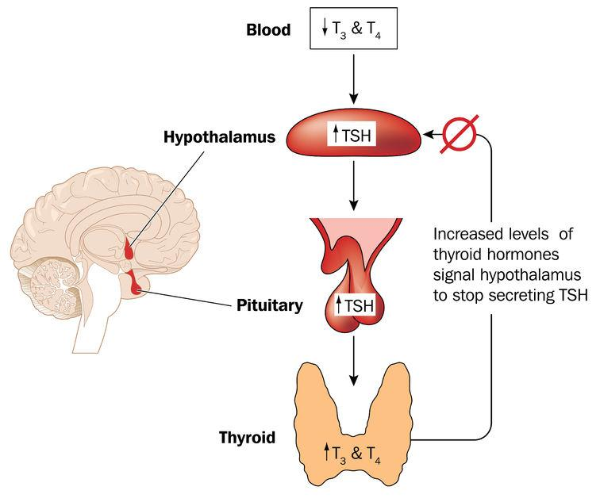
Regulation of Thyroid Hormone Secretion
By The hypothalamic-pituitary-thyroid axis
1
The hypothalamus senses low levels of T3/T4 and releases thyrotropin
releasing hormone (TRH)
TSH stimulates the thyroid to produce T3/T4 until levels return to normal
T3/T4 exert negative feedback control on the hypothalamus and pituitary
(Controlling the release of both TRH and TSH)
High thyroid hormone levels suppress TRH, TSH
Low thyroid hormone levels stimulate TRH, TSH to produce more hormone
2
TRH stimulates the pituitary to produce thyroid stimulating hormone (TSH)
3
4

Slide 6
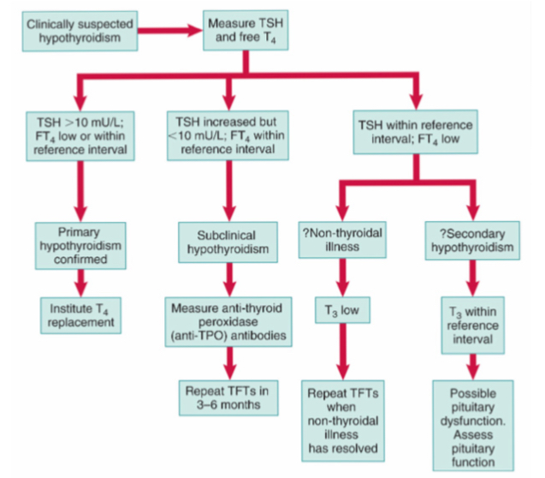
Thyroid Function Tests
TSH
Total or free T₄
Total or free T₃
Antibodies
Highly sensitive
(detects very low conc.)
Monitors thyroid treatment
T₃ toxicosis
*hyperthyroidism in which rise in T3 is
independent of T4 ( normal T4)
Autoimmune disease
*Diagnosis and monitoring
thyroid replacement
Anti-thyroid
Hashimoto’s thyroiditis
antibodies against TSH receptors that suppress thyroid secretion
Graves’ disease
antibodies against TSH receptors that stimulate thyroid secretion³
May take up to 8 weeks to
adjust to new level during treatment ¹
Earlier identification of thyrotoxicosis
Strategy for the Biochemical Investigation of Suspected Hypothyroidism
Goitre
Enlarged thyroid gland
May be associated with:
Hypofunction
Hyperfunction
Euthyroid
Normal thyroid hormone conc.
Causes
Iodine, selenium deficiency.
Hashimoto’s thyroiditis.
Graves’ disease (hyperthyroidism)
Congenital hypothyroidism
thyroid cancer.
During that time we use T₄ as a measure
T3 is more important in hyperthyroidism as it’s normally Lower in blood
Others e.g. antithyroglobulin antibodies

Slide 7
Hypothyroidism
Deficiency of thyroid hormones
1
2
Primary
Secondary
Failure of thyroid gland
Failure of the pituitary gland to secrete TSH
Elevated TSH
Failure of the hypothalamic-pituitary-thyroid axis
Deficiency of thyroid hormones
Causes
Non-thyroidal illness
Hashimoto’s thyroiditis.
Treatment of hyperthyroidism (Radioiodine or surgical)
Drug effects.
TSH deficiency.
Congenital
defects in thyroid synthesis .
thyroid resistance 
Severe iodine deficiency.
the normal regulation of TSH, T3 and T4 secretion and metabolism is disturbed
Most of T4 is converted to rT3 (inactive)
Deficiency of thyroid hormones
Secretion of T4 and T3 is decreased
Clinical features
Tiredness .
Cold intolerance .
Weight gain .
Dry skin .
Treatment
Replacement therapy with levothyroxine (T4)

Slide 8
hyperthyroidism
Hyperstimulation of thyroid gland by pituitary gland
Hypersecretion of thyroid hormones
Tissues are exposed to high levels of thyroid hormones (thyrotoxicosis)
Causes
Clinical features
Graves’ disease
Toxic multinodular goitre
Thyroid adenoma
Thyroiditis
Excessive intake of iodine / iodine drugs
Excessive intake of T₄ and T₃
Weight loss with normal appetite
Sweating / heat intolerance
Fatigue
Palpitation / agitation, tremor
Angina, heart failure
Diarrhea
Eyelid retraction and lid lag
Graves’ disease:
Due to antibodies against TSH receptors on thyroid gland
The antibodies mimic the action of pituitary hormone
Causing hypersecretion of thyroid hormone
Most common cause of hyperthyroidism
An autoimmune disease

Slide 9
hyperthyroidism
Diagnosis
Problems in diagnosis
Suppressed / undetectable TSH level
Total serum T4 varies due to changes in binding protein levels
Raised thyroid hormones levels
High estrogens in pregnancy increase TBG synthesis
Confirms primary hyperthyroidism
Congenital TBG deficiency can also influence results
Free T4 and TSH are first-line tests for diagnosis of thyroid dysfunction
Strategy for the Biochemical Investigation of Suspected Hyperthyroidism
Treatment
1
2
Antithyroid drugs: carbimazole, propylthiouracil
Radioiodine: sodium ¹³¹I inhibits T₄/T₃ synthesis
3
Surgery: thyroidectomy

Slide 10
Thermogenesis (Heat production)
Humans are homeothermic (keep constant body temp.)
Tightly controlled temperature homeostasis
Thermogenesis is of two types:
Facultative thermogenesis in brown adipose tissue is stimulated by sympathetic nervous system
Facultative: On-demand extra heat production from metabolic activity in brown adipose tissue, skeletal muscle, etc.
Obligatory: Heat production due to basal metabolic rate
1. Classical,
peripheral
Thyroid hormone (T3)
2. New: Central
brown fat
Thyroid Hormone and Thermogenesis
Body tissue cells
(muscle, liver)
Hypothalamus
Thyroid hormone plays essential roles in thermogenesis
It upregulates body temperature set
by the brain
It acts centrally on the hypothalamus that controls brown adipose tissue for thermogenesis
Activates brown
adipose tissue
Activates certain
enzymes by an
unknown mechanism
Increased
body energy
expenditure
THERMOGENESIS

Slide 11
Thermogenesis
Two concepts
of thyroid thermogenesis
In respiratory chain, some protons re-enter the mitochondrial matrix thru uncoupling proteins (UCPs) without ATP synthesis
These protons are released as heat
Thyroid hormone regulates mitochondrial UCPs
Examples:
UCP1 in brown adipose tissue
UCP3 in muscle, other tissues

Slide 12
Take Home Messages
Thyroid hormones are synthesized in the thyroid gland by iodination, coupling and binding to thyroglobulin protein
Thyroid hormones regulate metabolism and thermogenesis in the body
It is regulated by hypothalamic-pituitary-thyroid axis
Thyroid function tests such as TSH, total and free T₄ and T₃, and antibodies help diagnose and follow up thyroid disorders
Goiter, hypo- and hyperthyroidism are due to abnormalities in thyroid functions

Slide 13
Summary
 | Thyroid Hormones
Types | Thyroxine ( T₄ ) |  | Tri-iodothyronine ( T₃ )
Action | maturation | thermogenesis & metabolic regulation | stimulates the metabolic rate | Affects the rate of metabolisim
Clinical evidence | untreated congenital hypothyroidism →permanent brain damage |  | hyopthyroid pationts have high serum cholesterol
Regulation of Secretion | hypothalamic-pituitary-thyroid axis: hypothalamus → thyrotropin releasing hormone (TRH) → pituitary→thyroid stimulating hormone (TSH)→ thyroid → produce T3/T4 → negative feedback (stops secretion)
Thyroid Function Tests | TSH Highly sensitive | total or free T₄ Monitors thyroid treatment | total or free T₃ thyrotoxicosis | Antibodies Autoimmune disease
hypothyroidism
Deficiency of thyroid hormones
primary:
failiar of thyroid gland
hyperthyroidism
Hyperstimulation of thyroid gland by pituitary gland
Graves’ disease
Most common cause of hyperthyroidism
treatment
treatment
secondary:
Failure of the pituitary gland
Failure of the hypothalamic-pituitary-thyroid axis
Diagnosis
Suppressed TSH level
Raised thyroid hormones levels
Confirms primary hyperthyroidism
Replacement therapy with levothyroxine (T4)
Antithyroid drugs
Radioiodine
Surgery
Problems in diagnosis
Total serum T4 varies
High estrogens in pregnancy
Non-thyroidal illness

Slide 14
Quiz
MCQs :
Q1: hyperthyroidisim is caused by?
a) hypostimulation of thyroid gland b) graves’disease
c) hashimoto’s thyroiditis d) severe iodine deficiency
Q2: which of the following function tests are first-line test for diagnosis of thyroid dysfunction in the case of hyperthyroidisim?
a)free T4 and free T3 b) free T3 and TSH
c)free T4 and TSH d) free T4 and antibodies
Q3: Thyroid hormone regulates which mitochondrial UCPs ?
a) UCP1 in brown adipose tissue b) UCP3 in the liver
c) UCP3 in brown adipose tissue d) UCP1 in muscle, and other tissues
Q4: One of the symptoms of hypothyroidism is:
a) Fatigue. b) Intolerance to cold
c) Weight gain. d) All of the above
Q5: A person with untreated hypothyroidism may also have:
a) High cholesterol. b) Low blood pressure
c) Low blood sugar d) None of the above
Q6: The symptoms of hypothyroidism may be difficult to detect, so the condition can best be diagnosed with:
a) An MRI scan. b) An ultrasound
c) A thyroid stimulating hormone test (TSH). d) A hemoglobin test or hematocrit test
SAQs :
Q1: explain the mechanism of regulation of thyroid hormone secretion
Q2: state the two types of thermogenesis and the difference between them?
Q3: list 3 of thyroid hormone action
Q4: enumerate 4 causes of hypothyroidism
MCQs Answer key:
1) b 2) c 3) a 4) d 5) a 6) c
SAQs Answer key:
Slide 5
obligatory: its due to basal metabolic rate
facultative: its an on-demand extra heat production
Slide 4
slide 7

Slide 15
Team members
A goal should scare you a little and excite you a lot!
Girls Team:
Boys Team:
Ajeed Al-Rashoud
Alwateen Albalawi
Amira AlDakhilalla
Deema Almaziad
Ghaliah Alnufaei
Haifa Alwaily
Leena Alnassar
Lama Aldakhil
Lamiss Alzahrani
Nouf Alhumaidhi
Noura Alturki
Sarah Alkhalife
Shahd Alsalamah
Taif Alotaibi
Alkassem Binobaid
Fares Aldokhayel
Khayyal Alderaan
Mashal Abaalkhail
Naif Alsolais
Omar Alyabis
Omar Saeed
Rayyan Almousa
Yazen Bajeaifer
Team Leaders
We hear you
Lina Alosaimi
Mohannad Alqarni

