Slide 1
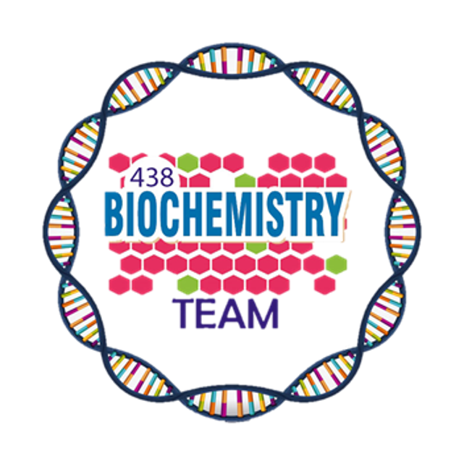
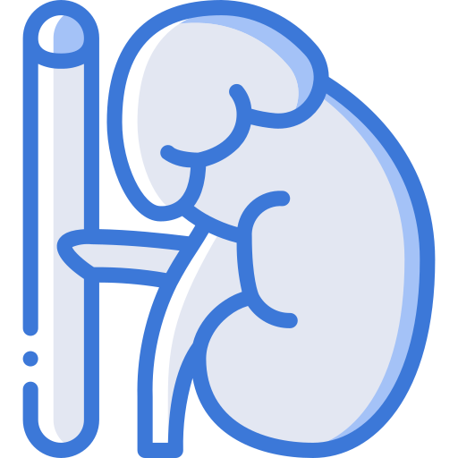
Vitamin D , Rickets & osteoporosis
Color Index:
Main Topic
Main content
Important
Drs’ notes
Extra info
Editing File
Biochemistry teamwork 438 - Endocrine Block

Slide 2
Objectives:
Understand the functions, metabolism and regulation of vitamin D
Discuss the role of vitamin D in calcium homeostasis
Identify the types and causes of rickets
Identify biomarkers used for the diagnosis and follow up of osteoporosis
Overview:
Vitamin D distribution, metabolism, regulation and functions
Vitamin D in calcium homeostasis
Nutritional and inherited rickets
–Types, diagnosis and treatment
Vitamin D deficiency
Osteoporosis
–Diagnosis, biomarkers, treatment and prevention

Slide 3
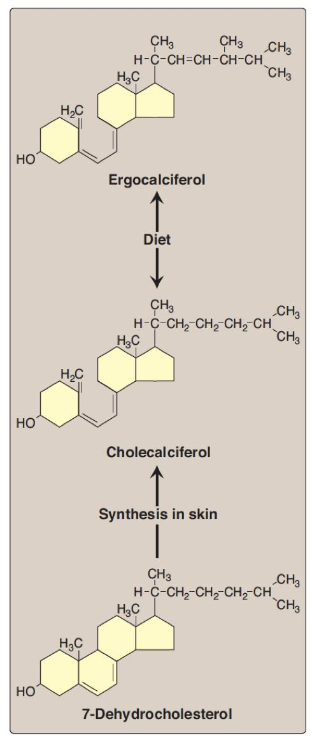
Vitamin D
Vitamin D Sources
& Distribution
Vitamin D is considered a steroid hormone
Vitamin D distribution
Cholecalciferol (vitamin D3) is synthesized in
the skin by the sunlight (UV)
Endogenous vitamin precursor
Dietary sources
Ergocalciferol (vitamin D2) found in plants
Cholecalciferol (vitamin D3) found in animal
tissue
7-Dehydrocholesterol is converted to vitamin
D3 in the dermis and epidermis exposed to
UV in sunlight
The biologically active form is 1,25-dihydroxycholecalciferol (calcitriol)
Ergocalciferol (vitamin D2) is derived from ergosterol in plants
Children 400
D3, D2 are also available as supplement
Daily requirement (IU/day)
Adults
600
Elderly
800

Slide 4
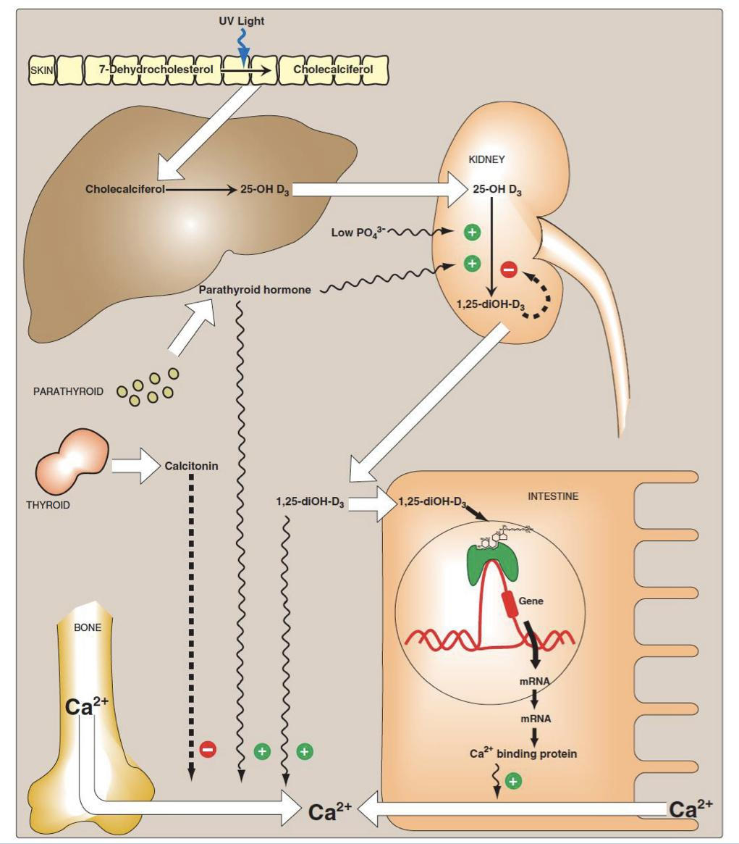
Vitamin D Metabolism
Vitamin D Metabolism
Vitamin D Action
Vitamin D action is typical of steroid hormones
1
in skin
Cholecalciferol (Vitamin D3) is derived from
7-dehydrocholesterol by the sunlight
2
in liver
Cholecalciferol is converted to
25-hydroxycholecalciferol (calcidiol)
( the storage form which is measured in the plasma )
by the enzyme 25-hydroxylase
It binds to intracellular receptor proteins
The receptor complex interacts with target DNA in cell nucleus
This stimulates or represses gene expression
3
in kidney
The 1-a-hydroxylase enzyme converts
25-hydroxycholecalciferol to
1,25-dihydroxycholecalciferol (biologically active)
4
Active vitamin D is transported in blood by
gc-globulin protein
1
1- in the skin 7- dehydrocholesterol will be converted to cholecalciferol by UV light ( active)
2 - first hydroxylation in the liver covert cholecalciferol to
25-hydroxycholecalciferol by the enzyme 25-hydroxylase ( inactive )
the stored and prominent form and the one measured in the lab.
3- second hydroxylation convert
25-hydroxycholecalciferol to
1,25-dihydroxycholecalciferol by the enzyme 1-a-hydroxylase (active)
This reaction is tightly regulated by the -level of phosphate (directly) and calcium (indirectly)
-Negative feedback
Vitamin D has a steroid like hormone activity, it diffuse through cell membrane and bind to cytosolic receptor this complex then inter into the nucleus to interact with the DNA to increase gene expression of calcium binding protein which will carry calcium from intestinal epithelium to the blood circulation.
Vitamin D Regulation & Calcium Homeostasis
2
3
- Vitamin D synthesis is tightly regulated by plasma levels of phosphate and calcium
Activity of 1-a-hydroxylase in kidneys
4
Directly Increased
Indirectly Increased
Due to low plasma phosphate
Via increased parathyroid hormone (PTH)
due to low plasma calcium
- Vitamin D has essential role in calcium homeostasis
- Calcium homeostasis is maintained by parathyroid hormone (PTH) and calcitonin

Slide 5
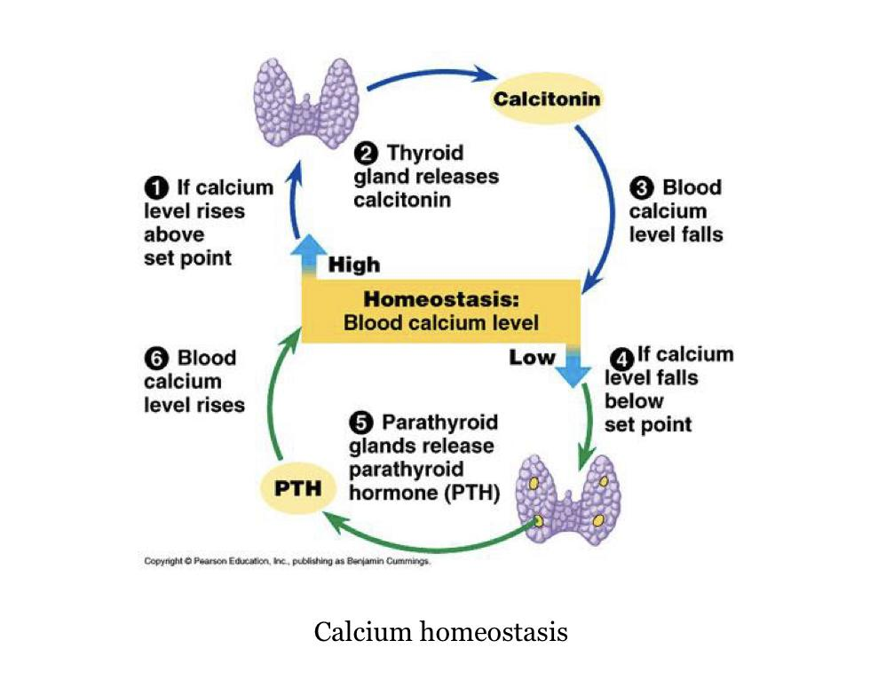
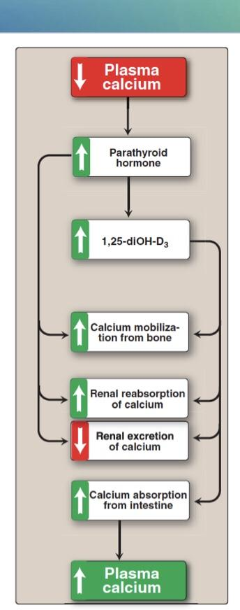
Vitamin D Functions
Vitamin D Deficiency
Mobilizes calcium and phosphate from bone to maintain plasma levels
5
1
Regulates plasma levels of calcium and phosphate
• Deficiency most common worldwide
• High prevalence in Saudi Arabia due to:
1- Low dietary intake
2- Insufficient exposure to Sun
3- Lifestyle (e.g. clothing)
• Circulating level of >75 nmol/L is required
for beneficial health effects
4
Minimizes loss of calcium by the kidneys
2
3
Promotes intestinal absorption of calcium and phosphate
Stimulates synthesis of calcium-binding protein for intestinal calcium uptake
< 25 nmol/L - Vitamin D Deficiency
25-75 nmol/L - Vitamin D Insufficiency
Vitamin D Response To Low Plasma Calcium

Slide 6
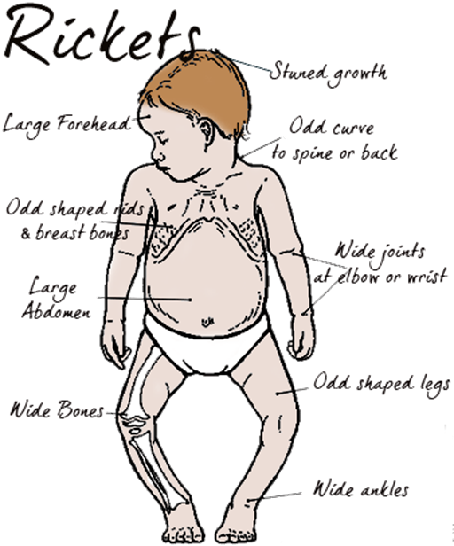
Rickets¹
Nutritional rickets
Rickets | Inherited rickets
Causes - Vitamin D deficiency because of: Poor nutrition Insufficient exposure to sunlight Renal osteodystrophy (causes decreased synthesis of active vitamin D in kidneys) Hypoparathyroidism (hypocalcemia) | Vitamin D-dependent rickets (types 1 and 2) - Rare types of rickets due to genetic disorders - Causing vitamin D deficiency mainly because of genetic defects in: Vitamin D synthesis Vitamin D receptor² (no hormone action)
Diagnosis
Measuring serum levels of: 25-hydroxycholecalciferol (low) PTH³ Calcium (low) Phosphate (high) Alkaline phosphatase (high)
Treatment
–Vitamin D and calcium supplementation
• A disease in children causing net demineralization of bone
• With continued formation of collagen matrix of bone
• Incomplete bone mineralization
• Bones become soft and pliable
• Causes skeletal deformities including bowed legs
• Patients have low serum levels of vitamin D (Osteomalacia: demineralization of bones in adults)
1.Two types of rickets: dietary and inherited
2. Defect in the receptor will cause inability to absorb Ca
3.(if the patient has hypoparathyroidism it will be low,if not it will increase to compensate)

Slide 7
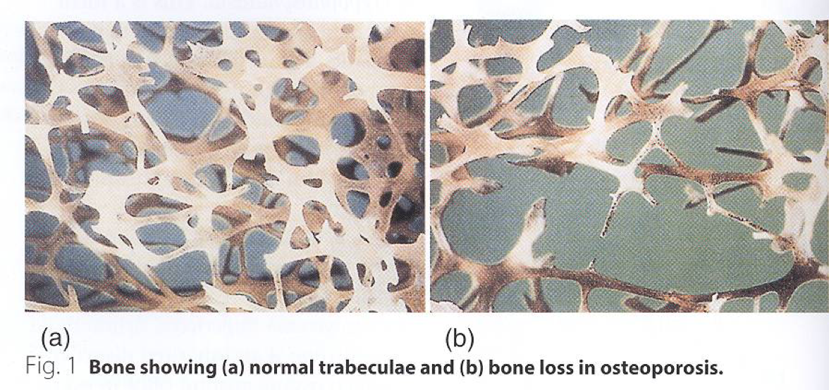
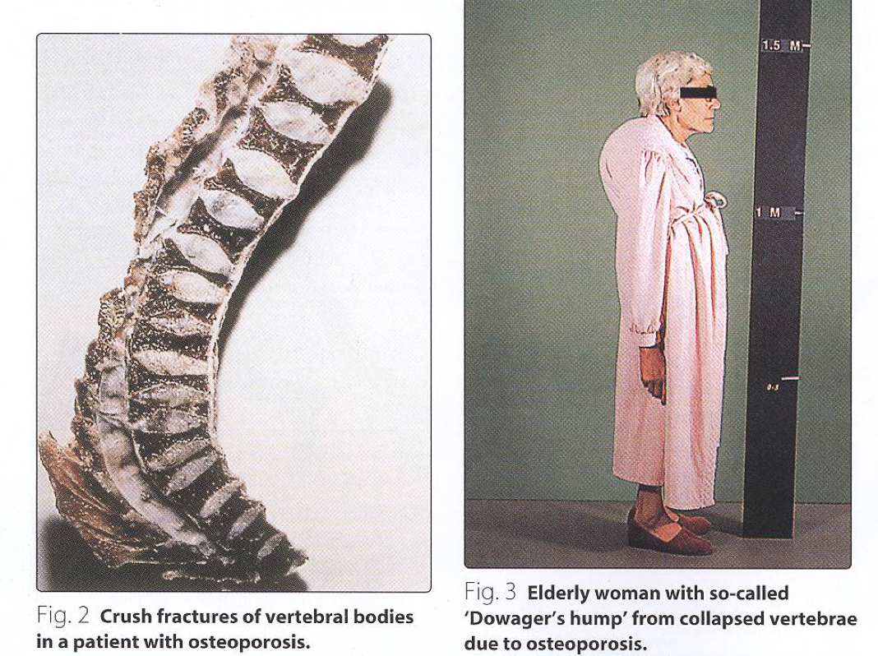
Osteoporosis
Reduction in bone mass per unit volume
Bone matrix composition is normal but it is reduced
Post-menopausal women lose more bone mass than men (primary osteoporosis)
Increases fragility of bones
Increases susceptibility to fractures
GI disease
Drugs
Hyperthyroidism
Immobilization
Secondary osteoporosis may be caused by:
Gonadal failure
Alcohol
Cushing syndrome
Smoking
Diagnosis of osteoporosis
1
WHO standard: Serial measurement of bone mineral density (by DEXA)
Biochemical tests (calcium, phosphate, vitamin D) alone cannot diagnose or monitor primary osteoporosis
2
The test results overlap in healthy subjects and patients with osteoporosis
3
Secondary osteoporosis (due to other causes) can be diagnosed by biochemical tests
4

Slide 8
Biomarkers of osteoporosis
Biomarkers of osteoporosis
Bone resorption markers
Bone formation markers
Osteocalcin
Produced by osteoblasts during bone formation
Involved in bone remodeling process
Released during bone formation and resorption (bone turnover)
Short half-life of few minutes
Bone-specific alkaline phosphatase
Present in osteoblast plasma membranes
Helps osteoblasts in bone formation
A Non-specific marker
Its isoenzymes are widely distributed in other tissues
P1NP (Procollagen type-1 amino-terminal propeptide)
Produced by osteoblasts
Involved in the process of type 1 collagen formation
Blood levels are highly responsive to
osteoporosis progression and treatment
CTX-1 (Carboxy-terminal cross-linked)
telopeptides of type 1 collagen)
A component of type-1 collagen
Released from type-1 collagen during bone resorption
Blood and urine levels are highly responsive to post-resorptive treatment
Levels vary largely by circadian variation
Treatment & Prevention
Treatment | Prevention
In confirmed cases of osteoporosis – Treatment options are unsatisfactory | Prevention from childhood is important
Oral calcium, estrogens, fluoride therapy may be beneficial | Good diet and exercise prevent osteoporosis later
Bisphosphonates inhibit bone resorption that slows down bone loss | Hormone replacement therapy in menopause may prevent osteoporosis

Slide 9
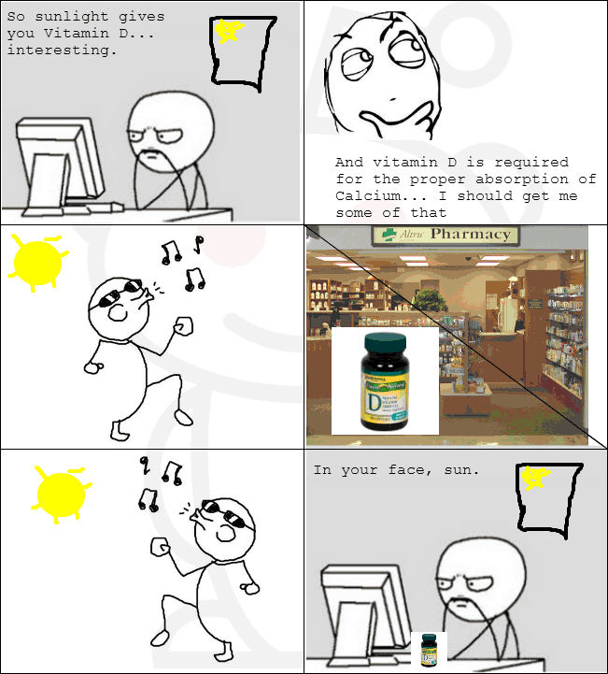
Take Home Messages
Overview of vitamin D metabolism and regulation
Importance of vitamin D functions
Vitamin D deficiency is common in populations
Rickets and osteomalacia are due to vitamin D deficiency
Various biochemical markers clinically important for assessment of osteoporosis

Slide 10
Summary
Vit D metabolism
In skin: Cholecalciferol (Vitamin D3) is derived
from 7-dehydrocholesterol by the sunlight
In liver: Cholecalciferol is converted to
25-hydroxycholecalciferol (calcidiol) by the
enzyme 25-hydroxylase
Vitamin D metabolism
In kidneys: The 1-a-hydroxylase enzyme converts
25-hydroxycholecalciferol to
1,25-dihydroxycholecalciferol (biologically active)
Vit D regulation
Vitamin D synthesis is tightly regulated by:
1- plasma levels of phosphate(directly) and calcium (indirectly)
- ↓PO₄ → ↑ vitamin D synthesis by kidneys
- ↓Ca2+ → PTH release → ↑ vitamin D synthesis by kidneys
2- ↑Ca2+ →↓ vitamin D synthesis by kidneys (Negative feedback)
Vitamin D action
•Vitamin D action is typical of steroid hormones
• It binds to intracellular receptor proteins
• The receptor complex interacts with target DNA in cell nucleus
• This stimulates or represses gene expression
Vit D functions
• Regulates plasma levels of calcium and phosphate
• Promotes intestinal absorption of calcium and phosphate
• Stimulates synthesis of calcium-binding protein for intestinal calcium uptake
• Minimizes loss of calcium by the kidneys
• Mobilizes calcium and phosphate from bone to maintain plasma levels
Vit D deficiency
• Deficiency most common worldwide
• High prevalence in Saudi Arabia due to:
– Low dietary intake
– Insufficient exposure to Sun
Rickets
-Children, incomplete bone mineralization
-Low serum levels of vit D
Causes:
nutrition
exposure to sunlight
Renal osteodystrophy
Hypoparathyroidism
Inherited rickets
Genetic defect in: vit D synthesis/receptor
Dx :25-OH D3, PTH,Ca, ALP,PO₄³⁻
Rx: Vit D & Ca supplements
Osteoporosis
Bone mass per unit volume
2ndry OP causes: drugs,alcohol,smoking,gi,cushing,hyperthyroidism
biomarkers
Bone formation: osteocalcin, bone specific ALP,P1NP
Bone resorption: CTX1
Dx : measure bone mineral density,biochemical tests
Rx : oral Ca,estrogen,fluoride,bisphosphonates

Slide 11
Quiz
MCQs :
Q1: which on of the following is the action of 25-hydroxylase enzyme?
a) converts 25-OH D3 to 1,25-diOH-D3 b)Converts 7-dehydrocholesterol to cholecalciferol c) converts 25-OH D3 to cholecalciferol d)Converts Cholecalciferol to 25-OH D3
Q2: what is the mechanism of action of vitamin D
a)Ion Channel–Linked Hormone b) G Protein–Linked Hormone c)Enzyme-Linked Hormone d) Intracellular Hormone Receptors & gene activation
Q3: Chronic renal failure requires oral administration of
a)1-25-dihydroxycalciferol b)25-hydroxycalciferol c)calciferol d)7-dehydrocholesterol
Q4: in diagnosing a patient with rickets, which one of the following will be low:
a)calcium b)alkaline phosphatase c)phosphate d)bone mass
Q5: which one of the following biomarkers involved in bone remodeling process
a)P1NP b)CTX1 c)Alkaline phosphatase d)osteocalcin
Q6: in treating osteoporosis, which one of the following will inhibit bone resorption:
a)fluoride therapy b)bisphosphonate c)oral calcium d)vitamin D
SAQs :
Q1: Explain how vitamin D is regulated.
Q2: enumerate 5 of the causes of secondary osteoporosis.
Q3: enumerate the biomarkers of osteoporosis.
Q4: list the functions of vitamin D.
MCQs Answer key:
1) d 2)d 3)a 4)a 5) d 6)b
SAQs Answer key:
↓PO₄ → ↑ vitamin D synthesis by kidneys ( Direct effect) ↓Ca2+ → PTH release → ↑ vitamin D synthesis by kidneys (indirect effect) ↑Ca2+ →↓ vitamin D synthesis by kidneys (Negative feedback)
GI disease , smoking , alcohol , drugs , hyperthyroidism .
Bone formation: osteocalcin,bone specific alkaline phosphatase,P1NP. Bone resorption: CTX1
Slide 5

Slide 12
Team members
"The way to get started is to quit talking and begin doing"
Girls Team:
Boys Team:
Ajeed Al-Rashoud
Alwateen Albalawi
Amira AlDakhilallah
Deema Almaziad
Ghaliah Alnufaei
Haifa Alwaily
Leena Alnassar
Lama Aldakhil
Lamiss Alzahrani
Nouf Alhumaidhi
Noura Alturki
Sarah Alkhalife
Shahd Alsalamah
Taif Alotaibi
Alkassem Binobaid
Fares Aldokhayel
Khayyal Alderaan
Mashal Abaalkhail
Naif Alsolais
Omar Alyabis
Omar Saeed
Rayyan Almousa
Yazen Bajeaifer
Team Leaders
We hear you
Lina Alosaimi
Mohannad Alqarni

