Slide 1
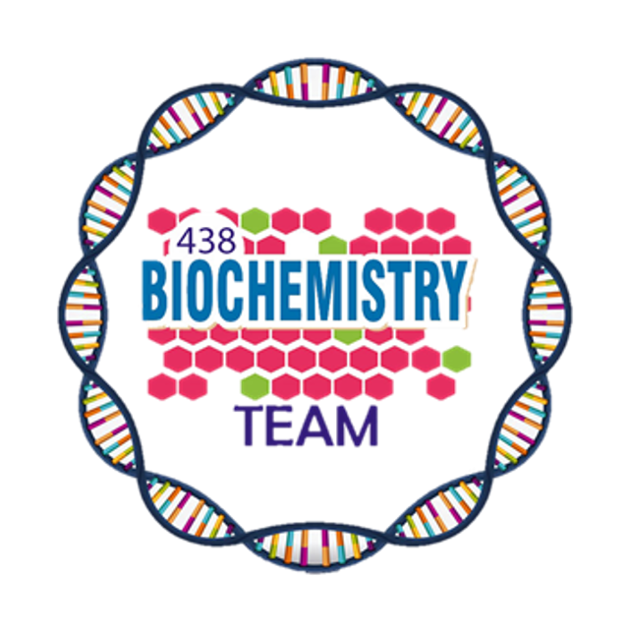
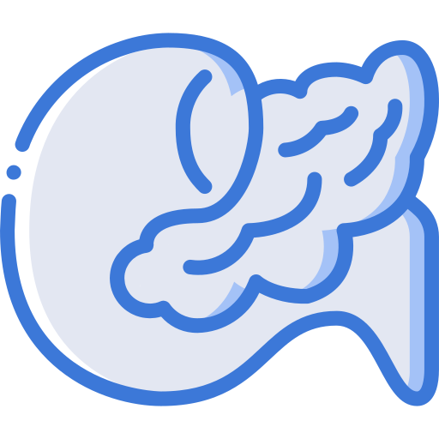
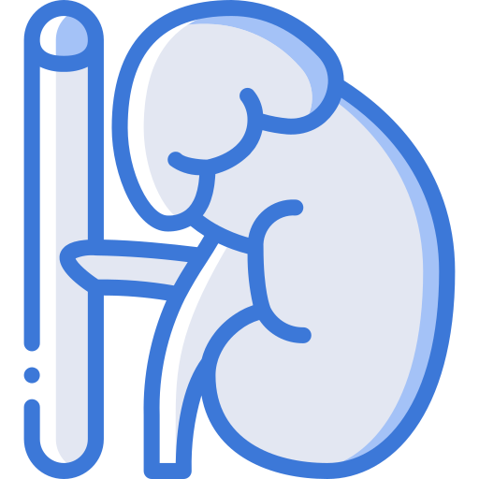
Cushing Syndrome
Color Index:
Main Topic
Main content
Important
Drs’ notes
Extra info
Editing File
Biochemistry teamwork 438 - Endocrine Block

Slide 2
Objectives:
To identify physiological and biochemical characteristics of cortisol
To understand the diagnostic algorithm for cushing’s syndrome
To understand the interpretation of laboratory and radiological investigation for diagnosis of cushing’s syndrome
*best show ever*

Slide 3
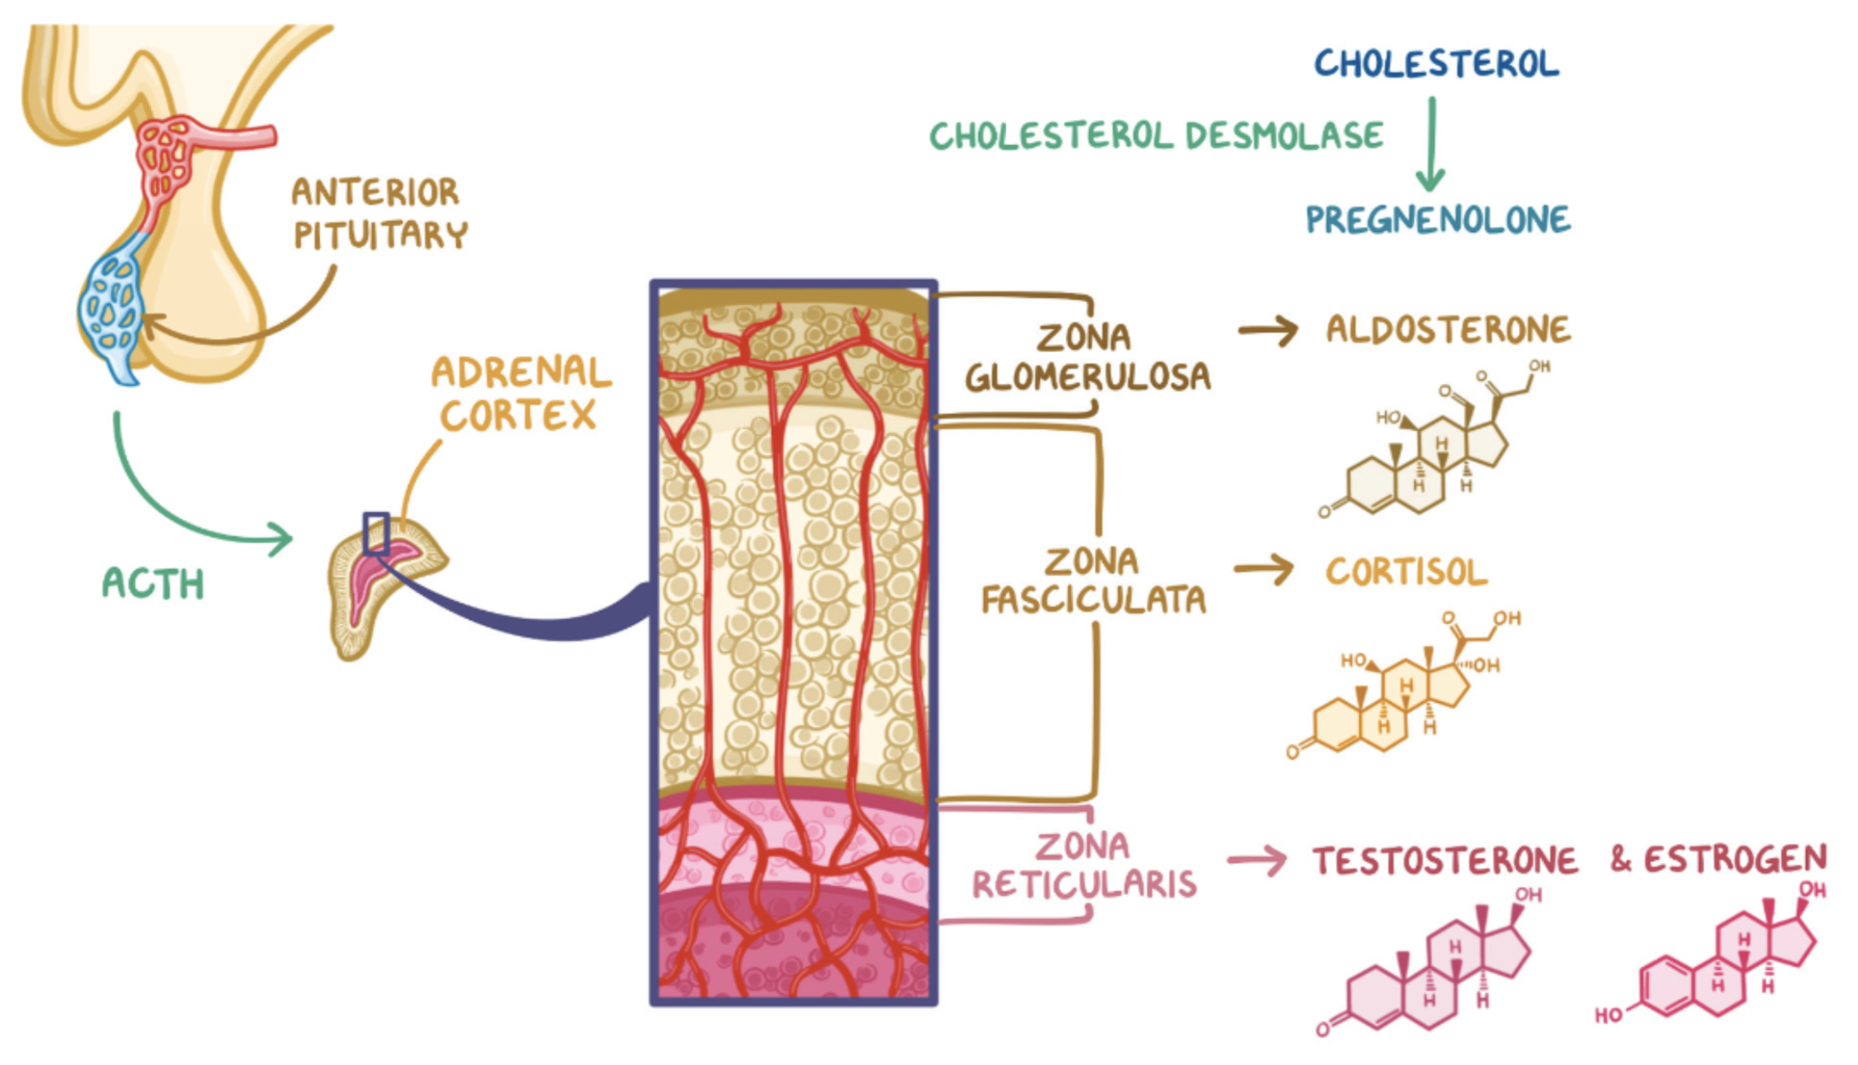
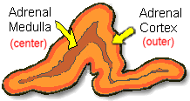
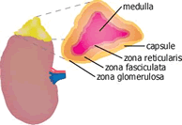
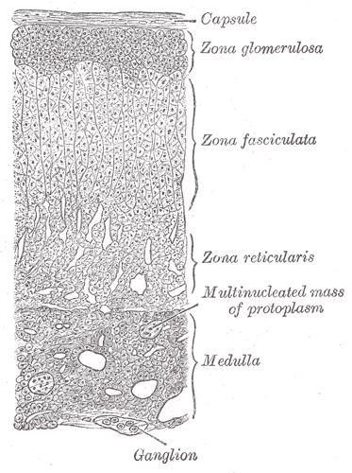
Adrenal Gland
Anatomically the gland is situated on the anterosuperior aspect of the kidney
Zona Glomerulsoa (outermost zone)→ Aldosterone (the principal mineralocorticoid)
Adrenal cortex
Based on cell type and function
Zona Fasciculata →
Glucocorticoids, mainly cortisol (95%)
Adrenal Gland
(Histology)
The Medulla and the Cortex differ in their embryological origin
Zona Reticularis → Sex hormones
Adrenal medulla

Slide 4
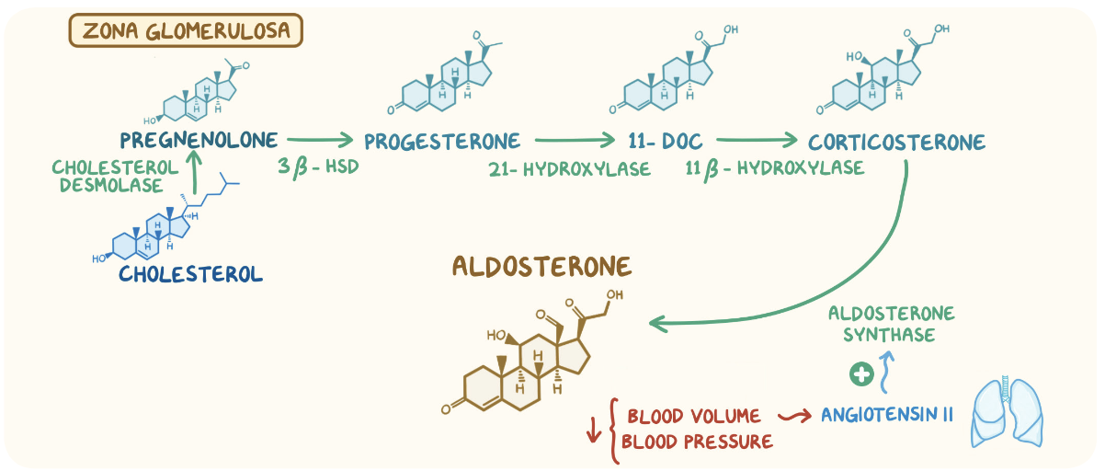
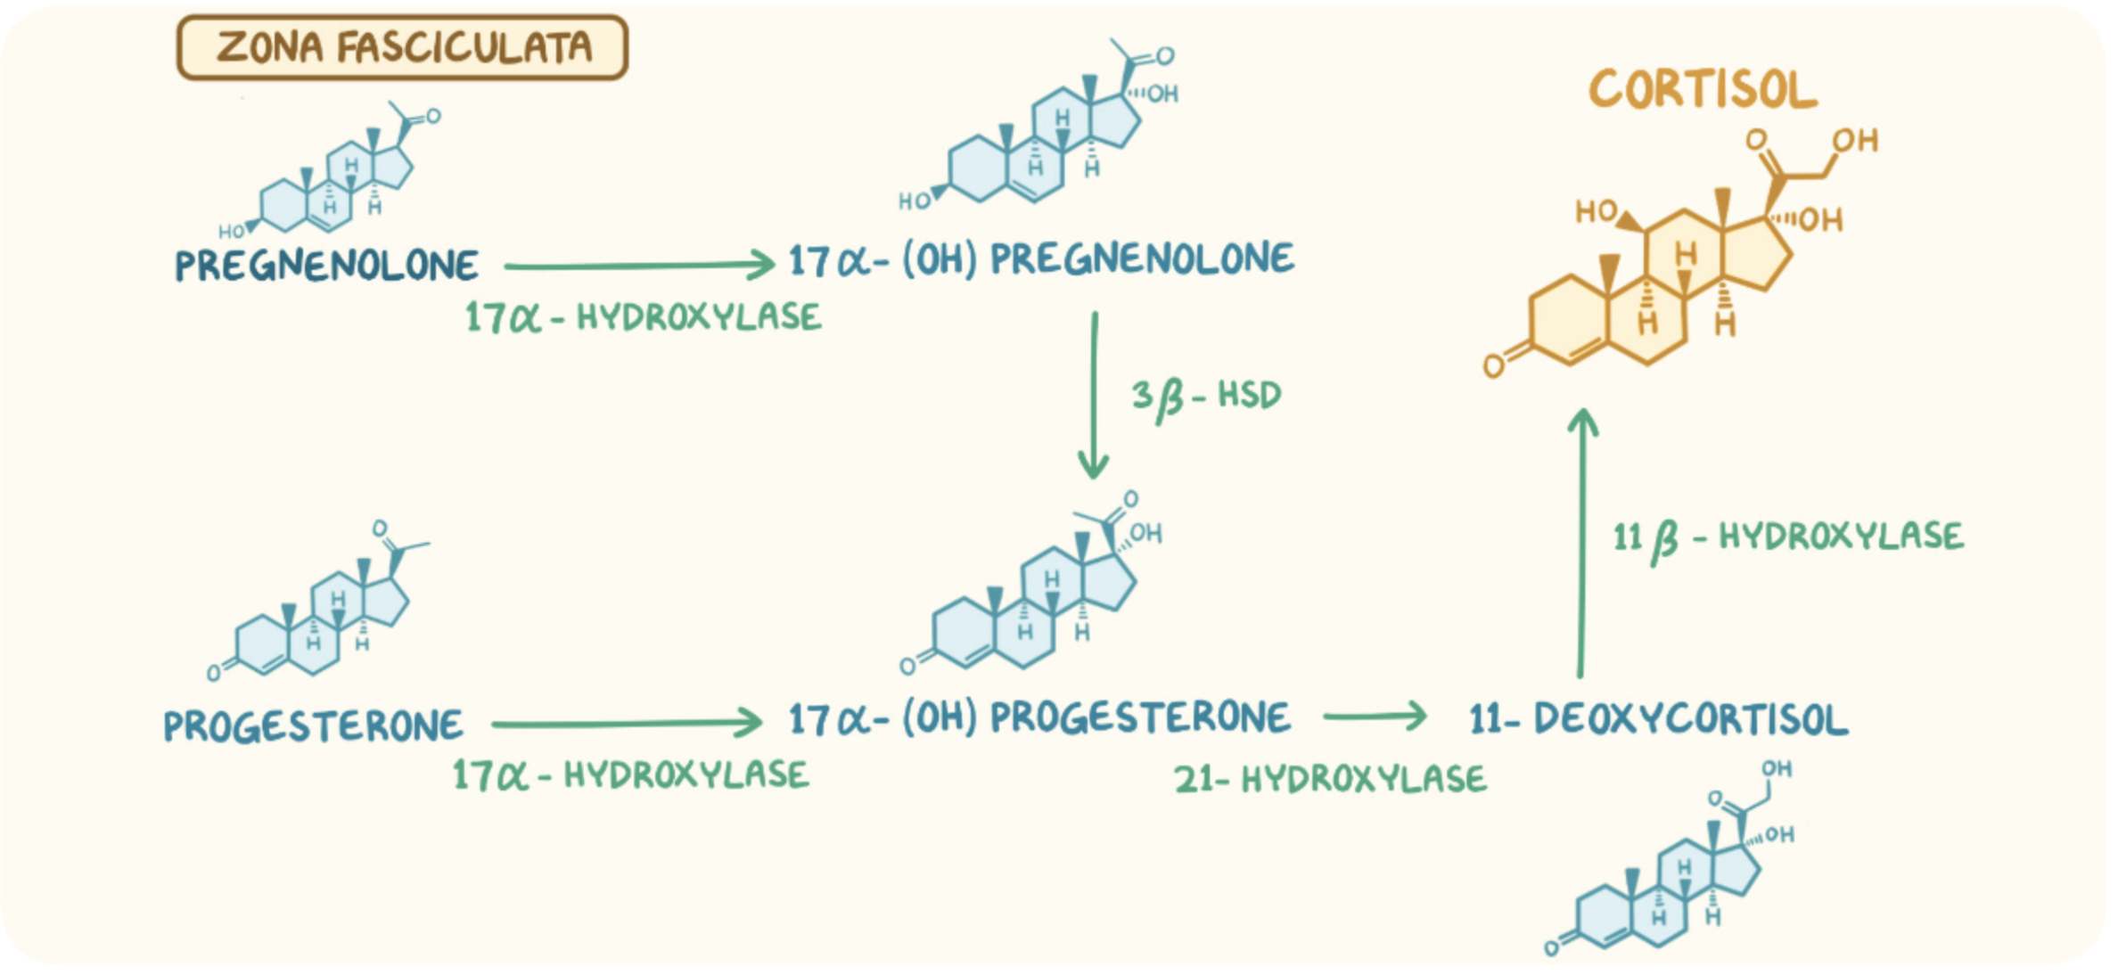
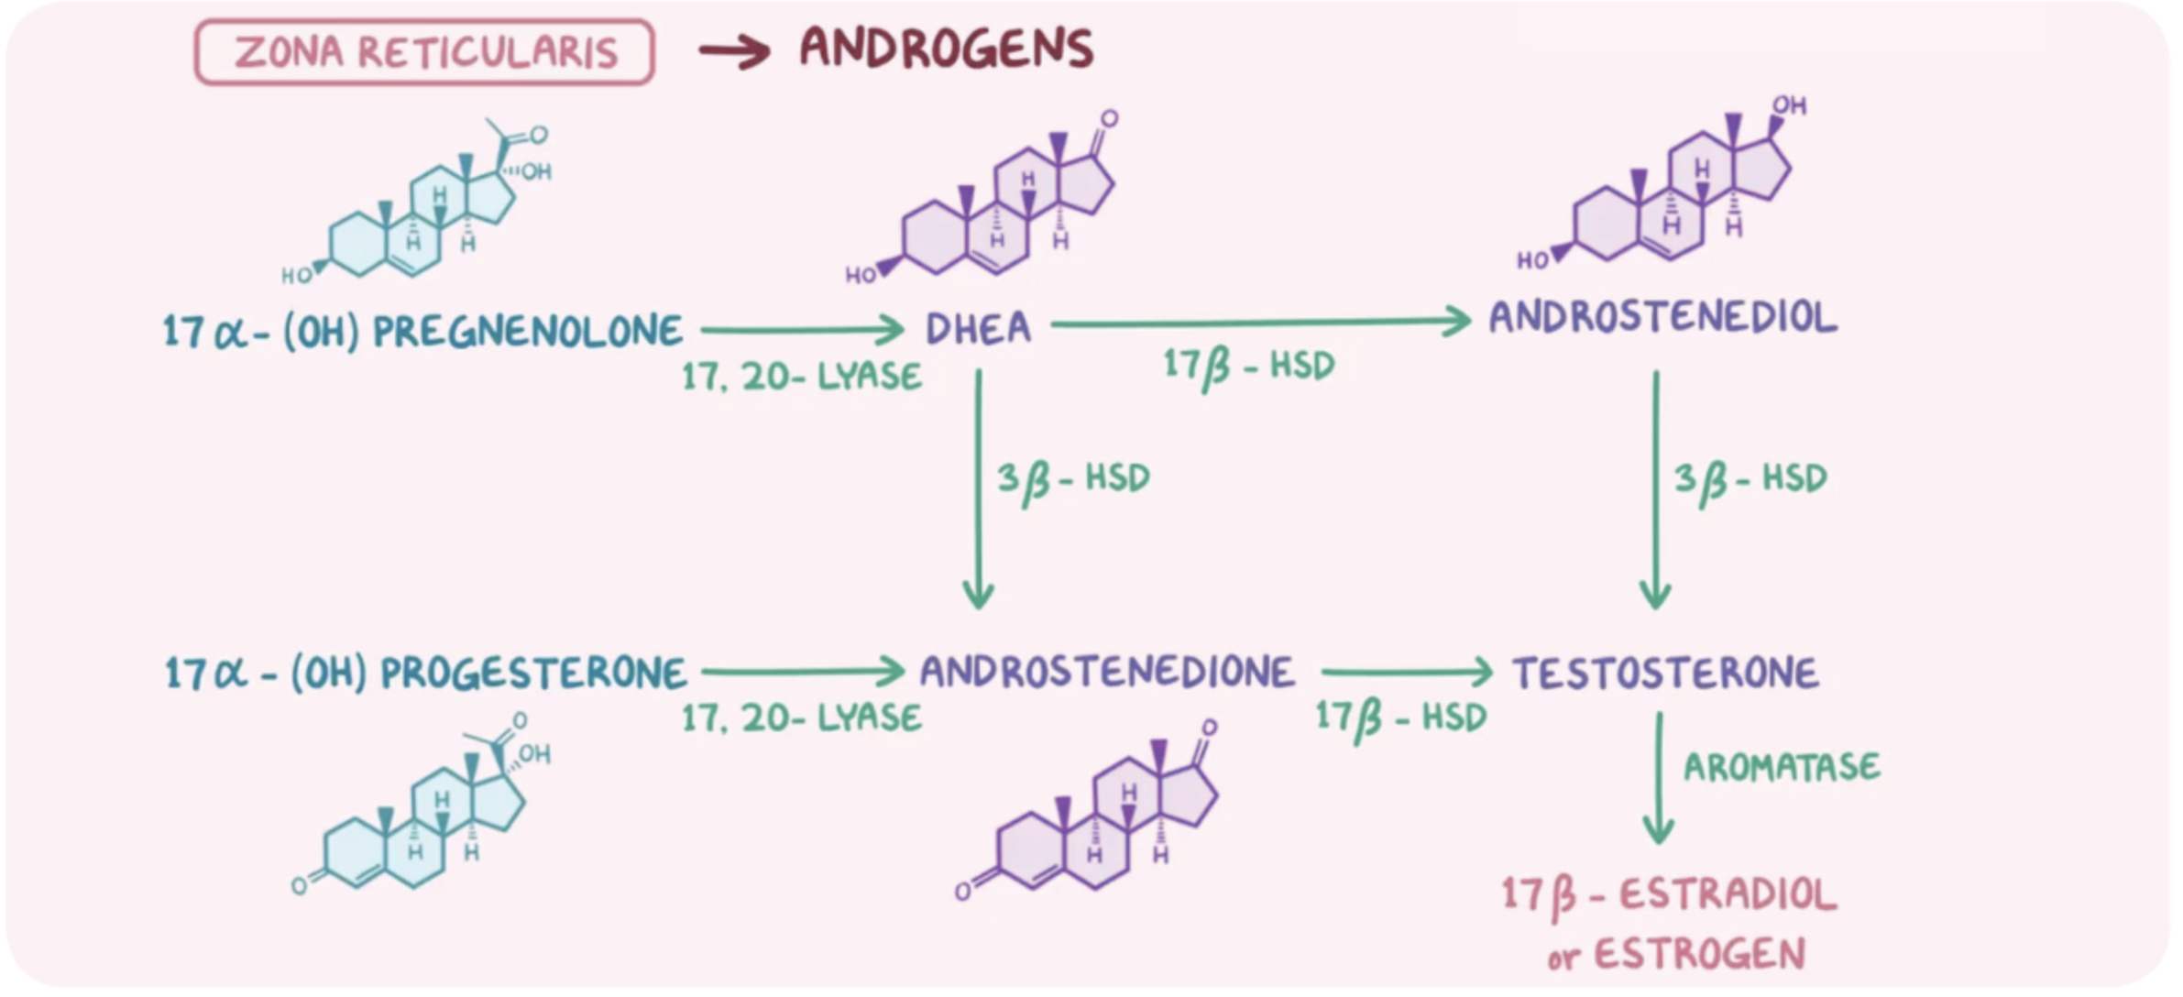
Hypothalamic Pituitary-Adrenal (HPA) Axis
The hypothalamus secrete corticotropin releasing hormone (CRH)
The CRH stimulate the anterior pituitary gland to secrete ACTH
ACTH acts on the Zona Fasciculata
Release of glucocorticoids
(Cortisol)
Steroid Hormone Synthesis
Cholesterol (27C)
Cholesterol Desmolase
Pregnenolone (21C)
3-ß-Hydroxysteroid dehydrogenase (3ß-HSD)
Progesteron (21C)
17-ɑ-Hydroxylase
11-Deoxycorticosterone (21C)
21-ɑ-Hydoxylase
17-ɑ-Hydroxyprogesterone (21C)
11-Deoxycortisol (21C)
Androstenedione (19C)
Corticosterone
11-ß-Hydroxylase
Peripheral tissues
Testosterone (19C)
Cortisol (21C)
Aldosterone (21C)
Estradiol (18C)
Dr’s note: It’s is important to know the number of C and the precursor in particular

Slide 5
Glucocorticoid Functions
Glucocorticoids have widespread metabolic effects on carbohydrates, fats and protein metabolism
Upon binding to its target, CORTISOL enhances metabolism in several ways:
In liver
In the liver it’s insulin antagonist¹ and has weak mineralocorticoid action:
↑↑ Gluconeogenesis² → production of glucose from newly-released amino acids and lipids
↑↑ Amino acid uptake and degradation
↑↑ Ketogenesis
In muscles
Cortisol → ↑↑ proteolysis and amino acids release
In adipose tissue ³
Cortisol → ↑↑ lipolysis through breakdown of fat
Conserving glucose
Conserve glucose by inhibiting its uptake into muscle and fat cells.
1-it will lower the level of insulin and increase glucose
2- The amino acid for gluconeogenesis are provided from the muscles and adipose tissue
3-The adipose tissue provide fats for both gluconeogenesis and ketogenesis

Slide 6
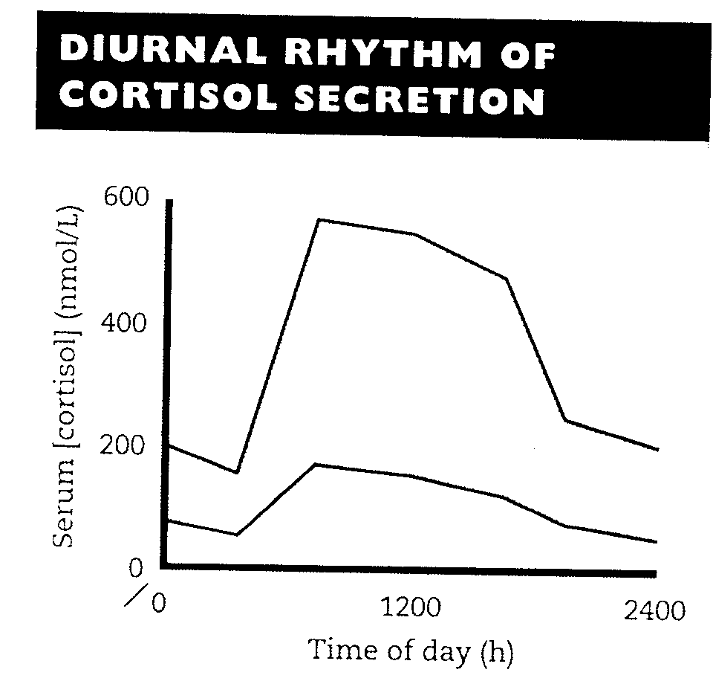
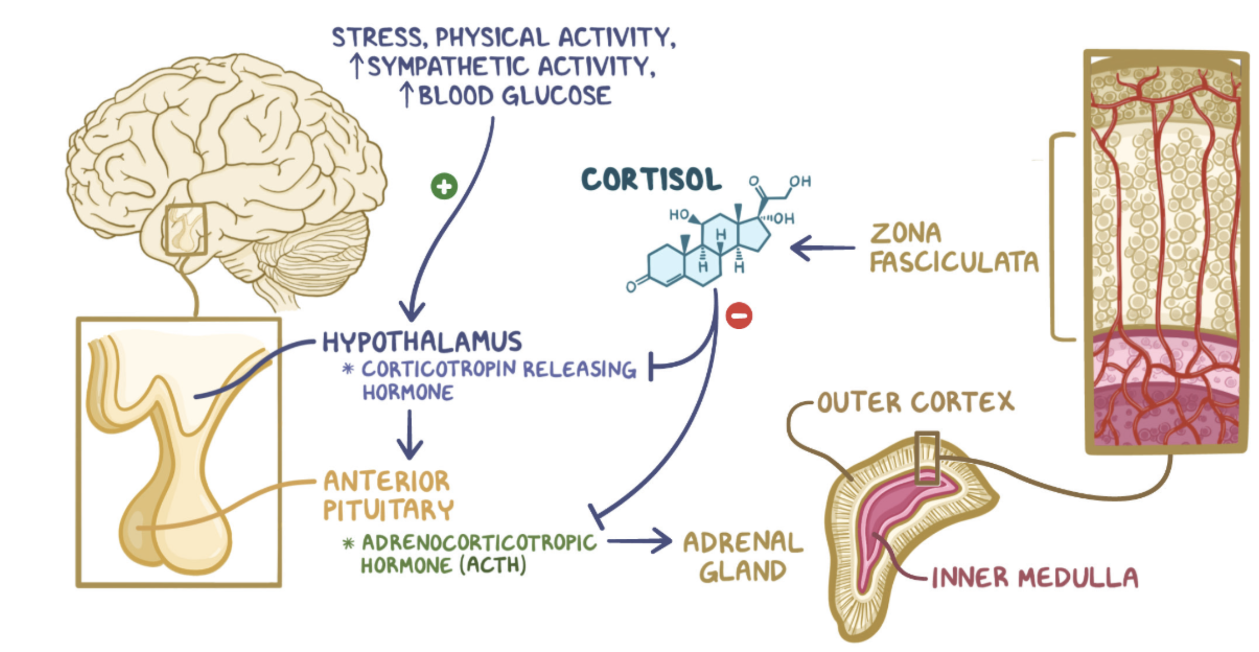
Regulation of ACTH and Cortisol Secretion
j
Negative feedback
ACTH release from the anterior pituitary is stimulated by hypothalamic secretion of CRH
CRH → ↑ ACTH → ↑[cortisol]
↑[Cortisol] or synthetic steroid suppress CRH and ACTH secretion
Highest cortisol level in the morning (8-9 AM)
Lowest cortisol level in the late afternoon and evening (8-9 PM)
The diurnal rhythm of serum cortisol
Stress
(e.g. major surgery, emotional stress) stress → ↑↑ CRH & ACTH → ↑↑ Cortisol
The diurnal rhythm of cortisol secretion the area between the curves represents values that lie within the reference range
Plasma Cortisol Binding Globulin (CBG)
In the circulation, glucocorticoids are mainly protein-bound (about 90%), chiefly to CBG
The diurnal rhythm of cortisol secretion; the area between the curves represents values that lie within the reference range
↑↑ In pregnancy and with estrogen treatment (e.g. oral contraceptives)
↓↓ In hypoproteinemic states (e.g. nephrotic syndrome)
The biologically active fraction of cortisol in plasma is the free(unbound) component¹
1- For investigation we look for the free form (The higher the level the higher the proteolysis)

Slide 7
Cortisol and ACTH Measurements
Serum Cortisol¹ and plasma (ACTH):
Urinary cortisol excretion:
Sample must be collected (without venous stasis) between 8a.m and 9a.m. and between 10p.m. and 12a.m. because of the diurnal rhythm
Temporary ↑ in these hormones may be observed as a response to emotional stress
Cortisol is removed from plasma by the liver → metabolically inactive compound → excreted in urine mainly as conjugated metabolite (e.g. glucuronide)
A small amount of cortisol is excreted unchanged in the urine (UFC)²
In normal individual: UFC is < 250 nmol/24 h
Causes of Elevated Serum Cortisol
Increased cortisol secretion
Increased CBG
Cushing’s syndrome
Exercise
Stress, anxiety and depression
Obesity
Alcohol abuse
Chronic renal failure
Congenital
Estrogen therapy
Pregnancy
1-Plasma cortisol not used ALONE because there might be interference which can lead to false positive or false negative results 2- urinary free cortisol

Slide 8
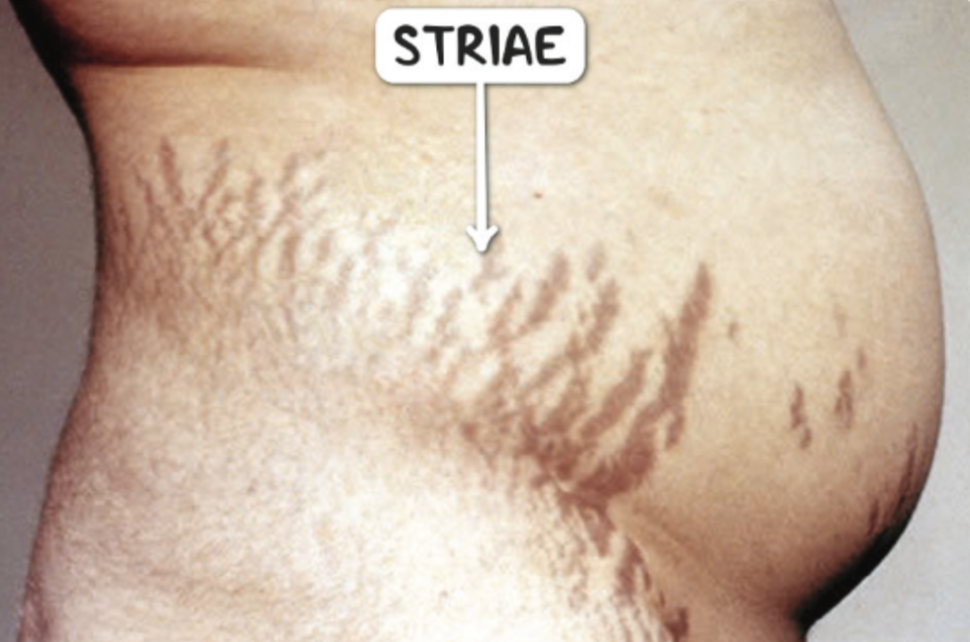
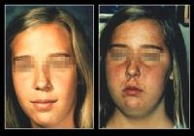
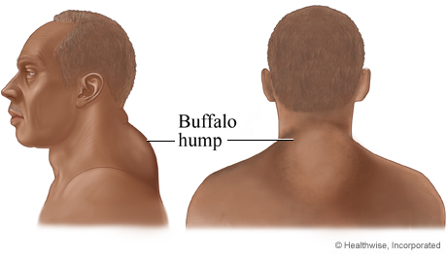
Signs and Symptoms of Cushing's Syndrome
↓ Libido, amenorrhea and infertility
“Excess cortisol may also affect other endocrine system”
Helpful video for Cushing
Patients frequently suffers various psychological disturbances ranging from euphoria to frank psychosis
Atrophy of the skin and mucous membrane
Symptoms
Weight gain and central obesity
Purple stria on the
trunk and legs
Moon face
Proximal muscle weakness
Hirsutism
Buffalo’s hump
Signs
↑ Protein metabolism
Hypertension
(due to aldosterone like effect)
Hypokalemic alkalosis
Hyperglycaemia or diabetes due to insulin resistance
Loss of diurnal rhythm of cortisol and ACTH
Impaired immunity

Slide 9
Investigations of Suspected Adrenocortical Hyperfunction
A. Screening and confirmatory tests
B. Test to determine the cause: to ascertain:
To assess the clinical diagnosis of adrenocortical hyperfunction
the site of the pathologic lesion
the nature of the pathologic lesion
Cushing?
Based on clinical history and examination
High
(ACTH-dependent)
Low DST¹/UFC/ midnight salivary cortisol
Screening
Pituitary MRI
Positive
(Hypercortisolism)
Negative
(Normal)
Positive
Negative
Insulin - induced hypoglycemia
Confirmatory
IPSS and/or High DST
Cushing syndrome
Pseudo-cushing
Non-responsive (Ectopic)
Responsive
ACTH
CT-Chest²
Low
(Non-ACTH dependent)
Cushing’s disease
2- Looking for small cell carcinoma of the lung
1- Dexamethasone suppression test

Slide 10
Screening Tests
LOW-dose DST
Procedure: 1 mg dexamethasone (DXM) administered at 11 PM -12 AM the night before attending the clinic.
Serum cortisol is measured at 8-9 AM.
Result: Cortisol < 50 nmol/L (suppression) → exclude hypercortisolemia (Cushing Syndrome)
Precautions: enzyme inducers drugs (Phenobarbitone & phenytoin) → ↑ DXM metabolism and ↓ DXM blood level to achieve CRH suppression (false diagnosis of Cushing)
24-hours urinary free cortisol
Procedure: 24 hours urinary collection from the patient.
Result: Cortisol < 250 nmol/day → exclude Cushing Syndrome
Disadvantage: incomplete collection of urine → a false-negative result.
Midnight Salivary Cortisol
Procedure: sample from patient’s saliva at Midnight.
Result: Cortisol < 100 ng/dL → exclude Cushing Syndrome.
Tests used to determine the cause of Cushing syndrome
Positive results of at least two screening tests would confirm the clinical diagnosis.
Radiological tests
ACTH-dependent causes
(Pituitary Vs Lung)
Confirmatory Tests
Further investigation are required
MRI of Pituitary
Ultrasound or CT of adrenals
High-dose DST
Inferior petrosal sinus sampling
ACTH- DEPENDENT OR ACTH-INDEPENDET
Plasma ACTH (Diurnal rhythm)

Slide 11
Causes of Adrenocortical Hyperfunction (Cushing’s Syndrome)
PLASMA ACTH
It should be measured on Blood specimens at 8-9a.m and 8-9 p.m
ACTH-dependent
ACTH-independent
Plasma ACTH
↑ Pituitary ACTH >90% (Cushing’s disease)
Ectopic ACTH by neoplasm <10%
Glucocorticoid therapy
Adrenal Tumor <20%
(adenoma or carcinoma)
Undetectable
↑↑ ACTH
↑↑↑↑ ACTH
High dose DST
Functional adrenal tumor → confirmed by an abdominal CT scan to detect an adrenal mass
Cushing’s disease
(pituitary-dependent)
Ectopic (non-endocrine) origin of ACTH
It is used to distinguish Cushing’s disease from ectopic ACTH secretion.
2mg DXM six-hourly for 48 hours to suppress cortisol secretion.
Full blood count
Basal (pre-DXM) serum cortisol or 24-hour urine free cortisol is compared with the results at the end of the 48-hour period.
Blood glucose
Other Blood tests
For patients suspected with Cushing
Blood electrolytes and pH
Suppression is defined as fall to less than 50% of basal value.
About 90% of patients with Cushing’s disease show suppression of cortisol output.
Renal function tests
In contrast, only 10% of patients with ectopic ACTH production
(or with adrenal tumors) show suppression. False positive
Liver function tests

Slide 12
Case Study
58 years old man was admitted with weight loss and Respiratory distress. He had increased pigmentation and BP was 140/80.
Lab tests | Result | Normal Range
Urea | 8.6 | (2.5-7 mmol/L)
Sodium | 144 | (135-145 mmol/L)
Potassium | 2.0 | (3.5-4.5 mmol/L)
Cortisol | 1650 | (150-550 nmol/L)
Post overnight DXM | 1530 | (<50 nmol/L)
Further investigation revealed the following:
DXM suppression test | Basal | After 48h 0.5mg qid | After 48h 2.0mg qid
Serum Cortisol | 1350 | 1420 | 1100 (No suppression) ¹
 | 8.00 am | 10.00 pm
Plasma ACTH (ng/L) | 220 (sky high) | 180 ² | Ref.range: 7-51ng/L
Didn’t fall to less than 50% → Ectopic
Independent

Slide 13
Take Home Messages
Initial screening for Cushing by 24 h UFC, LOW Dose DSA suppression test or Midnight Salivary Cortisol.
Confirmatory tests for Cushing by getting positive results of at least two of the screening tests.
Tests to determine the cause of Cushing: Plasma ACTH, High-dose DXM suppression test, inferior petrosal sinus sampling and radiological investigations.
ACTH-dependent Cushing: due to pituitary causes (Cushing’s disease) and due to ectopic production of ACTH.
ACTH-independent Cushing: due to adrenal carcinoma or carcinoma and due to steroid therapy.

Slide 14
Summary
 | Glucocorticoids (Cortisol)
Function | Anti insulin effect, Increase gluconeogenesis Proteolysis, lipolysis
Regulation | Highest in the morning, lowest in the evening CRH → ACTH → Cortisol
Increase Cortisol | Cushing Syndrome, Stress, Exercise, Chronic renal failure, Obesity Increased CBG: Congenital, Pregnancy, Estrogen therapy
Symptoms of Cushing | Moon face, Buffalo’s hump, Central obesity, purple striae, Proximal limb weakness, Hirsutism
Investigations of suspected Adrenocortical Hyperfunction
Screening and Confirmatory tests
Tests to determine the cause
High-dose dexamethasone
Plasma ACTH
Other blood tests

Slide 15
Quiz
MCQs :
Q1: How many carbon present in testosterone and estradiol respectively:
a) 19,18 b) 18,19 c) 19,19 d) 17,18
Q2: Which of the following is correct regarding cortisol function?
a) Lower the rate of lipolysis b) Gluconeogenesis from new amino acids c) Production of ketone bodies d) B & c
Q3: During which of the following cortisol level will increase?
a) Emotional stress b) 8-11pm c) Sleep
Q4: Which of the following tests would confirm Ectopic type of Adrenocortical hyperfunction ?
a) High-dose DSA b) Low-dose DSA
c) MRI of pituitary d) 24h Urine free cortisol
Q5: Which of the following is common site of Ectopic ACTH secreting tumor:
a) Breast b) Heart c) Pituitary gland d) Lungs
Q6: What is the cause of Cushing disease:
a) Adrenal tumor b) Pituitary tumor
c) Ectopic tumors d) Exogenous cortisol
SAQs :
Q1: Mention two conditions cause increase in CBG.
Q2: What if the effect of cortisol on the liver?
Q3: Mention two of the screening tests?
Q4: Mention four symptoms of Cushing Syndrome?
MCQs Answer key:
1) a 2) d 3) a 4) a 5) d 6) b
SAQs Answer key:
1- pregnancy 2- oral contraceptive
It’s insulin antagonist and have weak mineralocorticoid action:
Gluconeogenesis from amino acids and lipids
Ketogenesis
Increase amino acid uptake and degradation
3) 1- 24h urine free cortisol 2- Midnight Salivary Cortisol
4) - Increase BP - Hyperglycemia - buffalo’s hump -Weight gain

Slide 16
Team members
The best time for new beginning is NOW.
Girls Team:
Boys Team:
Ajeed Al-Rashoud
Alwateen Albalawi
Amira AlDakhilallah
Deema Almaziad
Ghaliah Alnufaei
Haifa Alwaily
Leena Alnassar
Lama Aldakhil
Lamiss Alzahrani
Nouf Alhumaidhi
Noura Alturki
Sarah Alkhalife
Shahd Alsalamah
Taif Alotaibi
Alkassem Binobaid
Fares Aldokhayel
Khayyal Alderaan
Mashal Abaalkhail
Naif Alsolais
Omar Alyabis
Omar Saeed
Rayyan Almousa
Yazen Bajeaifer
Team Leaders
We hear you
Lina Alosaimi
Mohannad Alqarni

