Slide 1
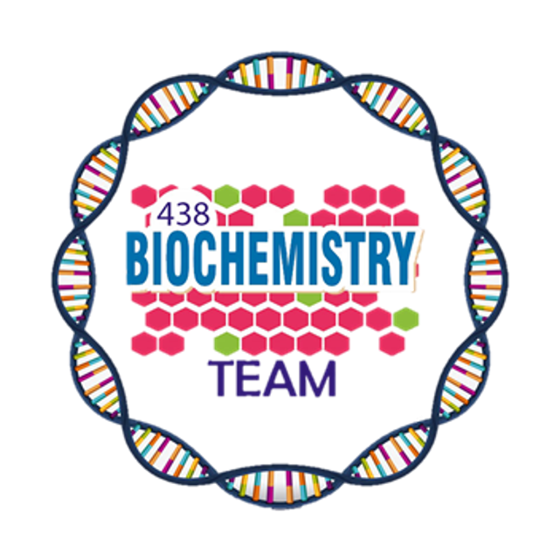
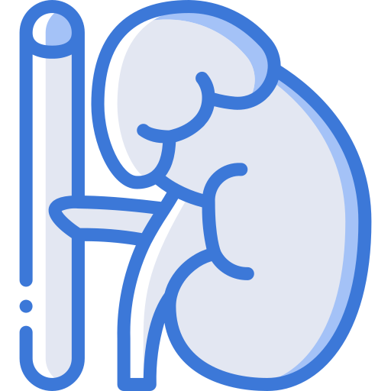
Addison’s Disease
Color Index:
Main Topic
Main content
Important
Drs’ notes
Extra info
Editing File
Biochemistry teamwork 438 - Endocrine Block

Slide 2
Objectives:
Identify different causes of primary adreno-cortical hypofunction(Addison’s disease).
Identify secondary causes of adreno-cortical hypofunction.
Understand the diagnostic algorithm for adreno-cortical hypofunction.
Understand the interpretation of laboratory tests of adreno-cortical hypofunction.

Slide 3
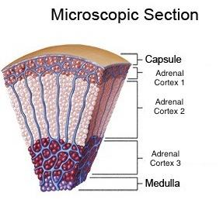
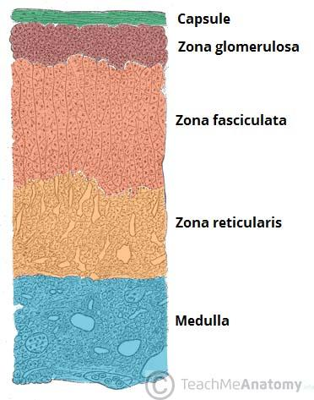
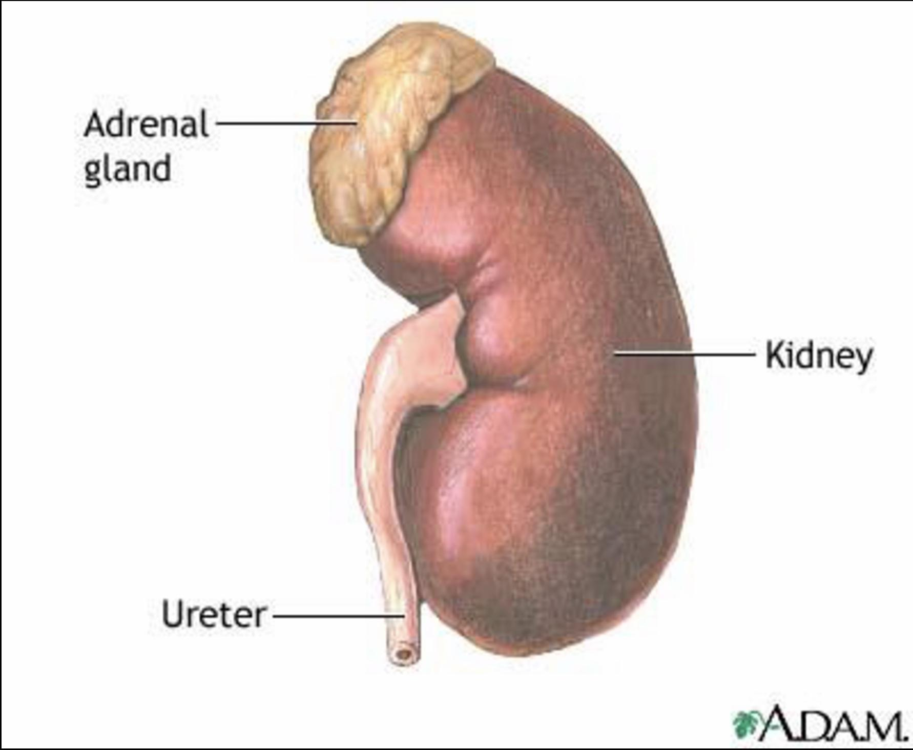
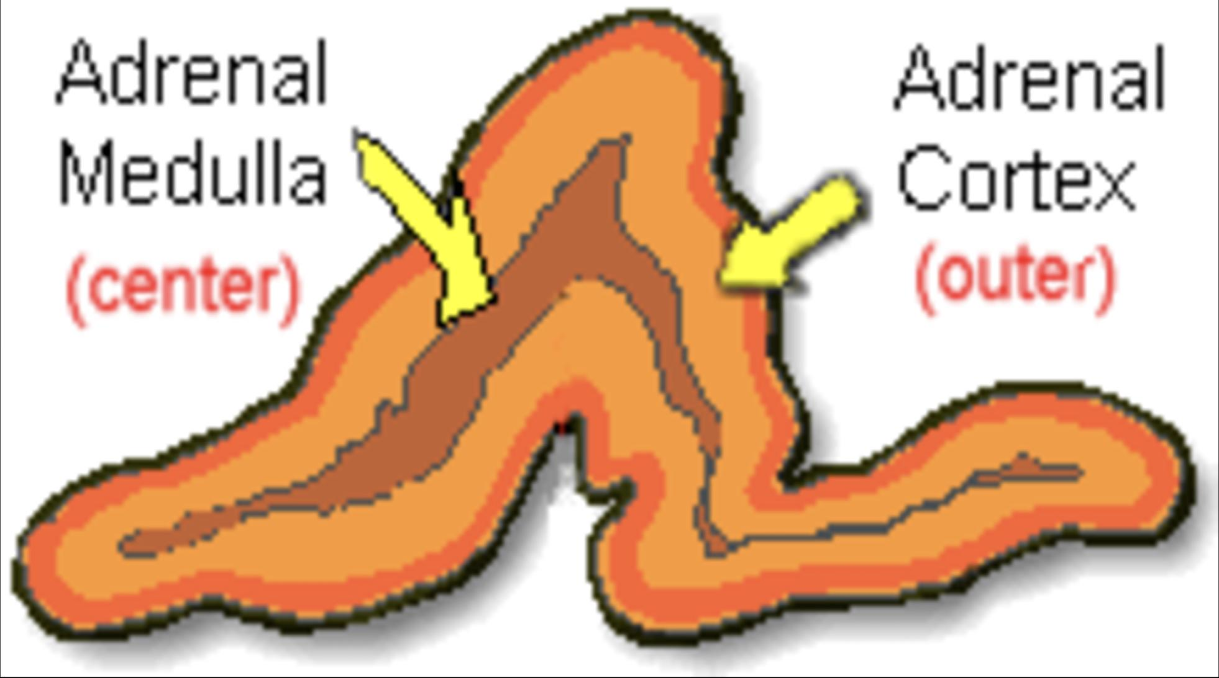
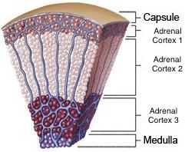
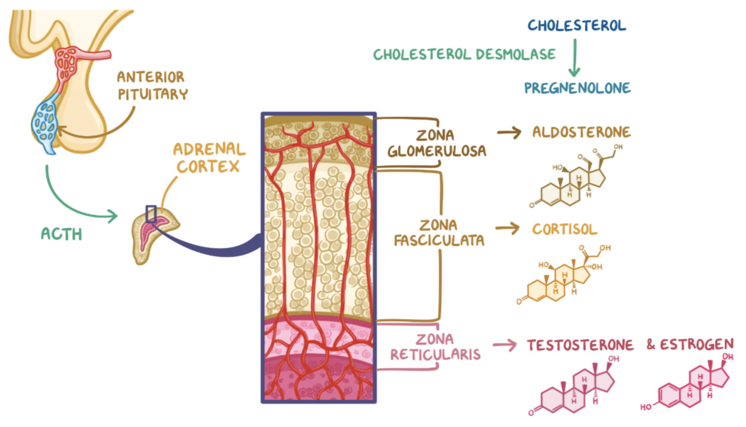
Adrenal gland
ANATOMY:
HISTOLOGY:
The adrenal gland is situated on the anterio-superior aspect of the kidney.
The adrenal gland consists of two distinct tissues of different embryological origin, the outer cortex and inner medulla.
Adrenal cortex zones:
The outermost zone aldosterone
(the principal mineralocorticoid).
Zona Glomerulosa
Glucocorticoids –
mainly cortisol (95%)
Zona Fasciculata
Sex hormones
Zona Reticularis

Slide 4
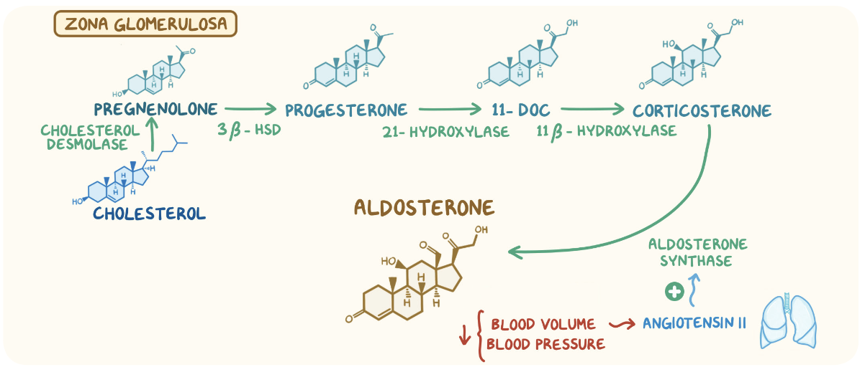
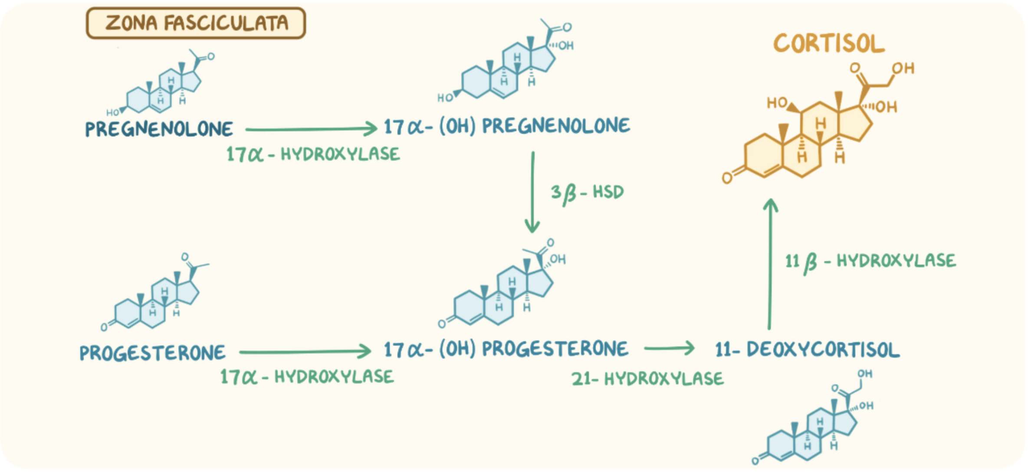
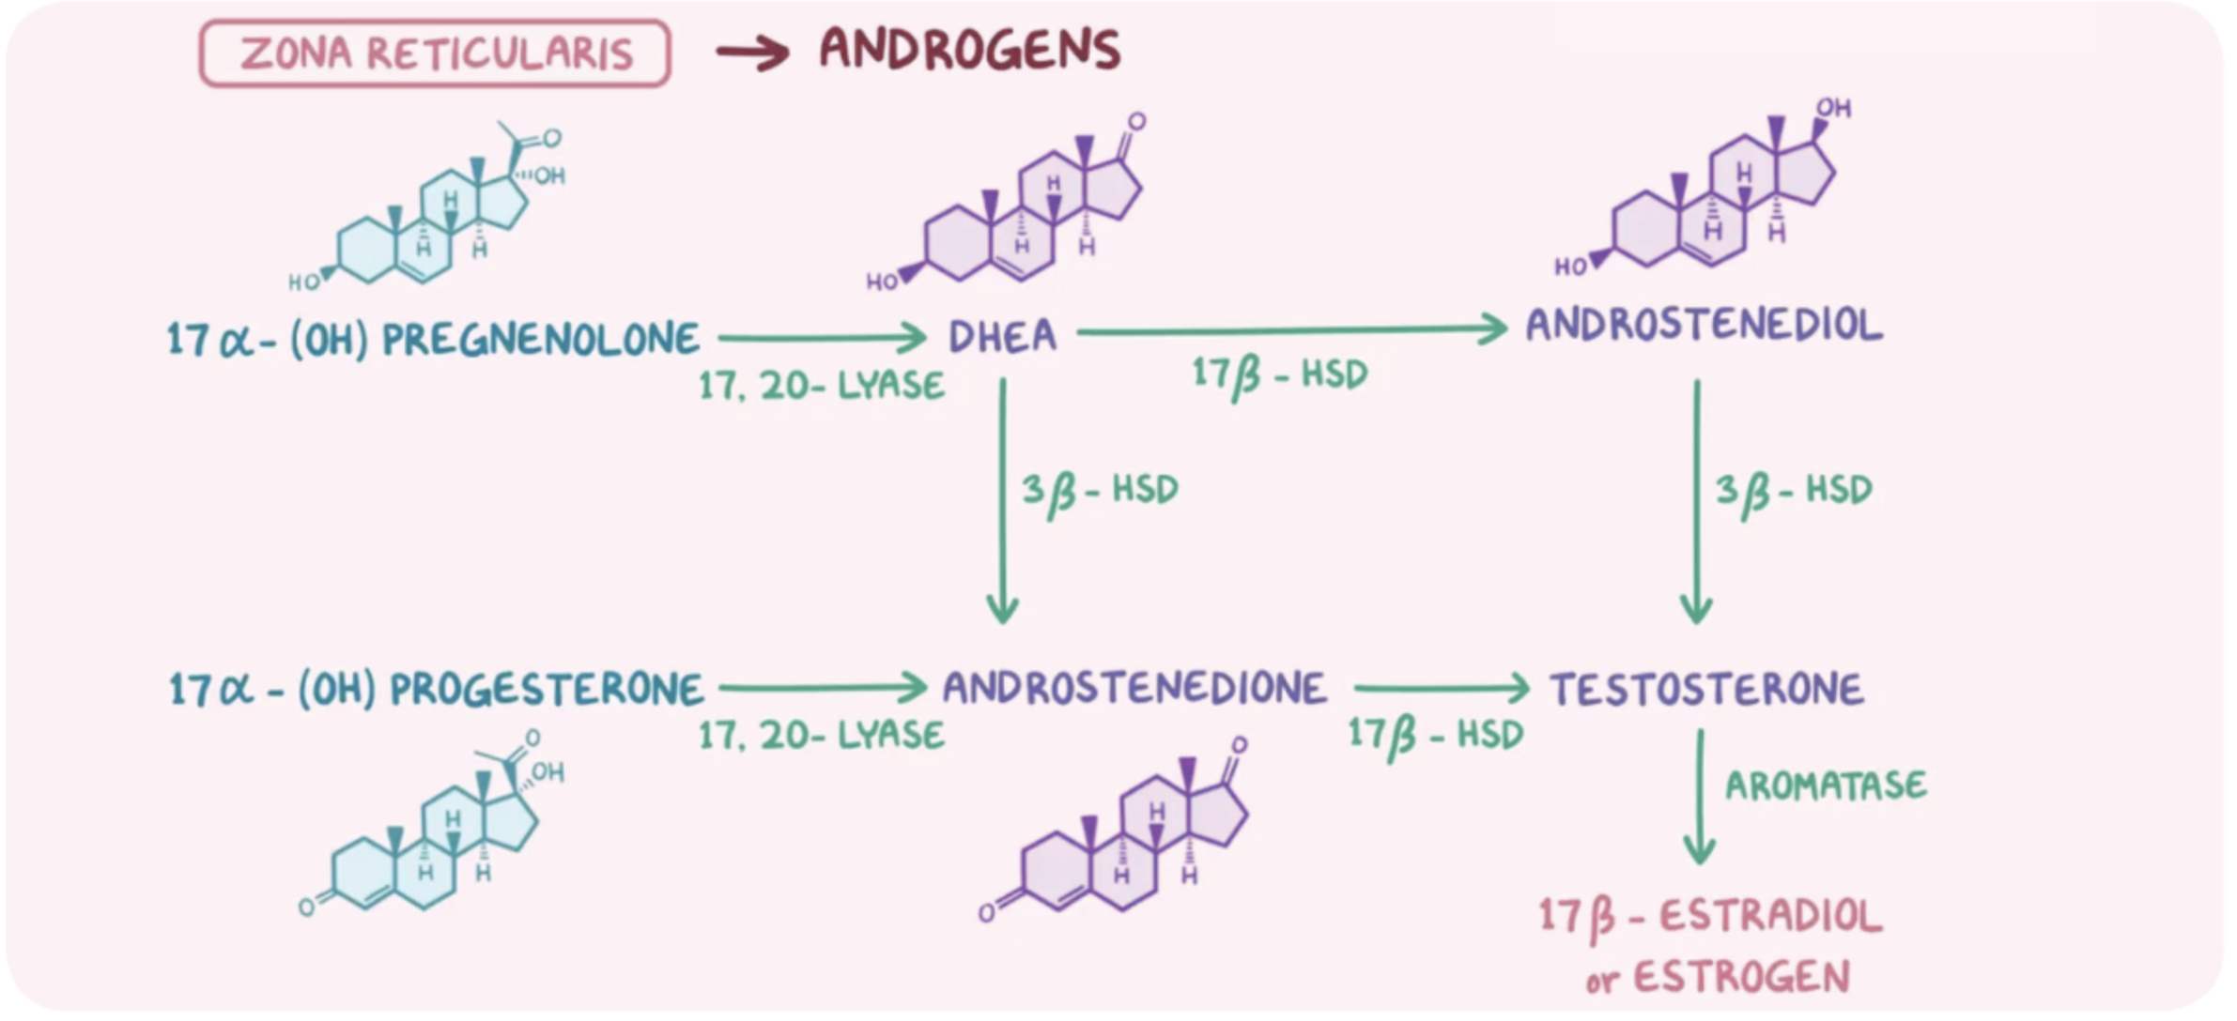
Steroid Hormone Synthesis
Cholesterol (27C)
Pregnenolone (21C)
3-𝛃-Hydroxysteroid dehydrogenase
Progesterone (21C)
21-𝛂-Hydroxylase
17-𝛂-Hydroxylase
17-𝛂-Hydroxyprogesterone (21C)
11-Deoxycorticosterone (21C)
21-𝛂-Hydroxylase
Androstenedione (19C)
11-𝛃-Hydroxylase
11-Deoxycortisol (21C)
Corticosterone
Testosterone (19C)
11-𝛃-Hydroxylase
Peripheral Tissue
Aldosterone (21C)
Cortisol (21C)
Estradiol (18C)

Slide 5
Aldosterone Hormone
The Renin-Angiotensin System
controls aldosterone secretion.
involved in blood pressure regulation.
The principal physiological function of aldosterone is:
to conserve Na+,mainly by facilitating Na+ reabsorption and reciprocal K+ or H+ secretion in the distal renal tubule.
Renin
Is a major regulator of water and electrolyte balance, as well as blood pressure.
A proteolytic enzyme produced by the juxtaglomerular cells of the afferent renal arteriole.
Sensitive to blood pressure changes through baroreceptors.
By acting on the distal convoluted tubule of kidney, leads to:
↑↑ potassium excretion
↑↑ sodium and water reabsorption
released into the circulation in response to:
fall in circulating blood volume.
Renin-Angiotensin system is the most important regulatory mechanism controlling aldosterone secretion.
fall in renal perfusion pressure.
loss of Na+.

Slide 6
Aldosterone and Renin-Angiotensin system
Angiotensinogen
(𝛂2-Globulin made in the liver)
Renin
Angiotensin I
ACE
Angiotensin II
↑↑ Aldosterone secretion.
↓↓ Renin release
Degraded
Vasoconstriction
Angiotensin III
↑ Blood pressure

Slide 7
1
Adrenocortical Hypofunction (AC)
Primary
Primary AC hypofunction: (destruction of adrenal gland, Addison’s disease)
Autoimmune
Infection, e.g., tuberculosis
Infiltrative lesions, e.g., amylodosis
Causes:
Helpful video for Addison
Signs and symptoms:
Signs and symptoms:
of primary adrenal failure (Addison’s disease):
(The symptoms are precipitated by trauma, infection or surgery)
of Hyperpigmentation
Lethargy, weakness, nausea & weight loss.
occurs because melanocyte- stimulating hormone (MSH) and (ACTH) share the same precursor molecule, Pro- opiomelanocortin (POMC).
Hypotension especially on standing (postural)
Hyperpigmentation (buccal mucosa, skin creases, scars)
The anterior pituitary POMC is cleaved into ACTH, γ-MSH, and β-lipotropin.
Deficiency of both glucocorticoids and mineralocorticoids
The subunit ACTH undergoes further cleavage to produce α-MSH, the most important MSH for skin pigmentation.
Hypoglycemia, ↓Na+, ↑K+ and raised urea
Life threatening and need urgent care.

Slide 8
2
Adrenocortical Hypofunction (AC)
Secondary
Pituitary tumors
Vascular lesions
Head trauma
Hypothalamic diseases
Iatrogenic (steroid therapy, surgery or radiotherapy)
Causes:
Signs and symptoms:
In secondary adrenocortical insufficiency, skin darkening does not occur.
of Hyperpigmentation
Investigation of Addison’s disease (AD)
The patient should be hospitalized
Basal measurement of:
Because they have hypoglycemia (one of the emergency conditions)
Serum urea, Na+, K+ & glucose
Serum cortisol and plasma ACTH
Normal serum cortisol and UFC does
not exclude AD.
Definitive diagnosis and confirmatory tests should be done later after crisis.
Simultaneous measurement of cortisol and ACTH improves the accuracy of diagnosis of primary adrenal failure:
Low serum cortisol ( <200 nmol/L) and
High plasma ACTH (>200 ng/L)

Slide 9
Confirmatory Tests
1. Short tetracosactrin (Synacthen) test
(Short ACTH stimulation test):
Measure basal S. cortisol
Stimulate with I.M. synthetic ACTH (0.25 mg)
Measure S. cortisol 30 min after I.M injection
Normal: ↑ of S. cortisol to >500 nmol/L
Failure of S. cortisol to respond to stimulation, confirm AD.
Abnormal results:
emotional stress
glucocorticoid therapy
estrogen contraceptives.
2. Adrenal antibodies
• Detection of adrenal antibodies in serum of
patients with autoimmune Addison’s disease
3. Imaging (Ultrasound/CT)
Ultrasound or CT for adrenal glands for identifying the cause of primary adrenal failure

Slide 10
Investigation of Secondary AC Insufficiency
Low serum cortisol with low plasma ACTH
No response to short synacthen test: Adrenocortical cells fail to respond to short ACTH stimulation
Depot Synacthen test (confirmatory test)
Depot Synacthen test (confirmatory test)
1
Measure basal S. cortisol
Interpretation of results:
Addison’s disease: No rise of S. cortisol >600 nmol/L at 5 h after 3rd injection.
Secondary AC: Stepwise increase in the S. cortisol after successive injections
Limitations:
2
Stimulate with I.M. synthetic ACTH (1.0 mg) on
each of three consecutive days
3
Measure S. cortisol at 5 hours after I.M. injection
on each of the three days
Other Investigations
Hypothyroidism: Thyroid deficiency must be corrected before testing of adrenocortical functions
Prolonged steroid therapy
MRI for pituitary gland
Insulin-induced hypoglycemia:
Adrenal failure secondary to pituitary causes

Slide 11
Investigations Summary
Very important slide!
 | Investigation for Addison’s disease | Investigation for Secondary AC Insufficiency
Screening | Basal plasma ACTH and basal serum cortisol, glucose, urea and electrolytes Screening High ACTH and Low cortisol | Low ACTH and Low cortisol
Confirmation | Short ACTH stimulation test: No response | Long ACTH stimulation test: Stepwise Confirmation increase in S. cortisol
Others | Adrenal autoantibodies Others Ultrasound/CT adrenal glands | Insulin-induced hypoglycemia Others MRI pituitary gland

Slide 12
Take Home Messages
Addison’s disease is due to destruction of adrenals by autoimmune, infection, or infiltrative lesions.
Adrenocortical hypofunction may occur secondary to pituitary disease, e.g., tumors, infection, trauma, or iatrogenic (surgery or radiation).
Initial screening for Addison’s disease by serum cortisol and ACTH. Other tests to support the diagnosis include serum urea, electrolytes and glucose.
Confirmatory tests for Addison’s disease by short Synacthen test.
Diagnosis of secondary adrenocortical hypofunction by depot (long) Synacthen test.

Slide 13
Summary
Renin-Angiotensin system is the most important regulatory mechanism for aldosterone secretion
1
Causes of primary adrenal insufficiency Autoimmune, Infection, e.g., tuberculosis and Infiltrative lesions, e.g., amyloidosis
2
Causes of secondary adrenal insufficiency are Pituitary tumors, Vascular lesions ,Trauma,Hypothalamic diseases (tertiary) and Iatrogenic (steroid therapy, surgery or radiotherapy.
3
In secondary adrenocortical insufficiency, skin darkening does not occur.
4
In primary adrenal insufficiency Low serum cortisol, High plasma ACTH but in secondary Low serum cortisol with low plasma ACTH.
5
Short tetracosactrin (Synacthen) test (Short ACTH stimulation test) is confirmatory test for both primary and secondary adrenal insufficiency but in primary there is no rise in S.cortisol and in case of secondary there is Stepwise increase in the S. cortisol
6

Slide 14
Quiz
MCQs :
Q1: From which zone the Cortisol secreted?
a) Zona Glomerulosa b) Zona Fasciculata c) Zona Reticularis d) All cortex
Q2: Aldosterone by acting on the distal convoluted tubule of kidney, leads to:
a) ↓ Sodium reabsorption b) ↑ Potassium excretion c) ↓ Water reabsorption d) A+C
Q3: Which of the following is not a symptom of Addison's Disease?
a) Weight loss b) Bronzing of the skin c) Craving for salty foods d) Weight gain
Q4: Which of the following is a confirmatory test for secondary AC insufficiency?
a) Adrenal autoantibodies b) Short ACTH stimulation test c) Long ACTH stimulation test d) Basal plasma ACTH
Q5: Which of the following describes 2ry AC insufficiency?
a) ↑ S. cortisol & Normal Plasma ACTH b) ↓ S. cortisol & sky high Plasma ACTH c) ↑ S. cortisol & ↑ Urinary cortisol d) ↓ S. cortisol with ↓ plasma ACTH
Q6: Normally in a Short tetracosactrin (Synacthen) test, there will be an .............. response to I.M injection of ACTH
a) Positive b) Negative c) Absent d) Mixed
SAQs :
Q1: What is the enzyme that convert 11-Deoxycortisol to cortisol?
Q2: What are the deficiencies and decreases that happen as signs and symptoms of Addison’s disease
Q3: Name 3 tests that are used to confirm the diagnosis of Addison’s disease.
Q4: What are the limitations to the Depot synacthen test?
MCQs Answer key:
1) B 2) B 3) D 4) C 5) D 6) A
SAQs Answer key:
11-𝛃-Hydroxylase
Deficiency of both glucocorticoids and mineralocorticoids, Hypoglycemia, ↓Na+
1- Short Synacthen (tetracosactrin) test ( Short ACTH stimulation test) 2-Adrenal Antibodies 3- Imaging (CT, Ultrasound) of the adrenal gland
1- hypothyrodism 2- prolonged steroid therapy

Slide 15
Team members
I won’t let you down
- Note to self
Girls Team:
Boys Team:
Ajeed Al-Rashoud
Alwateen Albalawi
Amira AlDakhilallah
Deema Almaziad
Ghaliah Alnufaei
Haifa Alwaily
Leena Alnassar
Lama Aldakhil
Lamiss Alzahrani
Nouf Alhumaidhi
Noura Alturki
Sarah Alkhalife
Shahd Alsalamah
Taif Alotaibi
Alkassem Binobaid
Fares Aldokhayel
Khayyal Alderaan
Mashal Abaalkhail
Naif Alsolais
Omar Alyabis
Omar Saeed
Rayyan Almousa
Yazen Bajeaifer
Team Leaders
We hear you
Lina Alosaimi
Mohannad Alqarni

