Slide 1
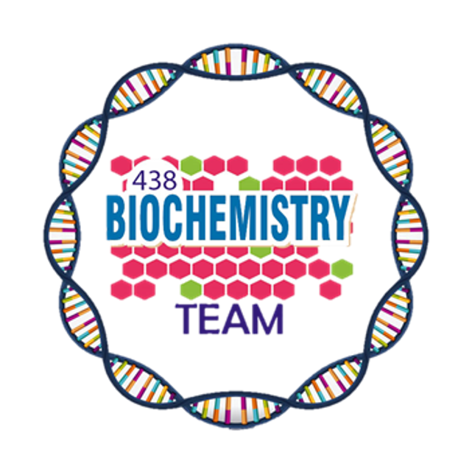
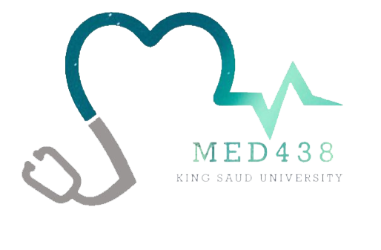
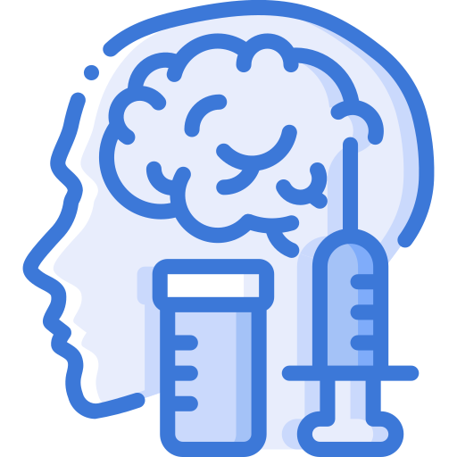
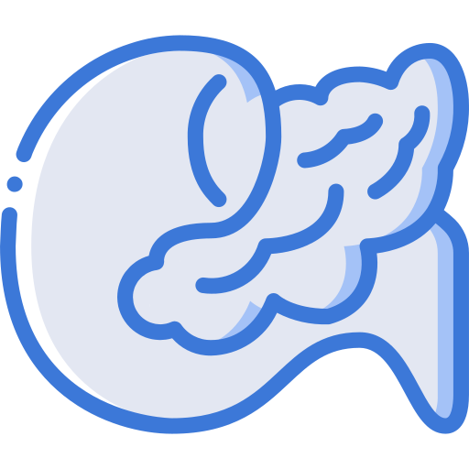
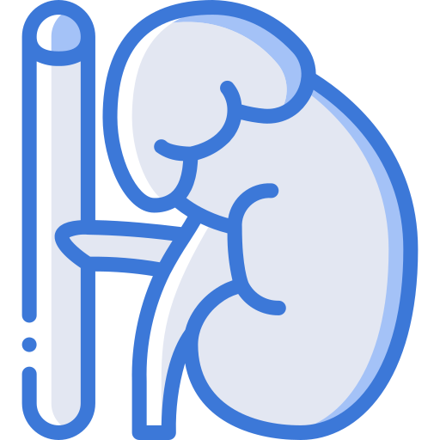
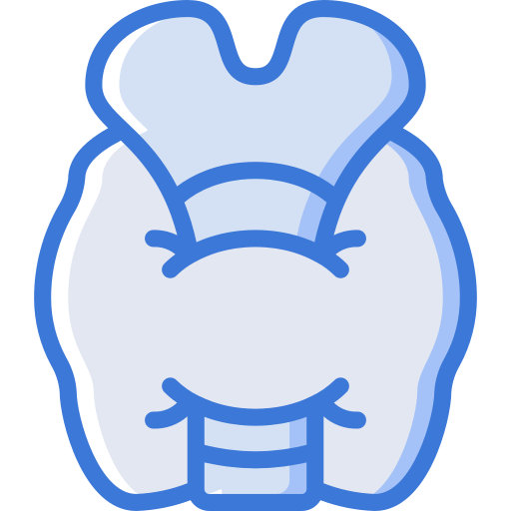
Obesity
Color Index:
Main Topic
Main content
Important
Drs’ notes
Extra info
Editing File
Biochemistry teamwork 438 - Endocrine Block

Slide 2
Objectives:
Define and characterize obesity in terms of BMI and risk factors.
Compare the anatomic and biochemical differences in fat deposition.
Understand the role of adipocytes in fat storage and release of hormones.
Discuss the hormonal control of obesity by leptin, adiponectin and other hormones.
Discuss the management and treatment options for obesity.
Overview:
Introduction & Body Mass Index (BMI).
Types of fat deposition in the body & Metabolic changes in obesity.
Adipocytes (fat cells) and weight gain & Hormones in obesity & Treatment options.

Slide 3
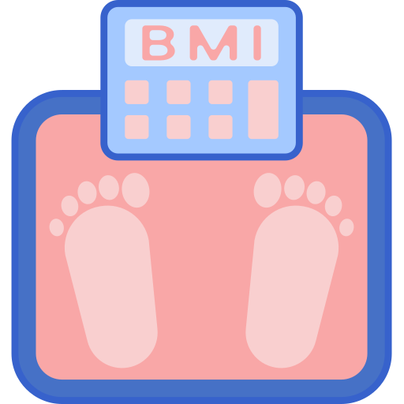
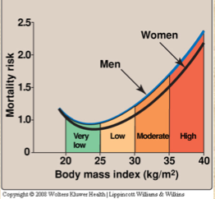
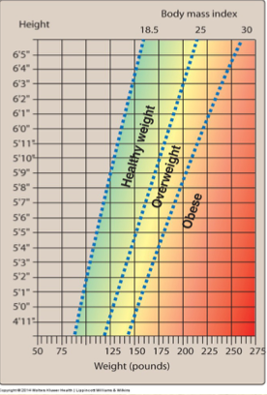
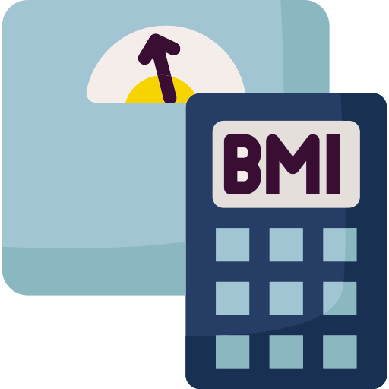
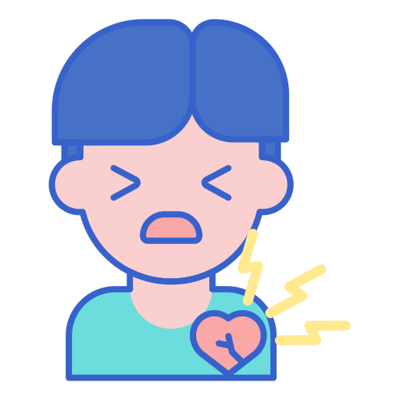
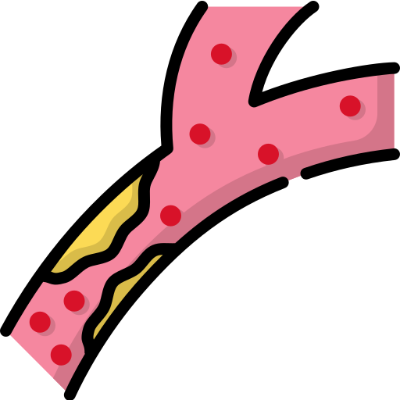
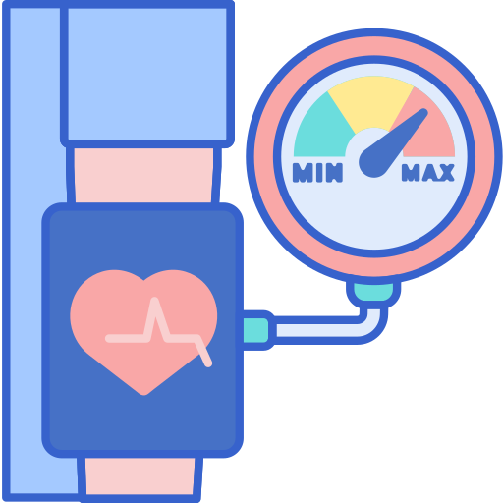
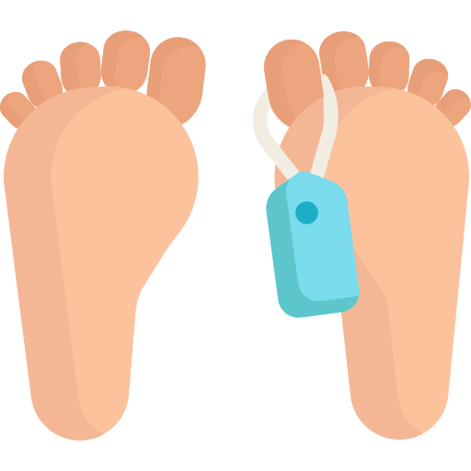
Obesity
Causes accumulation of excess body fat
A disorder of body weight regulatory systems
>20% of normal body weight
BMI is an indirect measure of obesity
 | BMI | GRADE
UNDERWEIGHT | ≤ 18.5
NORMAL | 18.5 - 24.9
OVERWEIGHT | 25.0 - 29.9
OBESE | 30.0 - 34.9 | I
OBESE | 35.0 - 39.9 | II
HIGHLY OBESE | ≥ 40 | III
Body Mass Index
Correlates height, weight and amount of body fat in an individual
High BMI is associated with increased mortality risk
Obesity is associated with a high risk of:
Diabetes mellitus
High plasma triglycerides
Heart disease
Gallstones,arthritis, gout
Hypercholesterolemia
Hypertension
Cancer
Mortality

Slide 4
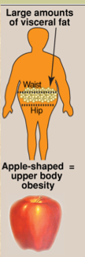
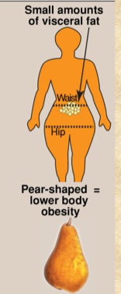
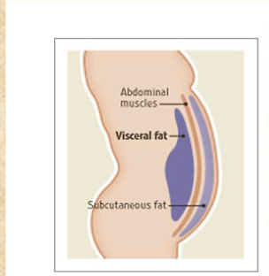
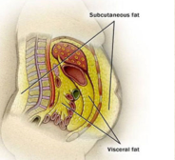
Anatomic Differences in Fat Deposition:
(Health risks depend on the pattern of fat deposition)
Android, “apple-shaped”, or upper body obesity
Gynoid, “pear-shaped”, or lower body obesity
excess body fat deposited in the central abdominal area
Fat deposited around the hips or gluteal region
Associated risks are lower
Associated risk factors are:
Hypertension
Coronary heart disease
Insulin resistance
Dyslipidemia
Diabetes
Different Fat Depots in The Body
Biochemical Differences in Fat Deposits
Subcutaneous Fat | Visceral Fat
The fat stored just under the skin in the abdominal and gluteal-femoral region | Composed of omental and mesenteric fat
Constitutes 80-90% of the total fat in the body | Present in close association with digestive tract
Abdominal Fat | Gluteal Fat
Smaller cells | Larger cells
More responsive to hormones (both visceral and subcutaneous) | Less responsive (subcutaneous)
Release substances via portal vein to the liver | Release substances to circulation with no effect on the liver

Slide 5
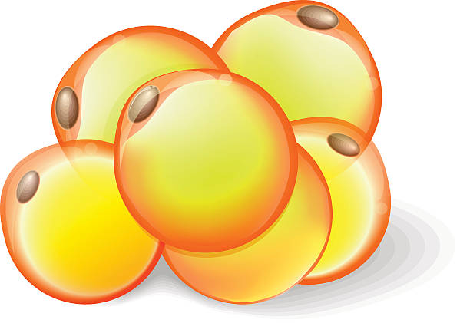
Adipocytes
Prolonged overnutrition stimulates
Pre-adipocytes in adipose tissue
Proliferation / differentiation into mature fat cells
Increases adipocyte number
Triacylglycerols (fats) are deposited in adipocytes (fat cells) which can increase in size up to a limit.
Thus obesity is due to a combination of increased fat cell size (hypertrophy) and number(hyperplasia).
Fat cells, once gained, are never lost
Reduction in weight causes adipocytes to reduce in size but not in number
Ectopic fat
Excessive calories that cannot be stored in adipose tissue “spill over” into other tissues such as muscle and liver
- It is called “ectopic fat” that is strongly associated with insulin resistance
Factors contributing to obesity
Environmental and behavioral
Genetic: familial tendency
Sex: women more susceptible
Drugs: e.g. tricyclic derivatives
Activity: lack of physical activity
Psychogenic: emotional deprivation/depression
Alcohol: problem drinking
Smoking: cessation of smoking

Slide 6
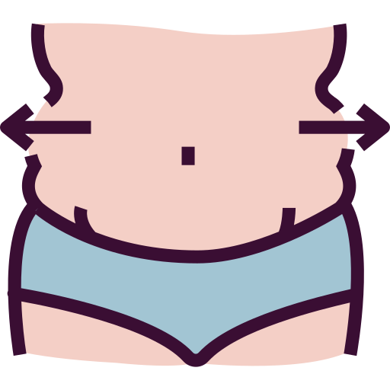
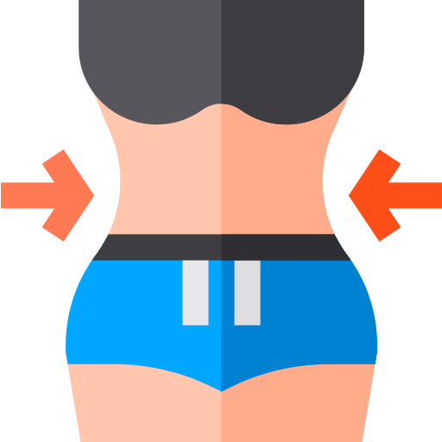
Causes of Weight Gain
More in and less out = weight gain
More out and less in = weight loss
Hypothalamus: control center for hunger and satiety
Energy imbalance
calories consumed not equal to calories used over a long period of time due to a combination of several factors:
Endocrine disorder: Hormonal imbalance
Individual behaviors
Social interactions
Genetics
Environmental factors
Afferent neural signals
Appetite is influenced by:
Circulating hormones
These signals cause the release of hypothalamic peptides and activate efferent neural signals
Metabolites
Hormonal Control
Adipocytes also function as endocrine cells
Leptin
They release many regulatory molecules:
Adiponectin
Explanation of the picture:
Undernourished state: afferent signals are sent to satiety center in hypothalamus by:
Stomach which increase the secretion of Ghrelin to increase the appetite.
Pancreas which decreases the secretion of Insulin so there’ll be decrease in metabolism.
Intestine which decreases the secretion of CCK.
Adipocyte which decreases the secretion of Leptin so there’ll be decrease in weight-loss. Hypothalamus then send efferent signals to increase appetite & decrease energy expenditure.
Overnourished: the opposite happens.
Resistin

Slide 7
Adipocyte hormones
Leptin hormone
Adiponectin hormone
Leptin causes overweight mice to lose weight and maintain weight loss
5
1
A protein hormone produced by adipocytes that is required to keep the body weight under control
Low levels are seen in metabolic syndrome and diabetes mellitus.
06
01
A protein hormone exclusively and abundantly secreted from adipocytes
Leptin secretion:
Suppressed in starvation (depletion of fat stores)
Enhanced in well-fed state (expansion of fat stores)
4
2
Adiponectin levels are inversely correlated with body fat percentage and parallels with the HDL level.
05
02
It promotes the uptake and oxidation of fatty acids and glucose by muscle and liver.
3
04
04
Regulates the amount of body fat by:
Controlling appetite (↓) and energy expenditure (↑)
Signals the brain about fat store level
It net effect is to increase the sensitivity to insulin, and improve glucose tolerance.
03
It Blocks the synthesis of fatty acids and gluconeogenesis by hepatocytes.
Leptin resistance may have some role in human obesity:
Dieting decreases leptin level
Reducing metabolism, stimulating appetite
6
1
Leptin ↑ metabolic rate and ↓ appetite in human
Leptin Resistance
Mutation in db gene causes leptin resistance in mice
5
2
Plasma leptin level in obese humans is usually normal for their fat mass
The receptor for leptin in the hypothalamus is produced db gene
4
3
Resistance to leptin has been found in obese humans
1: Obese people have the normal amount of Leptin, but they have a delayed Leptin response, It’s helpful to tell the patient to take a small break in the middle of eating a meal to allow leptin secretion.
2: The person either can’t produce enough leptin due to genetic abnormality and they become obese, so if you give them leptin they will respond and lose weight OR the receptors are defected, so the person has enough leptin but no usage and this is called “leptin resistance”.

Slide 8
Other Hormones
Ghrelin
A peptide hormone is secreted by stomach, the secretion increases just before meals and drops after meals.
It stimulates appetite & increases food intake & decreases energy expenditure and fat catabolism.
Levels in dieters are higher after weight loss: the body steps up ghrelin production in response to weight loss.
the higher the weight loss, the higher the ghrelin levels.
Cholecystokinin
Peptides released from the gut after a meal, sends satiety signals to the brain.
Insulin
Promotes metabolism (& suppresses the appetite immediately).
Metabolic Changes in Obesity
Adipocytes send signals that cause abnormal metabolic changes such as:
01
02
03
Dyslipidemia
Glucose Intolerance
Insulin
Resistance

Slide 9
Benefits of Weight Loss in Obesity
Treatment Options
Slow weight loss is more stable &
Weight loss decreases risk factors for obesity leading to:
Physical activity combined with healthy diet decreases the level of obesity & reduces risk for CVD and DM.
↓ Lower blood pressure.
Dieting: use of low-calorie diet & restriction of excessive energy intake
↓ Serum triacylglycerols.
↓ Blood glucose levels.
Drugs:
Orlistat: A pancreatic and gastric lipase inhibitor which decreases the breakdown of dietary fat.
Lorcaserin: promotes satiety.
↓ mortality.
↓ Energy requirement.
Surgery: Surgical procedures are designed to reduce food consumption in patients with BMI >40. It’s used when other treatment options fail.
↑ HDL levels.
Beneficial changes in BMR.

Slide 10
Take Home Messages
Obesity is correlated to an increased risk for a number of chronic conditions and mortality
Summary
Fat deposition (Shape/Anatomical)
Android / Apple-shaped | Gynoid / Pear-shaped
Fat deposited in the central abdominal area, has more risk. | Fat deposited around the hips or gluteal region, has less risk.
Fat deposition (Type)
Subcutaneous | Visceral
Fat stored just under the skin, in abdominal & gluteal regions, constitutes 80-90% of total fat. | Composed of omental and mesenteric fat, has close association with digestive tract.
Fat deposition (Location/Biochemical)
Abdominal | Gluteal
Smaller cells, more responsive to hormones (both visceral and subcutaneous), release substances via portal vein to liver. | Larger cells, less responsive (subcutaneous), release substances to circulation with no effect on the liver.
Ectopic fat
Excessive calories that cannot be stored in adipose tissue spill over into other tissues (e.g. muscle & liver), it’s strongly associated with insulin resistance.
Hormonal control
Leptin: decreases appetite, increases energy expenditure, helps in weight loss, it’s enhanced in well-fed state.
Adiponectin: promotes oxidation and uptake of FA & glucose by muscle & liver, blocks gluconeogenesis & FA synthesis, increases sensitivity to insulin, improves glucose tolerance.
Ghrelin: stimulates appetite, increases food intake, decreases energy expenditure and fat catabolism, it’s enhanced in starvation & weight loss.
Cholecystokinin: released after a meal, sends satiety signals to the brain.
Insulin: suppresses appetite & promotes metabolism.

Slide 11
Quiz
MCQs :
Q1: Which of the following is CORRECT about Leptin hormone:
a) it increases the appetite b) it decreases the energy expenditure c) it’s suppressed in starvation d) bd gene mutation cause Leptin resistance
Q2: Which of the following is CORRECT about Adiponectin hormone:
a) high level is seen in diabetes b) improves glucose tolerance c) block oxidation of fatty acids d) promote gluconeogenesis
Q3: Which of the following hormones decrease the energy expenditure:
a) CCK b) Insulin c) Leptin d) Ghrelin
Q4: A man’s BMI is 36.9 what grade of obese is he according to the measurement
a) I b) II c) III d) IIII
Q5: Modest weight gain or loss in non obese person effects:
a) the size and not the number of adipose tissue
b) the number and not the size of adipose tissue c) none of the above
Q6: Abdominal fat is:
a) large cells b) subcutaneous and visceral
c) Subcutaneous only d) no effect on liver
SAQs :
Q1: List 3 adipokines secreted by the adipocytes
Q2: List 3 metabolic changes that happens is obesity
Q3: List the difference between subcutaneous fat and visceral fat
Q4: List the different anatomical fat deposition and the risks associated with each one
MCQs Answer key:
1) C 2) B 3) D 4) B 5) A 6) B
SAQs Answer key:
Leptin, adiponectin and resistin.
Dyslipidemia. Glucose intolerance and Insulin resistance.
Slide No.4
Slide No.4

Slide 12
Team members
What doesn’t kill you makes you stronger.
Kelly Clarkson
Girls Team:
Boys Team:
Ajeed Al-Rashoud
Alwateen Albalawi
Amira AlDakhilallah
Deema Almaziad
Ghaliah Alnufaei
Haifa Alwaily
Leena Alnassar
Lama Aldakhil
Lamiss Alzahrani
Nouf Alhumaidhi
Noura Alturki
Sarah Alkhalife
Shahd Alsalamah
Taif Alotaibi
Alkassem Binobaid
Fares Aldokhayel
Khayyal Alderaan
Mashal Abaalkhail
Naif Alsolais
Omar Alyabis
Omar Saeed
Rayyan Almousa
Yazen Bajeaifer
Team Leaders
We hear you
Lina Alosaimi
Mohannad Alqarni

