Slide 1
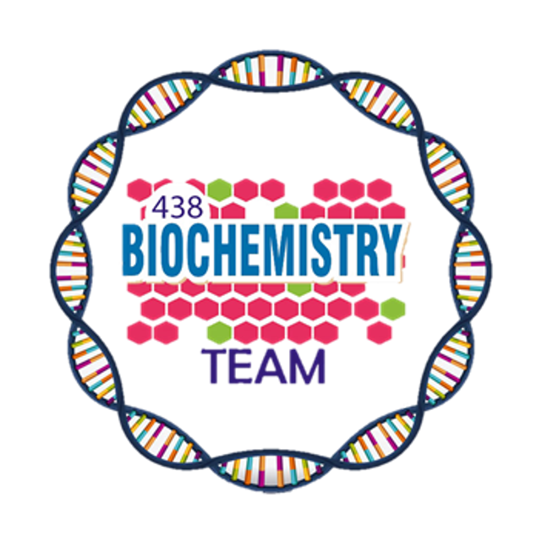
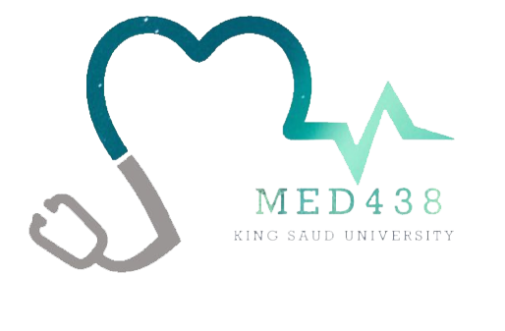
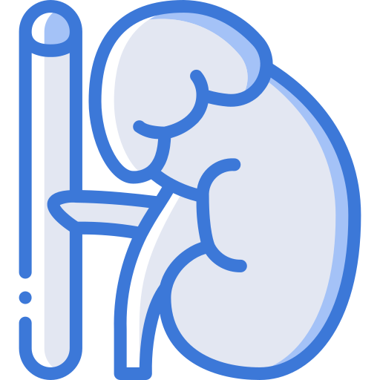
Metabolic Syndrome
Color Index:
Main Topic
Main content
Important
Drs’ notes
Extra info
Editing File
Biochemistry teamwork 438 - Endocrine Block

Slide 2
Objectives:
Define metabolic syndrome, insulin resistance and dyslipidemia
Discuss the risk factors for metabolic syndrome and other medical conditions associated with it
Define the diagnostic criteria for metabolic syndrome
Discuss the management of metabolic syndrome and current treatment options
Overview:
Introduction
Features of metabolic syndrome
Insulin resistance
Dyslipidemia
Risk factors
Markers & diagnosis
Management & treatment

Slide 3
Metabolic Syndrome
It is a combination of metabolic abnormalities which increase the risk of heart disease, diabetes, & other diseases
Features comprising metabolic syndrome¹
High serum triglycerides
Insulin resistance (hyperglycemia)
Hypertension
Obesity
Hyperglycemia
Low HDL cholesterol
In obesity, signals from adipocytes cause metabolic abnormalities such as:
Dyslipidemia
(next slide)
Insulin resistance ²
Glucose intolerance
Hypertension
Cells become less responsive to insulin → high plasma insulin → hyperglycemia
Hydrolysis of stored fats → high plasma FFAs
Reduction of glucose uptake/use by cells
Reduction of glycogenesis → hyperglycemia
Compensatory hyperinsulinemia → down-regulation of insulin receptors
Defects in insulin receptor
1- NOTE from 437: not necessary to find them all
2-NOTE from 437: why do you think we have insulin resistance? This is a fighting mechanism as the body of an obese person is forcing him/her to use excess fat for energy instead of glucose

Slide 4
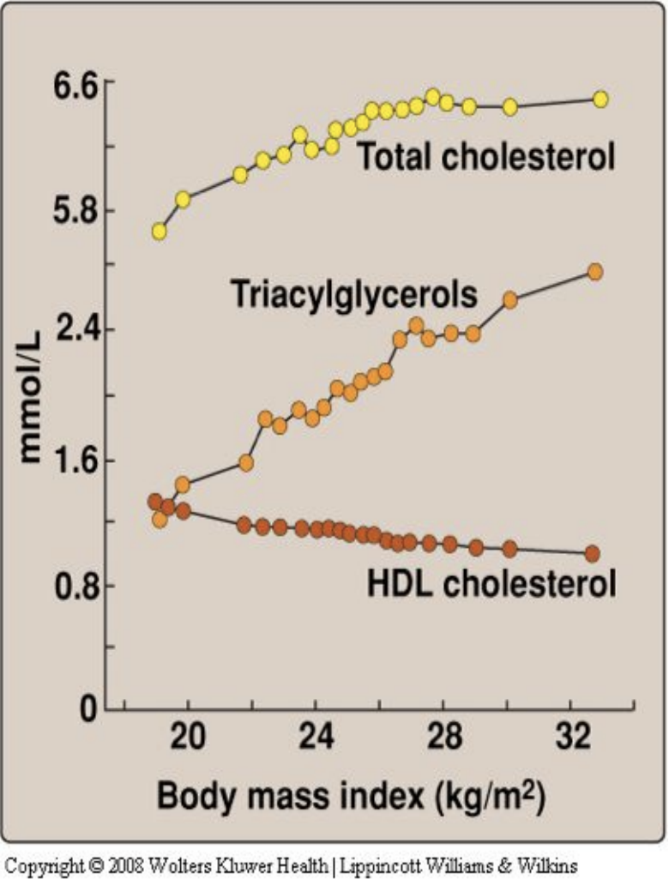
Dyslipidemia
Insulin resistance in adipocytes (in obese individuals)
increased activity of hormone sensitive lipase¹
High plasma FFAs ⇒ get carried to the liver & converted to: TG/cholesterol in the liver
Excess TGs/
cholesterol are released as VLDL² to the blood
HDL levels are decreased
Metabolic syndrome & dyslipidemia are closely related:
Dyslipidemia is an early indicator and consistent component of insulin resistance
Liver fat seems to be the unifying factor between dyslipidemia and insulin resistance
1) increased activity of lipase is because body can not use glucose as source of energy , the other source is FFAs which are broken down from triglycerides in adipocytes.
2) Recall VLDL is a major carrier of TG’s
- LDL/HDL are major carriers of cholesterol.
- Why? Remember excess glucose gets converted in the liver into FFA +TG’s + packaged into VLDL.

Slide 5
Risk factors for Metabolic Syndrome
Metabolic Syndrome Is Related to:
Heart disease
1.5-3 fold increase in atherosclerosis
Type 2 diabetes mellitus
Smoking/alcoholism
5 fold increase
Obesity
Kidney disease
Sedentary lifestyle
Reproductive abnormalities in women
Polycystic ovarian syndrome, impaired ovulation & fertility, irregular menstruation
Drugs (Rifampicin, Isoniazid, etc)
Nonalcoholic steatohepatitis (fatty liver disease)
Hypercortisolism (Steroid use/ Cushing disease)
Related to impaired lipid metabolism
Cancer
- Obesity is a major risk factor for cancer of the esophagus, colon & rectum, liver, gallbladder - Being overweight and obese accounts for 14% of all cancer deaths in men and 20% of those in women
Mutations of insulin receptor

Slide 6
Diagnosis |  |  |  | Markers
WHO criteria (1999) |  | NCEP* ATP** III Guideline (2002) |  | Lipoproteins | HDL (low) LDL (high)
One of the following: impaired glucose tolerance / diabetes mellitus / insulin resistance plus any 2 from what is mentioned below |  | If any 3 or more of these risk factors are present |  | Adipokines | -Leptin (high or normal) -Adiponectin (parallel with HDL levels, so low)
Hypertension | BP >140/90 mmHg | Blood pressure | 130/ 85 mm Hg | Inflammatory markers (obesity is an inflammatory state) | - C reactive protein - TNF a - IL - 6 - IL - 8 (All will be high)
Dyslipidemia | High plasma TGs (>1.7mmol/L) Low HDL cholesterol (men <0.9, women <1.0 mmol/L) | Triglycerides | >150 mg/dL
Central or General obesity | Waist to hip ratio >0.9 in men, >0.85 in women And/or BMI >30 | HDL cholesterol | Men<40 mg/dL Women<50 mg/dL | Hemostatic marker | Plasminogen activator inhibitor - 1 (PAI 1) PAI 1 inhibits fibrinolysis. Therefore, in metabolic syndrome people will be more prone to thrombosis
Micro- albuminuria | Urinary albumin excretion rate ≥ 20ug/min; or albumin:creatinine ratio ≥ 30mg/g | Waist circumference | Men>102 cm (>40 in) Women>88 cm (>35 in)
 |  | Fasting glucose | >100 mg/dL
*National cholesterol education programme
**Adult treatment panel

Slide 7
Managing Metabolic Syndrome
Lowering Blood Pressure
Primary intervention: Lifestyle changes
weight reduction ¹
Target BMI < 25
Reduced intake of calories and fats
More physical activity ²
Smoking cessation ³
Modification | Recommendation | Average drop in SBP*
Weight loss | Maintain normal body weight | 5-10 for every 22lbs
Healthy eating plan | Meals rich in fruits, vegetables;low fat dairy; low saturated fats and cholesterol | 8 - 14
Sodium restriction | < 2400 mg/day | 2 - 8
Regular physical activity | 30 min. Most of the week | 4 - 9
Secondary intervention: medication to treat existing risk factors
management of :
Blood pressure ( Anti-hypertensive drugs )
Lipids ( statins, fibrates )
Blood glucose( metformin, TZDs)
Aspirin for CVD prevention
1.It is the first thing because obesity is the main component
2. Physical activity also increases your HDL levels (directly proportional)
3. Smoking is a risk factor for obesity and metabolic syndrome
You don’t have to memorize the numbers here
This table shows how blood pressure is affected by lifestyle modification ( average drop in systolic blood pressure that can be achieved by doing this modification)
*SBP= systolic blood pressure

Slide 8
Hypertension and Clotting Disorders
1
Treat hypertension to goal ( < 130/80 mmHg )
3
ACE inhibitor ¹
2
4
Aspirin:
Low dose diuretics
To treat clotting disorders
Daily low dose aspirin (81 - 325 mg) for:
Men > 45
Postmenopausal women
Current treatment
Statins ²
Metformin ³
Fibrates
Thiazolidinediones (TZDs)
Aspirin
1.ACEI is preferred in diabetes because it protects from diabetic nephropathy
2. Are used to treat hyperlipidemia. They work by blocking HMG-CoA reductase ( a key enzyme in the synthesis of cholesterol) , it reduces LDL level
3. Anti diabetic drug
Dr said : what I need u to know the Biochemical effect of these drugs.

Slide 9
Metformin, fibrates, TZDs
Metformin
Fibrates
Thiazolidinediones ( TZDs )
Reduces blood glucose levels by inhibiting hepatic gluconeogenesis
○ Hepatic gluconeogenesis is active in patients due to liver’s resistance to the effects of insulin
● Reduces lipid synthesis in the liver
● Helps reducing blood lipids
● Reduce blood lipid levels
● Activate transcription factor¹:
○ Peroxisome proliferator activated receptor-α (PPAR-a)
● Activated PPAR-α → transcription of genes of lipid degradation / uptake by the cells:
● Carnitine: palmitoyl transferase I (enhances FA uptake into mitochondria)
● Lipoprotein Lipase “enhances TG uptake into the cell”
● Stimulates apoAI and apoAII protein synthesis (major proteins in HDL)²
● Used for the treatment of insulin resistance and type-2 diabetes mellitus
● TZDs activate PPAR-g (gamma) class of transcription factors expressed primarily in the adipose tissue
● Activates the transcription of adiponectin
● Adiponectin reduces the fat content of the liver and enhances insulin sensitivity
436 notes :
-If we give metformin to obese person who doesn’t have diabetes, it can lower body weight by decreasing lipid synthesis and blood glucose.
-When there’s insulin resistance (the cell can’t take up the glucose) the body perceives starving mode and the liver starts gluconeogenesis to make glucose which is a way to get hyperglycemia.
1.transcription factors are certain molecules that binds to regions in the DNA before the gene, and they affect the transcription of that gene, either increase transcription or decrease it ( usually increase)
2. Increase the amount of HDL, correct the dyslipidemia

Slide 10
Take Home Messages
Metabolic syndrome is a combination of metabolic abnormalities that increase the risk of heart disease, diabetes and other diseases
The features of metabolic syndrome include obesity, high serum triglycerides (TGs), low HDL cholesterol, hypertension, hyperglycemia and insulin resistance
Obesity, alcoholism, sedentary lifestyle and smoking are some of the risk factors for metabolic syndrome
Management of the syndrome includes lifestyle modifications to reduce weight and medications

Slide 11
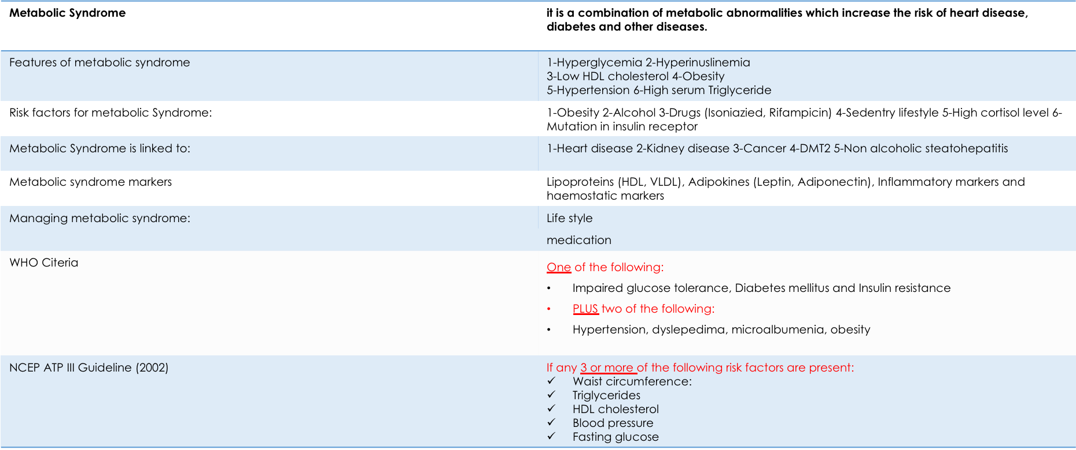
Summary

Slide 12
Quiz
MCQs :
Q1: Which one of the following is correct in metabolic syndrome?
a) High Serum TGs b) High HDL c) Hypoglycemia d) Glucose tolerance
Q2: Which one of the following is a marker for metabolic syndrome?
a) Low LDL b) increase Adiponectin c) High IL-6 d) Decreased Leptin
Q3: Which one of the following is a good management plan for hypertension?
a) ACE inhibitors b) Aspirin c) Statins d) Metformin
Q4: Which one of the following is correct about insulin resistance?
a) Cells have an increased response to insulin b) High plasma FFA c) Low plasma Insulin d) Hypoglycemia
Q5: Which of the following criteria fits to diagnose metabolic syndrome depending on the WHO?
a) DM + hypertension only b) DM, hypertension, & dyslipidemia c) DM + dyslipidemia d) hypertension + low TGs
Q6: According to WHO criteria to diagnose MS the blood pressure must be:
a) >140/90 mmHg b) 135/85 mmHg
c) 130/85 mmHg d) < 140/90 mmHg
SAQs :
Q1: Mention 3 abnormalities caused by obesity?
Q2: List 4 features that comprise the metabolic syndrome?
Q3: List 3 risk factors of metabolic syndrome.
Q4: list the markers for MS.
MCQs Answer key:
1) A 2) C 3 A 4) B 5) B 6) A
SAQs Answer key:
Dyslipidemia, hypertension, insulin intolerance
Obesity, hypertension, insulin resistance, low HDL cholesterol
Obesity, smoking, alcoholism.
Slide 6

Slide 13
Team members
Life is a succession of lessons which must be lived to be understood.
Girls Team:
Boys Team:
Ajeed Al-Rashoud
Alwateen Albalawi
Amira AlDakhilallah
Deema Almaziad
Ghaliah Alnufaei
Haifa Alwaily
Leena Alnassar
Lama Aldakhil
Lamiss Alzahrani
Nouf Alhumaidhi
Noura Alturki
Sarah Alkhalife
Shahd Alsalamah
Taif Alotaibi
Alkassem Binobaid
Fares Aldokhayel
Khayyal Alderaan
Mashal Abaalkhail
Naif Alsolais
Omar Alyabis
Omar Saeed
Rayyan Almousa
Yazen Bajeaifer
Team Leaders
We hear you
Lina Alosaimi
Mohannad Alqarni

