Slide 1
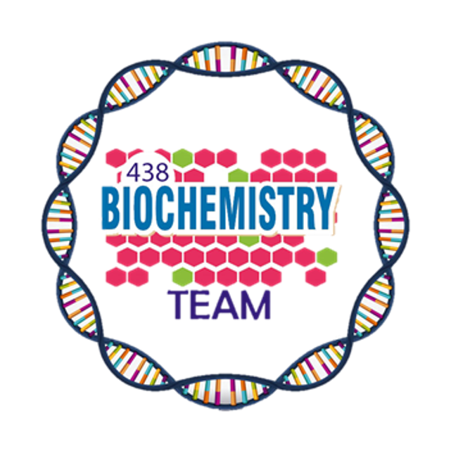
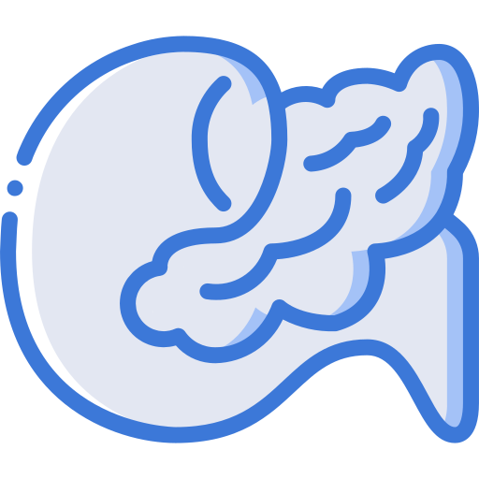
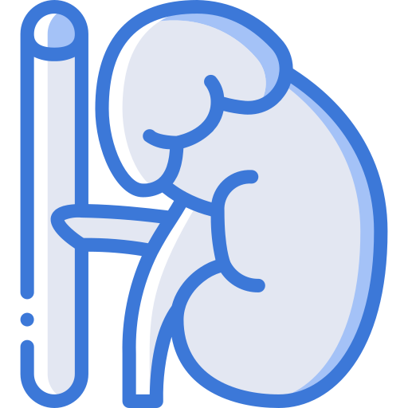
Glucose Homeostasis
Color Index:
Main Topic
Main content
Important
Drs’ notes
Extra info
Editing File
Biochemistry teamwork 438 - Endocrine Block

Slide 2
Objectives:
Define glucose homeostasis and the metabolic processes involved
Differentiate between different phases of glucose homeostasis
Discuss the primary sources of energy and major organs utilizing glucose during the five phases of homeostasis
Understand the role of hormones in maintaining glucose homeostasis
Overview:
Introduction
Sources of glucose
Phases of glucose homeostasis
Hormones in glucose homeostasis (actions, role in CHO metabolism)
– Insulin, Glucagon, Cortisol, Growth hormone, Epinephrine

Slide 3
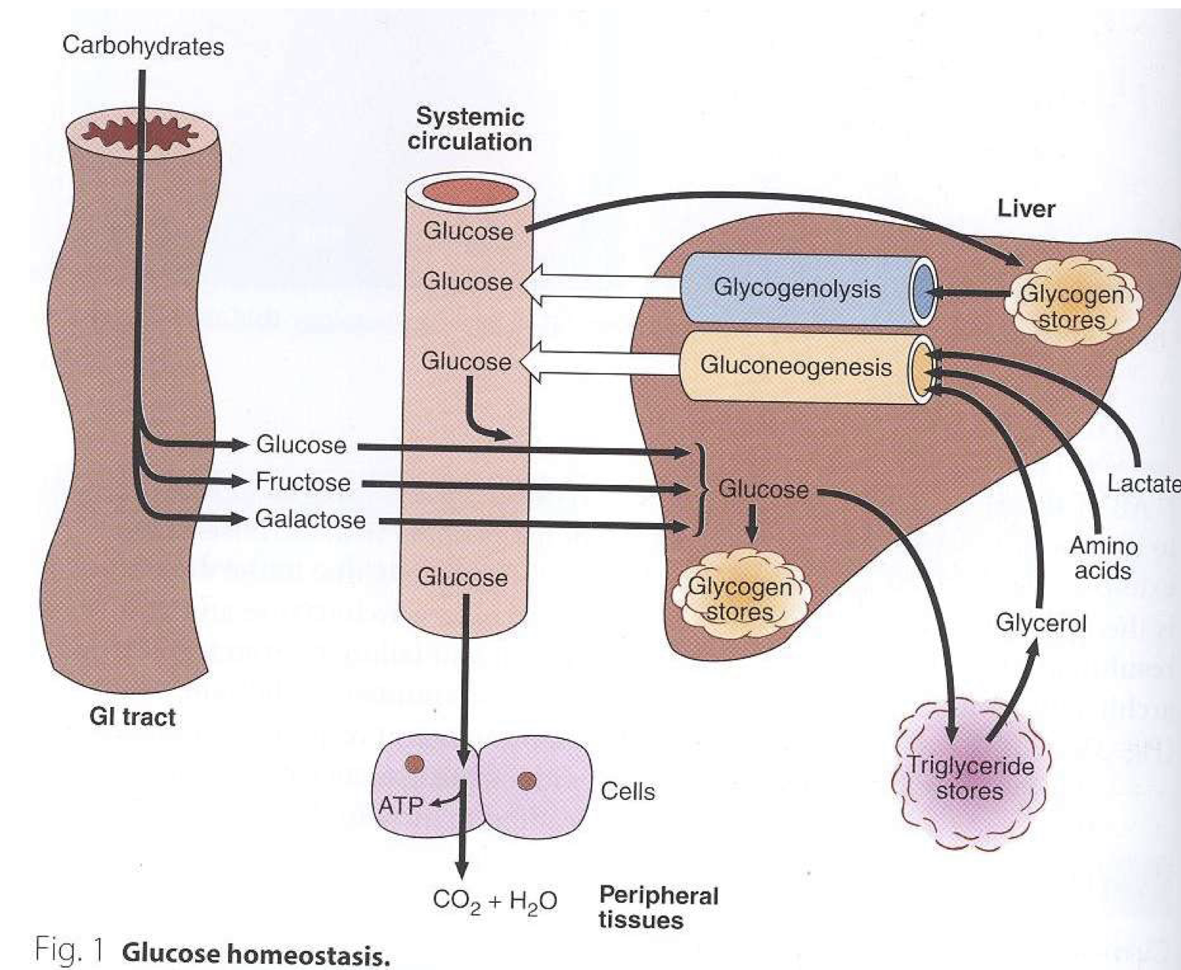
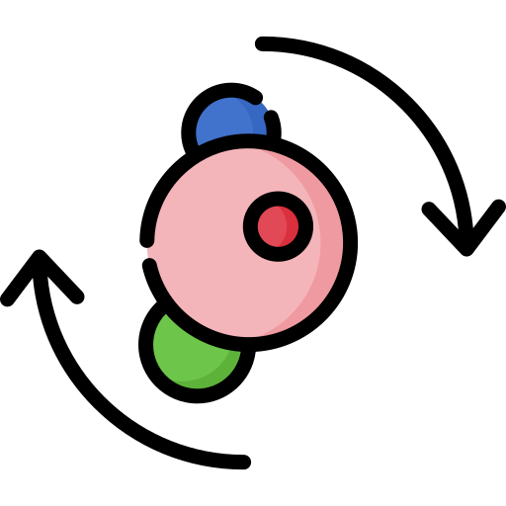
Glucose Homeostasis
Chronic hyperglycemia results in glycation of proteins, endothelial dysfunction and diabetes mellitus
A process that:
06
01
- control glucose metabolism
- Maintains normal blood glucose level in the body
Severe hypoglycemia can
cause coma and death
05
02
Glucose is a major source of body’s energy
04
04
03
It is tightly controlled as the
brain constantly needs glucose
The liver plays a key role in
maintaining blood glucose level
Sources of Glucose
Sources of glucose
Metabolic sources¹
(via gluconeogenesis³)
Dietary sources²
Glycerol
lactate
pyruvate
glucogenic amino acids
Dietary CHOs are digested to monosaccharides
Starch provides glucose directly
Fructose and galactose are converted to glucose in the liver
1. Endogenous sources 2. Exogenous sources 3. New glucose formation (from non-carbohydrate substrates)

Slide 4
Phases of Glucose Homeostasis
1
Phase I
(Well-fed state)
2
Phase II (Glycogenolysis)
3
Phase III (Gluconeogenesis)
4
Phase IV (Glucose, KB¹ oxidation)
5
Phase V (Fatty acid, KB oxidation)
Phase | Origin of blood glucose | Tissue using glucose | Major fuel of brain
I | Exogenous | All | Glucose
II | Glycogen, Hepatic gluconeogenesis | All except liver Muscle and adipose tissue at diminished rates | Glucose
III | Hepatic gluconeogenesis, Glycogen | All except liver Muscle and adipose tissue at rates intermediate between II and IV | Glucose
IV | Gluconeogenesis, Hepatic and renal | Brain, RBCs, renal medulla, small amount by muscle | Glucose, ketone bodies
V | Gluconeogenesis, Hepatic and renal | Brain at a diminished rate, RBCs, renal medulla All body tissues mainly use FA and KB | Ketone bodies, glucose
Ketone bodies

Slide 5
Phases of Glucose Homeostasis
Phases of glucose homeostasis
Phase II
(Glycogenolysis)
Phase III (Gluconeogenesis)
Phase IV
(Glucose and KB oxidation)
Phase I
(Well-fed state)
Phase V
(FA and KB oxidation)
 | Phase I (Well-fed state)
Origin of glucose | Dietary CHOs (Exogenous)
What happens in this phase | Liver removes about 70% of glucose load after a CHO meal Some glucose is converted to glycogen for storage in the liver (glycogenesis) Excess glucose is converted to fatty acids and triglycerides in the liver These are transported via VLDL (very low density lipoproteins) to adipose tissue for storage Gluconeogenesis is inhibited in this phase (Cori and glucose-alanine cycles are inhibited)

Slide 6
Phases of Glucose Homeostasis
Phases of glucose homeostasis
Phase II
(Glycogenolysis)
Phase III (Gluconeogenesis)
Phase IV
(Glucose and KB oxidation)
Phase I
(Well-fed state)
Phase V
(FA and KB oxidation)
 | Phase II (Glycogenolysis) | Phase III (Gluconeogenesis)
When does it start | during early fasting when dietary glucose supply is exhausted | starts when glycogen stores in liver are exhausted (< 20 hours)
Origin of Glucose | Hepatic glycogenolysis and gluconeogenesis maintain blood glucose level in this phase | Hepatic gluconeogenesis from: lactate, pyruvate, glycerol and alanine maintains blood glucose level
Major source of blood glucose | Glycogenolysis¹ and gluconeogenesis | Gluconeogenesis
Duration | - | Feeding status, Hepatic glycogen stores and Physical activity
1. Note that while both of them occur in this phase, Glycogenolysis is the main one

Slide 7
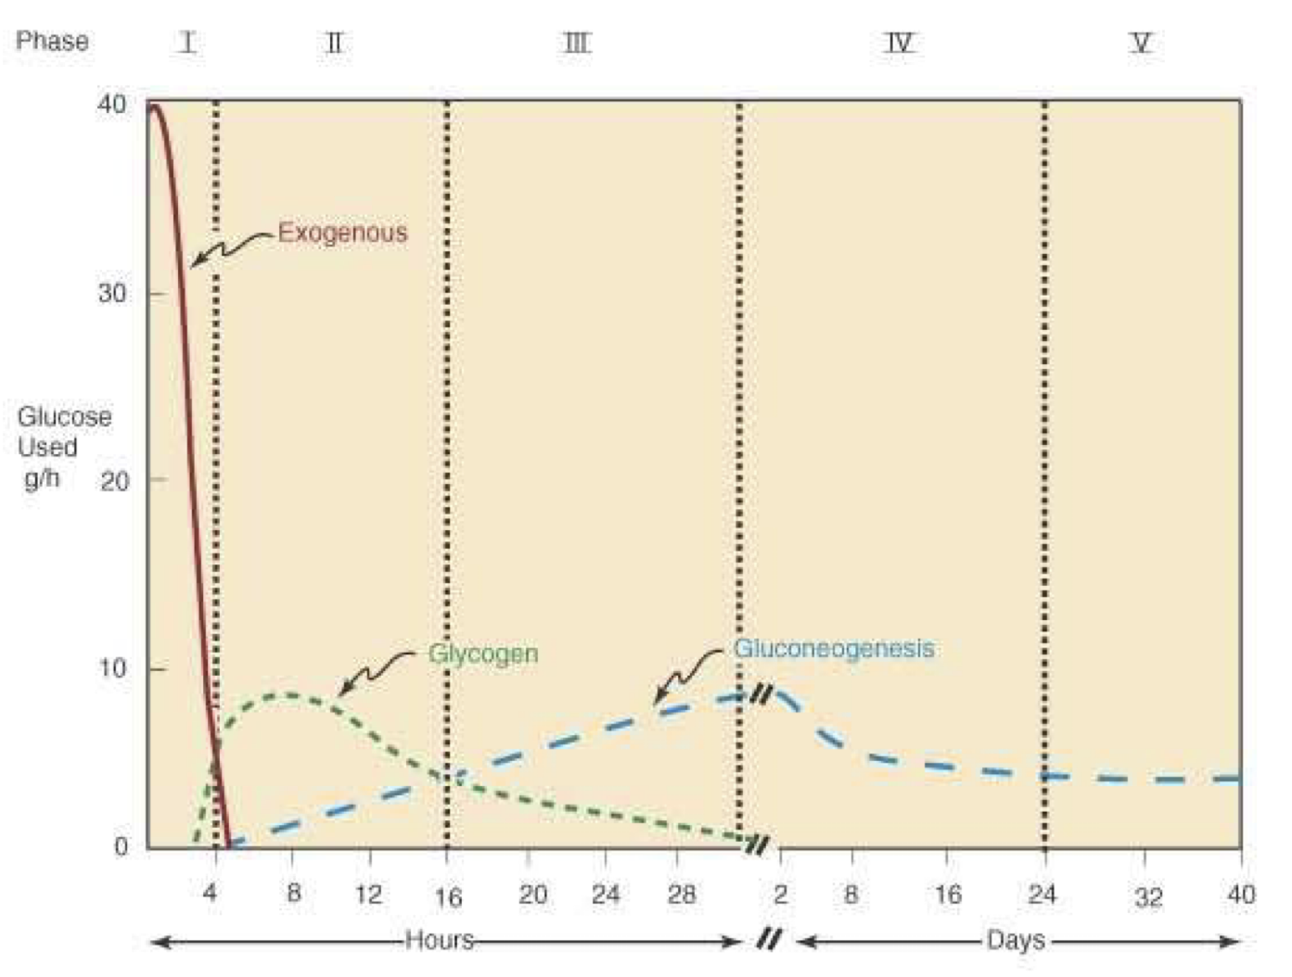
Phases of Glucose Homeostasis
Phases of glucose homeostasis
Phase II
(Glycogenolysis)
Phase III (Gluconeogenesis)
Phase IV
(Glucose and KB oxidation)
Phase I
(Well-fed state)
Phase V
(FA and KB oxidation)
 | Phase IV (Glucose and KB oxidation) | Phase V (FA and KB oxidation)
When does it start | Several days of fasting | Prolonged fasting
Origin of glucose | Hepatic & Renal gluconeogenesis | Hepatic & Renal gluconeogenesis Less dependence on gluconeogenesis Gluconeogenesis somewhat maintains blood glucose level in this phase
What happens in this phase | • Several days of fasting leads to phase IV • Gluconeogenesis starts to decrease • FA oxidation increases KB accumulation • KBs enter the brain and muscle for energy production | • High KB conc. and glucose levels inhibit proteolysis in muscle (conservation of muscle) • When all fat and KBs are used up (Body uses muscle protein to maintain blood glucose level)

Slide 8
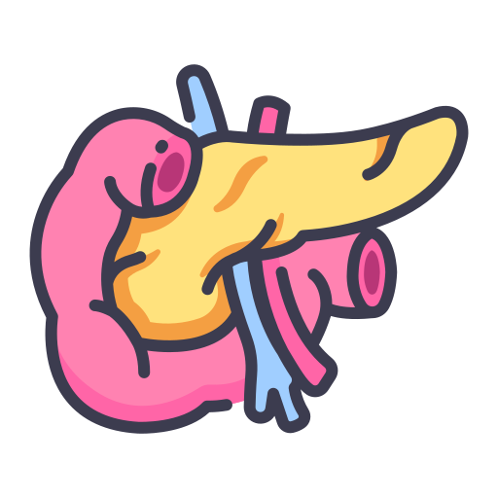
Hormones and Glucose Homeostasis
Insulin
Hormones that regulate glucose metabolism:
Play a major role in glucose homeostasis
Insulin (↓ blood glucose level)
Synthesized by the Beta-cells of islets of Langerhans of pancreas
Glucagon
A small protein composed of two chains
Cortisol
Antagonizing the insulin effect
Formed as prepro-insulin and converted to pro-insulin upon secretion
Growth hormone
Rise in blood glucose level stimulates insulin secretion
Epinephrine
(Adrenaline)
Promotes entry of glucose into cells

Slide 9
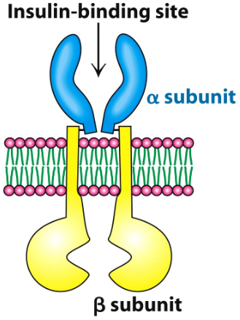
Insulin Mechanism of action
Insulin Actions
Recall from the 1st lecture (General mechanism of hormone regulation)
Inhibits | Stimulate
Glucogenogenesis | Glucose uptake in muscles and adipose
Glycogenolysis | Glycolysis
Lipolysis | Glycogen synthesis
Ketogenesis | Protein synthesis
Proteolysis | Uptake of ion (K⁺ and PO₄³⁻)
The insulin receptor is present on the plasma
membrane of cell
1
Composed of:
Alpha subunits (Extracellular)
Beta subunits (Cytoplasmic)
2
Extracellular
Binding of insulin to alpha subunit causes phosphorylation of Beta subunit
3
Cytoplasm
ATP-binding and tyrosine kinase domain
This activates the receptor
4
The activated receptor then phosphorylates intracellular proteins generating a biological response
5

Slide 10
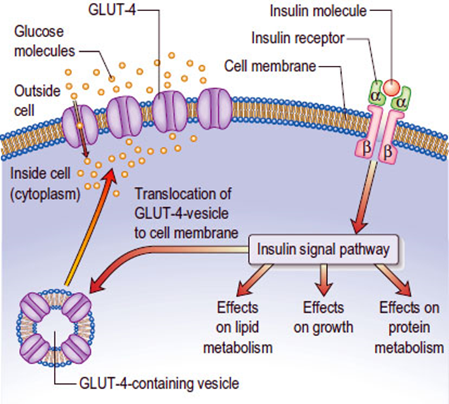
Insulin and CHO Metabolism
Promotes glucose uptake into cell:
1
Glucose is diffused into cells through hexose transporters such as GLUT4
2
GLUT4 is present in cytoplasmic vesicles
3
Insulin binding to its receptor causes vesicles to diffuse into plasma membrane
4
GLUT4 is inserted into the membrane
5
Allowing glucose transport into the cell
6
Brain and liver have non insulin dependent glucose transporter
Insulin’s MOA in decreasing blood glucose levels
1
Stimulates glycogen synthesis
2
Decreases blood glucose levels
3
Increases glycolysis
4
Stimulates protein synthesis
5
Insulin deficiency causes diabetes mellitus
6
Hyperinsulinemia is due to insulin resistance in (Diabetes mellitus or Metabolic syndrome)

Slide 11
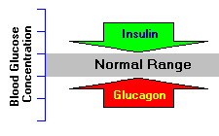
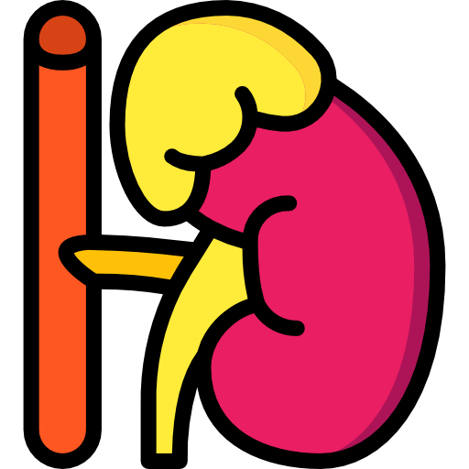
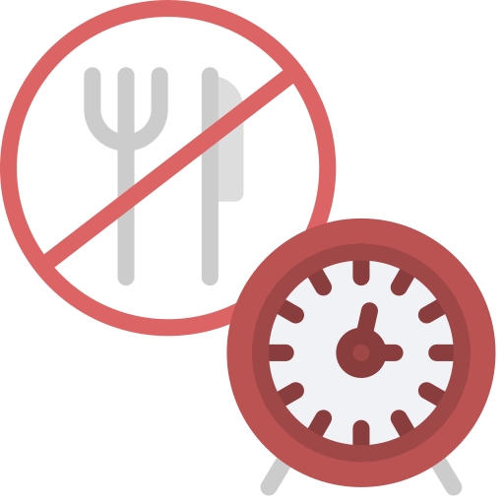
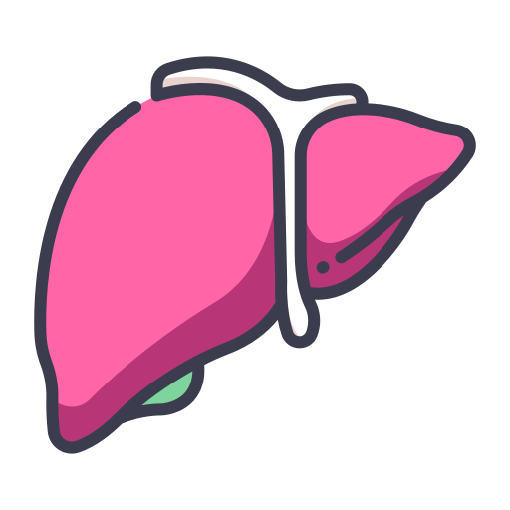
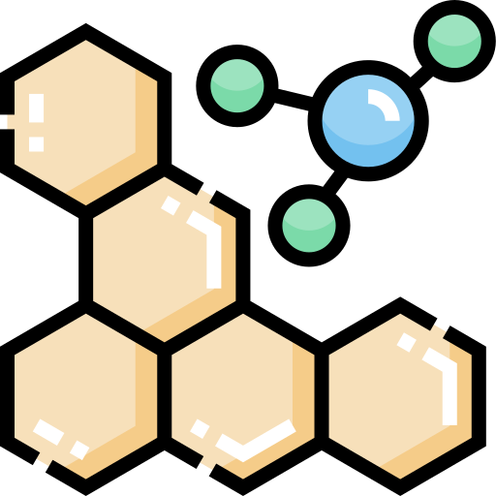
Glucagon
A peptide hormone secreted by a-cells of pancreatic islets
Secreted in response to hypoglycemia
Activates hepatic gluconeogenesis
Increases glucose levels
Stimulates glycogenolysis
Glucocorticoids (Cortisol)
01
02
03
04
05
06
• Cortisol is a steroid hormone secreted by adrenal gland
• Contributes to glucose homeostasis
• Maintains normal glucose levels in fasting
• Mobilizes amino acids for gluconeogenesis
• Stimulates fat breakdown in adipose tissue
• Stimulates gluconeogenesis in the liver

Slide 12
Growth hormone
1
1
2
2
A protein hormone secreted by anterior pituitary gland
Maintains blood glucose levels by:
Inhibiting insulin action
Stimulating gluconeogenesis in the liver
Epinephrine
1
A catecholamine hormone secreted by adrenal gland
2
Stimulates lipolysis in adipose tissue when blood glucose levels fall
3
Promotes glycogenolysis in skeletal muscle

Slide 13
Take Home Messages
Glucose homeostasis is a process that controls glucose metabolism and maintains blood glucose level in the body
There are five phases of glucose homeostasis- Phase I (well-fed state), Phase II (glycogenolysis), Phase III (gluconeogenesis), Phase IV (glucose, ketone bodies (KB) oxidation), Phase V (fatty acid (FA), KB oxidation)
Hormones that regulate glucose metabolism include insulin (lowers glucose level) and glucagon (increases glucose level)
Other hormone such as cortisol, growth hormone and adrenaline are known to antagonize the actions of insulin thus increases the blood glucose level

Slide 14
Summary
Phases | Phase I | Phase II | Phase III | Phase IV | Phase V
Origin of blood glucose | Dietary CHOs (Exogenous) | Hepatic glycogenolysis and gluconeogenesis | Hepatic gluconeogenesis | Hepatic & Renal gluconeogenesis | Hepatic & Renal gluconeogenesis Less dependence on gluconeogenesis
Tissue using glucose | All body tissue | All except liver, Muscle and adipose tissue. | All except liver, Muscle and adipose tissue. | Brain , RBCS , renal medulla . Small amount by muscle | All body tissues use FA and KB oxidation brain, RBC, Adrenal medulla
Major fuel for brain | Glucose | Glucose | Glucose | glucose and KB | glucose and KB
Notes | • Liver removes about 70% of glucose • Glycogenesis • Gluconeogenesis is inhibited (Cori and glucose-alanine cycles are inhibited) | Start during early fasting when dietary glucose supply is exhausted | starts when glycogen stores in liver are exhausted (< 20 hours) | • Gluconeogenesis starts to decrease • FA oxidation increases KB accumulation • KBs enter the brain and muscle for energy production | High KB conc. and glucose levels inhibit proteolysis in muscle (conservation of muscle)

Slide 15
Summary
Insulin | Glucagon | Cortisol | Growth hormone | Epinephrine
A protein hormone | A peptide hormone | A steroid hormone | A protein hormone | A catecholamine hormone
secreted by ß-cells of pancreatic islets | secreted by α-cells of pancreatic islets | secreted by adrenal gland | secreted by anterior pituitary gland. | secreted by adrenal gland
Stimulates: 1- Glycolysis 2-Glucose uptake 3-Glycogen and protein synthesis Inhibits: 1-Glucogenogenesis 2-Glycogenolysis 3-Ketogenesis | Increases glucose levels by: ● Stimulates glycogenolysis. ● Activates hepatic gluconeogenesis. | ● Stimulates gluconeogenesis in the liver. ● Mobilizes amino acids for gluconeogenesis. ● Stimulates fat breakdown in adipose tissue. | ● Inhibiting insulin action. ● Stimulating gluconeogenesis in the liver. | 1- Stimulates lipolysis in adipose tissue when blood glucose levels fall. 2- Promotes glycogenolysis in skeletal muscle.

Slide 16
Quiz
MCQs :
Q1: Which of the following phases is transported via VLDL?
a) Phase I b) Phase II c) Phase III d) Phase IV
Q2: Insulin stimulate the uptake of which ions?
a ) K b) PO4 c) Na d) Both a&b
Q3: Where does the ATP-binding receptor located?
a) Cytoplasm b) Extracellular c) Nucleus d) Nucleolus
Q4: Which one of the following does the insulin stimulates?
a) Lipolysis b) Gluconeogenesis c) Glycolysis d) Glycogenolysis
Q5: Which of the following phases of glucose homeostasis inhibit gluconeogenesis?
a) Phase I b) Phase II c) Phase III d) Phase IV
Q6: Which ONE of these mechanisms takes place in phase 2 of glucose homeostasis?
a) Ketone bodies formation b) Glycogenolysis c) Gluconeogenesis d) Glycolysis
SAQs :
Q1: How does growth hormone contribute in maintaining blood glucose?
Q2: What are the sources of glucose?
Q3: Name 4 hormones antagonize insulin action
Q4: What does chronic hyperglycemia result in?
MCQs Answer key:
1) a 2) d 3) a 4) c 5) a 6) b
SAQs Answer key:
Inhibit insulin action, stimulating gluconeogenesis in the liver
Dietary sources and metabolic sources
Glucagon, cortisol, growth hormone, epinephrine
Glycation of proteins, endothelial dysfunction and diabetes mellitus

Slide 17
Team members
“No matter how great the talent or efforts, some things just take time. You can’t produce a baby in 1 month by getting 9 women pregnant” - Warren Buffet
Girls Team:
Boys Team:
Ajeed Al-Rashoud
Alwateen Albalawi
Amira AlDakhilallah
Deema Almaziad
Ghaliah Alnufaei
Haifa Alwaily
Leena Alnassar
Lama Aldakhil
Lamiss Alzahrani
Nouf Alhumaidhi
Noura Alturki
Sarah Alkhalife
Shahd Alsalamah
Taif Alotaibi
Alkassem Binobaid
Fares Aldokhayel
Fahad Alsultan
Khayyal Alderaan
Mashal Abaalkhail
Naif Alsolais
Omar Alyabis
Omar Saeed
Rayyan Almousa
Yazen Bajeaifer
Team Leaders
We hear you
Lina Alosaimi
Mohannad Alqarni

