Slide 1
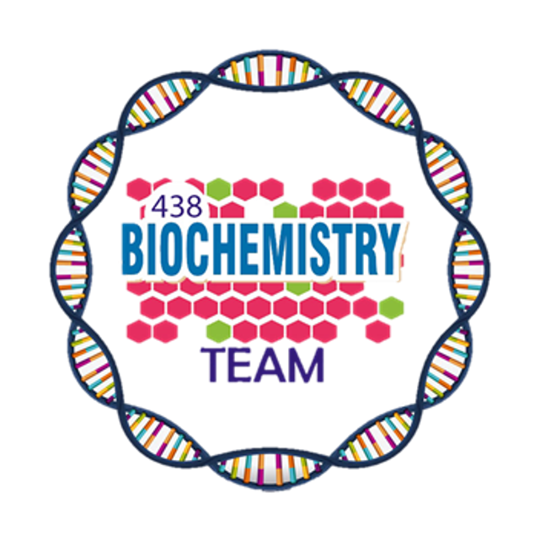
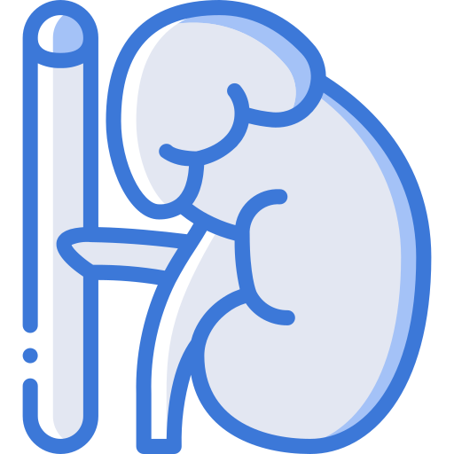
Metabolic Changes in Diabetes Mellitus
Color Index:
Main Topic
Main content
Important
Drs’ notes
Extra info
Editing File
Biochemistry teamwork 438 - Endocrine Block

Slide 2
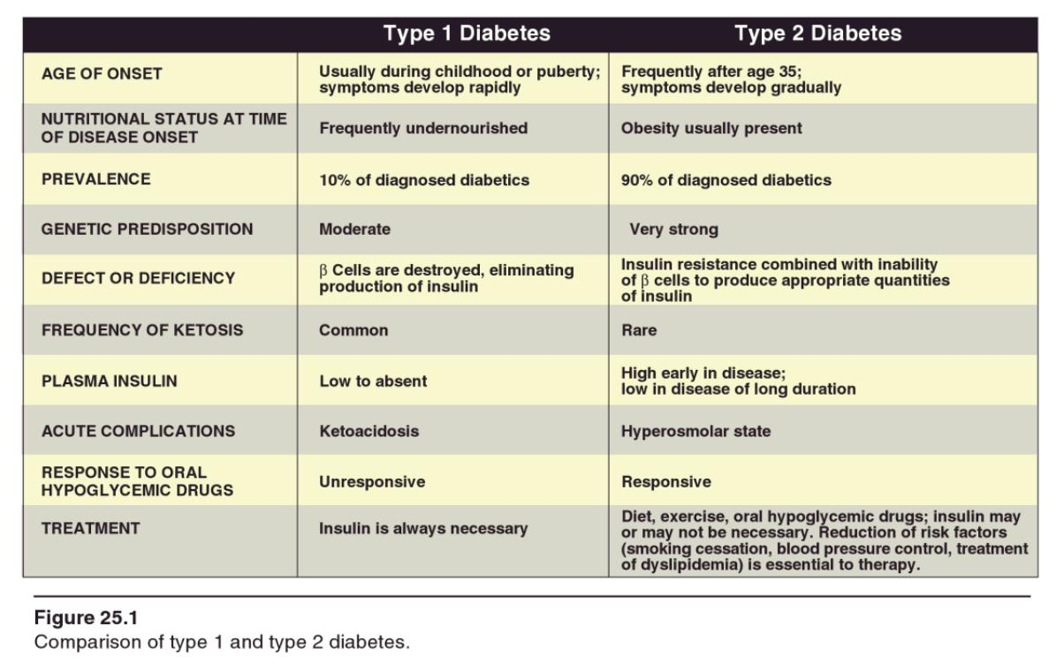
Lecture outline:
Diagnostic criteria for DM
Metabolic changes in DM
○ Increase of hepatic glucose output
○ Decrease of glucose uptake
○ Inter-organ relationship in T1DM and T2DM
Mechanisms of diabetic complications
Background:
Diﬀerences between type 1 and type 2 DM
Natural course of T1DM
Natural course of T2DM

Slide 3
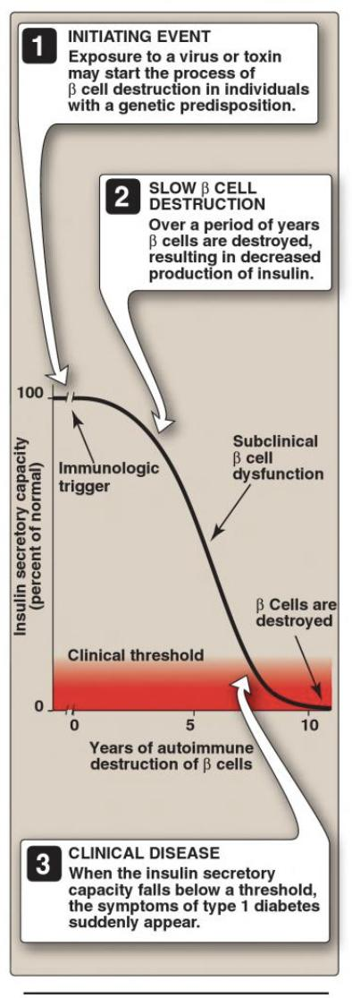
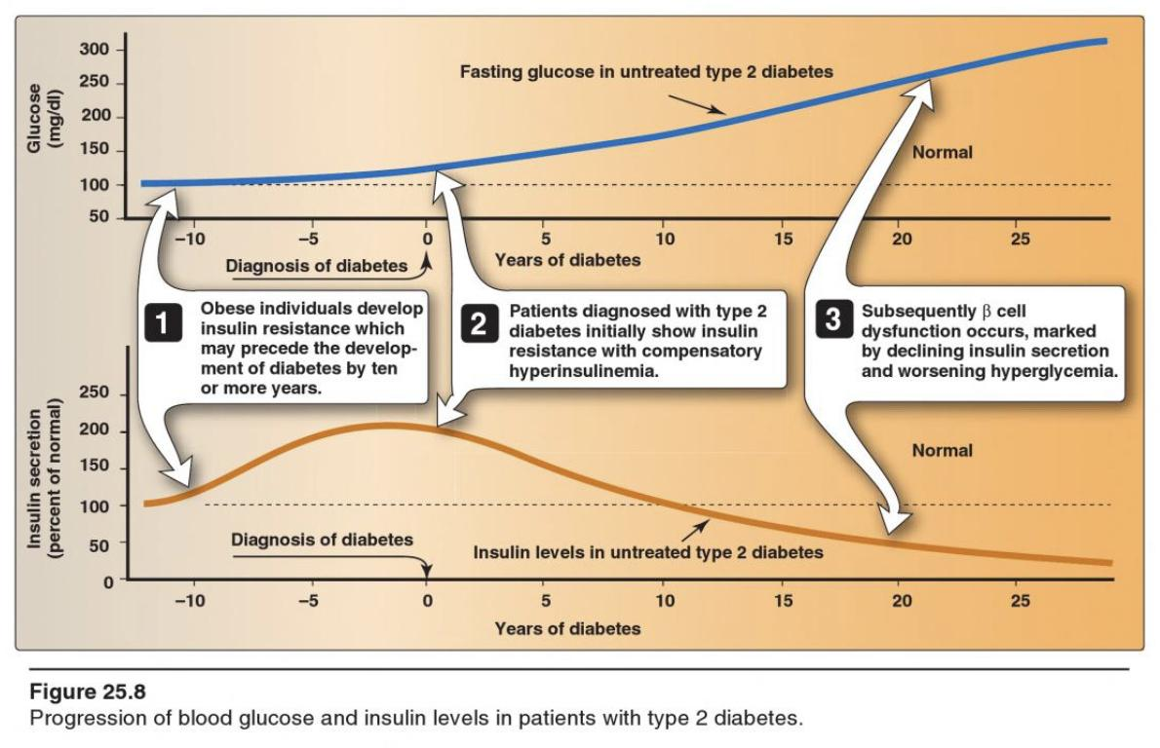
Natural course of T1DM
Progression of T2DM
Doctor’s explanation:
It starts with a genetic Predisposition to autoimmune disease + an initiating event like viral infection (immunologic trigger).
This trigger cause T-lymphocytes inﬁltration of islets of Langerhans and they start destroying 𝜷 cells. The process starts from the trigger and takes 7-8 years for the symptoms to appear.
At ﬁrst the insulin level will decreases gradually but you will not see any symptoms because this level is still suﬃcient to maintain glucose level.
after 80%-90% of 𝜷 cells have been destroyed clinical symptoms will appear, and when the symptoms appears the progression will be fast.
So, if you see the clinical symptoms that means the remaining insulin secretory capacity is only 10%-20% (the clinical threshold).
Doctor’s explanation:
The progression of T2DM starts 10-12 years before diagnosis.
Before the diagnosis the person's glucose levels is normal but the insulin is increased to be able to reduce the glucose due to insulin resistance.
At a certain point during the progression of the disease, the increase in insulin is no longer enough to lower the blood glucose and diagnosis happens.
If not managed, as the disease progresses, glucose will cause toxic eﬀects on 𝜷 cells and cause their dysfunction (not destruction because 𝜷 cells are there but not producing enough insulin) insulin levels will keep dropping, glucose levels are increased. but there will be some amount of insulin production.

Slide 4
*Don’t skip numbers
Criteria for Diagnosis of DM*
*American Diabetes Association (ADA), 2010
Test | About test | Increased risk for diabetes (Pre-diabetic state) | Diagnosis of diabetes
In FPG | Fasting is defined as no caloric intake for at least 8h. | 5.6-6.9 mmol/L (IFG) 100-125 mg/dL | 7 mmol/L ≥126 mg/dL
2h PG on 75g OGTT | 2-hour plasma glucose during an OGTT. test should be performed as described by the WHO, using a glucose load containing the equivalent of 75g anhydrous glucose dissolved in water. | 7.8-11 mmol/L (IGT) 140-199 mg/dL | 11 mmol/L ≥200 mg/dL
HbA1c¹ | The test should be performed in a laboratory using a method that is NGSP certiﬁed and standardized to the DCCT assay. | 5.7 - 6.4% | ≥6.5%
Random blood glucose |  |  | ≥11.1 mmol ≥200 mg/dL +classic symptoms of hyperglycemia
Test results can be affected by RBC disorder(eg. thalassemia , sickle cell anemia)

Slide 5
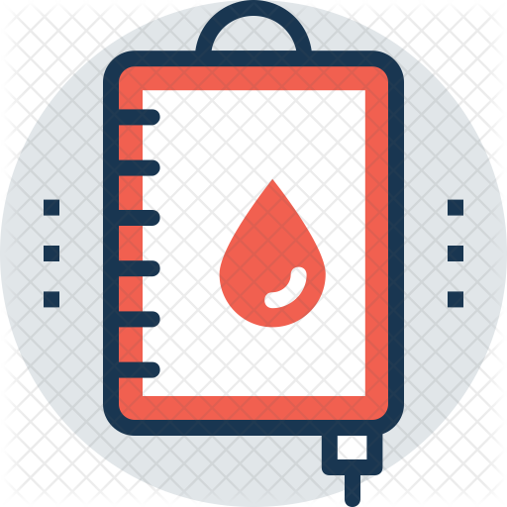
HEMOGLOBIN A1C¹
It’s the result of non enzymatic covalent glycosylation of hemoglobin
to estimate glycemic control in the last 1-2 months
Uses
Recently, A1C is recommended for the detection of T2DM
A1C and fasting plasma glucose (FPG) were found to be similarly eﬀective in
diagnosing diabetes.
A1C cut-oﬀ point of >6.5 % is used to diagnose diabetes.
A1C values also correlate with the prevalence of retinopathy.
Assays for A1C has to be standardized according to the National Glycohemoglobin Standardization Program (NGSP).
Fructosamine assay: glycated protein (Albumin) with a much shorter half life than glycated hemoglobin, reflecting control over a shorter period, approximately 14 to 21 days. May be advantageous in patient with hemoglobin variant than interfere with the accuracy of glycated hemoglobin tests.

Slide 6
T1DM
T2DM
Metabolic Effects of DM
↓ Glucose uptake (muscle & adipose tissue)
Absolute¹ or relative² insulin deﬁciency
↑ Glucose production (liver)
Major Metabolic changes in DM
Multiple metabolic eﬀects:
CHO metabolism
↓ Glucose uptake by certain tissue (adipose tissue & muscles)
↑ Glycogenolysis
↑ Gluconeogenesis
Lipid metabolism
↑ Lipolysis
↑ Fatty acid oxidation
↑ Production of ketone bodies
Protein metabolism
↓ Protein synthesis
↑ Protein degradation

Slide 7
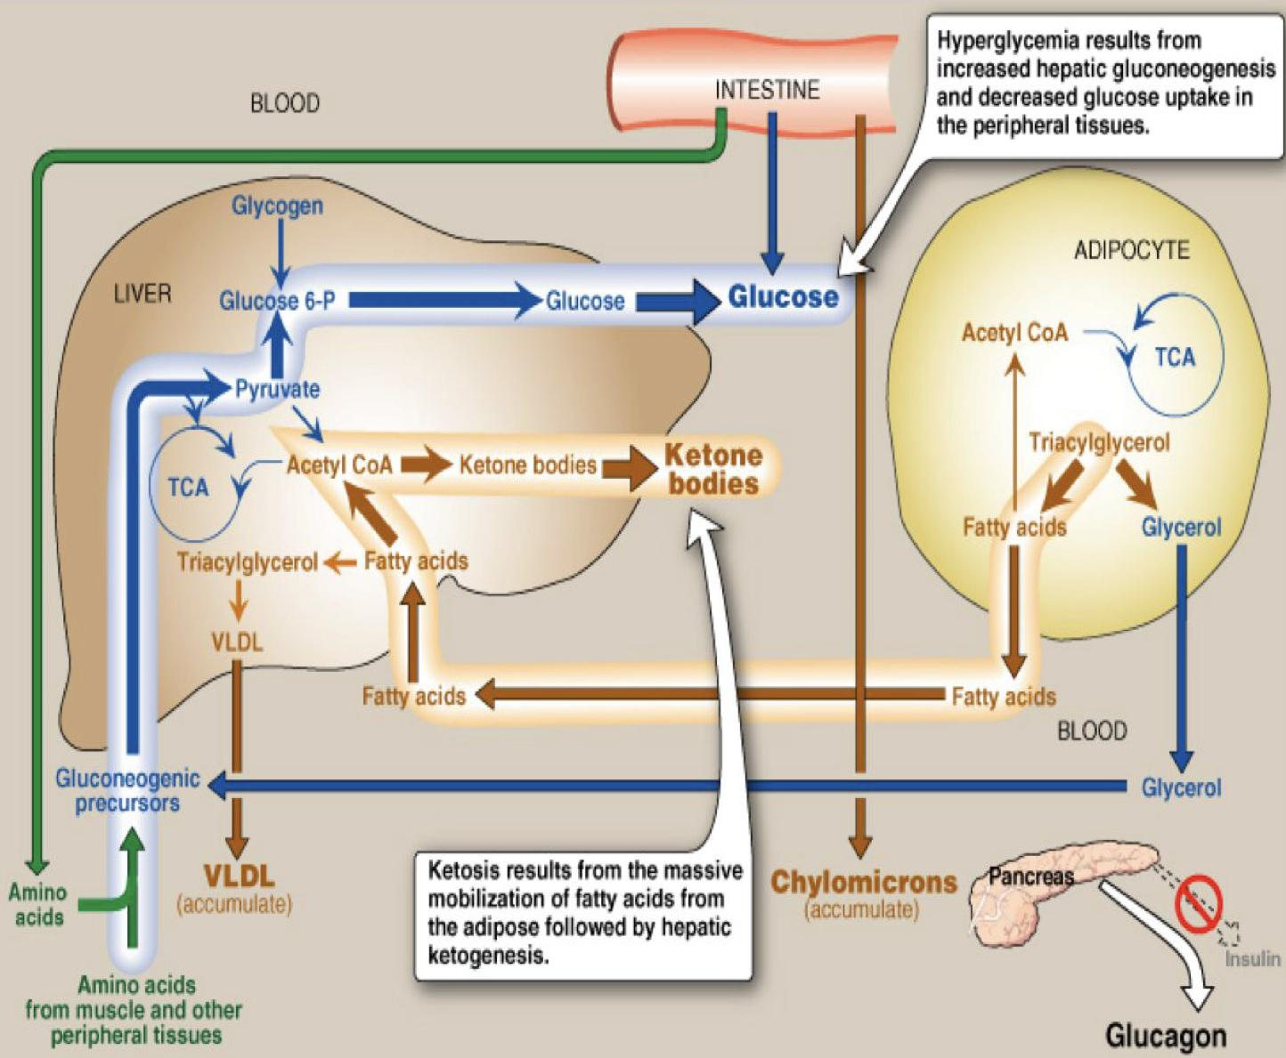
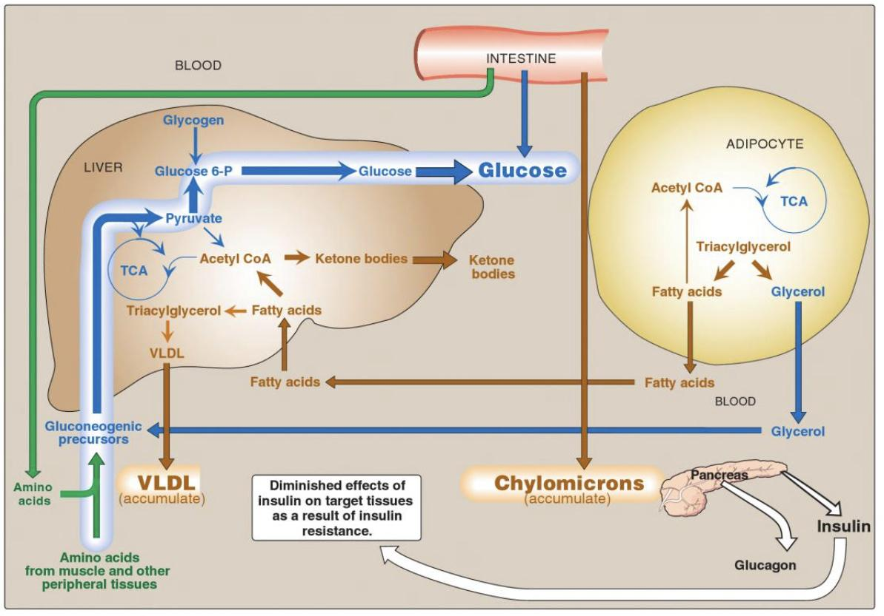
Intertissue Relationship in T1DM & T2DM
Type 1 diabetic Miletus
T1DM
the pancreas isn’t secreting insulin, but it’s is secreting glucagon which has 2 eﬀects: Gluconeogenesis and Glycogenolysis.
gluconeogenesis:
The intestine absorbs glucose, and amino acids which are delivered to the liver along with the amino acids coming from muscle breakdown and glycerol from triacylglycerol breakdown; these substances are used for gluconeogenesis.
glycogenolysis:
Glycogen is broken down in the liver which releases glucose.
fat breakdown:
the adipose tissues will undergo lipolysis and release FAs and glycerol.
Glycerol will be used in the gluconeogenesis, while FAs will enter the liver and give ketone bodies and some will turn into triacylglycerol and then VLDL and are released into the circulation.
So in the circulation we will have: hyperglycemia, ketonemia, dyslipidemia (VLDL and chylomicrons). *Lipoprotein degradation catalyzed by lipoprotein lipase in the capillary beds of muscle and adipose tissue is low in diabetics (synthesis of the enzyme is decreased when insulin levels are low), the plasma chylomicron and VLDL levels are elevated, resulting in hypertriacylglycerolemia.
T2DM
Type 2 diabetic Miletus
The same mechanism as type 1 BUT, Insulin is decreased and not absent.
That’s why the amount of ketone bodies won’t be as high as type 1, the little amount of insulin will inhibit it’s synthesis.
In type 1 patients the fatty acid is being used up for synthesis of ketone bodies that’s why they’re thin, But in type 2 they’re usually obese.
So in the circulation we will have: Dyslipidemia and hyperglycemia But no ketone bodies.

Slide 8
Mechanisms of:
Hepatic Glucose Output
↓ Insulin
↓ Inhibitory eﬀect on glucagon secretion (𝜷 destruction or dysfunction → 𝜶 more active)
↑ Glucagon
↑ Gluconeogenesis & glycogenolysis (Liver)
↑ Plasma glucose
Peripheral Glucose Uptake
Muscles
↓ Insulin
↓ Glucose and amino acid uptake
↑ Protein breakdown
↑ Plasma glucose and amino acids
Adipose tissue
↓ Insulin
↓ Glucose uptake
↑ Plasma glucose

Slide 9
Mechanisms of Diabetic Complications
General Mechanisms for
(Diabetic Microvascular Complications)
Chronic Hyperglycemia
AGEs¹ of essential
cellular proteins
Intracellular Sorbitol²
ROS
Cellular Defects
cell osmolality
Oxidative stress
(Advanced Glycation End Products): Like what happens in HbA1C ,other proteins in the blood spontaneously join to glucose (glycation) due to hyperglycemia.
Sorbitol is sugar alcohol made from unused glucose in the cells, and it is osmotically active.
Cellular Swelling
Cell Damage

Slide 10
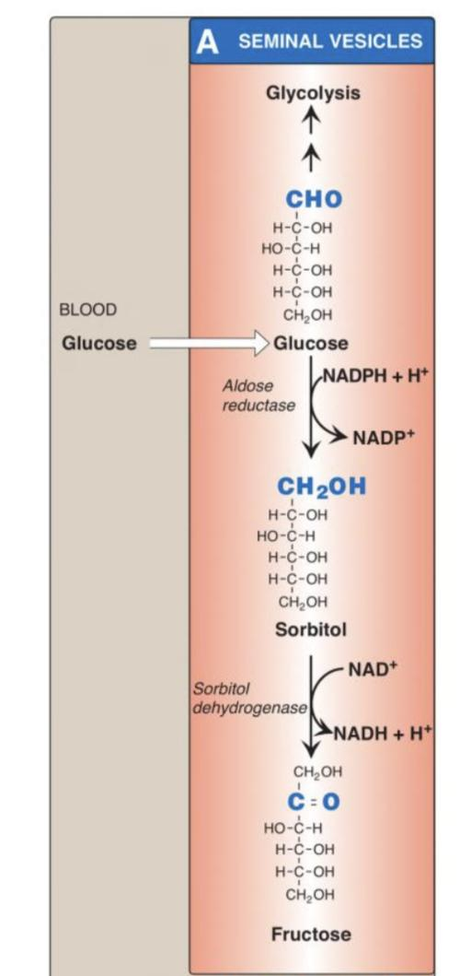
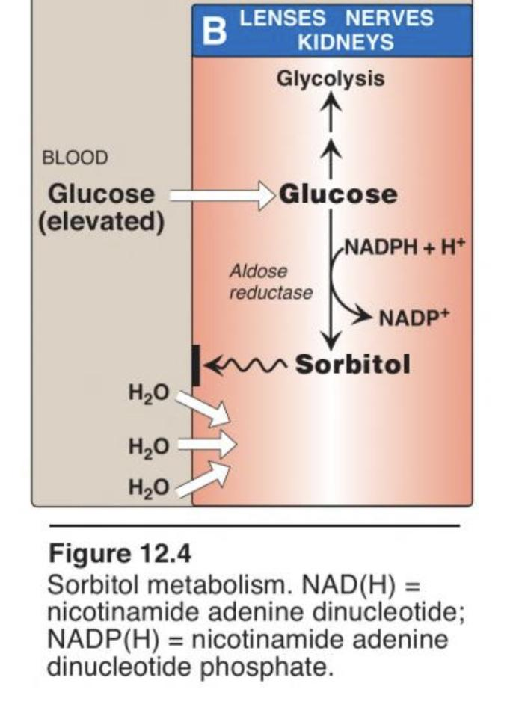
Advanced Glycation End Products (AGEs)
Polyol Pathway¹
Excess Glucose is metabolized to sorbitol within the cells by Aldose reductase.
The role of sorbitol in the pathogenesis of diabetic complications is uncertain.
Hypotheses are:
During sorbitol production, consumption of NADPH² → oxidative stress.
Sorbitol accumulation will:
Increase the intracellular osmotic pressure → osmotic drag of ﬂuid from extracellular space → cell swelling.
Alteration in the activity of PKC (protein kinase C) → altered VEGF (vascular endothelial growth factor) activity → altered vascular permeability.
Chronic Hyperglycemia ➔ non-enzymatic combination between excess Glucose & Amino acids in proteins ➔ formation of AGEs.
01
AGEs may cross link with collagen which leads to microvascular complications.
A
02
The interaction between AGEs and their receptor (RAGE) may generate reactive oxygen species (ROS) which leads to Inflammation.
In seminal vesicles & ovaries there is enzyme called sorbitol dehydrogenase that converts sorbitol to fructose.
But, most of other tissues do not have this enzyme, causing accumulation of sorbitol and cell swelling.
B
Sorbitol formation pathway
Remember NADPH is important for antioxidant pathway.

Slide 11
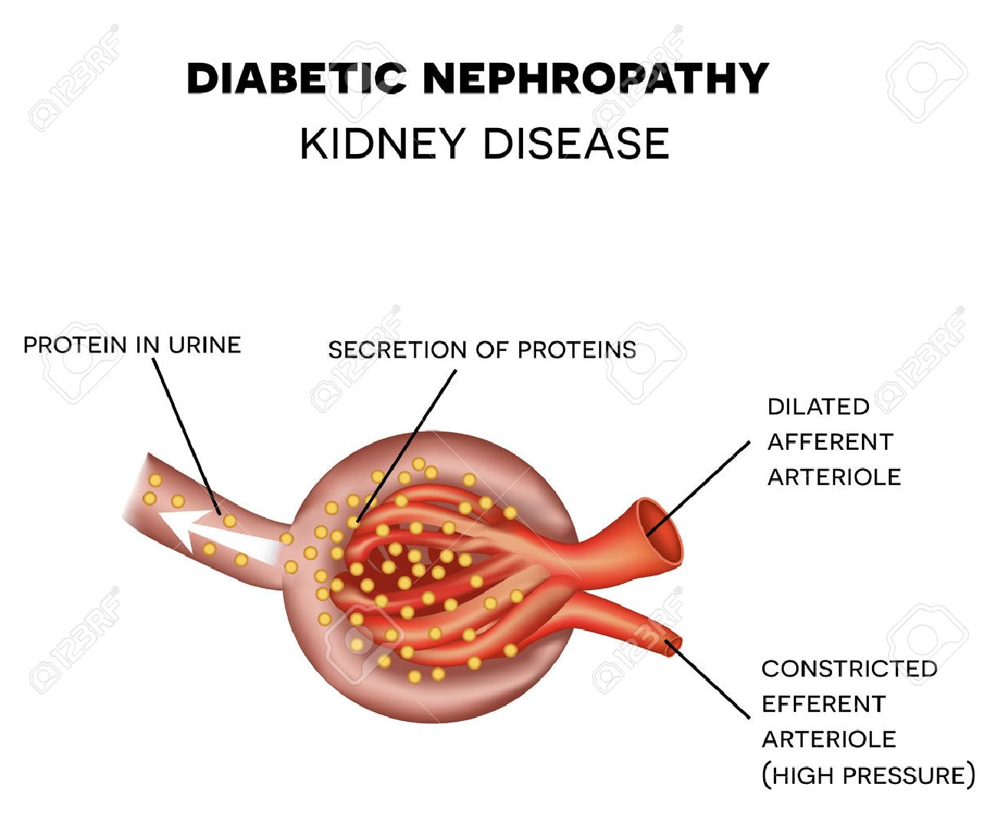
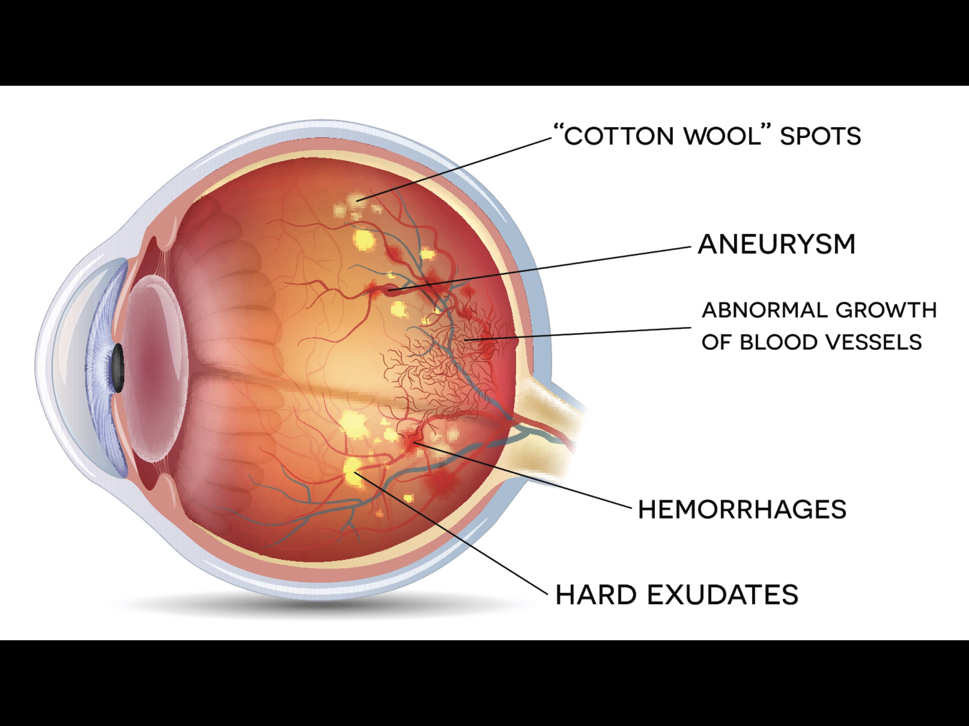
Diabetic Microvascular Complications
Diabetic Nephropathy
Diabetic Retinopathy
Occurs in both type 1 & type 2 DM.
The earliest clinical ﬁnding of diabetic nephropathy is microalbuminuria: The persistent excretion of small amounts of albumin (30-300 mg per day) into the urine.
Microalbuminuria is an important predictor of progression to proteinuria: the persistent excretion of >300 mg albumin per day into the urine.
Once proteinuria appears, there is a steady decrease in the glomerular ﬁltration rate (GFR).
Finally, end-stage renal disease occurs.
Sequence of Events in Diabetic Nephropathy:
A progressive microvascular complication of DM, aﬀecting the retina of the eye.
A major cause of morbidity in DM (blindness).
Its prevalence with increasing duration of disease in both type 1 & 2 DM .
After 20 years of the disease:
Is present in almost all T1DM.
Is present in 50 – 80% of T2DM.
Diabetic Neuropathy
Glomerular
hyperﬁltration
Microalbu-minuria
Proteinuria & ↓ GFR
End-stage renal disease
Loss of both myelinated and unmyelinated nerve ﬁbers.
Occurs in both type 1 & type 2 DM.
It correlates with the duration of DM & with glycemic control.
Hypothesis Nephromegaly: increase size of the kidney, maybe due to:
Ectopic lipid depositions or other mechanisms.
When a lot of glucose is reabsorbed through SGLT “Na dependent Glucose transporter” along with Na, that will lead to absorption of H₂O causing Hyperosmolar state. *When the blood glucose level exceeds about 160–180 mg/dL (8.9-10 mmol/L), the proximal tubule becomes overwhelmed and begins to excrete glucose in the urine.

Slide 12
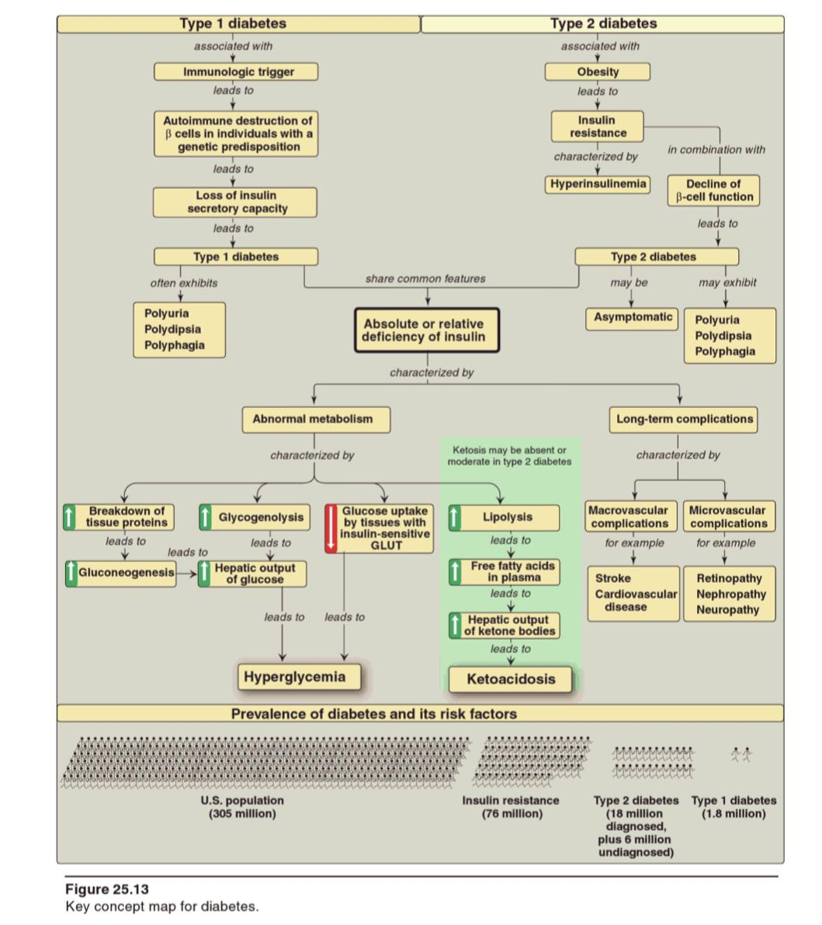
Summary
Diabetes
Diagnosis criteria
HbA1c
Tests:
FPG
7 mmol/L , ≥126 mg/dL
2h PG on 75g OGTT
11 mmol/L, ≥200 mg/dL
HbA1c
≥6.5%
Random blood glucose
≥11.1 mmol, ≥200 mg/dL + classic symptoms of hyperglycemia.
The result of non enzymatic covalent glycosylation of hemoglobin.
Use to estimate glycemic control in the last 1-2 months.
Recommended for T2DM detection (Similar to FPG in diagnosing DM)
Assay for A1C has to be standardized according to NGSP.
Microvascular complications
(Mechanism)
Chronic Hyperglycemia
AGEs of essential cellular proteins
“ Cellular Defects”
Intracellular sorbitol
ROS
Oxidative stress → “Cell Damage”
1) During sorbitol production, consumption of NADPH → oxidative stress.
2) Sorbitol accumulation will:
A. Increase the intracellular osmotic pressure → osmotic drag of ﬂuid from extracellular space → cell swelling.
B. Alteration in the activity of PKC → altered VEGF activity → altered vascular permeability.
AGEs may cross link with collagen which leads to microvascular complications.
Interaction between AGEs and their receptor (RAGE) may generate reactive oxygen species (ROS) which leads to Inflammation.

Slide 13
Quiz
MCQs :
Q1: which of the following used recently for detection of T2DM?
a) OGTT b) A1C
c) Random blood glucose d) 2 hours in FPG
Q2:which of the following is a Major Metabolic changes in DM effect on CHO?
a) Increase lipolysis b) Decrease glycogenolysis
c) Increase glycogenolysis d) Increase protein synthesis
Q3: patient present with ketonemia that indicate he has?
a) T2DM b) T1DM
Q4: which of the following considered as Microvascular complication of DM?
a) CVD b) Stroke
c) Neuropathy d) Peripheral arterial disease
Q5: Accumulation of sorbitol alters vascular permeability by:
a) Cross linkage with collagen b) Consumption of NADH c) ↑ the intracellular osmotic pressure d) Alteration in the activity of PKC
Q6: Excess Glucose is metabolized to sorbitol within the cells by:
a) Glucose reductase b) Glucose oxidase
c) Aldose reductase d) Aldose oxidase
SAQs :
Q1: Compare between T1DM and T2DM regarding to which they are result from?
Q2: Compare between T1DM and T2DM regarding to what will you have the circulation?
Q3: What are the General mechanisms for
microvascular complications in DM?
Q4: Briefly, Explain the hypotheses of sorbitol role in the pathogenesis of diabetic complications.
MCQs Answer key:
1) B 2) C 3) B 4)C 5)C&D 6) C
SAQs Answer key:
T1DM results from destruction of beta cells of the pancreas while T2DM is due to the development of insulin resistance.
Slide7
Slide 9
Slide 10

Slide 14
Team members
Make yourself proud!!
Girls Team:
Boys Team:
Ajeed Al-Rashoud
Alwateen Albalawi
Amira AlDakhilallah
Deema Almaziad
Ghaliah Alnufaei
Haifa Alwaily
Leena Alnassar
Lama Aldakhil
Lamiss Alzahrani
Nouf Alhumaidhi
Noura Alturki
Sarah Alkhalife
Shahd Alsalamah
Taif Alotaibi
Alkassem Binobaid
Fares Aldokhayel
Khayyal Alderaan
Mashal Abaalkhail
Naif Alsolais
Omar Alyabis
Omar Saeed
Rayyan Almousa
Yazen Bajeaifer
Team Leaders
We hear you
Lina Alosaimi
Mohannad Alqarni

