Slide 1
PITUITARY GLAND
Objectives:
The microscopic structure of the different parts of the pituitary gland in correlation with their functions.
The hypophyseal portal circulation components and significance.
Editing file
Important
Doctor notes / Extra

Slide 2
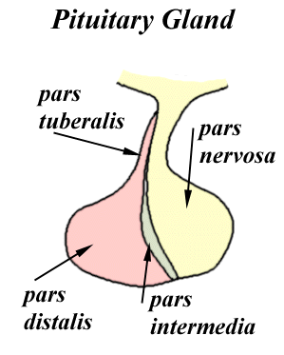
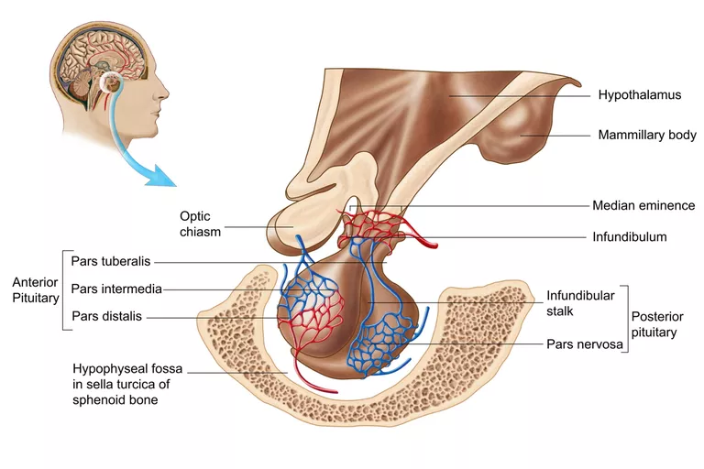
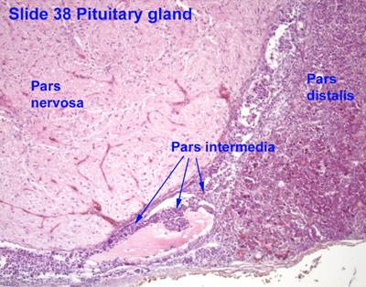
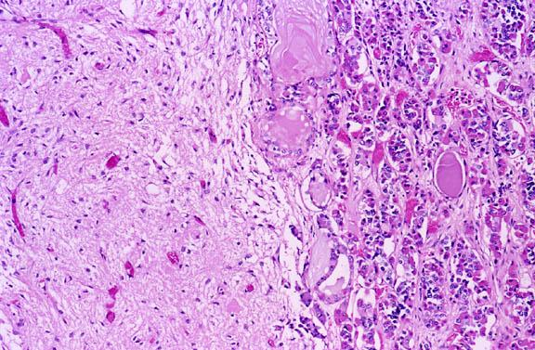
PITUITARY GLAND
ADENOHYPOPHYSIS CEREBRI:
Adeno=Gland
NEUROHYPOPHYSIS CEREBRI:
Pars Distalis (pars anterior)
Median eminence
Pars Tuberalis
Infundibulum: Neural (Infundibular) Stalk
Pars Intermedia
Pars Nervosa

Slide 3
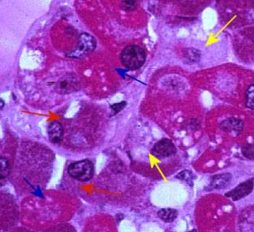
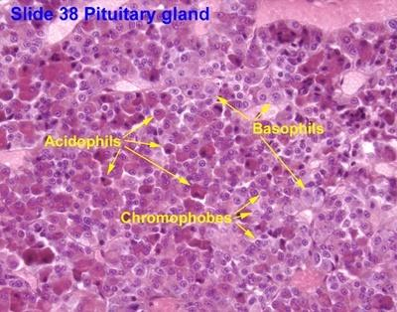
I- Adenohypophysis Cerebri
Pars distalis: Types of parenchymal cells
Chromophils | Chromophobes cytoplasm does not stain
1- Acidophils: Somatotrophs (GH cells). Growth hormone(most common type) Mammotrophs (Prolactin cells): Increase during lactation Milk formation hormone 2- Basophils: Thyrotrophs (TSH Cells) Thyroid stimulated hormone Corticotrophs (ACTH cells) Adrenocorticotropic hormone Gonadotrophs (Gonadotropic cells) (FSH, LH) Follicle Stimulating Hormones, Luteinizing hormone | may represent: stem cells. degranulated chromophils. degenerated cells.
Blue arrow: acidophils Red arrow: basophils Yellow arrow: chromophobes
Blood supply: extra, was in 436 lecture but now is removed
(1) Superior Hypophyseal Arteries (Rt & Lt): To median eminence & Neural stalk
Hypophyseal Portal System : It carries neurohormones from median eminence to adenohypophysis.
1ry capillary plexus of fenestrated capillaries
Hypophyseal portal Veins (or venules)
2ry capillary plexus of capillaries in adenohypophysis
(2) Inferior Hypophyseal Arteries (Rt & Lt):
Mainly to pars nervosa, They are Not participating in
hypophyseal portal circulation.

Slide 4
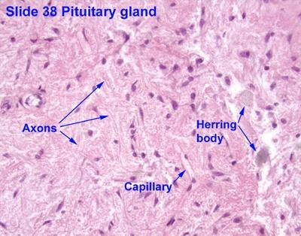
II- Neurohypophysis Cerebri
Pars nervosa content :
1- unmyelinated axons | 2- fenestrated blood capillaries. | 3. Herring bodies (Vesicles) | 4. Pituicytes:
Unmyelinated axons of secretory neurons situated in supraoptic & paraventricular nuclei (i.e. Axons of hypothalamohypophyseal tract). Function : Storage & release of: Vasopressin (ADH); by supraoptic nuclei Oxytocin; by paraventricular nuclei Oxytocin work in mammary gland for milk ejection (by contraction of myoepithelial cell, located around the acini) | The walls of their endothelial cells have pores (fenestrae) These pores are covered by diaphragm. Cardio flashback :) | Are distensions of the axons in p. nervosa. Representing accumulation of neurosecretory granules at axon termini and along the length of the axons in p. nervosa. | Are glial-like cells in p. nervosa. Structure: Have numerous cytoplasmic Processes. Functions: Support the axons of the p. nervosa. N.B. No secretory or neuronal cells in pars nervosa.

Slide 5
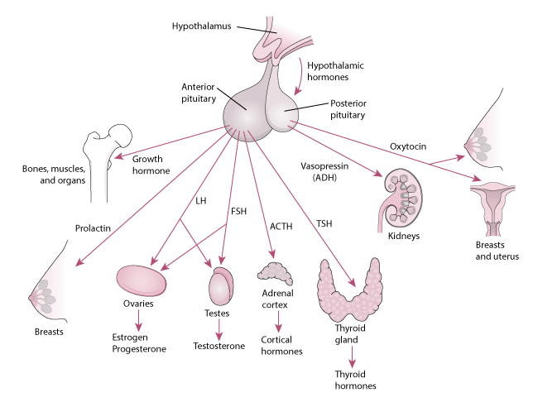
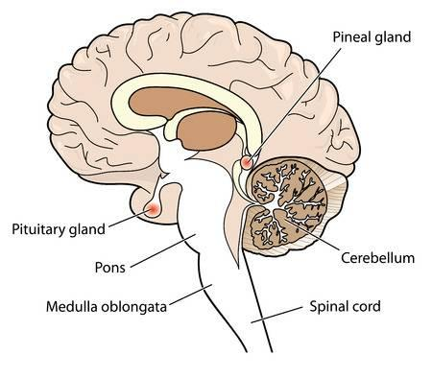
Extra:
The Pituitary and Its target Organs

Slide 6
1.B 2.C 3.A 4.A 5.B 6.C
Q1 : Which of the following cells belong to the basophils of pars distalis?
A. Chromophobes
B. Gonadotropins
C. Somatotrophs
D. Mammotrophs
Q2: Which one of the following structures is found in pars nervosa?
A. Chromophobes
B. Chromophils
C. Pituicytes
D. Prolactin cells
Q3: Corticotrophs contains which cells ?
A. ACTH cells.
B. TSH cells
C. GH cells
D. Prolactin cells
Q4 : The cell bodies of hypothalamohypophyseal tract are situated in?
A. Supraoptic nucleus
B. Suprachiasmatic nucleus
C. Dorsomedial nucleus
D. Lateral preoptic nucleus
Q5: Which type of blood capillaries is found in pars nervosa ?
A. fenestrated blood capillaries without diaphragm
B. fenestrated blood capillaries with diaphragm
C. Sinusoidal blood capillaries
D. Continuous blood capillaries
Which one of the following hormones is released by posterior pituitary gland ?
A. LH
B. Prolactin
C. Oxytocin
D. ACTH

Slide 7
Team Leaders
Good luck
Abdullah shadid
Sarah alflaij

