Slide 1
THYROID & PARATHYROID GLANDS
Objectives:
Describe the histological structure of thyroid & parathyroid glands.
Identify and correlate between the different endocrine cells in thyroid gland and their functions.
Describe the functional structure of the parathyroid cells.
Editing file
Important
Doctor notes / Extra

Slide 2
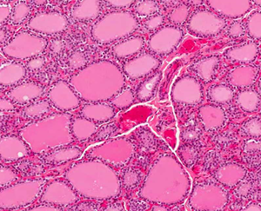
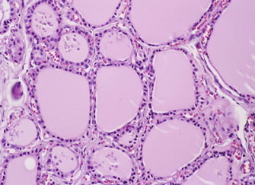
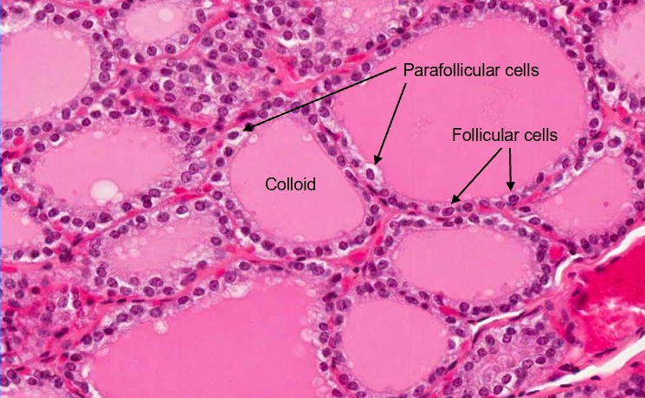
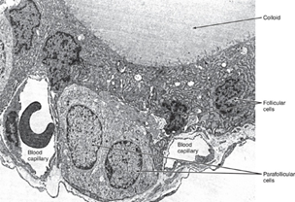
THYROID GLAND
STROMA
1- Capsule: dense irregular collagenous C.T. 2- Septa (Interlobular septa) 3- Reticular fibers: Thin C.T. composed mostly of reticular fibers with rich capillary plexus surrounds each thyroid follicle.
PARENCHYMA Are the structural and functional units of the thyroid gland.
1- Simple cuboidal epithelium: |  |  | 2- Colloid: central colloid-filled lumen.
 | a- Follicular (principal) cells | b- Parafollicular cells (C cells) (Clear cells)
L/M: | - Simple cuboidal cells. - Round nucleus with prominent nucleoli. - Basophilic cytoplasm. - Apical surface reaches the lumen of the thyroid follicle. | - Pale-stained cells (Clear Cells). (Polygonal/pyramidal cells) - Found singly or in clusters in between the follicular cells. - Their apices do not reach the lumen of the follicle. - Are larger than follicular cells (2-3 times).(larger but less in number) - Only 0.1% of the epithelial cells. - Have round nucleus | N.B. Each follicle is surrounded by thin basal lamina. (Acidophilic)
E/M: | - Mitochondria. - RER. (synthesis of thyroglobulin) - Supranuclear Golgi Complex. - Numerous apically-located lysosomes. - Numerous dispersed small vesicles - The vesicles contain newly formed thyroglobulin. - Numerous apical short microvilli. | - Mitochondria. - RER (moderate). - Well-developed Golgi.
Function: | Synthesis of thyroid hormones (T4 & T3). | Secrete calcitonin.

Slide 3
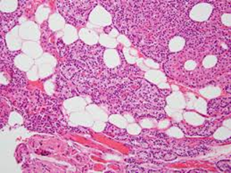
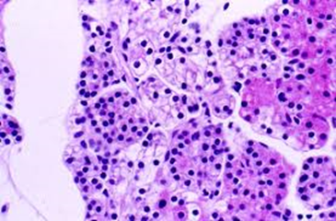
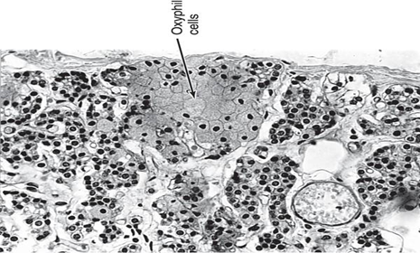
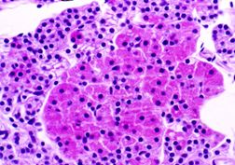
PARATHYROID GLAND They are 4 glands on the posterior of thyroid gland.
STROMA
1- Capsule: Each gland has its Thin capsule. 2. Septa: thin. 3. Reticular C.T. C.T. stroma in older adults often contains many adipose cells. (adipose cells found only in old people >20 year)
PARENCHYMA The parenchyma is formed of cords or clusters of epithelial cells (chief cells & oxyphil cell) with blood capillaries in between. These cells are surrounded by reticular fibers.
1. Chief cells | 2. Oxyphil cells
are slightly eosinophilic. (Pale acidophilic) are rich in rER. They secrete parathyroid hormone (blood calcium). In newborn only chief cell will be found | They are arranged in groups or clusters or as isolated cells. They are deep eosinophilic (acidophilic) They have more numerous mitochondria They are less numerous but larger than chief cells. They are of unknown function N.B. (They may be inactivated chief cells).

Slide 4
1.D 2.B 3.A 4.C 5.B 6.A 7.A 8.D
Q1 : Which of the following have unknown function?
A. Follicular (principal) cells
B. Parafollicular cells
C. Chief cells
D. Oxyphil cells
Q2: Which one of the following have more mitochondria?
A. Chief cells
B. Oxyphil cells
C. Chief cells and Oxyphil cells are equal in mitochondria count.
Q3: thyroid gland secretes:
A. T4 & T3 & calcitonin
B. T4 & T3 & PTH
C. PTH & calcitonin
Q4: Which one of the following organelles is responsible for the synthesis of thyroglobulin?
A. Lysosomes
B. Mitochondria
C. Rough endoplasmic reticulum
D. Smooth endoplasmic reticulum
Q5 : Which of the following is the largest thyroid cell?
A. Follicular (principal) cells
B. Parafollicular cells
C. Chief cells
D. Oxyphil cells
Q6: It secretes thyroid hormones
A. Follicular (principal)
B. Parafollicular cells
C. Chief cells
D. Oxyphil cells
Q7: Which gland have dense capsule?
A. thyroid gland
B. parathyroid gland
C. thyroid and parathyroid gland
Q8: Which ONE of the following is true about follicular cells?
A. Have pyramidal shape
B. Do not reach the luminal surface
C. Larger than parafollicular cells
D. Have round nucleus

Slide 5
Team Leaders
Good luck ❤
Abdullah shadid
Sarah alflaij

