Slide 1
ADRENAL GLAND
Objectives:
Differentiate between adrenal cortex and medulla.
Identify the histological features of each cortical zone and its cells.
Identify the histological features of the medullary cells.
Editing file
Important
Doctor notes / Extra

Slide 2
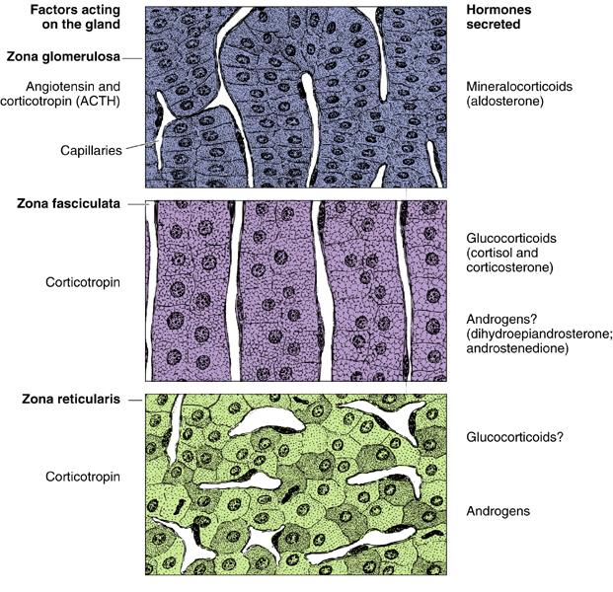
Zona glomerulosa
Stroma
Adrenal gland
Cortex
Zona fasciculata
Parenchyma
Zona reticularis
Medulla
The adrenal cortex layers have 5 features in common: extra but important
1- Acidophilic cytoplasm
2- Abundant SER
3- Numerous mitochondria
4- Mitochondrial cristae is tubular
5- few Droplet of lipids ( expect Zona fasciculata rich in lipids)
Suprarenal artery
Capsule
Zona glomerulosa
Zona fasciculata
Zona reticularis
Medulla
Central vein of medulla

Slide 3
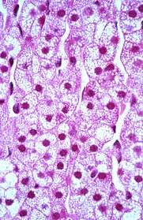
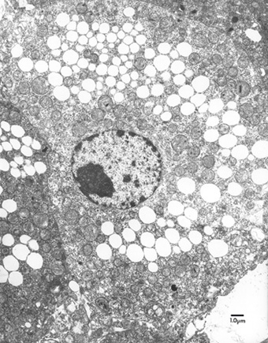
Adrenal Cortex
Zona glomerulosa | Zona fasciculata (spongiocytes) | Zona reticularis
formed of clusters of small columnar cells that are rich in SER and mitochondria. Produces mineralocorticoids e.g. aldosterone hormone (Reabsorb all the remaining sodium, and passively the chloride, from the lumen of the distal renal tubules into the renal interstitium. In addition, potassium and hydrogen ions are actively secreted into the lumen). | It is the intermediate and the largest layer of the cortex. It is formed of columns of large polyhedral cells that are separated by longitudinal sinusoidal capillaries. Its cells are rich in lipids, so they appear empty in sections (spongiocytes). Its cells are rich in mitochondria (with tubular cristae),SER and lipofuscin pigments. Its cells secrete glucocorticoids. It is regulated by ACTH of pituitary. | It is the innermost layer of adrenal cortex. It is formed of anastomosing cords of deep acidophilic cells. Its cells contains few lipofuscin and lipid droplets. The cells secrete androgens.

Slide 4
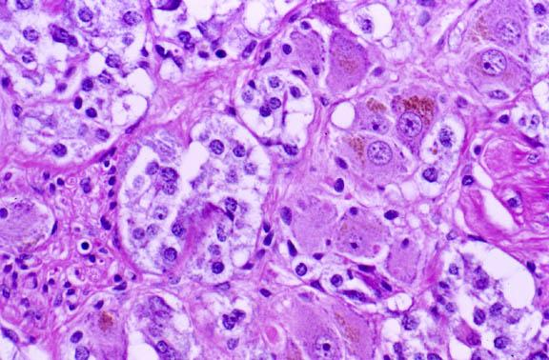
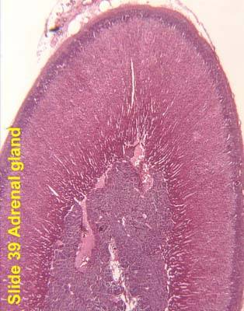
Neurons in adrenal medulla
Medulla of adrenal gland
it is the central portion of the adrenal gland.
It is completely invested with adrenal cortex (not separated from it by CT. septa)
1- Chromaffin cells (Pheochromocytes):
Contains granules of catecholamine as that of sympathetic nervous system.
They produce epinephrine and norepinephrine.
They stain deep brown with chromic saltalts.
It contains:
2- Sympathetic ganglion cells :
Relay on chromaffin cells.

Slide 5
1.D 2.B 3.D 4.A 5.C 6 D
Q1: Which of the following feature is true about Zona glomerulosa ?
A. Formed of Small cuboidal cells
B. Secrete glucocorticoids
C. Formed of polyhedral column
D. Has acidophilic cytoplasm
Q2: Which one of the following zone is rich in lipids ?
Zona glomerulosa
Zona fasciculata
Zona reticularis
Zona medullaris
Q3: Sex hormones are secreted by
all endocrine tissues of the body
zona glomerulosa
the gonads
zona reticularis and the gonads
Q4: Which one of the following cells secrete epinephrine ?
Pheochromocyte
Zona glomerulosa
Zona reticularis
Spongiocytes
Q5: all the following are true about the medulla expect
it is the central portion of the adrenal gland.
its produce epinephrine
it separated from the cortex by CT. septa
it is contain Pheochromocytes
Q6: Which one of the following Feature is common in the adrenal cortex layers ?
Acidophilic nucleus
Abundant RER
few mitochondria
Mitochondrial cristae is tubular

Slide 6
Team Leaders
Good luck :)
Abdullah shadid
Sarah alflaij

