Slide 1
Pancreas
Exocrine & Endocrine
Objectives:
Describe the endocrine part of the pancreas within the exocrine part.
Describe the histological features of the cells of islet of Langerhans.
Describe the function of different cells of islets of Langerhans.
Editing file
Important
Doctor notes / Extra

Slide 2
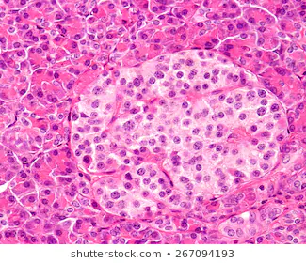
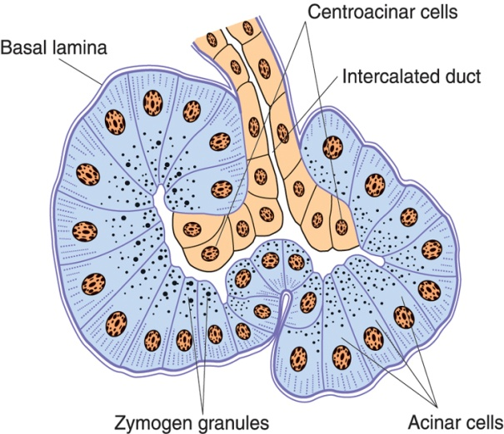
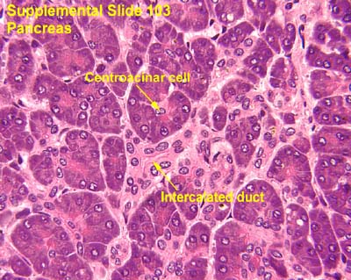
PANCREAS
Stroma | Parenchyma Pancreas is a mixed gland: ( exocrine and endocrine )
capsule, septa & reticular fibers. | Exocrine part (acini & ducts): produces digestive pancreatic enzymes. |  |  | Endocrine part (islets of Langerhans): produces hormones.
 | Pancreatic Acini | Pancreatic Acinar Cells | Duct System
 | They are serous acini: secreting a thin fluid rich in digestive pancreatic enzymes. Centroacinar cells: Their nuclei appear in the center of the acini. They represent the beginning of the ducts. No myoepithelial cells around the acini. | Pyramidal in shape. Nuclei are basal.( rounded and vascular) Cytoplasm: Basal part Basophilic (due to abundant rER). Apical part Acidophilic (due to secretory granules). | Centroacinar cells. Intercalated ducts (low cuboidal). Intralobular ducts (NOT prominent). Interlobular ducts. Main pancreatic duct.

Slide 3
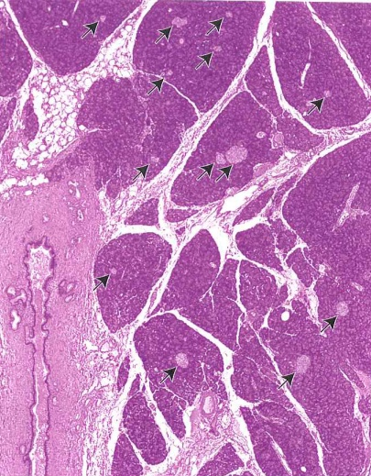
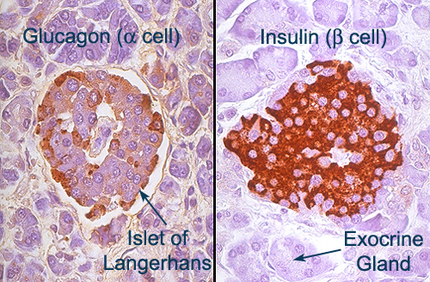
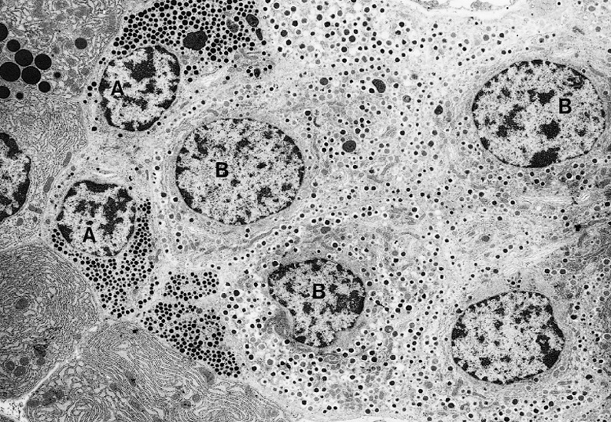
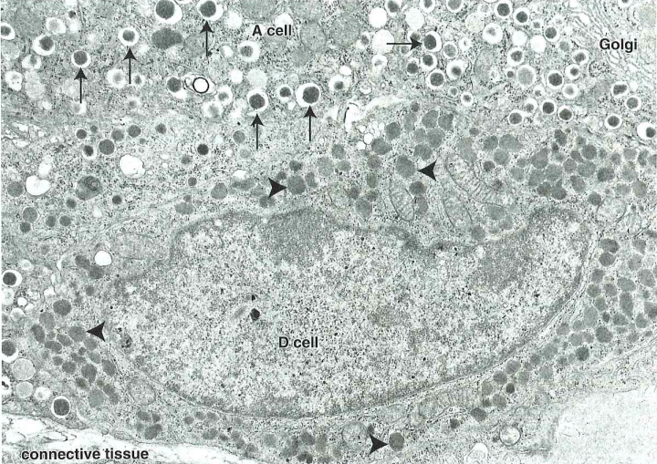
Endocrine Pancreas
Islets of Langerhans:
Pale-staining spherical collections of endocrine cells, scattered among the acini. Richly vascularized by fenestrated capillaries. ( without diaphragm) Each islet is surrounded and supported by reticular fibers. 1 million islets in human pancreas. Most numerous in the tail of pancreas. Cells of the Islets: 5 types of cells in each islet. Cannot be differentiated from one another by routine stains. (we can by immunohistochemistry or EM)
β (B) cells | α (A) cells | δ (D) cells | G cells | PP cells
Constitute 70% of islet cells. Concentrated in islet center. Function: secrete insulin which ↓ blood sugar. | Constitute 15-20%. Concentrated in islet periphery. Granules are much more numerous, more tightly packed, smaller, and denser than those of β cells. Function: secrete glucagon which ↑ blood sugar. | Constitute 5-10% Scattered throughout the islet. Granules are less dense than those of β and α cells. Function: secrete somatostatin which ↓ release of hormones from endocrine pancreas and enzymes from exocrine pancreas. | Constitute 1% of islet cells. Scattered throughout the islet. Function: secrete gastrin which ↑ production of HCl by parietal cells of the stomach. | Constitute 1% of islet cells. Scattered throughout the islet. Function: secrete pancreatic polypeptide which ↓ exocrine secretions of pancreas.

Slide 4
1.A 2.A 3.D 4.A 5.D 6.B 7.C 8.C
Q1 : Pancreatic acini is …….. acini
A. serous
B. mucous
C. mixed
Q2: Which of the following is correct?
A. Endocrine part produces hormones.
B. Exocrine part contain islets of Langerhans.
C. Endocrine part contain acini & ducts.
D. islets of Langerhans produce digestive pancreatic enzymes.
Q3: There is …… islets of langerhans in the human pancreas.
A. 80,000
B. 100,000
C. 200,000
D.1,000,000
Q4: Which of the following cells its secretion decrease exocrine secretions of pancreas.?
A. PP cells
B. G cells
C. D cells
D. A cells
Q5 : Which of the following is NOT a feature of islets of langerhans?
A. Pale-staining
B. spherical
C. scattered
D. most numerous in the head of pancreas
Q6 : which of the following is true regarding beta cells?
A. constitue 15-20%
B. concentrate in the centre of the islet
C. secretes glucagon
D. numerous small granules
Q7: Which of the following cells secretes somatostatin?
A. PP cells
B. G cells
C. D cells
D. A cells
Q8: We can differentiate between cells in the pancreas by ?
A. H & E stain
B. Immunofluorescence
C. immunohistochemistry
D. routine stains

Slide 5
Team Leaders
Good luck ❤
Abdullah shadid
Sarah Alflaij

