Slide 1
OSPE
⬓ FEMALE ⬓ MALE
Team leaders
Abdullah shadid , Sarah alflaij

Slide 2
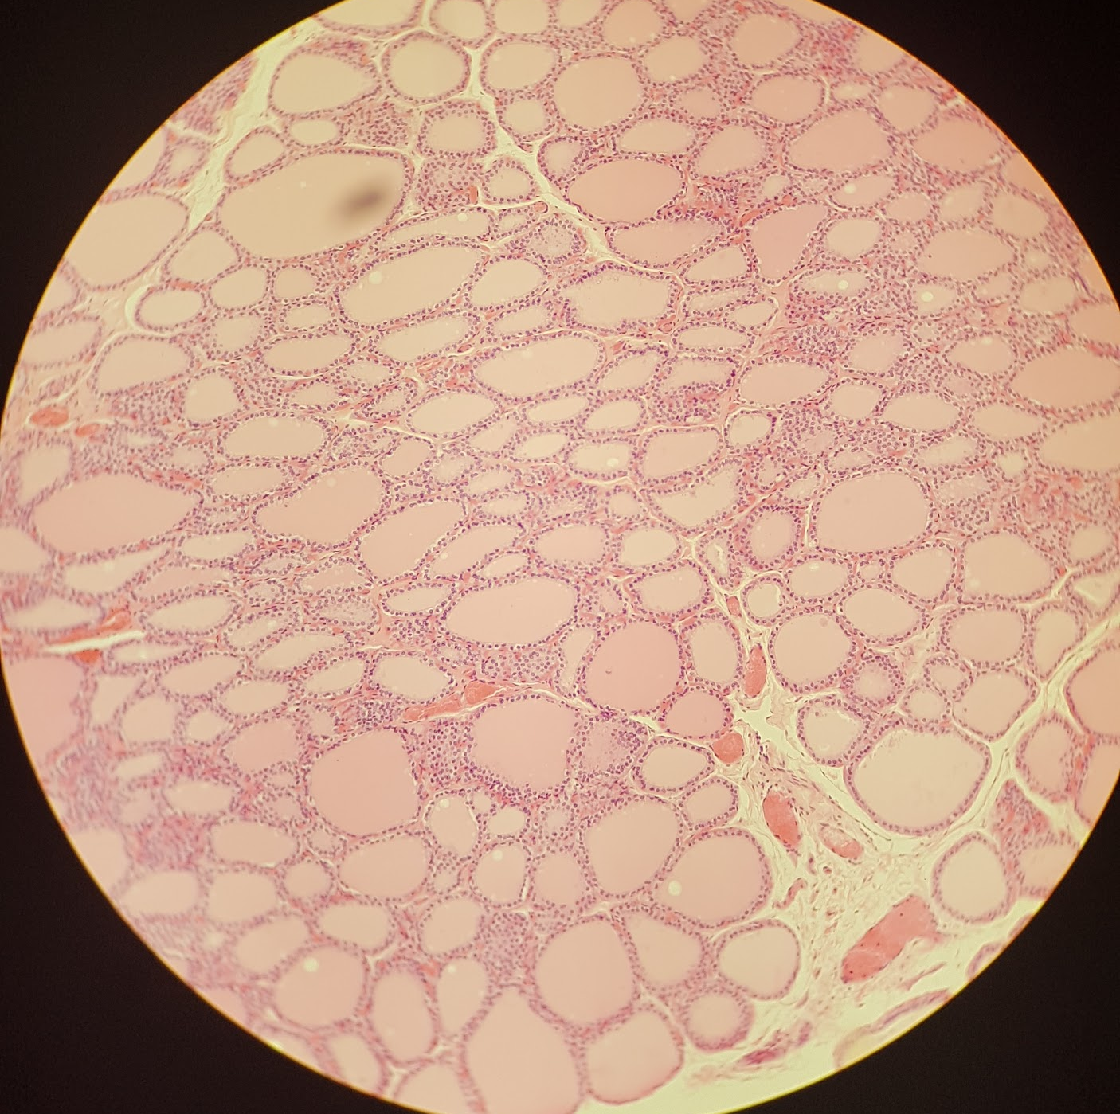
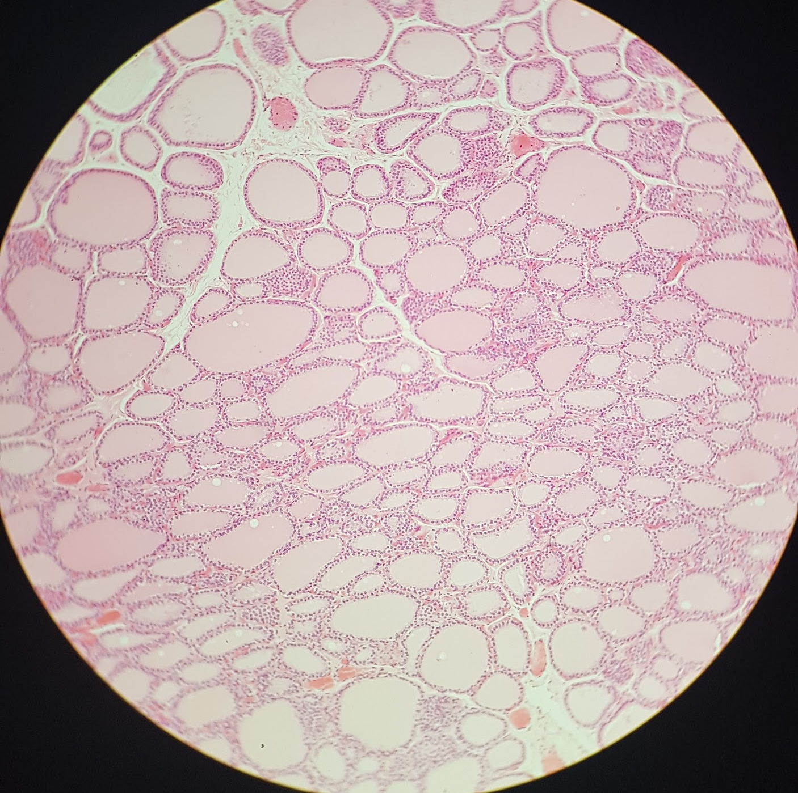
Thyroid gland
Q1: Identify the structure (name of the gland)?
Thyroid gland
Q2: What is the type of Epithelium in this structure?
Simple cuboidal Epithelium
Q3: What is the type of capillaries found in this structure?
Fenestrated blood capillaries
Q4: What are the cells found in this structure?
Follicular cells
small size
more numerous
Basophilic cytoplasm
Parafollicular cells
large size
less numerous
Pale-stained cells
Q5: What are the features of this structure?
Acidophilic Colloid
Follicular cells
Parafollicular cells in between the follicular cells

Slide 3
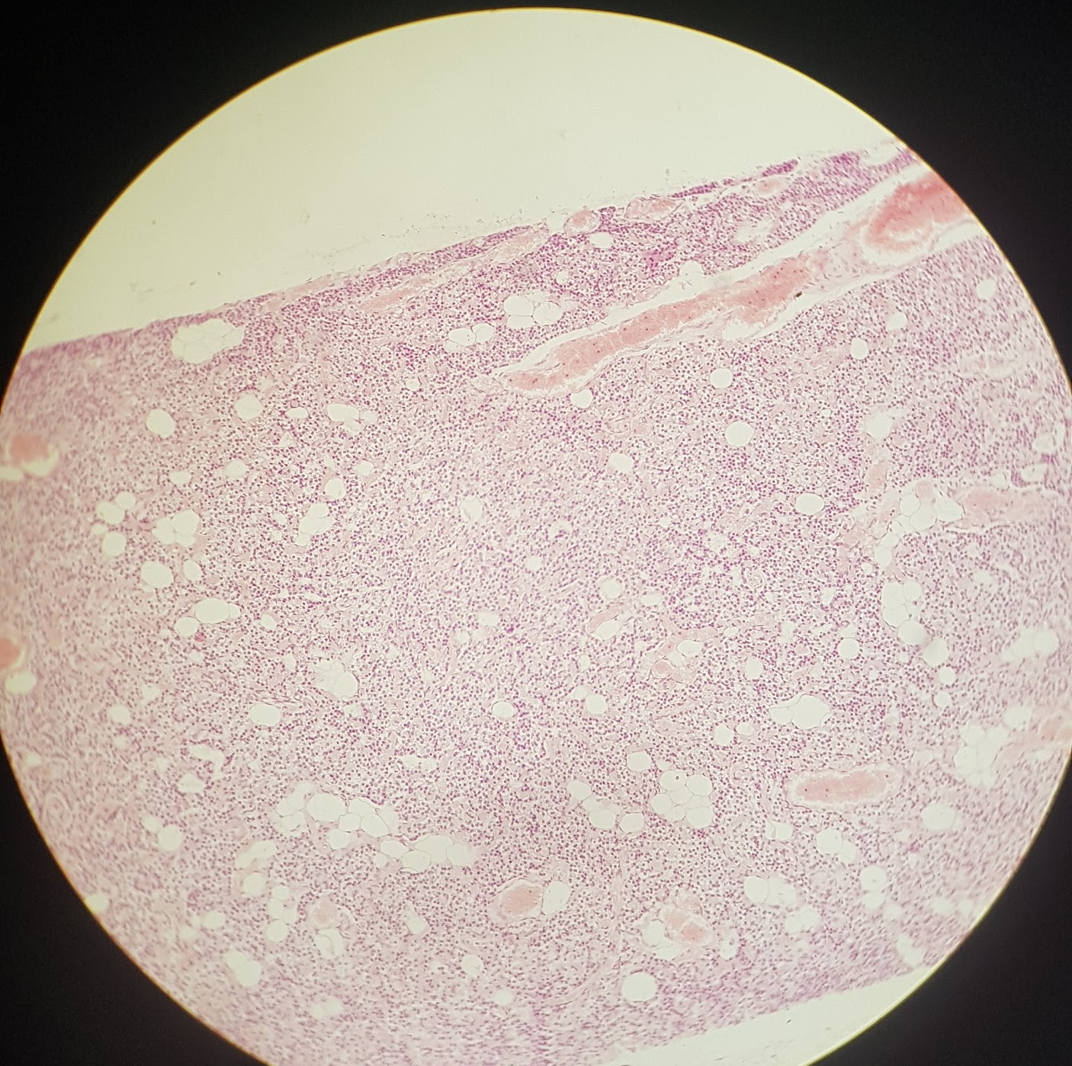
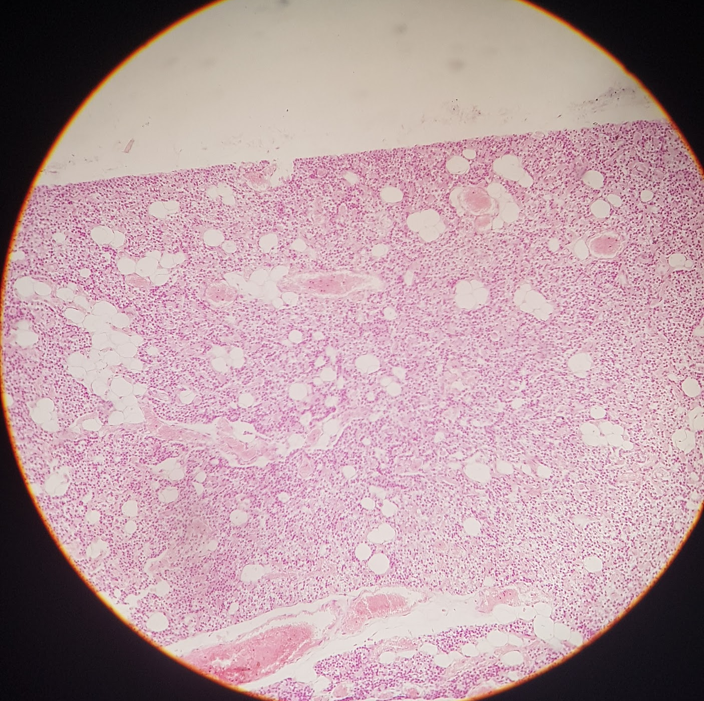
Parathyroid gland
Q1: Identify the structure (name of the gland)?
Parathyroid gland
Q2: What are the cells found in this structure?
Chief cells
small size
more numerous
slightly eosinophilic
Oxyphil cells
large size
less numerous
deep eosinophilic
Q3: What are the features of this structure?
Contain many adipose cells (Adipocytes)
Chief cells
Oxyphil cells

Slide 4
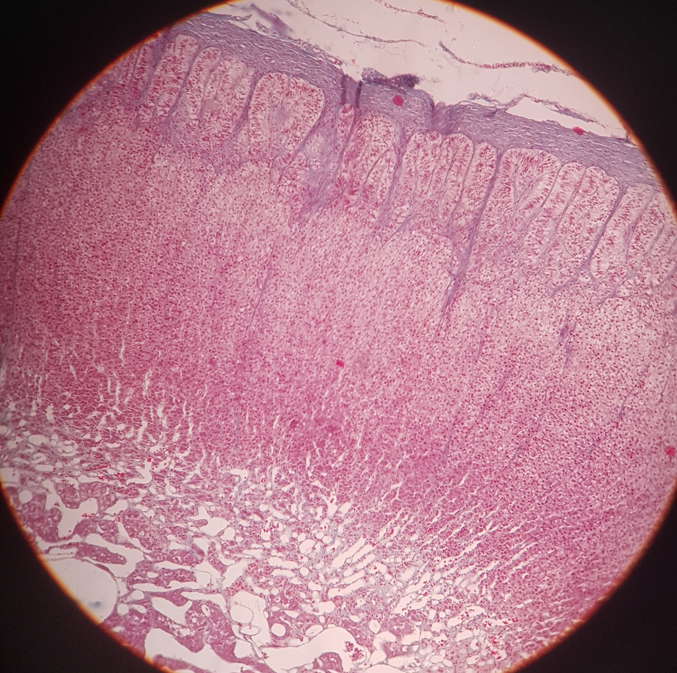
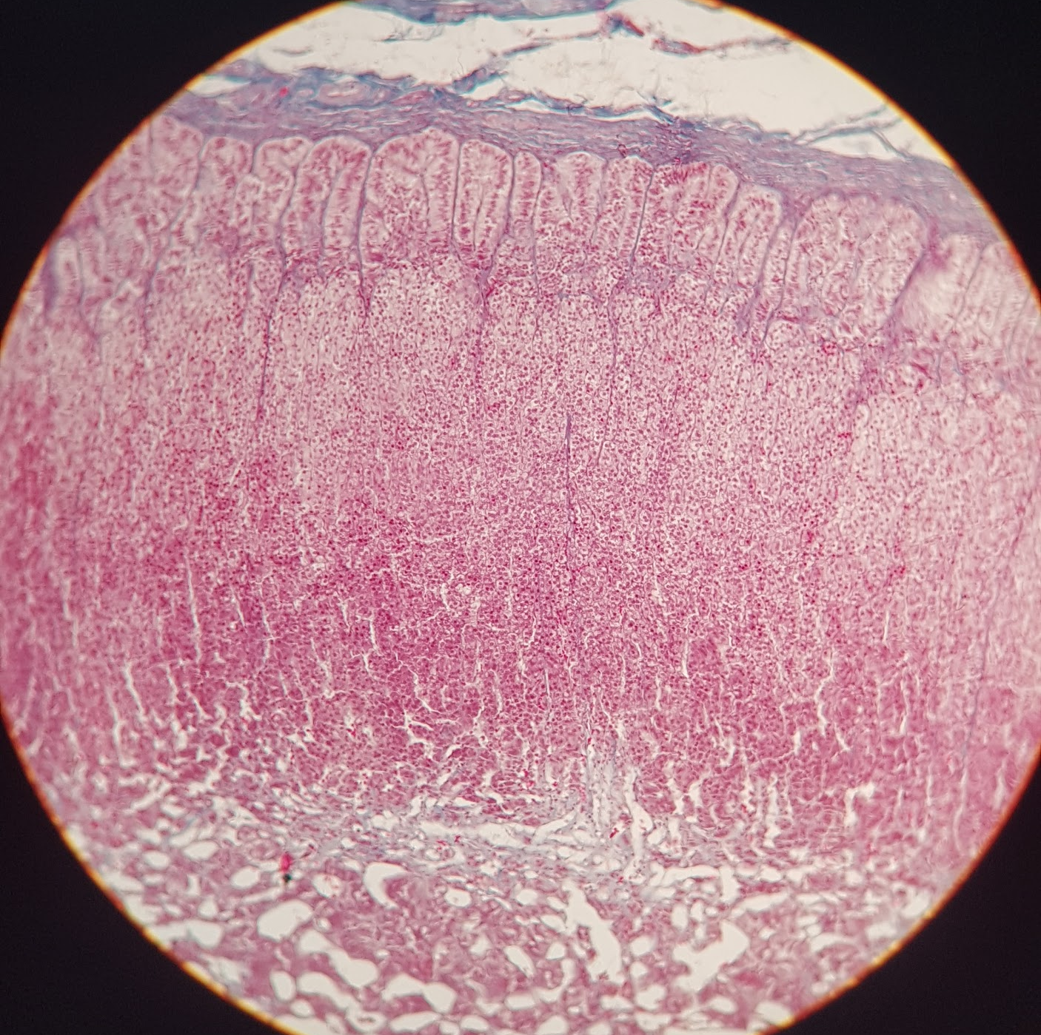
Adrenal gland
Q1: Identify the structure (name of the gland)?
Adrenal (suprarenal) gland
Q2: What are the parts of this structure?
Outer adrenal cortex
Inner adrenal medulla
Q3: What are the Zones found in the parts of this structure? or What is the feature of this structure
Outer adrenal cortex:
Zona glomerulosa (clusters of short columnar cells under the capsule)
Zona fasciculata (spongiocytes foamy cells)
Zona reticularis (cords and reticulum of acidophilic cells with lipofucin pigments)
Inner adrenal medulla:
Chromaffin cells (most abundant & Basophilic cytoplasm)
Sympathetic ganglion cells (large neurons with melanin pigments)

