Slide 1
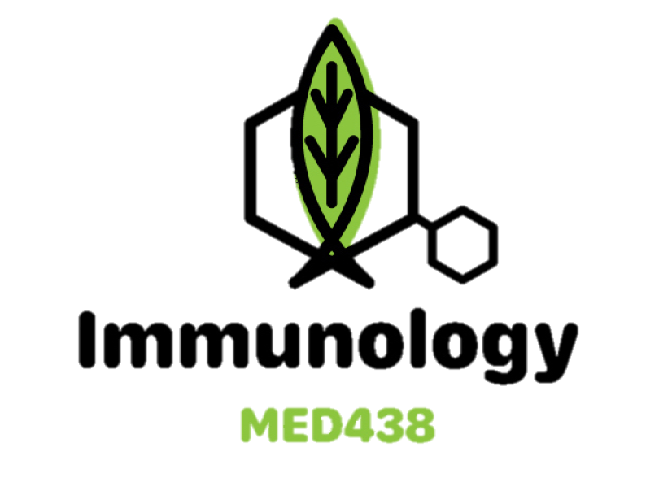
This block’s study mood
Endocrine Disorders
Color code:
Important in red
Extra in blue
:(
Editing file

Slide 2
Objectives
To recognize that many endocrine disorders are organ-specific autoimmune diseases.
To understand the mechanisms of damage which take place at endocrine glands and their consequences.
To know the important examples of autoimmunity which affect different endocrine glands and the pathogenesis of these disorders.
To actually read the objectives for once

Slide 3
Review (Extra)
Mechanisms of Autoimmunity
Sequestration | Some self antigens are hidden in tissues and are normally not sensed by the immune system. When those self antigens are exposed to T cells (as a result of infection/trauma), an autoimmune reaction occurs. e.g. Sympathetic Ophthalmia: Trauma in one eye releases the sequestered intraocular antigens to the Lymph node (activates T cells) The T cells will then move to the undamaged eye and attack the self-antigens there.
Molecular Mimicry | Viruses and bacteria possess similar/identical antigenic determinants to those of normal cells. e.g. HIV p24 antigen identical to the IgG constant region
Abnormal MHC II Expression | Abnormal expression of MHC Class II on non-APC cells (e.x. pancreatic 𝛃 cells) due to IFN𝛄 production (induced by a viral infection) causes self-reactive T cells to destroy them e.g. Type I Diabetes
Polyclonal B Cell Activation | Happens when a polyclonal B cell (nonspecific) is activated by certain viruses and bacteria without the help of T cells (T-independent).This self-reactive plasma cell will proliferate and eventually produce polyclonal antibodies (mainly IgM), some of which will be autoantibodies e.g. EBV causing infectious mononucleosis
Autoimmune diseases can be broadly divided into:
1- Systemic: e.g. SLE and Rheumatoid Arthritis
2- Organ-specific (discussed in this lecture)
tribute to a great editor and a great coleader

Slide 4
Endocrine Disorders
Examples
Many endocrine disorders are organ-specific autoimmune diseases
Response is directed to a target antigen unique to a single organ, with manifestations largely limited to that organ
The damage may be directly mediated by:
Humoral immunity (Autoantibodies overstimulate or block the normal function of the target organ)
Cell-mediated immunity
Both (e.g. Hashimoto and possibly Addison’s)
Thyroid | Hashimoto’s disease (Hypothyroidism): Autoantibodies against Thyroid Peroxidase Primary Myxoedema (Hypothyroidism): Atrophy of the thyroid gland Graves’ disease (Hyperthyroidism): Autoantibodies against TSH receptor
Pancreas | Type I Diabetes: Abnormal MHC Class II expression on 𝛃 cells
Adrenal | Addison’s disease: Insufficient steroid hormones (chronic adrenal gland disorder)
Gonads | Autoimmune Oophoritis: Ovarian inflammation Autoimmune Orchitis: Testicular pain involving swelling, inflammation, and infection
Pituitary | Lymphocytic hypophysitis: Low production of one or more pituitary hormones due to autoimmunity/autoantibodies

Slide 5
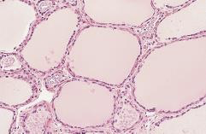
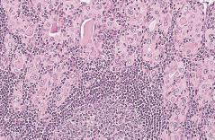
Thyroid Diseases
Chronic Lymphocytic Thyroiditis (Hashimoto)
Prevalence | Frequently seen in middle-aged women (M:F is 1:3) Associated with HLA II DR4 (predisposing) and HLA II DR13 (protective role)
Pathophysiology | Anti-thyroid peroxidase and Anti-thyroglobulin antibodies (both protein antigens are involved in Iodine uptake) with sensitized TH1(inflammatory) cells specific for thyroid antigens (Delayed-Type Hypersensitivity) Auto-abs bind to the proteins → Interfere with iodine uptake → Decreased production of thyroid hormones The DTH response is characterized by: Intense infiltration of the thyroid gland by lymphocytes, macrophages, and plasma cells (forming follicles and germinal centers) The inflammatory response will result in a goiter (physiological response to hypothyroidism) (Recall the Trophic effect of TSH, which will be elevated in Hashimoto)
Clinical features | Hypothyroidism: Fatigue & Loss of energy - Weight gain - Mental slowing Cold intolerance - Goiter
Normal thyroid gland
Hashimoto’s intense lymphocytic infiltration

Slide 6
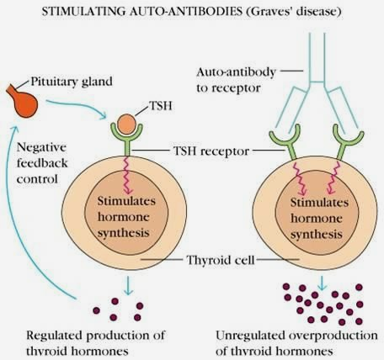
Thyroid Diseases
Graves’ disease
Prevalence | Less common than Hashimoto’s disease (M:F up to 1:7) Associated with HLA II DR3 (predisposing), HLA II DR7 (protective role), and HLA B8
Physiology Pathophysiology | T3/T4 production is normally monitored by TSH. It binds to a receptor on Thyroid cells and activates the Adenylate Cyclase pathway to stimulate the synthesis of those hormones. (TSH is controlled by -ve feedback) In Graves’ disease, auto-antibodies bind the TSH receptor and mimic its normal actions (activating AC pathway). Unlike TSH, the long-acting thyroid stimulating (LATS) antibodies are unregulated and overstimulate the thyroid
Clinical features | Hyperthyroidism: Agitation, tremor & sleep disturbance - Weight loss (w/increased appetite) - Ophthalmopathy Heat intolerance, Sweating & palpitations - Goiter - Muscle weakness

Slide 7
Insulin-Dependent Diabetes Mellitus (Type I)
IDDM
Pathophysiology | Type IV (Delayed-Type) Hypersensitivity Autoreactive T-cells invade pancreatic islets and destroy the 𝛃 (insulin-secreting) cells Macrophages are activated → Insulitis (CMI) → Decreased insulin → hyperglycemia
Mechanisms | 1- Genetic susceptibility (HLA-DQ alleles) 2- Autoimmunity 3- Environmental factors (Infections: e.g. Coxsackie virus, Echovirus) (recall that this autoimmunity is due to abnormal expression of MHC II on non-APC cells (𝛃 cells), which could be induced by viral infections through increased IFN𝛄 production → T cells will destroy the MHC II-expressing 𝛃 cells) Most likely scenario: Viruses cause mild 𝛃 cell injury followed by an autoimmune reaction in HLA-susceptible people About 10% of Type I IDDM patients are prone to other autoimmune disorders
A normal islet of langerhans containing several cell types (3 demonstrated), each secreting different hormones and expressing different proteins.
In Type I IDDM, an effector T cell attacks and kills the 𝝱 cell because it is abnormally expressing MHC peptides.
Insulin can no longer be produced due to the 𝝱 cell death, while glucagon (𝜶 cell) and somatostatin (𝞬 cell) will continue being produced.

Slide 8
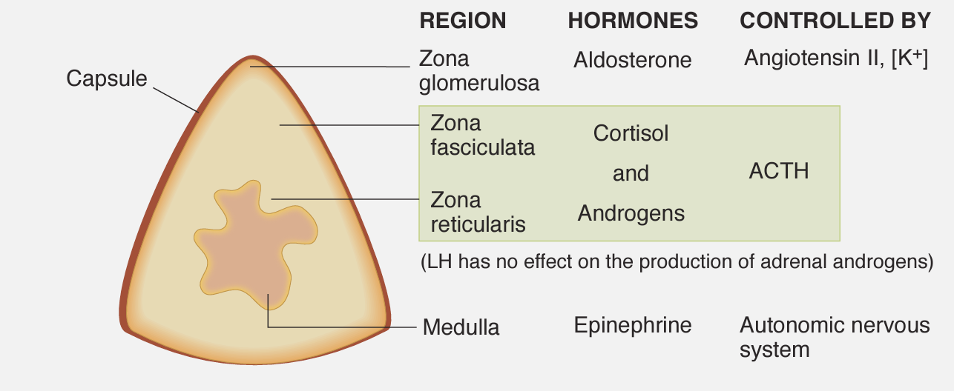
Adrenocortical Failure
Addison’s Disease (prototypical)
Prevalence | M:F ratio is 1:4 Associated with HLA II DR3 and/or DR4 (The most strongly associated DRB1*04 allele is DRB1*04:04)
Pathophysiology | Autoimmune destruction of steroid-producing cells in the adrenal gland A major autoantigen is 21-hydroxylase (21OH), involved in the biosynthesis of cortisol & aldosterone in the cortex T cell-mediated injury is likely to be central to pathogenesis (21 Hydroxylase-specific Cytotoxic T cells) Adrenal autoantibodies may have a pathogenic role (unclear yet) or could arise secondary to T-cell tissue damage
Clinical features | Adrenal Insufficiency: Weakness - Weight loss (w/poor appetite) - Confusion - Shock Hyperpigmentation (underarm) - Hypotension - Weak pulses
Damage to the adrenal cortex may be caused by:
Autoimmune disease
Infections
Hemorrhage
Tumors
Use of drugs (anticoagulants)

Slide 9
Quiz:
1. Which one of the following HLA genes is a predisposition for type 1 diabetes mellitus?
4. What autoimmune endocrine disorder is mediated by both humoral and cell-mediated immunities?
HLA DR4
HLA DR3
HLA DQ
HLA B1
Graves disease
Chronic Lymphocytic Thyroiditis
Systemic Lupus Erythematosus
Multiple Sclerosis
2. Which one of the following HLA genes is a predisposition for Hashimoto?
5. What type of hypersensitivity is associated with IDDM?
HLA DR3
HLA DR4
HLA DR13
HLA DR7
Type I
Type II
Type III
Type IV
3. What is the most likely pathogenic mechanism for Addison’s disease?
6. Which of the following plays a protective role in Hashimoto’s Thyroiditis?
21 Hydroxylase deficiency
Autoantigen against 21 Hydroxylase
Cytotoxic attack in the adrenal medulla
Destruction in the adrenal cortex
HLA DR4
HLA DR7
HLA DR13
HLA B8
1.C 2.B 3.D 4.B 5.D 6.C

Slide 10
Done by: Ibrahim Aldakhil
Edited by: Abdulrahman Alhawas
Special thanks to: Mohammed A. Alshehri and Meshari Alzeer
:(

