Slide 1
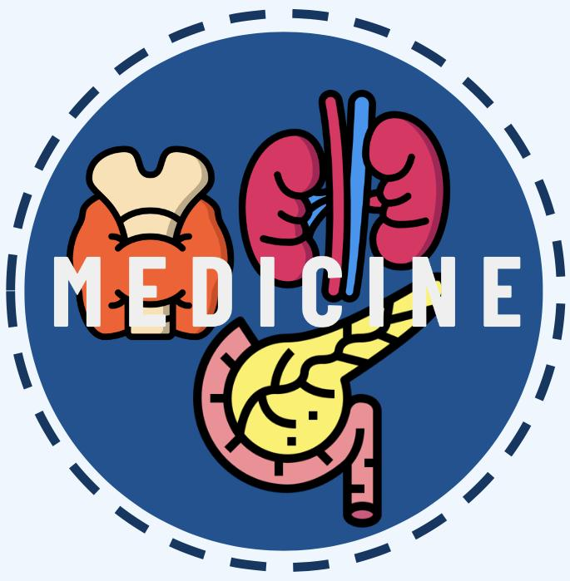
ANTERIOR PITUITARY DISORDERS
Editing file
Lecture Objectives:
To understand basic pathophysiology and feedback for anterior pituitary hormones.
Know about clinical approach for common anterior pituitary gland disorders:
Common clinical presentations.
Main laboratory investigations.
Radiological investigations.
Describe lines of management for each of these conditions.
Important
Original content
Only in girls slides
Only in boys slides
Doctor’s notes

Slide 2
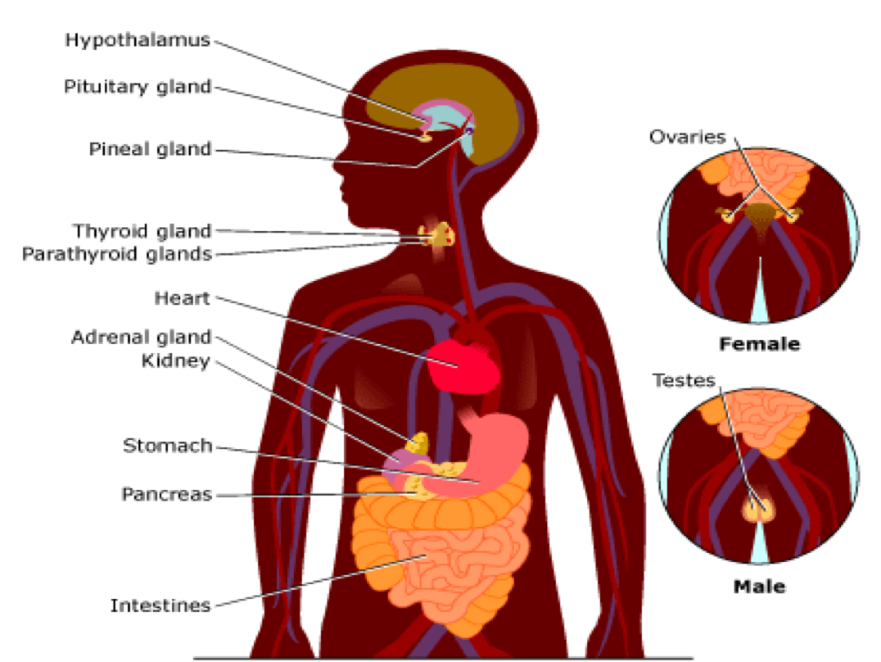
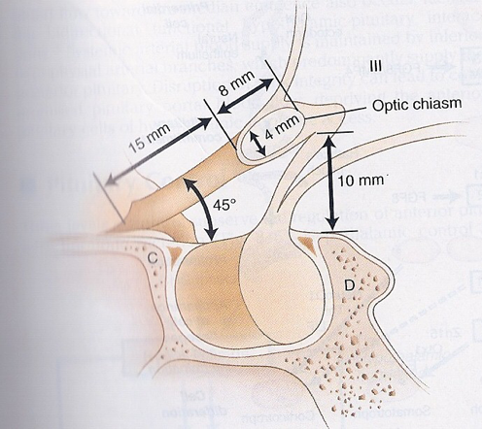
Introduction
Skip
Embryology overview:
Pituitary development
Pituitary stalk in midline joins the pituitary gland with hypothalamus that is below 3rd ventricle
Development of pituitary cells is controlled by a set of transcription growth factors like Pit-1, Prop-1, Pitx2.
Anterior pituitary
Posterior pituitary
Rathke’s pouch
Neural cells as an outpouching from the floor of 3rd ventricle.
It’s an Ectodermal evagination of oropharynx.
Recognizable by 4- 5th week of gestation and full maturation by 20th week.
Portion of Rathke’s pouch → Intermediate lobe
Remnant of Rathke’s pouch cell in oral cavity → pharyngeal pituitary
Anatomy overview:
Sella turcica:
Pituitary gland is protected by sella turcica which lies at the base of the skull (sphenoid body)..
Relations of pituitary gland:
Roof: Diaphragma sellae(Pituitary stalk and its blood vessels pass through the diaphragm)
Floor: Sphenoid sinus
Lateral walls: Cavernous sinus
Containing III, IV, VI, V1, V2 cranial nerves and internal carotid artery with sympathetic fibers.
Both adjacent to temporal lobes
Other info:
Pituitary gland measures: 15 X 10 X 6 mm, weighs 500 mg but about 1 g in women.
Optic chiasm: lies 10 mm above the gland and anterior to the stalk.
Blood supply: superior, middle, inferior hypophyseal arteries ( internal carotid artery) running in median eminence from hypothalamus.
Venous drainage: to superior and inferior petrosal sinuses to jugular vein

Slide 3
Introduction cont.
Pituitary Function
Anterior pituitary hormones
Posterior pituitary hormones
Synthesis and storage:
Go Look For The Adenoma Please.
GH LH, FSH, TSH, ACTH and Prolactin.
A compressive adenoma in pituitary will impair hormone production in this order.
Storage only (not synthesis):
Oxytocin
ADH(vasopressin)
NOTE: They’re synthesized by hypothalamus.
Summary of all hormones
 | Somatotroph | Gonadotroph | Lactotroph | Thyrotroph | Corticotroph
Stimulators | GHRH GHS | GnR E2 | TR E2 | TRH | CRH AVP gp-130 cytokines
Inhibitors | IGF-1 Somatostatin Activins | Testosterone E2 inhibin |  | T3, T4 Dopamine Somatostatin GH | Steroid
Hormone | GH | LH,FSH | PRL | TSH | ACTH POMC
Target Gland | Liver & other tissues | Ovary, Testes | Breast & other tissues | Thyroid | Adrenals
Target Hormone | IGF-1 | Testosterone, E2 |  | T4 | cortisol
Trophic Effects | IGF-1 production Growth induction Insulin antagonism | Sex Steroid Follicular growth Germ Cell maturation | Milk Production | T4 synthesis and secretion | Steroid production Androgen

Slide 4
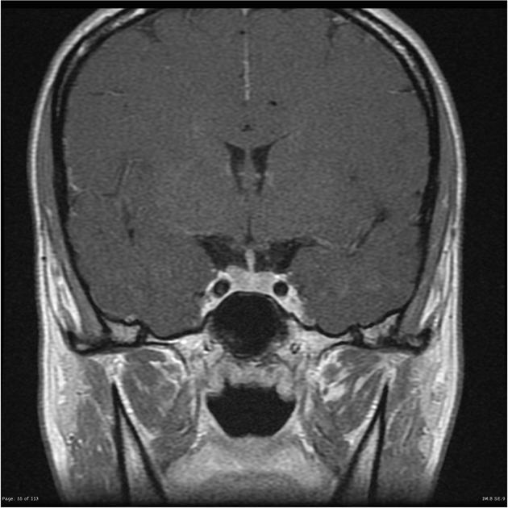
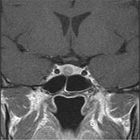
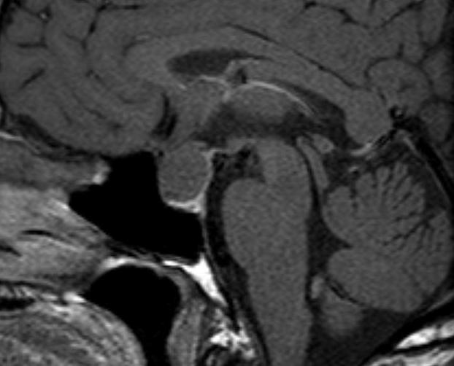
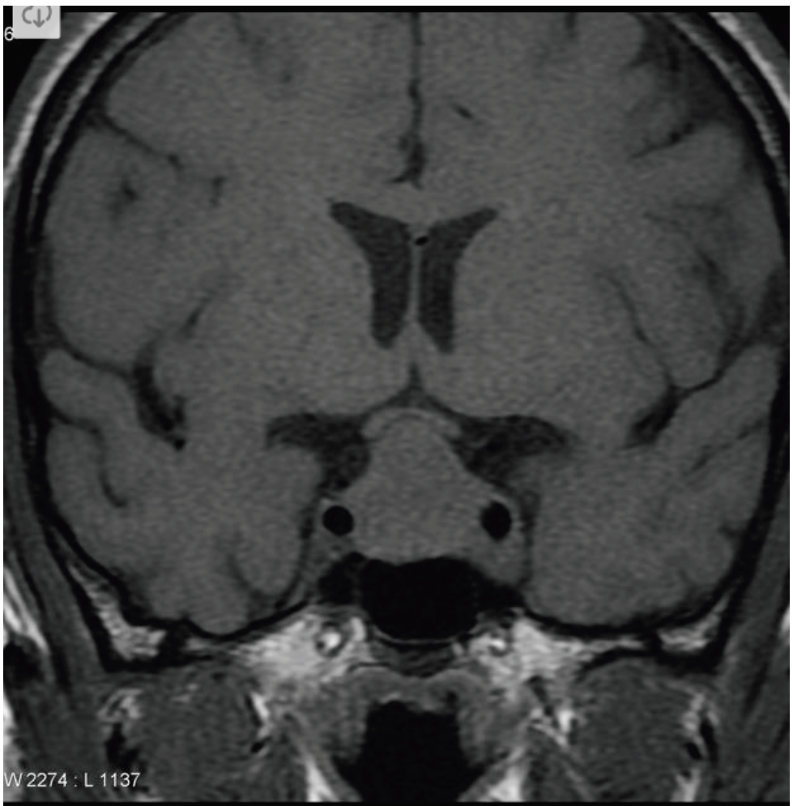
Pituitary disorders
Classified into:
Anterior pituitary disorders
Posterior Pituitary disorders
e.g. Diabetes insipidus
Anterior Pituitary disorders
1
Function:
Hypersecretion: (GH,LH,FSH,PRL,TSH,ACTH)
e.g. Hyperprolactinemia, Acromegaly (↑GH), Cushing’s Disease (↑ACTH).
Hyposecretion: hypopituitarism (isolated, multiple, pan)¹
e.g. Central hypoadrenalism, hypogonadism, hypothyroidism, GH deficiency or Panhypopituitarism
2
Types of masses
Functioning = Hypersecretion (Oversecretion).
Non- Functioning.
Could be with/without mass-effect:
Space occupying lesion
(compression symptoms², hypopituitarism)
Pituitary cysts: Rathke's cleft cyst, Mucoceles, Others
Non-Functioning Pituitary Adenomas³
Lymphocytic hypophysitis
Empty sella syndrome
Etiology of Pituitary hypothalamic lesion
Carotid aneurysm
and Pituitary abscess
Not Important
Metastases in the pituitary (breast, lung, stomach, kidney)
Malignant pituitary tumors: Functional and non-functional pituitary carcinoma
Endocrine active pituitary adenomas
Prolactinoma⁴
( PRL-oma)
Somatotropinoma
(GH secreting adenoma, Acromegaly)
Corticotropinoma
(ACTH secreting adenoma, Cushing’s disease )
Thyrotropinoma
(TSH-oma, rare)
Other mixed endocrine active adenomas
1: When a single pituitary hormone is affected, this is called isolated pituitary deficiency. When two or more pituitary hormones are affected, this is referred to as multiple pituitary hormone deficiency. Panhypopituitarism is a state of reduction of all pituitary hormones.
2: Mass effect in general can cause Nausea, Vomiting & Headache. If the mass is compressing the optic chiasma it will cause bitemporal hemianopia. If it invades the sphenoidal air sinus it will cause CSF leakage throughout the nose
3: Non-functioning adenoma are the most common.
4: Prolactinoma is the most common type of functioning adenomas

Slide 5
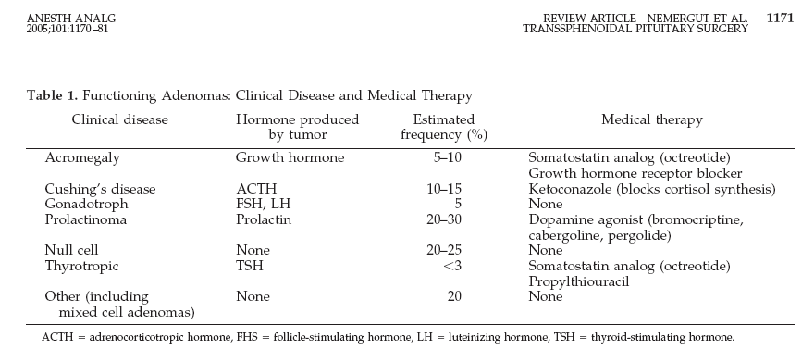
Evaluation of pituitary mass
Pituitary adenoma:
VS
Pituitary incidentaloma¹:
10 % of all pituitary lesions
Genetic-related:
MEN-1
Gs-alpha mutation
PTTG gene
FGF receptor-4
Not Important
1.5 -31% in autopsy (prevalence)
10% by MRI most of them <1 cm
To evaluate any patient we start in this order: CBA
Clinical
Biochemical
Anatomical.
Clinical² (History and Examination)
Function ( oversection or hyposecretion )
Mass ( headache, visual symptoms )
C
B
Biochemical
Screen Test
Confirmatory Test
A
Anatomical
MRI of sella turcica
Evaluation of pituitary lesion
Then treatment³:
Surgical – Medical – Radiation
Medical – Surgical – Radiation
Non-functional pituitary adenoma
C: Clinical | Asymptomatic, incidentaloma by imaging Mass-effect (mechanical pressure, hypopituitarism, visual ( bitemporal hemianopia) Gonadal hypersecretion
B: Biochemical | GH,LH,FSH,TSH,ACTH: not high PRL : low ,high, normal
A: Anatomical | MRI
Treatment | Surgery if indicated Observation Adjunctive therapy: - Radiation therapy - Dopamine agonist - Somatostatin analogue
1: In medical or research imaging, an incidental finding (commonly known as an "incidentaloma") is an unanticipated finding which is not related to the original diagnostic inquiry.
2: To assess the patient you should approach in 2 ways. First approach: ask about mass effect symptoms caused by the tumor (visual field defect, CSF rhinorrhea, headache, projectile vomiting) Second approach: assess the gland function by asking the patient about specific hormonal changes. E.g GH (excessive sweating, clothes size changes)
3: All adenomas are surgically removed EXCEPT prolactinoma, medically treated (Bromocriptine or Cabergoline)

Slide 6
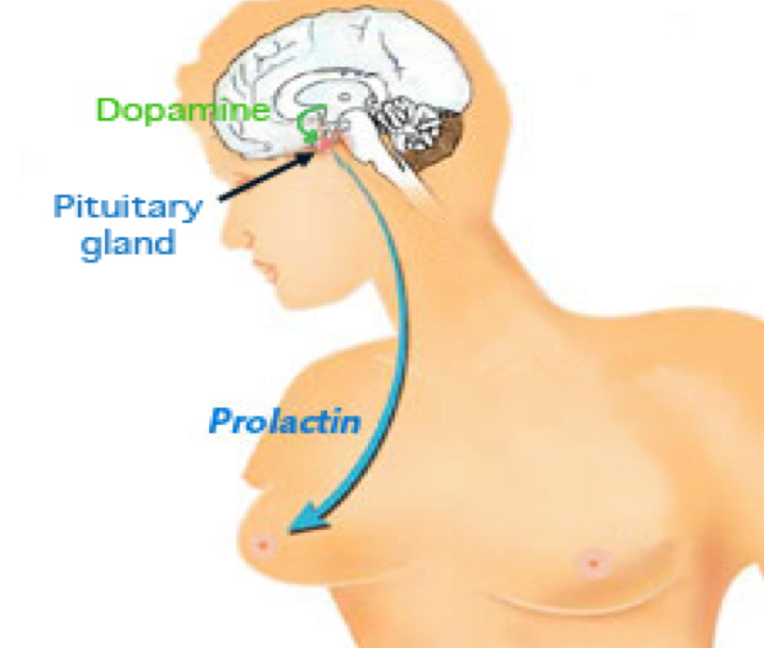
Functional pituitary mass
(Prolactinoma)
A- Prolactinoma
(High Prolactin + Mass)
Most common of functional pituitary adenoma, 25-30% of all pituitary adenoma.
Some growth hormone
(GH)–producing tumors also co-secrete PRL.
Prolactinomas in women:¹
90% present with microprolactinomas
Prolactinomas in men:¹
60% present with macroprolactinomas
What if prolactin was low?
No clinical significant if there is no mass invading the hypothalamus.
N.B.: PRL is the only pituitary hormone that is inhibited by hypothalamus.
C: Clinical | Oligomenorrhea, amenorrhea or infertility Galactorrhea Mass-effect ( mechanical pressure, hypopituitarism) Sexual dysfunction (in male) Asleep, stress, pregnancy, lactation and chest wall stimulation or trauma, Renal failure, Liver failure Medication O/E: Visual field defect ( Bitemporal hemianopia) Nipple discharge
B: Biochemical | GH,LH,FSH,TSH,ACTH: normal or low PRL : High TSH²: to rule out Primary Hypothyroidism IGF-1²: to rule out acromegaly with co-secretion of prolactin (in 15% of cases)
A: Anatomical | MRI
Treatment | Medical – Medical – Medical (Dopamine agonist e.g. Bromocriptine or Cabergoline)³ Surgical- Radiation (Second line)
1: The cause of difference between males and females in the size of the tumor (Macro & Micro) is that females usually present early, once they notice any changes in their menstrual cycle. While males tend to ignore the symptoms since they are not specific (fatigue, headache), they seek medical advice later.
2: Before you diagnose the patient with prolactinoma you should rule out Primary hypothyroidism and acromegaly by measuring TSH & IGF-1 respectively.
In case of primary hypothyroidism there will be low T3&T4 and high TSH(due to high TRH). Note that TRH can cause prolactin secretion as well not only TSH.
3: in prolactinomas always start with medical treatment (NOT SURGICAL) even if there is mass effect (Eg. visual field defect)

Slide 7
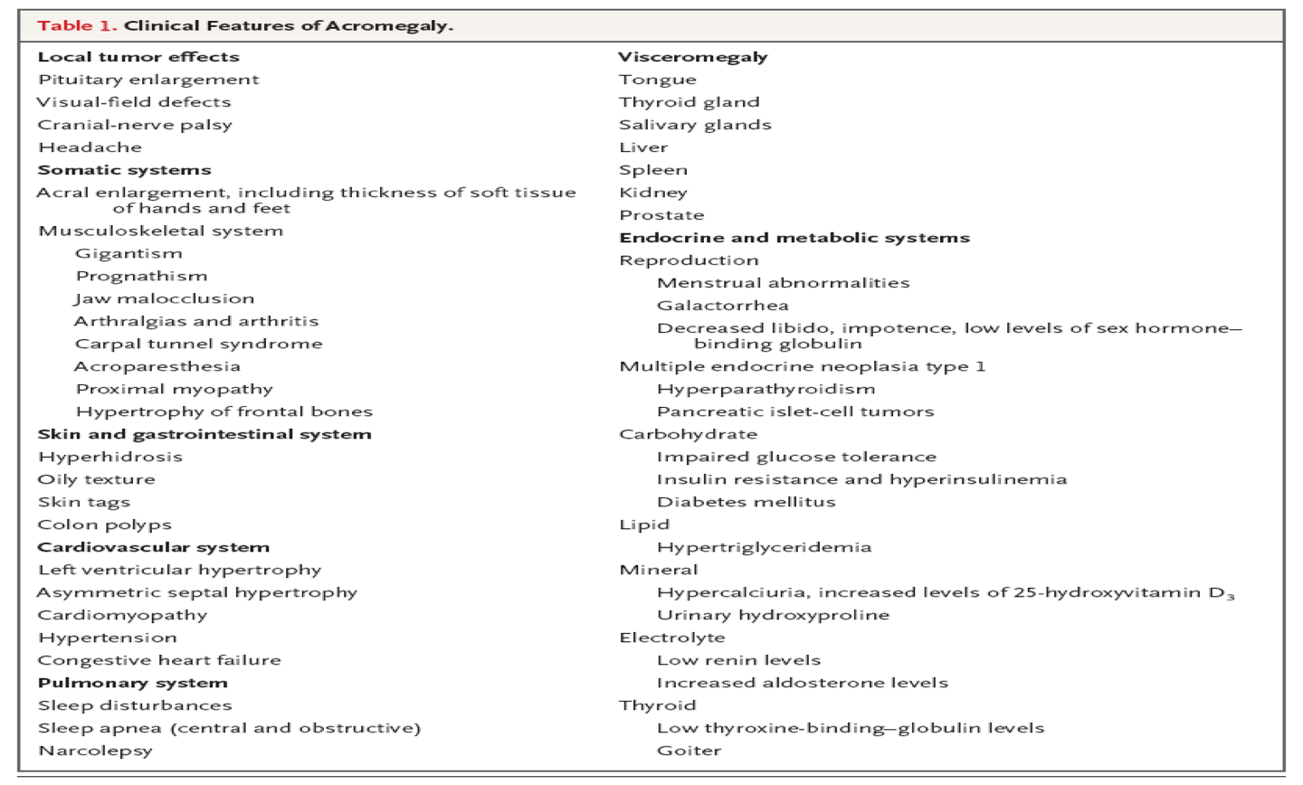
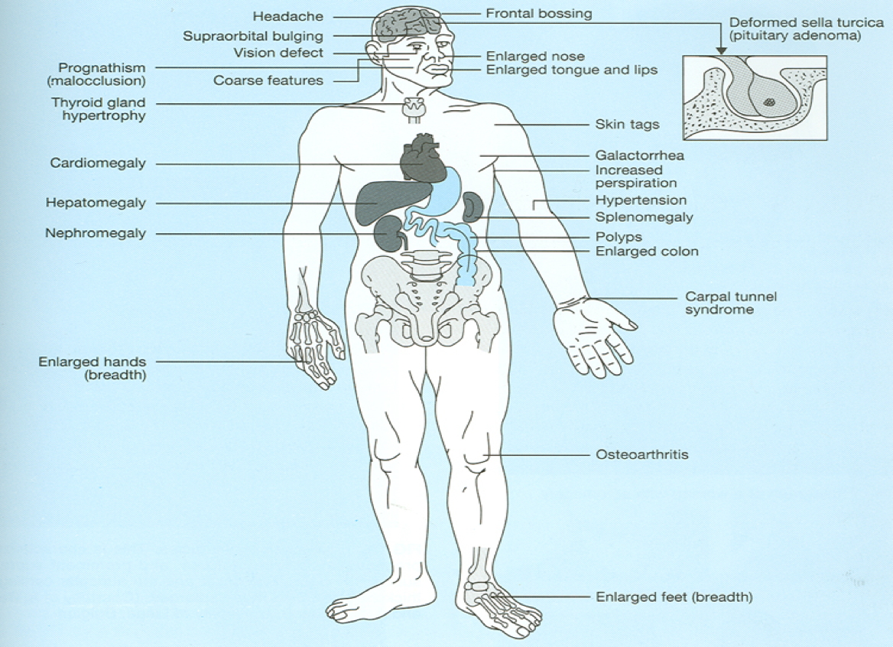
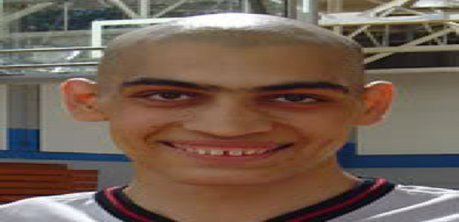
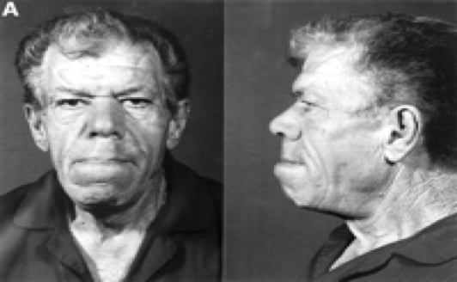
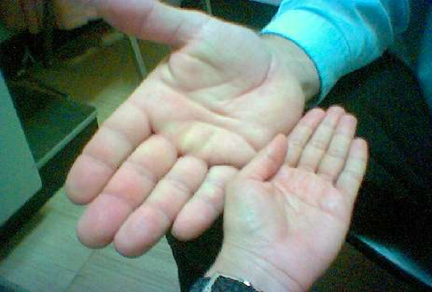
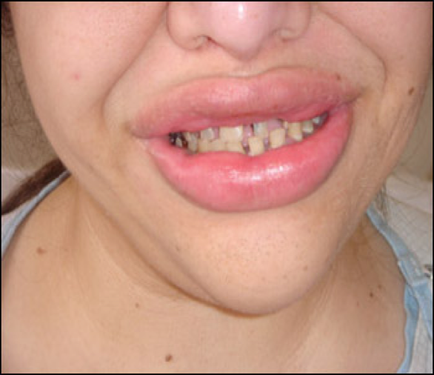
Functional pituitary mass cont.
(Acromegaly)
Definition: Acromegaly is a hormonal disorder that results from too much growth hormone (GH) in the body.
C: Clinical¹ | Function: Sweating, Enlargement (acral, face gross features, heart, tongue Jaw, gigantism in children) , Galactorrhea Mass-effect ( mechanical pressure, hypopituitarism) HTN,CHF, OSA,constipation O/E: Visual field defect ( Bitemporal hemianopia) Gross features of Acromegaly
B: Biochemical | Pituitary Function (LH,FSH.PRL, TSH, ACTH, cortisol, testosterone, T4) Screen: IGF-1 (will be high) Confirmatory Test : 75 g OGTT(Oral glucose tolerance test)² tolerance test for GH suppression Fasting and random blood sugar, HbA1c Lipid profile
A: Anatomical | MRI Echo: Cardiac disease is a major cause of morbidity and mortality 50 % died before age of 50 HTN in 40%, LVH in 50%, Diastolic dysfunction as an early sign of cardiomyopathy
Treatment | Surgical – Medical (Somatostatin analogue)- Radiation
- Growth usually stops after 3 year from puberty
1: They have high risk for IHD because the have large heart.
2: Doctors can't simply test for the level of growth hormone (GH) in your body because the level varies so much in one day—even in someone without acromegaly. In someone without acromegaly, a higher blood glucose level usually causes the body to stop producing GH (suppress it). Therefore, a doctor will purposely raise your blood glucose level using an OGTT and watch how your GH level responds. If your GH level doesn't drop to below 1 ng/mL during the OGTT, you have acromegaly.

Slide 8
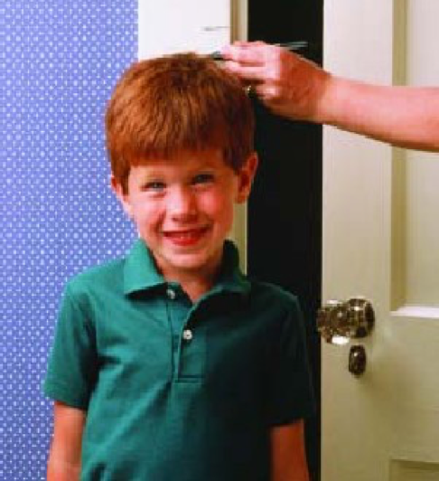
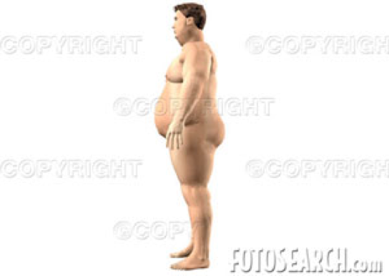
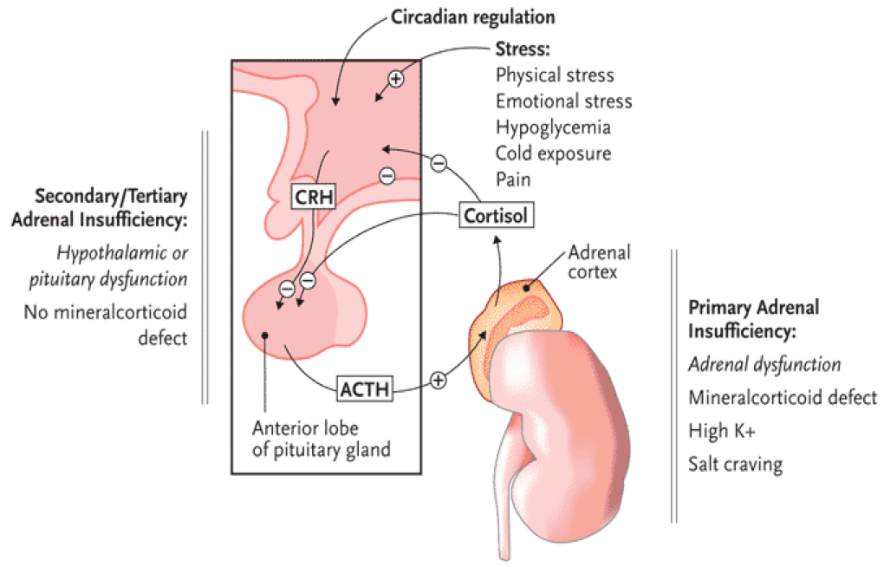
GH deficiency
Definition: rare disorder characterized by the inadequate secretion of growth hormone(GH) from the anterior pituitary gland.
Characteristics
Isolated, panhypopituitarism
Pituitary tumor as mass effect → Growth hormone deficiency
Diagnosis in children and adult
Disease in:
Children: Short stature
Adult: metabolic syndrome, weight gain and social isolation.
C: Clinical | Function : Short stature Mass-effect ( mechanical pressure, hypopituitarism)
B: Biochemical¹ | Pituitary Function (LH,FSH.PRL, TSH, ACTH, cortisol, testesterone, T4) Screen: IGF-1 Dynamic testing: clonidine stimulation test glucagon stimulation exercise testing,arginine-GHRH insulin tolerance testing
A: Anatomical | X-ray of hands: delayed bone age MRI
Treatment | GH replacement
ACTH disorders Introduction
ACTH disorders
High Cortisol
Low cortisol
ACTH adenoma → Cushing’s disease
Hypoadrenalism
1: If you want to measure the growth hormone in a Short statured patient, you should stimulate GH secretion by making him make him hypoglycemic(by giving him insulin) then measure the GH. If GH is stimulated that means he is normal. If not that confirms the diagnosis of GH deficiency .

Slide 9
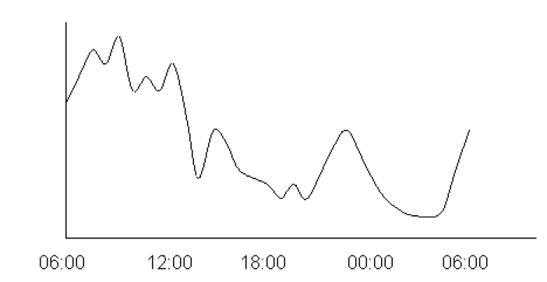
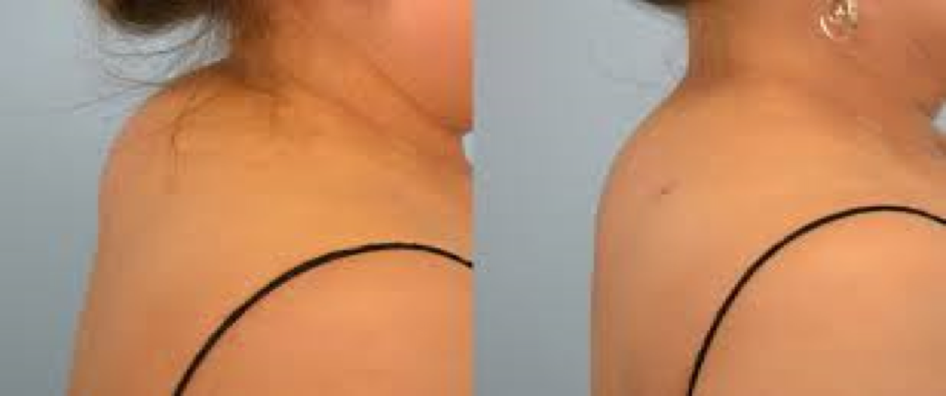
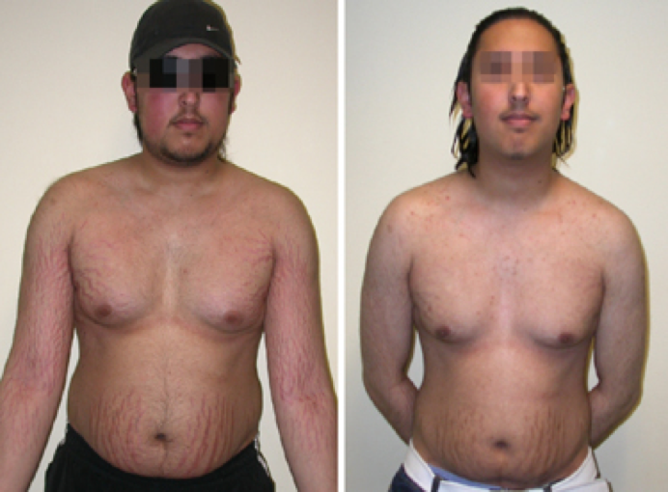
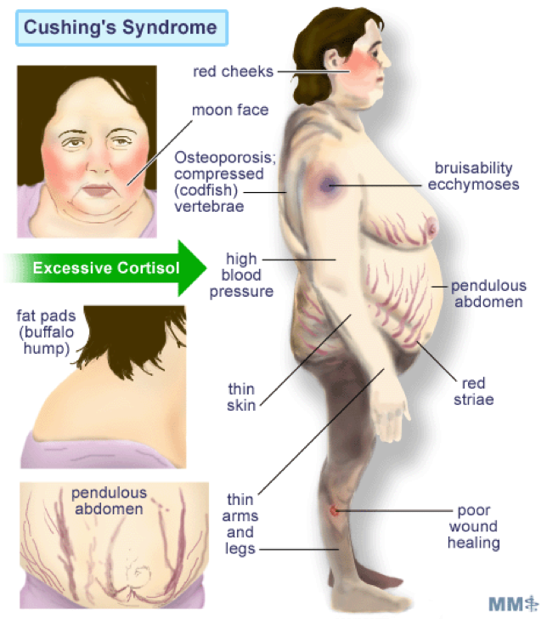
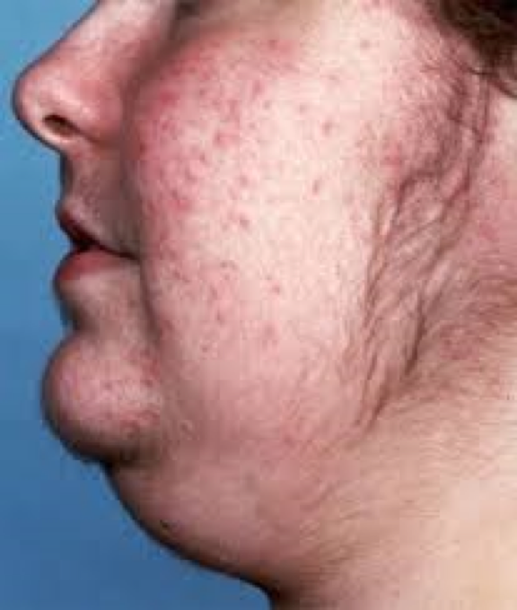
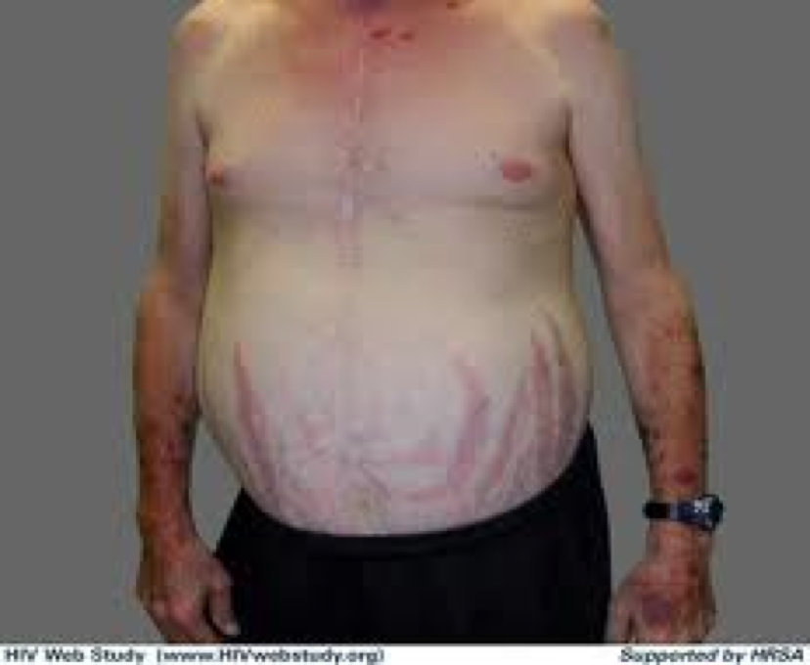
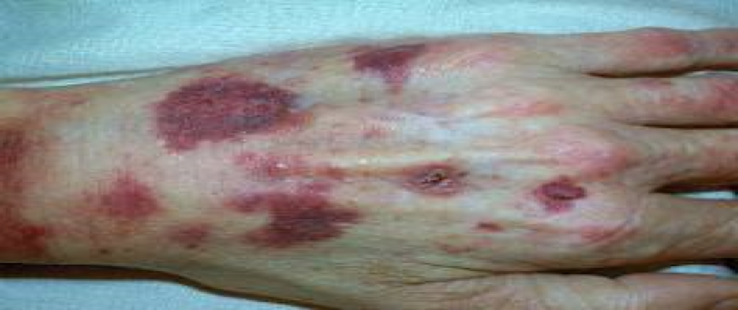
Functional pituitary mass cont.
(ACTH disorders)
HPA-axis:
Circadian rhythm of cortisol secretion.
Early morning cortisol between 8-9am (Highest).
lowest at midnight.
Excessive cortisol:
(ACTH adenoma → Cushing disease)
buffalo hump
Complications: Not Important
80 % HTN
Left ventricular hypertrophy
Diastolic dysfunction, interventricular septal hypertrophy
ECG needed: high QRS voltage, inverted T-wave
Echocardiogram pre-op
OSA: 33% mild, 18% severe. Needs respiratory assessment and careful use of sedative during surgery
Glucose intolerance in 60%, control of hyperglycemia
Osteoporosis with vertebral fracture→→ positioning of patient in OR ( 50 %), 20 % with fracture
thin skin→→ difficult IV cannulation, poor wound healing
C: Clinical | Function : Hirsutism, acne, easily bur, DM,HTN, irregular period, proximal weakness, recurrent infections, depression O/E: hirsutism, acne, moon face, central obesity, stria, proximal weakness, supraclavicular fat pad (buffalo hump),
B: Biochemical | Screening test: High cortisol , high ACTH Confirmatory tests: 24hrs for urine free cortisol (UFC)¹ 1MG DST Midnight salivary cortisol¹
A: Anatomical | MRI
Treatment | Surgical – Medical - Radiation
Hirsutism in women
Stria(purple, wide >1cm)
ecchymosis
1: If high this indicates Cushing disease.
Difference between cushing disease and syndrome: Cushing disease is caused by a pituitary gland tumor (usually benign) that over-secretes the hormone ACTH, thus over stimulating the adrenal glands' cortisol production. Cushing syndrome refers to the signs and symptoms associated with excess cortisol in the body, regardless of the cause, could be due to corticosteroid medications.

Slide 10
Low cortisol (Hypoadrenalism)
Clinical features | 1- Nausea, Vomiting, abdominal pain, Diarrhea. 2- Dizziness and weakness, Tiredness, Muscle ache. 3- Hypotension and Weight loss. 4- Very dark skin¹
Management | Cortisol replacement
Gonadotroph adenoma Not Important
Gonadotroph adenoma VS menopause & ovarian failure
High serum alpha subunit
A
B
High FSH
Low LH
D
C
High:
Estradiol
FSH
Thickened endometrium and polycystic ovaries
Gonadotroph adenoma:
Surgical resection if large
Radiation therapy
Assessment of pituitary function
Baseline: TSH, FT4, FT3, LH, FSH, Prolactin, GH, IGFI,Testosterone, Estradiol MRI brain Neuropthalmic evaluation of visual field Cardiac and respiratory assessment Anesthesiologist for airway and perioperative monitoring | Neurosurgeon ENT for Endonasal evaluation for surgical approach Preop hormonal replacement: all pituitary adenoma should be covered with stress dose of HC
1: Hyperpigmentation occurs because MSH(Melanocyte stimulating hormone) and ACTH share the same precursor molecule(POMC). POMC is cleaved into ACTH, gamma-MSH and beta-lipotropin. The subunit ACTH undergoes further cleavage to produce alpha-MSH, the most important MSH for skin pigmentation.

Slide 11
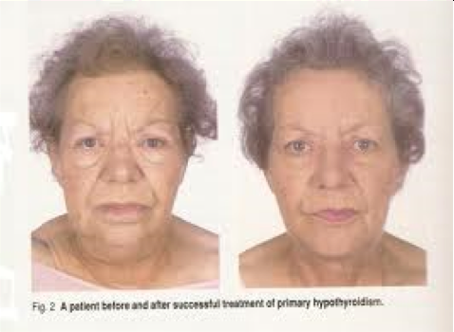
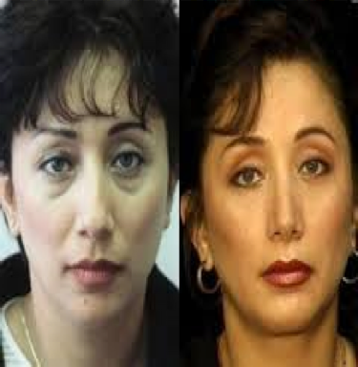
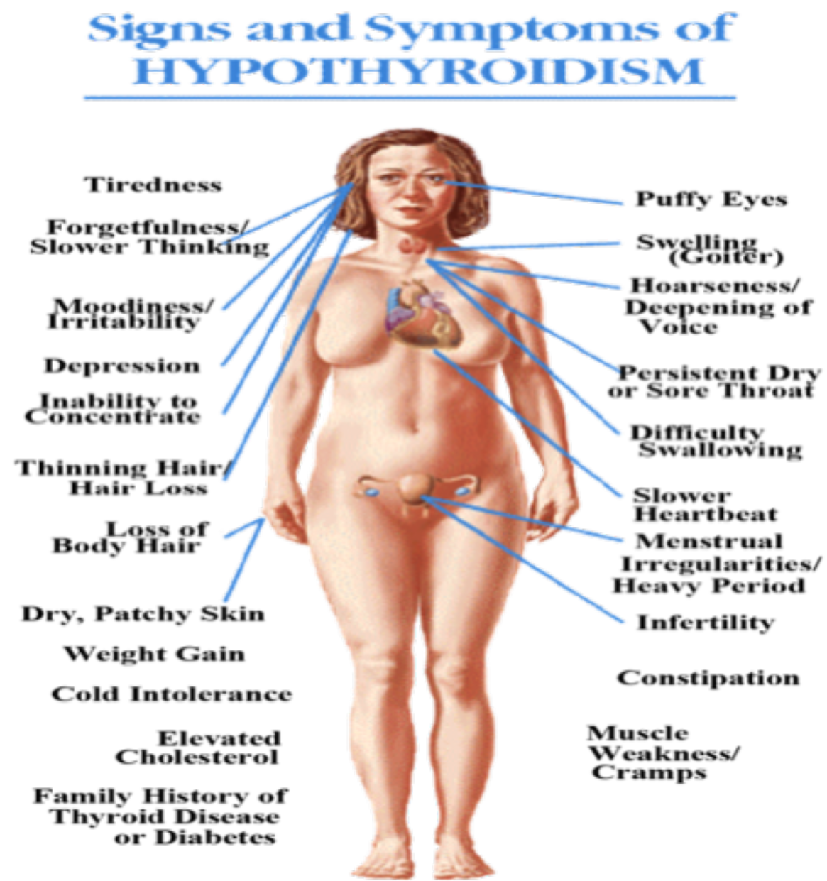
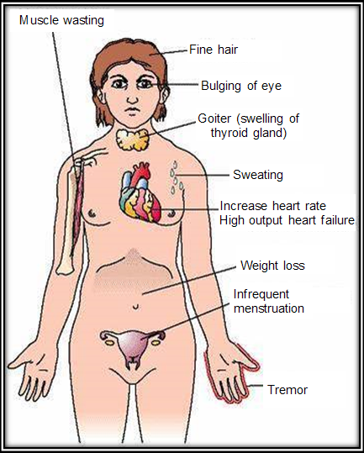
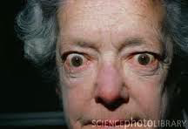
Central¹ Hypothyroidism
Definition: Central hypothyroidism refers to thyroid hormone deficiency due to a disorder of the pituitary, hypothalamus, or hypothalamic-pituitary portal circulation, resulting in diminished thyroid-stimulating hormone (TSH), thyrotropin-releasing hormone (TRH), or both.
C: Clinical | Function : fatigue, weight gain, irregular menses, dry skin, depression, cold intolerance, increase sleep, slow thinking O/E: obesity, Depressed face, eye brow.
B: Biochemical | Low T4 , Low TSH
A: Anatomical | MRI
Treatment | Thyroxine replacement Surgical removal of pituitary adenoma if large
TSH-Producing adenoma (Hyperthyroidism)
Definition: TSH-secreting pituitary adenomas are benign tumours of the pituitary gland. They produce too much thyroid stimulating hormone (TSH), which causes the thyroid gland to enlarge and produce thyroid hormone in excess, leading to an overactive thyroid (hyperthyroidism).
1
2
Signs of hyperthyroidism
Very rare < 2.8%
3
High TSH, FT4, FT3
4
Treatment preoperative
with anti-thyroid meds
5
Surgical resection of adenoma
6
Medical therapy: Somatostatin Analogue
1- What’s the difference between central hypothyroidism and primary hypothyroidism? Central hypothyroidism is due to disease in the pituitary gland while Primary hypothyroidism is due to disease in the thyroid gland. so we can conclude that both will have low T3,T4 but only central hypothyroidism will have low TSH.

Slide 12
QUIZ!
1) A 35-year-old woman complains of nipple discharge and irregular menses of 5 months duration. Physical examination reveals a milky discharge from both nipples. MRI shows an enlargement of the anterior pituitary. Which of the following is the most likely histologic diagnosis of this patient’s pituitary tumor?
(A) Adenoma (B) Choristoma
(C) Hamartoma (D) Papilloma
2) A 50-year-old woman presents with a 2-year history of upper truncal obesity and depression. Serum levels of glucose and cortisol are elevated. A CT scan of the abdomen reveals a 2-cm suprarenal mass. The surgical specimen is shown in the image. If this neoplasm is benign, which of the following is the most appropriate diagnosis?
(A) Prolactinoma (B) Hypothyroidism
(C) Adrenal Adenoma (D) Hyperthyroidism
3) A 40-year-old woman notices that her gloves from the previous winter no longer fit her hands. Her friends remark that her facial features have changed in the past year, and that her voice seems deeper. On physical examination, she is afebrile. Her blood pressure is 140/90 mm Hg. She has coarse facial features. There is decreased sensation to pinprick over the palms in the distribution of her thumb and first two fingers. A radiograph of the foot shows an increased amount of soft tissue beneath the calcaneus. A chest radiograph shows cardiomegaly. Laboratory studies indicate a fasting serum glucose level of 138 mg/dL and hemoglobin A 1c level of 8.6%. Which of the following additional test results is most likely to indicate the cause of these physical and laboratory findings?
(A) Elevated serum prolactin level (B) Failure of growth hormone suppression
(C) Increased serum cortisol level (D) Increased serum TSH level
4) A previously healthy 30-year-old woman visits her physician complaining of a racing heart, sweating, weight loss, and tremulousness. She appears anxious, and on further questioning reports that her anxiety and restlessness have begun to cause problems at her workplace. Physical examination reveals
tachycardia, moist skin, fine body hair, and bilateral bulging of her eyes.
(A) Gonadotroph adenoma (B) Hypothyroidism
(C) ACTH Adenoma (D) Hyperthyroidism
5) A 62-year-old man with a long history of alcoholism presents to the emergency department with steatorrhea and abdominal pain. CT of the abdomen is shown in the image. The intern on duty recalls learning about a drug indicated for acromegaly that may also reduce the secretion of pancreatic fluids and possibly decrease the patient’s pain. The drug works by mimicking the levels of which hormone?
(A) Secretin (B) Gastrin
(C) Cholecystokinin (D) Somatostatin
Answers
1. A, 2. C, 3. B, 4. D, 5. D

Slide 13
Team Leaders
Abdulrahman Bedaiwi & Jude Alotaibi
Team Members
Alhanouf Alhaluli
Ajeed Alrashoud
Jehad Alorainy
Mashal Abaalkhail
Mohannad Alqarni
Rahaf Alshabri
Rakan Alfaifi
Rawan Alzayed
Rema Almutawa
Thank you!
Give us your feedback!

