Slide 1
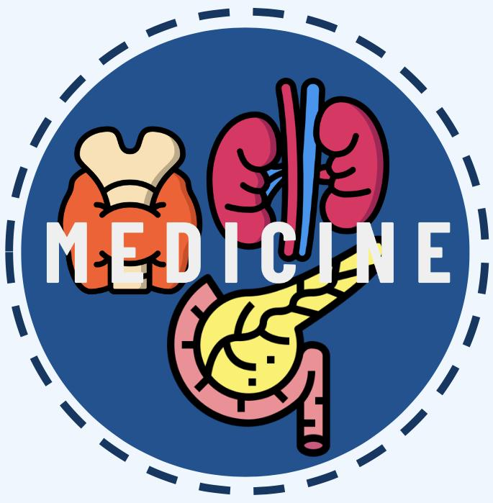
INTRODUCTION TO OSTEOPOROSIS
Editing file
Lecture Objectives:
Understanding the:
Definition of osteoporosis.
Causes of osteoporosis.
Impact of osteoporosis.
Diagnosis of osteoporosis.
Treatment of osteoporosis.
Important
Original content
Only in girls slides
Only in boys slides
Doctor’s notes

Slide 2
Introduction
Bone has three major functions:
Provide rigid support to extremities and body cavities containing vital organs.
Provide efficient levers and sites of attachment of muscles which are all crucial to locomotion.
Provide a large reservoir of ions such as calcium, phosphorus, magnesium and sodium which are critical for life and can be mobilized when the external environment fails to provide them.
Types of Bone
Cortical Bone | Trabecular Bone
The compact bone of Haversian systems such as in the shaft of long bones. | The lattice – like network of bone found in the vertebrae and the ends of long bones.
The difference pattern of bone loss affecting trabecular and cortical bone results in two different fracture syndrome.
Disorders in which cortical bone is scanty or defective lead to:
2
Disorders in which trabecular bone is scanty or defective lead to:
1
Fractures of long bones.
Vertebral fractures and may also help in fractures of long bones because of the loss of reinforcement.

Slide 3
Bone is resorbed and formed continuously throughout life and these important processes are dependent upon three major types of bone cells:
Osteoblasts
Osteocytes
Osteoclasts¹
-The bone forming cells which are actively involved in the synthesis of the matrix component of bone (primarily collagen) and probably facilitate the movement of minerals ions between extracellular fluids and bone surfaces.
-They are believed to act as a cellular syncytium that permits translocation of mineral in and out of regions of bone removed from surfaces as well as signaling between cells.
-The bone resorption cells.
Osteoporosis
“ The Silent Thief ”
Definition
↓ in bone mass and strength associated with an ↑ tendency to fractures.
(1 in 3 women and 1 in 5 men over 50 will experience osteoporosis fracture).
Clinical Features
It is usually an asymptomatic disease until fractures occur.
The first manifestation of reduced bone mass is usually a wrist fracture or a vertebral crush fracture caused by a small amount of force which produces severe localized pain.
Subsequent vertebral fractures may contribute to chronic back pain.
In well established osteoporosis dorsal Kyphosis and loss of height occurs.
Hip fractures with its fatal complications also occur commonly as osteoporosis become more severe.
A lethal complication of osteoporosis is “Pulmonary Embolism” due to hospital immobilization.
1: In any injury such as tiny fractures, osteoclasts re-absorb the injury and fill in the gaps.

Slide 4
Primary Osteoporosis
Type 1 Osteoporosis (Post Menopausal) | Type 2 Osteoporosis (Senile)
Fractures of bones composed mainly of trabecular bone. Example: Distal radius - Colle’s fracture Vertebra - Crush and wedge fractures. Usually affects woman within 15 years of menopause. | Fractures of bones composed of both cortical & trabecular bone. Example: Hip Femur neck fracture Usually affects individual over age of 70 years.
 | Type 1 | Type 2
Age | 51 : 75 | > 70
Sex ratio (F:M) | 6:1 | 2:1
Type of bone loss | Mainly trabecular | Trabecular & Cortical
Rate of bone loss | Accelerated | Not accelerated
Fracture sites | Vertebrae (Crush) & distal radius | Vertebrae (Multiple wedge), hip, pelvis, proximal humerus
Parathyroid Hormone | Decreased | Increased
Calcium absorption | Decreased | Decreased
Metabolism of 25(OH)2D to 1,25(OH)2d | Secondary Decreased | Primary Decreased
Main cause | Factors related to menopause | Factors related to aging
Not imp

Slide 5
Osteoporosis Cont.
Secondary Factors associated with decreased bone density
Medical conditions | Premature menopause.
 | Hypogonadism in men.²
 | Liver disease.
 | Hyperthyroidism.
 | Hyperparathyroidism.
 | Hemiplegia.
 | Chronic obstructive lung disease.
Drug therapy | Glucocorticoids ¹
 | Anticonvulsants: Phenytoin, Phenobarbitone.
Nutrition | Low calcium & Vitamin D intake.
 | High phosphorus (carbonated drinks), protein, sodium, caffeine intake.
Behavioral factors | Smoking & Alcohol abuse.
Imp
Laboratory and radiological findings
Bone profile ,ALP and PTH are within normal in patients with osteoporosis due to sex hormones deficiency and aging.
X-rays of skeleton do not show a decrease in osseous density until at least 30% of bone mass has been lost.
Age related bone loss particularly trabecular bone in the spine begins in women before menopause.
1: By having an Anti-Vit D effects.
2: Treatment is restoration of hormone levels.

Slide 6
Osteoporosis Cont.
Normal
Midcrush vertebral fractures
Last stage
Not imp
X-ray of spine show prominent trabeculae and prominent end plates of the vertebral bodies.
Cod fish appearance indicates protrusion of the disk into the body of the vertebrae secondary to mechanical failure.
X-ray of the upper part of the femur may also be helpful in assessing reduced bone mass and calculating the risk for hip fracture.

Slide 7
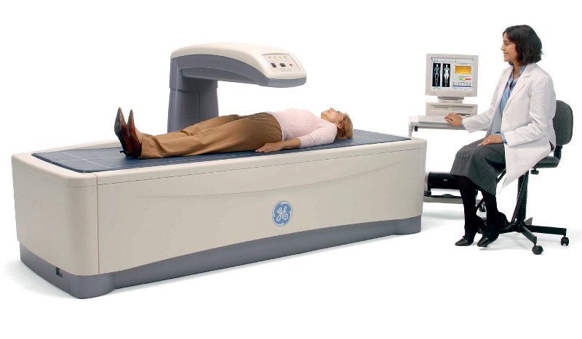
Osteoporosis Cont.
Methods for bone mass assessment
Single-Photon absorptiometry-SPA
Dual-Photon absorptiometry-DPA
Computed Tomography-CT
Dual-Energy X-ray Absorptiometry-DEXA/DXA
Current gold standard for diagnosis of osteoporosis.
Diagnosis based on comparing patient’s BMD to that of young, healthy individuals of same sex.
They measure bone mass by the ability of the tissue to absorb the photons emitted from the radionuclide source or the X-ray tube.
It is appropriate to begin to look for risk factors that predispose a person to osteoporosis and develop a rational prevention program tailored to person’s risk before the menopause.
High risk groups (in the presence of one or more of such risk factors measurement of BMD provides further information to the risk of fractures):
Women with thin light frame.
History of low calcium intake.
Decreased physical activity.
High alcohol or caffeine consumption.
Smoking.
Family history of osteoporosis.
History of prior menstrual disturbances.
History of drugs like antiepileptics or steroids.
Strategy for management of osteoporosis
Prevent Osteoporosis.
Detect and treat early to decrease further progression.
Limit disability and provide rehabilitation.

Slide 8
NOT important according to the female’s doctor
Treatment
Adolescent group (peak bone mass attainment)¹
A calcium intake of 1200 mg/day is recommended.
Adequate (direct) sun exposure or vit D supplementation to ensure adequate level.
A reasonable exercise program is recommended.
Premenopausal female (maintenance of bone mass)
Adequate calcium intake; 1000-1500 mgm/day (too much can lead to nephrocalcinosis).
Adequate (direct) sun exposure or vit D supplementation.
A reasonable exercise program is recommended.
Avoidance of osteopenia-producing conditions/medications/lifestyle:
1. Smoking , excessive caffeine/protein intake.
2. Amenorrhea/oligomenorrhea.
3. Cortisone, excessive thyroid hormone replacement, loop diuretics, prolonged heparin exposure.
4. Low estrogen & testosterone.
Immediately Postmenopausal Female (Prevention of bone mass loss)
Consideration of Hormone replacement therapy (conjugated equine estrogen (CEE) or its equivalent, 0.625 mg daily or cycled, or transdermal estrogen by patch 0.05-0.1 mg/day daily or cycled).
If intact uterus, consideration of medroxyprogesterone 5-10 mg daily or cycled.
Other modalities of therapy
Bisphosphonates².
SERMS (Selective estrogen receptor modulators e.g., Evista).
Anabolic Hormones³ e.g. PTH.
1: The age of peak bone mass is 25-30
2: Mostly given for Type II osteoporosis (senile), Alendronate is the most commonly used in KSA at 70mg/week.
3: Must not be given beyond two years because it may cause osteosarcoma.

Slide 9
NOT important according to the female’s doctor
Treatment
The elderly (>62) postmenopausal female with low bone mass but no compression fractures (Prevention of bone mass loss & restoration of bone mass previously lost)
Adequate calcium intake; 1000-1500 mgm/day (too much can lead to nephrocalcinosis).
A reasonable exercise program with physical therapy instruction in paraspinous muscle group strengthening exercise.
Avoidance of osteopenia-producing conditions/medications/lifestyle:
1. Smoking , excessive caffeine/protein intake.
2. Amenorrhea/oligomenorrhea.
3. Cortisone, excessive thyroid hormone replacement, loop diuretics, prolonged heparin exposure.
Adequate supplementation with vitamin D.
Consideration of Hormone replacement therapy.
Other modalities of therapy
Bisphosphonates.
SERMS (Selective estrogen receptor modulators e.g. Evista).
Anabolic Hormones¹ e.g. PTH.
The elderly (age>62) postmenopausal female with fragility fractures (Prevention of further fractures)
Adequate calcium intake; 1000-1500 mgm/day (too much can lead to nephrocalcinosis).
A careful exercise program with physical therapy instructions
Consideration of short-term back bracing (non-rigid brace)
Avoidance of osteopenia-producing conditions/medications/lifestyle:
1. Smoking , excessive caffeine/protein intake.
2. Cortisone, excessive thyroid hormone replacement , loop diuretics, prolonged heparin exposure.
1: Must not be given beyond two years because it may cause osteosarcoma.

Slide 10
NOT important according to the female’s doctor
Treatment
Adequate supplementation with vitamin D.
Consideration of Hormone replacement therapy.
Other modalities of therapy:
1. Bisphosphonates.
2. SERMS (Selective estrogen receptor modulators e.g. Evista).
3. Anabolic Hormones¹ e.g. PTH.
The male with low bone mass and/or fractures (Prevention of bone mass loss & restoration of bone mass previously lost; prevention of further fractures )
A program of reasonable calcium intake (1000-1500 mg daily) (too much can lead to nephrocalcinosis), exercise, short term back bracing and avoidance of osteopenia-producing situation is indicated.
Consideration of testosterone therapy if total and free testosterone levels are low.
1. Prostate concerns.
2. Cholesterol concerns.
Other modalities of therapy:
1. Bisphosphonates.
2. Anabolic Hormones¹ e.g. PTH.
1: Must not be given beyond two years because it may cause osteosarcoma.

Slide 11
NOT important according to the female’s doctor
Treatment
The male or female with corticosteroid induced osteopenia
(Prevention of bone mass loss & restoration of bone mass previously lost)
Bone mass measurement if possible to identify bone mass loss.
Lowest possible dose of corticosteroids.
A program of reasonable calcium intake (1000-1500 mg), (too much can lead to nephrocalcinosis), exercise, & avoidance of other osteopenia- producing situations is indicated.
Adequate supplementation with vitamin D.
Other modalities of therapy:
-Estrogen (Females), Testosterone (males), Bisphosphonates, PTH.
The amenorrheic female (Exercise induced amenorrhea, eating disorders,etc) (Prevention of bone loss)
General measures; decrease exercise if appropriate, regain body weight, adequate calcium intake (1000- 1500 mg/day) and avoidance of other osteopenia- producing situations.
Regain menses .
Other modalities of therapy:
1. Estrogen replacement.
2. Bisphosphonates .

Slide 12
QUIZ!
1) What are the cells that are believed to act as cellular syncytium that permits translocation of minerals in and out of regions of bone removed from surfaces as well as signaling between cells?
(A) osteoblasts (B) osteocytes
(C) osteoclasts (D) osteogenic
2) The first manifestation of reduced bone mass is?
(A) chronic back pain (B) dorsal kyphosis
(C) hip fractures (D) wrist fracture
3) If a 50 y/o (not senile) male came with osteoporosis what is the most likely cause of it?
(A) smoking (B) not enough Calcium intake
(C) hypogonadism (D) osteogenic
4) Fractures of bones composed of both cortical and trabecular is which type of osteoporosis?
(A) type 2 (B) type 3
(C) type 4 (D) type 1
Answers
1. B, 2. D, 3. C, 4. A

Slide 13
Team Leaders
Abdulrahman Bedaiwi & Jude Alotaibi
Team Members
Alhanouf Alhaluli
Ajeed Alrashoud
Jehad Alorainy
Mashal Abaalkhail
Mohannad Alqarni
Rahaf Alshabri
Rakan Alfaifi
Rawan Alzayed
Rema Almutawa
Thank you!
Give us your feedback!

