Slide 1
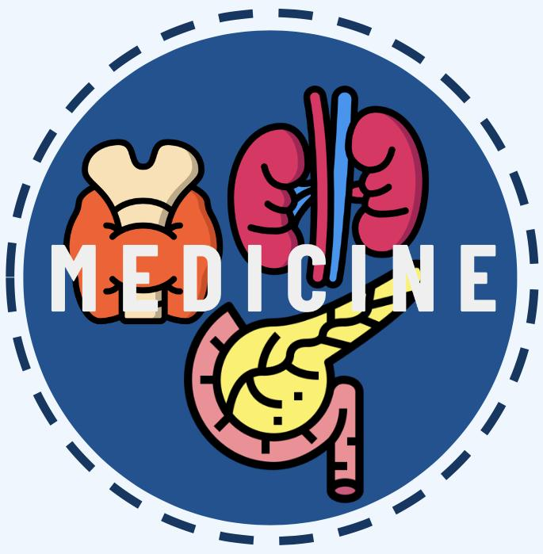
EPIDEMIOLOGY OF OBESITY
Editing file
Lecture Objectives:
To understand the magnitude of obesity worldwide and nationally
To define obesity.
To list the risk factors for obesity.
To list complication of obesity.
To learn the different treatment modalities for obesity.
To apply prevention measures for obesity, starting with the level of your community.
Important
Original content
Only in girls slides
Only in boys slides
Doctor’s notes

Slide 2
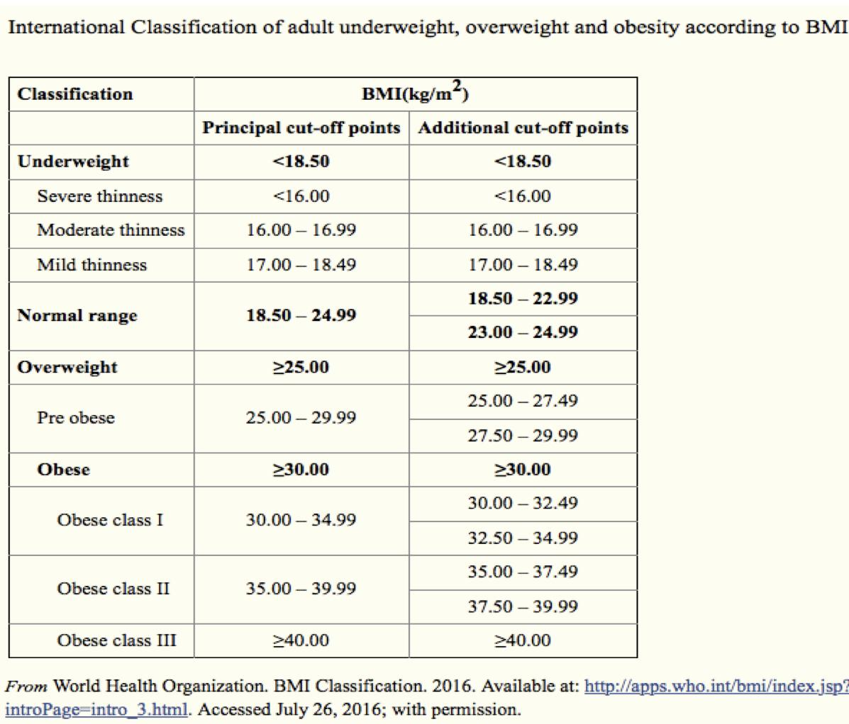
Definition of obesity & classification
Defining obesity:
“a condition of abnormal and excessive fat accumulation in adipose tissue to the extent that health may be adversely affected”.
“Overweight and obesity are defined as abnormal or excessive fat accumulation that may impair health.”
Adults
BMI ≥ 30.0 is obese
25.0-29.9 is overweight
18.5-24.9 is normal
< 18.5 is underweight
Children/Adolescent
• Sex/age-specific BMI
BMI ≥ 95th percentile is obese.
85th to less than 95th percentile is overweight.
Subdivision of obesity
Grade 1 obesity | BMI 30.0-34.9
Grade 2 obesity | BMI 35.0-39.9
Grade 3 obesity | BMI 40.0+ (extreme obesity)
Classification of child obesity (according to male’s slides)
In U.S : obesity weight greater than or equal to the 95th percentile.
International Obesity Taskforce
0-5 | 5-19
Overweight: 2 standard deviation (SD) Above median BMI | overweight: 1 SD above median BMI
Obese: 3 SD above median BMI | Obese: 2 SD above median BMI
Classification of obesity (Adults)

Slide 3
Primary Screening Measure for obesity
Body Mass Index (BMI) = weight(kg) / height(m)2 (according to female slide)
1
Calculated from a person's weight and height.
Other Ways of estimating obesity:
Look
Scale
Waist circumference
2
Reliable indicator of body fatness for most people.
3
Inexpensive & easy-to-perform screening for weight
categories that may lead to health problems.
4
Does not measure body fat directly.
BMI indicators provide a measure of body mass/weight rather than providing a direct measure of body fat. Whilst physicians continue to use BMI as a general indicator of weight-related health risks, there are some cases where its use should be considered more carefully: (according to male slide)
Muscle mass can increase body weight; this means athletes or individuals with a high muscle mass percentage can be deemed overweight on the BMI scale, even if they have a low or healthy body fat percentage.
Muscle and bone density tends to decline as we get older; this means that an older individual may have a higher percentage body fat than A younger individual with the same BMI.
Women tend to have a higher body fat percentage than men for a given BMI.
Global Burden
Overweight + obesity were estimated to cause 3.4 million deaths worldwide in 2010
Accounted for 3.9% of years of life lost
Accounted for 3.8% of DALYs Associated with reduction of life expectancy by 5-10 years

Slide 4
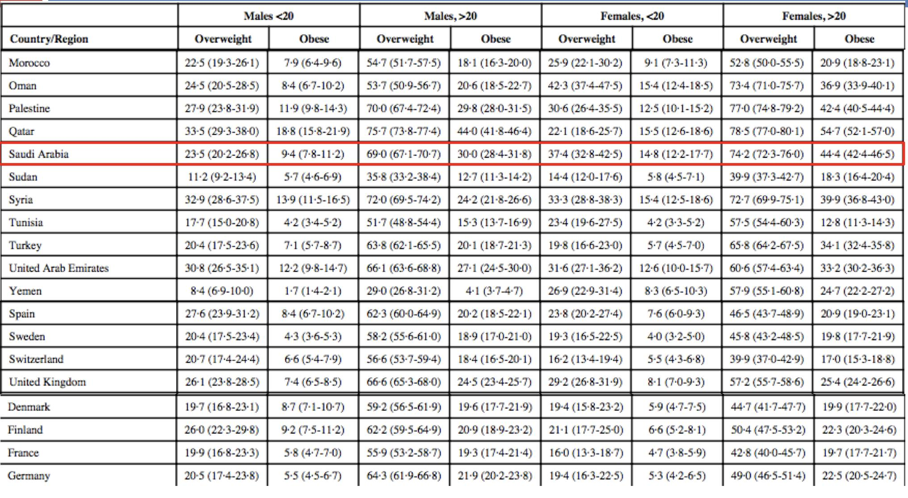
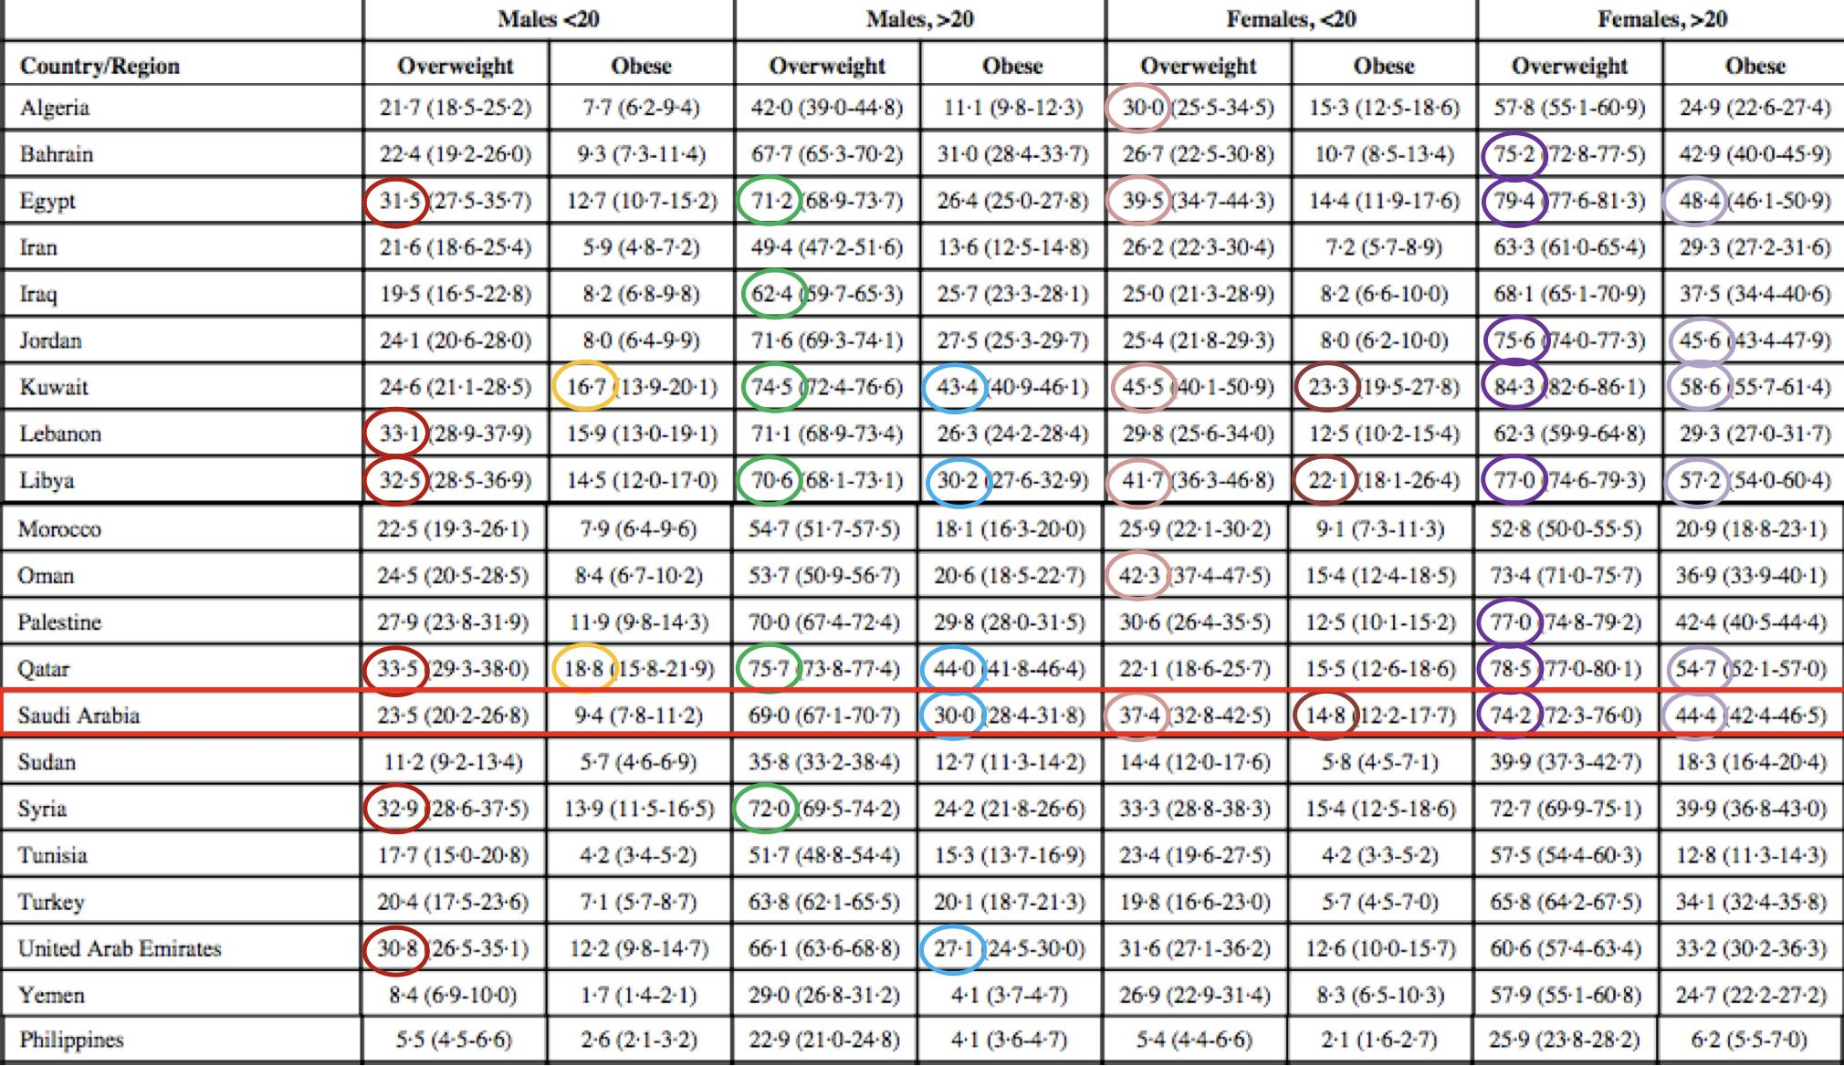
Obesity as disease
“recognize obesity as a disease state with multiple pathophysiological aspects requiring a range of interventions to advance obesity treatment and prevention.” - American Medical Association
Incidence of obesity:
No official measures of Saudi obesity incidence currently
Would require accurately identifying the population at risk (non-obese) at a given time, as well as new cases
Potential for prospective cohort studies
Obesity is associated with increase in
All-cause mortality
CVD-related mortality
Cancer related mortality
Comparing Estimates across countries 2013

Slide 5
Attributes associated with obesity
1
Race/ethnicity
2
Age
Sex
3
4
Income
5
Education
4
Geography & culture
Race/ethnicity
Adults | Children/Adolescents
47% Hispanic 46.8% non-Hispanic black 37.9% non-Hispanic white 12.7% non-Hispanic Asian | 25.8% Hispanic 22% non-Hispanic black 14.1% non-Hispanic white 11% non-Hispanic Asian
The assumption that race reflects only biological distinctions is inaccurate. Suggestion from WHO Western Pacific Region that BMI cutoffs may need to be lower for some Asian populations due to increased risk for poor health outcomes
Age
Adults (20+) | Children/Adolescents
42.8% ages 40-59 41% ages 60+ 39.6% ages 20-39 | 20.6% ages 12-19 18.4% ages 6-11 13.9% ages 2-5*

Slide 6
Attributes associated with obesity
1
Race/ethnicity
2
Age
Sex
3
4
Income
5
Education
4
Geography & culture
Income
Higher incomes associated with decreased risk of obesity in women, but increased risk in non- Hispanic black men and Mexican-American men Being at or below the poverty line is associated with higher rates of obesity among children 9 of 10 states with the highest obesity rates are among the poorest
Education
Women with college degrees have lower risk of obesity compared to those with less education. Generally, obesity rates are lower for children if the head of household has college degree versus not finishing high school.
Geography & culture
Higher prevalence of obesity in rural areas States with highest rates of obesity also have lowest physical activity rates for adults. Unhealthy food and physical activity environments Limited food access, availability, affordability.

Slide 7
Pathophysiology of Obesity
Change in adipose tissue
↑ Fatty acids
Proinflammatory factors
Infiltration of immune cells
Insulin resistance
Chronic low-grade inflammation
Dyslipidemia
Atherosclerosis
Cardiovascular disease
Stroke
Venous thromboembolism
Risk Factors for Obesity
Genetic
Environmental
Risk Factors
Hormonal
Behavioral

Slide 8
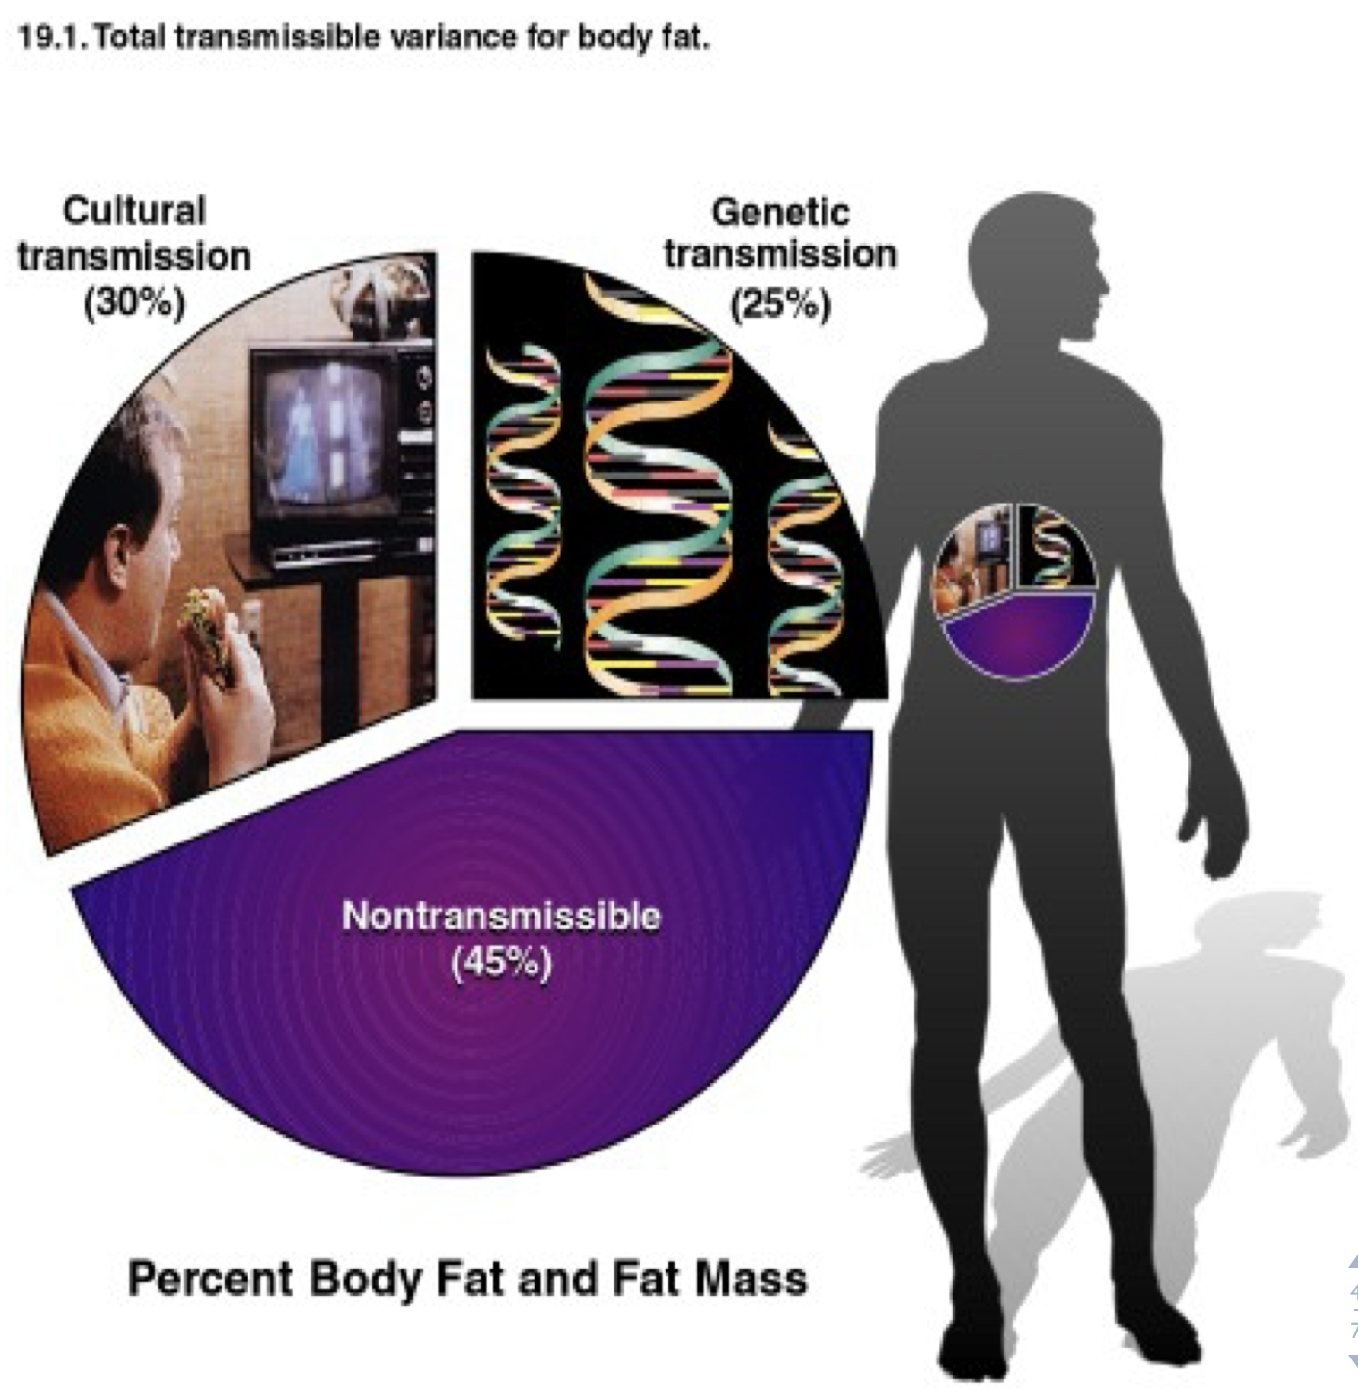
Genetic Risk Factors for Obesity
1
Parents who are obese (family history)
2
Genetic Disorders:
Trisomy 21 (Down’s Syndrome)
Prader-Willi Syndrome
Albright’s hereditary osteodystrophy
Leptin deficiency
Leptin receptor mutations
Melanocortin 4 receptor disorders
Cushing’s disease
Polycystic ovary syndrome
3
Potential gene variants affecting hunger or metabolism, interacting with environmental influences
How much variation in
weight gain among individuals can be accounted for by genetic factors?
Genetic plays a role
Largest transmissible variation is cultural
Hormonal Risk Factors for Obesity
1
Hypothyroidism
2
GH deficiency
3
Cushing syndrome
4
Hypothalamic obesity
5
Polycystic ovary syndrome (PCO)
6
Hyperprolactinemia

Slide 9
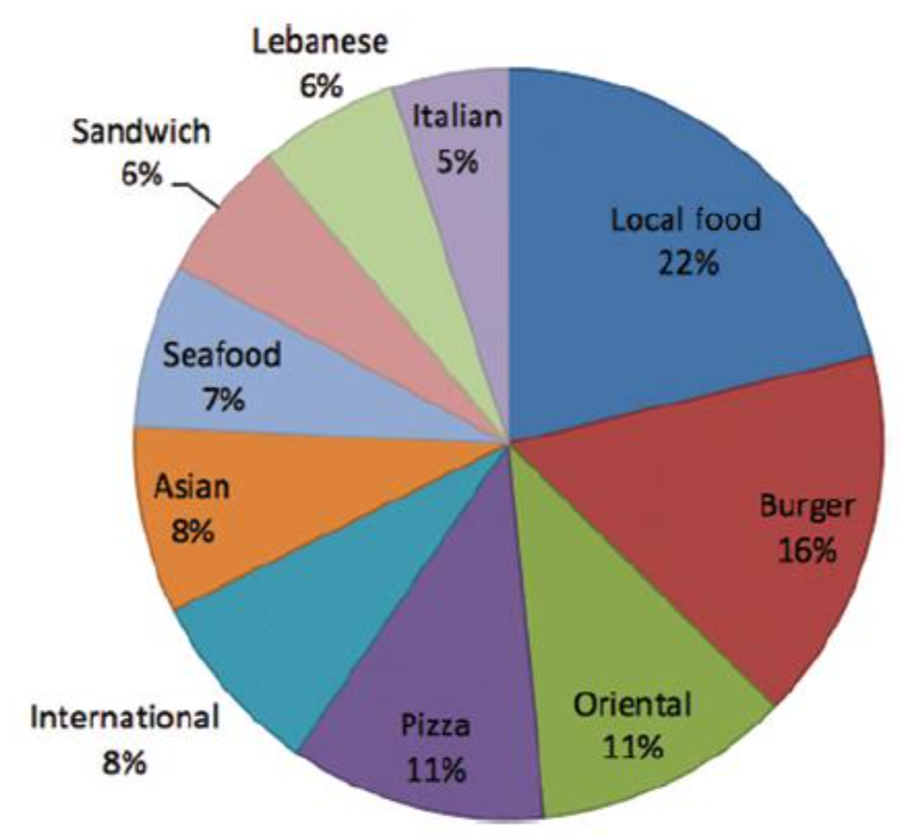
Environmental/Societal
Risk Factors for Obesity
1
Low income
2
Parents’ bad habits for
food and physical activity
3
Food desert (Difficulty accessing places with healthy food options)
4
Top Ten restaurant types searched on phone-apps in 2013
Living far away from parks
5
Dangerous neighborhoods
6
Food insecurity (no sufficient
quantity of affordable healthy food)
Behavioral Risk Factors for Obesity
1
Nutrition and diet
2
Physical activity
3
Sleep
4
Stress
Diets high in calories, added sugars, fast food
Average daily calorie intake for adults: 2,234
Only 19% of Americans meet minimum guidelines
Adverse behavior
Low physical activity
Saudi Arabia is one of the countries with low physical activity
Sedentary activity
Television or other media
Increased exposure to food/beverage marketing
Over 7.5 hours daily for older children/adolescents

Slide 10
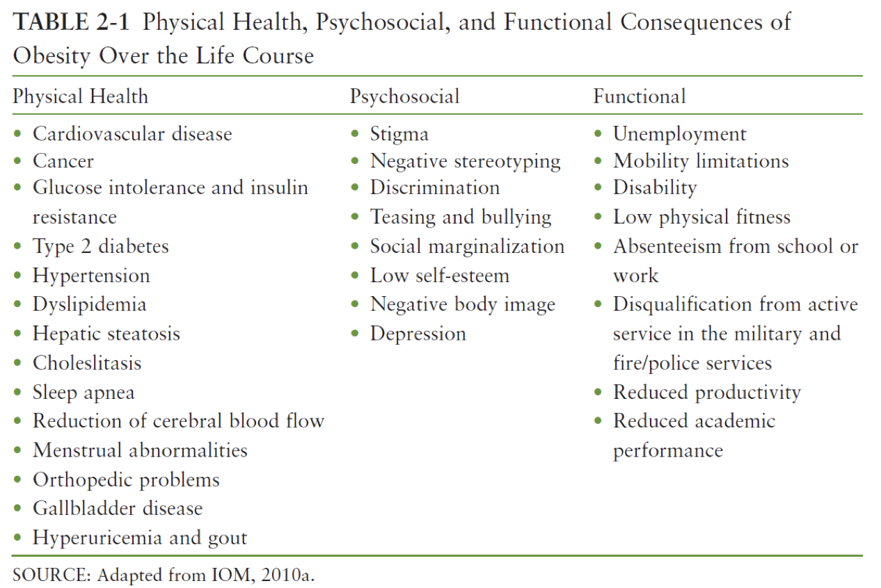
Other risk factors
Extreme birth weight (low or high)
Not being breastfed
Disabilities
Maternal smoking
Medications (steroids, antidepressants)
Morbidity/Mortality
Effects on population health
“I would argue that [obesity] is the most significant public health challenge we face at this time, both because of the huge number of people it affects and because of the ripple effects it has and will have on the development of debilitating and costly chronic diseases.”
- Daniel R. Glickman, Chair, Institute of Medicine’s Committee on Accelerating Progress in Obesity Prevention, 2012
Morbidity associated with obesity
Type 2 Diabetes Mellitus
Cardiovascular Disease
Stroke
Hypertension
Nonalcoholic fatty liver disease
Osteoarthritis
Some cancers
Morbidity from childhood obesity
Preschoolers who are overweight or obese are 5 times as likely to be overweight or obese as adults
Obesity is a long term process.
Obesity frequently begins in childhood.
Obese parents likely have overweight children.
Regardless of final body weight as adults, overweight children exhibit more illnesses as adults than normal kids.

Slide 11
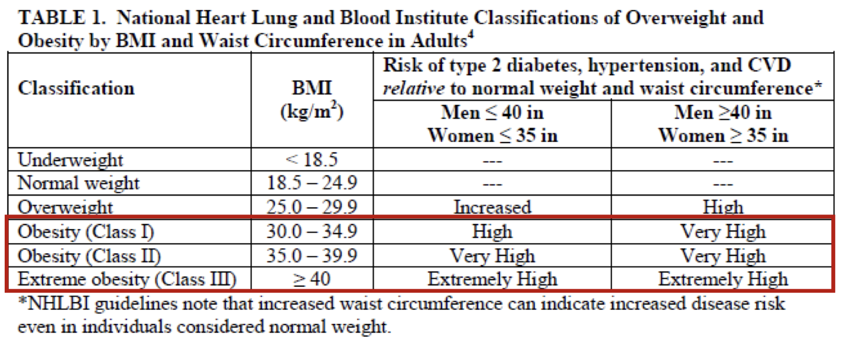
Mortality
More deaths globally associated with obesity/overweight than underweight (2.8 million/year)
Screening
Limitations and Recommendations
Body Mass Index
BMI was first used in 1835 as a way to estimate the proportion of body fat based on height and weight
BMI has low sensitivity, especially below 30
Cannot discern fat vs. muscle content or metabolic risk factors
Validity?
At the same BMI, women tend to have more body fat than men.
At the same BMI, older people, on average, tend to have more body fat than younger adults.
Highly trained athletes may have a high BMI because of increased muscularity rather than increased body fatness.
BMI + waist circumference
Additional limitations
Self-report of height & weight in surveys

Slide 12
Costs
Financial impacts on the healthcare system
Medical care costs increasing over time mostly due to rise in obesity prevalence
Socioeconomic costs also related to disability and premature death
$147 billion in health care costs in 2008 (10% of all medical spending)
Increases in spending from 1998-2006
8.5% ($34.3 billion) Medicare
11.8% ($27.6 billion) Medicaid
12.9% ($74.6 billion) Commercial insurance
Interventions
Primary, secondary, tertiary, community-level
Primary prevention
Preventing obesity before it occurs
Regulating caloric energy balance to prevent problematic weight gain
Diet
Physical activity
Environmental factors
Address barriers to a healthy diet
Address barriers to a healthy diet
Access to healthy food
Food advertising
Large portion sizes
Affordability of healthy food
Time constraints
Established behaviors
Zoning
Safety
Areas conductive to physical activity
Time constraints
Established behaviors
Physical activity guidelines
Policy options
2.5 hours/week for adults
1 hour/day for children/adolescents
Physical activity tends to decline as children get older
Tax unhealthy foods/beverages
Calorie labeling in food service facilities
Food purchasing standards for hospitals/schools

Slide 13
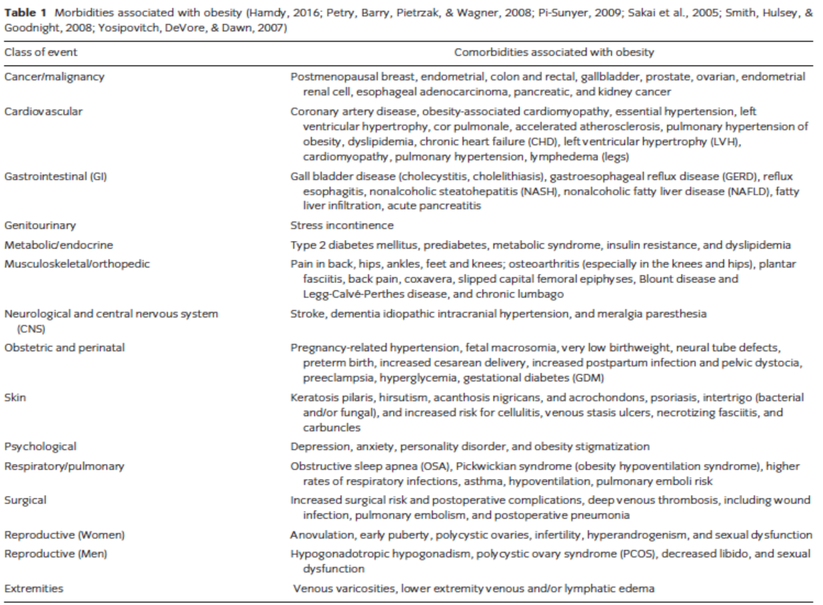
Secondary prevention
Recognize overweight or obese individuals early through screening in order to improve outcomes
Weight loss interventions
Challenges with sustaining weight loss over time
Reduce risk factors associated with obesity
Secondary screening for potential comorbidities
Need to understand different causes and responses to obesity in order to better target treatments
Tertiary prevention
Management of severe obesity to reduce complications
Behavioral modifications
Bariatric surgery
Type 2 diabetes, other comorbidities
Medications, if shown to be effective
Consequences of Obesity in Adults
Consequences of Obesity in Children
T2 Diabetes Mellitus Early onset metabolic syndrome Asthma Poor dental health Non-alcoholic fatty liver disease Gastroesophageal Reflux Disease (GERD) | Puberty (delay in boys, advance in girls) Hyperandrogenism, PCOS Poor self-esteem Attention Deficit Hyperactivity Disorder (ADHD) Sleep problems

Slide 14
Important Strategies For Maintaining Weight Reduction
1
Changing lifestyle
2
Set realistic goals
Modify food intake
Increase physical activity
Exercise 1 hour daily
Weigh weekly
Watch < 10 hours TV / week
Use a weight-loss program
5% - 15% of initial weight
3
4
Maintaining a food diary
Continuous support
5
Prepare the suitable environment
Prepare the suitable environment
Organized family meal times
Meal prepping (plan what you eat ahead of time)
Treatment of Obesity
Tertiary prevention
Behavioral modification
Bariatric surgery
Treatment of underlying cause (if hormonal causes)

Slide 15
Prevention of Obesity
In children
VS
In adult
Preventing Obesity in Children
Early stage prevention:
During infancy:
Maternal gestational weight control
Dietary intake (self-regulation of breastfeeding ↓ risk, early introduction of solid food ↑ risk)
Broad spectrum antibiotics (↑ risk)
During pre-school:
School and adolescents:
Response to child temperament
Dietary habits
Reducing screen time
Physical activity
Peer habits
Educational interventions in schools
Secondary Prevention Measures
Obesity in Children
Screening for obesity by primary care provider
Provide guidance on nutrition and physical activity
Provide counseling

Slide 16
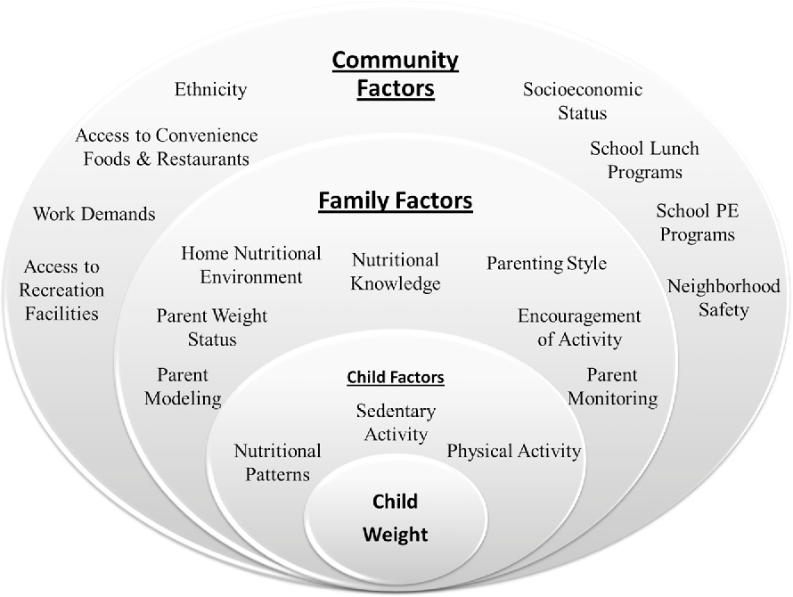
Prevention of Childhood Obesity at Community Level
Provide services for obesity prevention and treatment (BMI screening, well-visits)
1
2
Promote healthy food and beverages and physical activity at schools
01
02
6
3
Funding research for childhood obesity
06
03
Maintain safe neighborhoods
5
4
Availability of healthy food resources in all communities
05
04
Encourage going to parks and physical activity (especially summer vacation)
Tackling factors affecting childhood obesity

Slide 17
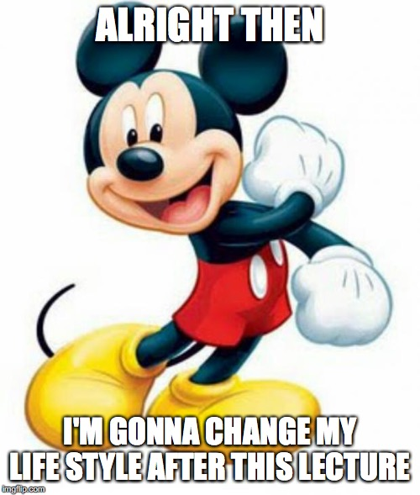
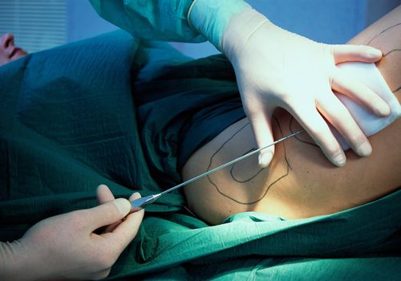
Preventing obesity in adults
Educate and promote healthy lifestyle
Promote social and environmental situation that prevents weight gain
Involve different stakeholders in combating this epidemic
Develop population-based policies that target:
barriers for healthy food and physical activity
Influence positive eating and physical activity behavior
Provide weight screening services, weight control services
Summary
Obesity is affected by a complex interaction between the environment, genetic predisposition, & human behavior.
The problem of overweight and obesity is one of the most pressing global issue with massive health care cost.
It has increased risk of numerous chronic diseases, from diabetes and cancers to many digestive diseases.
Demands attention from the healthcare community, researchers, and policy makers.

Slide 18
QUIZ!
1) In children between 0-5 years old who are obese considered:
(A) 3SD above the median BMI (B) 2SD above the median BMI
(C) 1SD above the median BMI (D) 4SD above the median BMI
2) The BMI of an adult obese class 3:
(A) 25-29.9 (B) 30-34.9
(C) 35-39.9 (D) above or equal to 40
3) A risk factor for obesity:
(A) Genetic (B) Environmental
(C) Behavioral (D) All of them
4) Genetic disorder that cause obesity:
(A) Trisomy 21 (B) Stress
(C) PCO (D) All of them
5) Which of the following diseases has low risk factors?
(A) Type 1 Diabetes (B) Type 2 Diabetes
(C) Obesity (D) Cancer
6) All of the following statements about obesity are true except:
(A) It frequently begins during childhood.
(B) People with BMI between 25.0-29.9 are obese.
(C) Genetics play a role.
(D) It can be measured by various methods.
Answers
1-A 2-D 3-D 4-A 5-A 6-B

Slide 19
Team Leaders
Abdulrahman Bedaiwi & Jude Alotaibi
Team Members
Alhanouf Alhaluli
Ajeed Alrashoud
Jehad Alorainy
Mashal Abaalkhail
Mohannad Alqarni
Rahaf Alshabri
Rakan Alfaifi
Rawan Sulaiman
Rema Almutawa
Thank you!
Give us your feedback!

