Slide 1
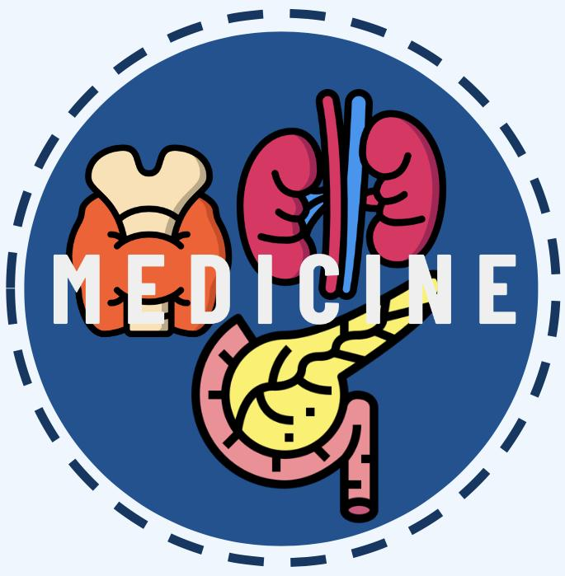
EPIDEMIOLOGY OF DIABETES MELLITUS
Editing file
Lecture Objectives:
To list the types of diabetes mellitus.
To describe the prevalence of diabetes mellitus.
To recognize the importance of diagnostic criteria for estimating the prevalence of diabetes mellitus.
To discuss the risk factors and complications of type II diabetes mellitus.
Important
Original content
Only in girls slides
Only in boys slides
Doctor’s notes

Slide 2
Diabetes Mellitus
Definition:
A metabolic disorder of multiple aetiology characterized by chronic hyperglycemia with disturbances of carbohydrate, fat and protein metabolism resulting from defects in insulin secretion, insulin action or both.
Main types of diabetes:
01
Type 1
02
Type 2
(5-10%) – due to autoimmune β-cell destruction, usually
leading to absolute insulin deficiency. Usually affects younger age group (not always).
(90 - 95%) – due to a progressive loss of β-cell insulin
secretion frequently on the background of insulin resistance.
Usually older age group (not always).
03
Gestational diabetes
04
Specific types of diabetes due to other causes
diabetes diagnosed in the second
or third trimester of pregnancy that was not clearly overt diabetes prior to gestation.
e.g., neonatal, maturity-onset diabetes of the young, diseases of the exocrine pancreas, drug- or chemical-induced diabetes.
Impaired glucose tolerance (IGT) and impaired fasting glycaemia (IFG) - intermediate conditions in the transition between normal blood glucose levels and diabetes (especially type 2).
Symptoms:
Increase frequency of Urine
Weight loss
Blurred vision
Easy fatigability
Slow healing wounds
Increase thirst
Increase appetite
Tingling hands and feet
Dry skin

Slide 3
Diabetes
Fasting plasma glucose 2-h plasma glucose HbA1c | ≥ 7.0 mmol/L (126 mg/dl) ≥ 11.1 mmol/L (200 mg/dl) ≥ 6.5%
Impaired glucose tolerance (IGT)
Fasting plasma glucose 2-h plasma glucose¹ | <7.0 mmol/L (126 mg/dl) and ≥ 7.8 and <11.1 mmol/L (140 mg/dl and 200 mg/dl)
Impaired fasting glucose (IFG)
Fasting plasma glucose 2-h plasma glucose¹ | 6.1 to 6.9 mmol/L (110 mg/dl to 125 mg/dl) and (if measured) <7.8 mmol/L (140 mg/dl)
Gestational diabetes (GDM)
One or more of the following: Fasting plasma glucose 1-h plasma glucose 2-h plasma glucose | 5.1–6.9 mmol/L (92–125 mg/dl) ≥ 10.0 mmol/L (180 mg/dl) 8.5–11.0 mmol/L (153–199 mg/dl)
Key facts :
The number of people with diabetes has risen from 108 million in 1980 to 422 million in 2014.
The global prevalence of diabetes² among adults over 18 years of age has risen from 4.7% in 1980 to 8.5% in 2014.
Diabetes prevalence has been rising more rapidly in middle- and low-income countries.
Diabetes is a major cause of blindness, kidney failure, heart attacks, stroke and lower limb amputation.
In 2015, an estimated 1.6 million deaths were directly caused by diabetes. Another 2.2 million deaths were attributable to high blood glucose in 2012³
Almost half of all deaths attributable to high blood glucose occur before the age of 70 years. WHO projects that diabetes will be the seventh leading cause of death in 2030.
Healthy diet, regular physical activity, maintaining a normal body weight and avoiding tobacco use are ways to prevent or delay the onset of type 2 diabetes.
Diabetes can be treated and its consequences avoided or delayed with diet, physical activity, medication and regular screening and treatment for complications.
1: Venous plasma glucose 2 hours after ingestion of 75 g oral glucose load.
2: Defined as FBG ≥ 7 mmol/L, or on medication for raised blood glucose, or with a history of diagnosis of diabetes.
3: High blood glucose is defined as a distribution of FBG in a population that is higher than the theoretical distribution that would minimize risks to health (derived from epidemiological studies). High blood glucose is a statistical concept, not a clinical or diagnostic category.

Slide 4
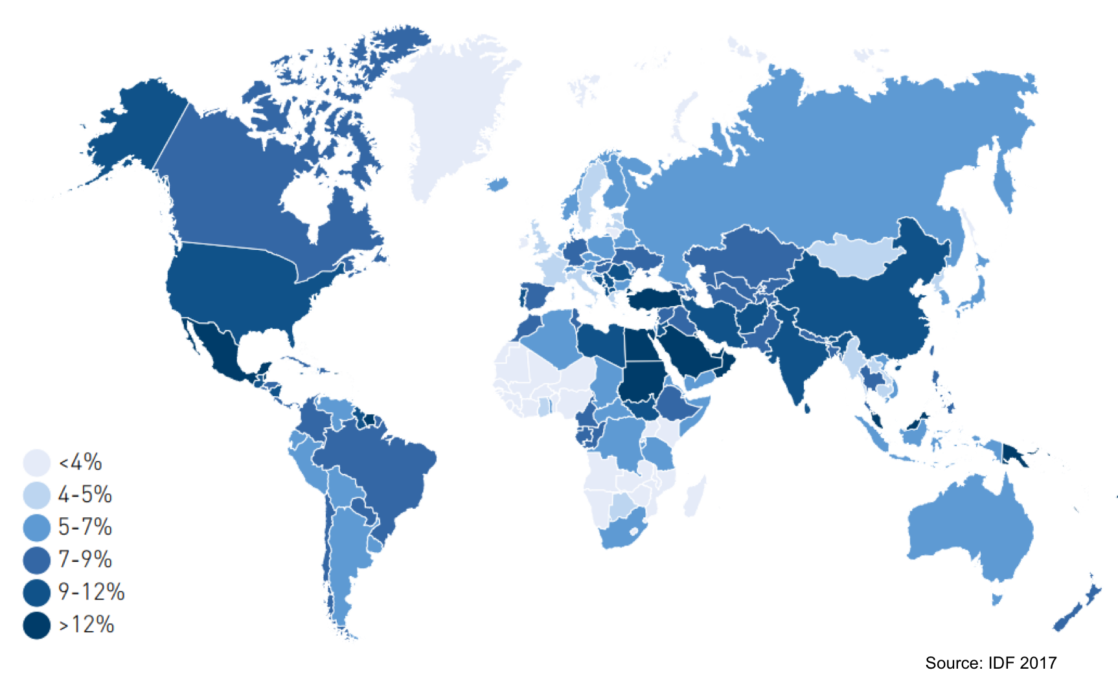
Regional and local prevalence
Estimated age-adjusted prevalence of diabetes in adults (20-79 years), 2017
Top 10 causes of death
Trends in age-standardized prevalence of diabetes in Saudi Arabia
Trends in prevalence of diabetes, 1980–2014, by WHO region¹
Trends in prevalence of diabetes, 1980–2014, by country income group
Percentage of all deaths attributable to high blood glucose for adults aged 20–69 years, by WHO region and sex, 2000 and 2012
Percentage of all-cause deaths globally attributed to high blood glucose in men, 2012
Percentage of all-cause deaths globally attributed to high blood glucose in women, 2012
1: Highest prevalence is in the eastern mediterranean region.

Slide 5
Regional and local prevalence
Rank | Country | % | Years
1 | Tuvalu | 27.25 | 2017
2 | Nauru | 24.07 | 2017
3 | New Caledonia | 23.36 | 2017
4 | Kiribati | 22.66 | 2017
5 | Mauritius | 22.02 | 2017
6 | Solomon Islands | 18.68 | 2017
7 | Saudi Arabia | 17.72 | 2017
8 | Papua New Guinea | 17.65 | 2017
9 | Egypt | 17.31 | 2017
10 | United Arab Emirates | 17.26 | 2017
WHO region | Both | Female | Male
African region | 111.3 | 110.9 | 111.1
Region of the americas | 72.6 | 63.9 | 82.8
Eastern Mediterranean region | 139.7 | 140.2 | 138.3
European region | 55.7 | 46.5 | 64.5
South-east Asia region | 115.3 | 101.8 | 129.1
Western pacific region | 67 | 65.8 | 67.8
Diabetes prevalence (% of population ages 20 to 79)
High blood glucose age-standardized mortality rates per 100000 by WHO region, age 20+, 2012
WHO region | Prevalence (%) |  | Numbers ( millions )
 | 1980 | 2014 | 1980 | 2014
African region | 3.1% | 7.1% | 4 | 25
Region of the americas | 5% | 8.3% | 18 | 62
Eastern Mediterranean region | 5.9% | 13.7% | 6 | 43
European region | 5.3% | 7.3% | 33 | 64
South-east Asia region | 4.1% | 8.6% | 17 | 96
Western pacific region | 4.4% | 8.4% | 29 | 131
Total | 4.7% | 8.5z | 108 | 422
Estimated prevalence and number of people with diabetes ( adults 18+ years)

Slide 6
Common Diabetes Complications
1
Loss of vision
2
End-stage renal disease
3
Cardiovascular events
4
Lower extremity amputations
Loss of vision
Cardiovascular events
Diabetic retinopathy caused 1.9% of moderate or severe visual impairment globally and 2.6% of blindness in 2010.
Studies suggest that prevalence of any retinopathy in persons with diabetes is 35% while proliferative (vision-threatening) retinopathy is 7%.
However, retinopathy rates are higher among people with type 1 diabetes ,people with longer duration of diabetes ,Caucasian populations and possibly among people of lower socioeconomic status.
Adults with diabetes historically have 2-3 times higher rate of cardiovascular disease (CVD) than adults without diabetes.
The risk of cardiovascular disease increases continuously with rising fasting plasma glucose levels, even before reaching levels sufficient for a diabetes diagnosis.
Almost 7 in 10 people with diabetes over age 65 will die of some type of heart disease. About 1 in 6 will die of stroke.
End-stage renal disease
Lower extremity amputations
Pooled data from 54 countries show that at least 80% of cases of end-stage renal disease (ESRD) are caused by diabetes, hypertension or a combination of the two.
The proportion of ESRD attributable to diabetes alone ranges from 12–55%.
The incidence of ESRD is up to 10 times as high in adults with diabetes as those without.
Diabetes appears to dramatically increase the risk of lower extremity amputation because of infected, non-healing foot ulcers.
Rates of amputation in populations with diagnosed diabetes are typically 10 to 20 times those of non-diabetic populations.
Encouragingly several studies show a 40% to 60% reduction in rates of amputations among adults with diabetes during the past 10–15 years in western countries.

Slide 7
Risk Factors
Genetic factors | May play a part in development of all types Autoimmune disease and viral infections may be risk factors in Type I diabetes. Twin studies
Family history | Compared with individuals without a family history of type 2 diabetes, individuals with a family history in any first degree relative have a two to three-fold increased risk of developing diabetes. The risk of type 2 diabetes is higher (five- to six fold) in those with both a maternal and paternal history of type 2 diabetes. The risk is likely mediated through genetic, anthropometric (body mass index, waist circumference), and lifestyle (diet,physical activity, smoking) factors.
Obesity | Contributes to the resistance to endogenous insulin. The risk of impaired glucose tolerance (IGT) or type 2 diabetes rises with increasing body weight. The Nurses’ Health Study demonstrated an approximately 100-fold increased risk of incident diabetes over 14 years in nurses whose baseline body mass index was >35 kg/m2 compared with those with BMI <22 . The risk of diabetes associated with body weight appears to be modified by age. Obesity acts at least in part by inducing resistance to insulin-mediated peripheral glucose uptake, which is an important component of type 2 diabetes.
Fat distribution | The distribution of excess adipose tissue is another important determinant of the risk of insulin resistance and type 2 diabetes. The incidence of type 2 diabetes are highest in those subjects with central or abdominal obesity, as measured by waist circumference or waist-to-hip circumference ratio. Intra-abdominal (visceral) fat rather than subcutaneous or retroperitoneal fat appears to be of primary importance.
Physical inactivity | Prolonged TV watching is associated with a significantly increased risk of type 2 diabetes. Men who watched TV more than 40 h per week had a nearly threefold increase in the risk of type 2 diabetes compared with those who spent less than 1 h per week watching TV.

Slide 8
Risk Factors Cont.
Diet | A number of dietary factors have been linked to an increased risk of type 1 diabetes, such as low vitamin D consumption; early exposure to cow's milk or cow's milk formula; or exposure to cereals before 4 months of age.However, none of these factors has been shown to cause type 1 diabetes. Consumption of red meat, processed meat, and sugar sweetened beverages is associated with an increased risk of diabetes. Fruits, vegetables, nuts, whole grains, and olive oil is associated with a reduced risk. It is important to recognize that most studies have used food frequency questionnaires to capture dietary patterns and that none of the food stuffs examined can be considered in isolation. For example, higher meat intake always means more saturated fat intake, relatively lower fruit and vegetable intake, and frequently, higher BMI (body mass index).
Smoking | Several large prospective studies have raised the possibility that cigarette smoking increases the risk of type 2 diabetes. In a meta-analysis of 25 prospective cohort studies, current smokers had an increased risk of developing type 2 diabetes compared with nonsmokers (pooled adjusted RR 1.4, 95% CI 1.3-1.6). A definitive causal association has not been established, a relationship between cigarette smoking and diabetes mellitus is biologically possible based upon a number of observations: 1-Smoking increases the blood glucose concentration after an oral glucose challenge. 2-Smoking may impair insulin sensitivity. 3-Cigarette smoking has been linked to increased abdominal fat distribution and greater waist-to-hip ratio that may have an impact upon glucose tolerance.
Infections | A range of relatively rare infections and illnesses can damage the pancreas and cause type 1 diabetes.
Pregnancy | Pregnancy causes weight gain and increases levels of estrogen and placental hormones, which antagonize insulin.
Medications | Drugs that are known to antagonize the effects of insulin: 1-Thiazide diuretics 2-Adrenal corticosteroids 3-Oral contraceptives.
Physiologic or emotional stress | Causes prolonged elevation of stress hormone levels (cortisol, epinephrine, glucagon and growth hormone), which raises blood glucose levels, placing increased demands on the pancreas.

Slide 9
QUIZ!
1) what type is due to autoimmune β-cell destruction, and usually leads to absolute insulin deficiency?
Type 1 (B) Gestational Diabetes
(C) Type 2 (D) None
2) Which statement is correct?
(A) DM causes weight gain (B) DM decreases the appetite
(C) DM causes moist skin (D) DM increases frequency of
urination
3) Retinopathy rates are higher among people with which type?
Type 1 (B) Gestational Diabetes
(C) Type 2 (D) None
4) End Stage Renal Failure (ESRF) is caused by?
(A) Diabetes only (B) HT with diabetes only
(C) Hypertension only (D) All answers are correct
5) if one or more of the following tests appeared as shown in pregnancy:
Fasting plasma glucose: 5.1–6.9 mmol/L (92–125 mg/dl)
1-h plasma glucose: ≥ 10.0 mmol/L (180 mg/dl)
2-h plasma glucose: 8.5–11.0 mmol/L (153–199 mg/dl)
(A) Diabetes (B) IGT
(C) Gestational Diabetes (D) IFG
Answers
1. A, 2. D, 3. A, 4. D, 5. C

Slide 10
Team Leaders
Abdulrahman Bedaiwi & Jude Alotaibi
Team Members
Alhanouf Alhaluli
Ajeed Alrashoud
Jehad Alorainy
Mashal Abaalkhail
Mohannad Alqarni
Rahaf Alshabri
Rakan Alfaifi
Rawan Sulaiman
Rema Almutawa
Thank you!
Give us your feedback!

