Slide 1
Candidiasis
(We highly recommend reading the Dr notes as they contain some highly imp info not in the main lec)
Lecture objectives:
Acquire the basic knowledge about Candida as a pathogen
know the main infections caused by Candida species
Identify the clinical settings of such infections
Know the laboratory diagnosis, and treatment of these infections.
Color index:
Important
Found in Females’ slides
Doctors’ note
Found in Males’ slides
Extra
EDITING FILE

Slide 2
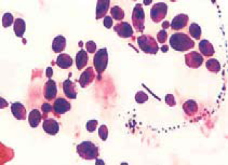
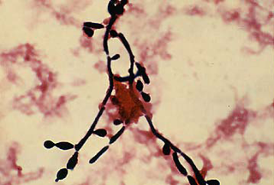
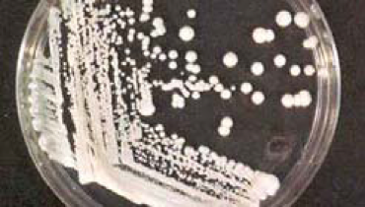
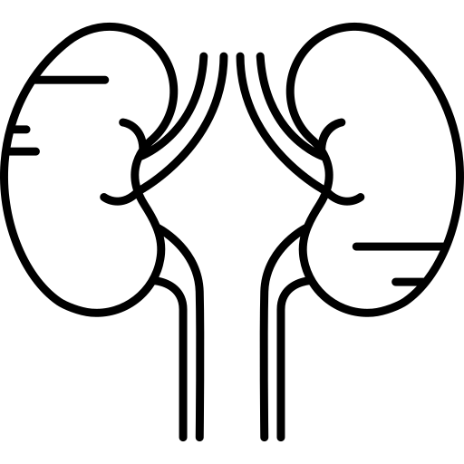
Candida
1
Candida is a unicellular yeast fungus.
It is imperfect reproducing by budding
Morphology¹
Microscopy
Culture
Round budding yeast cells, and Pseudohyphae.
Creamy colony, fast growing on Sabouraud Dextrose agar (SDA), Blood agar (48 hr)
Will appear as Gram + bacteria (violet in color) but they are larger in size with buds
SDA: Creamy white colonies
Species
There are many species of Candida (>150)
The common species are:
Candida albicans(Most common), C. parapsilosis, C. tropicalis, C. glabrata, C. krusei
Human commensal “Normal flora”
Oral cavity
Gastrointestinal tract
Skin
Genitourinary tracts e.g. Vagina, urethra
1- Almost all candida have the same morphology, so you can’t differentiate candida species by morphology.

Slide 3
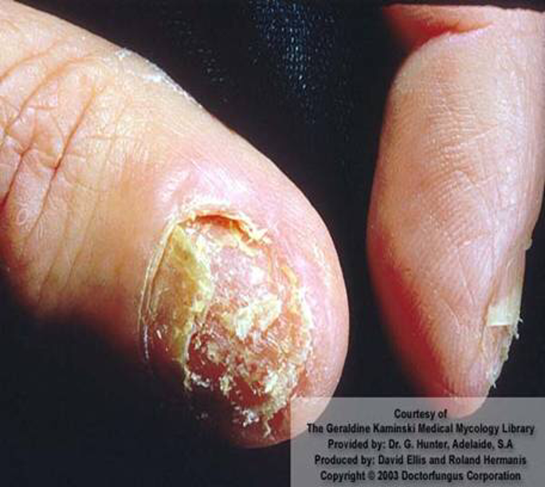
The disease: Candidiasis
2
Definition:
Any infection caused by any species of the yeast fungus Candida.
The most common invasive fungal infections in immunocompromised patients
4th most common cause of nosocomial bloodstream infection “Septicemia”
Modes of transmission:
Endogenous: “Usually normal flora” (More Common)
Colonization precedes infection
Antibiotic suppression of normal flora, fungal overgrowth
Exogenous: Very rare, could be from the environment in hospitals.
Pathogenesis:
Opportunistic Fungal infections:
Alteration in : Immunity¹ , Normal physiology² , Normal flora³
Damage in the barriers e.g. Skin, Intestinal mucosa. If damaged by Burns, Abdominal surgery or central lines, yeast cells will get the chance to reach the blood and cause septicemia.
Clinical : Spectrum of disease:
Mucous membrane infections | Cutaneous infections | Other diseases
Oral Thrush (oropharyngeal) Esophagitis Vaginitis | Paronychia (skin around nail bed) Onychomycosis (nails) Diaper rash Chronic mucocutaneous candidiasis : Children with T-cell abnormality | Urinary tract infection Candidemia which may disseminate⁵ (systemic, invasive) to: Endophthalmitis (eye)⁴, Liver and spleen, Kidneys, Skin, Brain, Lungs and Bone
Chronic mucocutaneous candidiasis:
Heterogeneous group of immune system defects → impaired cell-mediated immunity(T-cell dysfunction.) against Candida sp. Classic form caused by defects in AIRE.
Patients are born with defects in their immune system, so they are more susceptible to candida infections, They usually develop very severe cutaneous candidiasis (common in Skin and nails).
It’s Chronic, so it's more difficult to treat.
1- e.g. AIDS, Steroid medications, Diabetes, Chemotherapy.
2- e.g. Aging, pregnancy (Have more risk for developing vaginitis)
3- e.g. Broad spectrum Abx (e.g. Ampicillin, Aminoglycosides (except for streptomycin), Tetracyclines)
4- Especially in children.
5- Especially in neutropenic patients

Slide 4
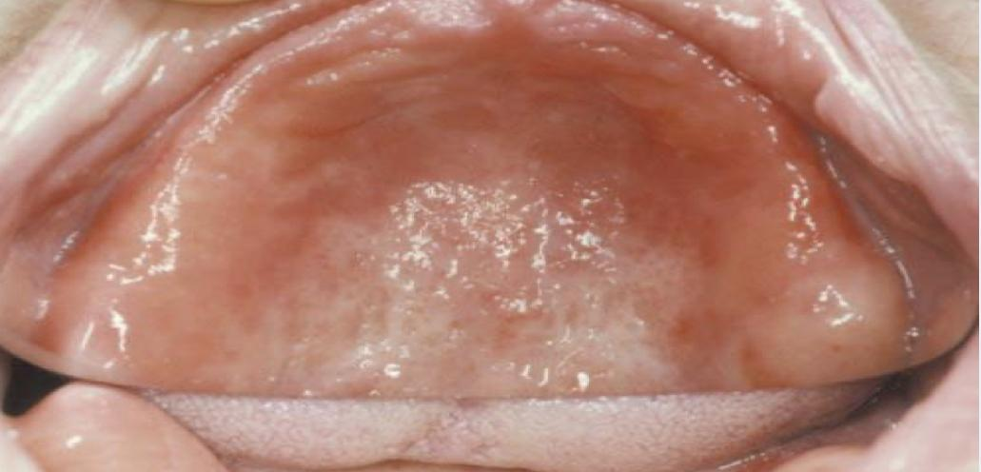
Mucocutaneous infections
3
1- Oropharyngeal Candidiasis :
Oral thrush:
White or grey Pseudomembranous patches on oral surfaces especially tongue and palate with underlying erythema.
Common in neonates ,infants , elderly, Patients on broad spectrum Abx, Asthmatic patients(because they use steroid medications) and In immunocompromised hosts^{1 ,}e.g.AIDS.
Forms of oral candidiasis:
Oral thrush
1- Erythematous form | 2-Pseudomembranous-erythematous form. | 3- Hyperplastic form:
Sometimes we don’t see white patches, we see something called erythematous candidiasis( redness and inflammation). It usually occurs in old people using dentures.
Both White patches and erythematous lesions.
White patches but difficult to remove unlike oral thrush, That was mistaken for leukoplakia
2- Esophagitis
3- Vulvovaginitis : “70% of women develop this, at least once in life”
Common in pregnancy, diabetics, use of contraceptives.
Thick discharge, itching irritation .
Lesion appear as white patches on vaginal mucosa
1-Usually Immunocompromised hosts present with esophagitis as well.

Slide 5
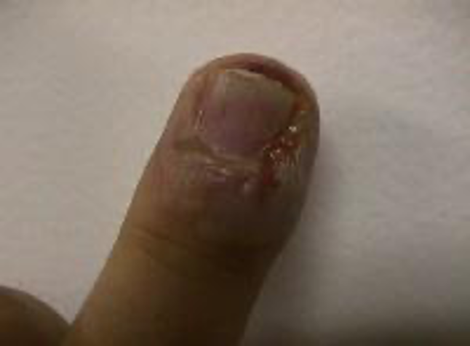
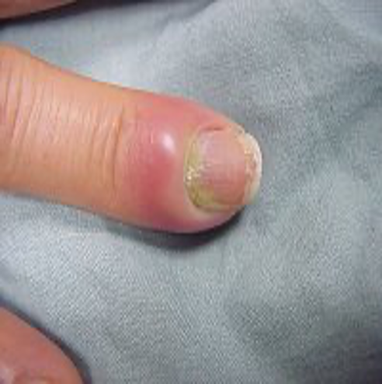
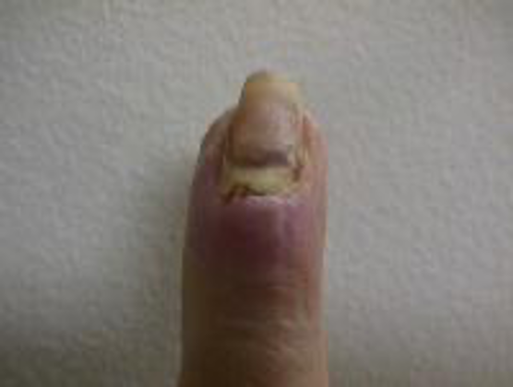
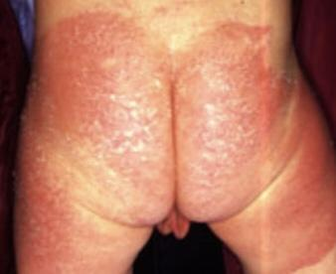
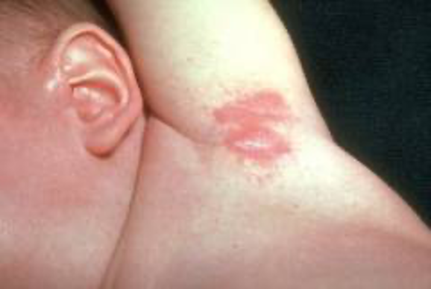
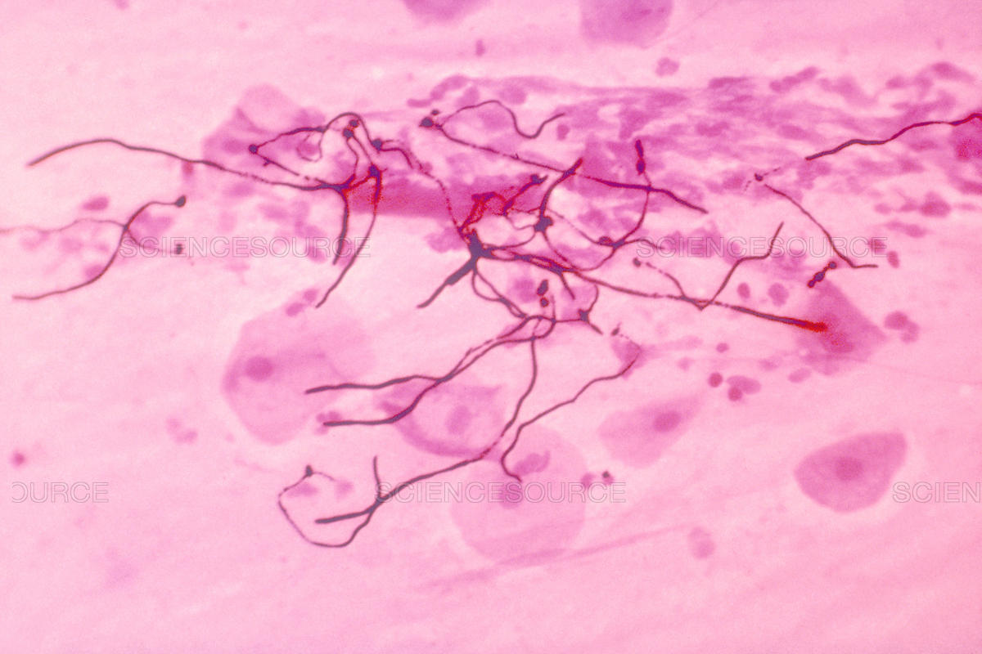
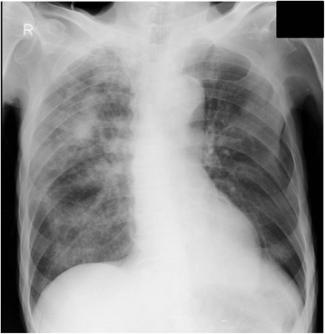
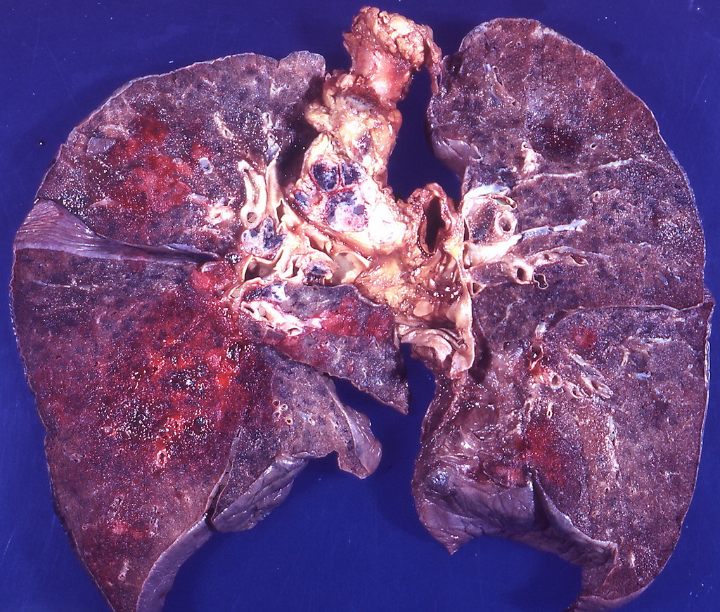
Cutaneous candidiasis
4
1- Intertriginous candidiasis:
Infections of skin folds eg. axilla, buttock, toe web, under breast.
Erythematous lesion, dry or moist or whitish accompanied by itching and burning.
2- Nail infections:
Onychomycosis and paronychia
Pulmonary Candidiasis
Primary pneumonia is less common and could be a result of Aspiration
Secondary pneumonia commonly seen with hematogenous candidiasis
Immunocompromised patients
Isolation of Candida from sputum¹, Bronchoalveolar lavage (BAL) is not always significant
Clinical features
Radiology,
Other Lab investigations
1- Positive sputum for candida isn’t diagnostic because candida is usually found in the normal flora of the mouth, BAL is better than sputum.

Slide 6
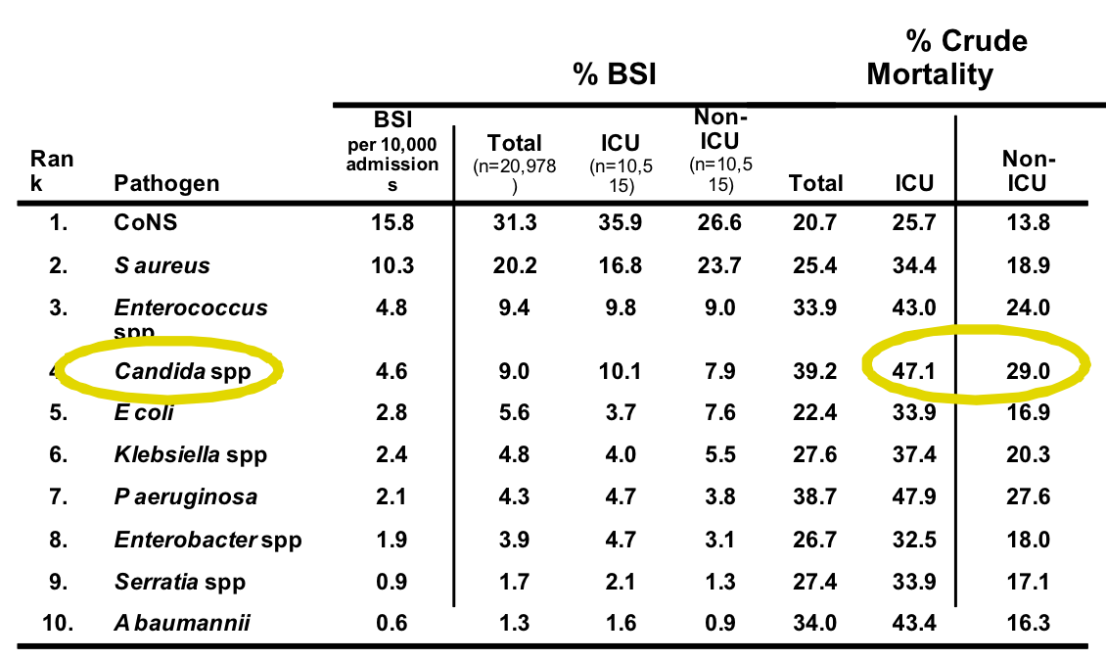
Candidemia
5
Candida is the fourth in causing nosocomial bloodstream infections (BSI)
Increased colonization (endogenous or exogenous factors)
Damage in host barriers by catheters¹, trauma, surgery
Immunosuppression
Central venous catheters (CVC)
Disseminated candidiasis (involvement of any organ):
Septic shock → Has bad prognosis (Death)
Meningitis
Ocular involvement (retinitis)
Fever could be the only clinical manifestation:
Usually the scenario is a patient in the ICU and has central lines, develops fever. What’s your first intervention? First Think of bacteria, so start with bacterial Abx, if there’s no response, think about yeast.
Mortality rate: Almost 50%.
Note that candida has higher mortality rate than bacteria.
1 - Always remember that Central lines are one of the major risk factors for developing candidiasis.

Slide 7
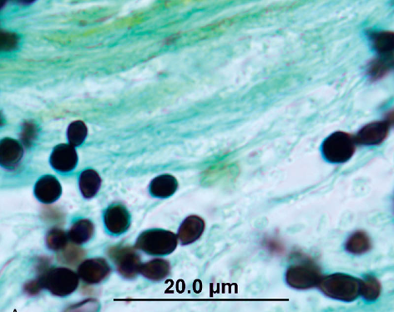
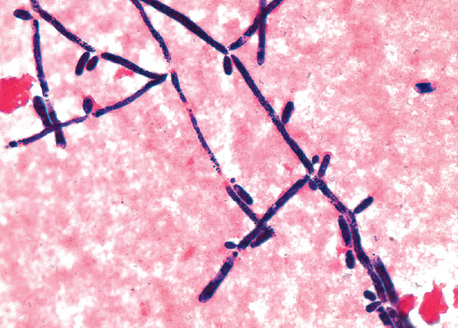
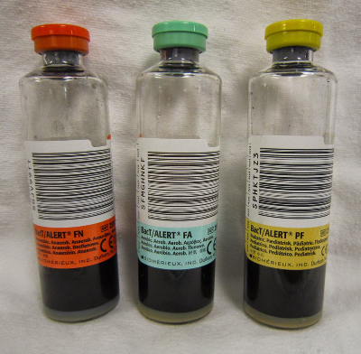
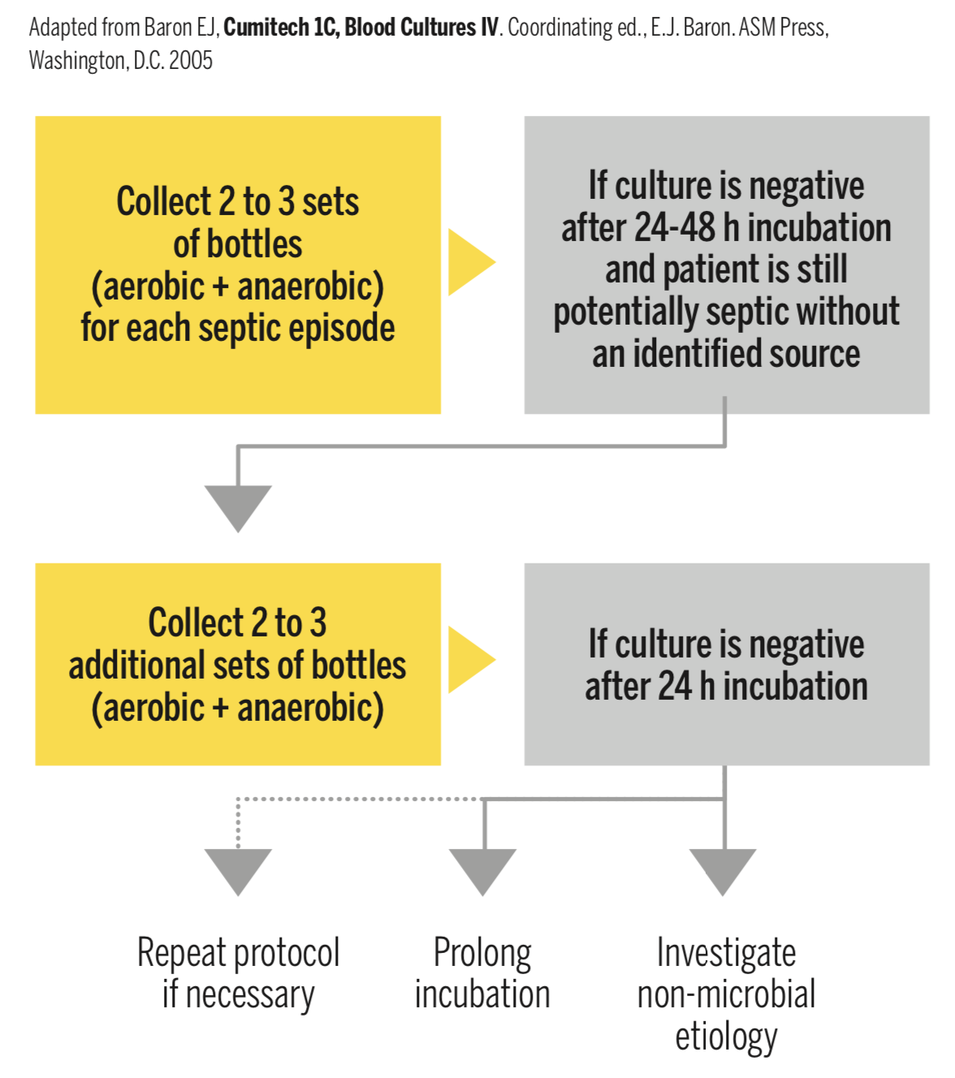
Laboratory diagnosis
6
Specimen depend on site of infection: e.g. UTI → Urine, Meningitis→ CSF etc.
Swabs. Urine, Blood, Respiratory specimens, CSF, vitreous sample, vaginal swabs.
Method | Description
Direct Microscopy | Stain: Gram stain, KOH, Giemsa, GMS¹, or PAS stained smears. Budding yeast cells and pseudohyphae will be seen in stained smear or KOH.
Culture | Media: SDA & Blood agar at 37oC, Creamy moist colonies in 24 - 48 hours.
Blood Culture (If patient is febrile and you suspect septicemia) | Uses: Detection of circulating microorganisms in septicemia Description : Different types of blood culture bottles and blood volumes required: Pediatric aerobic (0.5–4 mL blood) Adult aerobic (5–10 mL blood) Anaerobic (5–10 mL blood) Two sets of cultures before starting antibiotics is ideal
Serology | Patient serum Test for Antigen , e.g. Mannan² antigen using ELISA Test for Antibodies e.g. Anti-mannan antibodies
PCR | For detection of nucleic acid.
EXTRA info about blood culture:
Everything must be done aseptically to prevent false positive results.
Note: Brucella sp. require 21 days of incubation
Direct microscopy
Culture
Blood Culture
1- Grocott-Gomori's methenamine silver stain
2- Mannan is a polysaccharide and polymer of the sugar mannose that is a highly immunogenic component of the Candida cell wall. So if serology is positive mannan antigen this indicates a candida infection (specific for candida).

Slide 8
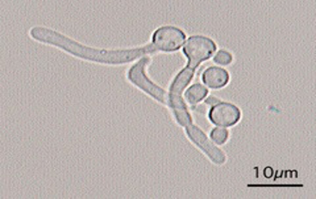
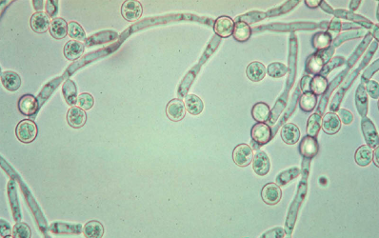
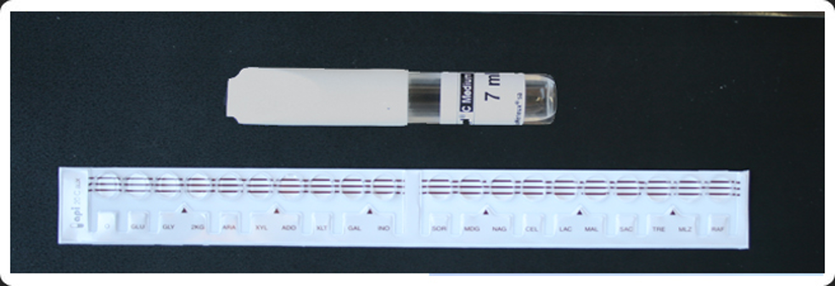
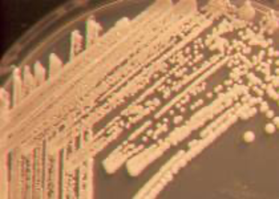
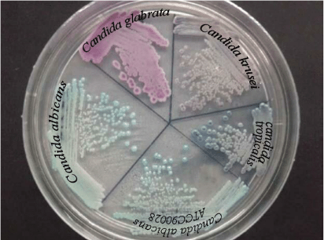
Laboratory diagnosis of yeast
7
Because C. albicans is the most common species to cause infection
The following tests are used to identify C. albicans:
1
2
3
Germ tube test¹:
Corn meal Agar :
Cycloheximide :
Formation of germ tube when cultured in serum at 37oC
Chlamydospore production in corn meal Agar
Resistance to 500 μg/ml Cycloheximide
Germ tube test
Chlamydospores of C. albicans in CMA
If these 3 are positive this yeast is C.albicans, If negative, then it could be any other yeast, we can do:
Carbohydrate assimilations and fermentation.²
Commercial kits available for this like: API 20C, API 32C
Culture on Chromogenic Media (CHROMagarTM Candida)
Carbohydrates assimilation test , API 20C
Candida species :
Candida albicans
Agar | Morphology | Picture
Sabouraud Agar | Creamy white yeast, may be dull, dry irregular and heaped up, glabrous and tough
Chromagar | producing green pigmented colonies on specially designed medium to speciate certain yeasts based on color they produce
1- We add the yeast to serum, and keep the sample in the incubator for 2hr and 30 min, only candida albicans will germinate and produce germ tubes.
2- If positive this indicates an infection by yeast. (Not specific, all yeasts are possible including albicans).

Slide 9
Management
8
Treatment
Oropharyngeal | Topical Nystatin suspension Clotrimazole troches Miconazole Fluconazole suspension
Vaginitis | Miconazole, Clotrimazole Fluconazole
Systemic treatment of Candidiasis (Indications: Septicemia, meningitis or severe UTI) | Fluconazole¹ Voriconazole¹ Caspofungin, micafungin, or anidulafungin Amphotericin²
candidemia | Treat for 14 days after last negative culture and resolution of signs and symptoms Remove catheters, if possible
Antifungal susceptibility testing in not done routinely in the microbiology lab, It is done in the following cases:
For fungi isolated from sterile samples e.g. Blood, CSF etc.
If the patient is not responding to treatment
In case of recurrent infections
Points to consider :
C. glabrata can be less susceptible or resistant to fluconazole³
C. krusei is resistant to fluconazole³
1- Only used if species are susceptible.
2- Amphotericin is a broad spectrum anti-fungal, but with candida, if we don’t know the exact specie we go with caspofungin because it’s more safe.
3- Use caspofungin instead.

Slide 10
Quiz
MCQ:
Answers: Q1:C | Q2:C | Q3:D | Q4:B| Q5:A
Q1: C. albicans is recognized in microscopic examination of infected tissues by the presence of:
A- Spherules containing endospores
B- Metachromatic granules
C- Yeasts and pseudohyphae
D- Asci containing 2–8 ascospores
Q2: A 31-year-old man with AIDS complains of painful swallowing. Physical examination of his oral cavity demonstrates a whitish membrane covering much of his tongue and palate. Endoscopic examination reveals the same whitish membrane covering his esophageal mucosa. Which of the following is the most likely etiologic agent responsible for this patient’s symptoms?
A- Chlamydia
B- Rickettsia
C- Fungus
D- Spirochete
Q3: A 35-year-old, HIV-positive man complains that he has had a “bad” taste in his mouth and discoloration of his tongue for the past 6 weeks. On physical examination, there are areas of adherent, yellow-tan, circumscribed plaque on the lateral aspects of the tongue. This plaque can be scraped off as a pseudomembrane to show an underlying granular, erythematous base. What is the most likely diagnosis?
A- Aphthous ulcer
B- Cheilosis
C- Hairy leukoplakia
D- Oral thrush
Q4: Which of the following is resistant to fluconazole?
A- C. Albicans
B- C. glabrata
C- C. parapsilosis
D- C. Tropicalis
Q5: Which of the following tests are used to differentiate C. albicans from other candida?
A- Germ tube test
B- Carbohydrate assimilations
C- Gram stain
D- macconkey agar
SAQ:
CASE: A patient with diabetes presents to her physician with a white, flaky, adherent substance on the skin under her breasts. Another patient, a woman who has just completed a course of oral Abx, presents with itching and copious vaginal discharge that resembles “cottage cheese”. A third patient, with AIDS, presents with white exudate on his oral mucosa and soft palate. The physician diagnoses the same causative microorganism for all three cases.
Q1: What is the most likely diagnosis?
A: Candidiasis
Q2: What is the most likely causative agent?
A: Candida albicans
Q3: How would you confirm that these conditions are caused by the organism you mentioned In Q2?
A: By Germ tube test.
Q4: What media is used for this organism?
A: Sabouraud dextrose agar (SDA)
Q5: Describe its morphology on the media you mentioned in Q4.
A: Creamy white yeast

Slide 11
Members board
Team Leaders:
Abdulaziz Alshoumar Ghada Alsadhan
Team sub-leader:
Mohammed Alhumud
This lecture was done by:
Ghada Alsadhan
Mashal abaalkhail

