Slide 1
Diabetic Foot
Lecture objectives:
Recall the reasons that diabetic patients are at increased risk to have infections.
Recall common infections in diabetic patients ( with emphasis on diabetic foot infection)
List the causative organisms and the pathogenesis of common infections in diabetic patients.
Recognize the clinical presentations of common infections.
Describe lab and radiological tests of common infections.
Recall the complications of diabetes mellitus ( diabetic foot )
Recall the management and antimicrobial therapy of common infections in diabetic patients.
Color index:
Important
Found in Females’ slides
Doctors’ note
Found in Males’ slides
Extra
EDITING FILE
EDITING FILE

Slide 2
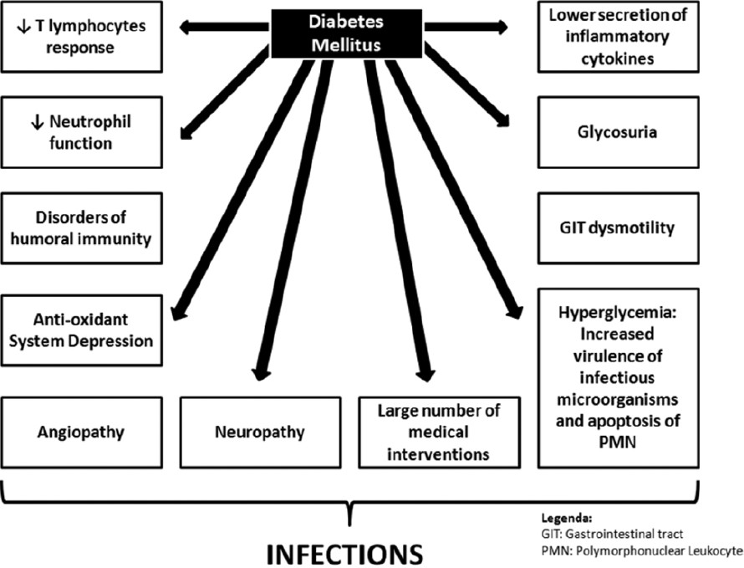
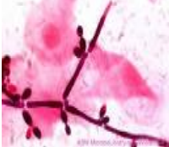
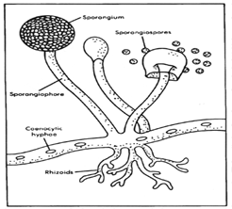
introduction
1
Introduction
Diabetic patients are predisposed to infections.
Nearly half of all diabetic patients had at least one hospitalization or outpatient visit for infections compared to non-diabetic patients.
Infections may increase the morbidity and mortality in diabetic patients.
Why diabetic patients are at increased risk to have infections ?
Because of Host related factors & Organisms related factors
Organisms Specific Factors¹
Organisms Specific Factors
Candida albicans | Glucose inducible proteins promote adhesion of C. albicans to buccal² or vaginal epithelium which in turn, impairs phagocytosis, giving the organism advantage over the host.
Rhizopus spp. | Ketoacidosis allow Rhizopus spp. which cause Mucormycosis (Zygomycosis) to thrive in high glucose acidic conditions .
Any organisms even the low pathogenic, cause infections in diabetic patients.
Causing oral thrush

Slide 3
introduction
2
Host Related Factors
Host Related Factors
Sensory peripheral neuropathy | Minor local trauma may result in skin ulcers, which leads to diabetic foot infections
Surgical site infections | Associated with postoperative hyperglycemia which is related to deleterious effect on chemotaxis, phagocytosis and adherence of granulocytes
Autonomic neuropathy | Diabetic patients may develop urinary retention and stasis that in turn, predisposes to develop urinary tract infections.
Hyperglycemia¹ and metabolic derangements | In diabetic patient may facilitate infection.
Immune defects in diabetes | Such as : 1- Depressed Neutrophil function 2- Affected adherence to the endothelium. 3- Affected chemotaxis and phagocytosis 4- Compromised bactericidal activity. 5- Depressed cell mediated immunity
Increased skin and mucosal colonization | • Diabetics on insulin have asymptomatic nasal and skin colonization with S. aureus particularly MRSA • Colonization predisposes to skin infection and transient bacteremia which may result in distal sites infection such as damaged muscle. • In type- 2 diabetes; Mucosal colonization with C. albicans is common. Vulvovaginitis caused by Non-albicans Candida spp. is common in patients with poor glycemic control
Vascular insufficiency | Results in local tissue ischemia that enhances the growth of microaerophilic and anaerobic organisms while depressing the O2 dependent bactericidal functions of leukocytes. There may be also impairment of the local inflammatory response and absorption of antibiotics
Uncontrolled diabetes have even higher risk of infections.

Slide 4
Infections in diabetic patients
3
Common infections in diabetic patients
Upper & lower respiratory tract infections
Periodontal infections
Genitourinary
infections
Abdominal infections
Skin and soft tissue & diabetic foot infections
Upper respiratory tract infections
1- Invasive (malignant)
otitis externa
2- Rhinocerebral
Mucormycosis
1- Invasive ( malignant) otitis externa
General info. :
Uncommon but potentially life threatening.
Cause:
involves P.aeruginosa.
Pathogenesis:
Slowly invades from the external canal into adjacent soft tissues, mastoid and temporal bone and eventually spreads across the base of the skull.
Signs/Symptoms:
Patient presents with severe pain, otorrhoea, and hearing loss. Intense cellulitis and oedema of the ear canal.
Diagnosis:
CT scan and MRI studies to define the extent of bone destruction
Treatment:
Surgical debridement & IV anti-Pseudomonas¹ antibiotics.
Antipseudomonal antibiotics: “CAMPFIRE” (EXTRA)
Carbapenems, Aminoglycosides(e.g. gentamicin), Monobactams, Polymyxins(e.g. Polymyxin B, Colistin), Fluoroquinolones(e.g. Ciprofloxacin, levofloxacin), ThIRd generation cephalosporins(e.g. Ceftazidime, cefepime), Extended-spectrum penicillins(e.g. Piperacillin, Ticarcillin)

Slide 5
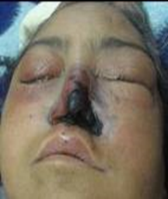
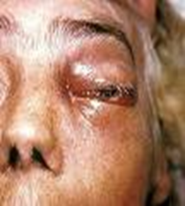
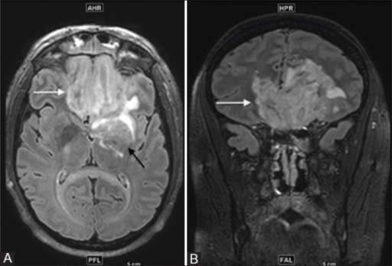
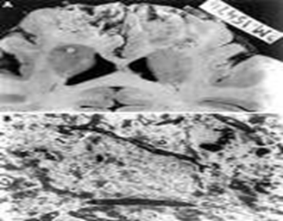
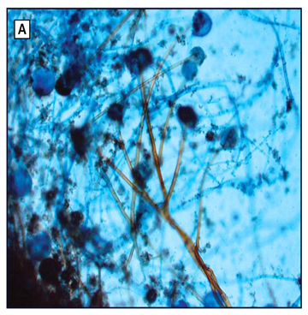
Infections in diabetic patients
4
2- Rhinocerebral Mucormycosis
General info. :
A life threatening fungal infection
Cause:
(Mucormycosis) Rhizopus³, Absidia and Mucor species
Signs and Symptoms:
facial or ocular pain and nasal stuffiness, generalized malaise and fever.
May be intranasal black eschars or necrotic turbinate.
Diagnosis:
Biopsy of the necrotic tissue .
Direct smear examination for hyphae (Non-septate hyphae).
Treatment:
Surgical debridement and prolonged IV therapy with Amphotericin B¹.
Lower respiratory tract infections:
Pneumonia and Influenza
Diabetic patients are 4 times more likely to die from pneumonia or influenza than non-diabetic patients.
Common organisms :
Gram positive
Gram negative
Others
S.aureus
Enterobacteriaceae
Influenza virus
S.pneumoniae
Legionella
Mycobacterium tuberculosis
Routine pneumococcal and influenza vaccination recommended².
Broad spectrum antifungal.
Due to the high risk diabetic patients must take vaccination.
Q: diabetic patient with ketoacidosis presented with a nasal mass →(Mucormycosis) Rhizopus
Notes:
Other diagram is needed

Slide 6
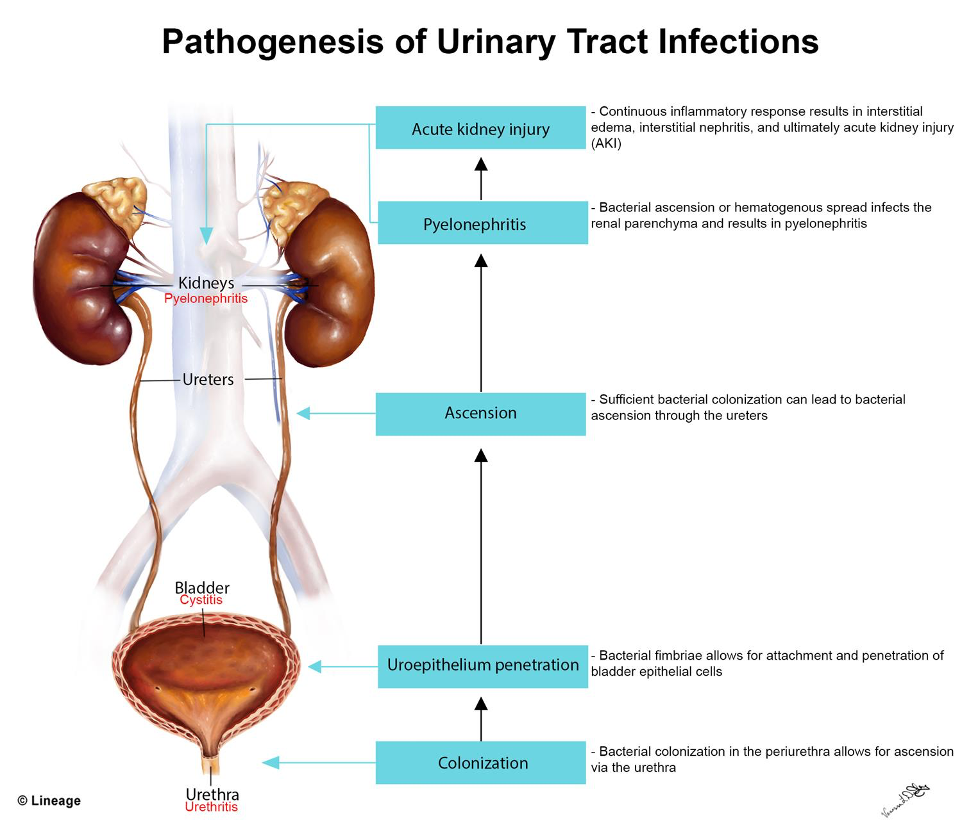
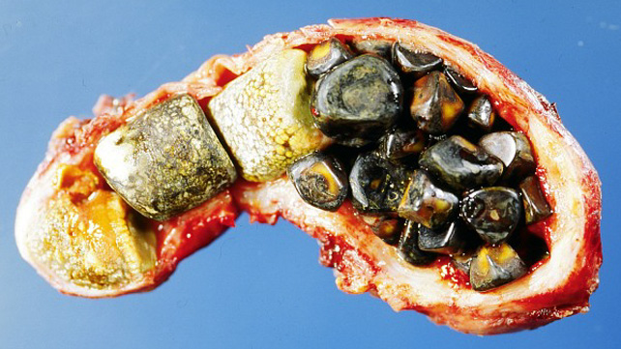
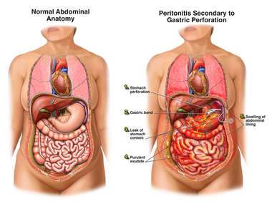
Infections in diabetic patients
5
Genitourinary infections
1- Cystitis: (more common in women)
Same as non-diabetics, incomplete bladder emptying and high incidence of unsuspected upper UTI.
Bacteria: Gram negative rods(e.g. E.coli) or Group B Streptococcus (S.agalactiae)
Fungi: Candida albicans may be involved.
Symptoms: Pain above the pubic region
2- Bilateral Pyelonephritis:
Diabetes predisposes to a more severe infection of the upper urinary tract.
Emphysematous Pyelonephritis exclusively an infection of diabetics (60%) and carries grave prognosis ( 30% fatal).
Most common caustive organism: E.coli
Diagnosis:
flank mass & crepitus & High fever
CT scan shows gas in the renal tissues.
Management:
supportive & IV antibiotics, nephrectomy may be needed.
3- Vulvovaginitis:
As mentioned earlier.
Abdominal infections
Severe fulminating Cholecystitis
Common causes:
Enteric Gram negative bacteria and anaerobes
Gall stone or peritonitis may be present.
Gas gangrene and perforation may occur.
Management:
Cholecystectomy and broad spectrum antibiotics.

Slide 7
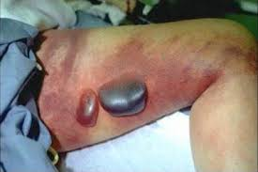
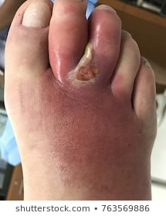
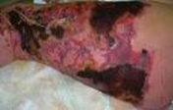
Infections in diabetic patients
6
Skin and soft tissue infections
Risk factors in diabetic patients:
Sensory neuropathy: no pain perception¹.
Atherosclerotic vascular disease
Hyperglycemia: >250 mg/ dl
History of cellulitis, peripheral vascular diseases, tinea infection², and dry skin.
Organisms
Group A Streptococcus (S. pyogenes) and S. aureus
CA-MRSA ( community acquired -MRSA) causes (77%) of skin and soft tissue infections
Necrotizing fasciitis
A deep-seated ,life threatening infection of subcutaneous tissue with progressive destruction of fascia, fat and muscles.
Organisms:
10% associated with GAS ,with or without S.aureus, anaerobes may be involved.
Clinical features
1-Very severe pain of proportion of skin and anesthesia of overlying skin.
2-Violaceous discoloration of skin that evolves into vesicles and bullae.
3-Crepitus.
4-Soft tissue gas seen in radiograph or CT scan.
Management:
Aggressive surgical debridement & IV antibiotics.
The patient is not aware of the trauma.
Tinea infections are superficial fungal infections caused by three species of fungi collectively known as dermatophytes.

Slide 8
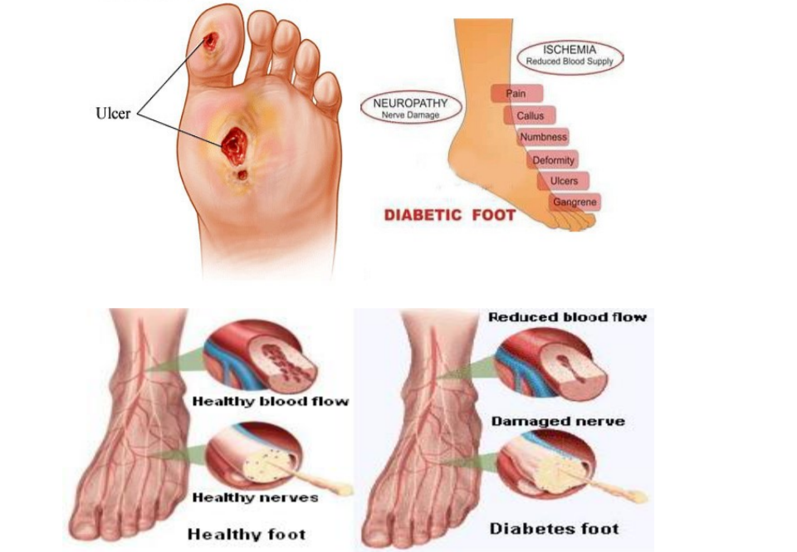
Diabetic foot infections
7
General info.
The most common and most important soft tissue infection in diabetic patient is diabetic foot infection, why ?
because it is related to peripheral neuropathy and compromised microvascular circulation which limits the access of phagocytic cells to the infected area and poor concentration of antibiotics in the affected area.
Complicated by chronic osteomyelitis, gas gangrene, amputation and death.
The spectrum of foot infection ranges from superficial cellulitis¹ to chronic osteomyelitis². Combined infection involving bone and soft tissue may occur
Infection may involve the skin, soft tissues, bone ,or all.
Diabetic neuropathy may lead to incidental trauma that goes unrecognized.
Sinus tract may be present.
Pathophysiology
a microvascular disease limits blood supply to the superficial and deep structures
Pressure from ill fitting shoes
trauma compromises local blood supply predisposing foot to infection.
Organisms involved in diabetic foot infections
Cellulitis³ | Beta-hemolytic streptococci ( group A,B Streptococcus ), S. aureus, Entertobacteriacae ( E. coli, Klebsiella, Proteus spp.) in chronic ulcers.
Macerated ulcer or nail injury (sinus) | P. aeruginosa .
Deep soft tissue infections (necrotizing fasciitis, or myositis). | GAS & gas producing gram positive bacilli(Clostridium perfringens).
Chronic osteomyelitis | GAS and Group B Streptococcus, S. aureus, Enterobacteriacae (E.coli ,Proteus mirabilis , K.pneumoniae.) & Bacteroides fragilis
Involving the dermis and epidermis.
Bones + soft tissue
Superficial Infection

Slide 9
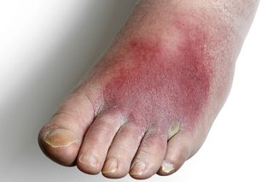
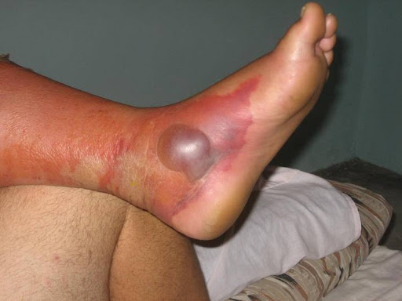
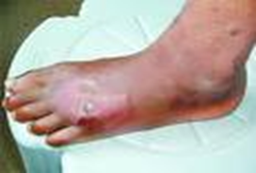
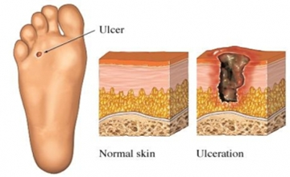
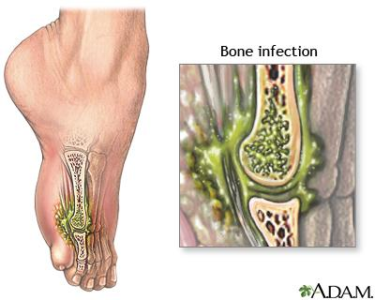
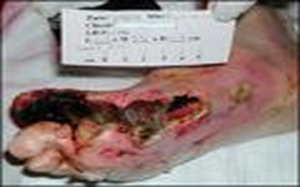
Diabetic foot infections
8
Cellulitis
tender, erythematous non-raised skin lesion on the lower limb, may be accompanied with lymphangitis which suggests GAS.
Bullae suggests S. aureus ,occasionally GAS.
Erythemaous non raised skin lesion
Deep skin and soft tissue infections
Bullous (raised) lesion
patient acutely ill, with painful induration of the limb especially the thigh.
Foot may be involved
Foul discharge suggest anaerobes¹
Deep skin infection involoving the foot
Osteomyelitis
Acute osteomyelitis:
pain at the involved bone, fever and adenopathy (lymphadenopathy)
Chronic osteomyelitis:
fever
foul discharge
There may be pain
No lymphangitis
Deep penetrating ulcer and sinuses on the plantar surface of the foot.
Factors that increases the development of osteomyelitis:
Grossly visible bone or ability to probe to bone
ulcer size >2x2 cm
ulcer depth > 3mm
ulcer duration longer than 1-2 wks
ESR >70 mm/hr.
E.g. Bacteroides

Slide 10
Diabetic foot infections
9
Diagnosis
Thorough examination to evaluate the patient’s vascular and neurological status. Radiological examination including doppler ultrasonography, transcutaneous oxymetry, MR angiography. CT scan ,MRI and gallium scan for soft tissue and bone evaluation. Exploration of ulcer to determine its depth and the presence of sinus tract. Deep specimens¹ (tissues) for culture and susceptibility testing.
Management & treatment
Control blood sugar and hydration² Evaluation of neuropathy and vasculopathy
Mild cases | Moderate to severe cases
Surgical debridement of necrotic tissues and use of antibiotics according to the causative bacteria eg. Cloxacillin³, Cephalexin³, Clindamycin⁴ , TMP-SMX⁴ (for CA-MRSA), Quinolones⁵, Amoxacillin-clavulunic acid⁵. | Places the foot at risk of amputation. Needs hospitalization,IV antibiotics and surgical intervention as needed
Prevention
Is the cornerstone of diabetic foot care.
It is multidisciplinary including family physician, social worker, home care nurse and specialist.
Patient education about the control and complication of diabetes.
Blood sugar should be controlled promptly ( shift to insulin if oral hypoglycemic agents were not effective),weight reduction, a diet low in fat and cholesterol.
Proper foot care, using protective footwear and pressure reduction.
Self and family member examination of foot.
Not superficial tissues, due to the presence of normal flora.
First thing first, management is difficult with uncontrolled blood glucose.
Used for MSSA
Used for MRSA
Used for gram negative bacteria

Slide 11
Extra
10
Gram +ve
S.aureus | -Cocci in clusters -Catalase: + -Coagulase : + -yellow colonies on blood agar -DNAse +ve
strept. pyogenes (group A) | -Cocci in chains -Catalase: - -Coagulase : - -𝝱 hemolytic - Bacitracin sensitive
strept. agalactiae (group B ) | -Cocci in chains -Catalase: - -Coagulase : - - 𝝱 hemolytic - Bacitracin resistant
strept. pneumoniae | -Diplococci -Catalase: - -Coagulase : - -𝞪 hemolytic -Bile soluble -Optochin sensitive
Clostridium perfringens | -Spore forming rods -Double zone of hemolysis -Transmission: foodborne and traumatic implantation
Gram -ve
Enterobacteriaceae | -Oxidase : - -Catalase : + -Ferment glucose
Legionella | -Gram stains poorly, use silver stain -Grow on charcoal yeast extract medium -Transmission: aerosols from environmental water source habitat ( air conditioning systems) , no person-to-person transmission
Pseudo. aeruginosa | - bacilli - non-lactose fermenter - oxidase: +
Bacteroides fragilis | -Reservoir: predominant anaerobe in the human colon -Transmission: endogenous from bowel defect

Slide 12
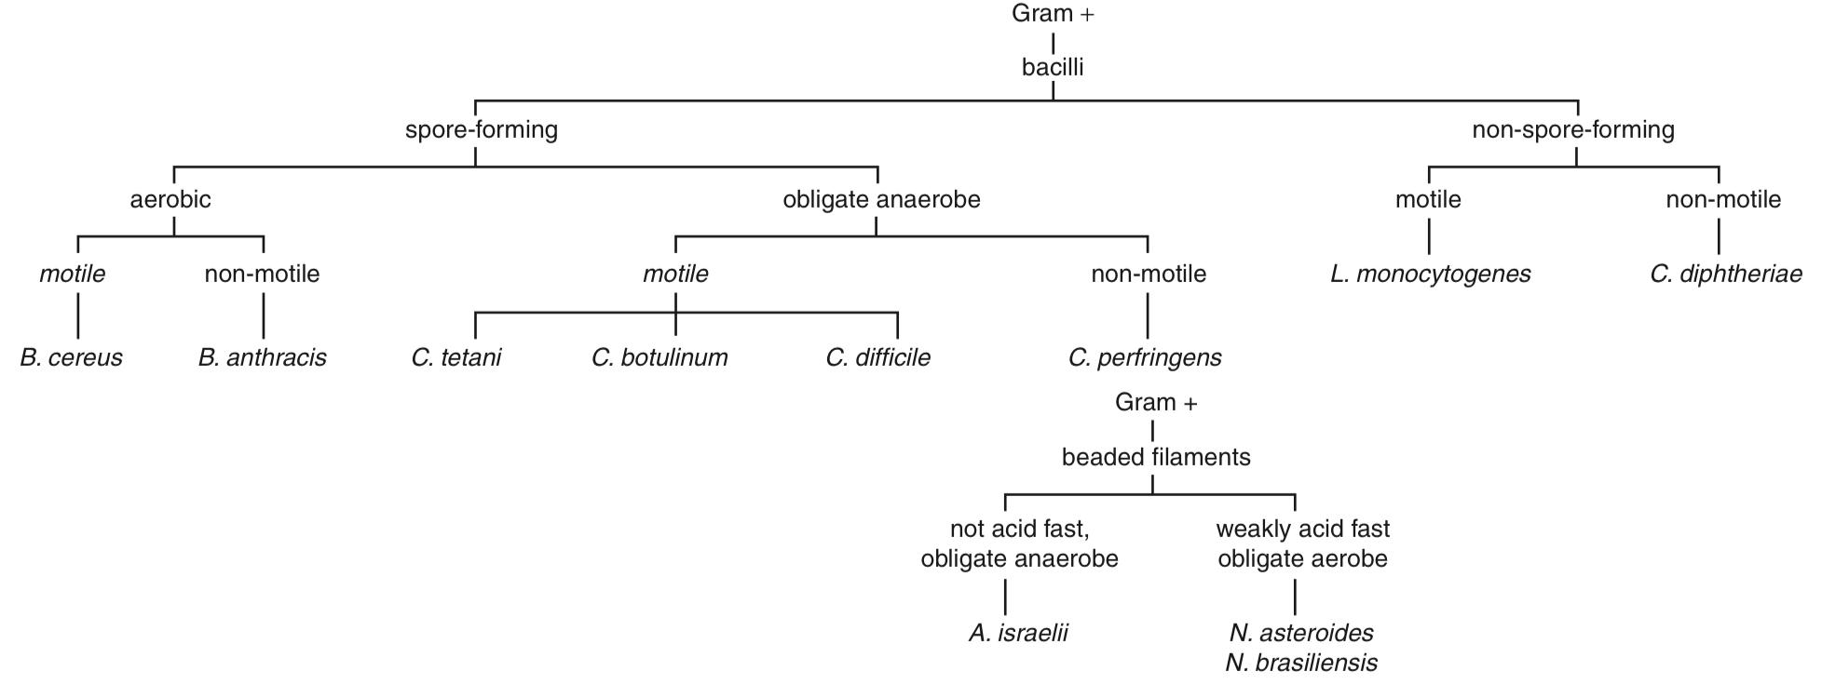
Extra
11

Slide 13
Explanation:
Q1: Pyelonephritis (E.coli is the most common)
Q2: Osteomyelitis (S.aureus is the most common)
Q3: Mucormycosis due to rhizopus
Q4: Necrotizing fasciitis is commonly caused by GAS
Quiz
MCQ:
Answers: Q1:A | Q2:D | Q3:B | Q4:A
Q1: A 28-year-old woman with a history of asthma & diabetes presents to the emergency department with a temperature of 38.2°C (100.8°F) and complains of shaking chills and pain on her right side, which she locates by pointing to the area above her right iliac crest. She notes that she has never had this occur before. During the examination, there is tenderness to percussion at the junction of the lower ribs and the thoracic vertebrae. Urinalysis reveals WBC casts. What is the organism most likely causing her condition?
(A) Escherichia coli
(B) Klebsiella pneumoniae
(C) Proteus mirabilis
(D) Staphylococcus saprophyticus
Q2: A 35 -year-old diabetic patient sustains a deep puncture wound in his left heel while playing football. Four days later, his son brings him to the emergency department because he has become lethargic and has developed shaking chills. He refuses to bear weight on his left foot. The patient’s temperature is 39.7°C (103.4°F). Physical examination shows a warm, swollen, and extremely tender area around the puncture wound. A specimen through uninfected tissue is obtained via percutaneous needle biopsy. A Gram stain of this sample is most likely to show which of the following?
(A) Acid-fast bacilli
(B) Catalase-negative, gram-positive cocci in chains
(C) Coagulase-negative, gram-positive cocci in clusters
(D) Coagulase-positive, gram-positive cocci in clusters
Q3: A physician is caring for a hospitalized 31-year-old man with long-standing, poorly controlled type 1 diabetes mellitus. He is blind and has peripheral neuropathy with sensory loss in both feet, and his most recent hemoglobin A1c level was 13.9%. He recently presented with altered mental status, polyuria, and polydipsia. At that time, his serum glucose level was 475 mg/dL, arterial blood pH was 6.96, and his anion gap was 27. Since then his acidosis has resolved with appropriate treatment, and fingerstick blood glucose levels have normalized. However, he has persistent nasal discharge; paranasal sinus tenderness; black necrotic eschar on his face; and new onset of periorbital edema, proptosis, facial numbness, and obtundation. Which of the following is most likely cause of this condition?
(A) Escherichia coli
(B) Rhizopus
(C) Staphylococcus Aureus
(D) GAS
Q4: Recently, there have been sensational media reports of patients infected with invasive, “flesh-eating” bacteria that spread rapidly through the tissues. This necrotizing fasciitis is usually caused by:
(A) Group A streptococci
(B) Micrococcus
(C) Bacillus cereus
(D) Clostridium tetani
SAQ:
CASE: A 55-year-old woman presents to the emergency department with confusion and lethargy. On physical examination she is found to be tachypneic and tachycardic, and her breath smells somewhat like nail polish remover. A review of her electronic medical record reveals that she was diagnosed with type 1 DM at 12 years of age. She is admitted to the hospital and treated for DKA, and her symptoms begin to improve. However, 4 days after admission she develops fever, mucoid nasal discharge, and periorbital swelling. While cultures are pending, she is treated with empiric abx but fails to improve.
Q1: What is the most likely diagnosis?
A: Mucormycosis
Q2: What is the most likely causative agent?
A: Rhizopus
Q3: What is the main risk factor for this condition?
A: Diabetic ketoacidosis.
Q4: How to confirm diagnosis?
A: Biopsy of necrotic tissue and direct smear examination for hyphae.
Q5: How to treat?
A: 1- Surgical debridement 2- Prolonged IV Amphotericin B

Slide 14
Members board
Team Leaders:
Abdulaziz Alshoumar Ghada Alsadhan
Team sub-leader:
Mohammed Alhumud
This lecture was done by:
Abdulaziz Alshoumar
Abdulrahman Alsayed
Alwaleed Alzunaidi
Tariq Aloqail
Naif Alhusaini
Mashal abaalkhail
Razan Alrabah

