Slide 1
Pathology of thyroid gland
Know the ways in which thyroid disorders present.
Know the major causes and manifestations of hypo, hyperthyroidism and thyroiditis.
Know the causes of the thyroid endemic goiter and its pathology.
Editing File

Slide 2
Hyperthyroidism
Introduction
Clinical recognition of diseases of the thyroid is important, because most are amenable to medical or surgical management.
Diseases include:
Hyperthyroidism: Excessive release of thyroid hormones.
Hypothyroidism: Thyroid hormone deficiency.
Mass lesions.
Autoimmune thyroid diseases: Thyroiditis and Antibody mediated
Thyrotoxicosis
Thyrotoxicosis is a hypermetabolic state due to elevated circulating levels of free T3 and T4.
Hyperthyroidism is hyperfunction of the thyroid gland, and it is the most common cause of thyrotoxicosis.
Causes of thyrotoxicosis
Associated with hyperthyroidism | Not associated with hyperthyroidism²
Primary Diffuse toxic hyperplasia (Graves disease). Hyperfunctioning¹ (toxic) multinodular goiter. Hyperfunctioning² (toxic) adenoma. Iodine-induced hyperthyroidism. Neonatal thyrotoxicosis associated with maternal Graves disease. Secondary TSH-secreting pituitary adenoma (rare). | Granulomatous (de Quervain) thyroiditis (painful). Subacute lymphocytic thyroiditis (painless). Struma ovarii (ovarian teratoma with ectopic thyroid). Factitious thyrotoxicosis (exogenous thyroxine intake).
It is important to mention “hyperfunctioning” because it could be enlargement without hyperfunctioning in these cases.
There is no excessive secretion but there is excessive release due to damage to the cells.

Slide 3
Hyperthyroidism
Clinical manifestation
Hypermetabolic state induced by excessive amounts of thyroid hormone and over activity of the sympathetic nervous system:
Constitutional symptoms:
Soft, warm, and flushed skin, weight loss despite increased appetite.
Gastrointestinal:
Hypermotility.
Cardiac:
Palpitations and tachycardia.
Neuromuscular:
Nervousness, tremor, and irritability.
Ocular:
Wide, staring gaze and lid lag.
Thyroid storm (medical emergency):
The abrupt onset of severe hyperthyroidism. It occurs most often in patients with Graves disease.
Apathetic hyperthyroidism:
Refers to thyrotoxicosis occurring in older adults, in whom the typical features of thyroid hormone excess often are blunted
Diagnosis
The diagnosis of is based on clinical features and laboratory data.
The measurement of serum TSH is the most useful single screening test.
Free thyroid hormone assays, T3 and T4.
Measurement of radioactive iodine uptake by the thyroid gland¹.
High radioactive iodine uptake → Hyperfunctioning gland.

Slide 4
Graves disease
Introduction
The most common cause of endogenous hyperthyroidism.
Prevalence:
Between the ages of 20 and 40.
Women seven times more commonly than men.
Genetic factors: Females only Female doctor skipped it
Associated with the presence of certain human leukocyte antigen (HLA) haplotypes, specifically HLA-DR3.
Polymorphisms in genes whose products regulate T-cell responses, including the inhibitory T-cell receptor CTLA-4.
Pathogenesis
Breakdown in self-tolerance to thyroid autoantigens, of which the most important is the TSH receptor. The result is the production of multiple autoantibodies, including:
Thyroid-stimulating immunoglobulin
Thyroid growth-stimulating immunoglobulins
TSH-binding inhibitory immunoglobulins
An IgG antibody that binds to the TSH receptor and mimics the action of TSH, relatively specific for Graves disease.
Also directed against the TSH receptor.
Anti-TSH receptor antibodies prevent TSH from binding to its receptor on thyroid epithelial cells and may inhibit thyroid cell function.
The coexistence of stimulating and inhibiting immunoglobulins in the serum of the same patient is not unusual, a finding that may explain why some patients with Graves disease spontaneously develop episodes of hypothyroidism.

Slide 5
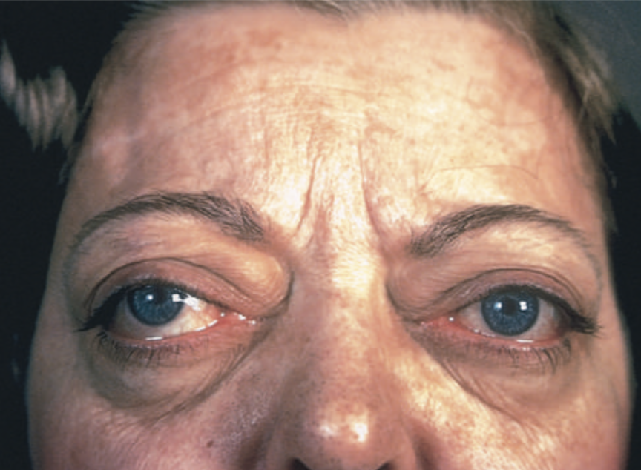
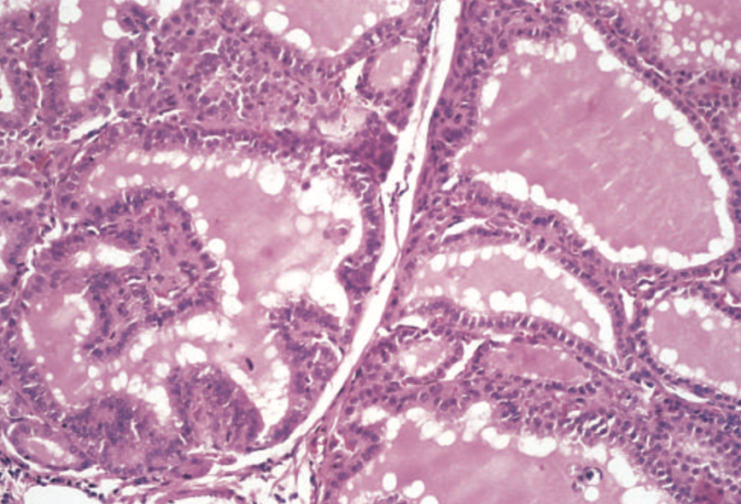
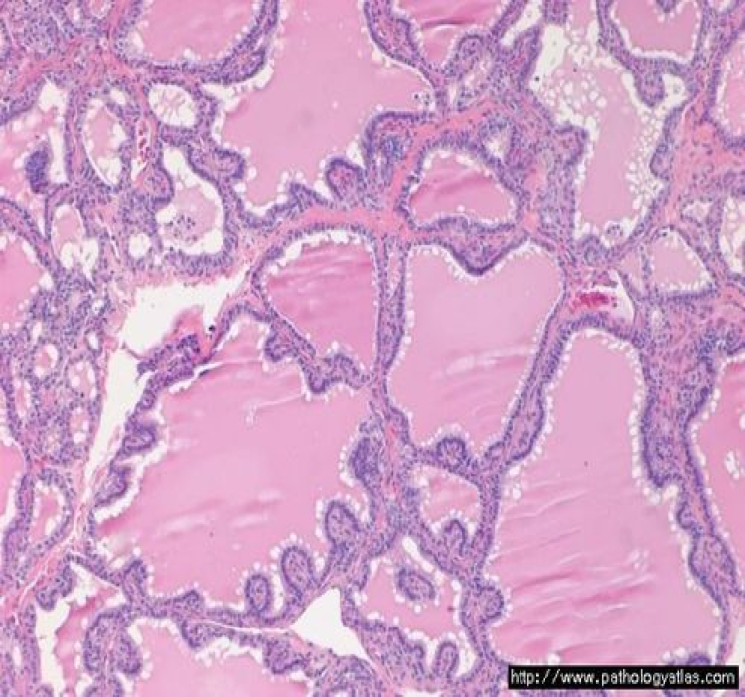
Graves disease
Triad of manifestations
Thyrotoxicosis | - Diffusely enlarged, hyperfunctional thyroid. - Present in all cases.
Ophthalmopathy | Exophthalmos, Caused by: - Retro orbital infiltration by mononuclear cells (mainly T-cells). - Inflammatory edema and swelling of extraocular muscles. - Accumulation of extracellular matrix components (glycosaminoglycan). - Increased numbers of adipocytes.
Dermopathy | - Localized. - Pretibial myxedema. - Thickening of the dermis. - As a result of deposition of glycosaminoglycans and lymphocyte infiltration.
Morphology
Macroscopic:
Enlarged gland (usually symmetrically¹) due to diffuse
hypertrophy and hyperplasia of thyroid follicular epithelial cells.
The gland is smooth and soft, and its capsule is intact.
Microscopic:
The follicular epithelial cells are tall, columnar, and crowded.
Formation of small papillae. That lacks fibrovascular cores,
in contrast with those of papillary carcinoma.
The colloid is pale, with scalloped margins.
Lymphoid infiltrates, are present throughout the
interstitium; germinal centers are common.
Laboratory findings
Elevated serum free T4 and T3 and depressed serum TSH.
Because of ongoing stimulation of the thyroid follicles by TSIs², radioactive iodine uptake is increased, and radioiodine scans show a diffuse³ uptake of iodine.
Both lobes.
Thyroid stimulating immunoglobulin.
All the gland is hyperfunctioning (diffuse), No nodules.

Slide 6
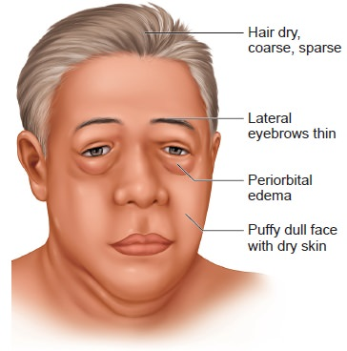
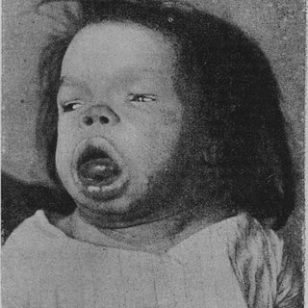
Hypothyroidism
Introduction
Hypothyroidism is caused by any structural or functional derangement that interferes with the production of adequate levels of thyroid hormone.
Worldwide, the most common cause of hypothyroidism is endemic dietary deficiency of iodine.
In most developed nations, autoimmune causes predominate.
Causes
Primary:
Postablative: Surgery, radioiodine therapy, or external irradiation.
Autoimmune hypothyroidism: Hashimoto thyroiditis.
Iodine deficiency.
Drugs (lithium, iodides, p-aminosalicylic acid).
Rare causes:
Congenital biosynthetic defect (dyshormonogenetic goiter).
Genetic defects in thyroid development. (PAX8, FOXE1, TSH receptor mutation)
Thyroid hormone resistance syndrome. (THRB mutations)
Secondary (rare):
Pituitary failure or Hypothalamic failure.
Clinical manifestations
Cretinism
Myxedema
Hypothyroidism developing in infancy or early childhood: Endemic cretinism, sporadic cretinism.
Clinical features:
- Impaired development of skeletal system & CNS.
- Severe mental retardation.
- Short stature.
- Coarse facial features with protruding tongue.
- Umbilical hernia.
Hypothyroidism developing in older children and adults.
Clinical features:
- Generalized apathy and mental sluggishness in the early stages may mimic depression.
- Cold intolerance and obesity.
- Cold and pale skin.
- Shortness of breath.
- Broadening and coarsening of facial features (matrix substance).
- Enlargement of the tongue, and deepening of the voice.
- Constipation. Pericardial effusions are common.
- In later stages, the heart is enlarged, and heart failure may supervene.
Diagnosis
Measurement of serum TSH is the most sensitive screening test:
Increased in primary hypothyroidism.
Serum T4 is decreased in patients with hypothyroidism of any origin.

Slide 7
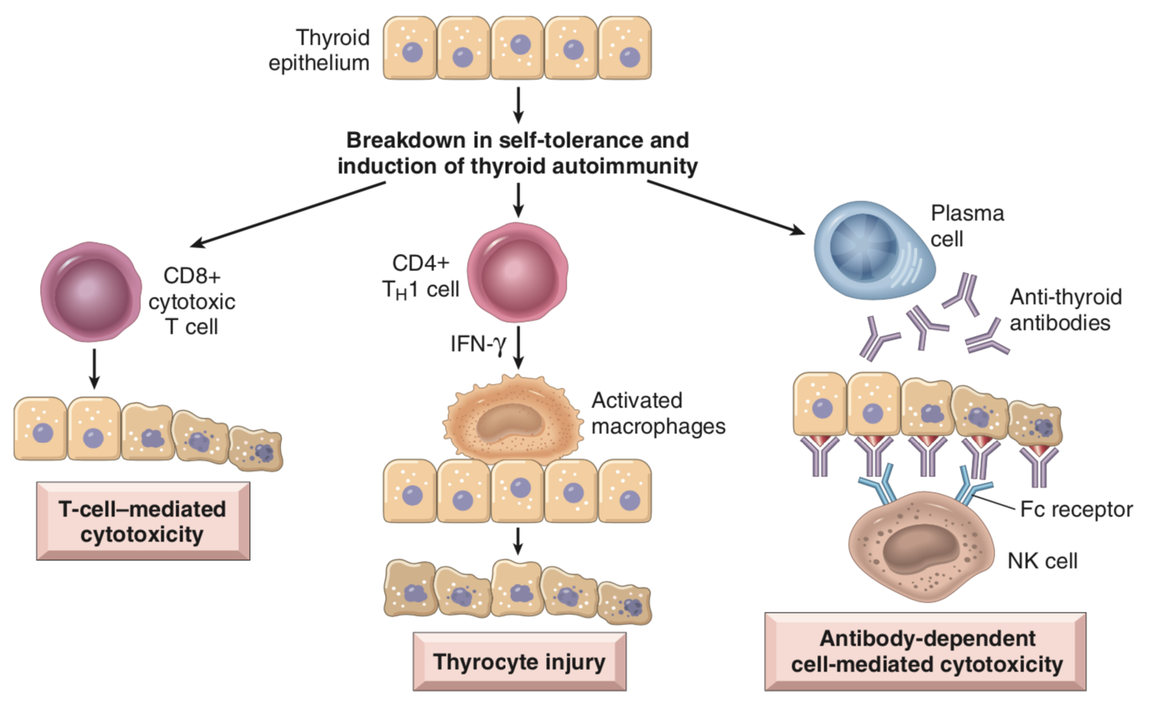
Thyroiditis
Introduction
Clinically significant types of thyroiditis:
Hashimoto thyroiditis (or chronic lymphocytic thyroiditis).
Granulomatous (de Quervain) thyroiditis. (resolve within two months)
Subacute lymphocytic thyroiditis.
1- Chronic Lymphocytic (Hashimoto) Thyroiditis
The most common cause of hypothyroidism in areas of the world where iodine levels are sufficient.
Characterized by gradual thyroid failure secondary to autoimmune destruction of the thyroid gland.
Prevalence:
Between the ages of 45 and 65 years.
Women more than in men, in a ratio of 10:1 to 20:1.
Pathogenesis
Breakdown in self-tolerance to thyroid autoantigens.
Circulating autoantibodies against thyroid antigens.
The immune response leads to progressive depletion
of thyroid epithelial cells associated with lymphocytic
infiltrates and fibrosis.
Risk factor:
Polymorphisms in multiple immune regulation–associated genes: the linkage to cytotoxic T lymphocyte–associated antigen-4 gene (CTLA4).
Clinical features
Painless enlargement of the thyroid, usually associated hypothyroidism.
As hypothyroidism supervenes, T4 and T3 levels fall, with increase in TSH.
Hashitoxicosis: transient thyrotoxicosis caused by disruption of thyroid follicles, with secondary release of thyroid hormones.
Patients often have other autoimmune diseases and are at increased risk for the development of B cell non-Hodgkin lymphomas but rare.

Slide 8
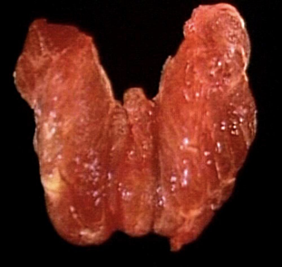
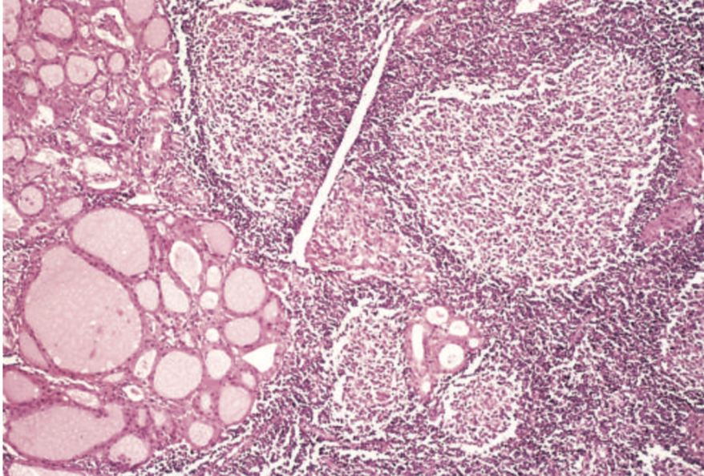
Thyroiditis
Morphology
Macroscopic:
Diffuse and symmetrical enlargement
On cut surface: pale and gray-tan in appearance, and the tissue is firm and friable.
Microscopic:
Mononuclear inflammatory infiltrate containing small lymphocytes, plasma cells, and well-developed germinal centers.
Hürthle, or oxyphil cells: Metaplasia, atrophic follicles lined by epithelial cells with abundant eosinophilic, granular cytoplasm.
Interstitial connective tissue is increased and may be abundant.
Fibrosing variant: small and atrophic thyroid as a result of more extensive fibrosis.
Unlike in Reidel thyroiditis, the fibrosis does not extend beyond the capsule of the gland.
2- Subacute Granulomatous (de Quervain) Thyroiditis
It is believed to be caused by a viral infection or an inflammatory process triggered by viral infections.
A majority of patients have a history of an upper respiratory infection just before the onset of thyroiditis.
The onset of this form of thyroiditis often is acute, characterized by:
Pain in the neck (particularly with swallowing).
Fever and malaise.
Variable enlargement of the thyroid.
Prevalence:
Between 30 and 50 years of age.
Women more commonly than men.

Slide 9
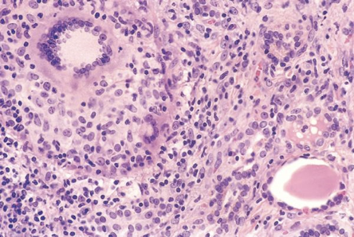
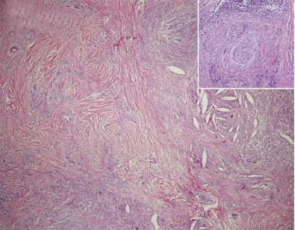
Thyroiditis
Clinical features
Transient hyperthyroidism may occur, as in other cases of thyroiditis, as a result of disruption of thyroid follicles.
The leukocyte count and erythrocyte sedimentation rates are increased¹.
Transient hypothyroidism: due to progression of disease and gland destruction.
The condition typically is self-limited, with most patients returning to a euthyroid state within 6 to 8 weeks.
Morphology
Macroscopic:
Gland is firm, with an intact capsule.
Unilaterally or bilaterally enlarged.
Microscopic:
Disruption of thyroid follicles, with extravasation of colloid leading to a polymorphonuclear infiltrate, which is replaced over time by lymphocytes, plasma cells, and macrophages.
The extravasated colloid provokes an exuberant granulomatous reaction with giant cells.
Healing occurs by resolution of inflammation and fibrosis.
3- Subacute Lymphocytic Thyroiditis (female slides only)
In a subset of patients the onset of disease follows pregnancy (postpartum thyroiditis).
This disease is most likely to be autoimmune in etiology.
Painless neck mass or features of thyroid hormone excess.
The histologic features: lymphocytic infiltration and hyperplastic germinal centers.
4- Riedel thyroiditis
Rare disorder of unknown etiology, is characterized by
extensive fibrosis involving the thyroid and contiguous
neck structures.
Clinical evaluation demonstrates a hard and fixed thyroid
mass, simulating a thyroid neoplasm.
Neoplasms are in elderly patients, while this is in
young adults.
Due to inflammation.

Slide 10
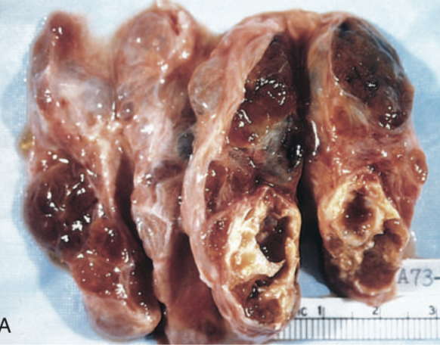
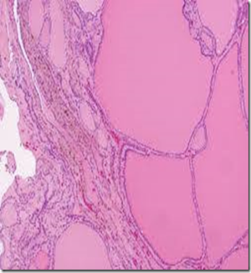
Goiter
Introduction
Enlargement of the thyroid, is the most common manifestation of thyroid disease.
They reflect impaired synthesis of thyroid hormone, caused by:
Leads to a compensatory rise in the serum TSH, causes hypertrophy and hyperplasia of thyroid follicular cells and → enlargement of the thyroid gland.
Euthyroid metabolic state: The compensatory increase in functional mass of the gland is enough to overcome the hormone deficiency.
Goitrous hypothyroidism: If the underlying disorder is sever the compensatory responses are inadequate to overcome the impairment in hormone synthesis.
Can be endemic or sporadic.
The clinical features are caused by the mass effects → Cosmetic problem, Airway obstruction, dysphagia, and compression of large vessels in the neck.
Types of goiter
1
Dietary iodine deficiency
2
Ingestion of certain food e.g. cabbage
3
Rare inherited defect in hormone synthesis.
4
Drug induced
Diffuse goiter
Colloid goiter
Multinodular goiters
Diffuse, symmetric enlargement of the gland.
The follicles are lined by crowded columnar cells, which may pile up and form projections.
All long-standing diffuse goiters convert into multinodular goiters.
Colloid rich gland.
Typically are hormonally silent.
Can manifest toxic multinodular goiter or Plummer syndrome: Thyrotoxicosis secondary to the development of autonomous nodules that produce thyroid hormone independent of TSH stimulation.
Low incidence of malignancy.
Concern for malignancy arise in sudden change In size or symptoms (hoarseness of voice).
Morphology of Multinodular goiters
Macroscopic:
Multilobulated, asymmetrically enlarged glands, which may attain massive size.
On cut surface, irregular nodules containing variable amounts of brown, gelatinous colloid.
Older lesions show fibrosis, hemorrhage, calcification, and cystic change.
Microscopic:
Colloid-rich follicles lined by flattened, inactive epithelium.
Areas of follicular epithelial hypertrophy and hyperplasia.

Slide 11
Summary
Grave’s disease | Chronic Lymphocytic (Hashimoto) Thyroiditis
- Most common cause of hyperthyroidism. - Produce autoantibody: 1- Thyroid-stimulating Ig. 2- Thyroid growth-stimulating Ig. 3- TSH-binding inhibitory Ig. - Triad of manifestations: Thyrotoxicosis, ophthalmopathy and dermopathy. - Morphology: - Macro: Enlarged diffuse hypertrophy. - Micro: Small papillae and colloid with scalloped margins. - Findings: ↑T4 & T3, ↓TSH and ↑radioactive iodine uptake. | - Most common cause of hypothyroidism. - Autoimmune destruction of the thyroid gland. - Increase risk related to (CTLA4). - Clinical features: - Painless. - Episodes of hypothyroidism and transient Hashitoxicosis. - Morphology: - Macro: Diffuse enlargement, gray-tan appearance. - Micro: Mononuclear inflammatory infiltrate with germinal centers.
Thyroiditis
Subacute Granulomatous (de Quervain) Thyroiditis | - Caused by a viral infection, with acute onset. - Characterized by Pain in the neck. - Mainly self-limited (euthyroid). - Morphology: - Macro: firm, with an intact capsule. - Micro: extravasation of colloid and granulomatous reaction with giant cells.
Subacute Lymphocytic Thyroiditis | - Follows pregnancy (postpartum thyroiditis). - Painless.
Riedel thyroiditis | - Characterized by extensive fibrosis in thyroid and contiguous neck structures.
Goiter
- Enlargement of the thyroid. - Most common causes: dietary iodine deficiency. - Types: Diffuse goiter, colloid goiter and multinodular goiters. - Morphology: - Macro: Multilobulated, asymmetrically enlargement, irregular nodules containing colloid. - Micro: Colloid-rich follicles.

Slide 12
Quiz
1- Exophthalmos with weak extraocular muscle movement occurs in a 20-year-old female. what is the most closely related laboratory finding?
Decreased serum free T4 level.
Decreased serum calcium level.
Decreased serum TSH level.
Increased serum cortisol level.
2- A 29-year-old woman complains of nervousness and muscle weakness of 6 months in duration. She is intolerant of heat and sweats excessively. She has lost 9 kg despite increased appetite. She also states that she has missed several menstrual periods. Physical examination reveals warm and moist skin and exophthalmos. Laboratory studies will likely reveal which of the following endocrine abnormalities?
Anti-thyroid DNA antibodies.
Anti-TSH receptor antibodies.
Decreased uptake of radioactive iodine in the thyroid.
Increased serum TSH.
Low serum T3.
3- A 2-year-old child has had failure to thrive. The child is short, with coarse facial features, a protruding tongue, and an umbilical hernia. Profound mental retardation is apparent as the child matures. These findings are best explained by a lack of ?
Cortisol.
Norepinephrine.
Somatostatin.
Thyroxine.
4- Which of the following histopathological features expected to be seen in Hashimoto Thyroiditis?
Colloid is pale, with scalloped margins.
Hürthle, or oxyphil cells.
Psammoma bodies.
Granuloma with giant cells.
5- A 37-year-old woman complain, that she has had difficulty swallowing for about a week. accompanied by • feeling of fullness in the anterior neck. She has a slight fever. Palpation of the thyroid elicits pain. Her serum free T4 level is increased. When seen by an endocrinologist 2 months later. after waiting for an appointment, she no longer has these complaints, and the free T4 level is normal. The condition that best explains these findings is:
Medullary carcinoma
Subacute granulomatous thyroiditis
Toxic multinodular goiter
Toxic follicular adenoma
6- Which of the following genetic mutations increase the susceptibility of Hashimoto Thyroiditis?
CTLA4
NTRK1
P53
BRAF
7- Which of the following tests should be done first when assessing the functional status of the thyroid gland?
A total T4 level
Total T3 level
Thyroid-stimulating hormone (TSH) level
Radioiodine scan
1. C
2. B
3. D
4. B
5. B
6. A
7. C

