Slide 1
Thyroid nodules and neoplasms
Know the definition of a solitary nodule in the thyroid.
Recognize the differential diagnosis of a solitary thyroid nodule.
Understand the classification, pathology and behavior of thyroid carcinoma.
Editing File

Slide 2
Thyroid nodules
Introduction
Hot nodules: Nodules that take up radioactive iodine in imaging studies, produces excess thyroid hormones. more likely to be benign.
Cold nodules: take up iodine less avidly than normal thyroid parenchyma.
Several clinical criteria provide a clue to the nature of a given thyroid nodule:
Neoplastic “Tumor” | Non neoplastic “Hyperplasia”
- Adenoma and carcinoma. - Solitary nodules. - Nodules in males. - Nodules in younger patients. | - A dominant nodule in multinodular goiter. - Simple cysts or foci of thyroiditis.
Radiation treatment to the head and neck → ↑incidence of thyroid malignancy.
Morphologic evaluation by fine needle aspiration and histologic study of surgically resected thyroid parenchyma determine the nature of the nodule.
Adenoma
Benign neoplasms derived from follicular epithelium. usually are solitary.
Difficult to distinguish from a dominant nodule in multinodular goiter, or from follicular carcinomas.
Although the vast majority of adenomas are nonfunctional, a small proportion produce thyroid hormones (toxic adenomas).
Follicular adenomas are not forerunners to carcinomas.
Diagnosis
Radionuclide scanning: adenomas appear as cold nodules relative to the adjacent normal thyroid gland. While toxic adenomas appear as Hot or Warm nodules.
Ultrasonography and fine needle aspiration¹ biopsy: preoperative evaluation of suspected adenomas.
Prognosis
Excellent prognosis and do not recur or metastasize.
Removed surgically to exclude malignancy.
Can’t distinguish between adenoma and carcinoma by fine needle aspiration.

Slide 3
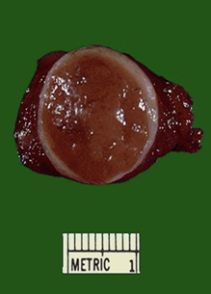
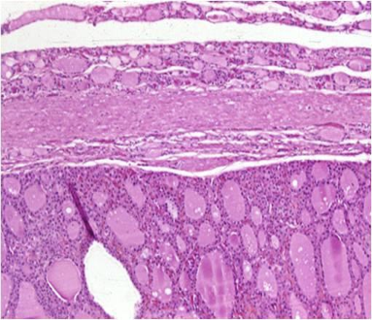
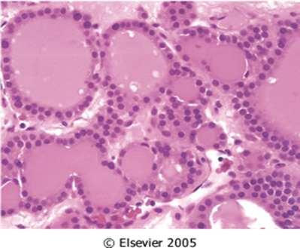
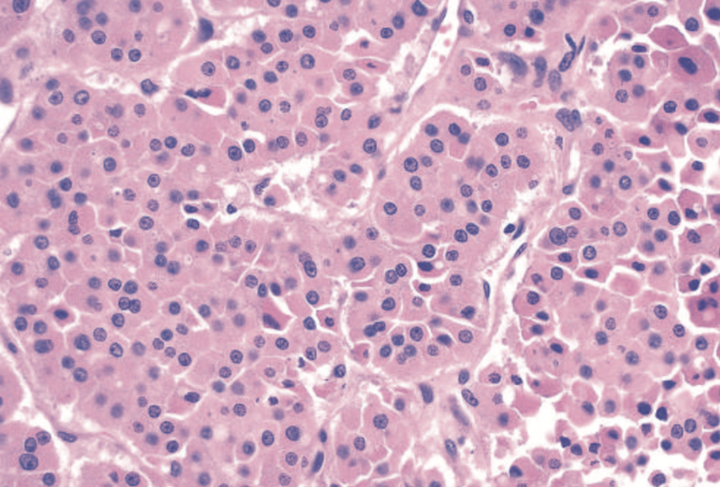
Thyroid nodules
Morphology
Macroscopic:
Multinodular goiters
- Multiple nodules. -Do not compress adjacent thyroid.
- Lack a well-formed capsule.
Adenoma
- Solitary, spherical lesion. - Compresses the adjacent non-neoplastic thyroid.
Neoplastic cells are demarcated from the adjacent parenchyma by: well-defined, intact capsule.
Microscopic:
Cells are arranged in uniform follicles that contain colloid (arrow).
Oxyphil or Hürthle cell change: brightly eosinophilic granular cytoplasm. Clinically no different from conventional adenoma.
Follicular carcinomas is different from follicular adenoma in which it demonstrate capsular and/or vascular invasion.
Hürthle cell adenoma
Normal
Capsule
Nodules

Slide 4
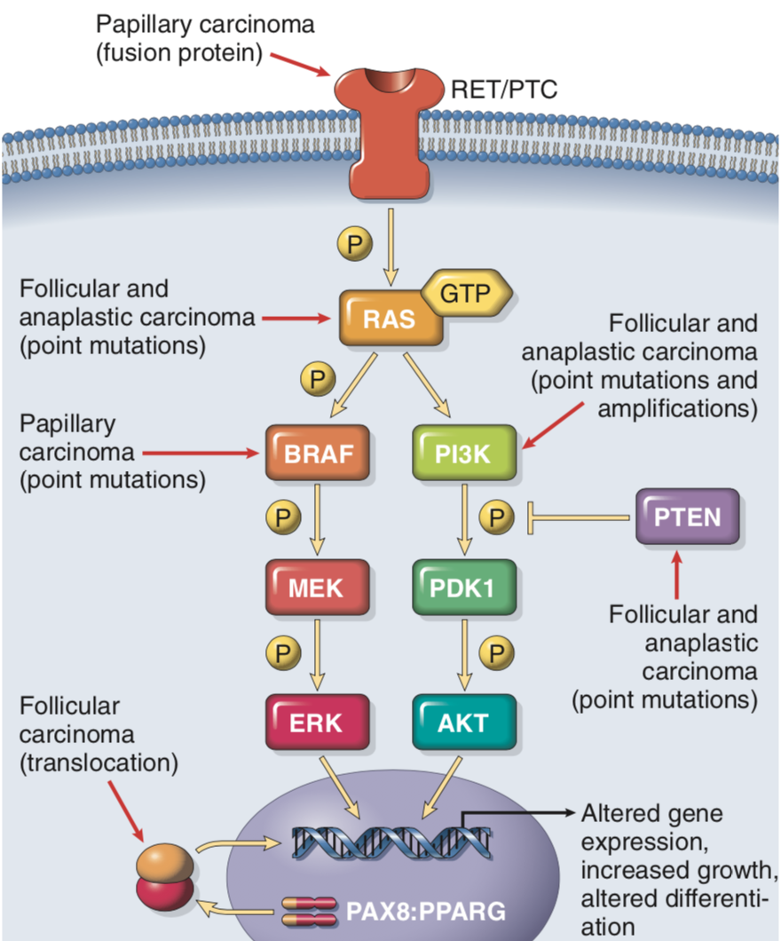
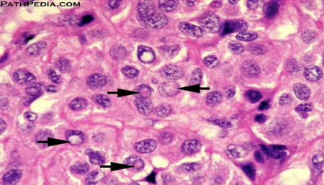
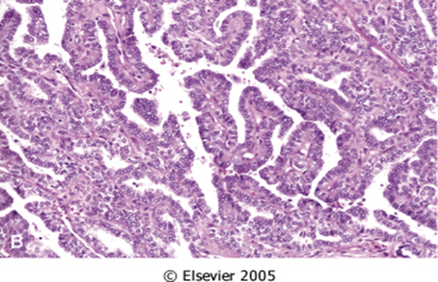
Carcinomas
Types
Papillary carcinoma (> 85% of cases)
Follicular carcinoma (5% to 15% of cases)
Medullary carcinoma (5% of cases)
Anaplastic carcinoma (<5% of cases)
Incidence
Exposure to ionizing radiation.
The ages of 25 and 50.
Solitary or multifocal lesions.
1- Papillary carcinoma (PTC)
The most common form of thyroid cancer.
Occur at any age.
Associated with previous exposure to ionizing radiation.
Well differentiated
Pathogenesis | Rearrangements of the tyrosine kinase receptors RET or Neurotrophic Tyrosine Kinase Receptor (NTRK1) or activating point mutations in BRAF.
Clinical manifestation | Nonfunctional¹ tumors, Painless mass in the neck, either within the thyroid or as metastasis in a cervical lymph node.
Prognosis | - Indolent lesions, with 10-year survival rates in excess of 95% - Less favorable among patients >40 years and the presence of extrathyroidal extension, and presence of distant metastases.
Diagnosis | - Established by fine-needle. - Based on nuclear features even in the absence of a papillary architecture.
Morphology | - The nuclei of papillary carcinoma cells: - Optically clear appearance, ground glass or “Orphan Annie eye” nuclei: very finely dispersed chromatin. - Grooves. - Intranuclear inclusions (pseudoinclusions). - Papillary architecture. - Psammoma bodies: Concentrically calcified structures. Most common variant of PTC: follicular variant which composed predominantly or exclusively of follicles.
Not associated with hypo or hyperthyroidism.

Slide 5
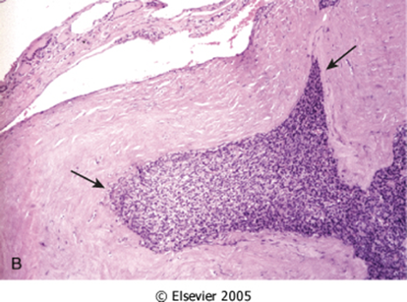
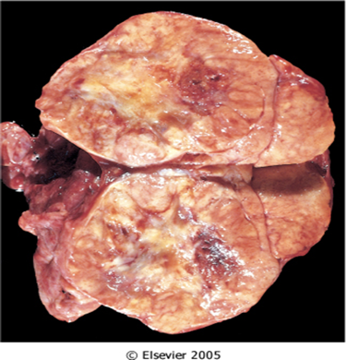
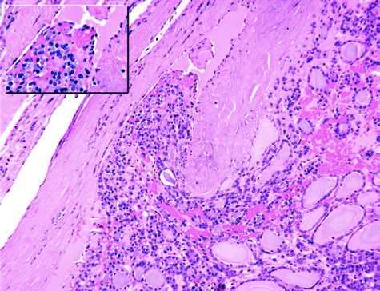
Carcinomas
2- Follicular carcinoma
More common in women (3:1).
Between 40 and 60 years.
More frequent in areas with dietary iodine deficiency.
Pathogenesis | Mutations in the RAS family of oncogenes.
Manifestation | - Solitary cold thyroid nodules. - Metastasize through the bloodstream to the lungs, bone, and liver.
Prognosis | - Minimally invasive (well encapsulated) → 10 year survival rate 90%. - Widely invasive carcinoma → 10 year survival rate less than 50%.
Morphology | - Fairly uniform cells forming small follicles. - Reminiscent of normal thyroid.
 | Widely invasive: infiltrating the thyroid parenchyma and extrathyroidal soft tissue.
 | Minimally invasive: sharply demarcated lesions. - Impossible to distinguish from follicular adenomas on gross examination. - Extensive histologic sampling of the tumor capsule–thyroid interface is needed, to exclude capsular and/or vascular invasion.
Follicular carcinomas demonstrate capsular invasion (arrows)
Minimal invasion

Slide 6
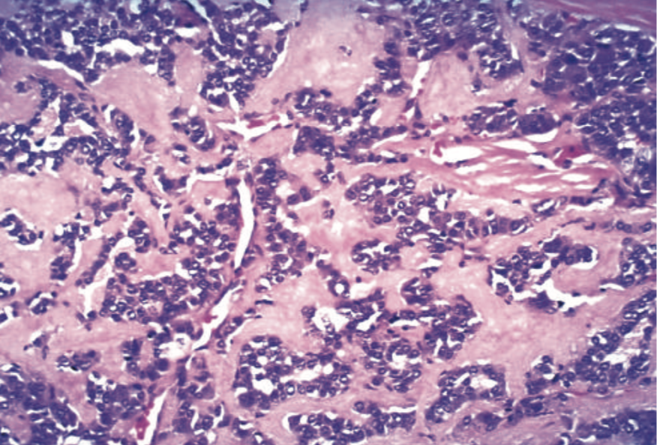
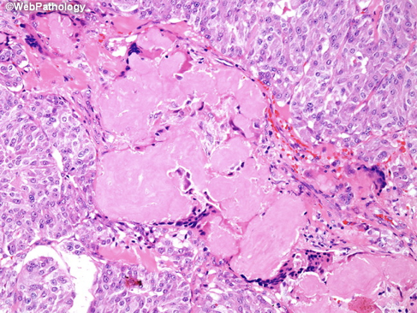
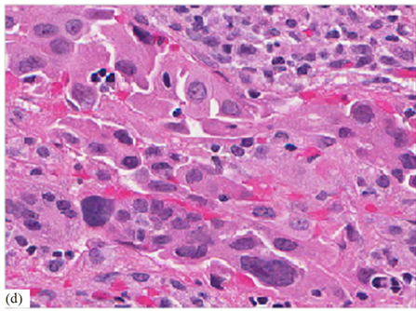
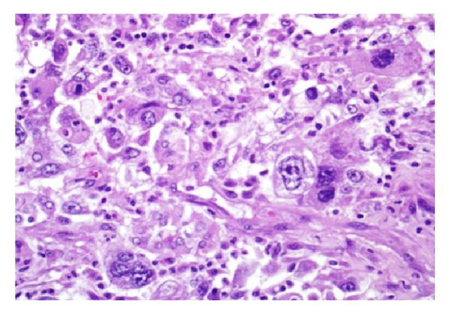
Carcinomas
3- Medullary carcinoma
Neuroendocrine neoplasms derived from the parafollicular cells, or C cells of the thyroid.
Secrete calcitonin, which its measurement used in diagnosis and postoperative follow-up.
Pathogenesis
70% of tumors arise sporadically.
30% are Familial, occurring in the setting of multiple endocrine neoplasia (MEN-2) syndrome¹ 2A or 2B.
Or Familial medullary thyroid carcinoma, or FMTC²: Familial tumors without an associated MEN syndrome.
Both familial and sporadic forms are associated with RET
proto-oncogene mutation.
Morphology
Polygonal to spindle cells.
Amyloid deposition (arrows), stain with congo red stain.
Bilaterality.
Multicentricity.
Necrosis.
Hemorrhage.
4- Anaplastic Carcinomas
Undifferentiated tumors of the thyroid follicular epithelium.
Can be arising from a more differentiated carcinoma (e.g papillary)
Inactivating point mutations in the p53 tumor suppressor gene.
100% lethal.
Occur in older age group > 65 year.
Morphology
Highly anaplastic cells:
Large, pleomorphic giant cells, including occasional osteoclast-
like multinucleated giant cells.
Spindle cells with a sarcomatous appearance.
Mixed spindle and giant cells.
Small cells.
In younger patients.
Adults. 50-60.

Slide 7
Summary
 | Definition | Pathogenesis | Morphology | Prognosis
Adenoma | Benign neoplasms derived from follicular epithelium. Cold nodules | __ | - Macro: Solitary lesion compressing the adjacent tissue, demarcated with intact capsule. - Micro: - Follicles contain colloid. - Hürthle cell. | Excellent prognosis and do not recur or metastasize.
Papillary carcinoma >85% | The most common form of thyroid cancer. | - Rearrangements of RET or NTRK1. - Activating point mutations in BRAF. | Nuclei: Orphan Annie eye, Grooves, pseudoinclusions, Papillary architecture and Psammoma bodies. | 10-year survival rates: 95% Less favorable among patients >40
Follicular carcinoma 5% - 15% | - Solitary cold thyroid nodules. - Metastasize through the bloodstream to the lungs, bone, and liver. | Mutations in the RAS family of oncogenes. | - Small follicles. - Widely invasive: infiltrating the thyroid and extrathyroidal tissue - Minimally invasive: sharply demarcated. | - Minimally invasive → 10 year survival 90%. - Widely invasive carcinoma → 10 year survival <50%.
Medullary carcinoma 5% | Neuroendocrine neoplasms derived from the parafollicular cells, or C cells of the thyroid. | - Familial, with (MEN-2) 2A or 2B. - Familial medullary thyroid carcinoma. - RET proto oncogene mutation. | Polygonal to spindle cells. Amyloid deposition Bilaterality. Multicentricity. Necrosis. Hemorrhage. | __
Anaplastic carcinoma <5% | - Undifferentiated tumors of the thyroid follicular epithelium. - Can be arising from a more differentiated carcinoma (e.g papillary). | Inactivating point mutations in the p53 tumor suppressor gene. | Large, pleomorphic giant cells. Spindle cells with a sarcomatous appearance. Small cells. | 100% lethal.

Slide 8
Quiz
1- Which of the following increases the incidence of thyroid malignancy?
Hot nodules.
Follicular adenomas.
Radiation treatment.
Dominant nodule in multinodular goiter.
2- A 32-year-old woman presents with a solitary, nontender, firm nodule on the left side of her neck. Thyroid function tests are within normal limits. A fine-needle biopsy reveals malignant cells. light microscopy shows ground glass nuclei, grooves and pseudoinclusions. What is the appropriate pathologic diagnosis?
Anaplastic carcinoma.
Follicular carcinoma.
Lymphoma.
Papillary carcinoma.
3-Which ONE of the following mutations is commonly seen in cases of follicular carcinoma?
BRAF
MEN-2
p53
RAS
4- Which ONE of the following carcinomas is characterized by the presence of Congo red material in its stroma?
Medullary carcinoma.
Anaplastic carcinoma.
Papillary carcinoma.
Follicular carcinoma.
5- Which of the following is the difference between follicular adenoma and
follicular carcinoma?
Presence of oxyphil cell changes.
Vascular invasion.
Well-defined, intact capsule.
Presence of amyloid deposition.
6- A 50 year old man presents with a thyroid neoplasm. Detailed history elicits that his aunt had died from a "thyroid illness". His family and first order blood relatives are examined. His sister and a nephew also are found to have small thyroid tumors. His son is found to have a pheochromocytoma. Which of the following gene mutations are most likely to be associated with this condition?
NTRK1
RAS
MEN-1
RET
7- Which one of the following is most likely to have papillary carcinoma?
32 years old female with previous history of ionizing radiation.
21 years old male with painful mass in the neck.
69 years old male who has dyspnea.
47 years old female with dietary iodine deficiency.
8- Which of the following thyroid neoplasm has the worst prognosis?
Follicular carcinoma.
Papillary carcinoma.
Anaplastic carcinoma.
Medullary carcinoma.
1. C
2. D
3. D
4. A
5. B
6. D
7. A
8. C

