Slide 1
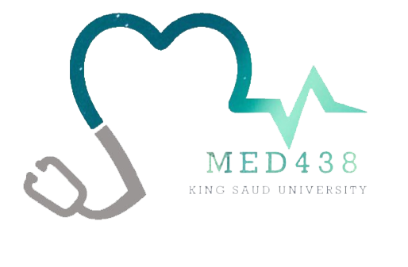
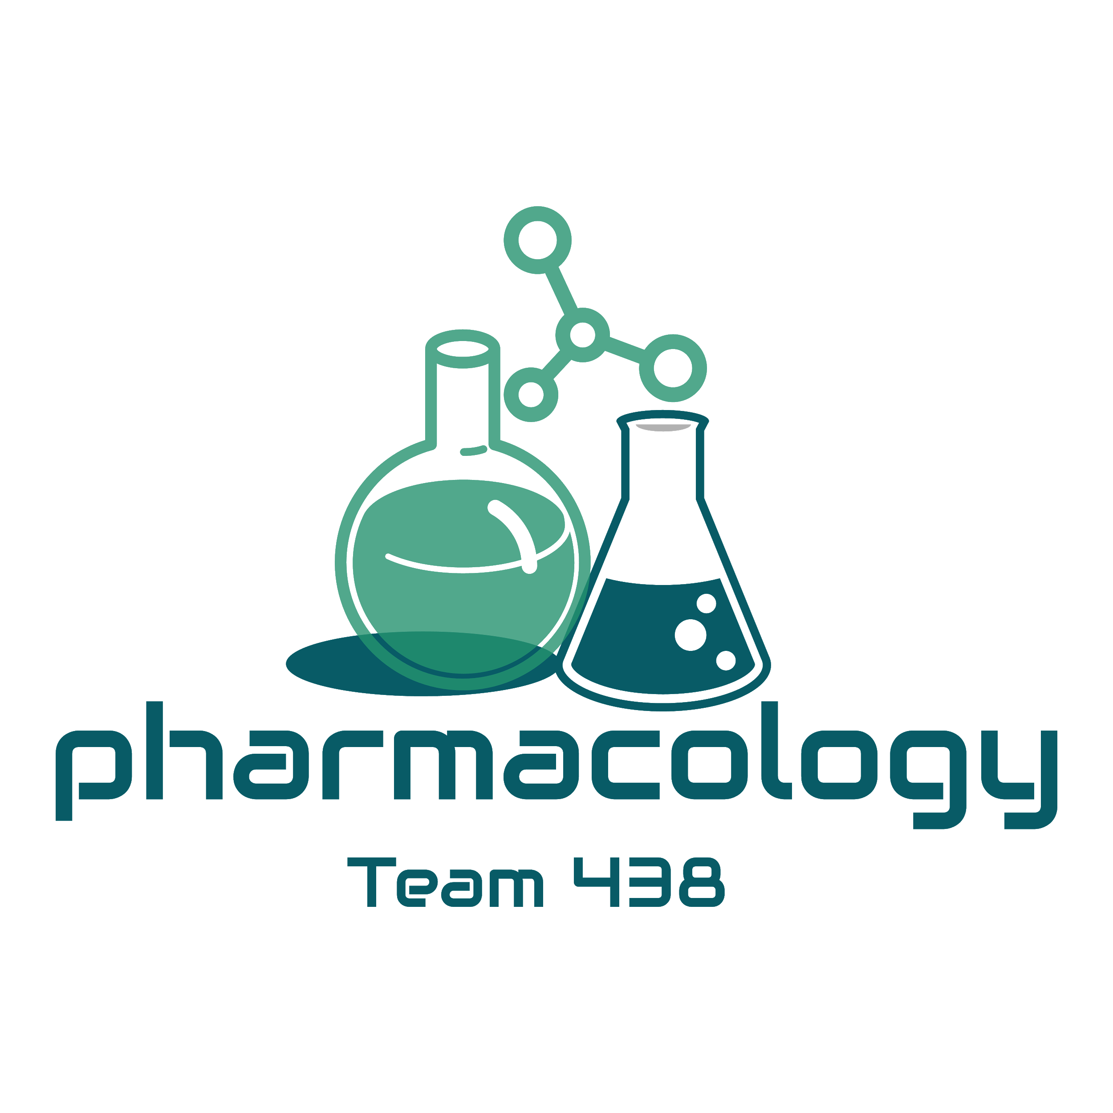
Editing File
Mnemonic File
Endocrine Block
Pharmacology team 438
Oral Hypoglycemic Drugs
Objectives:
By the end of the lecture , you should know:
Classify different categories of antidiabetic drugs.
Identify mechanism of action, pharmacokinetics and pharmacodynamics of each class of antidiabetic drugs.
Identify the clinical uses of antidiabetic drugs
Know the side effects, contraindications of each class of antidiabetic drugs.
Color index:
Black : Main content
Red : Important
Blue: Males’ slides only
Purple: Females’ slides only
Grey: Extra info or explanation
Green : Dr. notes

Slide 2
Types of diabetes mellitus
Type II
VS
Type I
Due to obesity & genetic factors
-80-90% occurrence
-Over age 35
Due to autoimmune or viral diseases (the only treatment for insulin dependent diabetes is insulin injections)
Patients with Type II diabetes have two physiological defects:
Abnormal insulin secretion. (partial production of insulin)
Resistance to insulin action in target tissues associated with decreased number of insulin receptors.
Treatment of Type II Diabetes (NIDDM)¹
Proper dietary management.
Caloric restriction and weight loss are IMP in obese diabetic patients.
Oral antidiabetic drugs.
Increase physical activity.
Oral hypoglycemic drugs
( Antidiabetic drugs )
1
Insulin secretagogues ²:
Sulfonylurea drugs.
Meglitinides.
Incretin mimetics.
2
Insulin sensitizers ³:
Biguanides
Thiazolidinediones
3
Agents that reduce carbohydrate absorption:
Alpha glucosidase inhibitors
4
Agents that reduce glucose renal reabsorption
(Increase glucose excretion):
Sodium/glucose cotransporter 2 (SGLT2) inhibitors
Type 2 diabetes is managed through a stepwise approach, starting with diet and exercise, followed by oral hypoglycemic drugs, then combination therapy if the patient is not responding to monotherapy of oral hypoglycemics, and finally in advanced severe cases insulin injections are used.
They increase the production of insulin
They increase the sensitivity of peripheral tissues to insulin.

Slide 3
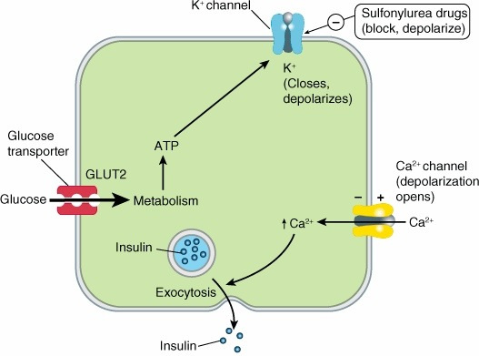
Insulin secretagogues
Are drugs which increase the amount of insulin secreted by the pancreas
Their action depends upon functioning pancreatic β-cells (Not for T1D)
It includes: 1. Sulfonylureas 2. Meglitinides 3. Incretin mimetics
sulfonylureas
Prof.Hanan= memorize the highlighted drugs
Class | First generation (-amide) |  | Second generation (-ride/zide)
Drug | -Acetohexamide -Tolazamide -Chlorpropamide | - Tolbutamide | - Glyburide (glibenclamide) - Glimepiride | - Gliclazide - Glipizide
 | Long acting | Short acting | Long acting (-ride) | Short acting (-zide)
MOA | ↑Hyperglycemia→Blockade of ATP dependent K+channels→ Opening of voltage-dependent Ca+ channels → ↑intracellular calcium in the beta cells → ↑Insulin release Stimulate insulin release from functioning B cells by blocking of ATP-sensitive K channels which causes depolarization and opening of voltage- dependent calcium channels, which causes an increase in intracellular calcium in the beta cells, which stimulates insulin release.
P.K | Orally, well absorbed. All are highly bound to plasma proteins. Excreted in urine (caution:elderly and renal disease). Cross placenta, stimulate fetal β-cells to release insulin → fetal hypoglycemia at birth.¹
 | - |  | More potent than first generation Have longer duration of action. Have fewer adverse effects & drug interactions. Less frequency of administration.
Uses | Treatment of Type II diabetes monotherapy or in combination with other antidiabetic drugs ²
ADR | Hyperinsulinemia & Hypoglycemia: More common in long acting sulfonylureas; particularly (glyburide, and glimepiride) More in old age, hepatic or renal diseases. Weight gain due to increase in appetite unless the diabetic diet and exercise program are followed. Allergy manifestation as they contain Sulfa.
Reach peak concentration
after 2-4 hr
Duration of action is variable
Metabolized in liver
 | Glipizide | Glyburide (Glibenclamide) | Glimepiride
Absorption | Well reduced by food | Well
Metabolism | Yes | Yes
Duration of action | 10 – 16 hrs, short | 12 – 24 hrs, long
Doses | Divided doses 30 min before meals | Single dose
Excretion | Urine
All hypoglycemic drugs are C.I during pregnancy, even if the patient was diagnosed with type 2 diabetes. The only treatment that is allowed during pregnancy is insulin.
Determined by measuring blood glucose level and the patient’s response to the treatment

Slide 4
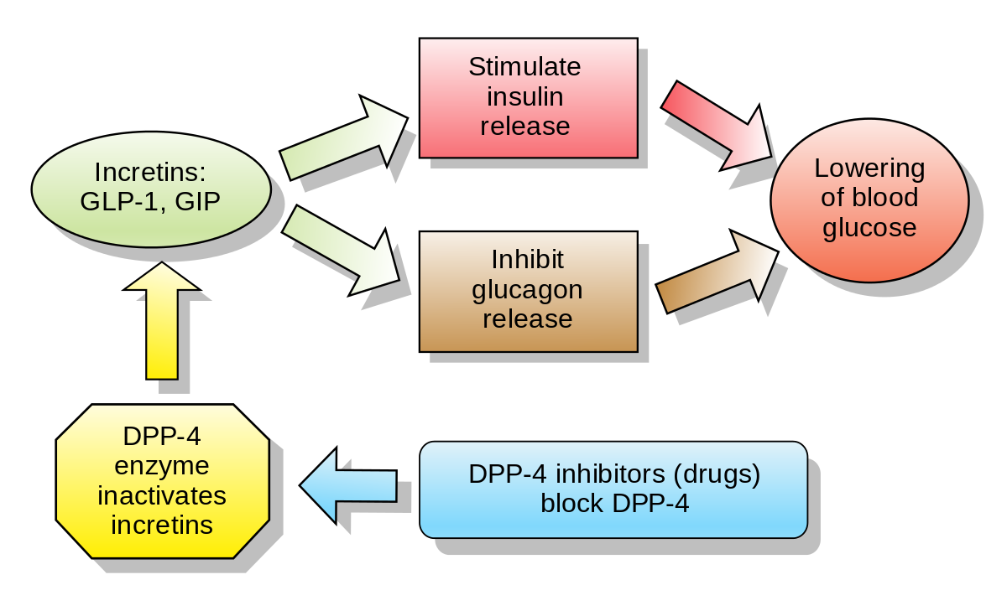
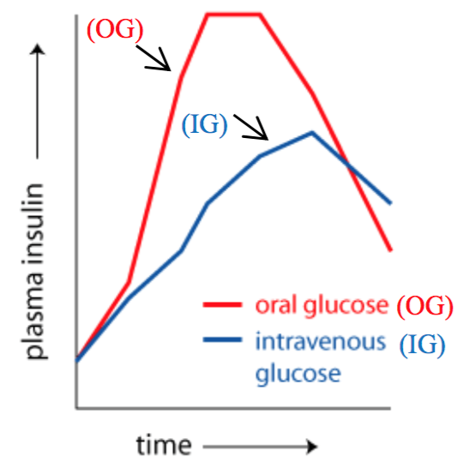
2) Meglitinides
Drug | Repaglinide (-glinide)
MOA | Rapidly acting insulin secretagogues Mechanism of action is identical to sulfonylureas (↑Hyperglycemia→Blockade of ATP dependent K+channels→ Opening of voltage-dependent Ca+ channels → ↑intracellular calcium in the beta cells → ↑Insulin release)
P.K | Orally, well absorbed. Very fast onset of action, peak 1 h. Short duration of action (4 h). Metabolized in liver and excreted in bile. Taken just before each meal (3 times/day) The dose should be skipped if the meal is missed ¹.
Uses | Type II diabetes as a monotherapy or in combination with other oral hypoglycemic drugs As alternative to sulfonylureas (SU) in patients allergic to SU and in elderly
ADR | Less incidence than sulfonylureas ²: Hypoglycemia. Weight gain.
3) Incretin mimetics
Incretins
They are GI hormones secreted from intestine in response to food even before blood glucose level becomes elevated.
They are carried through circulation to
pancreatic beta cells.
Incretins regulate blood glucose by (MAO):
Increase insulin secretion
Decrease glucagon secretion
Incritine includes:
GLP-1 (glucagon-like peptide-1)
GIP (gastric inhibitory peptide)
Both are inactivated by dipeptidyl peptidase-4 (DPP-4)
A comparison between the the amount of insulin secretion in response to Oral and I.V glucose.
It shows that oral glucose induces insulin secretion more than I.V glucose due to the action of incretins
To avoid hypoglycemia.
Because they have shorter duration of action.

Slide 5
Types of Incretin mimetics
GLP-1 agonists
(-glutide)
DPP- 4 inhibitors
(-gliptin)
Dulaglutide (Trulicity¹)
Liraglutide
Victoza ¹, the lower dose for diabetes
Saxenda ¹, the higher dose for obesity
Exenatide
Byetta, immediate-release given S.C. twice daily
Bydureon, extended-release given once weekly
Semaglutide (Rybelsus¹) the first oral GLP-1
Sitagliptin (Januvia¹)
vildagliptin
Linagliptin
Class | GLP-1 agonists (-glutide) | DPP- 4 inhibitors (-gliptin)
Drugs | Liraglutide (Victoza, Saxenda) | Sitagliptin (Januvia)
MOA | Binds to GLP-1 receptors & stimulates insulin secretion from β cells It also reduces glucagon secretion by inhibiting a cells of the pancreas It decreases appetite and inhibits body weight gain | Inhibit DPP-4 enzyme and leads to an increase in incretin hormones (GLP-1) level. This results in an increase in insulin secretion & decrease in glucagon secretion
P.K | given s.c. once/day (single- dose prefilled disposable pens) The maximum dose of Victoza is 1.8mg ² | given orally given once daily half life = 8– 14 h
Uses | Saxenda: As a treatment for adults who are obese or overweight with at least one weight-related comorbid condition (e.g. hypertension, type 2 diabetes mellitus, or dyslipidemia). Used together with diet and exercise to treat type 2 diabetes and in patients who are not controlled with other oral antidiabetics. | Type II DM as an adjunct to diet & exercise as a monotherapy or in combination with other antidiabetic drugs
ADR | Nausea,vomiting and diarrhea (most common) Hypoglycemia when combined with sulfonylureas or insulin (not alone) Loss of appetite Pancreatitis (rare) | Nausea, abdominal pain, diarrhea Nasopharyngitis Headache
C.I | Not used in type 1 diabetes | -
Trade name
to avoid the dose side effects, you give partial doses (e.g. starting at 0.6) and gradually increasing it (0.8, 1.2, etc) but the maximum is 1.8

Slide 6
Insulin sensitizers¹
Drugs that increase the sensitivity of peripheral target organs to insulin
Biguanides
E.g. Metformin
Thiazolidinediones
E.g Pioglitazone
Biguanides
Drug | Metformin
MOA | Reduces insulin resistance. Increases sensitivity of liver, muscle & adipose tissues to insulin & increase peripheral glucose utilization (tissue glycolysis). Inhibits hepatic glucose production (gluconeogenesis). Impairs glucose absorption from GIT. Improve lipid profile : ↓LDL, ↓ VLDL , ↑HDL
P.K | Orally Not bound to serum protein, t 1⁄2: 3 hours. Not metabolized, excreted unchanged in urine
Advantages | No risk of hypoglycemia² No weight gain has prominent lipid-lowering activity³ Inexpensive
Uses | In patients with type 2 diabetes who are obese because it promotes modest weight reduction (first-line therapy). Type 2 diabetes as monotherapy or in combination with other antidiabetics.
ADR | GIT disturbances⁴: Metallic taste in the mouth, nausea, vomiting, diarrhea Metformin should be taken with meals and should be started at a low dose to avoid intestinal side effects then increase gradually. Lactic acidosis⁵ (very rare): Serious lactic acid accumulation usually occurs only in the presence of predisposing conditions: Renal insufficiency Severe liver disease Alcohol abuse⁶ Heart failure⁷ Pulmonary insufficiency⁷ Cardiogenic or septic shock⁷ In long term use: Interference with vitamin B12 absorption⁸.
C.I | Renal disease Liver disease Cardiopulmonary dysfunction Pregnancy Alcoholism
1: first line therapy afterlife style modifications.
2: only happens with insulin secretagogues, because they ONLY increase the sensitivity and won’t increase insulin secretion.
3: very beneficial as most diabetic patients have abnormal lipid profile, these drugs are even used by some obese patients to decrease obesity and correct lipid profile without the risk of hypoglycemia.
4: particularly at the beginning of the therapy, ask patient to tolerate GIT disturbances as they will subside in a few weeks
5: due to their glycolytic action
6: because alcohol itself increases glycolysis
7: due to low oxygen delivery to tissues. Tissues start depending more on glycolysis so patient already has high glycolysis.
8: later on in the therapy when B₁₂ absorption is affected it is recommended to give the patient supplements.

Slide 7
2) Thiazolidinediones
Drug | Pioglitazone & Rosiglitazone (-glitazone)
MOA | Activate peroxisome proliferator-activated receptor-Gamma (PPAR-Gamma¹) Increase sensitivity of target tissues to insulin. Increase glucose uptake and utilization in muscle and adipose tissue
P.K | Orally (once daily dose). Highly bound to plasma albumins (99%) Slow onset of activity Half life 3-4 h² Metabolized in the liver Excreted in bile and urine
Uses | Type II diabetes with insulin resistance. Used either alone or in combination with sulfonylurea, biguanides or insulin. No risk of hypoglycemia when used alone
ADR | Hepatotoxicity (monitor liver function tests for 1st year of therapy). Fluid retention (Edema) Congestive heart failure³ Mild weight gain Failure of estrogen-containing oral contraceptives⁴
α-Glucosidase inhibitors
Drug | Acarbose | Miglitol
MOA | Reversible inhibitors of intestinal α-glucosidases in intestinal brush border cells that are responsible for carbohydrate digestion. Decrease carbohydrate digestion and glucose absorption in small intestine (lower postprandial glucose level).
P.K | No hypoglycemia if used alone Given orally, not absorbed⁵ and taken just before meals. | -
Uses | Are effective alone in the earliest stages of impaired glucose tolerance⁶ Are not recommended alone as therapy for moderate to severe hyperglycemia⁷ Most useful in combination with other oral hypoglycemic drugs or with insulin.
ADR | GIT: Flatulence, bloating, diarrhea, abdominal pain.
C.I | Irritable bowel syndrome. Inflammatory bowel disorders. Intestinal obstruction
1: present in peripheral tissue, increase the tissues’ insulin sensitivity.
2: only given once daily despite short half life because even though its plasma level decreases, its effect (configurations changes) that it does to the receptor are long lasting.
3: not given to cardiac patients. 4: drug-drug interaction
5:advantage as its effect is in the GIT. 6: pre-diabetes
7: not given alone if patient is proven to be diabetic

Slide 8
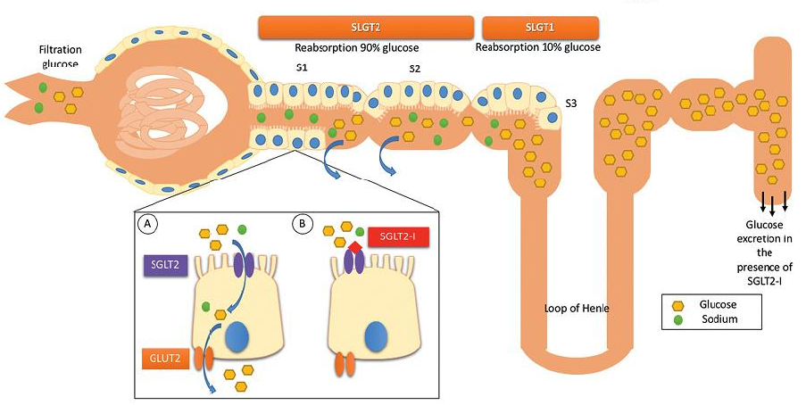
Sodium-glucose transporter 2 inhibitors
Drug | Canagliflozin, Dapagliflozin, Empagliflozin (-gliflozin)
MOA | Inhibits SGLT2 in the kidneys→inhibits glucose and Na reabsorption→ this allows excess glucose to be excreted in the urine→ this will reduce blood sugar levels.
Uses | Used with diet and exercise to control high blood sugar in patients with type 2 diabetes. To reduce risk of major adverse cardiovascular events¹ in adults with type 2 diabetes and established cardiovascular disease.
ADR | Urinary tract infections. Yeast infections²(vagina or penis) Increased urination and dry mouth. Thirst Itching (vagina or penis) Fatigue
Summary from Dr. slides
Class \ Drug | Mechanism | Site of Action | Main Advantages | Main ADRs
Sulfonylureas E.g Gliclazide | Stimulates insulin secretion | Pancreatic beta-cells | - Effective - Inexpensive | - Hypoglycemia - Weight gain
Meglitinides E.g Repaglinide |  |  | - Sulfa free
Biguanides E.g Metformin | Decrease insulin resistance | Liver | - Mild weight loss - No hypoglycemia | - GI symptoms - Lactic Acidosis - Metallic taste
Thiazolidinediones E.g Pioglitazone |  | Fat, muscle | - No hypoglycemia | - Hepatotoxicity - Edema - Mild weight gain
Incretins mimetics E.g Dulaglutide | Increase incretin | GI tract | - S.C once a day | -N&V
DPP-4 inhibitors E.g Sitagliptin | Inhibit incretin breakdown |  | - Orally | - N & abdominal pain
a-Glucosidase E.g Acarbose | Decrease glucose absorption in small intestine |  | - Low risk | - GI symptoms, flatulence
SGLT-2 inhibitors E.g Dapagliflozin, Canagliflozin | Inhibit renal SGLT-2 | Kidney | - Orally - Reduced Na (CV benefits ) | - Genital yeast - UTI - Increased Urination
1: used in patients with cardiac problems due to its effect on sodium excretion.
2: e.g.: candidiasis.

Slide 9
Quiz
MCQ
Q1- Which of the following classes of oral diabetes drugs is paired most appropriately with its primary mechanism of action?
A. DPP-4 inhibitor—inhibits breakdown of complex carbohydrates.
B. Sulfonylurea—increases insulin secretion.
C. Thiazolidinedione—decreases hepatic gluconeogenesis.
Q2- Which of the following statements is characteristic of metformin?
A. Metformin is inappropriate for initial management of type 2 diabetes.
B. Metformin decreases hepatic glucose production.
C. Metformin undergoes significant metabolism via the cytochrome P450 system.
D. Metformin should not be combined with sulfonylureas or insulin.
E. Weight gain is a common adverse effect.
Q3- A 64-year-old woman with a history of type 2 diabetes is diagnosed with heart failure. Which of the following medications would be a poor choice for controlling her diabetes?
A. Glyburide. B. Nateglinide. C. Pioglitazone. D. Sitagliptin.
Q4- KD is a 69-year-old male with type 2 diabetes and advanced chronic kidney disease. Which of the following diabetes medications is contraindicated in this patient?
A. Glipizide. B. Metformin. C. Liraglutide. D.Tolbutamide
Q5- Which of the following drugs for diabetes would be LEAST likely to cause weight gain?
A. Glimepiride. B. Liraglutide. C. Pioglitazone. D. Repaglinide.
Q6- Which of the following diabetes medications is most appropriately paired with an adverse effect associated with its use?
A. Canagliflozin—lactic acidosis. B. Metformin—urinary tract infections.
C. Repaglinide—heart failure. D. Liraglutide—pancreatitis.
SAQ
- 48-years-old male who is obese and he failed to loss his weight with diet and exercises , his blood glucose and lipid is significantly high and has diagnosed with type 2 DM.
Q1- Which drug is the first line of treatment in his case?
Q2- What is the M.O.A of that drug?
Q3- If the patient drinks alcohol almost daily and he did not tell his doctor that , what is the adverse effect that could be seen in this patient after taking the drug in q1?
Q4- Newly patient who was prediabetes, he is diagnosed now with type 2 diabetes. The medical history relieves that he can not tolerance Sulfasalazine or sulfamethoxazole. What is the drug that can be safe to be used in his case ?
Q5- 45-years-old female with type 2 diabetes, she has history of IBD “Crohn’s disease”, what is the drug that contraindicated in this case?
MCQ
SAQ
Q1 | B
Q2 | B
Q3 | C
Q4 | B
Q5 | B
Q6 | D
Q1 | Metformin
Q2 | Increases liver,muscle & adipose tissues sensitivity to insulin & increase peripheral glucose utilization (tissue glycolysis)
Q3 | Lactic acidosis
Q4 | Repaglinide
Q5 | α-Glucosidase inhibitors E.g. Acarbose, Miglitol
Answers:

Slide 10
Thank you for all your love and support.
Good luck future doctors!
Team Leaders:
May Babaeer Zyad Aldosari
This Magnificent Work was Done By:
Joud AlKhalifah Reema AlSerhani
Note writers
Raghad AlKhashan Nouf AlShammari
Quiz writers
Noura AlMazrou Shahad Alsahil

