Slide 1
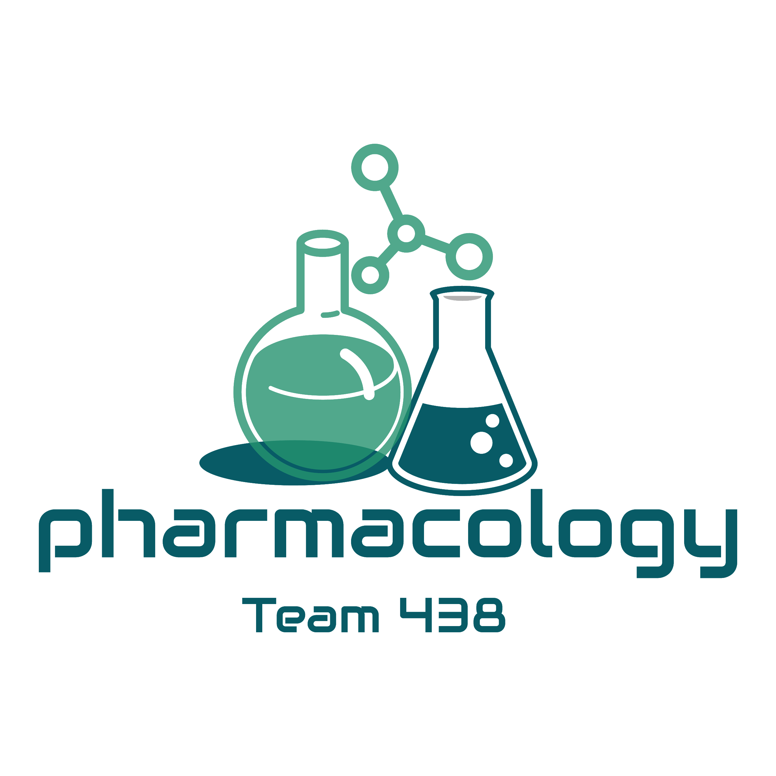
Editing File
Mnemonic File
Endocrine Block
Pharmacology team 438
Growth Hormone & Drugs used in Pituitary Adenoma
Objectives:
By the end of the lecture , you should know:
بمناسبة دخولنا ما يسمى "ربيع الطب", نود أن نعلن عن مسابقة mnemonics
طريقة المسابقة:
1- كتابة mnemonics من إنشاء الطالب في الرابط المخصص لذلك.
2- كتابة بجانب الmnemonics إسم مستعار (Nickname).
سيتم التصويت على أفضل mnemonics وإعلان الإسم المستعار الذي يفوز نهاية البلوك.
تمنياتنا لكم بربيع طب موفق
الإدارة العليا لتيم الفارما
Color index:
Black : Main content
Red : Important
Blue: Males’ slides only
Purple: Females’ slides only
Grey: Extra info or explanation
Green : Dr. notes

Slide 2
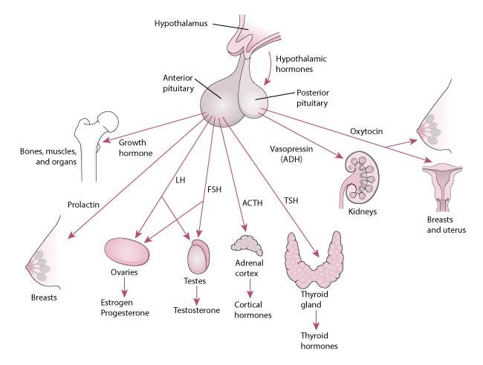
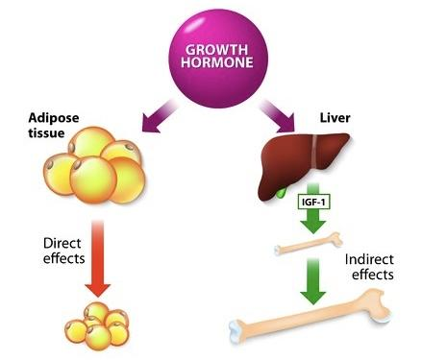
Pituitary and hypothalamus are the link between the nervous system and
the endocrine system.
Hypothalamus is a major regulator of body homeostasis:
Homeostatic control includes regulating hunger, thirst, sex drive, sleep-wake cycles, body temperature, blood glucose.
Endocrine control via regulating the release of pituitary hormones.
Autonomic control via descending pathways to sympathetic & parasympathetic preganglionic neurons.
Limbic function via connections to limbic system regulating emotional behaviors.
Hypothalamic Pituitary Functions
Pituitary and hypothalamus are the link between the nervous system and the endocrine system.
Hypothalamus is a major regulator of body homeostasis:
1
Homeostatic control includes regulating hunger, thirst, sex drive, sleep-wake cycles, body temperature, blood glucose.
2
Endocrine control via regulating the release of pituitary hormones.
3
Autonomic control via descending pathways to sympathetic & parasympathetic preganglionic neurons.
4
Limbic function via connections to limbic system regulating emotional behaviors.
Mechanism of Action of GH
1
Binding of GH to its receptor activates the signaling cascade mediated by receptor associated to JAK tyrosine kinases.
2
The effects of GH are primarily mediated by insulin-like growth factor 1 (IGF-1) released by liver in response to GH.
Stimulates increase in size & mitotic rate of body cells, increases fat utilization
GHRH stimulates secretion of GH; Somatostatins inhibits secretion of GH
Anterior Pituitary: Growth Hormone (GH)
Promotes long bone growth
Enhances amino acid movement through membranes & promotes protein synthesis
Effects of GH
Direct Effect
Indirect Effect ¹
Binds to adipocytes & causes them to break down triglycerides & prevents them from accumulating fat in the blood.
Releases insulin-like growth factor-1 (IGF-1) from the liver.
Stimulates:
Bone growth
Cartilage cells (chondrocytes) growth.
Myoblasts growth & differentiation
Amino Acid uptake & protein synthesis.
Through IGF

Slide 3
Abnormalities of the GH
1
Deficiency or absence of somatotroph cells
Leads to
Underproduction of growth hormone
Example
Pituitary Dwarfism, primary.
(Laron Syndrome/Lorain dwarfism)
Delayed skeletal growth &
retarded sexual development
but alert, intelligent, well proportioned child.
2
Overactivity
(or tumor) of somatotroph cells
Leads to
Overproduction of growth hormone which will increase IGF-1
(Stimulates protein synthesis + Influenced CHO and fat metabolism + Mitosis of all cell types)
Example
Gigantism in children
Onset before bony epiphysis have closed at puberty.
Acromegaly in adults
Onset after puberty.
3
Pituitary Adenoma
A benign tumor of the anterior lobe of the pituitary that causes symptoms either by:
Underproduction: growth hormone deficiency, major problem in children’s growth, hypothyroidism.
Overproduction of the pituitary hormones:
Growth hormone excess resulting in acromegaly or gigantism
Prolactin excess leads to galactorrhoea, menstrual abnormalities and infertility
adrenocorticotropic hormone (ACTH) cause Cushing disease
Thyroid stimulating hormone (TSH) excess lead to Hyperthyroidism.
Drugs Used in Case of GH Deficiency
(GH Agonist)
Drug | Sermorelin | Somatropin ¹ | Somatrem | Mecasermin
 | Synthetic growth hormone releasing hormone (GHRH) | Recombinant human growth hormone which is a 191-amino acid peptide, identical to the native form of hGH. | Recombinant human growth hormone | Recombinant² IGF-1, administered S.C.
Uses | Used if a patient possesses defective hypothalamic releasing of GHRH BUT normally functioning anterior pituitary somatrophs. | Documented Growth failure in pediatric patients associated with GH deﬁciency and Turner syndrome³ (to increase height in girls by 10-15 cm). Idiopathic short stature. Wasting muscle in patients with AIDS. Short bowel syndrome⁴ in patients who are also receiving specialized nutritional support. |  | Used for children with severe IGF1 deﬁciency due to mutations in the GH receptor (Laron dwarﬁsm) or development of neutralizing antibodies against GH.
ADRs⁵ | - | Leukemia. Rapid growth of melanocytic lesions.(pigmentation) Hypothyroidism. Insulin resistance. Arthralgia. Increase in cytochrome P450 activity. |  | The common ADR is Hypoglycemia⁶: can be avoided by consumption of meal 20 min before or after the administration of drug.
Somatropin is more commonly used compared to Somatrem.
Recombinant DNA is a technology used to synthesize proteins and hormones by inserting a specific DNA into the plasmid, forcing the plasmid to synthesize a target hormone.
Chromosomal condition that affects development in females causing short stature.
Bowel resection and intestinal bypass.
Children can tolerate the ADR of GH agonists. 6. Due to its insulin-like effect

Slide 4
Drugs Used in Case of GH Overproduction
(GH Antagonist)
Drug | Octreotide | Lanreotide | Pegvisomant
 | synthetic long-lasting peptide analogue of somatostatin. |  | GH receptor antagonist
MOA | Normally: Somatostatin physiologically inhibits GH secretion, but is rarely used clinically, since it has a very short half-life (few minutes) Octreotide: Mainly Inhibit GH secretion Partially inhibits GH-induced IGF-1 generation. Reduce GHRH release. | - | Normally: GH has 2 distinct receptor binding sites, initiates cellular signaling cascades by dimerizing -conformational changing- 2 GH receptors Pegvisomant: A long-acting derivative of a mutant GH that is able to cross-link GH receptors-bind to the receptor- but is incapable of inducing the conformational changes required for receptor activation.
P.K | Very expensive 45 times more potent Suppress GH levels for 6–12 h. Half-life in plasma being 113 min Peak plasma concentrations within 1 h. Given every 4 weeks. Given S.C \ I.M | Given I.M | Given S.C. Check IGF-1 level every 4-6 weeks. Monitoring GH not useful. Dose 10-40 mg/d.
Uses | Treatment of acromegaly & gigantism.
ADRs | Signiﬁcant Gastrointestinal disturbances. Gallstones. Cardiac conduction abnormalities. |  | -
Dopamine agonists can be used as primary and adjuvant treatment but their response rate is low.
Bromocriptine up to 20 mg\day
Cabergoline 1-2 mg\week
Comparison between the drugs and their effect on GH and IGF-1¹
 | Bromocriptine | Cabergoline
GH reduction | 20% | 44%
IGF-1 reduction | 10% | 35%
 | Octreotide (S.C) 100 to 500 mic.gm TDS | Octreotide (I.M) at 28 days interval | Lanreotide (I.M) every 7-14 days | Pegvisomant | Bromocriptine | Cabergoline
GH reduction | 47% | 56% | 50% | Not useful | 20% | 44%
IGF-1 reduction | 46% | 66% | 48% | 97% | 10% | 35%
1: explanation of the table:
Note that the efficacy of Octreotide can increase by changing the route of administration.
D2 receptor agonists are not very effective, but Cabergoline shows more efficacy than Bromocriptine.

Slide 5
Dopamine D2 receptor Agonist
Dopamine D2 receptor agonists such as bromocriptine are more effective at inhibiting prolactin release than inhibiting GH release.
However, high doses of D2 receptor agonists have some efficacy in the treatment of small GH-secreting tumors, they are only used in high doses.
In case of Prolactinoma (pituitary adenoma with excess release of prolactin) the initial therapy is generally dopamine agonists.
Drug | Bromocriptine | Cabergoline
 | Ergot derivatives
MOA | Selective activation of D2 receptors located on lactotroph cell surface (PRL-producing cells) → decrease adenylate cyclase activity → decreasing in cAMP level → inhibition of PRL synthesis & release.
P.K | inhibiting prolactin secretion without the uterotonic, vasospastic properties of other ergots safe in pregnancy The absorption rate from the GI tract is 25-30%. Given orally Very high first-pass effect, with 93.6% of a dose being metabolized and only 6.5% of an absorbed dose reaching the systemic circulation unchanged Excreted via the biliary route into the feces start low dose at 2.5 mg day at night before increasing to 2.5 – 10 mg per day in divided doses Take with food to reduce side effects | more effective than bromocriptine for tumor shrinkage Well tolerated but not safe in pregnancy more expensive given once or twice a week with a starting dose of 0.25 mg 2 x week
ADR | - | Orthostatic hypotension, nausea, dizziness and CVS side effects; can be avoided by beginning with low dose (gradual therapy).
 | GI intolerance, postural hypotension, constipation, nasal stuffiness
2-bromo-α- ergocryptine mesylate
Drug | Pergolide Mesylate
 | Long-acting ergot derivatives with dopaminergic properties but strong vasospasm and uterotonic ¹ .
MOA | Same as Btomocriptein and cabergoline
ADR | GI intolerance, postural hypotension, constipation, nasal stuffiness
contraindicated during pregnancy.
Generally speaking, Pregnant? Bromocriptine. Not pregnant? Cabergoline.

Slide 6
Quiz
MCQ
1- Which of the following have no effect on GH reduction?
A- Pegvisomant B- Octreotide C- Cabergoline D- Bromocriptine
2- Which of the following medications can be used safe in pregnancy?
A- Pergolide Mesylate B- Bromocriptine C- Cabergoline D- Trimethoprim
3- Which of the following drugs can’t be used with cardiac patients due to cardiac conduction abnormalities?
A- Pergolide Mesylate B- Octreotide C- Cabergoline D- Somatrem
4- Which of the following have a hypoglycemic side effect?
A- Lanreotide B- Somatropin C- Cabergoline D- Mecasermin
5- Which of the following can be used in treating turner syndrome?
A- Lanreotide B- Somatropin C- Bromocriptine D- Pegvisomant
SAQ
1- A 32 years old pregnant woman was taking medication for back pain for a long time, later she developed galactorrhea and amenorrhea and was diagnosed with prolactinoma after looking to her PRL concentration in her blood that showed increase amount of the prolactin caused by a tumor.
Q1-What is the best drug to be used in this case?
Q2- What is the M.O.A of the drug?
2- A 39 years old male was diagnosed before by acromegaly, he uses his medication regularly. After while, he visited the clinic complaining of abdominal pain. Based on physical and laboratory finding he was diagnosed with gallstones.
Q3-What is the drug he use?
Q4-List 2 other side effect of those drugs.
MCQ
SAQ
Q1 | A
Q2 | B
Q3 | B
Q4 | D
Q5 | B
Q1 | Bromocriptine
Q2 | Selective activation of D2 receptors located on lactotroph cell surface
Q3 | Octreotide, Lanreotide
Q4 | GI disturbances & Cardiac conduction abnormalities
Answers:

Slide 7
Thank you for all your love and support.
Good luck future doctors!
Team Leaders:
May Babaeer Zyad Aldosari
This Magnificent Work was Done By:
Abdulrahman M. Bedaiwi
Note writer
Abdulrahman M. Bedaiwi Nouf AlShammari
Quiz writer
Abdulrahman M. Bedaiwi

