Slide 1
Editing File
Mnemonic File
Endocrine Block
Pharmacology team 438
Drugs used in Osteoporosis
Objectives:
By the end of the lecture , you should know:
Revise the composition, regulation & the remodeling stages of bone turnover
Recognize the interlinks of osteoblastic and osteoclastic function
Relate the changes to the development of osteoporosis
Classify drugs according to their replacement, antiresorptive or anabolic MOA
Detail the pharmacology of such group of drugs and their clinical use in osteoporosis
Color index:
Black : Main content
Red : Important
Blue: Males’ slides only
Purple: Females’ slides only
Grey: Extra info or explanation
Green : Dr. notes

Slide 2
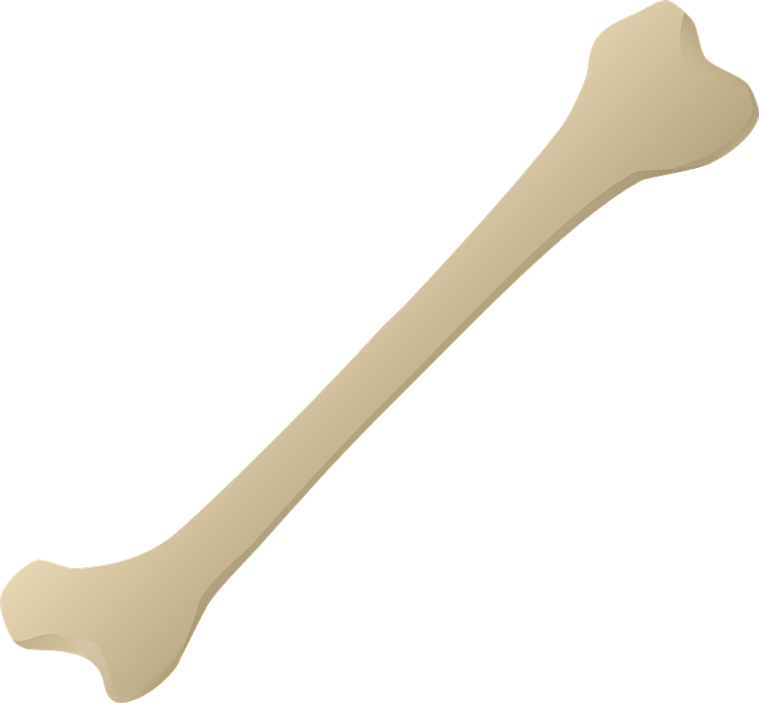
Healthy Bones
Bones are living tissues which are constantly being broken down and rebuilt in a process called remodeling
Types of bones
Components of bones
Bone Remodeling
Normally, bones are continuously formed and absorbed under the control of systemic hormones, body mineral contents and local autocrine/paracrine such as: cytokines, Growth Factors and PGs.
It is meant to maintain calcium homeostasis and to renew bone in case of micro damages
Cortical
Trabecular
Hard, compact, & dense bone
Ex:
Long bones of arms and legs
Spongy, porous & flexible bone
Ex:
End of the wrist, hip and spine
Bones are basically composed of two types of tissue:
Inorganic (65% of mass)
Consists of crystalline calcium phosphate salts called hydroxyapatite¹
Organic (35% of mass)
Consists of living cells which are: osteocytes, osteoclasts and osteoblasts
Bone cells are either bone forming or bone resorptive cell
Osteoclast
Bone resorptive cells
- Phagocytic cells
- Hematopoietic in origin
-Reside in pits (resorption bay)
- Secrete lysosomal enzyme (e.g.collagenase , metalloproteinase) and HCl to dissolve bone matrix
Bone forming cells
- Osteogenic cells
- Mesenchymal in origin
- Found on all bone surface
- Forms osteoid framework and helps in its mineralization
Osteoblast
01
Phase 1: Resorption
Osteoclasts seek out old bone or damaged ones and destroy it, leaving a small empty space
Phase 2: Formation
02
Osteoblasts use minerals like calcium, phosphorus and Vit D to fill in this space with new bone cells
1: required for bone mineralization, giving the bone its strength.

Slide 3
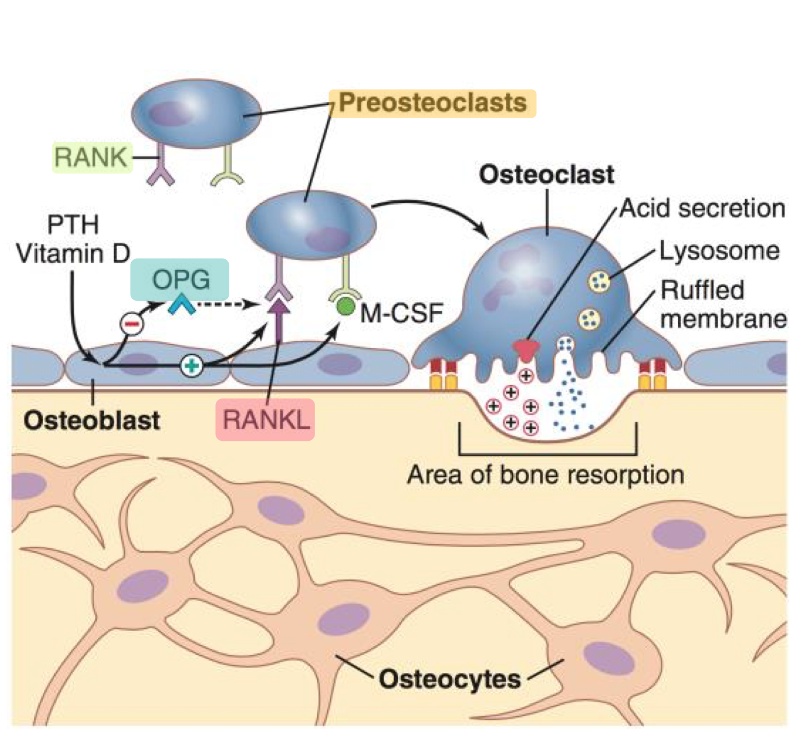
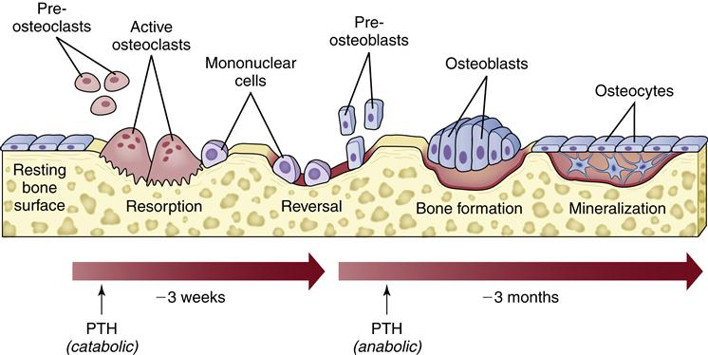
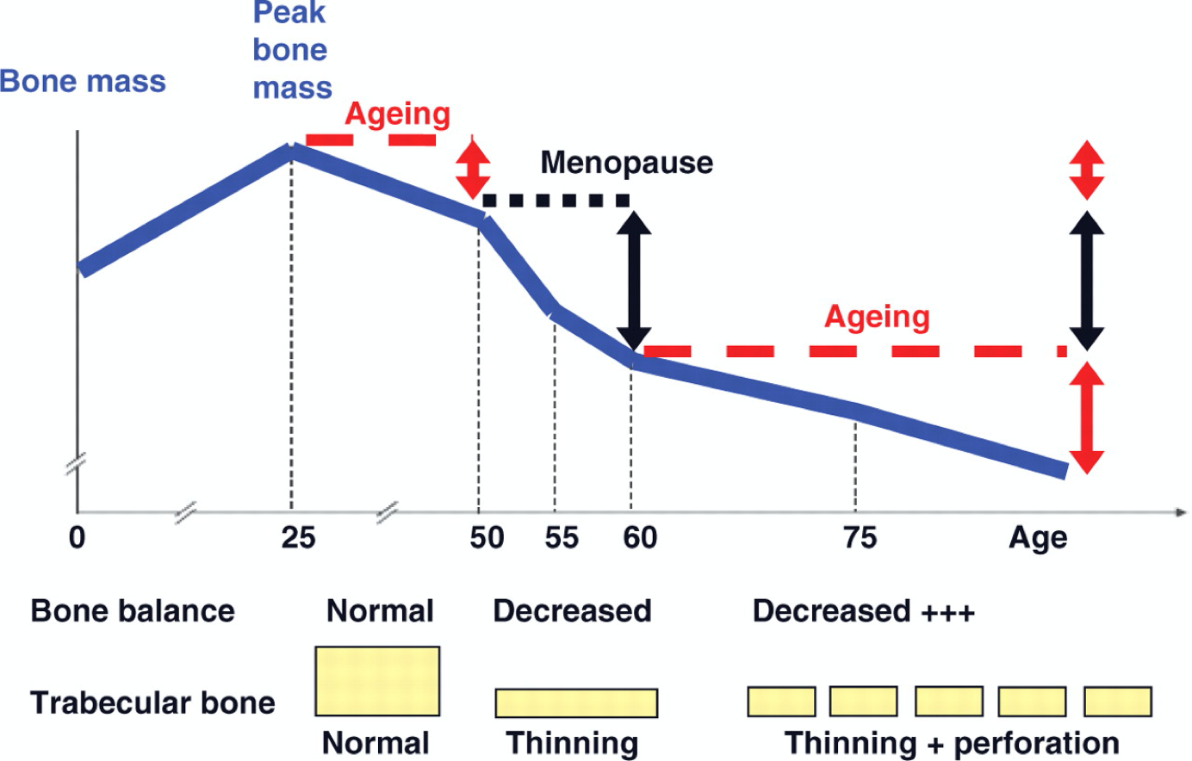
Balance of Bone Remodeling
Osteoporosis
A complex endocrinological disorder of bone and mineral metabolism leading to a decrease in bone mass, disruption of its architecture, density reducing its strength and increase the risk for fractures “Bone resorption > Bone formation”
Risk Factors
Bone Loss and Aging
Doctor explanation (important to understand as it has pharmacological application):
Osteoblasts express a ligand called RANKL¹
(Receptor Activator of Nuclear factor Kappa-B Ligand). It’s a family member of TNF cytokine.
RANKL binds to a receptor located on the surface
of preosteoclasts called RANK.
This will convert the preosteoclast into a mature osteoclast (osteoclastogenesis). As RANKL is high in osteoporosis, maturation of preosteoclast and resorption of the bone are increased.
RANKL can be inhibited physiologically by an endogenous inhibitor called osteoprotegerin (OPG)², OPG binds to RANK receptor
Potentially modifiable³
Non-modifiable
Cigarette smoking
Low calcium/ Vit D⁴ in diet
Glucocorticoids
Anticonvulsants
Excessive alcohol intake
Obesity
Sedentary lifestyle
Environmental risks
History of fractures (personal\1st degree relative)
Elderly
Poor health
Dementia
Hormonal disorders
Neoplastic disorders
Metabolic abnormalities
Race(Caucasian or Asian)
1
2
The first 5-15 years after menopause, a woman can lose approximately 25-30% of her trabecular bone and 10-15% of her cortical bone
Bone loss often occurs without symptoms or warning signs
Most common symptom is bone fracture after minor trauma
This loss is due to loss of estrogen levels after menopause
Bones become porous
1: ensures maturation of osteoclasts by binding to pre-osteoclasts
2: prevents the maturation of osteoclasts = decrease bone resorption (some osteoporosis drugs work in the same mechanism).
3: can be changed, to minimize bone damage.
4: required for calcium absorption.

Slide 4
Treatment for Osteoporosis
(1) Antiresorptive: Bisphosphonates⁴
Replace the missing components such as: Ca, Vit D, Na fluoride
Used to enhance the strength of the bone by the formation of fluorapatite
Considered when there is a decrease in the trabecular bone density with normal cortical bone.
Restore the balance of remodeling by using:
Antiresorptive
Bone Anabolic
Dual effect
- Bisphosphonates¹
- Estrogen analogues
- Androgen analogues
- SERMS²
- Calcitonin
- RANKL inhibitors
- Parathyroid hormone (PTH)
- Teriparatide³
(PTH analogue)
- Strontium
Mainly inhibit osteoclasts
Mainly activate osteoblasts
Both effects
Class | Nitrogenous | Non-Nitrogenous
Drugs | Alendronate (oral) Ibandronate (oral) Risedronate (oral) Zoledronate (I.V.) | Etidronate Clodronate Tiludronate
MOA Both are important | Bisphosphonates are compounds made of two phosphate groups (PO₃) They are structurally similar to pyrophosphate⁵ and works as: Bind to calcium and concentrate in bones, bound to hydroxyapatite decreasing its solubility and make it more resistance to osteoclastic activity since osteoclasts mainly dissolve and break pyrophosphate not bisphosphonates Prevent bone resorption by Inhibit osteoclast function Block steps in cholesterol synthetic pathway⁶ in osteoclast that act as signaling molecules responsible for the osteoclastic hydrolytic & phagocytic activity → osteoclast stops functioning leading to apoptosis.
P.K | Zoledronate (3rd generation) has the highest potency for osteoclast inhibition Poorly absorbed (<10%), food impair absorption more so must be given on an empty stomach / infused IV T½ = 1 hr ½ of absorbed drug accumulates in bones⁷, remainder is excreted in urine In bones it is retained for months⁸, depending on bone turnover
Dosing | Once weekly or on two consecutive days each month Should be taken in upright position to prevent esophagitis Should be taken with a large amount of water to prevent esophagitis Should be given 4 hrs before having any Ca, Mg, Al containing drugs Note: Calcium and Vit D supplementation should be given after a gap from ingestion of bisphosphonates because it can inhibit their absorption
Uses | Osteoporosis; secondary to menopause or glucocorticoids..etc Paget’s Disease⁹ Malignancy associated with hypercalcemia¹⁰
1: most used drug in osteoporosis. 2: selective estrogen receptor modulators.
3: Recombinant DNA derivative of PTH. 4: if asked about MOA write both
5: involved in normal bone mineralization.
6: leads to destruction of normal osteoclastic brush border = dysfunctional osteoclasts
7: the therapeutic site of action. 8: long duration of action.
9: diseases of excessive breakdown of bone. 10: helps by storing calcium in the bone = decrease serum calcium.

Slide 5
(1) Antiresorptive: Bisphosphonates cont...
(2) Antiresorptive: RANKL inhibitors
Drug | Nitrogenous | Non-Nitrogenous
ADR | GIT irritation: nausea, vomiting, gastritis, ulceration→ Drinking large amount of water to prevent the risk of tablet from getting stuck in esophagus. Gastroesophageal reflux ± ulceration→ Avoiding this by giving it on empty stomach and sitting while sitting in upright for 30 min. Flu like manifestation: fever, chills when given I.V. infusion Osteonecrosis of the of the mandible bone of jaw upon long use with IV infusion preparation usually after dental surgical procedures If a dental implant or extraction is already planned, delay bisphosphonate therapy for a few months until the jaw heals completely Atrial fibrillation → more in women with alendronate and zoledronate
C.I | Decreased renal function Peptic Ulcer Esophageal reflux
Drug | Denosumab (Still under investigation)
 | It is a fully humanized monoclonal antibody that mimics the activity of osteoprotegerin (OPG)
MOA | Normally: RANKL binds to its receptor RANK on the surface of precursor (preosteoclast)& mature osteoclasts → stimulates these cells to mature & resorb bone. OPG, which competes with RANKL for binding to RANK, is the physiological inhibitor of RANKL. Denosumab: Blocks RANKL from interacting with RANK receptor expressed on preosteoclast→↓osteoclastogenesis→ no mature osteoclasts Binds also to mature osteoclasts → increase their apoptosis Net effect is decreasing bone resorption
P.K | Administered subcutaneously every 6 months
Uses | Extremely expensive treatment reserved for patients who cant tolerate nor respond to bisphosphonates
ADR | Respiratory and urinary infections¹ Eczema and skin rash Pancreatitis
C.I | Patients with hypocalcemia as denosumab decreases serum calcium conc. correct Ca and Vit D levels before starting the treatment
1: because RANKL is a cytokines, inhibiting cytokines will compromise immunity.

Slide 6
(3) Antiresorptive + Bone Anabolic Agents (Dual effect)
(4) Sex Hormones
Drug | Strontium
 | Sr²⁺ is a divalent cation resembling Ca²⁺ in atomic and ionic properties 1st drug to possess a dual effect has both anabolic & antiresorptive effects, resulting in rebalance of bone turnover in favor of bone formation
MOA | Effects on Osteoblasts: Acts as an agonist on Ca Sensing Receptor [CaSR] a GP coupled receptor → enhances differentiation of preosteoblast to osteoblast → increase bone formation Stimulate the expression of OPG → increase RANKL binding →↓bone resorption Effects on Osteoclasts: Acts as an agonist on CaSR → suppress differentiation of preosteoclast to osteoclast → decrease bone resorption
P.K | Orally active as distrontium with a modest bioavailability of 25% Binds partially to plasma proteins and strongly to bones T½ = 60 hrs Excreted mainly by the kidney
Uses | Osteoporosis; secondary to menopause or glucocorticoids..etc Malignancy associated hypercalcemia
ADR | GIT irritation: nausea, vomiting, headache & eczema All resolve within the first 3 months
C.I | Severe renal disease Hypersensitivity to the drug
inter- action | Food containing milk or its products Antacids Oral Tetracycline and quinolones chelates² it They can be prevented by having a 2 hrs spacing between them
Risk of venous thromboembolism
Phenylketonuria¹
Drugs | Estrogen | Androgen
MOA | Estrogen in females and Androgens in males are essential for normal bone remodeling: ↑ osteoclast apoptosis and Inhibit osteoblast apoptosis ↑ release of growth factors from osteoblasts ↓ number and depth of resorption cavities ↓ release of inflammatory cytokines causing resorption
Uses | Hysterectomy³: use estrogen only If uterus is present: Estrogen + Progestin Hormonal Replacement therapy (HRT): menopausal symptoms SERMs: Menopause\ elderly | For elderly men only
ADR⁴ | Risk for breast cancer Vaginal bleeding Venous thromboembolism | -
1: inborn disorder of phenylalanine metabolism, and since strontium contain phenylalanine, it will accumulate leading to complications.
2: bind to it = decrease its activity.
3: uterus is resected.
4: most common in females taking HRT.

Slide 7
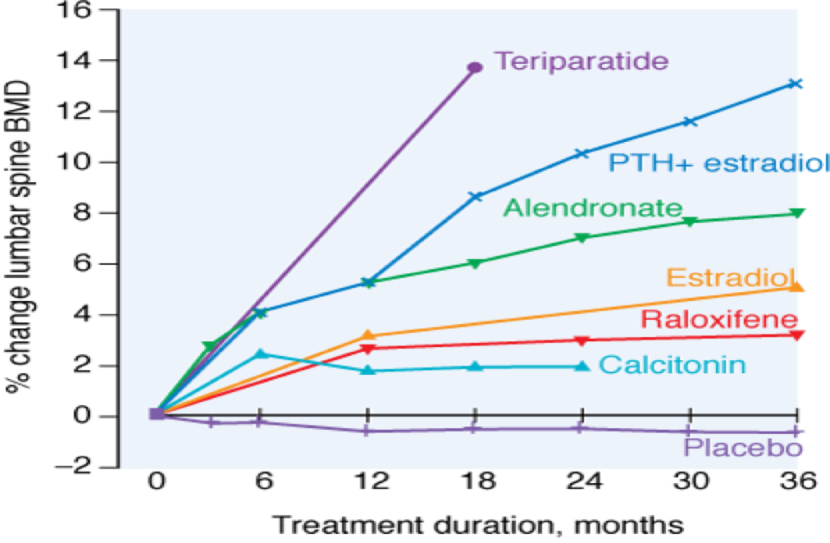
(5) Selective Estrogen Receptor Modulators (SERMs)
Drug | Raloxifene
 | Raloxifene is the 1st SERM for prevention and treatment of osteoporosis
MOA | Antiestrogens that exhibit partial agonistic action Acting as an agonist in bones and an antagonist in female sex organs Works only on women especially post-menopausal women
 | Increase bone density by 2% and decrease fracture risk by 30% No stimulation of breasts nor endometrial tissue No need for progestin in women with a uterus Decrease LDL Good for women with a risk of uterine and breast cancer Lower risk for thromboembolism compared to estrogen
 | May increase hot flashes No effect on HDL
 | Brain | Uterus | Vagina | Breast | Bone | CVS
Estradiol¹ | ++ | ++ | ++ | ++ | ++ | ++
Raloxifene | - | - | -² | -² | + | +
Selectivity
Raloxifene has a partial agonism on bones and heart only. It doesn’t work as estrogen on the sex organs, thus decreasing its risk for uterine and breast cancer. “MALE doctor note”
Advantages
Dis-
advantages
Relative efficacy of different therapeutic interventions on bone mineral density of the lumbar spine
1: = estrogen.
2: no risk of vaginal bleeding or breast cancer.

Slide 8
Quiz
MCQ
Q1- Which of the following drugs exhibits its therapeutic effect for osteoporosis by agonizing CaSR to enhance osteoblasts and suppress osteoclasts?
A- Alendronate B- Strontium C- Raloxifene D- Denosumab
Q2- A 68-year-old woman came to the clinic for pain around her pelvis. The doctor suspected an osteoporotic microfracture, so he ordered a DEXA scan. The scan showed diminished bone density. The doctor gave the patient a drug and asked her to take it in an upright position and drink a full glass of water with it. Which of the following is the most likely prescribed drug?
A- Estrogen HRT B- Strontium C- Risedronate D- Denosumab
Q3- Which of the following is one benefit of Raloxifene over Estrogen in treating post-menopausal osteoporosis?
A- Estrogen causes increase HDL in blood
B- Raloxifene antagonizes some estrogen receptors
C- Estrogen exerts unwanted effects on the brain
D- Raloxifene increases osteoclast apoptosis and Inhibits osteoblast apoptosis
Q4- Which of the following mimics OPG activity in inhibiting RANKL
A- Raloxifene B- Teriparatide C- Denosumab D- Strontium Ranelate
SAQ
A 59-year-old post-menopause lady came to the clinic for her periodic health examination. She has an excellent health and no past medical or surgical history. The doctor ordered a bone-density test and found out that her bone density decreased by at least 40%. She was diagnosed with postmenopausal osteoporosis.
Q1) What is the drug of choice in her case?
Q2) What is the M.O.A of that drug?
Q3) What are 2 non-pharmacological approaches the doctor can recommend?
MCQ
SAQ
Q1 | B
Q2 | C
Q3 | B
Q4 | c
Q1 | Bisphosphonates such as: Alendronate, Risedronate...
Q2 | Increase resistance to osteoclasts and inhibit osteoclasts signaling
Q3 | Increase Calcium and Vit D in diet, increase physical activity, & reduce weight
Answers:

Slide 9
Thank you for all your love and support.
Good luck future doctors!
Team Leaders:
May Babaeer Zyad Aldosari
This Magnificent Work was Done By:
Mohammed Alhuqbani
Note writers
Raghad AlKhashan
Quiz writers
Mohammed Alhuqbani

