Slide 1
Editing File
Mnemonic File
Endocrine Block
Pharmacology team 438
Pharmacology of drugs used in calcium and Vit D disorder
Objectives:
By the end of the lecture , you should know:
Recognize the common drugs used in calcium & vitamin D disorders.
Classify them according to sources & Pharmacological effects.
Detail the pharmacology of each drug regarding; Mechanism, clinical utility in affecting calcium & vitamin D.
Color index:
Black : Main content
Red : Important
Blue: Males’ slides only
Purple: Females’ slides only
Grey: Extra info or explanation
Green : Dr. notes

Slide 2
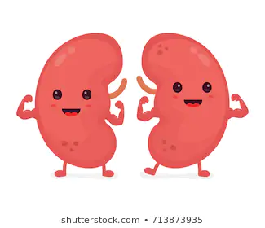
Calcium Metabolism
Calcium plays an essential role in many cellular processes, including:
muscle contraction
hormone secretion
cell proliferation
gene expression
Calcium balance is a dynamic process that reflects a balance between:
calcium absorption by the intestinal tract ¹.
calcium excretion by the kidney.
release and uptake of calcium by bone during bone formation and resorption.
3 principal hormones regulate Ca⁺² homeostasis
Parathyroid hormone (PTH)
Vitamin D
Calcitonin
3 target tissues regulate Ca⁺² homeostasis and Vit D:
1-Bone
2-Kidneys
3-Intestine
• Calcium plays an essential role in many cellular processes, including: (1) muscle contraction, (2) hormone secretion, (3) cell proliferation, and (4) gene expression.
• Calcium balance is a dynamic process that reflects a balance between:
calcium absorption by the intestinal tract.
calcium excretion by the kidney.
release and uptake of calcium by bone during bone formation and resorption.
Bones:
Is a dynamic organ undergoes continuous remodeling process involving resorption of old bone by osteoclast & formation of new bone by osteoblast
The dominant site of calcium storage in the body is bone, which contains nearly 99.9% of body calcium.
Although only a small fraction of total body calcium is located in the plasma, it is the plasma concentration of ionized calcium that is tightly regulated, primarily under the control of PTH and vitamin D.
Ca metabolism:
Absorption and reabsorption of Ca
Reabsorption
Ca absorption
Bones
Is a dynamic organ undergoes continuous remodeling process involving resorption of old bone by osteoclast & formation of new bone by osteoblast ²
The dominant site of calcium storage in the body is bone, which contains nearly 99.9% of body calcium.
Although only a small fraction of total body calcium is located in the plasma, it is the plasma concentration of ionized calcium that is tightly regulated, primarily under the control of PTH and vitamin D.
Parathyroid Hormone(PTH)
Teriparatide
Principal factors involved in Ca metabolism & bone remodelling:
Principal factors involved in Ca metabolism & bone remodelling
Vitamin D
Calcitonin
Parathyroid Hormone(PTH) ³
Vitamin D
Teriparatide
Calcitonin
PTH and vitamin D play central roles in the regulation of bone metabolism.
Calcitonin is a physiological antagonist to PTH with regard to Ca2+ homeostasis.
1. Intestinal absorption of calcium occurs under the influence of Vit. D.
2. Anabolic drugs are drugs that have the capability to increase bone mass by stimulating osteoblasts.
3. Either a recombinant human PTH or a synthetic PTH analogue.

Slide 3
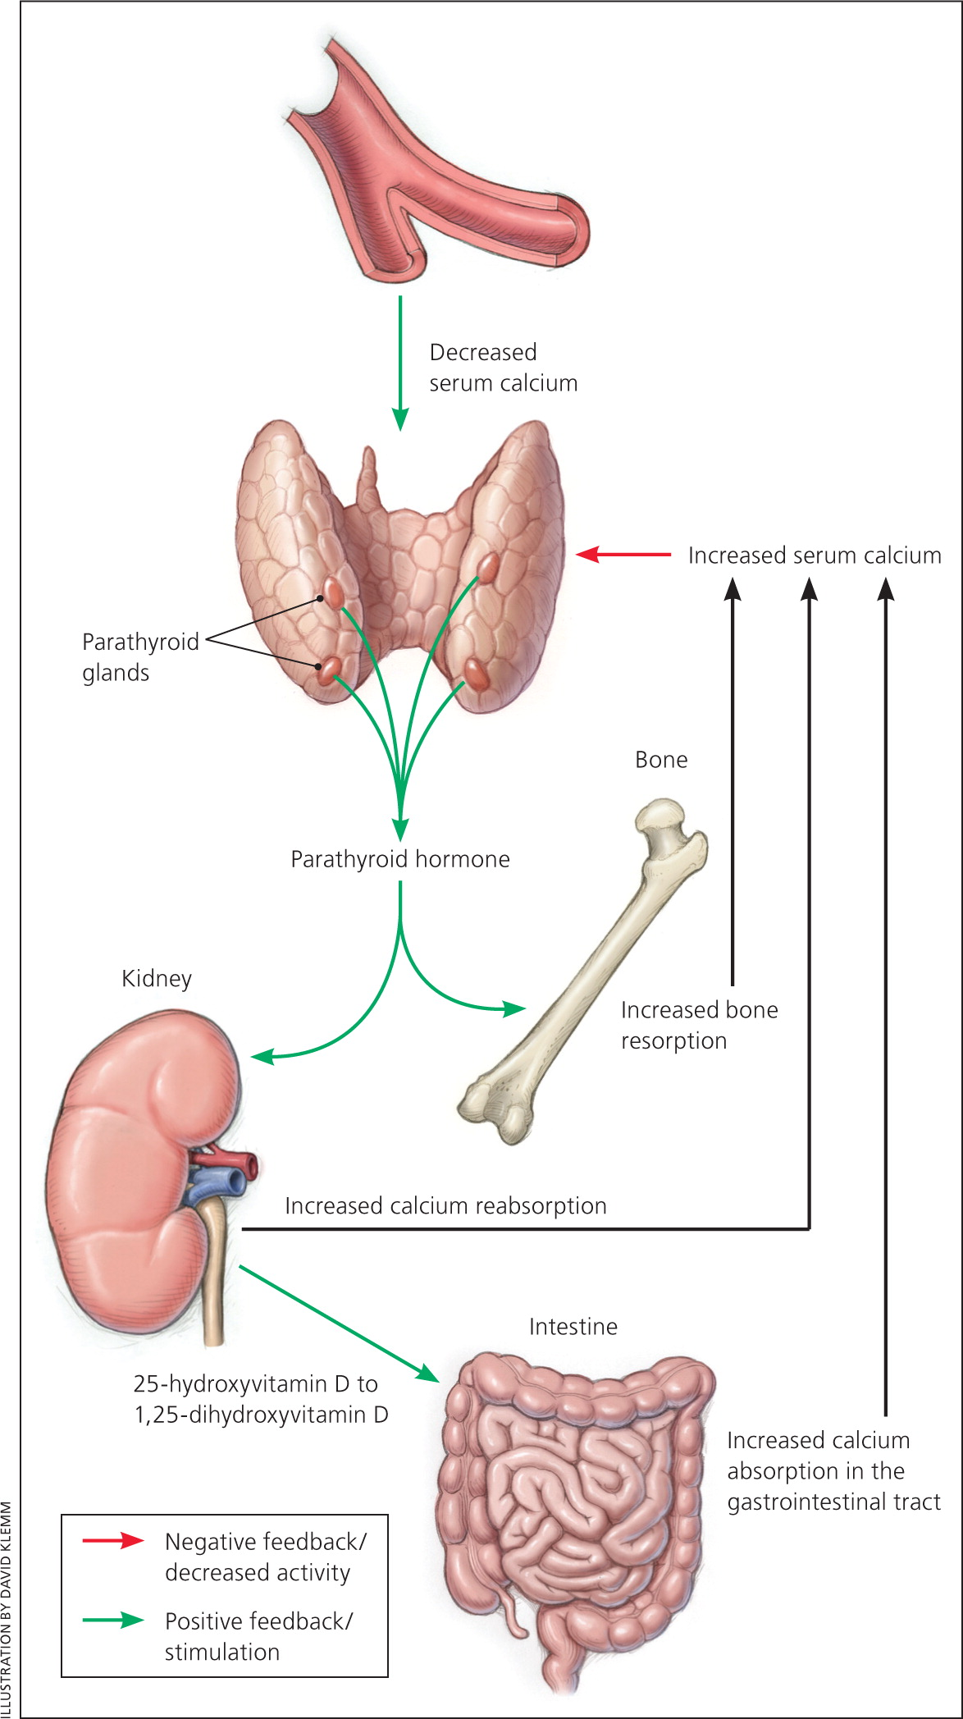
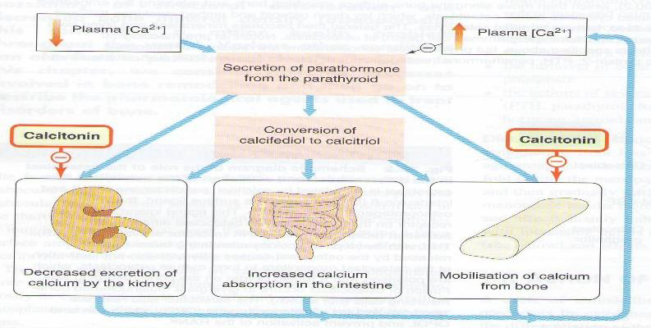
Parathyroid Hormone (PTH)
Definition | PTH: A hormone that plays a critical role in controlling calcium , and phosphate balance. PTH is released from the parathyroid gland in response to low plasma Ca2+ level , its secretion is inversely related to [Ca2+ ]
Action | The overall action of PTH is to increase plasma Ca2+ levels in response to hypocalcemia: Bone: Mobilization of Ca & PO from bone, PTH stimulates osteoclasts cells to↑the outward flux of calcium to restore serum calcium level Kidney: ↑ calcium active reabsorption and↑formation of calcitriol which is the active form of vitamin D GIT:↑absorption of calcium in the presence of permissive amount of Vit D
Response | Daily, Intermittent administration of recombinant human PTH, SC in the thigh (alternate thigh every day ) leads to a net stimulation of bone formation for treatment of osteoporosis. Mechanism:↑Osteoblast number/function→↑Bone formation→ ↑Bone mass/strength Anabolic action Continuous ¹ or chronic exposure to high serum PTH concentrations (as seen with primary or secondary hyperparathyroidism) results in bone resorption and risk of fractures. Mechanism: ↑Osteoclast →↑Bone resorption →↑Serum Ca2+
Uses | Treatment of severe osteoporosis Resistant cases failed to respond to other medications
Teriparatide
Definition | Synthetic polypeptide form of PTH ( PTH analogue ). It belongs to a class of anti- osteoporosis drugs, the so-called “anabolic” agents.
P.K | Given once daily as subcutaneous injection
Response | As PTH ,the therapeutic effects of teriparatide depend upon the pattern of systemic exposure Daily administration→ new bone formation Continuous administration→ bone resorption
Uses | Should not be used routinely due to carcinogenic effects. Use in severs osteoporosis or patients not responding to other drugs. For treatment of osteoporosis in people who have a risk of getting fracture ( increase bone mass & strength ) Good for postmenopausal osteoporosis.
ADR | Carcinogenic effect (osteosarcoma) Elevated serum calcium can occur in some cases can lead to kidney stones
C.I | Should not be used by people with increased risk for bone tumors (osteosarcoma) including : People with paget’s disease of bone People who had radiation treatment involving bones Not recommended in children
Daily , intermittent administration of PTH
for 1 to 2 hours / day leads to a net
stimulation of bone formation .
Continuous exposure to elevated PTH leads
to bone resorption and risk of fracture.
Diarrhea, heartburn, nausea
headache, leg cramps
Orthostatic hypotension
1. Due to a pathological condition.

Slide 4
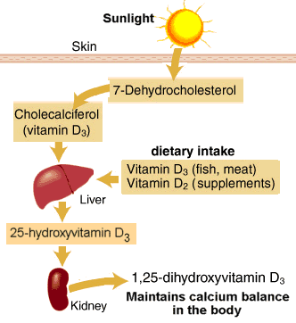
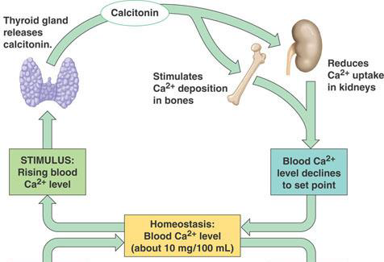
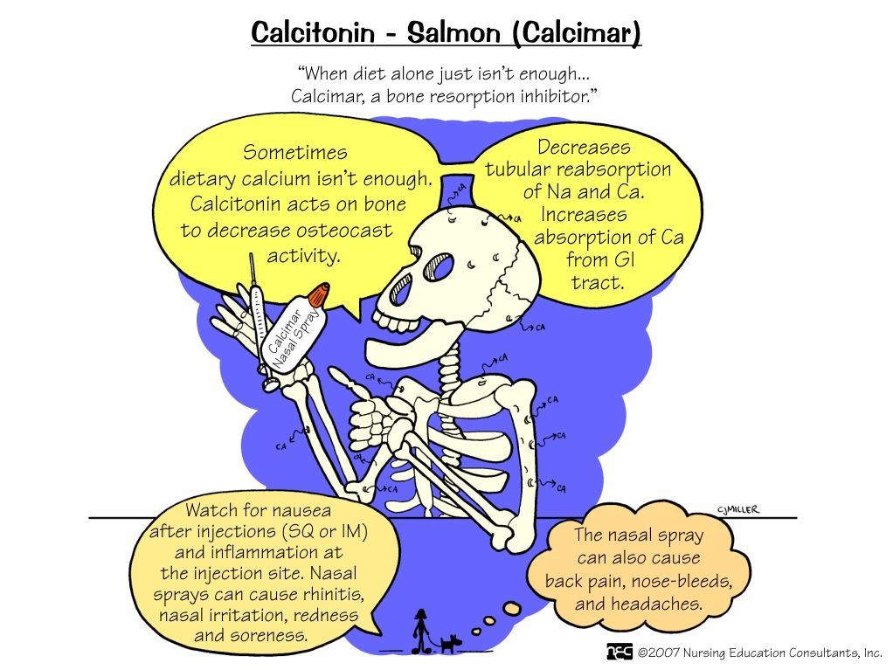
Vitamin D
Definition | Vitamin D is a steroid hormone that is intimately involved in the regulation of plasma calcium levels. Its role in calcium metabolism first was recognized in the childhood disease rickets, which is characterized by hypocalcaemia and various skeletal abnormalities.
 | Exposure to the ultraviolet rays in the sunlight convert 7 dehydrocholesterol to cholecalciferol (vitamin D3) The initial transformation (Vitamin D3) is metabolically inactive until it is hydroxylated in first in the liver. Then in the kidney, parathyroid hormone stimulates the formation of the active form of vitamin D (calcitriol /1,25 Dihydroxycholecalciferol ) by α hydroxylase.
Forms | Cholecalciferol (Vitamin D3) :found in the skin Vitamin D3 is usually for vitamin D-fortified milk & foods. It is also available in drug combination product Ergocalciferol (Vitamin D2): found in the plants Vitamin D2 is the prescription form of vitamin D & is also used as food additive (milk) Note: Vit D2 and Vit D3 have equal biological activities.
Effects | The overall effect of vitamin D is to increase plasma Ca² concentrations: Bone: ↑ bone resorption, activation of osteoblast GIT: ↑ Ca² absorption Kidney: ↑reabsorption of Ca² and PO4 ↓ the production of PTH by the parathyroid glands.
Uses
Teriparatide
Definition | Synthetic polypeptide form of PTH ( PTH analogue ). It belongs to a class of anti- osteoporosis drugs, the so-called “anabolic” agents.
P.K | Given once daily as subcutaneous injection
Response | As PTH ,the therapeutic effects of teriparatide depend upon the pattern of systemic exposure Daily administration→ new bone formation Continuous administration→ bone resorption
Uses | Should not be used routinely due to carcinogenic effects. Use in severs osteoporosis or patients not responding to other drugs. For treatment of osteoporosis in people who have a risk of getting fracture ( increase bone mass & strength ) Good for postmenopausal osteoporosis.
ADR | Carcinogenic effect (osteosarcoma) Elevated serum calcium can occur in some cases can lead to kidney stones
C.I | Should not be used by people with increased risk for bone tumors (osteosarcoma) including : People with paget’s disease of bone People who had radiation treatment involving bones Not recommended in children
Calcitonin
Definition | Calcitonin is synthesized and secreted by the parafollicular cells (C cells) of the thyroid gland and It is released when there is a rise in plasma Ca levels . Calcitonin does not appear to be critical for the regulation of calcium homeostasis even if thyroid gland is removed. While PTH and vitamin D act to increase plasma Ca², only calcitonin causes a decrease in plasma Ca. Calcitonin protects against development of hypercalcemia caused by a variety of conditions including: 1- increased calcium absorption (milk alkali syndrome). 2-decreased calcium excretion (thiazide use).
Effect ¹ | The major effect of calcitonin administration is a rapid fall in Ca² caused by: Bone: ↓ resorption by inhibiting osteoclast activity. The osteoclast bone cells appear to be a particular target of calcitonin. Kidney:↓reabsorption of Ca² & PO 4, thus increasing their excretion.
P.K | Gevin S.C , Nasal spray or solution (Calcitonin derived from Salmon) has more affinity towards human calcitonin receptors.
Uses | Osteoporosis (major indication; alternative to other drugs). Hypercalcemia (short term treatment of hypercalcemia of malignancy), Paget's disease In certain bone diseases in which sustained reduction of osteoclastic resorption is therapeutically advantageous. It has lower efficacy compared to other drugs ².
ADR | Nausea Nasal irritation Local inflammation at site of injection Flushing of face & hands
1
Metabolism
Diarrhea, heartburn, nausea
headache, leg cramps
Orthostatic hypotension
Deficiency
● Rickets in children ● Osteomalacia ● Osteoporosis
● Rickets & Osteomalacia ● Osteoporosis
● Psoriasis ● Cancer prevention (prostate & colorectal)
Definition
mnemonic: Calcitonin, Cancel the calcium from plasma.
1. Calcitonin is not an anabolic agent because it works by inhibiting the osteoclastic activity.
2. Thus drug synergism is preferred.

Slide 5
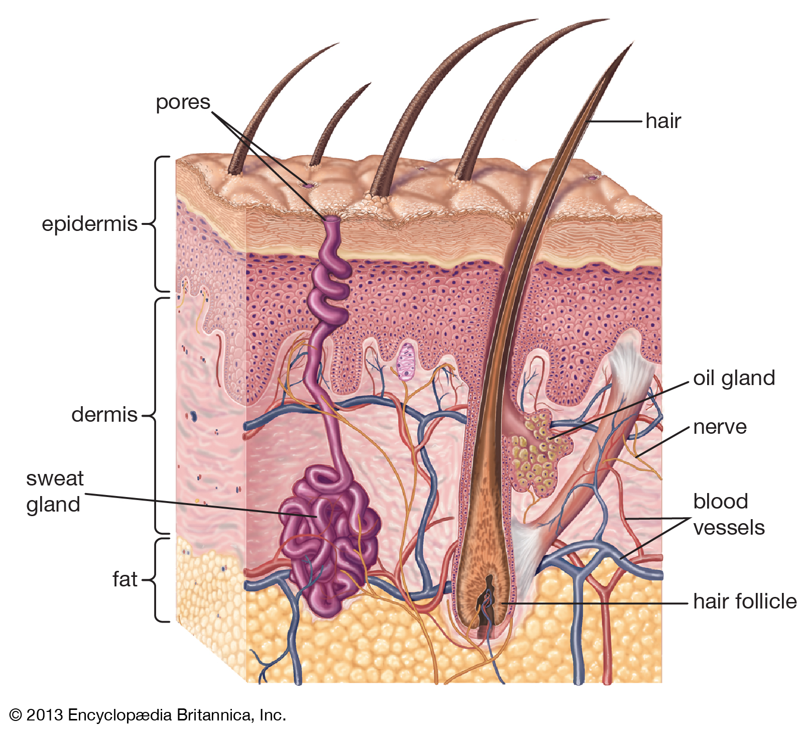
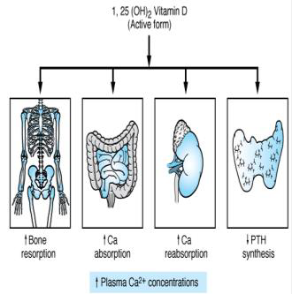
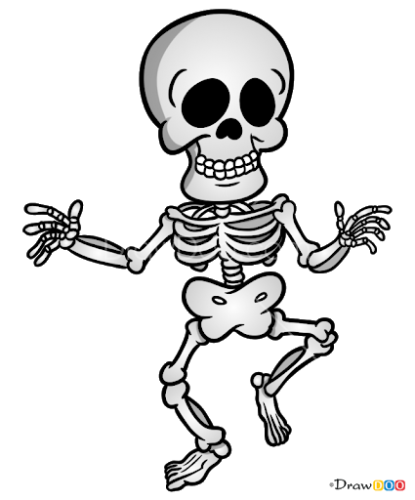
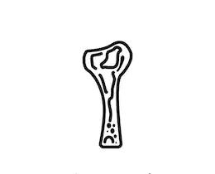
Vitamin D
Definition | Vitamin D is a steroid hormone that is intimately involved in the regulation of plasma calcium levels. Its role in calcium metabolism first was recognized in the childhood disease rickets, which is characterized by hypocalcaemia and various skeletal abnormalities.
 | Exposure to the ultraviolet rays in the sunlight convert 7 dehydrocholesterol to cholecalciferol (vitamin D3) The initial transformation (Vitamin D3) is metabolically inactive until it is hydroxylated in first in the liver. Then in the kidney, parathyroid hormone stimulates the formation of the active form of vitamin D (calcitriol /1,25 Dihydroxycholecalciferol ) by α hydroxylase.
Forms | Cholecalciferol (Vitamin D3)² :found in the skin Vitamin D3 is usually for vitamin D-fortified milk & foods. It is also available in drug combination product Ergocalciferol (Vitamin D2): found in the plants Vitamin D2 is the prescription form of vitamin D & is also used as food additive (milk+ egg yolk, & fish oil) Note: Vit D2 and Vit D3 have equal biological activities.
Effects³ | The overall effect of vitamin D is to increase plasma Ca² concentrations: Bone: ↑ bone resorption, activation of osteoblast GIT: ↑ Ca² absorption Kidney: ↑reabsorption of Ca² and PO4 ↓ the production of PTH by the parathyroid glands.
 | Rickets in children Osteomalacia Osteoporosis
Uses | Rickets & Osteomalacia Psoriasis Osteoporosis Cancer prevention (prostate & colorectal)
Definition
Vit D2 and Vit D3 have equal biological activities.
Metabolism
1
Metabolism
Simply U will get Vit D3 from the sun
--> hydroxylation will occur in the liver.
--> another hydroxylation will occur in the kidney and u will get the active form
Cholecalciferol (Vitamin D3)
Ergocalciferol (Vitamin D2)
In the skin
In the plants
Forms
Vitamin D3 is usually for vitamin D-fortified milk & foods. It is also available in drug combination product
Vitamin D2 is the prescription form of vitamin D & is also used as food additive (milk)
Ca2 & Vit D
03
Rickets in small children
Deficiency
Osteoporosis
Deficiency
0
Osteomalacia
1. Simply you will get Vit D3 from the sun → hydroxylation will occur in the liver → another hydroxylation will occur in the kidney and you will get the active form.
2. D3 is more potent than D2
3 if asked about the MOA, you should write at least the first 3 effects.

Slide 6
Quiz
MCQ
1- Administration of parathyroid hormone must be ……
A- Continuous B- Continuous following a loading dose C- Daily, intermittent
2- What is Vitamin D’s effect on the kidney?
A- Decrease renal Ca2+ & PO4 reabsorption B- Increase renal Ca2+ & PO4 reabsorption C- Increases renal Ca2+ absorption and decreases PO4 reabsorption
3- Which of the following is an adverse effect of teriparatide?
A- Osteosarcoma B- Leukopenia C- Arthropathy D- Autoimmune hepatitis
4- Which one of the following treatment is recommended in case of postmenopausal osteoporosis?
A- PTH B- Teriparatide C- Calcitonin
5- Which one of the following can be used in case of Paget’s disease?
A- PTH B- Teriparatide C- Calcitonin D- Vitamin D
SAQ
1- A 50 year old woman visits her family physician and the physician prescribes her medication to prevent postmenopausal osteoporosis. She tells her this drug is a synthetic PTH analogue.
Q1) What is the name of the drug that was prescribed?
Q2) List three possible adverse effects:
Q3) List two other hormones that can be used in the treatment of osteoporosis
MCQ
SAQ
Q1 | C
Q2 | B
Q3 | A
Q4 | B
Q5 | C
Q1 | Teriparatide
Q2 | Carcinogenic effect (osteosarcoma), Diarrhea, heartburn, nausea, headache, leg cramps, Hypotension when standing, and kidney stones
Q3 | Vitamin D, PTH, Calcitonin
Answers:

Slide 7
Thank you for all your love and support.
Good luck future doctors!
Team Leaders:
May Babaeer Zyad Aldosari
This Magnificent Work was Done By:
Salman Alagla Khalid Aldossari
Talal Abozaid Naif Aldossari
Note writers
Nouf AlShammari
Quiz writers
Salman Alagla

