Slide 1
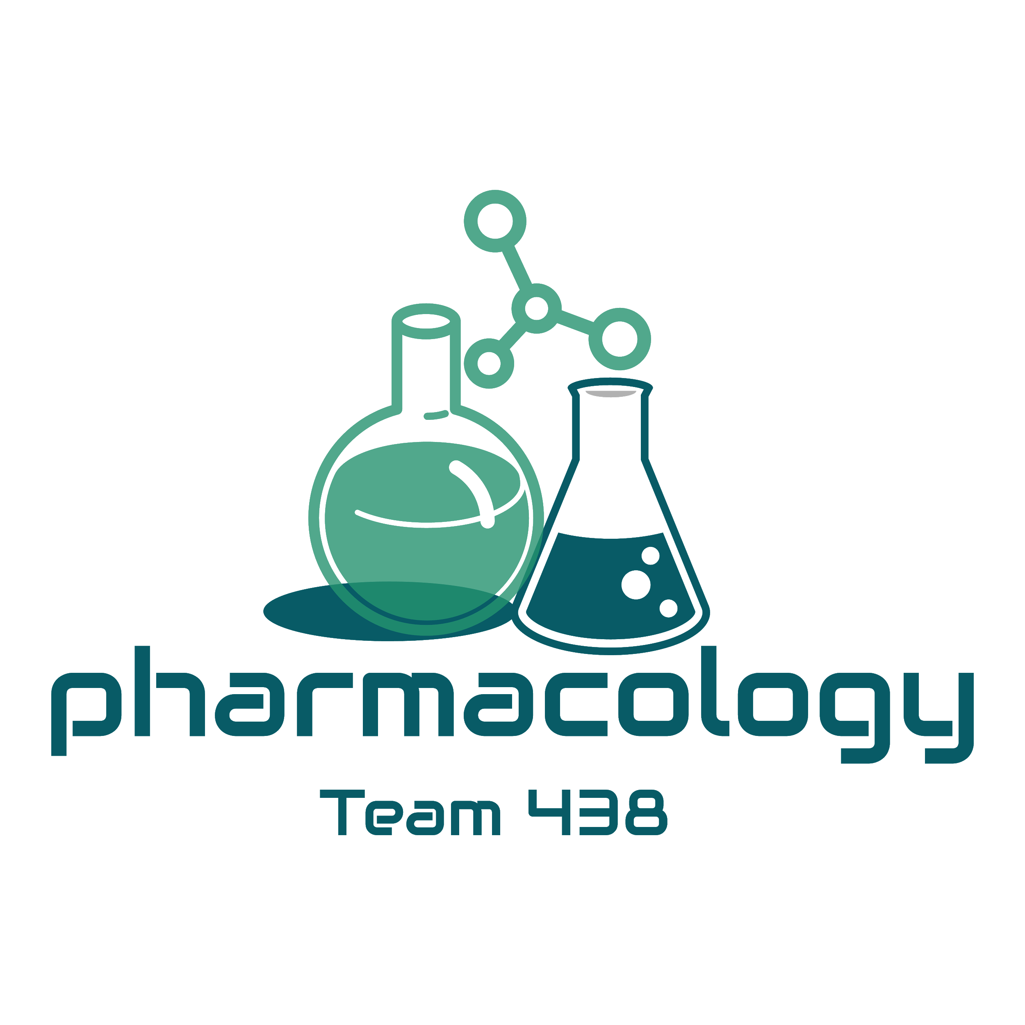
Editing File
Mnemonic File
Endocrine Block
Pharmacology team 438
Uses of insulin in treatment of diabetes
Objectives:
By the end of the lecture , you should know:
Define diabetes and mention different types of diabetes.
Differentiate between difference in treating type I and type II diabetes.
Understand mechanism of action, secretion, and actions of insulin.
Describe different types of insulin analogues
Be able to recognize the difference in pharmacokinetic profile between different types of insulin analogues.
Know uses of different insulin analogues.
Color index:
Black : Main content
Red : Important
Blue: Males’ slides only
Purple: Females’ slides only
Grey: Extra info or explanation
Green : Dr. notes

Slide 2
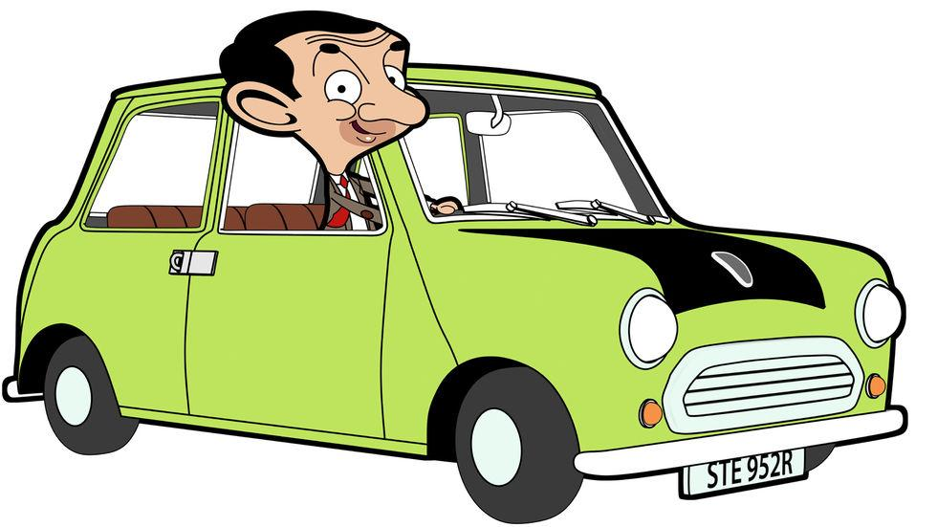
Diabetes mellitus
Is a chronic metabolic disorder characterized by high blood glucose level caused by caused by deficiency of insulin or by increased insulin resistance.
Fasting plasma glucose (no food for 8 hrs)
Normal
<100 mg/dl (5.6 mmol/l).
Pre-diabetes
100-125 mg/dl (5.6-6.9 mmol/L).
Diabetes
Fasting >126 mg/dl (7 mmol/L) or 2h after a meal > 200mg/dl (11.1 mmol/L).
Types of diabetes
Characteristic | Type I diabetes (IDDM) due to autoimmune or viral diseases | Type II diabetes (NIDDM) due to genetic susceptibility and other factors (age, obesity).
Onset (Age) | Usually during childhood or puberty | Usually over age 40
Type of onset | Abrupt | Gradual
Prevalence | 10-20% | 80-90 %
Genetic | Moderate | Very strong
Defects | β-cells are completely destroyed | β-cells produce inadequate quantity of insulin
Endogenous insulin | Absent | Present (not enough)
Insulin resistance | Absent | present
Nutritional status | Usually thin | Usually obese (Obesity is an important factor)
Ketosis | Frequent | Usually absent
Clinical symptoms | Polydipsia, polyphagia, polyuria, weight loss | Often asymptomatic
Related lipid abnormalities | Hypercholesterolemia frequent | Cholesterol & triglycerides often elevated
Treatment | Insulin injection | Oral hypoglycemic drugs (antidiabetic drugs)
Complications of diabetes
Blindness (retinopathy)
Neuropathy
(Abnormal peripheral sensation)
Renal failure (nephropathy)
BeaN’s CAR
Cardiovascular problems
Micro- and macro
vascular disease
Risk of foot Amputation

Slide 3
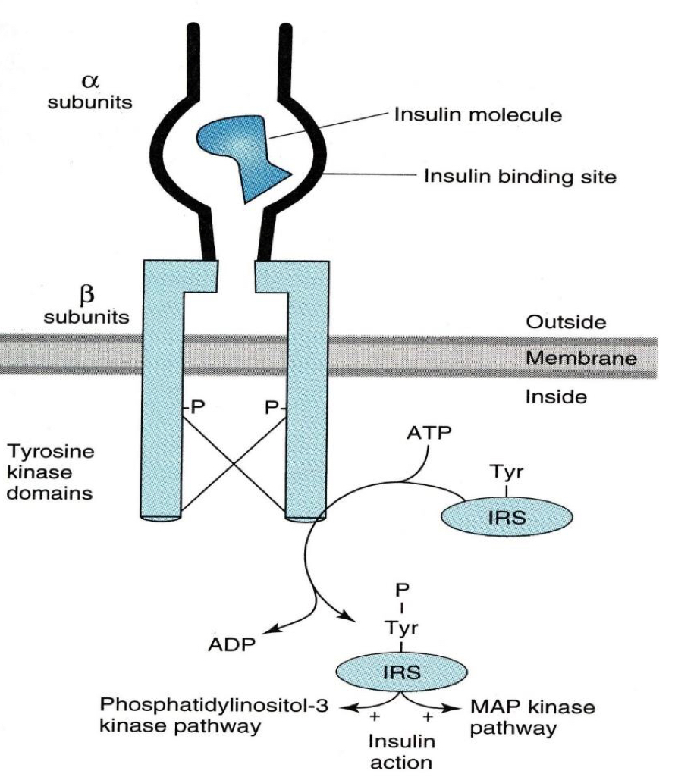
Insulin
Insulin receptors¹:
Present on cell membranes of most tissues.
Liver, muscle and adipose tissue.
Mechanism of action of insulin² :
Phosphorylation of IRS-1 and IRS-2 (insulin receptor substrate)
binding and activating other kinases : (e.g., PI3-K) or
bind to adaptor proteins (e.g. growth factor receptor-binding protein 2) that translates insulin signal to a guanine nucleotide-releasing factor that ultimately activates the GTP binding protein ras, and the MAPK system .
Effects of insulin :
Carbohydrate Metabolism
– ↑glucose uptake & utilization by peripheral tissues (Translocation of glucose transporters (GLUT) to cell membrane) – ↑Glycogen synthesis (glycogen synthase³) – ↑Conversion of carbohydrate to fats. – ↓Gluconeogenesis. – ↓Glycogenolysis (liver). – ↑Glycolysis (muscle).
Fat Metabolism
Liver: – ↑Lipogenesis. – ↓Lipolysis. – Inhibits conversion of fatty acids to keto acids. Adipose Tissue: – ↑Triglycerides storage. – ↑Fatty acids synthesis. – ↓Lipolysis
Protein Metabolism
Liver: – ↓protein catabolism. Muscle: – ↑amino acids uptake. – ↑protein synthesis – ↑glycogen synthesis (glycogenesis).
potassium
– ↑potassium uptake into cells.
Pharmacokinetics of insulin :
Routes of administrations of exogenous insulin
Can not be given orally because its a protein and it will be digested Insulin syringes, given s.c in arms, abdomen, thighs⁴ Portable pin injector (pre-filled) Continuous S.C. infusion⁵ (insulin pump) More convenient Eliminate multiple daily injection Programmed to deliver basal rate of insulin Intravenously in a hyperglycemic emergency Inhaled aerosols, transdermal, intranasal (Under Clinical Trials)
Insulin degradation
Basal level of endogenous insulin is 5-15 µU/ml Half life of circulating insulin is 3-5 min 60% liver & 40% kidney (endogenous insulin) 60% kidney & 40% liver (exogenous insulin)
1: act by tyrosine kinase cascade 2: chain A: 21 AA, chain B: 30 AA, and 3 disulfide bonds.
3: unregulated/stimulated.
4: alternate area of injection to avoid lipodystrophy
5: not given IM due to fast degradation.

Slide 4
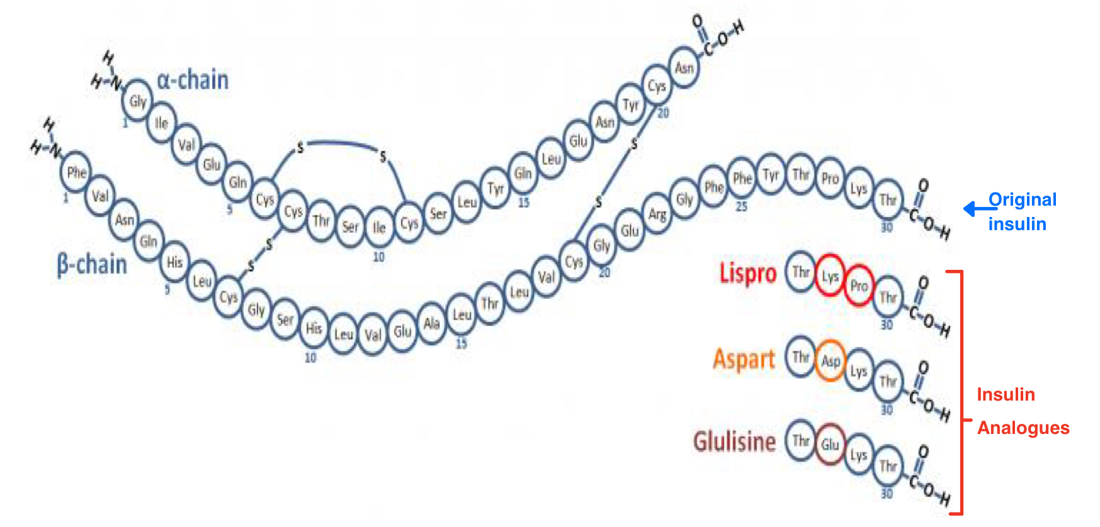
Insulin Cont...
Source of insulin :
Exogenous Insulin
Beef Insulin : Differs from human insulin by 3 amino acids (antigenic). Porcine Insulin: Differs by one amino acid (antigenic).
Human Insulin analogues¹
Prepared by recombinant DNA techniques. Less immunogenic. Modifications of amino acid sequence of human insulin can change pharmacokinetics .
Types of insulin preparations
Differ in pharmacokinetic properties mainly in:
Onset of action (Rate of absorption)
Duration of action.
Variation is due to:
Change of amino acid sequence².
Size and composition of insulin crystals in preparations (monomers³, dimers, hexamers).
Prof. Hanan= For each type, you should know the onset and the duration
Ultra-short acting insulins | Short acting insulins | Intermediate acting insulins | Long acting insulins
e.g. Lispro, aspart -very fast onset of action and short duration . | e.g. regular insulin , Humulin R⁴ -fast onset of action and short duration. | e.g. NPH, lente -Slow onset, intermediate duration of action. | e.g. glargine, detemir -Slow onset and long duration of action (24hrs).
Ultra-short acting insulins
Drug | Insulin lispro, insulin aspart
P.K | Clear⁵ solutions at neutral pH. Do not aggregate or form dimers or hexamers (monomeric analogue). Fast onset of action (5-15 min) Short duration of action (3-5 h) S.C. (5 -15 min before meal), 3 times/day⁶ I.V. in emergency. Reach peak level 30-90 min after injection. Mimic the prandial mealtime insulin release.
Uses | Preferred for external insulin pump used to control post-prandial hyperglycemia (s.c.) and emergency diabetic ketoacidosis (i.v).
1: multiplicated by e.coli in labs, then purified.
2: changes pharmacokinetics of insulin ONLY. pharmacological action is not affected.
3: small: fast onset of action but less duration of action.
4: R= regular = short acting insulin.
5: clear = can be given IV
6: patient should skip dose if they skip meal (only take with meals) to avoid hypoglycemia.

Slide 5
short acting insulins
Drug | Humulin (Regular insulin)
P.K | Soluble crystalline zinc insulin¹ Clear solutions at neutral pH Forms hexamers Onset of action 30-45 min (s.c.) Duration 6-8 h I.V. in emergency situations Peak 2-4 h 2-3 times/day
Uses | Control postprandial hyperglycemia (s.c.) & emergency diabetic ketoacidosis (i.v.) Can be used in pregnancy²
Comparison between Ultrashort and short acting insulins
Characteristic | Ultra-Short acting insulins e.g. Lispro, aspart, glulisine | Short-acting (regular) insulins e.g. Humulin R, Novolin R
Physical characteristics | Clear solution at neutral pH
chemistry | Monomeric analogue | Hexameric analogue
Route & time of administration | S.C. 5 min (no more than 15 min) before meal I.V. in emergency (e.g. diabetic ketoacidosis) | S.C. 30 – 45 min before meal I.V. in emergency (e.g. diabetic ketoacidosis)
Onset of action | Fast 5 – 15 min ( S.C ) | rapid 30 – 45 min ( S.C )
Peak Level | 30 – 90 min | 2 – 4 hr
Duration | 3 – 5 hr Shorter | 6 – 8 hr longer
Usual administration | 2 – 3 times/day | 2 – 3 times/day
Uses | postprandial hyperglycemia & emergency diabetic ketoacidosis
Advantages of Ultra-short vs Short Insulin :
Rapid onset of action ( patients will not wait long before they eat ). Its duration of action is no longer than 3-4 hrs regardless of the dose: Decreased risk of hyperinsulinemia . Decreased risk of postprandial hypoglycemia Thus, they are preferable in elderly
1 just like endogenous insulin that is also found linked to zinc, making short acting insulin the most similar to endogenous in both crystallization form and duration of action/onset.
2: preferred form to be used in pregnancy as S.C injection.

Slide 6
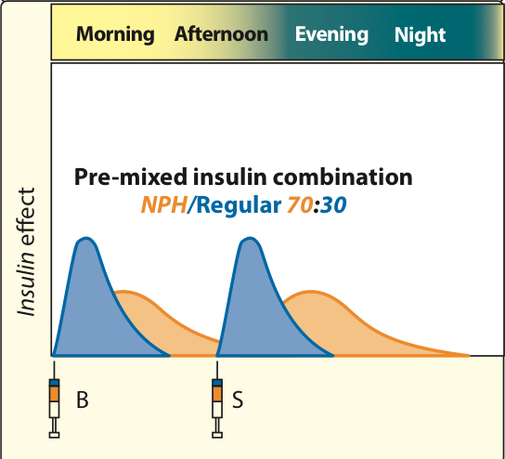
Intermediate acting insulins
Drug | 1- Isophane (NPH) insulin
Characteristics | NPH, is a Neutral Protamine¹ Hagedorn insulin in phosphate buffer. NPH insulin is combination of protamine & crystalline zinc insulin (1:6 molecules) proteolysis release insulin.
P.K | Turbid suspension at neutral pH Given S.C. only, not I.V² Can not be used in ketoacidosis or emergency Onset of action 1-2 h Duration of action 13-18 h Peak serum level 5-7 h
Insulin Mixtures | NPH/regular insulin 75/25 , 70/30 , 50/50 . (NPL= NPH / Lispro) (NPA= NPH / Aspart) , NPL & NPA have the same duration as NPH, have two peaks³.
Prandial and basal insulin replacement (special thanks to 436 team)
(intermediate & short acting insulin) Before meals : diabetic patients takes short acting insulin which is regular insulin used to cover the daily need of the insulin after meals. Before sleeping : no need for strong and fast action because glucose levels before sleeping not high like after meals so, to avoid hypoglycemia and coma the patients takes instead of short acting insulin the insulin intermediate. | (intermediate & Ultra short acting insulin) Same idea but the short acting insulin is replaced with the ultra-short acting insulin which has a rapid effect As long as the body needs the insulin as a basal level between meals , the patients take double dose of the insulin intermediate to control the glucose level for the whole day not only before meals or sleeping time. | (Insulin mixture(combination) = intermediate + short acting insulin)⁴ Is a helpful drug to reduce the use of injections for the diabetic patients and provide a basal level of insulin during the day and once the patient eat a meal short acting insulin is ready.
1: protamine is clinically used as heparin antidote
2: cannot be used in emergency (slow onset of action)
3: first peak due to ultra short acting part of the preparation, second peak due to NPH.
4: basal insulin level is maintained at all times

Slide 7
Intermediate acting insulins Cont..
Drug | 2- Lente insulin (Humulin L, Novolin L)
Characteristics | Mixture of : 30% semilente insulin (amorphous precipitate of zinc insulin in acetate buffer) 70% ultralente insulin (poorly soluble crystal of zinc insulin) Turbid suspension at neutral pH. Given S.C. , not intravenously
P.K | Delayed onset of action (1-3 h). Peak serum level 4-8 h. Duration of action 13-20 h. Lente and NPH insulins are equivalent in activity. Lente is not used in diabetic ketoacidosis or emergency.
Long acting insulins
Insulin glargine (lantus) , Insulin detemir (Levemir)
Drug | Insulin glargine (lantus)
Characteristics | Clear solution BUT forms precipitate¹ (hexamer) at injection site. Slow onset of action 2 hr Absorbed less rapidly than NPH & Lente insulin Given S.C. only, not intravenously Should not be mixed with other insulins in the same syringe.
P.K | Maximum effect after 4-5 h Prolonged duration of action (24 h) Once daily. Produce broad plasma concentration plateau (low continuous insulin level)² Glargine must be used in regimens with rapid or short acting insulins³.
Advantages over intermediate- acting insulins | Constant circulating insulin over 24 hr , with no peak (peak-less profile). Produce flat prolonged hypoglycemic effect. reduced risk of nocturnal hypoglycemia → Safer than NPH & Lente insulins.
Comparison between the onset and the duration of actions
1: precipitation is induced by the body’s pH, is why it should not be given IV.
2: ADVANTAGE.
3: to produce peaks at meal times

Slide 8
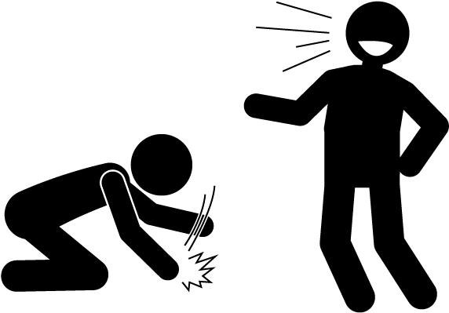
Insulin Dosing considerations
Blood glucose monitoring is required in all patients receiving insulin
Rotate injection sites within the same region
Insulin should be stored in refrigerator and warm up to room temp before use
Complications of insulin
Insulin resistance
Lipodystrophy
(a buildup of
fatty tissue)
at the injection sites.
Weight gain
(due to anabolic effects of insulin)
Hypersensitivity Reactions
We R Laughing
Ha Ha Ha
Hypokalemia
Hypoglycemia
(Most important)
Summary from dr slides
Insulin analogues are used to treat type I diabetes.
Fast acting insulins
(lispro, aspart)
Given s.c. or i.v.
produce fast action, used to mimic postprandial insulin.
Short acting insulin (Regular insulin)
Given s.c. or i.v.
produce rapid action, used to mimic postprandial insulin.
Intermediate acting insulin
(lente, Isophane)
given s.c. not i.v.
slower action, than regular insulin
Long acting insulins
(glargine, detemir)
Given s.c. not i.v.
Produce constant circulating insulin over 24 hr with no peak (peakless profile)

Slide 9
Quiz
MCQ
Q1 : Which one of the following is an advantage for lispro over humulin ?
A- Fast onset of action. B-Longer duration. C- Form dimers and hexamers .
Q2: Which one of the following is an insulin in combination with protamine & crystalline zinc ?
A- Insulin lispro. B-Lente insulin. C- Isophane.
Q3: What is the treatment for Type I Diabetes ?
A- Insulin injection. B- I.V dextrose. C- Oral hypoglycemics.
Q4: Which one of the following is a complication of insulin therapy?
A- Hyperglycemia. B- hypokalemia. C- Weight loss.
Q5: Which one of the following sources provide the least immunogenic insulin ?
A- Beef Insulin B- Porcine Insulin C- Human Insulin analogues
SAQ
1- 30 years old diabetic patient presented at emergency unit because of emergency diabetic ketoacidosis .
Q1 : Mention the fastest insulin analogue that will control his condition.
Q2 : Mention 2 complications that can result from the treatment you mentioned in (Q1) .
Q3: What is the variation between different insulin preparation? (Mention 2)
MCQ
SAQ
Q1 | A
Q2 | C
Q3 | A
Q4 | B
Q5 | C
Q1 | Insulin lispro or Insulin Aspart
Q2 | Hypoglycemia . Hypokalemia
Q3 | Change of amino acid sequence. Size and composition of insulin crystals in preparations (monomers, dimers, hexamers).
Answers:

Slide 10
Thank you for all your love and support.
Good luck future doctors!
Team Leaders:
May Babaeer Zyad Aldosari
This Magnificent Work was Done By:
Mohsen Almutairi Abdullah Alassaf
Bader Aldhafeeri
Note writers
Raghad AlKhashan
Quiz writers
Abdullah Alassaf

