Slide 1
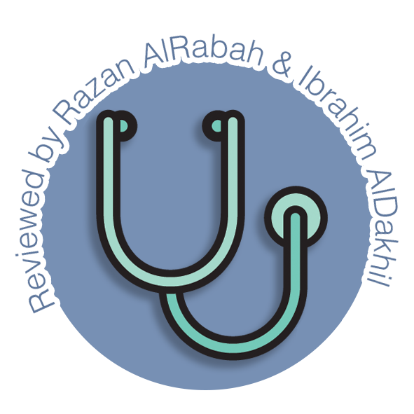
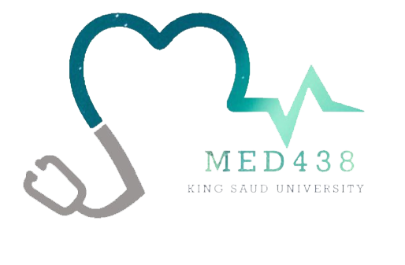
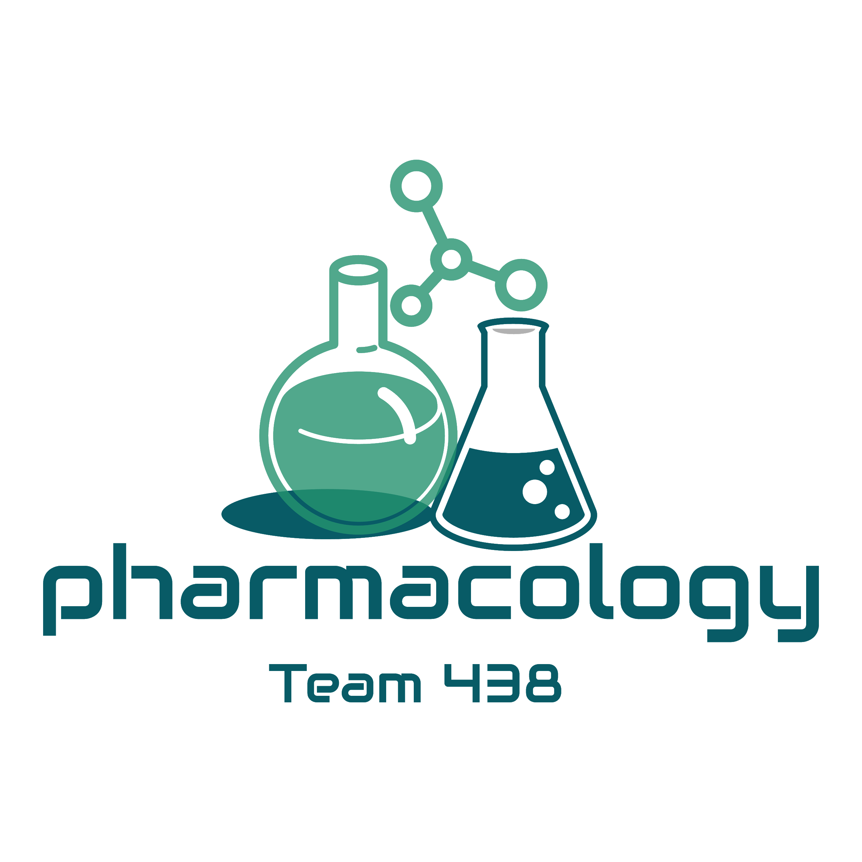
Editing File
Mnemonic File
Endocrine Block
Pharmacology team 438
Hyper and Hypothyroidism
Objectives:
By the end of the lecture , you should know:
Describe different classes of drugs used in hyperthyroidism and hypothyroidism and their mechanism of action
Understand their pharmacological effects, clinical uses and adverse effects
Recognize treatment of special cases such as hyperthyroidism during pregnancy, Graves’ disease and Thyroid Storm and special cases of hypothyroidism such as myxedema coma
Color index:
Black : Main content
Red : Important
Blue: Males’ slides only
Purple: Females’ slides only
Grey: Extra info or explanation
Green : Dr. notes

Slide 2
Hyperthyroidism
Thyroid Function
Normal amount of thyroid hormones are essential for normal growth and development by maintaining the level of energy metabolism in the tissue.
Either too little or too much thyroid hormones will bring disorders to the body.
Important Functions
Growth & development, especially in the embryo & brain
Thermoregulation
increase basal metabolic rate (BMR)
Helps maintain metabolic energy balance
CVS: increase heart rate & cardiac output which increase oxygen demand
Iodine Importance
Thyroid hormones are unique biological molecules in that they incorporate iodine¹ in their structure
Adequate iodine intake (diet, water) is required for normal thyroid hormone production
Major sources of iodine are: iodized salt, iodated bread, dairy products, shellfish
Minimum requirement: 75 micrograms/day
Iodine Metabolism
1
2
3
Dietary iodine is absorbed in the GI tract, then taken up by the thyroid gland (or removed from the body by the kidneys)
Iodide taken up by the thyroid gland is oxidized by peroxidase in the lumen of the follicle:
Oxidized iodine can then be used in production of thyroid hormones
I⁻
Peroxidase
I₂
Iodide
Iodine
Thyroid Hormones²
Tetraiodothyronine (T₄\ thyroxine)
Triiodothyronine (T₃)
Synthesis
Iodine trapping: uptake of iodine by the thyroid gland
Oxidation of iodine:
(to its active form)
thyroid peroxidase
(key enzyme of the synthesis)
Iodine organification:
The iodination of tyrosyl groups of thyroglobulin into
MIT and DIT
Formation of T₄ and T₃ from MIT and DIT:
Thyroid peroxidase
1: Cannot be synthesized by the body, has to be supplied by diet.
2: once produced, they can control their own levels by feedback mechanisms

Slide 3
Thyroid Regulation
Hypothalamus secretes Thyrotropin-Releasing Hormone (TRH) which stimulates synthesis and release of thyrotropin (Thyroid Stimulating Hormone or TSH) by the anterior pituitary.
TSH then stimulates the thyroid gland to uptake iodine, synthesize and release T4&T3.
T4 & T3 levels feedback to both hypothalamus and pituitary affecting the release of TRH & TSH.
Thyroid hormones exert negative feedback on TSH release at the level of the anterior pituitary:
Inhibition of TSH synthesis.
Decrease in pituitary receptor for TRH.
TSH release is influenced by hypothalamic (TRH), and by thyroid hormones themselves
-
Hypothalamus
TRH
+
-
Ant. pituitary
TSH
+
Thyroid gland
T₃ / T₄
Thyroid Hormone Disorders
Hypothyroidism:
Refers to disorders in which the thyroid gland secretes decreased amounts of hormones
Thyroid neoplasia:
Benign enlargement or malignancies of the gland
Thyrotoxicosis:
Is a term for all disorders with increased levels of circulating thyroid hormones¹
Hyperthyroidism:
Refers to disorders in which the thyroid gland secretes increased amounts of hormones
Also defined as: Hypermetabolic state cause by thyroid hormone excess at the tissue level | Also defined as: Increased thyroid hormone synthesis and secretion
Not all patients with thyrotoxicosis have hyperthyroidism | All patients with hyperthyroidism have thyrotoxicosis
Causes of Thyrotoxicosis²
With High RAIU
With low RAIU
Thyroiditis
Iodine-induced thyrotoxicosis:
Drugs (e.g. amiodarone³)
Radiografic contrast media
Graves’ disease (60-80%)
Multinodular goitre (14%)
Adenomas/ Carcinomas
1: Regardless of the cause. Therefor we can consider hyperthyroidism is a type of thyrotoxicosis but not vise versa.
2: Tested by hyperactive iodine uptake.
3: a powerful anti arrhythmic drug that contains iodine.

Slide 4
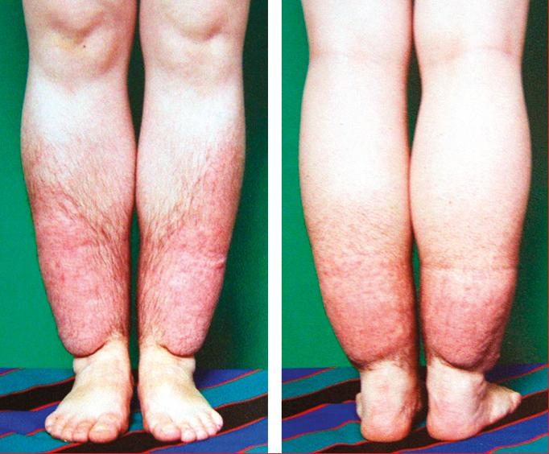
Features of Diseases
Features of Graves’ Disease (diffuse toxic goiter)
Cause by thyroid stimulating immunoglobulins that stimulate TSH receptor, resulting in sustained thyroid over activity.
Mainly in young adults aged 20-25
5 times more frequent in women
Swelling and soft tissues of hands and feet
Clubbing of fingers and toes
Half of cases have Exophthalmos (not seen with other causes of hyperthyroidism)
5% have pretibial myxedemia (thyroid dermopathy)
Exophthalmos
Normal
pretibial myxedema
Goiter
Features of Toxic Multinodular Goiter
Second most common cause of hyperthyroidism
Most cases in women in 5th to 7th decades
Often have long-standing goiter (chronic)
Symptoms usually develop slowly
Thyrotoxicosis
Symptoms:
Signs:
Irritability
Dysphoria
Heat intolerance and sweating¹
Palpitations
Fatigue & weakness
Weight loss²
Diarrhea
Arrhythmia
Thyroid enlargement
Warm, moist skin
Exophthalmos
Pretibial myxedema
Treatment of Hyperthyroidism
01
02
03
04
05
Thioamides
(Antithyroids)
Iodides\
Iodine
Radioactive
Iodine
β-blockers
Surgery
1: Very typical presentation, characteristic for graves.
2:Despite increased food uptake

Slide 5
Thioamides
Drugs | Propylthiouracil (PTU)
MOA | Both PTU and Methimazole: Inhibits synthesis of thyroid hormones by inhibiting the peroxidase enzyme that catalyzes the iodination of tyrosine residues. Additional Mechanism for PTU ONLY: blocks the conversion of T₄ to T₃ in peripheral tissues
P.K | Rapidly absorbed Protein binding: 80-90% Accumulation: in thyroid Excreted by kidneys as inactive metabolite within 24 hours Half-life: 1.5 hours (short) Administered every 6-8 hours | Rapidly absorbed Protein binding: most of the drug is free¹ Accumulation: in thyroid Excretion is slow, 60-70% of drug is recovered in urine in 48 hours² Half-life: 6 hours (long)² Administered every 8 hours
 | Crosses placenta less readily as it is highly protein bound Recommended in pregnancy | Concentrated in thyroid & crosses placenta Not recommended in pregnancy
Breast feeding | Less secreted in breast milk Recommended | Secreted Not recommended
ADRs | Skin reactions (frequency: 4-6%): Urticarial or macular reaction³ Arthralgia (1-5%) GIT effects (1-5%): Gastric distress and nausea Polyarthritis (1-2%): So-called anti-thyroid arthritis⁴ Agranulocytosis (0.1-0.5%): Seen in patients with Graves’ disease; occurs within 90 days of treatment
 | Immunoallergic hepatitis(0.1-0.5%) ANCA-positive vasculitis (Anti-neutrophil cytoplasmic antibodies⁵) (rare) | Abnormal sense of taste or smell (rare)
Methimazole\Carbimazole
Carbimazole: prodrug converted to the active metabolite
methimazole
Pregnancy
2) Iodine\ Iodide
Drug | 1- Organic iodides: iopanoic acid or ipodate 2- Potassium iodide or lugol’s solution
MOA | Inhibit thyroid hormone synthesis and release Block the peripheral conversion of T₄ to T₃ The effect is not sustained⁶ (produce a temporary remission of symptoms)
Uses | Prior to thyroid surgery to decrease vascularity & the size of gland Following radioactive iodine therapy Thyrotoxicosis
C.I | Should not be used as single therapy Should not be used in pregnancy⁷
ADR | May produce iodism⁸ (rare, as iodine isn’t much used now), Iodism symptoms: skin rash, hypersalivation, oral ulcers, metallic taste, bad breath
1: More free drug = more drug available to induce its action 2: Long duration of action = less frequent administration.
3: most common side effect.
4: that is why when a patient comes complaining of arthritis always ask about medications.
5: test for ANCA levels when treating with PTU.
6: should not be given alone unless used for a short period of time. 7: cross the placenta
8: only if given in large amounts

Slide 6
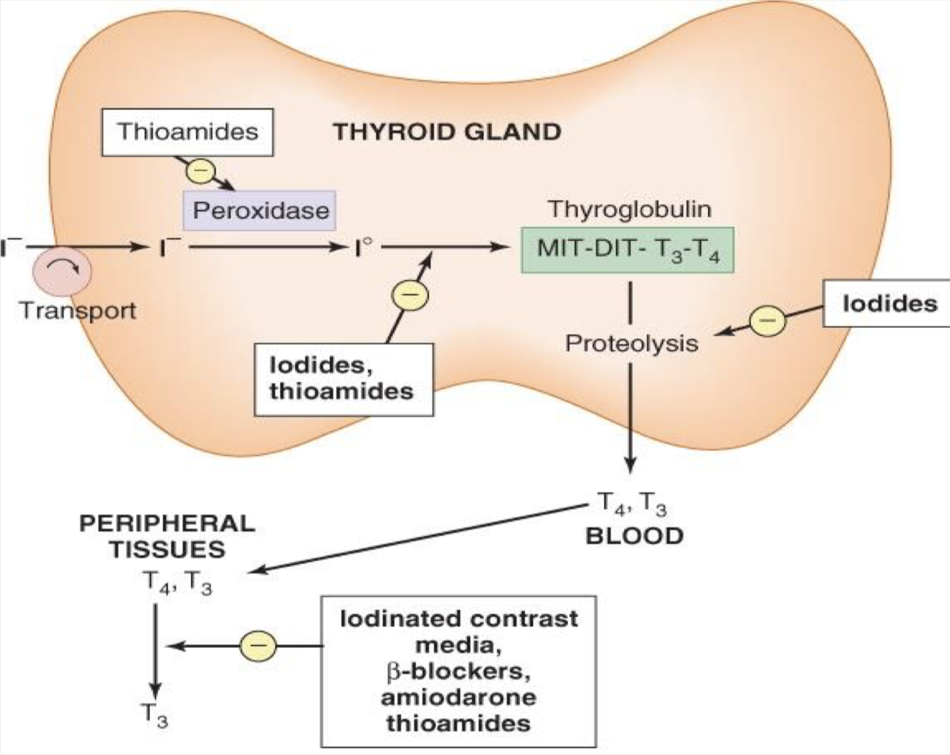
2) Iodine\ Iodide
3) Radioactive Iodine (RAI)
Drug | 1- Organic iodides: iopanoic acid or ipodate 2- Potassium iodide or lugol’s solution
MOA | Inhibit thyroid hormone synthesis and release Block the peripheral conversion of T₄ to T₃ The effect is not sustained¹ (produce a temporary remission of symptoms)
Uses | Prior to thyroid surgery to decrease vascularity & the size of gland Following radioactive iodine therapy Thyrotoxicosis
C.I | Should not be used as single therapy Should not be used in pregnancy²
ADR | May produce iodism³ (rare, as iodine isn’t much used now), Iodism symptoms: skin rash, hypersalivation, oral ulcers, metallic taste, bad breath
Drug | Radioactive Iodine (RAI)
MOA | 131 I isotope (therapeutic effect due to emission of β rays¹) Accumulates in the thyroid gland and destroys parenchymal cells, producing a long-term decrease in thyroid hormone levels.
P.K | Clinical improvement may take 2-3 months Half-life 5 days Cross placenta & excreted in breast milk = C.I in pregnancy and breastfeeding Available as a solution or in capsules Advantages: Easy to administer, effective, painless and less expensive safe if given within therapeutic dose, and less toxic than other drugs Disadvantages: High incidence of delayed hypothyroidism² Large doses have cytotoxic actions (necrosis³ of follicular cells followed by fibrosis) May cause genetic damage May cause leukemia & neoplasia induced by the genetic damage
Uses⁴ | Hyperthyroidism mainly in old patients (above 40) Graves’ disease Patients with toxic nodular goiter⁵ Can be used as a diagnostic method
4) β-blockers⁶
Drug | Propranolol\ Atenolol\ Metoprolol
Uses | Adjunctive therapy to relief the adrenergic symptoms of hyperthyroidism such as tremors, palpitation, heat intolerance and nervousness
C.I | Propranolol⁷ is contraindicated in asthmatic patients
5) Thyroidectomy
Sub-total thyroidectomy is the treatment of choice in very large gland or multinodular goiter
Summary for the MOAs
1: leading to disruption of the hyperactive follicles.
2: due to disruption of more follicles than intended = production of less hormones than normal.
3: as necrosis is irreversible, if patient reaches to this stages, he/she will need life-long supplementation of thyroid hormones
4: RAI can be used for both diagnostic and therapeutic measures. 5: to decrease functional cells
6: symptomatic treatment only (treats the symptoms of sympathetic activation induced by excess thyroid hormones)
7: non-selective, possibly leading to bronchospasm
1- Crosses the placenta
2- Non-selective

Slide 7
Special Conditions of Hyperthyroidism
and their Management
Thyrotoxicosis during pregnancy
Better to start therapy before pregnancy with ¹³¹I or subtotal thyroidectomy to avoid acute exacerbation during pregnancy
During pregnancy:
Radioiodine is contraindicated
Propylthiouracil is the drug of choice during pregnancy
Thyrotoxicosis during pregnancy
Thyrotoxicosis during pregnancy
Thyrotoxicosis during pregnancy
Thyroid Storm
It is a medical emergency of a sudden acute exacerbation of all the symptoms of thyrotoxicosis, presenting as a life-threatening syndrome.
There is hypermetabolism, and excessive adrenergic activity, death may occur due to heart failure and shock.
Management of Thyroid Storm:
It should be treated in an ICU for close monitoring of vital signs and for access to invasive monitoring and inotropic support
Correct electrolyte abnormalities, treat cardiac arrhythmia (if present) & aggressively control hyperthermia by applying ice packs
Promptly administer antiadrenergic drugs (e.g. propranolol) to minimize sympathomimetic symptoms (Life saving treatment)
High-dose propylthiouracil (PTU) is preferred because of its early onset of action, but it has a risk of severe liver injury and acute liver failure.
Administer iodine compounds (Lugol’s iodine or potassium iodide) orally or via a nasogastric tube.
Hydrocortisone 50 mg IV every 6 hours to prevent shock.
Rarely, plasmapheresis has been used to treat Thyroid Storm.
Management of Graves’ Disease
Mild/Moderate Hyperthyroidism
Severe Hyperthyroidism:
[small or moderately enlarged thyroid;
children or pregnant or lactating women]
[markedly elevated serum T4 or T3 and very
large goitre, >4 times normal]
1
Primary antithyroid drug therapy should be considered
1
Definitive therapy with radioiodine preferred in adults
2
Start methimazole, 5-30 mg/day, (PTU preferred in pregnant women)
Normalization of thyroid function with antithyroid drugs before surgery in elderly patients and those with heart disease
2
3
Monitor thyroid function every 4-6 weeks until euthyroid state achieved
4
Discontinue drug therapy after 12-18
Relapse: Definitive radioiodine therapy in adults (second course of antithyroid drug therapy in children)
5
Monitor thyroid function every 2 months for 6 months, then less frequently, if:
Remission: Monitor thyroid function every 12 months indefinitely

Slide 8
Hypothyroidism
Hypothyroidism
Thyroid gland does not produce enough hormones
May be congenital, primary or secondary
Congenital: in children, hypothyroidism leads to delay in growth (dwarfism) and intellectual development (cretinism)
People who are most at risk include those over age 50 & mainly in females
Prevalence is 14/1000 females and 1/1000 males .
Diagnosed by low plasma levels of T3 & T4 and TSH
Types of Hypothyroidism
Primary: Inadequate function of the gland itself.
Iodine deficiency: most common cause of primary hypothyroidism & endemic goiter worldwide
Autoimmune: Hashimoto’s thyroiditis
Radioactive iodine treatment of hyperthyroidism
Post-thyroidectomy
Antithyroid drugs (CMZ , PTU)
Other drugs (lithium, amiodarone¹)
Subacute thyroiditis
Thyroid carcinoma
Secondary:
Hypothalamic disease
Pituitary disease
Manifestations of Hypothyroidism
Early
VS
Late
Fatigue and lack of energy
Cold intolerance
Constipation
Weakness
Muscle or joint pain
Paleness
Thin, brittle hair and fingernails
Decreased sense of taste and smell
Dry flaky skin
Hoarseness
Menstrual disorders, infertility
Puffy face, hands and feet
Thinning of eyebrows
Treatment of Hypothyroidism
Replacement therapy with synthetic thyroid hormone preparations²:
01
02
03
Levothyroxine (T4)
Liothyronine (T3)
Liotrix ³
1: Amiodarone is a powerful antiarrhythmic that’s rich in iodine and can lead to both hypothyroidism and hyperthyroidism. The most likely mechanisms of AIH are an enhanced susceptibility to the inhibitory effect of iodine on thyroid hormone synthesis and the inability of the thyroid gland to escape from the Wolff-Chaikoff effect after an iodine load in patients with preexisting Hashimoto thyroiditis. In addition, iodine-induced damage to the thyroid follicles may accelerate the natural trend of Hashimoto thyroiditis toward hypothyroidism. Patients without underlying thyroid abnormalities are postulated to have subtle defects in iodine organification that lead to decreased thyroid hormone synthesis, peripheral down regulation of thyroid hormone receptors, and subsequent hypothyroidism.
2: Treat the underlying cause first and then give replacement therapy . 3: A mixture of both T4 and T3.

Slide 9
Drug | Levothyroxine (T4)
P.K | A synthetic form of thyroxine (T4) is the drug of choice for replacement therapy¹ Stable, long half life (7days) Administered once daily Restore normal thyroid levels within 2-3 weeks Absorption is increased when hormone is given on empty stomach Metabolism: Major pathway of thyroid hormone metabolism is through sequential deiodination 80% of circulating T3 is derived from peripheral T4 by monodeiodination The liver is the major site of degradation for both T4 & T3 80% daily dose of T4 is deiodinated to yield equal amount of T3 and rT3 (reverse T3, which is inactive)
Uses | Hypothyroidism regardless of etiology: Congenital Pregnancy Hashimoto thyroiditis
Dose | Oral preparations are available form 0.0025-0.3mg tablets Parenteral preparations² 200-500μg Given in a dose of 12.5-25μg/d for 2 weeks then increased every 2 weeks
ADR | ADRs of overdose (shows the symptoms of hyperthyroidism) In children: restlessness , insomnia accelerated bone maturation In adult: cardiac arrhythmia (tachycardia , atrial fibrillation) tremor, restlessness, headache, change in appetite, weight loss, heat intolerance muscle pain
 | In old patients and in patients with cardiac problems treatment is started with reduced dosage.
Caution
Drug | Liothyronine (T3)
P.K | Advantages: More potent (3-4 times) rapid onset of action than levothyroxine Disadvantages: It has short half life, so not recommended for routine replacement therapy (requires multiple daily doses) should be avoided in cardiac patients³
Dose | Oral preparation available are 5-50μg tablets Parenteral use 10μg/ml
Levothyroxine is the drug of choice and used for routine replacement therapy because its half life is long and less administrations are required.
For emergencies
Liothyronine has more cardiac side effects than Levothyroxine.

Slide 10
Comparison in P.K of the drugs
Hormone | Levothyroxine (T4) | Liothyronine (T3)
Biologic Potency | 1 | 4
T ½ | 6-7 days | ≤2 days
Potency Binding | 99.96% | 99.5%
 | Potencity | T1\2 (days) | Protein binding
Levothyroxine (T4) | 1 (low) | 6-7 (longer) | 99.96
Liothyronine (T3) | 4 (more potent) | ⩽ 2 (short) | 99.5
Drug | Liotrix
MOA | Combination of synthetic T4 & T3 in a ratio 4:1 that attempt to mimic the natural hormonal secretion
 | The major limitations to this product are: High cost Lack of therapeutic rationale because 35% of T4 is peripherally converted to T3
Disadvantages
Special Conditions of Hypothyroidism
and their Management
Myxedema Coma
Life –threatening hypothyroidism
The treatment of choice is loading dose of levothyroxine intravenously 300-400μg initially followed by 50μg daily
I.V. liothyronine can be used for rapid response but it may provoke cardiotoxicity¹
I.V. hydrocortisone may be used in case of adrenal and pituitary insufficiency.
Hypothyroidism in Pregnancy²
In pregnant hypothyroid patient 20-30% increase in thyroxine is required because of :
elevated maternal thyroxine binding globulin (TBG) induced by estrogen
early development of fetal brain which depends on maternal thyroxine
Used for healthy adults with no history of cardiac problems
In either hypo or hyper, it’s recommended to treat the condition before pregnancy.

Slide 11
Quiz
MCQ
Q1- Which of the following is the treatment of choice for hypothyroidism ?
A- Iodide B- Levothyroxine C- Liotrix D- Propylthiouracil
Q2- A 42-year-old man was undergoing surgery in order to remove a very large nontoxic goiter, apparently due to iodide deficiency. A short course of potassium iodide was administered before surgery. Which of the following statements best explains why this drug was given to the patient?
A-To overcome iodine deficiency after surgery
B- To reduce the size and vascularity of the thyroid gland
C- To decrease the risk of hypothyroidism after surgery
D- To inhibit the excessive secretion of TSH from the pituitary
Q3- A 41-year-old man complained to his physician of increased appetite, palpitation and diarrhea. Lab results confirmed the diagnosis of mild hyperthyroidism and a treatment with methimazole was started. Which of the following actions most likely mediated the therapeutic effectiveness of the drug in this patient?
A- Inhibition of iodine absorption from the gut B- Stimulation of thyroid peroxidase
C- Blockade of iodine uptake by the thyroid gland D- Inhibition of tyrosine iodination
Q4- A 47-year-old woman complained to her physician of painless enlargement of thyroid gland and fullness in her throat. Lab results revealed high titers of thyroid peroxidase antibodies. A diagnosis of Hashimoto's thyroiditis was made and an appropriate treatment was started. Which of the following drugs was most likely prescribed?
A- Propranolol B- Potassium iodide C- Levothyroxine D- Methimazole
SAQ
Q1-A 30-years-old pregnant patient was diagnosed with mild hyperthyroidism, what is the drug of choice in this case ?
2-3)40-years-old patient came with signs of hyperthyroidism, after investigations it turns out that he has severe hyperthyroidism and need a thyroidectomy.
Q2-Which drug can be used in this case before the surgery?
Q3-What is the M.O.A of that drug?
Q4-A 56-years-old cardiac patient diagnosed recently with hypothyroidism, what is the drug that should be avoid in this case?
Q5-A patient with Myxedema Coma was diagnosed to have adrenal and pituitary insufficiency, what is the drug of choice in this case ?
MCQ
SAQ
Q1 | B
Q2 | B
Q3 | D
Q4 | C
Q1 | Propylthiouracil
Q2 | Iodides
Q3 | Inhibit thyroid hormone synthesis and release, Block the conversion of T4 to T3.
Q4 | Liothyronine
Q5 | I.V. hydrocortisone
Answers:

Slide 12
Thank you for all your love and support.
Good luck future doctors!
Team Leaders:
May Babaeer Zyad Aldosari
This Magnificent Work was Done By:
Deana Awartani Shahad AlThaqib
Note writers
Raghad AlKhashan Nouf AlShammari
Quiz writers
Noura AlMazrou Shahad AlSahil

