Slide 1
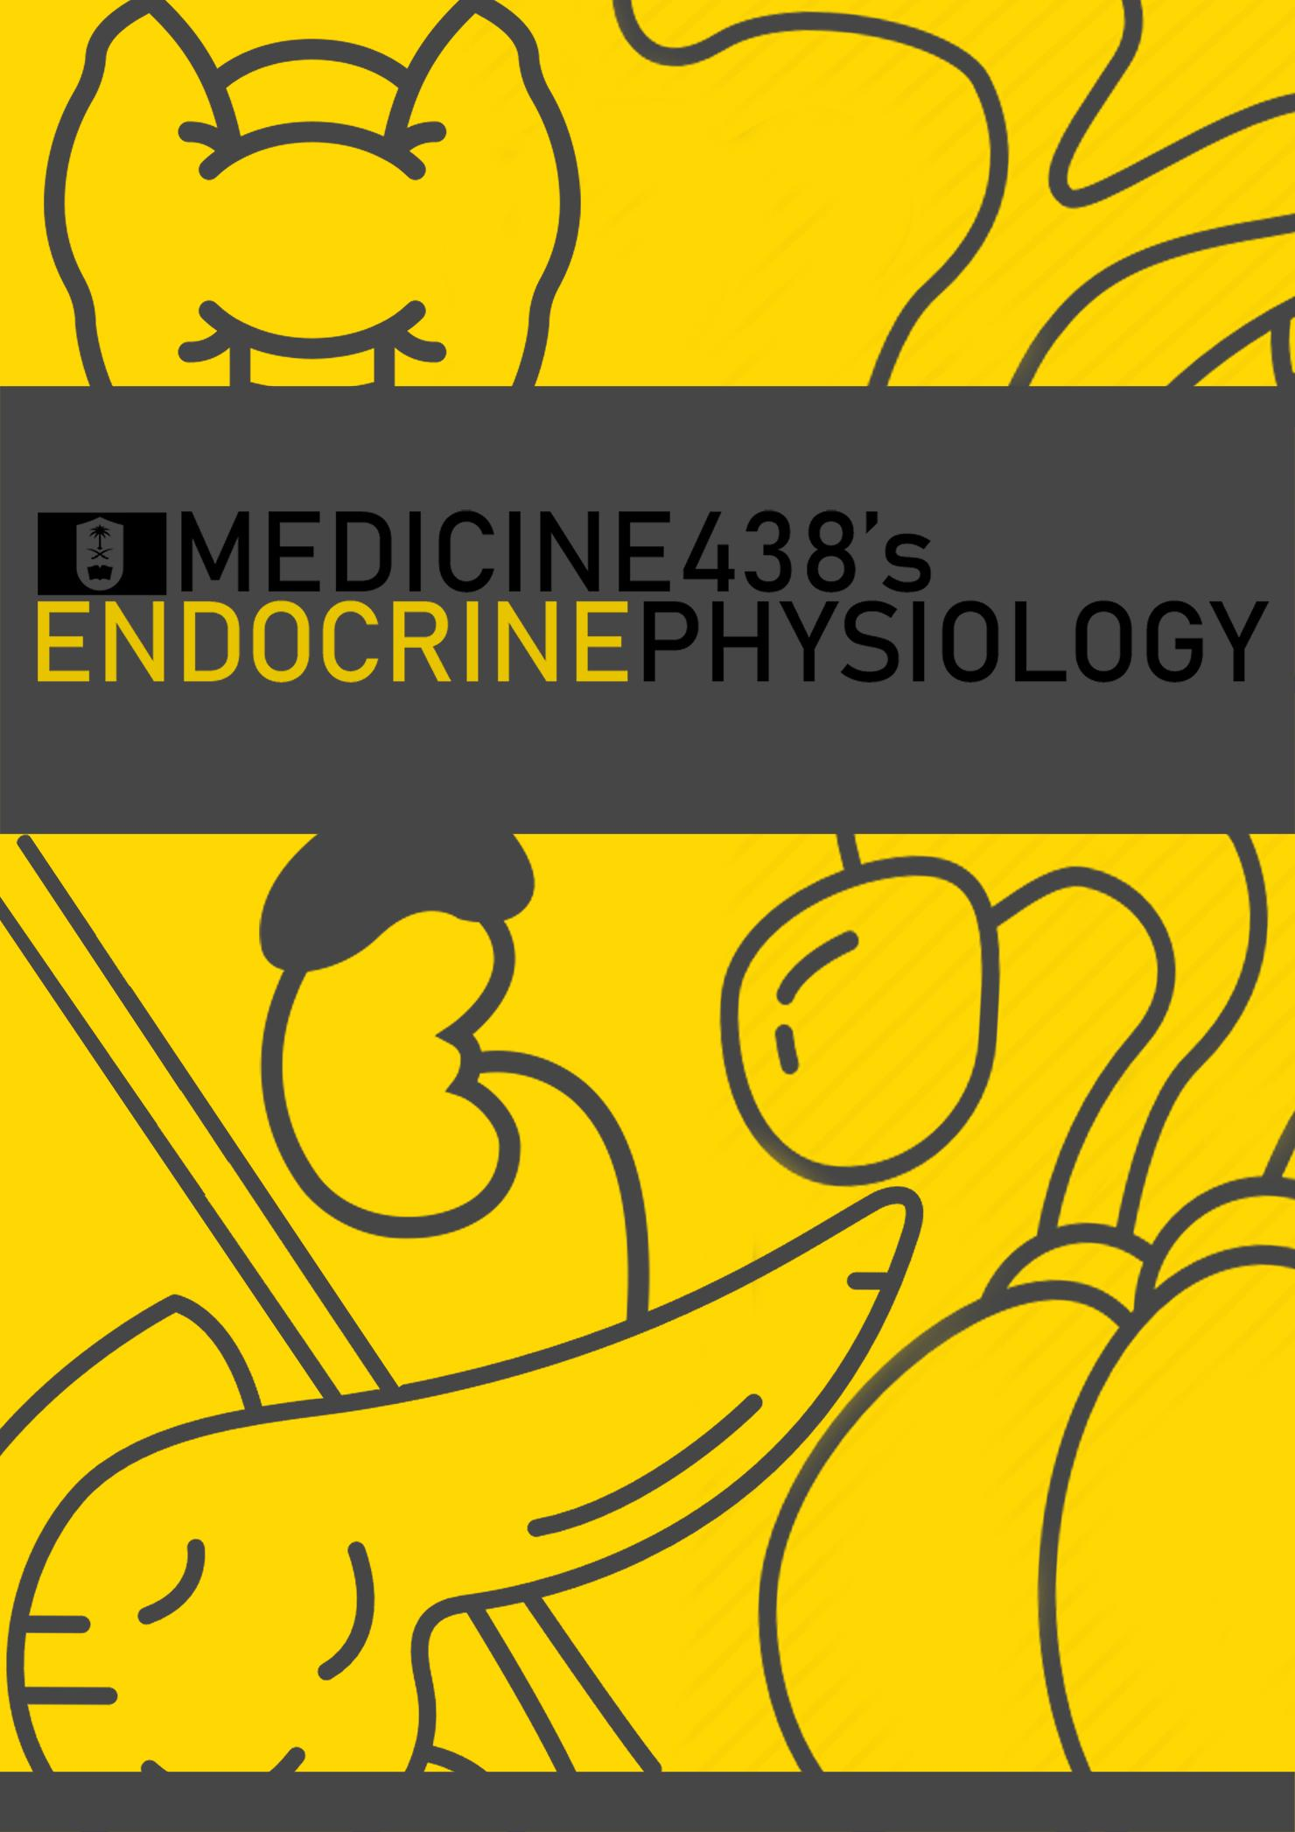
LECTURES X-XII: Adrenocortical Hormones
EDITING FILE
IMPORTANT
MALE SLIDES
EXTRA
FEMALE SLIDES
LECTURER’S NOTES

Slide 2
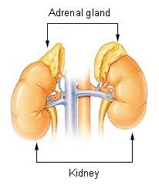
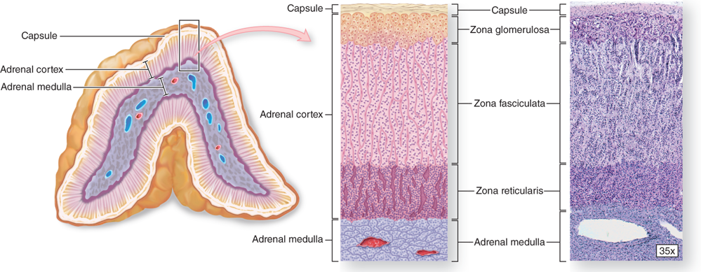
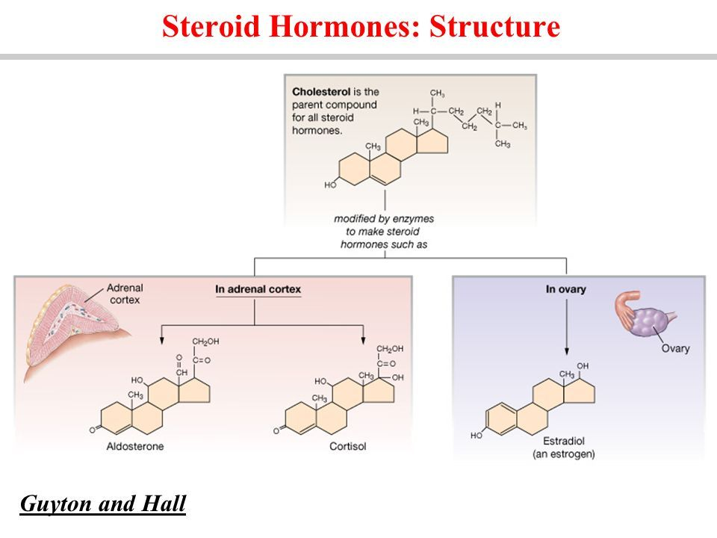
1
MINERALOCORTICOIDS
Lecture Ten
OBJECTIVES
The cellular arrangements and functional components of the adrenal gland.
The hormones secreted by the medulla and cortex of the adrenal gland.
The synthesis of the adrenocortical steroids.
The physiological actions of aldosterone.
The regulation of aldosterone secretion.
The major stimulus for aldosterone secretion.
Adrenal Gland
There are two adrenal (suprarenal) glands that lie at the superior pole of the two kidneys
Small, pyramid-shaped
Weigh 6 / 4 -10 g
Adrenal Cortex
(Outer)
Adrenal Medulla
(Inner)
80-90% of the gland, derived from embryonic mesoderm
Synthesizes and releases group of hormones called corticosteroids (steroid hormones).
All synthesized from the steroid cholesterol.
Different corticosteroids are produced in each of the three layers and they have different functions.
Divided into two morphologically
& distinct regions:
Formed from neural ectoderm, can be considered a modified sympathetic ganglion.
It is the central region
10-20% of the gland
Secretes epinephrine and norepinephrine (related to sympathetic nervous system).
Figure 10-1
Adrenal Cortex
Region | Types | Hormones
Zona Glomerulosa | Mineralocorticoids | Aldosterone (mainly)
Zona Fasciculata | Glucocorticoids | Cortisol (mainly) Corticosterone Androgens (small amount) Estrogens (small amount)
Zona Reticularis | Gonadocorticoids | Androgens: DHEA “dehydroepiandrosterone“ (mainly) Androstenedione Estrogen (small amount) Glucocorticoids small amounts
Table 10-1
Figure 10-2 Shows cross section- histology of adrenal gland
Figure 10-3 Shows structure of steroid hormones

Slide 3
2
MINERALCORTICOIDS
Lecture Ten
Synthesis Of Steroid Hormones
Steroids are derivatives of cholesterol. Cholesterol is from the lipid droplets in cortical cells (cholesterol esters in LDL).¹
1
2
Removed cholesterol is replenished by cholesterol in LDL in blood or synthesized from acetate.
3
Steroidogenic Acute regulatory protein (StAR protein) transfers cholesterol to the inner membrane of the mitochondria (mutation causes accumulation of cholesterol in the cytoplasm).
4
Steroid hormones are synthesized and secreted on demand (not stored).
5
The first step in the synthesis of all steroid hormones is conversion of cholesterol to pregnenolone by the enzyme cholesterol desmolase (aka cholesterol side chain cleavage (SCC) enzyme.
6
Newly synthesized steroid hormones are rapidly secreted from the cell. Following secretion, all steroids bind to some extent to plasma proteins: CBG aka Transcortin and albumin.
Synthesis Of Steroid Hormones
Cholesterol
Cholesterol Desmolase
Pregnenolone ²
17-Hydroxylase
17-Hydroxypregnenolone
17-Hydroxylase
Dehydroepiandrosterone
3β-Dehydrogenase
3β-Dehydrogenase
3β-Dehydrogenase
Progesterone
17-Hydroxylase
17-Hydroxyprogesterone
17-Hydroxylase
Androstenedione
21-Hydroxylase
21-Hydroxylase
Deoxycorticosterone
11-Deoxycortisol
Testosterone
11β-Hydroxylase
11β-Hydroxylase
Aromatase
5α-Reductase
Corticosterone
Cortisone
Oestradiol
Dihydrotestosterone
18-Hydroxylase ³
18-Hydroxycorticosterone
Aldosterone
FOOTNOTES
ACTH upregulates LDL receptors on adrenocortical cells, thus enhancing corticosteroid synthesis. This mechanism is perhaps responsible to why ACTH enhances aldosterone secretion.
Precursor to all steroid hormones.
18-Hydroxylase: Only found in zona glomerulosa.

Slide 4
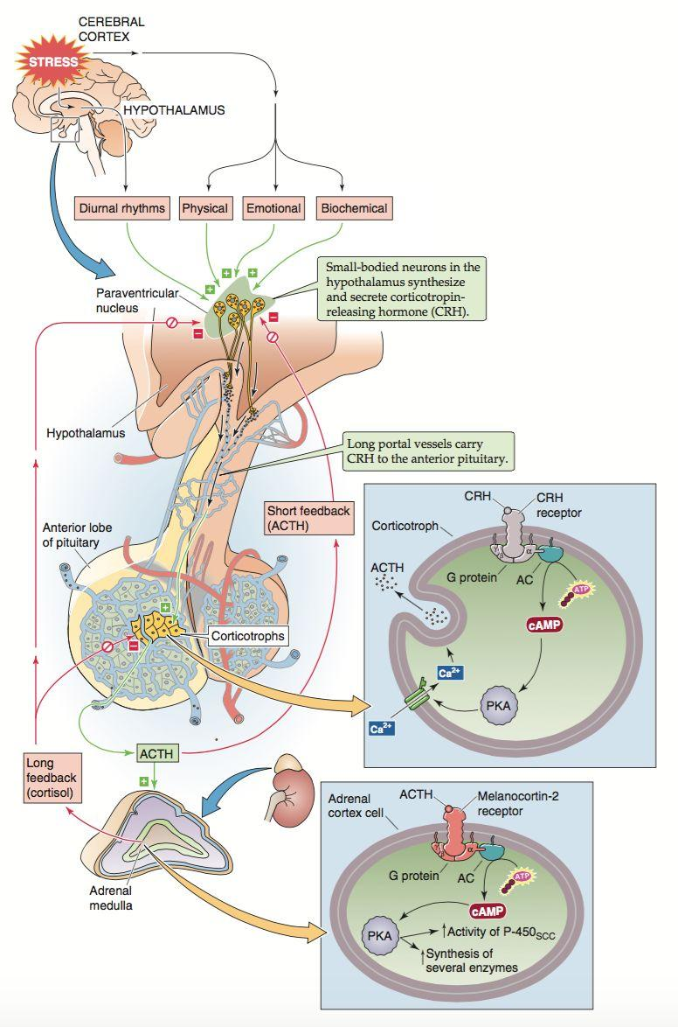
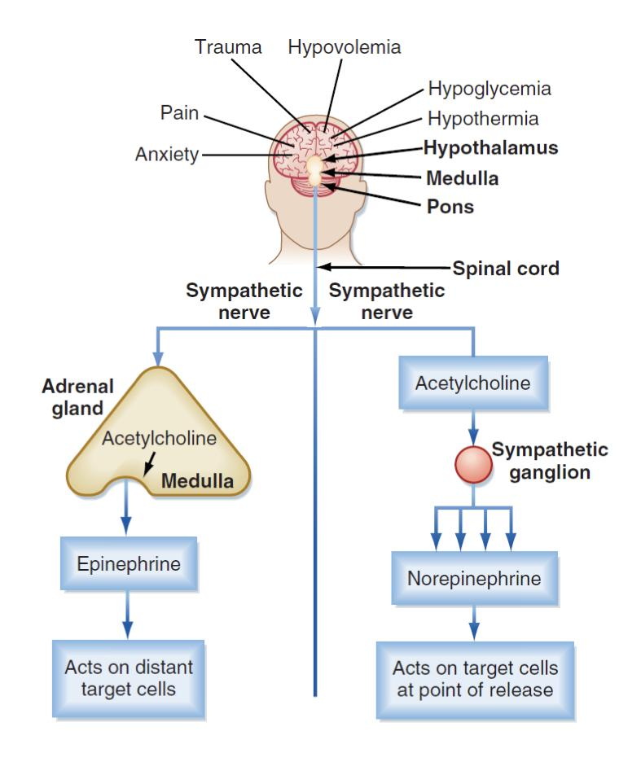
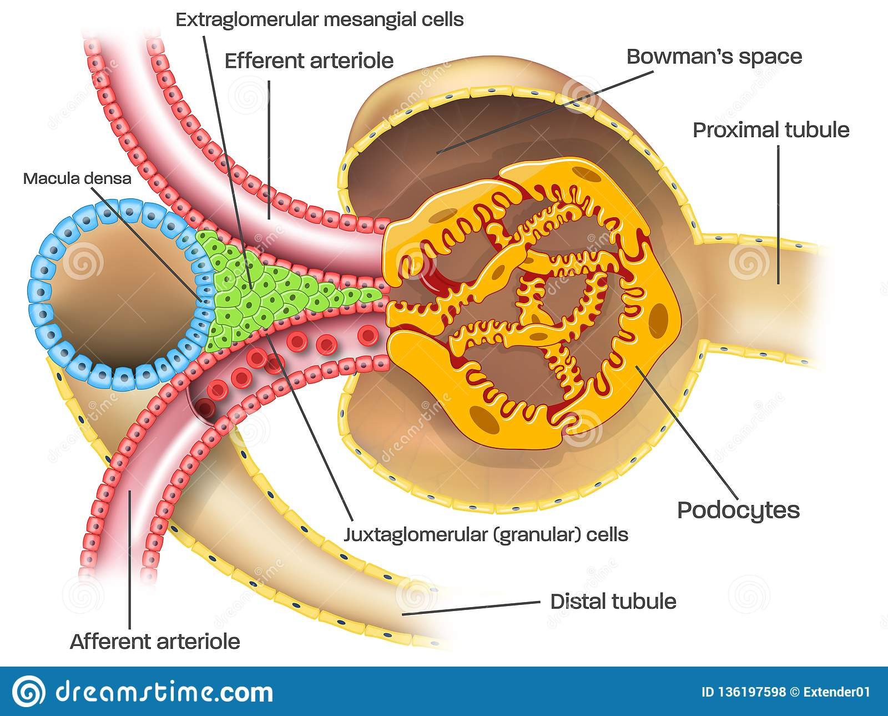
3
MINERALCORTICOIDS
Lecture Ten
Figure 10-4 HPA Axis “ Hypothalamus, Pituitary & Adrenal glands”
The Different Parts of the Nephron
The nephron, for our purposes in this lecture, can be divided in the following manner:
Proximal Tubules: Reabsorbs 70% of water, Na, Cl, and K (Passively permeable to water, secondary to sodium reabsorption) - Not a main target for aldosterone.
Loop of Henle: Reabsorbs 20-25% of NaCl and K - Not a main target for aldosterone.
Thin descending limb: permeable to water, less permeable for NaCl
Thin ascending limb: impermeable to water, but permeable for NaCl (passively)
Thick ascending limb: Impermeable to water, actively reabsorb NaCl and K through Na-2Cl-1K cotransporter (blocked by loop diuretics)
3. Early Distal Convoluted Tubules - Targeted by aldosterone (Figure 10-6): Impermeable to H2O without ADH. Reabsorbs some of the remaining NaCl and K.
Contains special Na-Cl cotransporters (NCC), upregulated by aldosterone. Thus enhancing sodium reabsorption (keep in mind that the same mechanisms that cause aldosterone secretion, like RAAS, usually also cause ADH secretion, therefore water is also reabsorbed here, and plasma sodium concentration is kept relatively normal)(It’s worth noting that this channel is blocked by thiazide diuretics)
Aldosterone upregulates Na/K-ATPase at the basolateral membrane which pumps Na outside of the cell into the blood, decreasing the amount of Na within the cell as well as increasing negativity within the cell to pull in more sodium from the lumen.
Figure 10-5
Figure 10-6
Figure 10-7
4. Late Distal Convoluted Tubules and Collecting Ducts - Targeted by aldosterone (Figure 10-7):
A) Principal cells: Reabsorb Na+ , water, and secrete K+
Contain special channels called ENaC (Epithelial Na Channels), that are upregulated by aldosterone leading to increased reabsorption.
Contain potassium channels, increased sodium reabsorption by ENaC, causes negativity inside of the lumen of the tubules, and more positivity within the cells, this traps potassium within the lumen and thus enhances its excretion by aldosterone.
B) Intercalated cells: Secrete or reabsorb H+, reabsorb K+. (for acid and base balance)
Contain H/K-ATPase (the effect of aldosterone on this pump remain unclear)
Contain H-ATPase that pumps H+ ions into the lumen, upregulated by aldosterone, and therefore hyperaldosteronism can cause alkalosis.
Renin-Angiotensin Aldosterone System
Renin is released by juxtaglomerular cells of the afferent arteriole.
The renal glomerulus lies close to the distal tubule which contains special cells called macula densa.
These cells senses a decrease in sodium and chloride levels, signals the juxtaglomerular cells of the afferent arteriole to release renin.
Renin finds its substrate, angiotensinogen, and converts it to angiotensin I.
Angiotensin I is converted to angiotensin II by Angiotensin Converting Enzyme (ACE)
Angiotensin II then stimulates its receptors on the cells of zona glomerulosa of the adrenal cortex to stimulate aldosterone release.
Aldosterone then, as we explained above, causes sodium reabsorption from DCT and CD.
A decrease in the blood volume (and consequently a decrease in blood pressure), usually decreases the amount of sodium and chloride delivered to macula densa cells, and therefore a decrease in blood pressure or volume usually stimulates RAAS.
Figure 10-8 Note the close proximity of the afferent arteriole to the distal tubules.

Slide 5
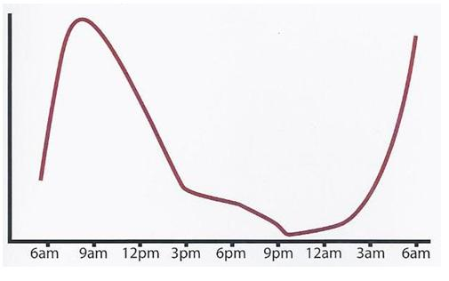
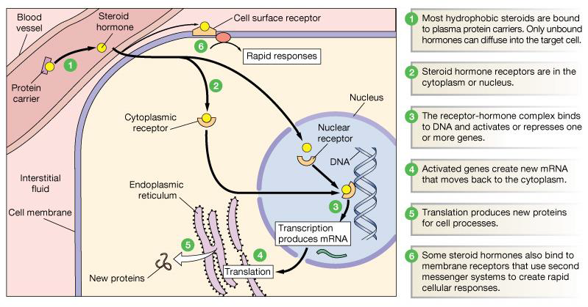
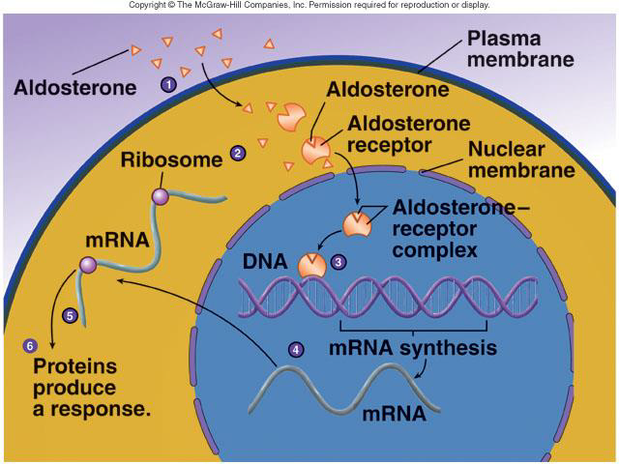
4
MINERALCORTICOIDS
Lecture Ten
Aldosterone
The main mineralocorticoid produced by the adrenal gland.
A steroid hormone, essential for life.
Synthesized in zona glomerulosa.
Aldosterone exerts 90% of all the mineralocorticoid activity.
Responsible for regulating Na⁺ reabsorption in the distal tubule and the cortical collecting duct.
Target cells are called “principal (P) cell”.
60% of aldosterone bound to plasma protein (binds to albumin and corticosteroid-binding protein in blood with low affinity). 40% is free form.
Half life: 20 min
Aldosterone is inactivated by the liver and conjugated to a tetrahydro-glucuronide derivative/glucuronic acid or sulfate and secreted in bile or excreted by the kidney.
Aldosterone levels fluctuate diurnally
Highest concentration being at 8 AM
Lowest at 11 PM in parallel to cortisol rhythms.
Normal diurnal rhythm
Figure 10-9 Shows serum cortisol level.
Mechanism of Action of Steroid Hormones
Figure 10-10
Mechanism of action of Aldosterone:
Increases transcription of Na⁺/K⁺ pump.
Increases the expression of apical Na⁺ channels and Na⁺/K⁺/Cl⁻ cotransporter.
Figure 10-11

Slide 6
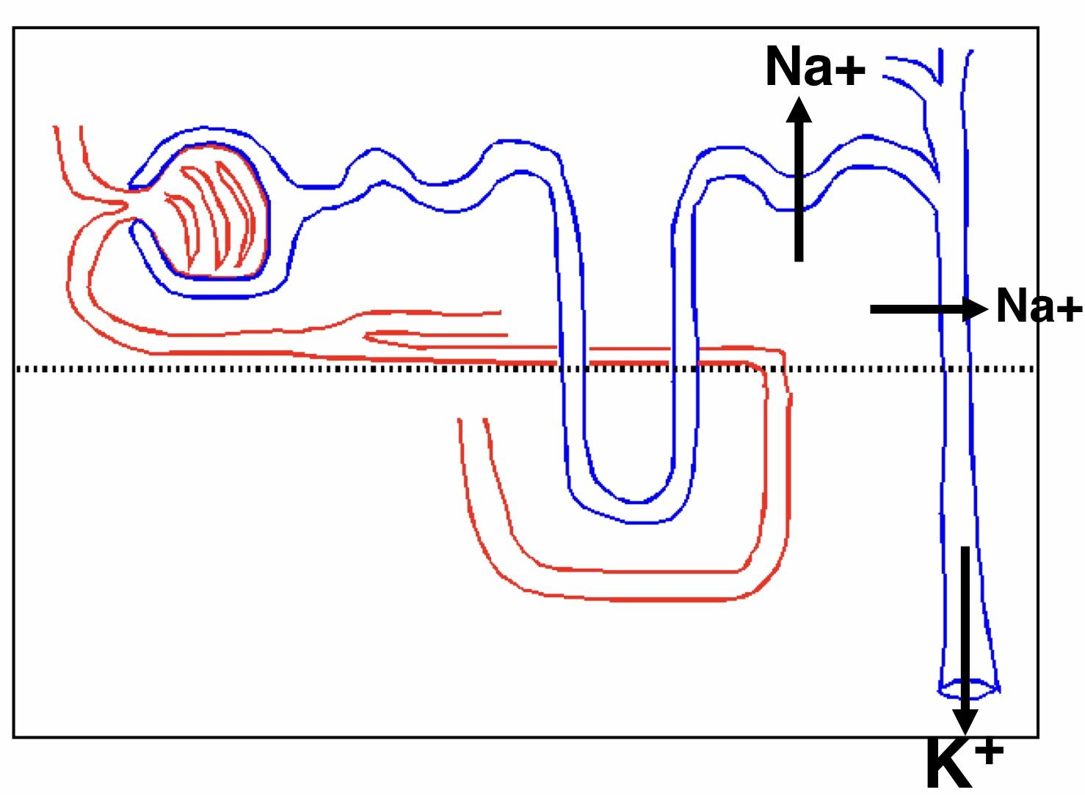
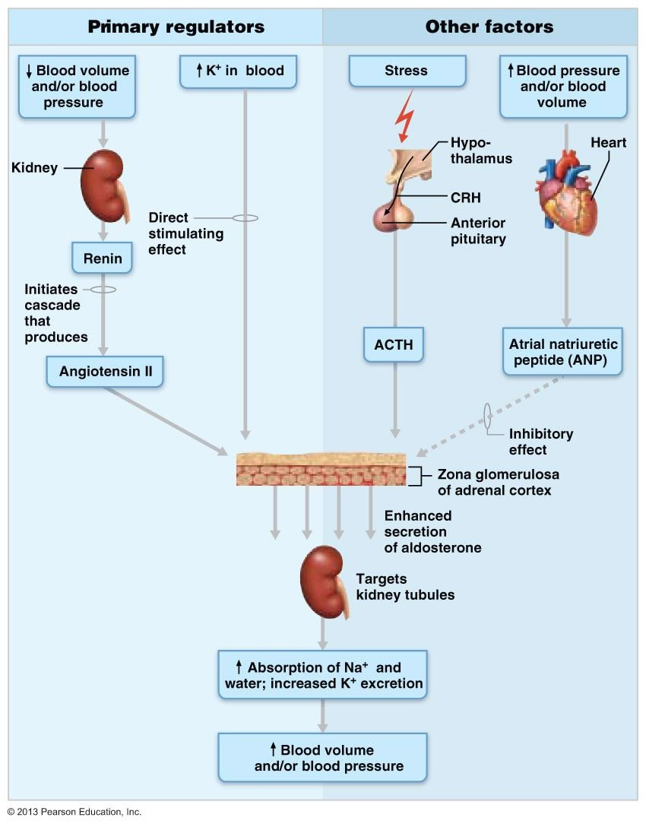
5
MINERALCORTICOIDS
Lecture Ten
Action of Aldosterone¹
Acts mainly on the cells of the collecting ducts and distal tubules.
Binds to mineralocorticoid receptor [MR]
Stimulates Na⁺ reabsorption by distal tubule and collecting duct of the nephron and promotes K⁺ and H⁺ ion excretion.
Increases transcription of Na/K pump (basolateral).
Increases the expression of apical Na channels and Na/Cl cotransporters (NCC)
Stimulates the secretion of K⁺ into the tubular lumen.
Stimulates secretion of H⁺ via the H⁺/ATPase by the intercalated cells of the cortical collecting tubule.
Excess Aldosterone Increases Tubular Hydrogen Ion Secretion and Causes Alkalosis.
Renal Action:
1
Aldosterone causes sodium to be conserved in the ECF while increasing potassium excretion in the urine.
It also stimulates transport of potassium from the extracellular fluid into most cells of the body.
2
Circulatory Action:
Aldosterone increases ECF volume and Arterial Pressure (but has only a small effect on plasma sodium concentration).
3
Na⁺ Reabsorption Action:
Figure 10-12
It also affects Na+ reabsorption and Cl- and excretion of K+ by sweat, salivary and intestinal cells. (Stimulates synthesis of more Na/K-ATPase pumps).
Aldosterone also greatly enhances Na⁺ absorption by the intestines, especially in the colon.²
Aldosterone Secretion is Stimulated By:
Hyperkalemia (increased K⁺ concentration in the ECF). The most important factor.
Decreased Na+ concentration in the ECF
Increased activity of the renin- angiotensin system (increased levels of angiotensin II)
Hypovolemia, renin-angiotensin system is the major stimulant.
Hypotension
ACTH: also stimulates aldosterone synthesis. However the ACTH stimulation is more transient than the other stimuli and is diminished within several days.
Stress, surgery.
Aldosterone Secretion is Inhibited By Atrial Natriuretic Peptide (ANP).
ANP inhibits adenylate cyclase through an inhibitory G protein.
Figure 10-13
Figure 10-14
FOOTNOTES
We strongly suggest reading page three to better appreciate aldosterone’s mechanism of action.
In the absence of aldosterone, intestinal sodium absorption is decreased, sodium draws water into the lumen and causes diarrhea, as in addison’s disease.

Slide 7
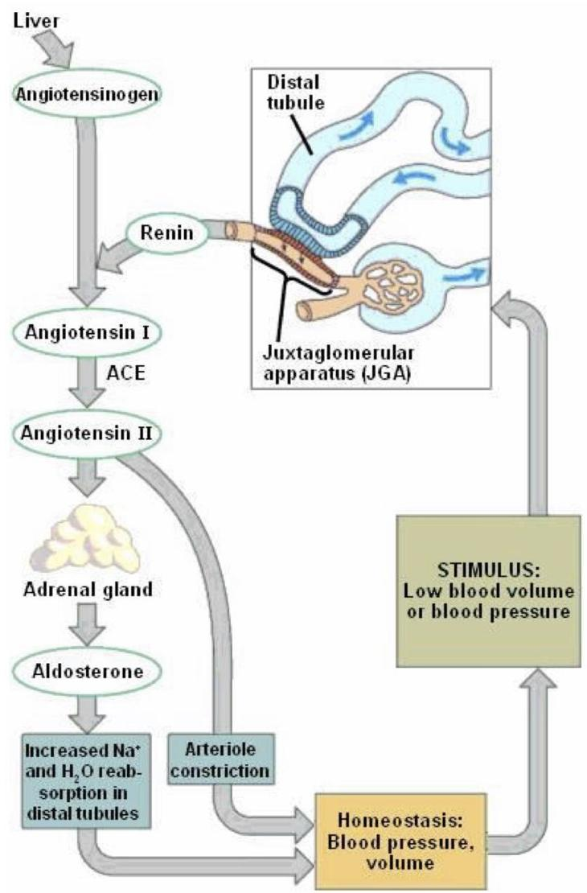
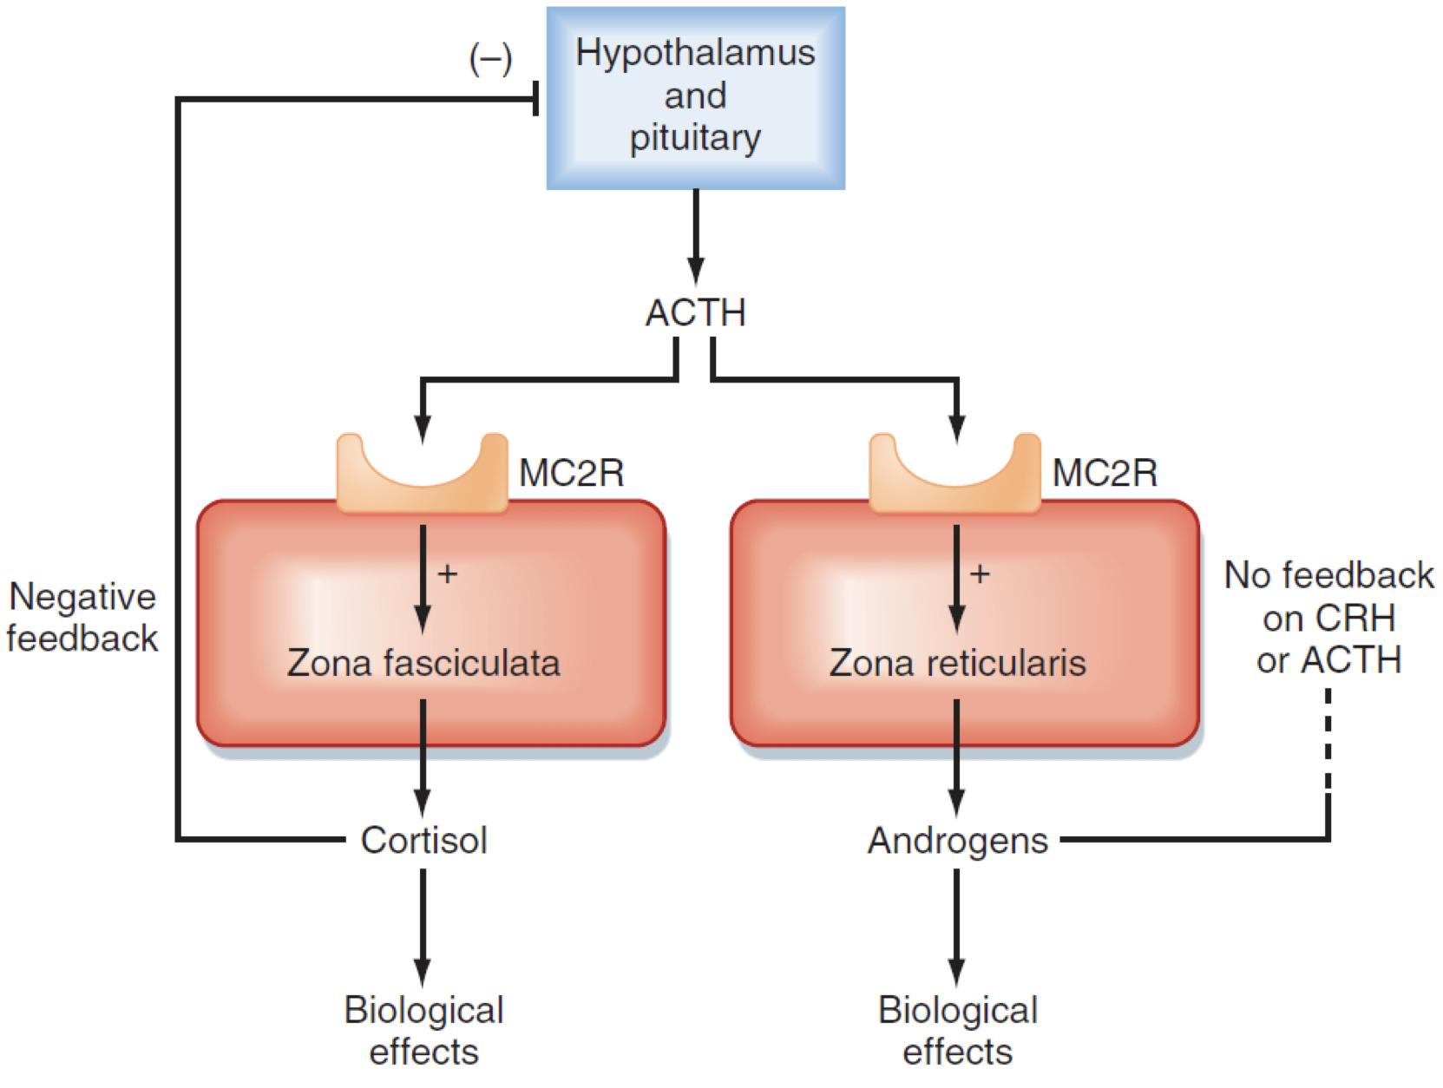
6
MINERALCORTICOIDS
Lecture Ten
Renin
An enzyme released by the kidneys when the arterial pressure falls.
Synthesized and stored in in the juxtaglomerular cells (JG cells) of the kidneys.
The JG cells are modified smooth muscle cells located in the walls of the afferent arterioles immediately proximal to the glomeruli.
Acts on another plasma protein (angiotensinogen), to release angiotensin I which is converted to angiotensin II (in the lungs).
Angiotensin II
Increases the blood pressure through:
Vasoconstriction occurs intensely in the arterioles & much less so in the veins, increasing the total peripheral resistance.
Decrease excretion of both salt and water by the kidneys, increasing ECF volume, which then increases the arterial pressure during subsequent hours and days.
Acts on the zona glomerulosa to stimulate aldosterone synthesis. Acts via increased intracellular cAMP to stimulate aldosterone synthesis.
Genetic Defects In Steroidogenesis
Figure 10-15
Congenital adrenal hyperplasia:
Low cortisol High ACTH Adrenal hyperplasia.
21-hydroxylase (P450c21) deficiency:
Cortisol, corticosterone, and aldosterone deficiency ¹, leading to:
High ACTH Adrenal hypertrophy and high amounts of androgen.
Virilization of female (masculinization)².
Figure 10-16
FOOTNOTES
Cortisol deficiency leads to hypoglycemia.
Aldosterone deficiency increases the loss of Na⁺ and water in the urine and increases K⁺ level in the blood. This is commonly referred to as “Salt-Wasting”.
When 17-Hydroxyprogesterone and 17-Hydroxypregnenolone fail to get used in the cortisol pathways they get shunted into the zona reticularis and eventually become excess Androgens.

Slide 8
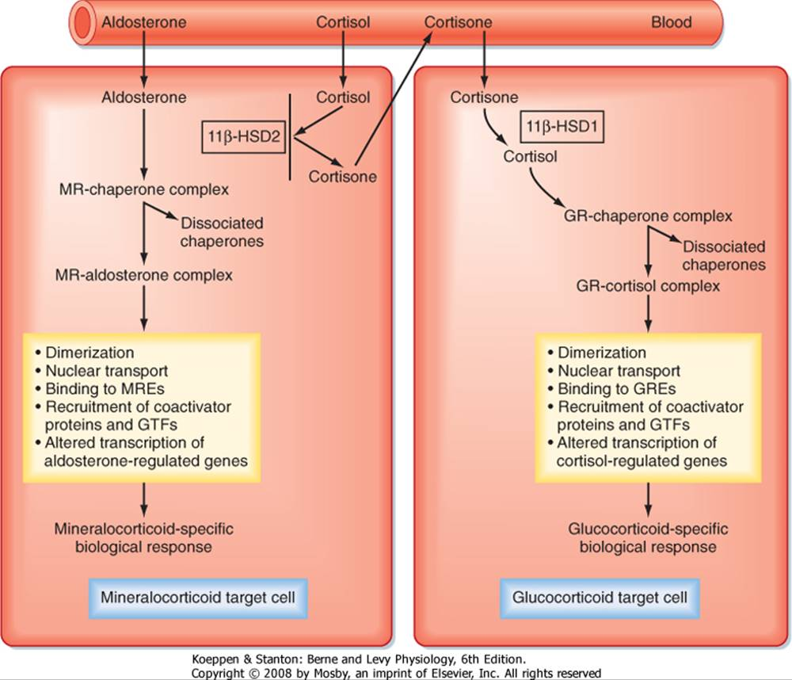
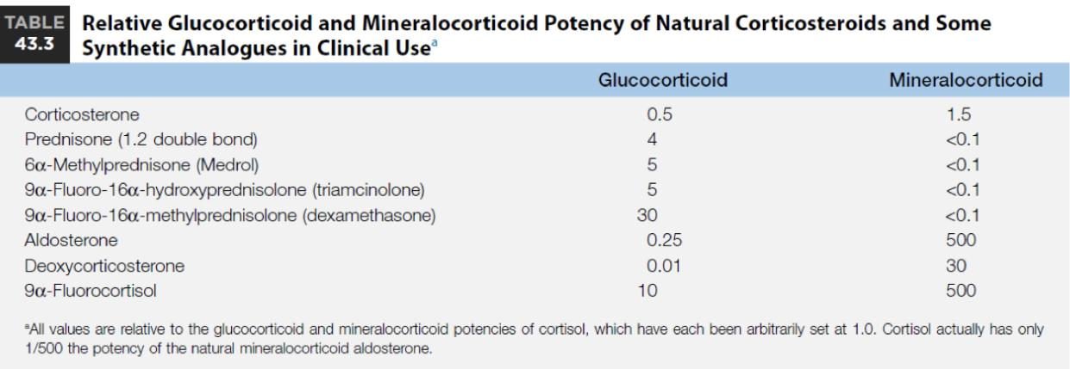
7
MINERALCORTICOIDS
Lecture Ten
Aldosterone Abnormalities
Complete failing to secrete aldosterone: leads to death (dehydration, low blood volume, Low blood pressure, and shock).
Hyperaldosterone states: Contribute to hypertension associated with increased blood volume.
Primary Hyperaldosteronism (Conn’s Syndrome): Decreased plasma renin.
Secondary Hyperaldosteronism: Increased plasma renin.
Hyperaldosteronism
Primary
Example | Conn's Syndrome (increase secretion of mineralocorticoids)
Causes | Tumor of the zona glomerulosa cells (adenoma), Nodular hyperplasia → secretes large amounts of aldosterone.
Signs & symptoms | Hypervolemia: Slight increase in ECF volume and blood volume. very slight increase in plasma sodium concentration. Hypertension Headache Hypokalemia and hypernatremia Decreased plasma renin concentration (from feedback suppression of renin secretion caused by the increased aldosterone) or by the excess ECF volume and arterial pressure. Nocturnal polyuria & polydipsia Increased tubular (intercalated cells) hydrogen ion cosecretion with potassium, with resultant mild metabolic alkalosis. Neuromuscular manifestations: Periods of muscle paralysis (weakness) caused by the hypokalemia., paresthesia Intermittent paralysis Hand cramping
Treatment | Surgical removal for adenoma Spironolactone, a potassium-sparing diuretic that acts as an aldosterone antagonist.
Secondary
Cause | Hyperreninism. 2) Left ventricular failure. 3) cor pulmonale. 4) cirrhosis. 5) Ascitis.
Other causes
Example | Apparent mineralocorticoid excess syndrome (AME) (cortisol binds MR) Cortisol can bind to mineralocorticoid receptors and have mineralocorticoid effects. This prevented by the enzyme: “11β-HSD2 (11β-hydroxysteroid dehydrogenase)”, which converts cortisol to cortisone that does not bind mineralocorticoid receptors. A genetic deficiency of 11β-HSD2 will lead to AME. Fig 10-17
Table 10-2
Figure 10-17 Mineralocorticoid Receptor and Cortisol
Figure 10-18 Minerlaocorticoid vs. Glucocorticoid Potency

Slide 9
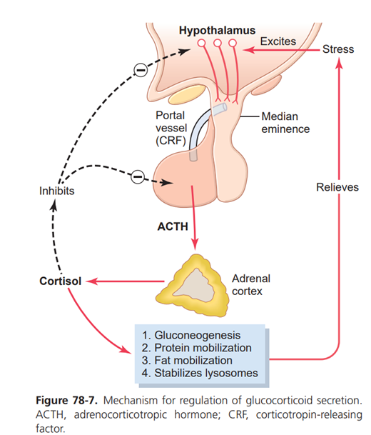
8
GLUCOCORTICOIDS
Lecture Eleven
OBJECTIVESS
Describe the metabolism and physiological effects of glucocorticoids.
Describe the mechanisms that regulate secretion of glucocorticoids.
Describe the main features of the diseases caused by excess or deficiency of each of the hormones of the adrenal gland.
Main Glucocorticoids in Humans
01
Cortisol: Very potent¹
Account for 95% of glucocorticoid activity.
Corticosterone:
Account for about 4% of total glucocorticoid activity. Less potent than cortisol.
Cortisol: Corticosterone:
Produced in humans in a ratio of 10:1
02
03
Glucocorticoids
Produced by the fasciculata and reticularis layers of the adrenal cortex.
Glucocorticoids (cortisol): recognized early to increase plasma glucose levels:
Mobilization of amino acids from proteins.
Enhance liver gluconeogenesis.
Target tissues: most body tissues.
Regulation of Glucocorticoid Secretion
CRH from hypothalamus is the major regulator of ACTH secretion.
ADH is also secretagogue for ACTH
ACTH from anterior pituitary stimulates cortisol synthesis and secretion.
CRH (and ACTH) are secreted in pulses.
The greatest ACTH secretory activity occurs in the early morning hours and diminish late in the afternoon.
Cortisol has a direct negative feedback effect on both the hypothalamus and ant. pituitary.
Figure 11-1
FOOTNOTES
Footnotes
Also known as hydrocortisone when used for therapeutic purposes.
Cellular mechanism of cortisol action: Cortisol can act through (genomic or non-genomic actions), genomic actions involve gene transcription and formation of protein, this process takes around an hour, and the proteins can take up to several hours or days to produce their effect. There is some evidence of 2nd messenger action of cortisol, meaning it can bind cell-surface receptors, but this is still under investigation.

Slide 10
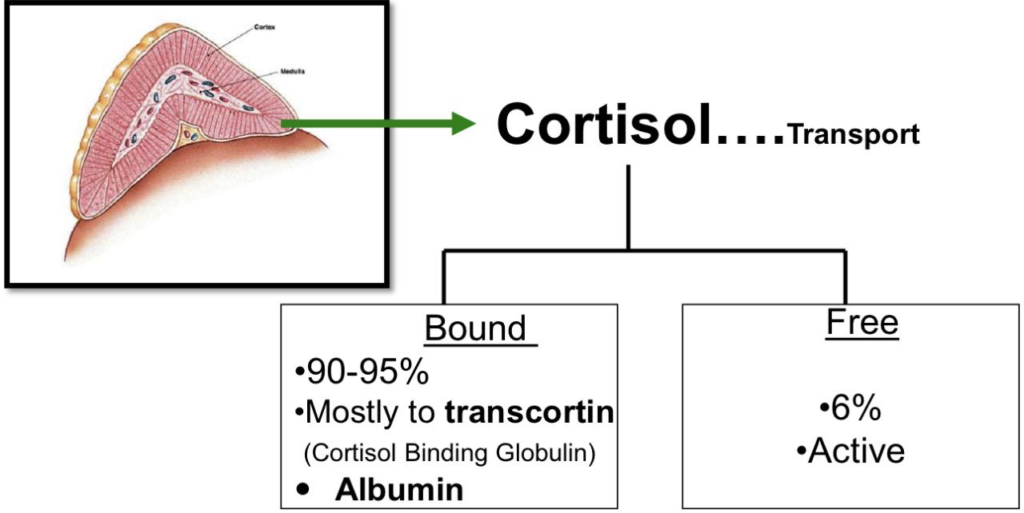
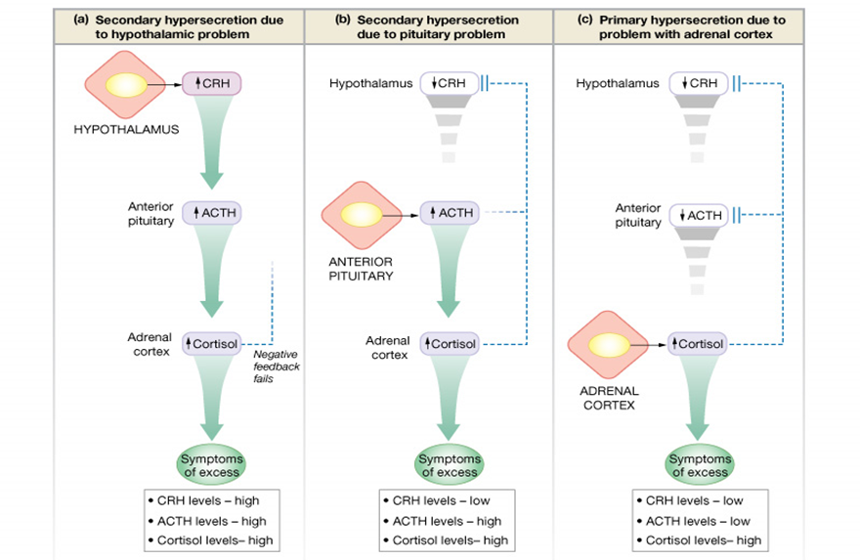
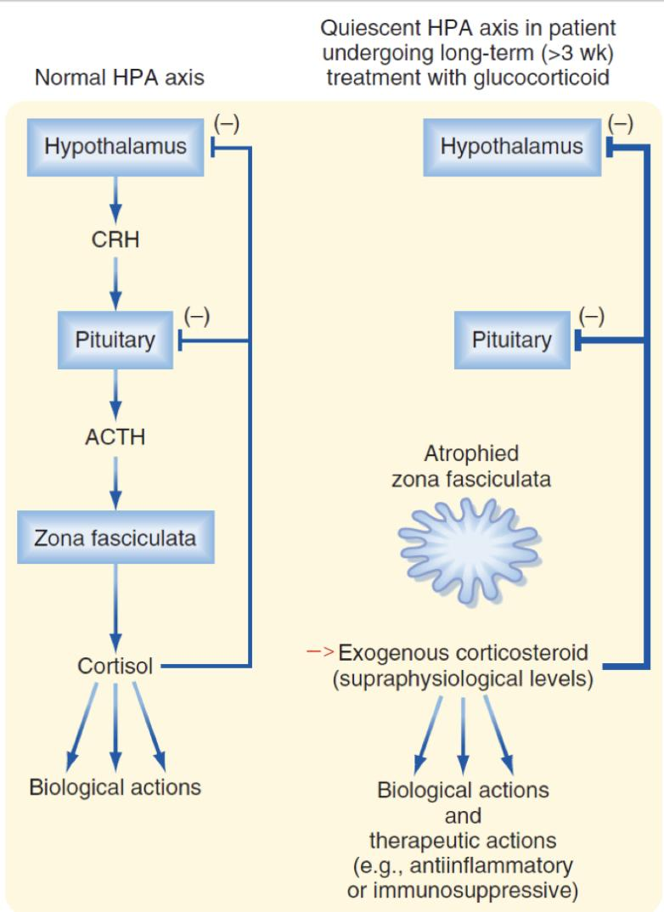
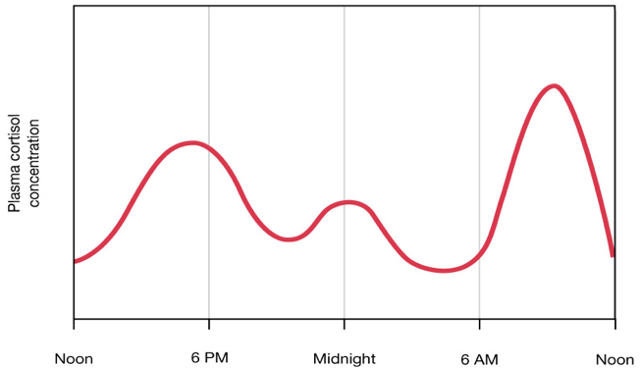
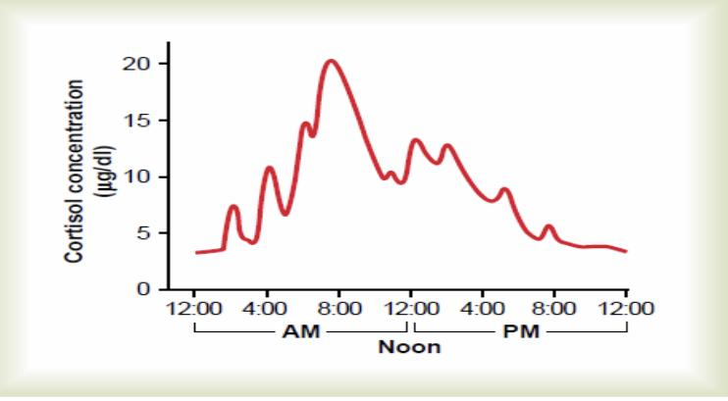
9
GLUCOCORTICOIDS
Lecture Eleven
Cortisol Transport & Metabolism
Bound (90-95%):
Mostly to transcortin (Cortisol Binding Globulin).
Albumin.
Free (6%): Active.
Half life = 60-90 minutes
Metabolized in liver by reductases & conjugated to glucuronides → excreted via kidney.
Free cortisol is excreted into urine.
Figure 11-2
Figure 11-4 Quiescent HPA axis is due to exogenous ingestion of corticosteroids, this will lead to atrophied zona fasciculata.
Figure 11-3 Primary and secondary hypersecretion of cortisol
Circadian Rhythm of Cortisol Secretion
The Secretory Rates of CRF, ACTH, and Cortisol
High in the early morning:
The plasma cortisol level ranges between a high of about 20 µg/dl an hour before arising in the morning.
Low in the late evening:
Low of about 5 µg/dl around midnight.
This effect results from a 24-hour cyclical alteration in the signals from the hypothalamus that cause cortisol secretion.
When a person changes daily sleeping habits, the cycle changes correspondingly. Therefore, measurements of blood cortisol levels are meaningful only when expressed in terms of the time in the cycle at which the measurements are made.
Figure 11-5 Typical pattern of cortisol concentration during the day. Note the oscillations in secretion, as well as a daily secretory surge an hour or so after waking in the morning.

Slide 11
10
GLUCOCORTICOIDS
Lecture Eleven
Actions of Glucocorticoids (Cortisol’s Actions Are Mediated By Glucocorticoid Receptors Which Regulate Gene Transcription).
Metabolic
Carbohydrates | Increase glycogen storage in liver cells. Promote glucose sparing by potentiating the effects of catecholamines on lipolysis, thereby making FFAs available as energy sources. (helpful in starvation and stress) Mobilization of amino acids from extrahepatic tissues (muscles) for gluconeogenesis (6-10 folds) (increased expression of the enzymes) (PEPCK)(catalyzes a rate-limiting step in gluconeogenesis) ↓ GLUT4-mediated glucose uptake in skeletal muscle & adipose tissue. (insulin-dependent, GCs decrease insulin sensitivity by mechanisms similar to that of growth hormone) ↓Glucose utilization by the cells/increase glucose level in the blood. (Mechanism is unclear)
Proteins | Mobilization of amino acids from non-hepatic tissues. Decreased amino acids transport into extrahepatic tissues (muscles, lymphatic tissues) Increased blood amino acid levels Proteocatabolic effect in all body cells except of the liver Decreased protein synthesis Proteoanabolic effect in the liver: (1) enhanced liver proteins (2) increased plasma proteins With excess cortisol, the muscles can become so weak due to decreased protein synthesis that a person can not get up from a squatting position!
Lipids | ↑ Mobilization of fatty acids from adipose tissue stores. ↑ Fatty acid concentration in blood. Increases fatty acid utilization for energy.
Stress
Without GCs, the body cannot cope with even mild stressors Stress include (trauma, infection, surgery, any debilitating disease, increase heat or cold). Cortisol causes rapid mobilization of amino acids and FFA from their cellular stores, making them immediately available both for energy & synthesis of other compounds, including glucose, needed by the different tissues in the body. Increase BP, glycogen, prevents stress induced reaction from becoming excessive. Maintenance of the vascular response to norepinephrine The effects on the CNS are involved in modulating the stress response. How does stress increase cortisol secretion? Stressful stimuli (visual, auditory or emotional) → these stimuli are integrated in 2ndary sensory centers (like 2ndary somatosensory cortex) → signals sent to hypothalamus → ↑ CRH leading to more ACTH and cortisol It is unclear why cortisol is beneficial to the animal during times of stress.

Slide 12
11
GLUCOCORTICOIDS
Lecture Eleven
Actions of Glucocorticoids
Inflammation
Damage to the tissues by trauma/infection almost always leads to inflammation. Inflammation can be more damaging than the trauma or disease itself. Reduces all aspects of the inflammatory process. How cortisol exerts its anti-inflammatory effect: Block the early stages of the inflammation process before inflammation even it begins. If inflammation begun: It cause rapid resolution of the inflammation and increase rapidity of healing Resolution of inflammation Mechanism of the anti-inflammatory effect: Stabilizes lysosomal membrane: More difficult for these membranes to rupture → less release of proteolytic enzymes that cause inflammation. (anti-allergic) Inhibit production of prostaglandins, leukotrienes, and thromboxane (mediate inflammation). This occurs via inhibiting phospholipase A2. (anti-allergic) Reduces degree of vasodilatation and decreases permeability of capillaries and therefore reduces swelling (by blocking phospholipase A2, and prostaglandin production, which cause vasodilation and increased permeability) Decreases migration of white blood cells (by decreasing leukotriene production, remember that they act as chemotactic factors) Suppresses immune system. Decreases the effects of histamine (anti-allergic) It decreases fibroblastic activity and local swelling, and inhibits collagenases from breaking proteins. (anti-allergic) Cortisol can prevent death from anaphylactic shock. Attenuates fever mainly because cortisol reduces the release of interleukin-1 from white blood cells. (Can activate PLA2, which can release PGs, these PGs are called pyeretics, because they act on hypothalamus to increase body temperature, causing fever)
Immunosuppression And Blood Cells
Decrease the production of eosinophils and lymphocytes¹ Administration of large doses of cortisol causes significant atrophy of lymphoid tissue throughout the body, thereby decreasing T-lymphocyte and antibody production. (as a result, the level of immunity to all foreign invaders is increased) Decrease immunity could be fatal in diseases such as tuberculosis Decrease immunity effect of cortisol is useful during transplant operations in reducing organ rejection. Cortisol increases the production of red blood cells through increased expression and synthesis of erythropoietin.²
FOOTNOTES
Diagnostic for hyperaldosteronism, prevents differentiation of immune cell progenitors by inhibiting protein synthesis, such as cluster of differentiation proteins “CD”)
In hypercortisolism there is often polycythemia as a result, whereas in hypocortisolism there is often anemia.

Slide 13
12
GLUCOCORTICOIDS
Lecture Eleven
Actions of Glucocorticoids
Circulation
Cortisol levels vary with water intake Mineral metabolism: Cortisol has mineralocorticoid effect but not as potent as aldosterone. (1/3000th): Na+ reabsorption and K+ secretion. Anti-vitamin D effect, reduces osteoblast differentiation, reduces calcium absorption. Maintains body fluid volumes & vascular integrity BP regulation & cardiovascular function: Sensitizes arterioles to action of noradrenaline (Permissive effect).¹ Increases RBC production. Increases vascular permeability Increase in GFR (vasodilation of afferent arterioles which increases renal blood flow)
Others
CNS | Negative feedback control on release of ACTH Decreases REM sleep Increase slow-wave sleep Increases awake time Modulates perception & emotion
GIT | Increases HCl secretion
Metabolic Response to Fasting | Gluconeogenesis from amino acids (increased expression of the enzymes) (PEPCK). Cortisol also decreases GLUT4-mediated glucose uptake in skeletal muscle and adipose tissue. Mobilization of stored fat (activation of HSL) and its use in ǃ-oxidation and the production of ketone bodies²
Developmental | Permissive regulation of fetal organ maturation, required for the development of CNS, retina, skin, GI tract, and lungs. Surfactant synthesis (phospholipid that maintains alveolar surface tension). Inhibition of linear growth in children due to direct effects on bone & connective tissue
Cushing’s Syndrome
Cushing’s syndrome results from continued high glucocorticoid levels
When Cushing's syndrome is secondary to increased ACTH secretion by the anterior pituitary: Cushing's disease, when it is from any other source it is called Cushing’s syndrome.
Onset 3rd - 6th decade, 4:1 females: Males
Causes
Adenomas of the anterior pituitary → Increased ACTH.
Abnormal function of the hypothalamus → increased CRH.
Ectopic secretion of ACTH by a tumor elsewhere in the body, such as an abdominal carcinoma.
Adenomas or carcinoma of the adrenal cortex.
Pharmacologic: Cushing's syndrome may occur when large amounts of glucocorticoids are administered over prolonged periods for therapeutic purposes. (Chronic inflammatory states like rheumatoid arthritis)
FOOTNOTES
In adrenally insufficient animals, the vascular smooth muscles become unresponsive to catecholamines due to loss of this permissive response.
HSL: Hormone sensitive lipase, hydrolyzes free fatty acids from tri- and digylecerides. The process of converting fatty acids to Acetyl-CoA (the substrate for Krebs cycle, is called beta-oxidation), if fatty acids are present in excess, the enzymes of krebs cycle become saturated and Acetyl-CoA is converted to ketone bodies, which can then can be reconverted back into acetyl-CoA for energy production.

Slide 14
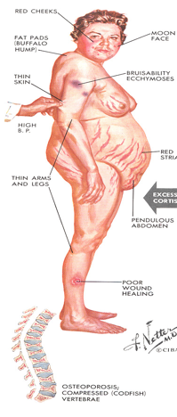
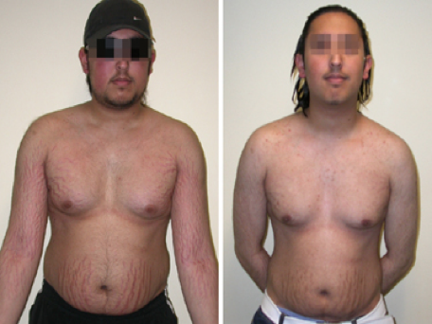
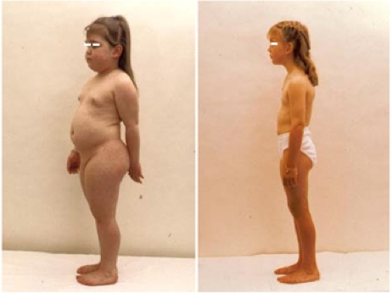
13
GLUCOCORTICOIDS
Lecture Eleven
Protein Metabolism
Decreased tissue proteins almost
everywhere in the body (except liver).
Protein loss from the muscles in particular causes severe weakness.
Decreased protein collagen fibers in the s.c.(loss of CT), causing stria
Thinning of the skin. Severely ↓ protein deposition in bones →
severe osteoporosis.
Suppressed immune system.
Fat Metabolism
Abnormal fat redistribution
Mobilization of fat from the lower part of the body, with deposition of fat in the thoracic and upper abdominal regions, giving rise to a buffalo torso (truncal obesity).
The appearance of the face described as a "moon face".
Buffalo hump.
Carbohydrate Metabolism
Increases blood glucose levels through:
Increased gluconeogenesis
Decreased glucose utilization
Decreased glucose uptake
May cause beta cells to die¹
Cushing’s syndrome
How to differentiate between ACTH-dependent and ACTH-Independent Cushing's syndrome?
By administering large doses of cortisol (dexamethasone). In patients with increased ACTH → no suppression of ACTH secretion.
Patients with primary adrenal overproduction of cortisol (ACTH-independent) → ↓ levels of ACTH.
Characteristics of Cushing’s
Fat is deposited in the body trunk (central obesity)
Buffalo hump
Moon facies (subcutaneous fat in cheeks and submandibular spaces)
Purple striae
Blood-glucose levels rises chronically, causing adrenal diabetes
May cause beta cells to die
Figure 11-7 Purple striae
Figure 11-6
The treatment is based on the underlying cause.
Footnotes
Figure 11-8
Figure 11-9
FOOTNOTES
Beta cells literally burnout due to increased insulin resistance, which leads to increased insulin production. The mechanisms for resistance are the following: cortisol causes an increase in plasma free fatty acids, these fatty acids can act on inflammatory cells and adipose tissue to cause the release of inflammatory mediators such as (TNF-alpha, IL-1 and IL-6), in turn, these cytokines can act on body tissues to antagonize the effect of insulin. This mechanism is also mainly responsible for the increased incidence of diabetes in obese individuals.

Slide 15
14
GLUCOCORTICOIDS
Lecture Eleven
Addison’s Disease (Primary Adrenocortical Insufficiency): Decreased secretion of both mineralcorticoids and glucocorticois.
Whereas secondary adrenocortical insufficiency affects mainly glucocorticoids.
Primary Causes
Autoimmune disease
Tumors
Infection
Hemorrhage
Metabolic failure
Ketoconazole (glucocorticoid antagonist activity)
Adrenocortical
Insufficiency
Secondary Causes
Hypopituitarism
Suppression by exogenous steroids
Signs and Symptoms
Increased excretion of sodium and water.
Reduction in ECF volume.
Tendency toward low blood pressure.
Complete absence of aldosterone, the volume depletion may be severe.
Reduced cortisol leads to poor cortisol regulation: hypoglycemia
Skin pigmentation¹
Women loss of axillary and pubic hair
Fatigability, weakness, nausea and anorexia
Patient cannot cope with stress
Adrenal crisis: asthenia, severe pains in the abdomen, vascular collapse
Treatment: Glucocorticoid replacement, mineralocorticoid replacement
The person is allowed to eat large amounts of salt and drink large amounts of water to balance the increased urine output of salt and water.
Figure 11-10
Figure 11-11
FOOTNOTES
Hyperpigmentation: When cortisol secretion is suppressed, there loss of negative feedback on the hypothalamus to secrete CRH, consequently, CRH causes the transcription of a certain molecule called POMC, which is degraded to products like ACTH and gamma-MSH, however, gamma-MSH is produced in low amounts, but even ACTH contains within it an MSH peptide sequence called alpha-MSH, which can act on melanocytes in the skin to increase the production of the black pigment, melanin, which is then transported to epidermis. Treatment with alpha-MSH, causes increases pigmentation of the skin within 24hrs in humans, causes it to be black.

Slide 16
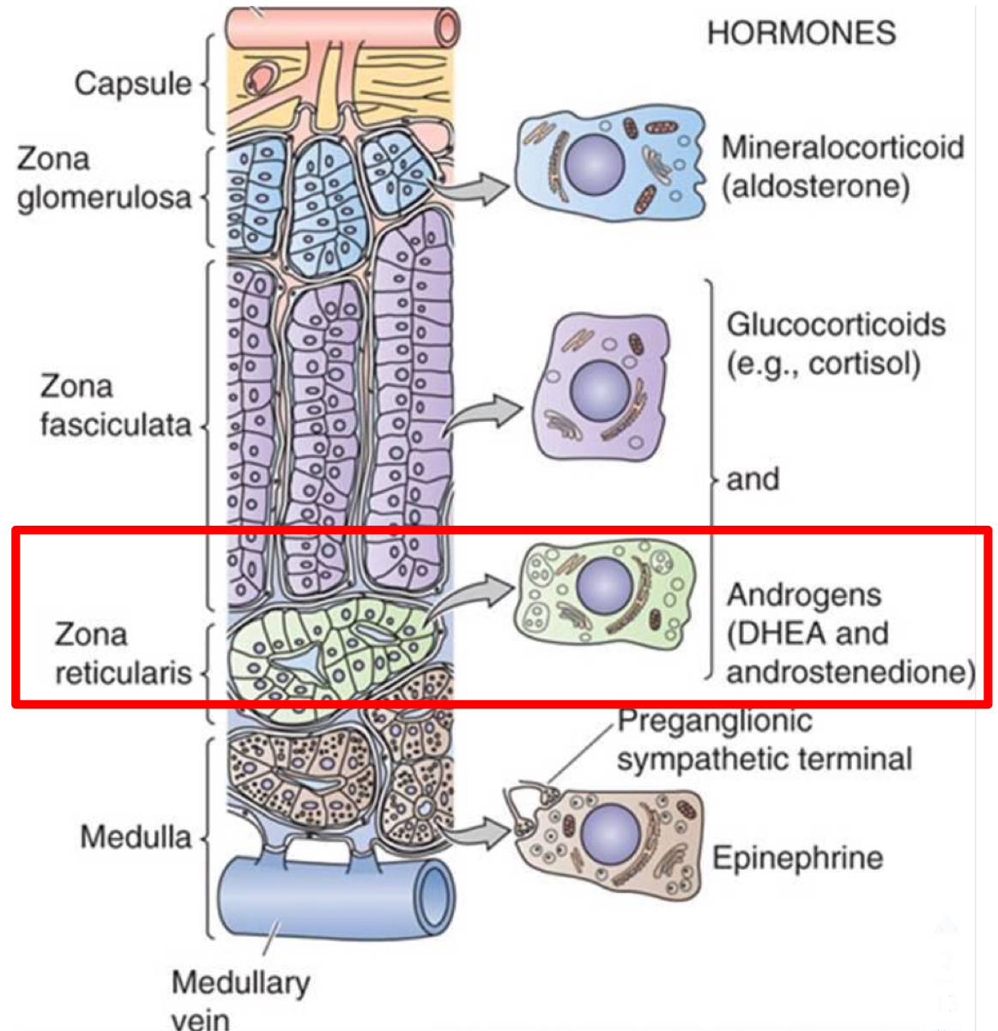
15
ANDROGENS
Lecture Twelve
Zona Reticularis
Produces significant amounts of androgens, mostly dehydroepiandrosterone sulfate (DHEAS).
Hormone Control
ACTH
Target tissue
General body cells
Figure 12-1
Androgens
Androgens are the male sex hormones, they exert masculinizing effects and promote anabolism and growth. They include:
Testosterone (Testis) The major active androgen | Adrenal androgens (Adrenal Gland) Have less than 20% of testosterone activity.
Adrenal Androgens
Effect
Have little androgenic activity, but they provide a pool of circulating precursor (DHEA) for peripheral conversion to more potent androgens (e.g. testosterone, T) and estrogens, (e.g.estradiol).
They include
Dehydroepiandrosterone (DHEA): It is the most abundant adrenal androgen DHEA is the primary precursor of natural estrogens. Normally they exert very little masculinizing effect (weak) when secreted in normal amount (mild effect in female). DHEA sulfate (DHEAS). Androstenedione: An androgenic steroid produced by the testes, adrenal cortex, and ovaries. Androstenediones are converted metabolically to testosterone and to estrogens in the fat and other peripheral tissues. It is an important source of estrogen in men and postmenopausal women. Androstenedione were used as an athletic or body building supplement. Androstenediol 11β-hydroxyandrostenedione (11OHA) 11β-hydroxytestosterone (11OHT)

Slide 17
16
ANDROGENS
Lecture Twelve
Cont… Adrenal Androgens
Protein Binding and Metabolism
About 90% of adrenal androgens are bound to albumin and 3% approximately is bound to sex hormone-binding globulin (SHBG). DHEAS has high affinity to albumin, half-life 7-10 hours. DHEA has low affinity, 15-30 minutes. DHEA, DHEAS, and Androstenedione are converted to the potent androgens T and DHT in peripheral tissues.
Androgens and Estrogens
The adrenal cortex produces:
Androgens “male sex hormones”: DHEA, Androstenedione.
Estrogens or “female sex hormones: Estrogen, progesterone.
The adrenal cortex in both sexes produces small amounts of sex hormone of the opposite sex.
Additional small amounts of sex hormones come from non adrenal sources (testes and ovaries).
Some testosterone in males is converted into estrogen by the enzyme aromatase found in adipose tissues.
In females, ovaries produce androgen as an intermediate step in estrogen production. Little of this androgen is released in the blood instead of being converted into estrogen.
Adrenarche¹
It’s the premature activation of the adrenal glands to send androgens.
The onset of adrenarche in humans is a gradual process that precedes the onset of puberty (6-7 years of age in girls and 7-8 years of age in boys).
FOOTNOTES
Footnotes
What’s the difference between Adrenarche and Puberty? Adrenarche is the awakening of the adrenal gland (when it starts to secrete androgens) it is associated with the development of acne, pubic hair and body odor, Puberty is when the body as a whole starts making androgens in the testes and ovaries, puberty is believed to be caused by a burst in the secretion of Gonadotropin-Releasing Hormones. Whereas adrenarche is associated with adrenal androgens.

Slide 18
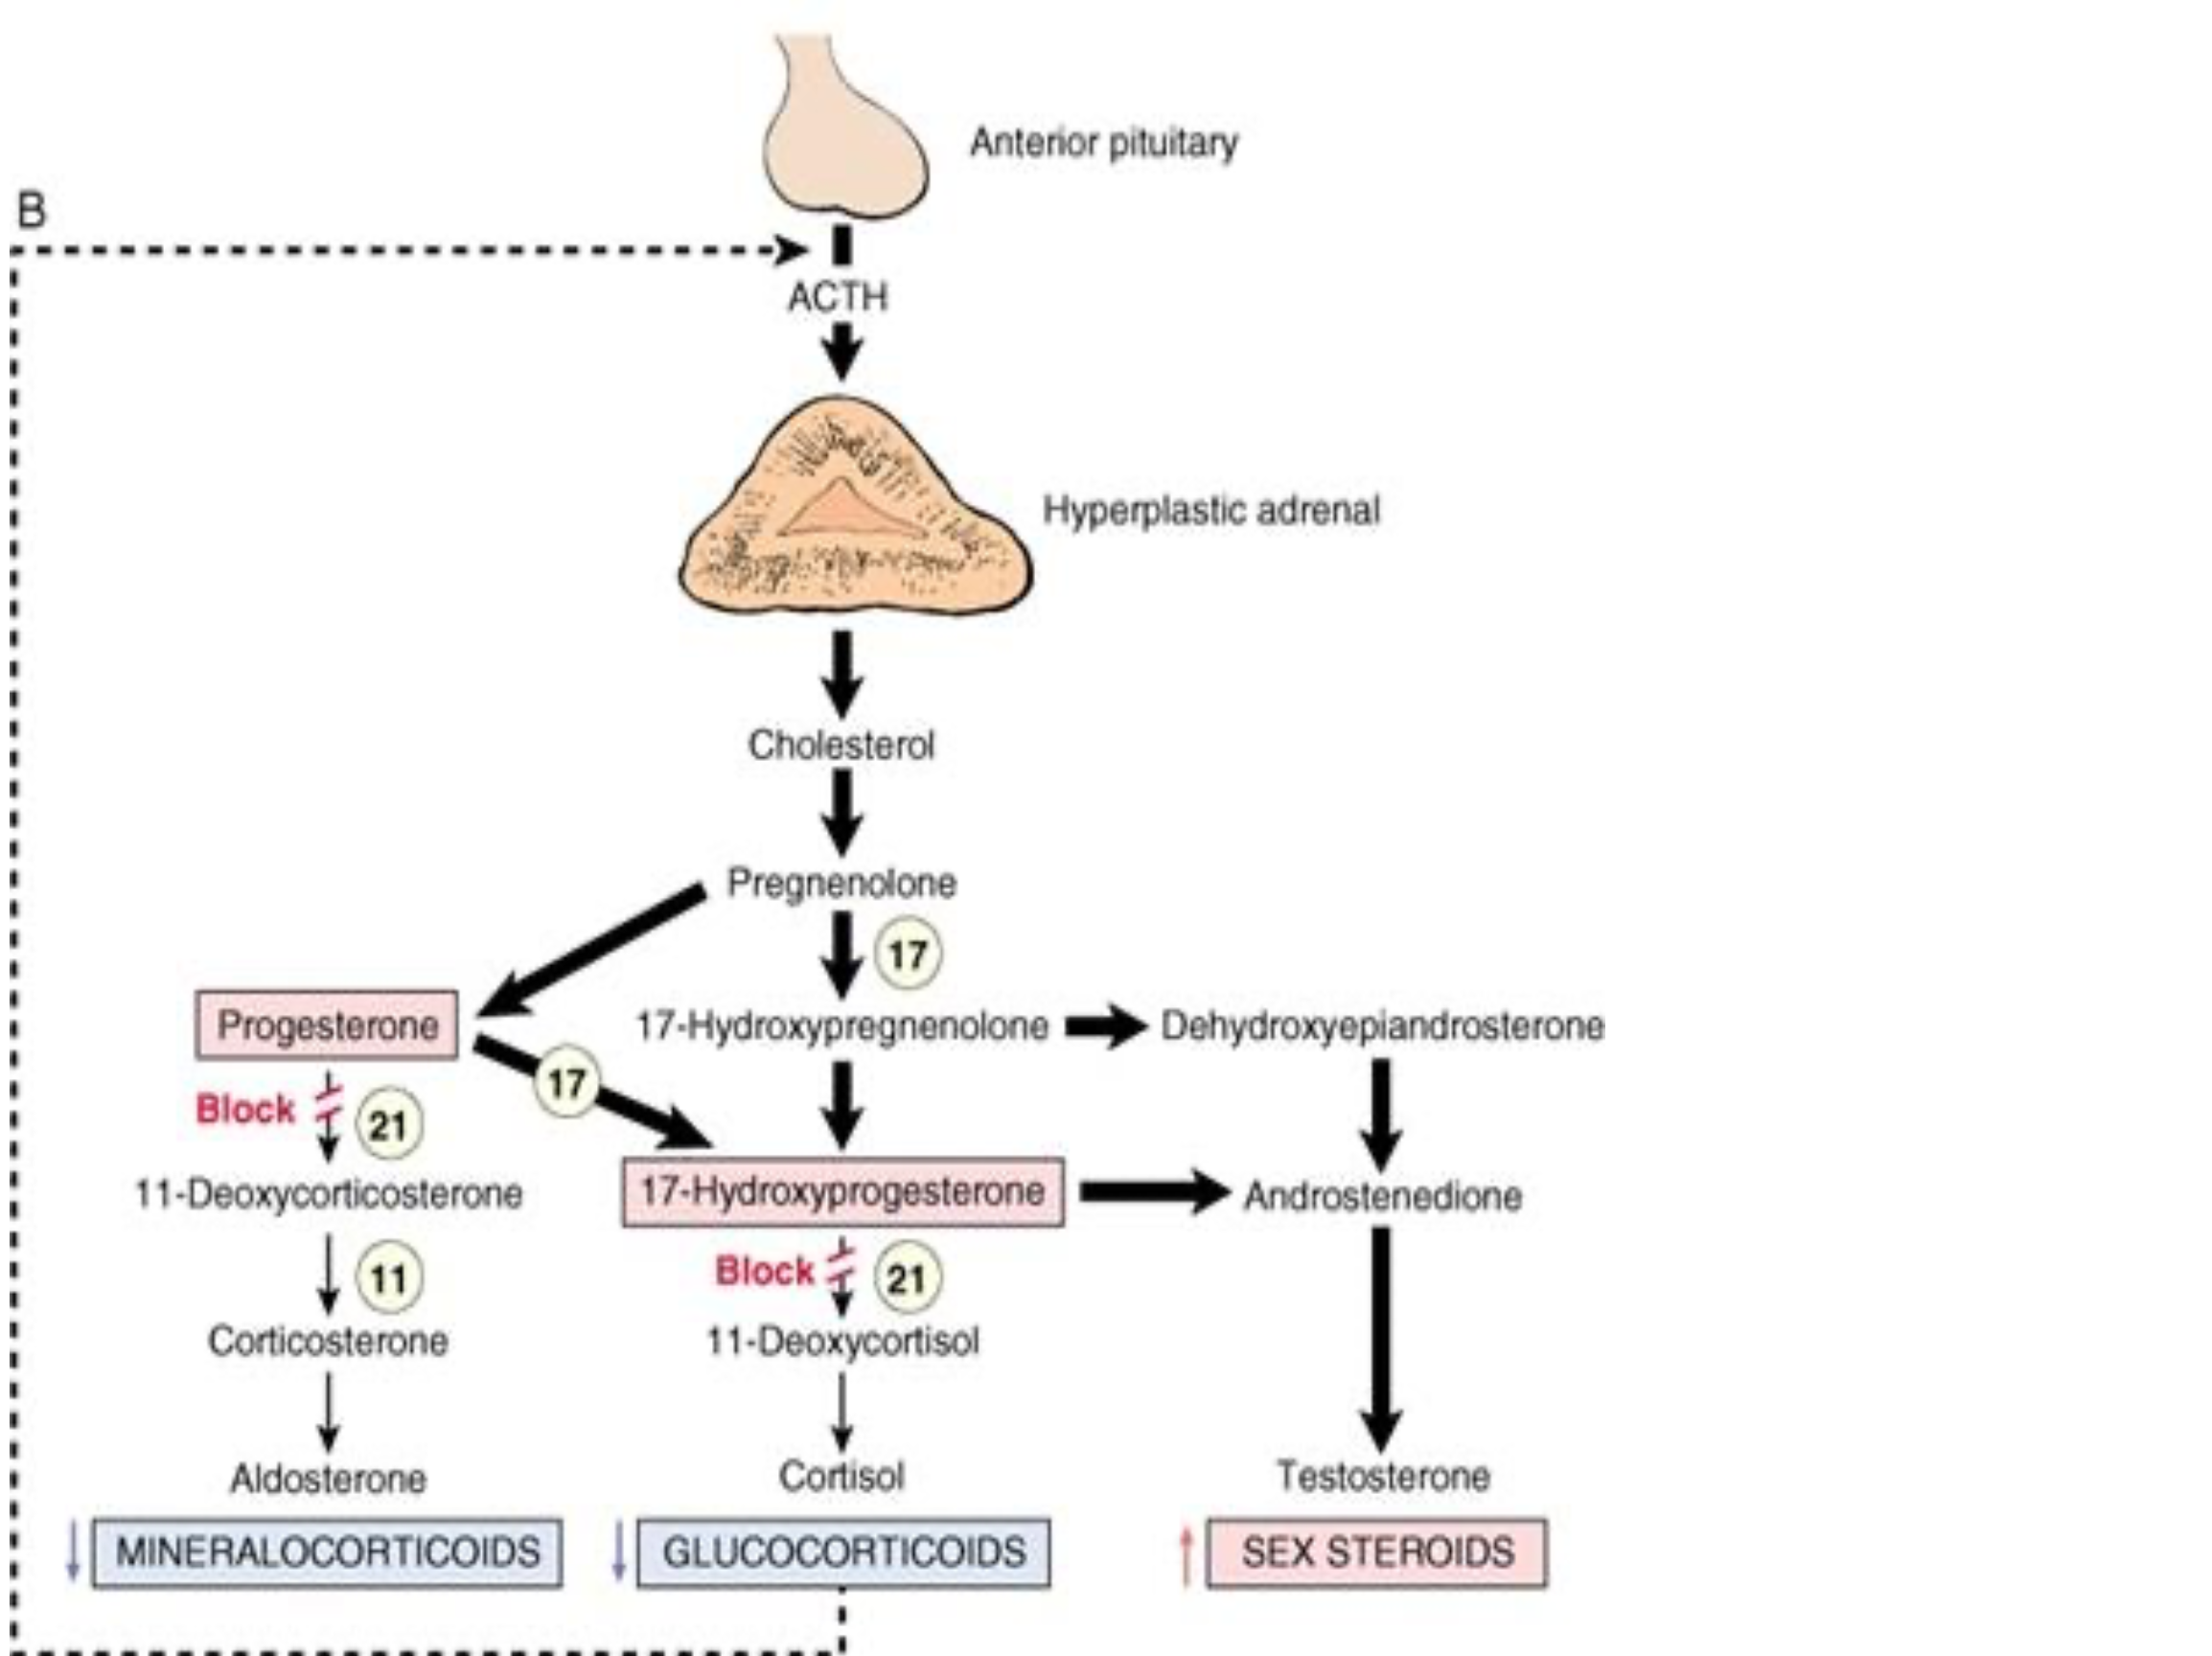
17
ANDROGENS
Lecture Twelve
Effects of Adrenal Androgens
In Males | In females
Spermatogenesis | Growth of pubic and axillary hair.
Inhibition of fat deposition. | Pubertal growth spurt development
Muscle mass | Androgens have potential roles in relaxation of the myometrium preventing premature Uterine contractions in pregnancy
Brain: Androgen levels have been implicated in the regulation of human aggression and libido. | Development and maintenance of female sex drive (libido).
Masculinization of the developing male fetus (including penis and scrotum formation).
Adrenogenital Syndrome
Excessive adrenal androgens secretion¹, Causes:
Adrenocortical tumors | Congenital adrenal hyperplasia
Congenital Adrenal Hyperplasia (CAH)
Familial disorder of adrenal steroid biosynthesis with autosomal recessive mode of inheritance. It affect both males and females.
It’s a group of diseases with a mutation in the genes for enzymes that mediate steroidogenesis.
Most Important enzyme deficiencies are:
21 α-Hydroxylase (>80% of cases).
11 β-Hydroxylase (5-10% of cases).
17 α-Hydroxylase (deficiency in this enzyme is rare, associated with hypogonadisim since it is involved in androgen synthesis, unlike the others which mainly affect mineralocorticoids and glucocorticoids)
The enzyme deficiency causes reduction in end-products, accumulation of hormone precursors and increased ACTH production.
The clinical picture reflects the effects of inadequate production of cortisol and aldosterone and the increased production of androgens and steroid metabolites.
Figure 12-1
FOOTNOTES
Footnotes
In adult males, excessive adrenal androgens production has no clinical consequences. In prepubertal males it causes premature penile enlargement and early development of secondary sexual characteristic. In females it causes hirsutism and virilization -male pattern hair growth and other masculine physical traits- .
Androgen insensitivity syndrome : A genetic disorder in which a person with an XY genotype (male) can’t respond to androgens. Their androgen production is normal but they can’t exert their action due to a defect in the androgen receptor on various target tissue like the external genitalia, genital ducts and the testes. Consequently, the person has the physical traits of a woman, but the genotype (XY) of a male.

Slide 19
18
ANDROGENS
Lecture Twelve
Signs And Symptoms of Adrenogenital Syndrome
Before birth (female) | After birth (Female) | After birth (Prepubertal Male) | Adult Male
Pseudohermaphroditism: Before 12 weeks in female fetus. XX true female with external male genitalia. Cause: exposure of the mother to excessive androgens. | Virilization Development of male characters in females: Increase bulk of muscles. Masculine distribution of hair on the body Hoarseness or deeper voice Increase body hair Increase facial hair Occasionally baldness (if she possesses the gene for baldness) Atrophy of the breast Amenorrhea Occasionally baldness Growth of the clitoris to resemble a penis. Growth of a beard | A virilizing (masculinizing) adrenal tumor causes the same characteristics as in the female plus rapid development of the male sexual organ. Precocious puberty. Early appearance of male characters. Increase musculature. Development of external genitalia organ to adult size. No spermatogenesis. Increased growth but shorter stature because of early closure of epiphyseal plates. Rapid development of secondary sexual characteristics | The virilizing characteristics of adrenogenital syndrome are usually obscured by the normal virilizing characteristics of the testosterone secreted by the testes.
Diagnosis: It is often difficult to make a diagnosis. However, the excretion of 17 ketosteroids (derived from androgens) in urine may be 10 to 15 times normal, used in diagnosing the disease.
Table 1-1 Showing types of synapses according to their anatomical structure.

Slide 20
19
ADRENOCORTICAL HORMONES
Lectures X-XII
Further Reading
Aldosterone Escape
Aldosterone Can Cause Enhanced Sodium Excretion
In some patients with hyperaldosteronism sodium levels are actually decreased, and its excretion is increased! This happens in the following manner:
Aldosterone causes an expansion in ECF volume, this causes the release of ANP which directly inhibits sodium reabsorption in CD.
Also, increased sodium reabsorption increases plasma sodium concentration and this stimulates the thirst centers in the hypothalamus, causing the person to drink water, therefore diluting sodium concentration.
One additional mechanism is, as we learned in renal block, increased ECF volume, increases the blood pressure which can increase GFR, and if the GFR is too high, then the fluid entering the nephron moves too fast for substances to be reabsorbed, this decreases sodium reabsorption in proximal convoluted tubules.
All of these effects contribute to electrolyte homeostasis, and decreases the chance of the development of edema in patients with hyperaldosteronism, because remember edema is caused partially by high hydrostatic pressure, and this mechanism decreases BP and is therefore protective.
ACTH, MSH & How Animals Use Them For Their Survival (Hint: Pigmentation)
We’ve established by now that the reason behind skin hyperpigmentation in cases of excess ACTH, is due to ACTH having the Melanocyte Stimulating Hormone (MSH) sequence.
Which in other words mean that more ACTH, more stimulation to melanocytes!
In some animals the Pars Intermedia -yes, of the pituitary gland.- happens to be more developed and secretes large amounts of MSH and that process like most processes of the pituitary, is regulated by the hypothalamic signals which increase in response to the amount of light.
So, in summer days (more sunlight) some Arctic animals develop darkened fur and yet have a completely white coat in winter!

Slide 21
Which one of the following is NOT true about Aldosterone?
Synthesis in zona glomerulosa (in adrenal cortex)
Considered as mineralocorticoids
Highest conc. begin in 8 PM
The target cell is called Principal (P) cell
2. All of the following increases Aldosterone secretion, Except?
Increase K concentration In ECF
Increase Na concentration In ECF
Hypovolemia
Hypotension
3. Which one of the following is Primary Aldosteronism?
Hyperreninism
Apparent Mineralocorticoid Excess Syndrome (AME)
Conn’s Syndrome
A&B
4. Which one of the following is NOT a sign & symptom of Conn’s Syndrome?
Hypokalemia
Hypernatremia
Muscle weakness
Acidosis
5. About 90% of the adrenal androgen is bound to:
Prealbumin
SHBG
Albumin
Transferrine
SHORT ANSWER QUESTIONS
Compare between the regions of adrenal cortex and their hormones.
Enumerate three effects of cortisol on carbohydrate metabolism:
1) Decrease glucose utilization by tissues, 2) Decrease GLUT-4 mediated glucose uptake by tissues, 3) Increase gluconeogenesis from amino acids derived from extrahepatic sources.
Region | Types | Hormones
Zona Glomerulosa | Mineralocorticoids | Aldosterone (mainly)
Zona Fasciculata | Glucocorticoids | Cortisol (mainly) Corticosterone Androgens (small amount) Estrogens (small amount)
Zona Reticularis | Gonadocorticoids | Androgens DHEA “dehydroepiandrosterone“ (mainly) Androstenedione Estrogen (small amount) Glucocorticoids small amounts
ANSWER KEY: C, B, C, D, C

Slide 22
Nouf Alhumaidhi, Shahad BinSelayem
Abdullah Almuammar, Mohammed A. Alshehri
Abdullah Alassaf, Aued Alanazi
Co-Editors: Nouf Alshammari, Njoud Alabdullatif
FEMALE PHYSIOLOGY CO-LEADERS
Maha Alnahdi, Taif Alshammari
MALE PHYSIOLOGY CO-LEADERS
Nayef Alsaber, Hameed M. Humaid
REFERENCES
Guyton and Hall Textbook of Medical Physiology
Ganong’s Review of Medical Physiology

