Slide 1
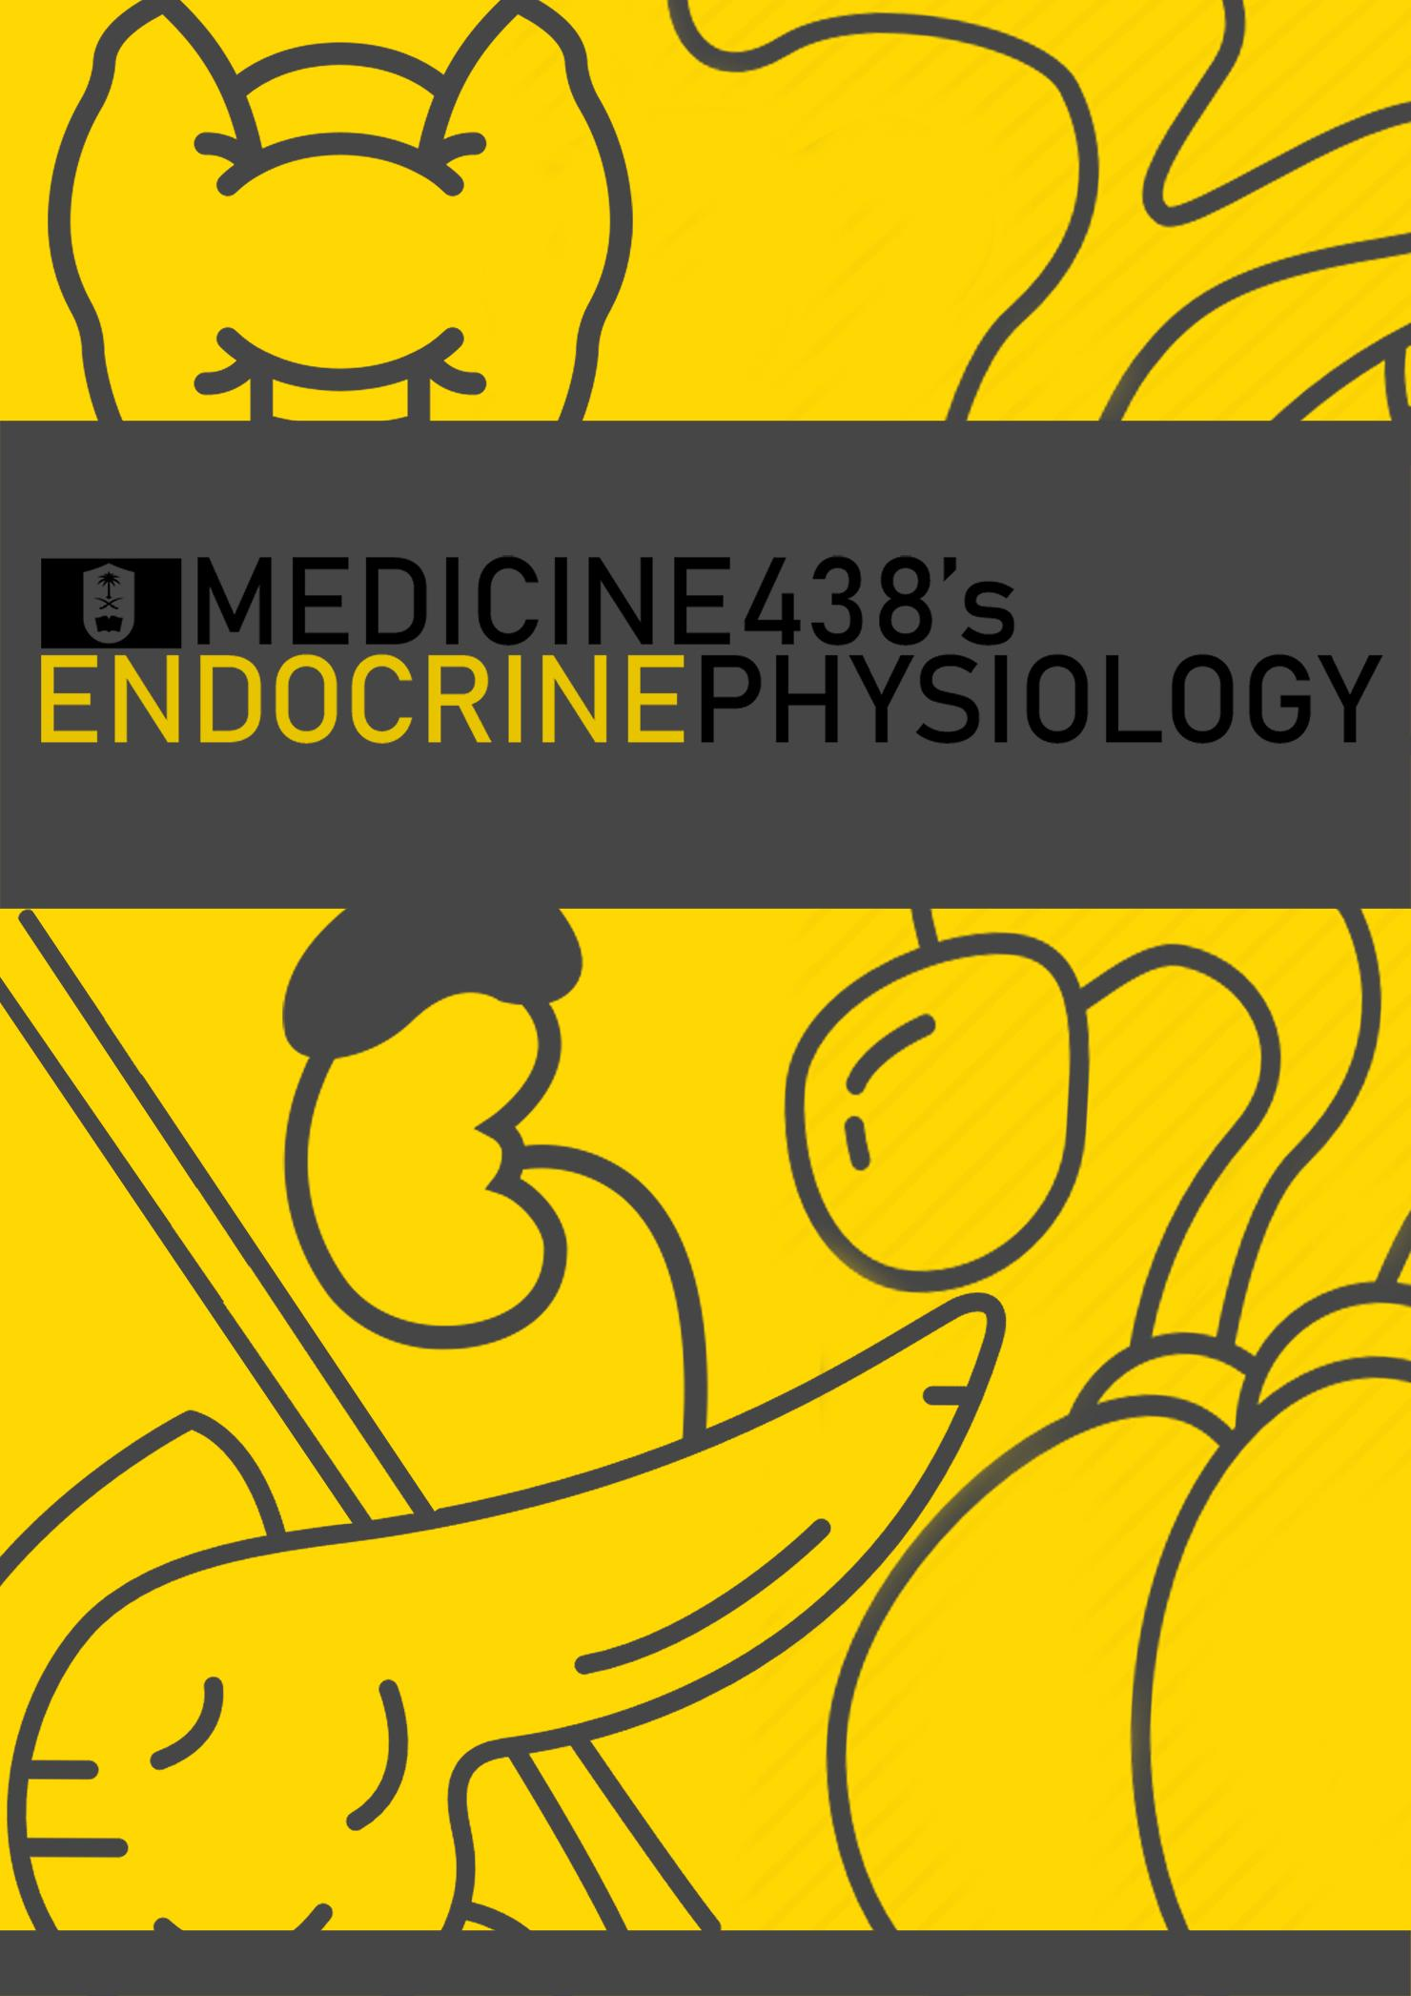
LECTURE XIII: Physiology of Adrenal Medulla and Pheochromocytoma
EDITING FILE
IMPORTANT
MALE SLIDES
EXTRA
FEMALE SLIDES
LECTURER’S NOTES

Slide 2
1
PHYSIOLOGY OF ADRENAL MEDULLA AND PHEOCHROMOCYTOMA
Lecture Thirteen
OBJECTIVES
Summarize the actions of adrenal androgens.
Describe the causes and major manifestations of hyperadrenocorticism and Hypoadrenocorticism
Describe circumstances in which catecholamines are released from the adrenal gland.
List the major actions of catecholamines.
Adrenal medulla
The adrenal medulla is the inner part or core of each adrenal gland.
Medullary cells are derived from the embryonic neural crest, simply modified neurons (Chromaffin cells, also called pheochromocytes).
It is considered as part of sympathetic nervous system, innervated by cholinergic preganglionic sympathetic neurons.
High levels of cortisol that drain into the medulla from the adrenal cortex induce expression of the enzyme phenylethanolamine N-methyl transferase (PNMT), which converts norepinephrine to epinephrine.
Figure 13-1
Figure 13-2
1
The adrenal medulla is, functionally, integral part of the sympathetic system.
5
2
It secretes catecholamines (released from chromaffin cells, synthesize from tyrosin).
NE in blood comes from BOTH
adrenal medulla and
postganglionic sympathetic
nerves. This is because postganglionic
sympathetic nerves can not
synthesize EP from its
precursor NE, because they
lack the enzyme
(PNMT)
needed for conversion of NE
into EP.
Adrenal medulla
3
80% of its secretion is
Epinephrine
(EP) and
20% of its secretion is
Norepinephrine (NE)¹ and small amount of dopamine.
4
EP in the bloodstream comes
solely from the adrenal medulla.
Figure 13-3
FOOTNOTES
Footnotes
The majority of NE is produced by sympathetic postgangliomic fibers.

Slide 3
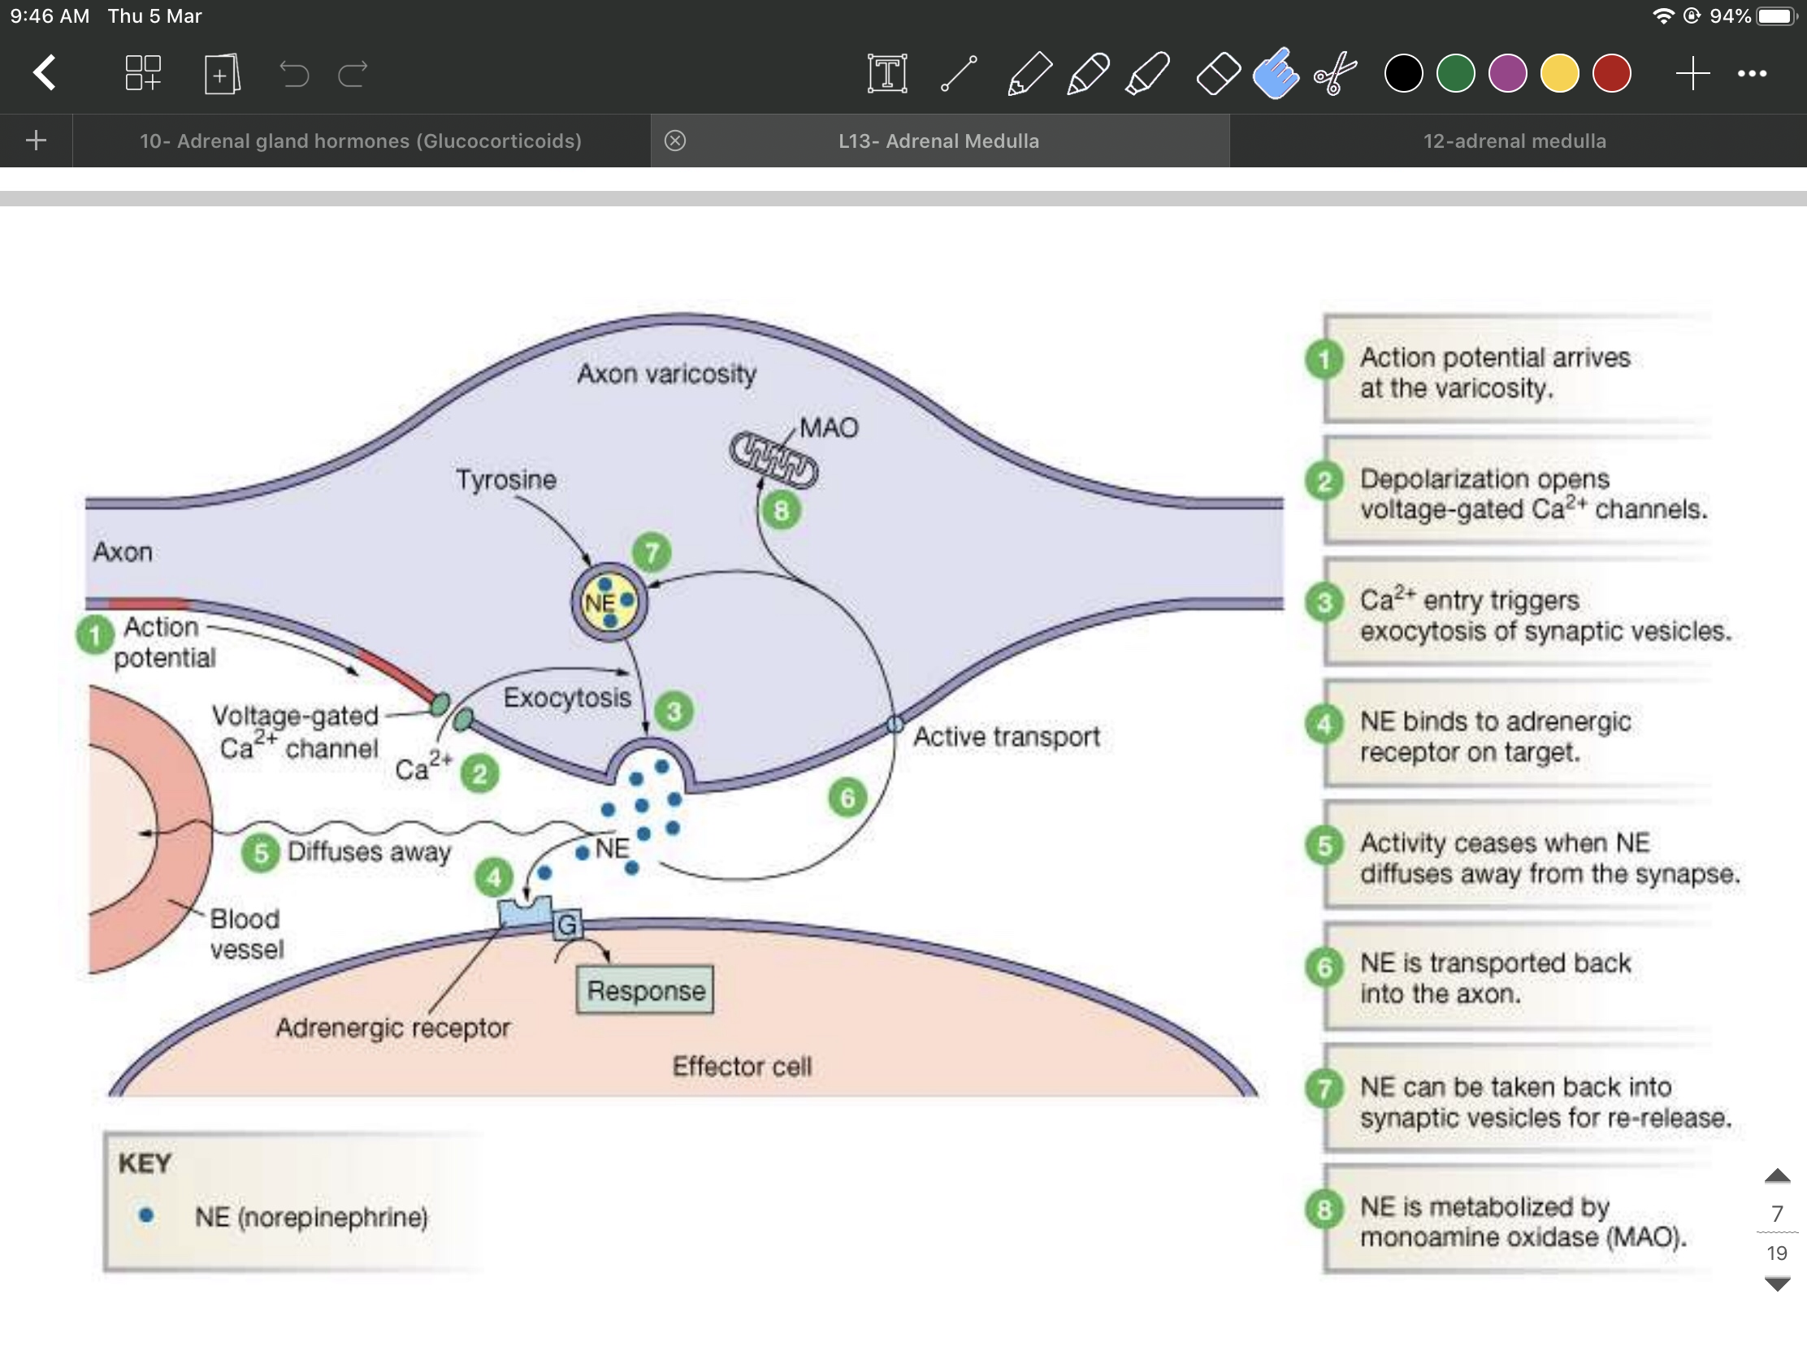
21
PHYSIOLOGY OF ADRENAL MEDULLA AND PHEOCHROMOCYTOMA
Lecture Thirteen
Adrenal medulla
Secretion of these hormones causes:
Epinephrine¹ is the more potent stimulator of the heart and metabolic activities
Norepinephrine² is more influential on peripheral vasoconstriction and blood pressure
Causes
Blood to be diverted to the brain, heart,
and skeletal muscle.
Role of the adrenal medullary hormones
Enhance the effects of the
sympathetic nervous system.
Prepare the body for a
stressful event.
The response is known as the “fight or flight” response.
Actions of adrenal medullary hormones
The effects of the adrenal medullary hormones underlie the role of these hormones in preparation of body for fight or flight.
The overall effect is to ensure that all requirements for increased muscle activity are available. What are these?
Figure 13-4 norepinephrine release and recycling
FOOTNOTES
Footnotes
Epinephrine has more affinity on beta receptors which control these actions.
Norepinephrine has more affinity on alpha receptors which mediate these effects.

Slide 4
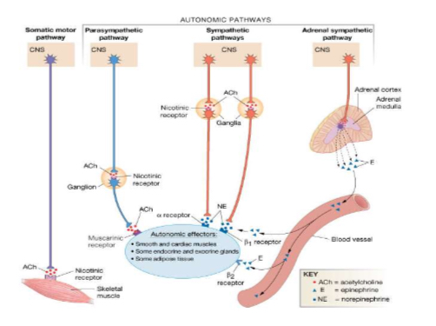
31
PHYSIOLOGY OF ADRENAL MEDULLA AND PHEOCHROMOCYTOMA
Lecture Thirteen
Control of secretion of adrenal medullary hormones
The adrenal medulla is innervated by the sympathetic nervous system¹.
Adrenal hormones are released from the medulla in response to signals from the sympathetic nervous system.
The sympathetic nervous system is activated in response to stress also known as the “fight or flight” response.
Stress can be physical (exercise), physiological (hypoglycemia, hemorrhage), or emotional
Cortisol, when secreted from the adrenal cortex in response to stress, causes release of these hormones from the medulla.
Figure 13-5
Exercise as an example of Adrenal Medulla activation
• Exercise is similar to the “fight-or-flight” response but without the subjective element of fear.
• It involves a greater adrenomedullary response ( endocrine role of epinephrine) than a sympathetic nervous response (neurotransmitter role of norepinephrine).
• The overall goal of the sympathoadrenal system during exercise is to meet the increased energy demands of skeletal and cardiac muscle while maintaining sufficient oxygen and glucose supply to the brain.
Figure 13-6
Figure 13-8
Figure 13-7
Adrenergic Receptors
Alpha-Adrenergic Receptors
Beta-Adrenergic Receptors
alpha 1 : vasoconstriction, intestinal relaxation, uterine contraction, pupillary dilation
alpha 2 : platelet aggregation, vasoconstriction, insulin secretion
beta 1 : HR/contractility, lipolysis, renin secretion
beta 2 : vasodilation, bronchodilation, . glycogenolysis
beta 3 : lipolysis, brown fat thermogenesis
FOOTNOTES
Footnotes
Recall that endocrine glands stimuli maybe Humoral-like the parathyroid-, Hormonal-like the pituitary- or Neural like in our case here with the adrenal glands.

Slide 5
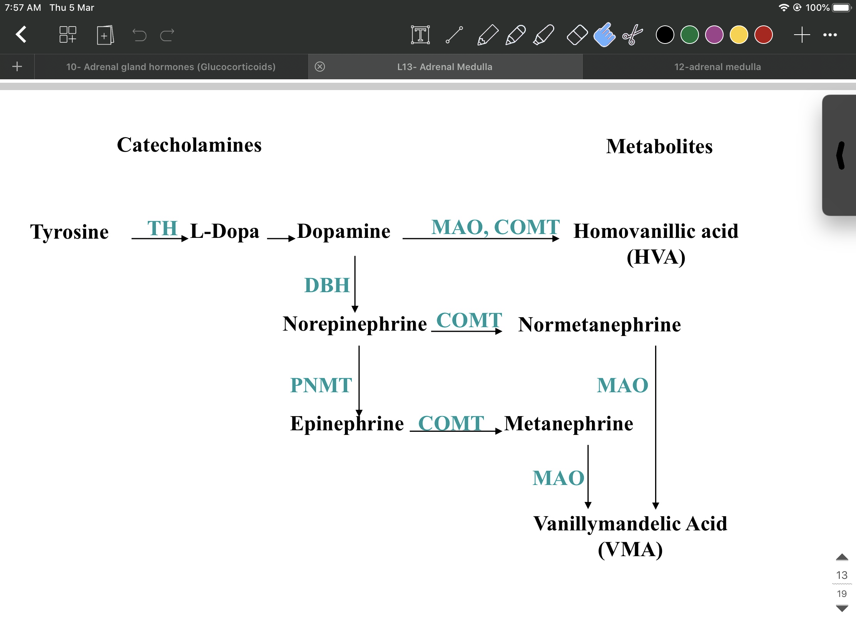
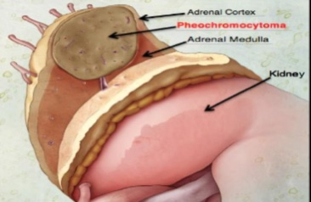
41
PHYSIOLOGY OF ADRENAL MEDULLA AND PHEOCHROMOCYTOMA
Lecture Thirteen
Functions of catecholamines
Effect on carbohydrate metabolism
Both of them can increase glycogenolysis in liver and skeletal muscle (can lead to hyperglycemia) and gluconeogenesis and decrease glycogenesis.
i. Catecholamine promote the release of glucose from liver and decrease its utilization by muscle; ii. Epinephrine inhibit insulin secretion but promote glucagon secretion.
Effect on lipid metabolism
Both of them enhance the breakdown of TAG in adipose tissue (lipolysis).
This cause increase in the free fatty acid in the circulation which are effectively utilized by the heart and muscle as fuel source.
Effect on physiological function
increase cardiac output, blood pressure and oxygen consumption.
cause smooth muscle relaxation in bronchi, GIT and blood vessels supplying skeletal muscle
Cause vasoconstriction of blood vessels¹
Metabolism of Catecholamines
Two primary enzymes are involved in the degradation of catecholamines:
1. monoamine oxidase (MAO) and
2. catechol-O-methyltransferase (COMT).
Urinary vanillylmandelic acid (VMA) and metanephrine are sometimes used clinically to assess the level of catecholamine production in a patient.
Figure 13-9
Case study
“James” a 35-year-old husband and father of three children, has been experiencing headaches and palpitations of increasing frequency and severity over the past six months.
In addition, he has had periods of intense anxiety and panic attacks.
FOOTNOTES
Footnotes
Vasoconstriction of the peripheral blood vessels to divert the blood to more vital organs and to increase peripheral resistances.

Slide 6
51
PHYSIOLOGY OF ADRENAL MEDULLA AND PHEOCHROMOCYTOMA
Lecture Thirteen
Pheochromocytoma
Pheochromocytoma is a relatively rare tumor of the adrenal medulla or of similar specialized cells outside of the adrenal glands derived from chromaffin cells (arise from neural crest) along the paravertebral sympathetic chain extending from pelvis to base of skull
Most often occurs in middle age, It can be life threatening if not recognized & not treated.
Most tumors secrete epinephrine, norepinephrine, and dopamine and can cause Episodic hypertension¹.
Associated with neurofibromatosis.
About 10% of pheochromocytomas are malignant.
It can occur in combination with other tumors, conditions and in some familial (inherited) syndromes.
• >95% are abdominal
• >90% in adrenal medulla
• 80% occur unilateral
Clinical Features
Diagnosis
Headache, sweating, palpitation, and a fast heartbeat are typical symptoms, usually in association with markedly high BP.
Hypertension(resistant hypertension 95%) often severe, occasionally malignant, and may be resistant to treatment with standard antihypertensive drug.
Paroxysms or Crisis: frequent or sporadic, occurring at intervals as long as weeks or months. With time, the paroxysms usually increase in frequency, duration, and severity
Increased metabolic rate, such as profuse sweating and mild to moderate weight loss
Sinus tachycardia, sinus bradycardia, supraventricular arrhythmias, and ventricular premature contractions have all been noted.
Angina and acute myocardial infarction
• Headache 80%
• Perspiration(sweating)71%
• Palpitation 64%
• Pallor 42%
•Anxiety and glucose intolerance.
• The diagnosis is established by the demonstration of:
• increased production of catecholamines or
• Catecholamine metabolites:metanephrine and vanillylmandelic acid(VMA) in plasma and/or urine.
The diagnosis can usually be made by the analysis of a single 24-h urine sample, provided the patient is hypertensive or symptomatic at the time of collection.
• Imaging: CT, MRI
Treatment
• Laparoscopic Adrenalectomy² (surgical resection)
Pre-op:
(1) Control of hypertension
(2) α blockers to prevent intraoperative hypertensive crisis due to tumor manipulation and release of catecholamines
(3) Fluid resuscitation to prevent circulatory collapse after removal of the catecholamine-secreting tumor
Further reading from female’s doctor
3
1
2
FOOTNOTES
Footnotes
Most pheochromocytomas release NE more than EP because the catalytic action of PNMT is exceeded.
An operation formed in the abdomen or pelvis using small incisions with the aid of a camera.

Slide 7
1-What stimulates the release of catecholamines?
A. Preganglionic parasympathetic nerves
B. Postganglionic parasympathetic nerves
C. Preganglionic sympathetic nerves
D. Postganglionic sympathetic nerves
2- Which of the following is not an effect of catecholamines?
A. Increasing heart rate
B. Increasing oxygen consumption
C. Pupil dilation
D. Increasing GI secretion & motility
3- NE increase blood pressure by :
A. increase cardiac output
B. increase peripheral resistance
C. increase metabolic rate
D. decrease oxygen consumption
4-Which of the following is not a sign of pheochromocytoma?
A.Resistant hypotension
B. Glucose intolerance
C. Sweating
D. Anxiety
5- Which one of the following result can be used to confirm pheochromocytoma:
A. Low vanillin mandelic acid
B. High ACTH
C. High vanillin mandelic acid
D. Low ACTH
SHORT ANSWER QUESTIONS
1-What are the effects of catecholamines?
2-From which cells does pheochromocytoma originate?
ANSWERS
1- Increase heart rate and blood pressure
Cause vasoconstriction
Moblization of free fatty acids
Increase metabolic rate and O2 consumption
2- From chromaffin cells along the paravertibral
sympathatic chain extending from pelvis to base of skull
ANSWER KEY: C, D, B, A, C

Slide 8
Shahad alsalamh, Taibah alzaid
Co-Editor: Njoud Alabdullatif
Shahd Alsalamah
FEMALE PHYSIOLOGY CO-LEADERS
Maha Alnahdi, Taif Alshammari
MALE PHYSIOLOGY CO-LEADERS
Nayef Alsaber, Hameed M. Humaid
REFERENCES
Guyton and Hall Textbook of Medical Physiology
Ganong’s Review of Medical Physiology

