Slide 1
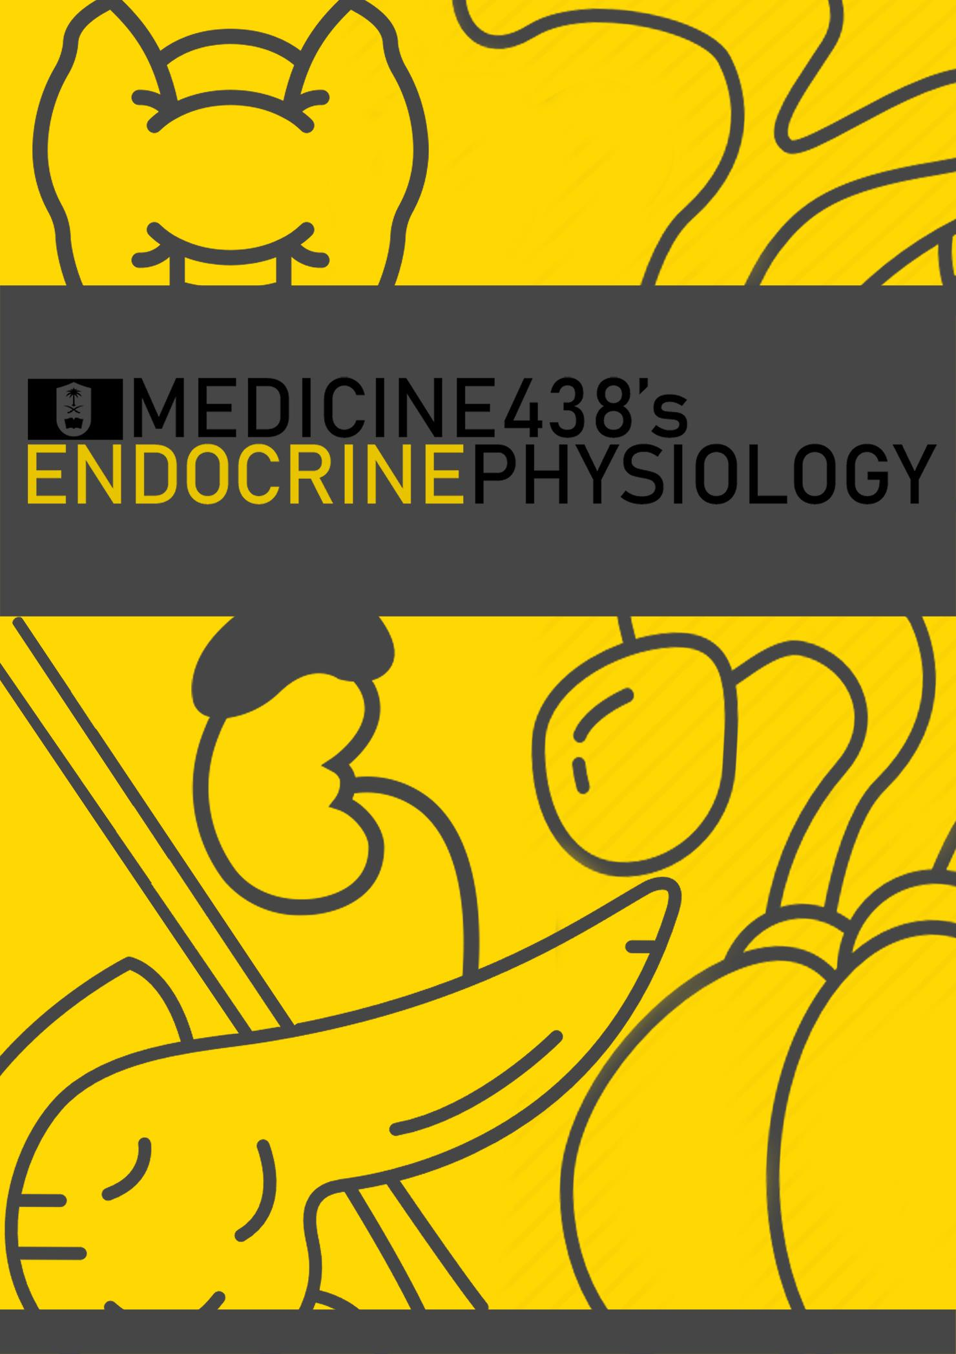
LECTURES XIV & XV: Physiology of the Pancreas and Pathophysiology of Diabetes Mellitus
EDITING FILE
IMPORTANT
MALE SLIDES
EXTRA
FEMALE SLIDES
LECTURER’S NOTES

Slide 2
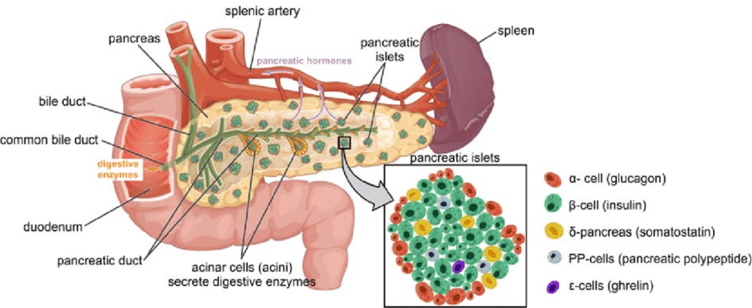
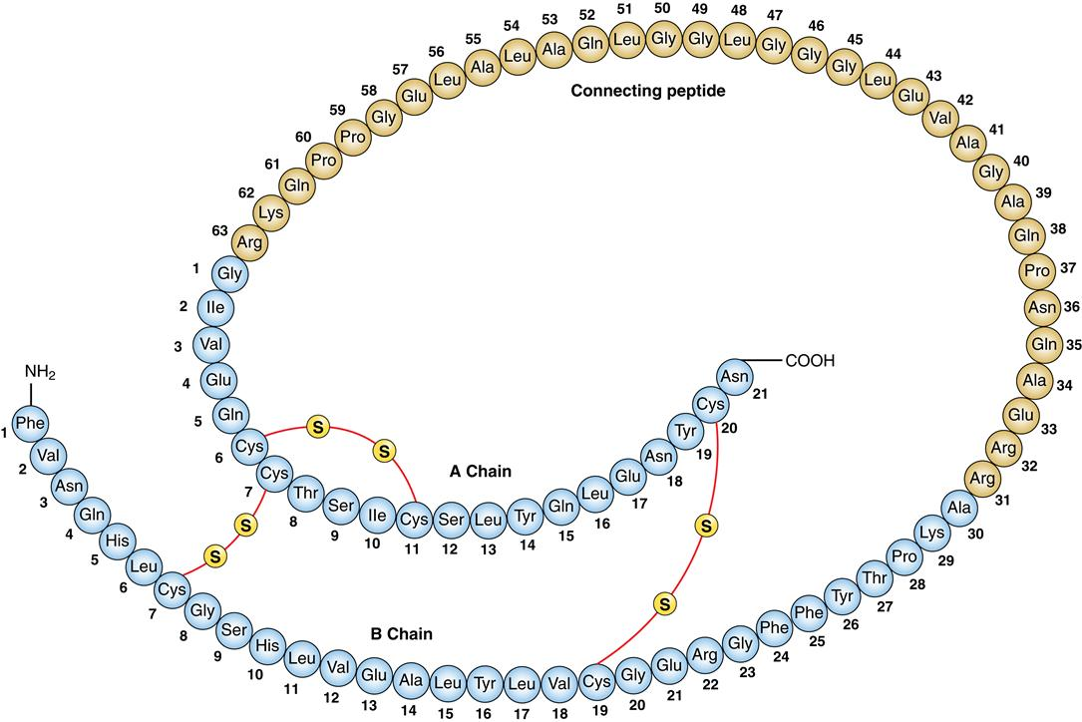
1
PHYSIOLOGY OF THE PANCREAS
Lecture Fourteen
INTRODUCTION
EXTRACURRICULAR
Why is it important to keep glucose levels within the normal range?
Even though most tissue can switch to protein and fatty acid metabolism when glucose levels are low, some tissues like the brain, retina can only normally use glucose for energy.
After the ingestion of a meal, most of the carbohydrates are stored in the liver and muscle in the form of glycogen. Insulin secretion after the ingestion of a meal is is important to help in this storage.
As soon as the body’s existing supply of glucose is exhausted, glucose levels fall, with it a fall in insulin but with a rise in glucagon that triggers glycogenolysis. Once glycogen stores are exhausted, gluconeogenesis takes place as one of the last resorts, all of this is to protect special tissues like the brain that rely on glucose for energy.
The harmful effects of high blood glucose that frequently damages the tissues in diabetics will be discussed later.
Pancreas
A triangular gland, which has both exocrine and endocrine cells, located behind the stomach.
Strategic location.
Acinar cells produce an enzyme-rich juice used for digestion (exocrine product).
Pancreatic islets (islets of Langerhans) produce hormones involved in regulating fuel storage and use (endocrine product).
Figure 14-1 The endocrine pancreas.
Cells of Islets Of Langerhans
1-2 million islets
Beta (β) cells produce insulin and amylin (70%).¹
Alpha (α) cells produce glucagon (20%).
Delta (δ) cells produce somatostatin (5%).
F (PP) cells produce pancreatic polypeptide (5%).²
G cells produce gastrin (1%),
Insulin
Hormone of nutrient abundance.³
A protein hormone consisting of two amino acid chains (α & β) linked by disulfide bonds.
Synthesized as preproinsulin, consisting of signaling peptide and proinsulin (86 AA) and then excised by enzymes, releasing functional insulin (51 AA) and C peptide⁴ (29 AA).
Has a plasma half-life of 6 minutes.
Figure 14-2 Insulin Structure.
FOOTNOTES
Amylin is an amyloid (important in pathogenesis of DM) hormone with an uncertain function that is usually co-secreted with insulin, it is thought that inhibits further insulin release. However, amylin analogues are now used in the treatment of type II diabetes, since they’ve been shown to decrease glucagon secretion and appetite.
Inhibits the secretion of exocrine pancreas, however even this is uncertain, and facilitates digestion.
As we already mentioned in the introduction, insulin is secreted after a meal (by GIT hormones, direct effect of glucose levels and amino acids), and increase their uptake into the tissues to prevent their losses in the urine.
C-peptide is used to monitor insulin levels.

Slide 3
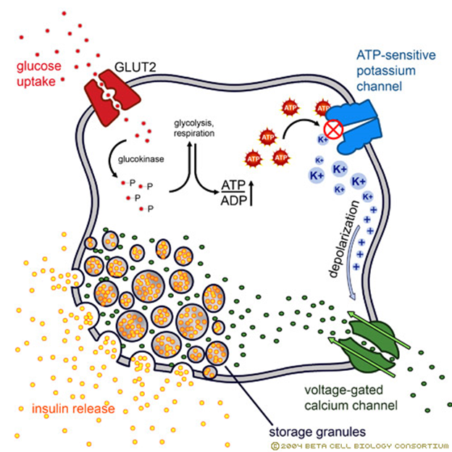
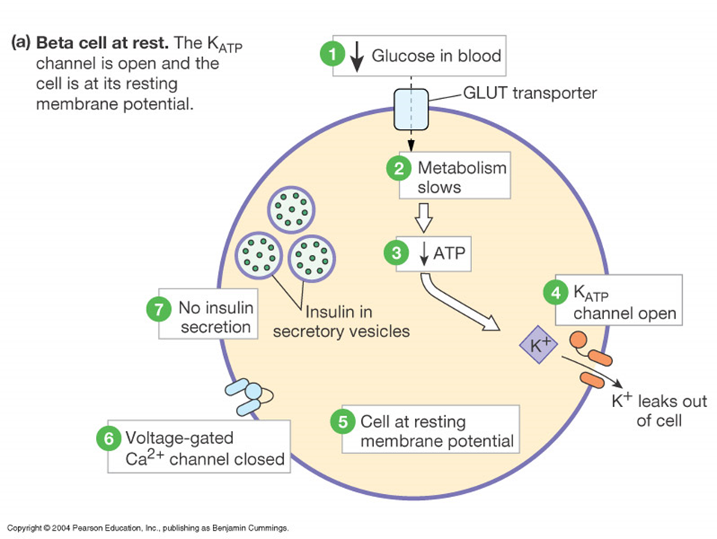
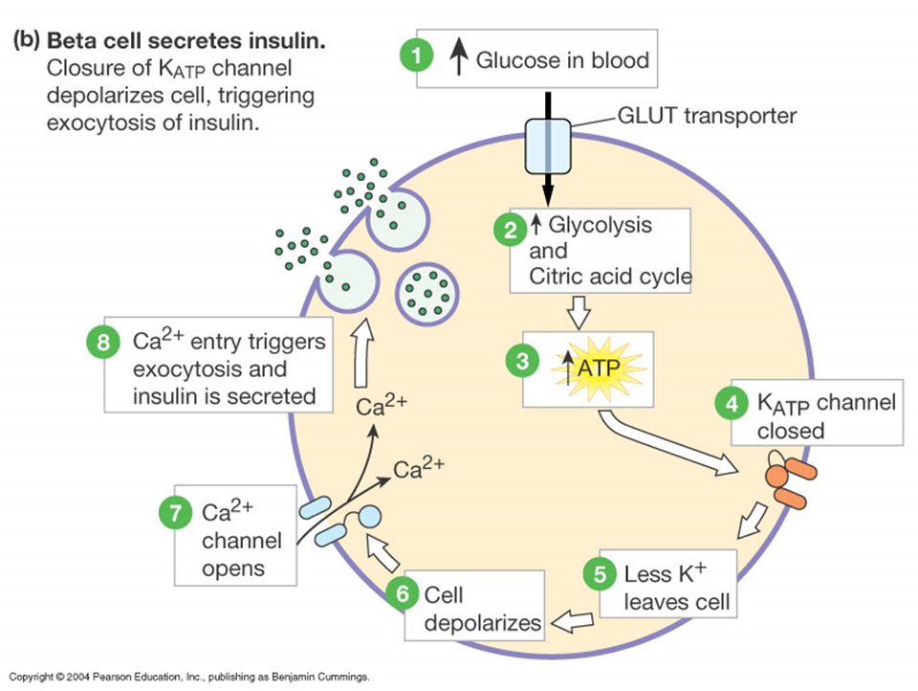
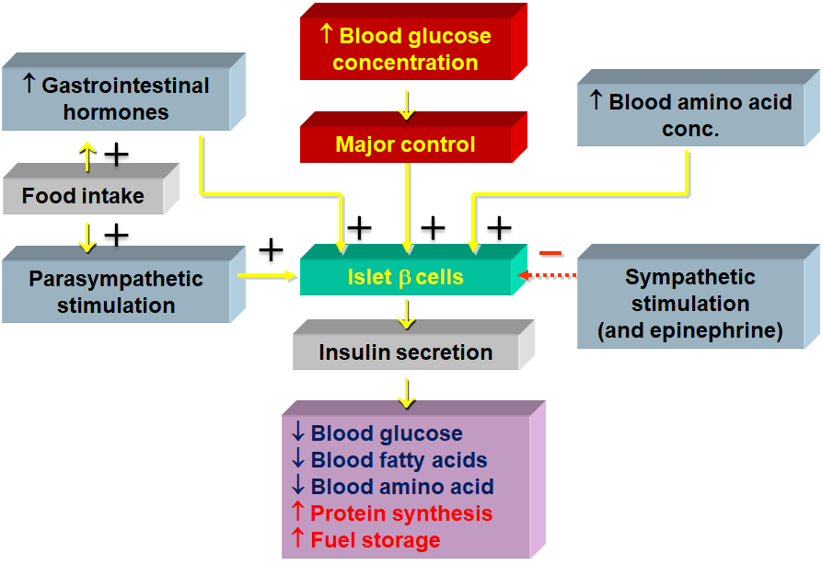
2
PHYSIOLOGY OF THE PANCREAS
Lecture Fourteen
Insulin Synthesis
Insulin synthesis is stimulated by glucose or feeding and decreased by fasting¹
Threshold of glucose-stimulated insulin secretion is 100 mg/dl.²
Glucose rapidly increase the translation of the insulin mRNA and slowly increases transcription of the insulin gene.
DNA (chromosome 11) in β cells → mRNA → Preproinsulin (signal peptide, A chain, B chain, and peptide C) → proinsulin → insulin.
Glucose is the primary stimulator of insulin secretion.
Figure 14-3 Insulin Synthesis
The rate limiting enzyme is glucokinase⁴ and its function is to attach phosphate with the glucose to keep it inside the beta cell
Figure 14-4 Insulin regulation.
Glucose enters through GLUT-2 (insulin-independent) into the beta cells of pancreas, this way beta cells function as glucose-sensing cells.
This glucose is used for ATP synthesis
The ATP is used to close K_{ATP} channels³, which traps more potassium inside the cells and help the cells reach the voltage needed to open voltage-gated calcium channels.
Calcium enters the cells, which acts as a key to stimulate exocytosis and release of insulin
Figure 14-5 Factors controlling insulin secretion.
FOOTNOTES
As we said, the main function of insulin is to help us make use of the nutrients we ingest. Therefore it is released after feeding to help glucose storage as glycogen in the liver and muscle, and decreased during fasting when existing blood glucose has been exhausted so that glucagon can be released and trigger glycogenolysis (and later on, gluconeogenesis when glycogen stores are also exhausted)
Glucose levels in the early morning (fasting state before breakfast) lie between 90-100 mg/dl, it then rises up to 140 mg/dl, in the first hour after a meal, but within two hours or-so, insulin helps return plasma glucose to fasting levels. This will be discussed further in the next lecture.
Sulfonylurea is an anti-diabetic drug that binds to and blocks ATP sensitive K⁺ channels to increase the secretion of insulin. Diazoxide is a drug that keeps the K⁺ channels open to inhibit the release of Insulin. Mutations in this channel causes it to be constitutionally active, potassium continues to efflux, and the cell is hyperpolarized with no insulin secretion, resulting in a peculiar type of diabetes called permanent neonatal diabetes, which requires a lifelong treatment of hypoglycemic agents and insulin.
MODY (Maturity Onset Diabetes of the Young): results from a mutation in glucokinase enzyme which leads to ineffective insulin production.

Slide 4
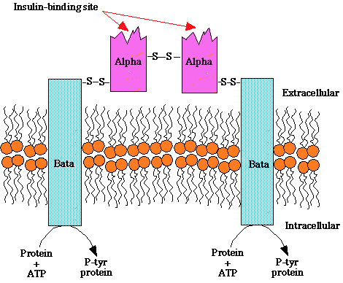
3
PHYSIOLOGY OF THE PANCREAS
Lecture Fourteen
Regulation Of Insulin Secretions
STIMULATORS | INHIBITORS
↑ Serum glucose. ↑ Serum amino acids. ↑ Serum free fatty acids. ↑ Serum ketone bodies.¹ Hormones: Gastric Inhibitory peptide (GIP). Glucagon. Gastrin. Cholecystokinin (CCK). Secretin. Epinephrine (β-receptor). Vasoactive intestinal peptide (VIP). Parasympathetic nervous system. | ↓Glucose. ↓ Amino acids. ↓ Free fatty acids. Serum ketone bodies. Hormones: Somatostatin. Epinephrine (α-receptor). Sympathetic nervous system².
Table 14-1
Insulin Receptor
The insulin receptor is a transmembrane receptor.
Belongs to the large class of tyrosine kinase receptors.
Made of two alpha (extracellular) subunits and two beta (intracellular) subunits.
Mechanism of activation is discussed in Biochemistry’s Glucose Homeostasis.
Figure 14-6 Insulin Receptor.
Glucose Regulation And Metabolism Terms
Gluconeogenesis: Synthesis of glucose from noncarbohydrate precursors, Lactic acid, glycerol, amino acids, liver cells synthesis glucose when carbohydrates are depleted.
Glycogenesis: Formation of glycogen, glucose stored in liver and skeletal muscle as glycogen, important energy reserve.
Glycogenolysis: Breakdown of glycogen (polysaccharide) into glucose molecules (monosaccharide).
Glycolysis: The breakdown of glucose into pyruvate by cells for the production of ATP.
FOOTNOTES
Ketone Bodies: Excess glucose is converted in the liver to fatty acids, which can then either be packaged as VLDL and transported to adipose tissue, or if insulin is absent, liver cells convert this excess fatty acids to acetyl-CoA by beta-oxidation. Excess acetyl-CoA then condenses to form ketone bodies. Ketone bodies can be converted later on to acetyl-CoA to provide energy, this is helpful when glucose levels are very low. Ketone bodies can save the brain because, unlike fatty acids, they can cross BBB and can be used by neurons for energy.
Stimulation of Alpha-2 receptors inhibits insulin release. Stimulation of Beta-2 receptors stimulates the release of insulin. However, the overall effect is the inhibition of insulin release because the number of Alpha-2 receptors is higher than Beta-2 receptors.

Slide 5
4
PHYSIOLOGY OF THE PANCREAS
Lecture Fourteen
Actions of Insulin
Rapid (seconds):
↑ Transport of glucose, amino acids, K+ into insulin-sensitive cells.
Intermediate (minutes):
↑ Protein synthesis.
↑ Glycolytic enzymes and glycogen synthase¹.
↓ Protein degradation.
↓ Phosphorylase and gluconeogenic enzymes².
Delayed (hours):
↑ mRNAs for lipogenic processes and other enzymes.
TISSUE | ACTION OF INSULIN
Adipose tissue | ↑ Glucose entry ↑ Fatty acid synthesis. ↑ Glycerol phosphate synthesis. ↑ Triglyceride deposition. Rationale: Glucose enters adipose cells, which can be converted into fatty acids and glycerol → Fatty acids + glycerol → triglycerides ↑ Lipoprotein lipase³. ↑ K uptake. ↓ Hormone-sensitive lipase⁴.
Muscle | ↑ Glucose entry. ↑ Glycogen synthesis. ↑ Amino acid uptake. ↑ Protein synthesis in ribosomes. ↑ Ketone uptake. ↑ K uptake. ↓ Protein catabolism. ↓ Release of gluconeogenic amino acids.
Liver | ↑ Protein synthesis. ↑ Lipid synthesis⁵. ↑ Glycogen synthesis. ↑ Glycolysis. ↓ Ketogenesis.⁶ ↓ Gluconeogenesis. ↓ Urea cycle activity.
General | ↑ Cell growth (by increasing protein synthesis, and preventing amino acids use for gluconeogenesis)
Table 14-2
FOOTNOTES
Glycogen synthase: Stimulated by insulin and inhibited by glucagon, stimulates synthesis of glycogen from glucose.
Phosphorylase: Stimulated by glucagon and inhibited by insulin, stimulates the breakdown of glycogen to produce glucose.
Lipoprotein Lipase: Excess glucose is converted to fatty acids by the liver → Newly formed fatty acids are packaged in VLDLs → VLDLs are transported to adipose tissue → Lipoprotein Lipase present near the adipose tissue is stimulated by insulin to cause hydrolysis of fatty acids from VLDLs → Fatty acids enter adipose tissue and are combined with glycerol to form triglycerides → VLDLs are then returned to the liver as LDLs (insulin also upregulates LDL receptors). Hypertriglyceridemia is a common feature in patients with insulin resistance and diabetes, and therefore they are also at an increased risk for atherosclerosis.
Hormone-Sensitive Lipase (HSL): Releases fatty acids from triglycerides and diglycerides, so that fatty acids can be used for energy. Since insulin is abundant, glucose is abundant, and so fatty acids are not much needed for energy and this enzyme is inhibited.
Again, excess glucose is converted fatty acids, which in the present of insulin are packaged into triglycerides that are incorporated into VLDLs .
By decreasing the use of fatty acids in energy production, less acetyl-CoA is condensed to form ketone bodies, as we explained in the previous page.

Slide 6
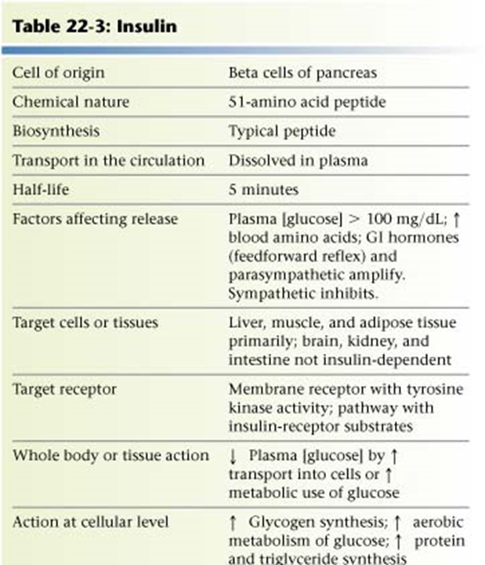
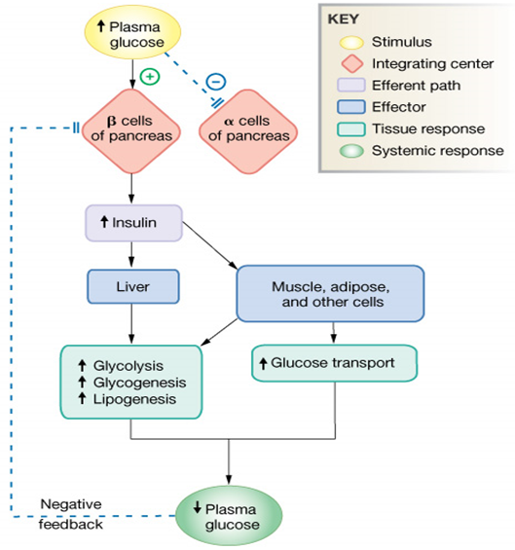
5
PHYSIOLOGY OF THE PANCREAS
Lecture Fourteen
Glucose Transporters System
TRANSPORTERS | PRESENT IN
GLUT-1 | Blood brain barrier, RBCs, Placenta, Kidneys and Colon.
GLUT-2 | β cells of Pancreas, Liver, Epithelial cells of small intestines and Kidneys.
GLUT-3 | Brain, Placenta and Kidneys.
GLUT-4 (Insulin sensitive transporter) | Skeletal Muscles¹, Cardiac muscles and Adipose tissue.
GLUT-5 | Jejunum and Sperm.
Table 14-3
Figure 14-7 Summary of insulin.
Figure 14-8 Summary of insulin actions.
Glucagon
A 29-amino-acid polypeptide hormone that is a potent hyperglycemic agent. (when glucagon is injected into an animal, a profound hyperglycemia occurs)
Produced by α-cells in the pancreas.
DNA (chromosome 2) in α-cells → mRNA → Preproglucagon → Proglucagon → Glucagon.
FOOTNOTES
During exercise insulin levels are low. However, the skeletal muscle glucose uptake is high and that results from a coordinated increase in rates of glucose delivery (higher perfusion) and surface membrane glucose transport (GLUT4). The mechanism behind the movement of GLUT4 to surface membrane and the subsequent increase in transport by muscle contractions is likely to occur through intracellular signaling involving Ca²⁺-calmodulin -dependent protein kinase and possibly protein kinase C.

Slide 7
6
PHYSIOLOGY OF THE PANCREAS
Lecture Fourteen
Regulation and Actions of Glucagon¹
↓ Serum glucose.
↑ Serum amino acids (Alanine, arginine).
Stress
Exercise (mainly due to sympathetic nervous system stimulation).
Sympathetic nervous system stimulation.
↑ Glucose.
Somatostatin.
Insulin
Inhibitors
Stimuli
Table 14-4
Glycogenolysis
Gluconeogenesis
Glucagon → G-protein coupled receptor → cAMP → Activates protein kinases → protein kinases activate the enzyme phosphorylase (causes glycogen breakdown) → Glycogenolysis.
- After exhaustion of glycogen stores → Gluconeogenesis (by increasing amino acid transport and activating gluconeogenic enzymes).
Its major target is liver
Release of Glucose From Liver Cells into the Bloodstream.
Lipid oxidation (fully to CO₂ or partially to produce keto acids “ketone bodies”).
Figure 14-9 Summary of glucagon actions.
Figure 14-10 Summary of glucagon.
Figure 14-11 The Regulation Of Blood Glucose Concentrations.
FOOTNOTES
Glucagon in higher concentrations can act on the myocardium to enhance the contractility of the heart by binding to G protein coupled receptor which will activate Ca²⁺ channels (Positive Inotropic agent, used in the treatment of shock.

Slide 8
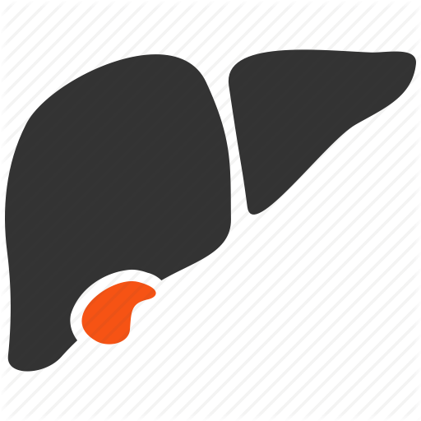
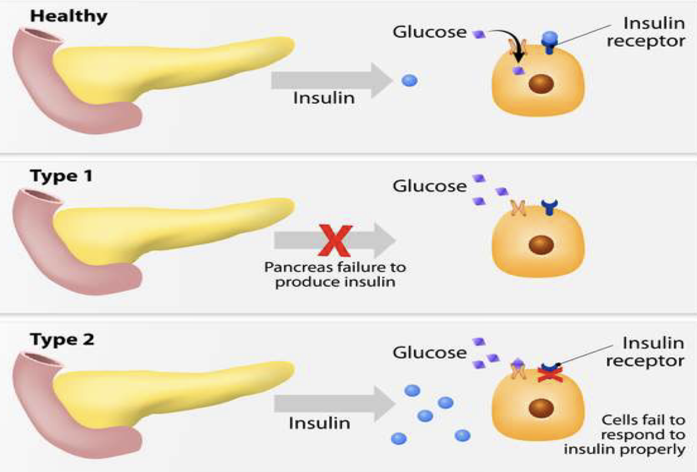
7
PATHOPHYSIOLOGY OF DIABETES MELLITUS
Lecture Fifteen
Diabetes
Polyuria
(excessive urination)
Diabetes is probably the most important metabolic disease.
It affects every cell in the body and affects carbohydrate, lipid, and protein metabolism.
Characterized by the polytriad seen on the right:
Symptoms of Diabetes
Polydypsia
(excessive thirst)
Polyphagia
(excessive hunger)
Hyperglycemia
Polydipsia
Ketoacidosis (IDDM)
Muscle wasting
Polyuria²
Polyphagia¹
Hyperlipidemia
Electrolyte depletion
Diabetes Mellitus Type I³ (10%)
Mainly affects children, and caused by an immune-mediated selective destruction of β cells
(Juvenile onset, hyposecretion of insulin, insulin dependent)
β
β cells are destroyed while α cells are preserved:
No insulin, ↑ glucagon
High production of glucose
and ketones by liver
↑ Glucose & ketones
Osmotic diuresis²
↑ Keto acids
Diabetic ketoacidosis
Figure 15-1
Treatment: Insulin Injection
FOOTNOTES
Polyphagia Mechanism: Recall that insulin increases lipid deposition. Normally, when insulin increases lipid storage in the adipose tissue, the adipose tissue acts like an endocrine organ and secrete Leptin (satiety hormone) which acts on the hypothalamus, specifically the Satiety center -senses fullness-to reduce feeding urges. But with insulin gone, this whole process is turned off and the person feels hungry even if they’ve just eaten!
Hyperglycemia Can Cause Both Cellular And Extracellular Dehydration: The renal threshold for glucose is normally 180 mg/dl, now remember that glucose is easily filtered through the glomerulus, and the nephrons are able to absorb around 180 mg/dl, anymore than that is excreted in the urine, therefore: Hyperglycemia of >180mg/dl → Increased urine osmolality → Water is drawn to tubular lumen from ECF → ECF dehydration. Also, cellular dehydration occurs, glucose is hydrophilic and doesn’t cross plasma membranes easily, so to maintain equilibrium it is water that escapes from cell into the ECF → Water is drawn from cells into the ECF. However, this dilution is soon compensated by increased glucagon release, and more plasma glucose, and more ECF osmolality and osmotic diuresis and the cycle continues.
Pathophysiology of Type I Diabetes: The autoimmune destruction is probably initiated by one of the following mechanisms: (1) a viral infection of pancreatic beta cells that causes them to expose previously sequestered antigens that attract immune cells (antigen sequestration)(we know that normal body cells expose very selective peptides on MHC, to inform immune cells that they are normal and harmless, viral infection causes beta cells to expose peptides that are recognized by the immune system as foreign, resulting in recognition and autoimmune destruction), (2) Molecular mimicry, this happens when the peptide exposed on MHC is actually similar to a peptide exposed by a pathogen, this results in an autoimmune attack and destruction of beta cells by the immune system.

Slide 9
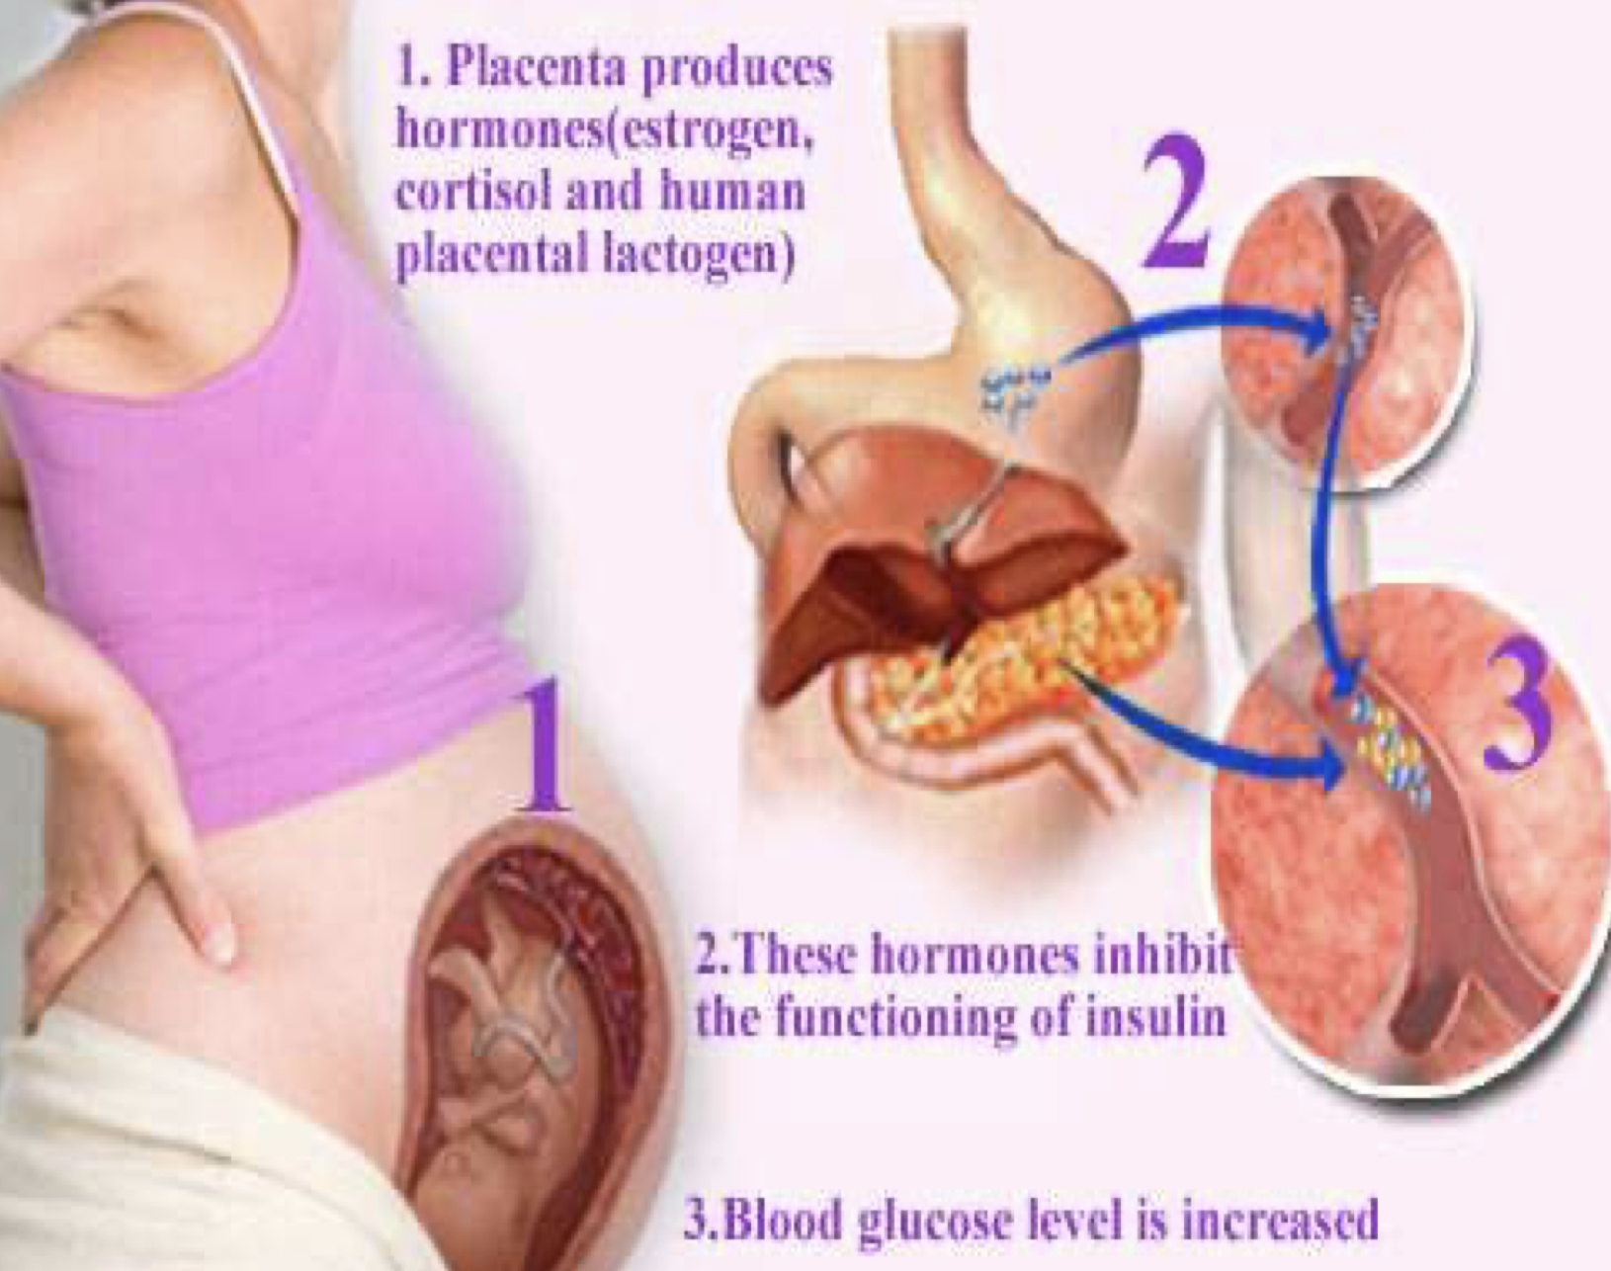
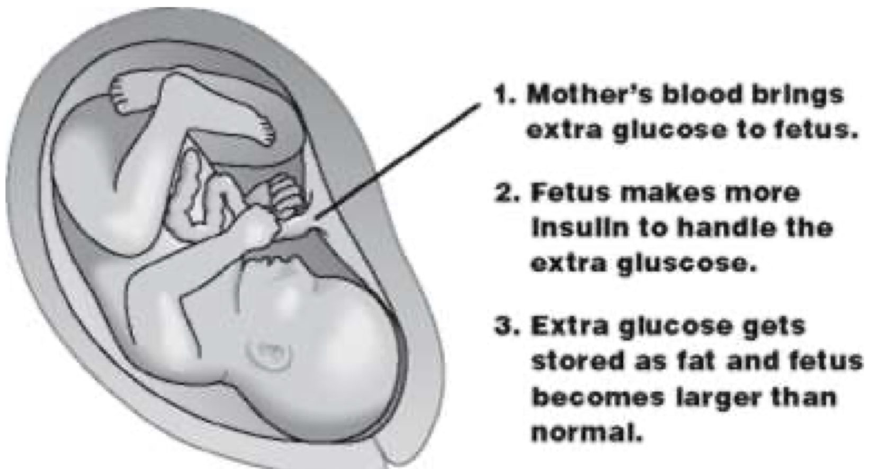
8
PATHOPHYSIOLOGY OF DIABETES MELLITUS
Lecture Fifteen
Diabetes Mellitus Type II¹ (85%-90%)
Late onset, genetic and family related risk factors.
1
2
More common in some ethnic groups.
01
02
6
3
Chronic complications: atherosclerosis³, renal failure & blindness.
06
03
Unhealthy foods and inactive lifestyles with sedentary behaviour.
5
4
Resistance of body cells to insulin keeps blood glucose too high
Manage by lifestyle modification with physical activity and/or healthy diet
Treatment: Diet and oral hypoglycemic agents
Gestational Diabetes (during pregnancy)
Associated with decreased
insulin levels and/or insulin resistance
Resembles Type 2 Diabetes
Usually transient: symptoms improve following delivery
Occurs in 2-5% of pregnancies
If untreated → macrosomia²
(high birth weight)
Figure 15-2
Figure 15-3
Long Term Complications of Uncontrolled Diabetes
(Microvascular disease)³
Hyperglycemia damages small blood vessels:
Diabetic retinopathy³
vision loss
Diabetic neuropathy³
damage to nerves
Most common cause of
amputation⁴ in Western world
Diabetic nephropathy³
kidney damage
Chronic renal failure
FOOTNOTES
Pathophysiology of Type II Diabetes: ↑ Insulin resistance (usually in obese persons, mechanism is explained in the last page of this lecture) → Increased insulin secretion to compensate for the resistance (glucose keeps on stimulating beta cells) → Hyperinsulinemia → In some people the plasma glucose levels can return to normal, but usually in people with genetic susceptibility beta cells become exhausted and diabetes develop. Please note that insulin is co-secreted with the hormone amylin, which is essentially an amyloid, in high secretory rates this amyloid accumulates, and much like in alzheimer’s it is toxic to beta cells → Beta cell dysfunction.
Studies have shown that maternal hyperglycemia causes increased secretion of IGF-1, which causes several growth effects in the fetus, therefore macrosomia occurs.
The mechanism for atherosclerosis, nephropathy, neuropathy and retinopathy is explained in the further readings (page after the next).
Patients don’t feel any injury and slow healing → infection → necrosis → change in color → amputation

Slide 10
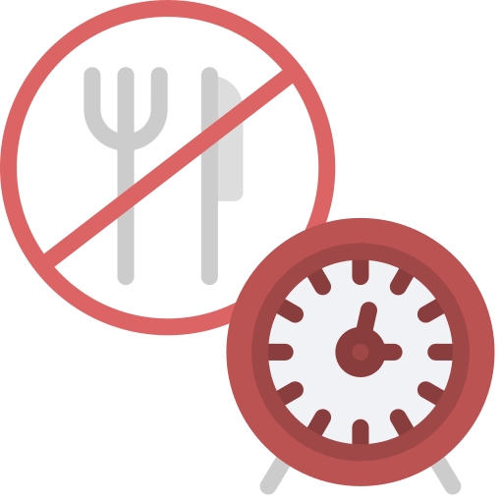
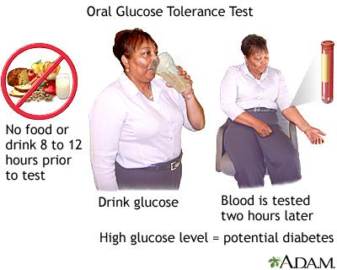
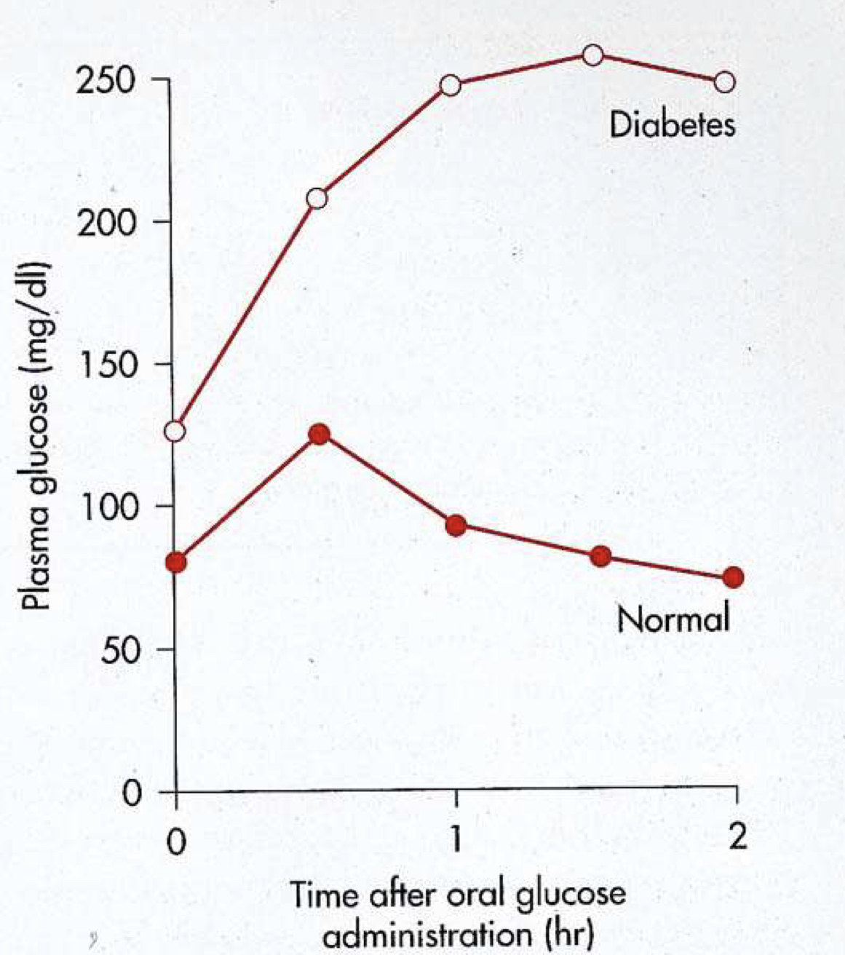
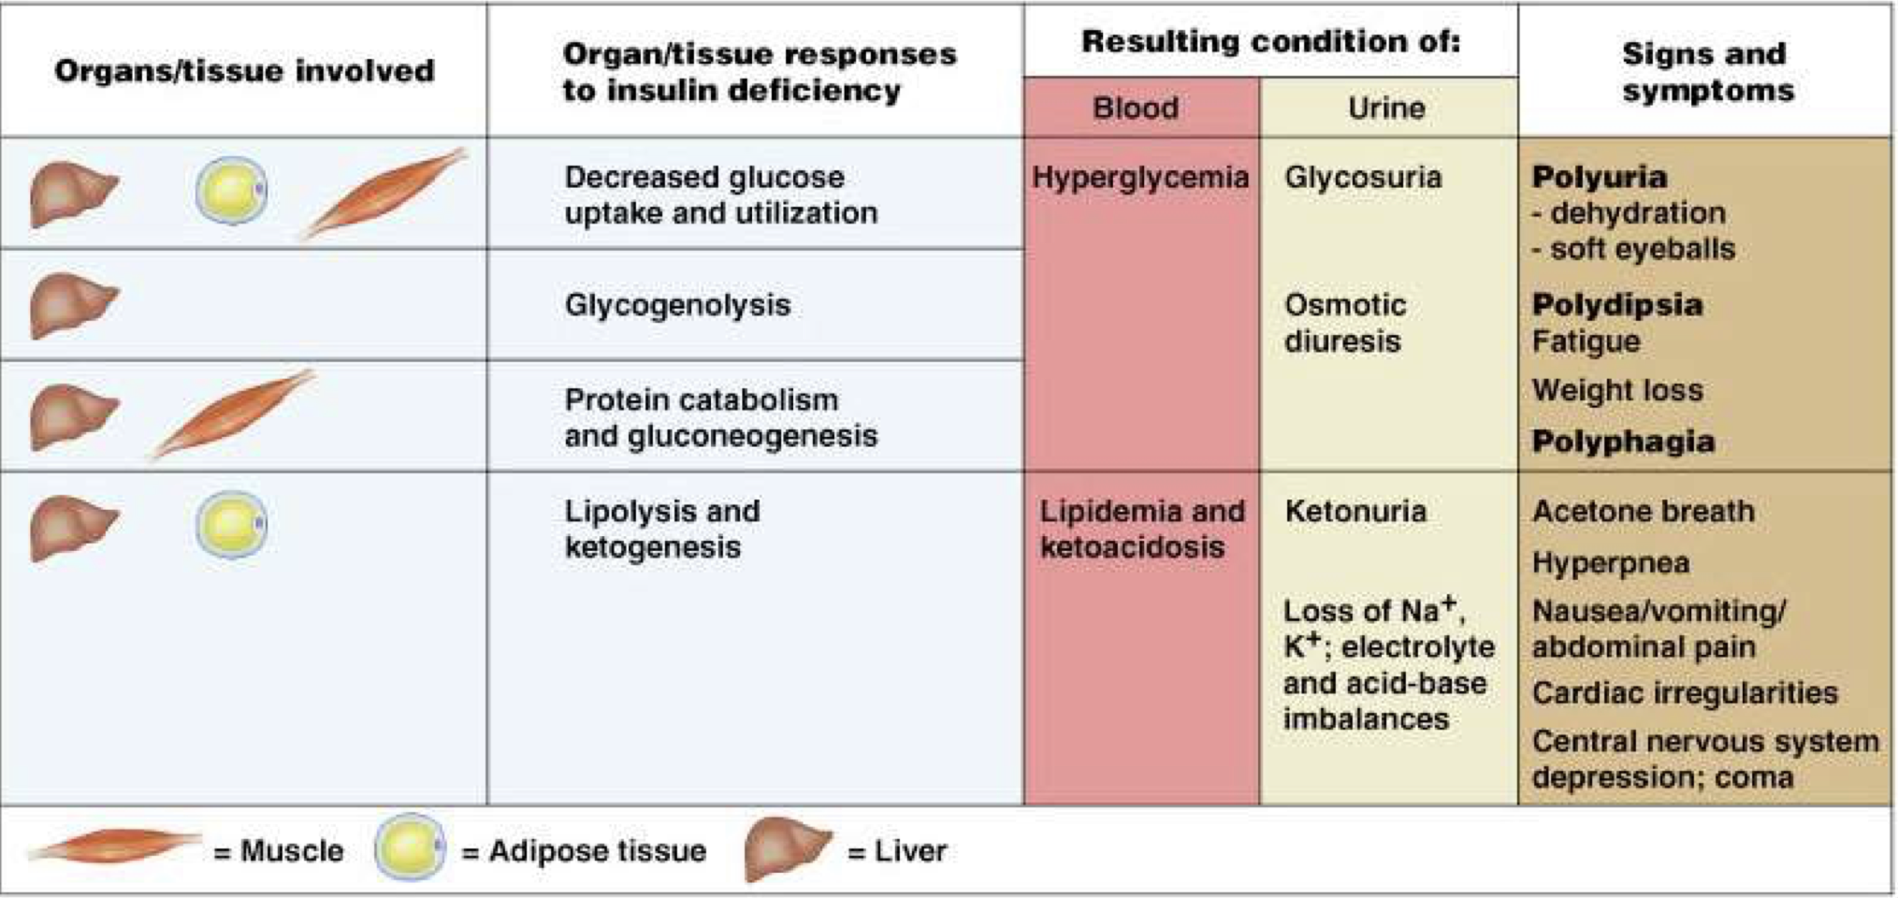
9
PATHOPHYSIOLOGY OF DIABETES MELLITUS
Lecture Fifteen
Glucose Tolerance Test
Both the Fasting Plasma Glucose (FPG) test and Oral Glucose Tolerance Test (OGTT) require that the patient fast for at least 8 hours (ideally 12 hr) prior to the test.
The oral glucose tolerance test (OGTT):
Fasting Plasma
Glucose (FPG) test
Blood is then taken 2 hours after drinking a special glucose solution
Figure 15-4
Following the oral administration of a standard dose of glucose, the plasma glucose concentration normally rises but returns to the fasting level within 2 hours.
If insulin activity is reduced, the plasma glucose concentration takes longer than 2 hours to return to normal and often rises above 200 mg/dl.
Measurement of urine glucose allows determination of the renal threshold for glucose.
The Following Results Suggest Different Conditions
Normal values
Impaired glucose tolerance (pre-diabetic)
Impaired fasting glucose
Diabetes
FPG <100 mg/dL
2h PPG = 140 - 199 mg/dL
FPG = 100-125 mg/dL
FPG ≥ 126 mg/dL
2h PPG < 140 mg/dL
2h PPG levels ≥ 200 mg/dL
Resistance
or no insulin
Glucose uptake
Figure 15-5
Figure 15-6 Summary of the effects of DM

Slide 11
10
PHYSIOLOGY OF THE PANCREAS & PATHOPHYSIOLOGY OF DM
Lecture XIV & XV
Further Reading
Insulinoma
Insulinoma are the most common type of functional pancreatic neuroendocrine tumors.
They arise from beta cells and they hypersecrete insulin.
Usually a benign solitary tumor.
Associated with MEN-1.
Symptoms: Hypoglycemia, confusion and loss of consciousness.
Excess insulin secretion causes glucose levels to fall, a programmed response by neurons to hyperglycemia in these situations sensitizes neurons, causing neuronal hyperexcitability..
As a result of the neuronal hyperexcitability caused by hypoglycemia, seizures occur. This is followed by loss of consciousness.
Treatment: Intravenous administration of large amounts of glucose.
Mechanism of Insulin Resistance
Beta cells literally burnout due to increased insulin resistance, which leads to increased insulin production.
The mechanisms for resistance are the following: decreased insulin causes an increase in plasma free fatty acids (since their uptake into the adipose tissue is mediated by insulin as well)
These fatty acids can act on inflammatory cells and adipose tissue to cause the release of inflammatory mediators such as (TNF-alpha, IL-1 and IL-6), in turn, these cytokines can act on body tissues to antagonize the effect of insulin.
This mechanism is also mainly responsible for the increased incidence of diabetes in obese individuals.
Advanced Glycation End Products (AGEs) and Diabetic Complications
AGEs are complex molecules, as we learned in biochemistry, formed when excess glucose inside the cells bind to amino acids within proteins, resulting in “glycated proteins” called AGEs.
These AGEs can bind to specific receptors on endothelial cells in blood vessels, which triggers formation of procoagulants, ROS, and synthesis of excess matrix components (all of which contribute to atherosclerosis)
AGEs cross-link with collagen fibers in blood vessels causing them to become more “leaky”, also endothelial cells atop the collagen fibers adhere less to the underlying abnormal collagen, resulting in exposed collagen and a higher risk for coagulation and of an atherosclerotic plaque.
The capillaries become thickened and more permeable throughout the body, glycation of susceptible passing proteins results in “trapping” of some proteins that cross the capillaries by the abnormal cross-linked collagen and matrix including LDLs, which becomes engulfed by macrophages resulting in formation of foam cells, however some proteins do pass through even with an increased transit time resulting in proteinuria in the case of the glomeruli, one of the classical features of nephrotic syndrome.
The increased leakiness caused by the cross-linking of AGEs with the matrix components (collagen), causes fluid to pass through the capillaries more easily, one of the most susceptible capillaries are those in the ocular regions, resulting in passage of exudate (protein-rich fluid) and edema, causing glaucoma and cataract.

Slide 12
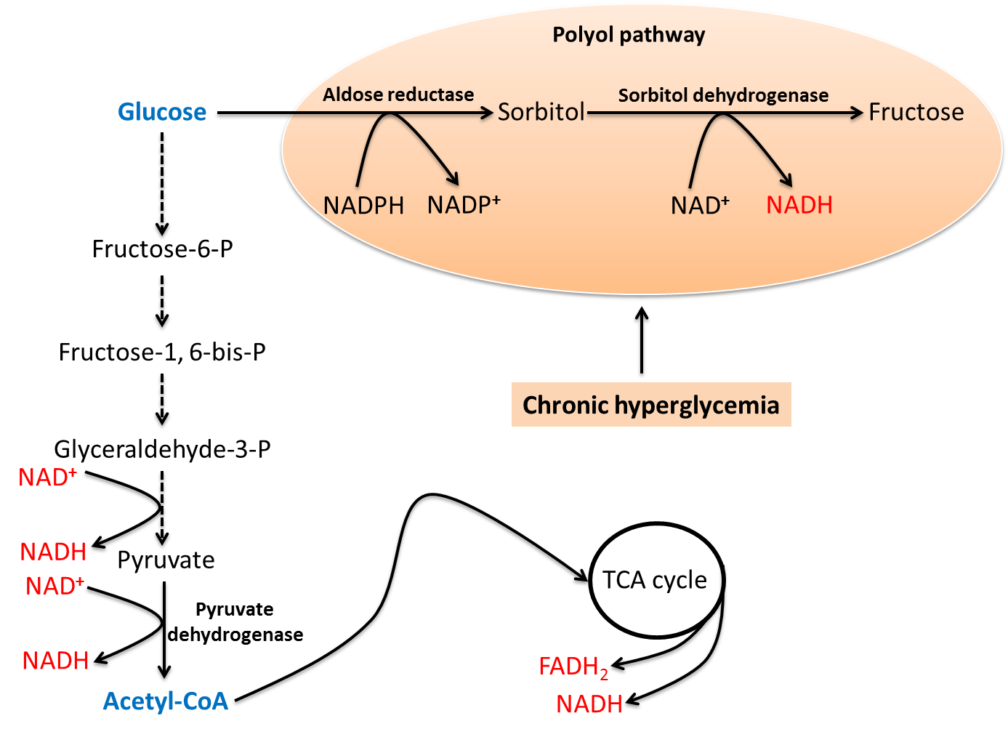
11
PHYSIOLOGY OF THE PANCREAS & PATHOPHYSIOLOGY OF DM
Lecture XIV & XV
Further Reading
Polyol Pathway and Diabetic Neuropathy, Atherosclerosis
Remember that some cells do not require insulin for glucose transport, like most neurons, endothelial cells, pancreas, the retina and so on.
Therefore in diabetes, the excess extracellular glucose can enter those cells without insulin’s help, resulting in excess intracellular glucose.
Intracellular glucose in chronic hyperglycemia is converted to sorbitol which is consequently converted to fructose for glycolysis. Conversion of glucose to sorbitol sadly consumes NADPH, which is an antioxidant, this makes cells more susceptible to oxidative stress.
Therefore, neuropathy in diabetics can occur due to excess intracellular glucose, which leads to NADPH depletion and an oxidative stress against neurons. The excess sorbitol formed can also cause hyperosmotic state within neurons, resulting in neuronal swelling and possibly neuronal death.
The cells of the retina can also be affected in the same manner, resulting in oxidative stress, inflammation in the retina and retinopathy.
SUMMARY
Action of insulin on different tissues:
Adipose tissue (Fat):
↑ Glucose uptake by increasing GLUT-4 availability, ↑ Glucose use, ↑ Glycolysis, ↑ Production of α-glycerol phosphate, ↑ Esterification of fats, ↓ Lipolysis.
Muscle:
↑ Glucose uptake by increasing GLUT-4 availability, ↑ Glucose use, ↑ Glycolysis, ↑ Glycogenesis, ↑ Amino acid uptake (particularly branched chain), ↑ Protein synthesis, ↓ Glycogenolysis, ↓ Proteolysis.
Liver:
↑ Glucose uptake (if blood glucose level is high), ↑ Glucose use,↑ Glycolysis, ↑ Glycogenesis, ↓ Glycogenolysis, ↓ Gluconeogenesis, ↑ Fatty acid synthesis and Very-low density lipoprotein formation, ↓ Ketogenesis, ↓ Urea cycle activity.

Slide 13
1. Insulin is associated with:
Lipolysis
Proteolysis
Glycogenolysis
Growth
2. Which one of the following is insulin stimulator?
Increase glucose.
Increase fatty acids.
Increase amino acids.
All of the above.
3. Which of the following result suggest impaired glucose intolerance two hours after a meal?
< 140 mg/dL
126 mg/dL
170 mg/dL
200 mg/dL
4. What are the metabolic changes in DM?
Increased glucose uptake by skeletal muscle
Increased lipolysis
Decreased ketone bodies
Both A & B
SHORT ANSWER QUESTIONS
-Mention 3 actions of insulin on adipose tissue (fat), liver & muscle?
Adipose tissue (Fat):
Liver:
Muscle:
ANSWERS
Adipose tissue (Fat):
↑ Glucose uptake by increasing GLUT-4 availability, ↑ Glucose use, ↑ Glycolysis,
Muscle:
↑ Glucose uptake by increasing GLUT-4 availability, ↑ Glucose use, ↑ Glycolysis,
Liver:
↑ Glucose uptake (if blood glucose level is high), ↑ Glucose use,↑ Glycolysis.
ANSWER KEY: D, D, C, B

Slide 14
Abdulrahman M. Bedaiwi
Naif Alsolais , Mohannad Alqarni
Co-editors: Njoud Alabdullatif, Nouf Alshammari
FEMALE PHYSIOLOGY CO-LEADERS
Maha Alnahdi, Taif Alshammari
MALE PHYSIOLOGY CO-LEADERS
Nayef Alsaber, Hameed M. Humaid
REFERENCES
Guyton and Hall Textbook of Medical Physiology
Ganong’s Review of Medical Physiology

