Slide 1
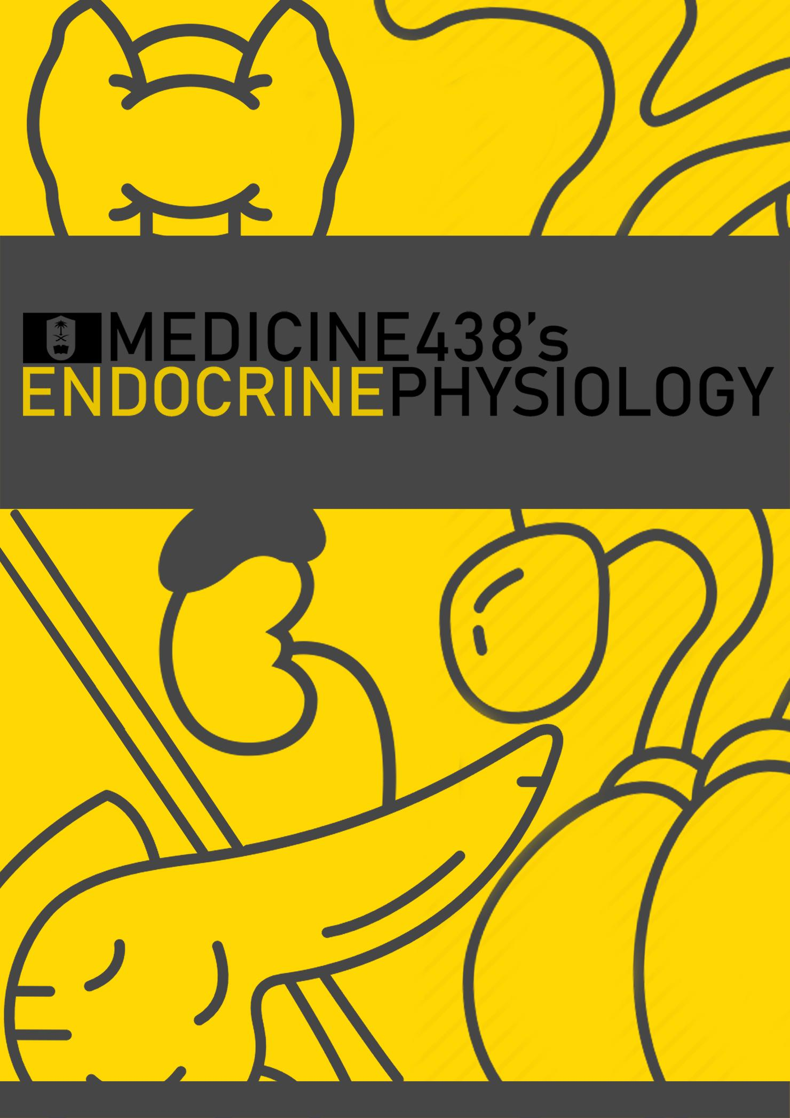
LECTURE I: Introduction to the Endocrine Physiology
EDITING FILE
IMPORTANT
MALE SLIDES
EXTRA
FEMALE SLIDES
LECTURER’S NOTES

Slide 2
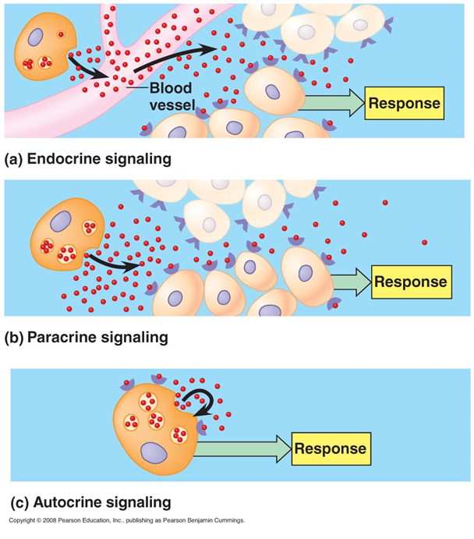
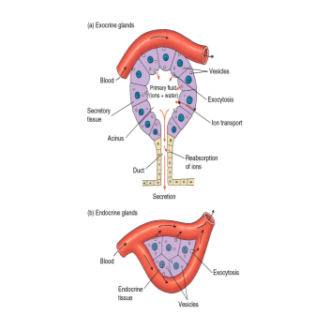
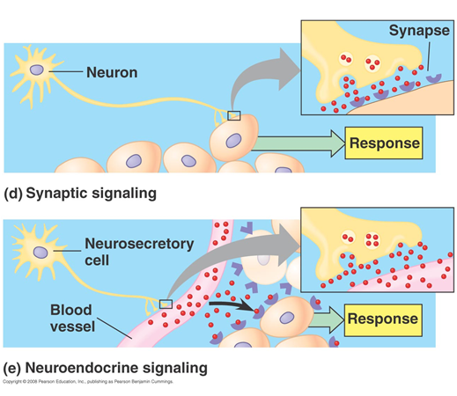
1
INTRODUCTION TO THE ENDOCRINE PHYSIOLOGY
Lecture One
OBJECTIVES
Endocrine vs exocrine gland
Chemical messengers
Hormone: Definition, chemical structure
Paracrine, autocrine, endocrine, neuroendocrine signaling
Transport and clearance
Mechanism of action of hormones
Receptors, down-regulation and up-regulation
Intracellular signaling: second messenger (cAMP, IP3)
Introduction
What are hormones? Chemical substances secreted in a small amount from endocrine gland directly to the bloodstream in response to stimulus to cause physiological responses at the target tissues.
Exocrine Glands
Ducts
Secrete enzymes
Secretion into lumen of ducts and body surfaces (e.g. sweat glands)
Endocrine Glands
No ducts
Secrete chemical messengers
Secretion into bloodstream
The activities of cells, tissues and organs are
coordinated by chemical messengers, these can be classified in the following manner:
Neurotransmitters: Chemical substance released from the axon of one neuron across a synaptic cleft to act on another cell.
Endocrine Hormones: Chemical substance released by mostly glands into the bloodstream.
Autocrine Secretions: Chemical substance secreted by a cell into the ECF to affect the function of the same cell that produced them.
Paracrine Secretions: Chemical substance secreted by a cell into the ECF to affect the function of adjacent cells other than those that produced them.. (e.g. histamine by ECL cells)
Cytokines¹: Chemical substance released by cells into the ECF and can function as autocrines, endocrines and paracrines. Peptides (interleukins, lymphokines, adipokines)
Neuroendocrine Hormones: Chemical substance released by neuronal axons directly into the bloodstream.
Figure 1-1
Types of Hormones
Figure 1-2
According to Chemical Structure
Peptides and Proteins | Steroid Hormones | Amines (hormones derived from the amino acids tryptophan and tyrosine)
Parathyroid, pancreatic and pituitary hormones. Stored inside vesicles until needed. | Adrenocortical hormones (adrenal cortex), ovaries, testes and placenta. Diffuse across cell membranes and are not stored inside vesicles. | Thyroid hormones (tyrosine-derived), catecholamines from adrenal medulla (tyrosine-derived), melatonin (tryptophan-derived).
According to Target Cells
Affect many different types of cells (eg. Growth hormone and thyroxin) Affect only specific target cells (eg. ACTH² and estrogen)
According to Stimuli
Humoral: Secretion of hormones in direct response to changing in blood levels of ions and nutrients | Neural: Nerve fibers stimulate hormone release. | Hormonal: Release of hormones in response to hormones produced by other endocrine gland.
FOOTNOTES
The distinction between cytokines and hormones is that hormones tend to be released by glands and are present in higher concentrations. But no definite distinction exists.
Released by anterior pituitary to stimulate adrenal cortex. Specificity depends if the cells express receptors for that particular hormone.

Slide 3
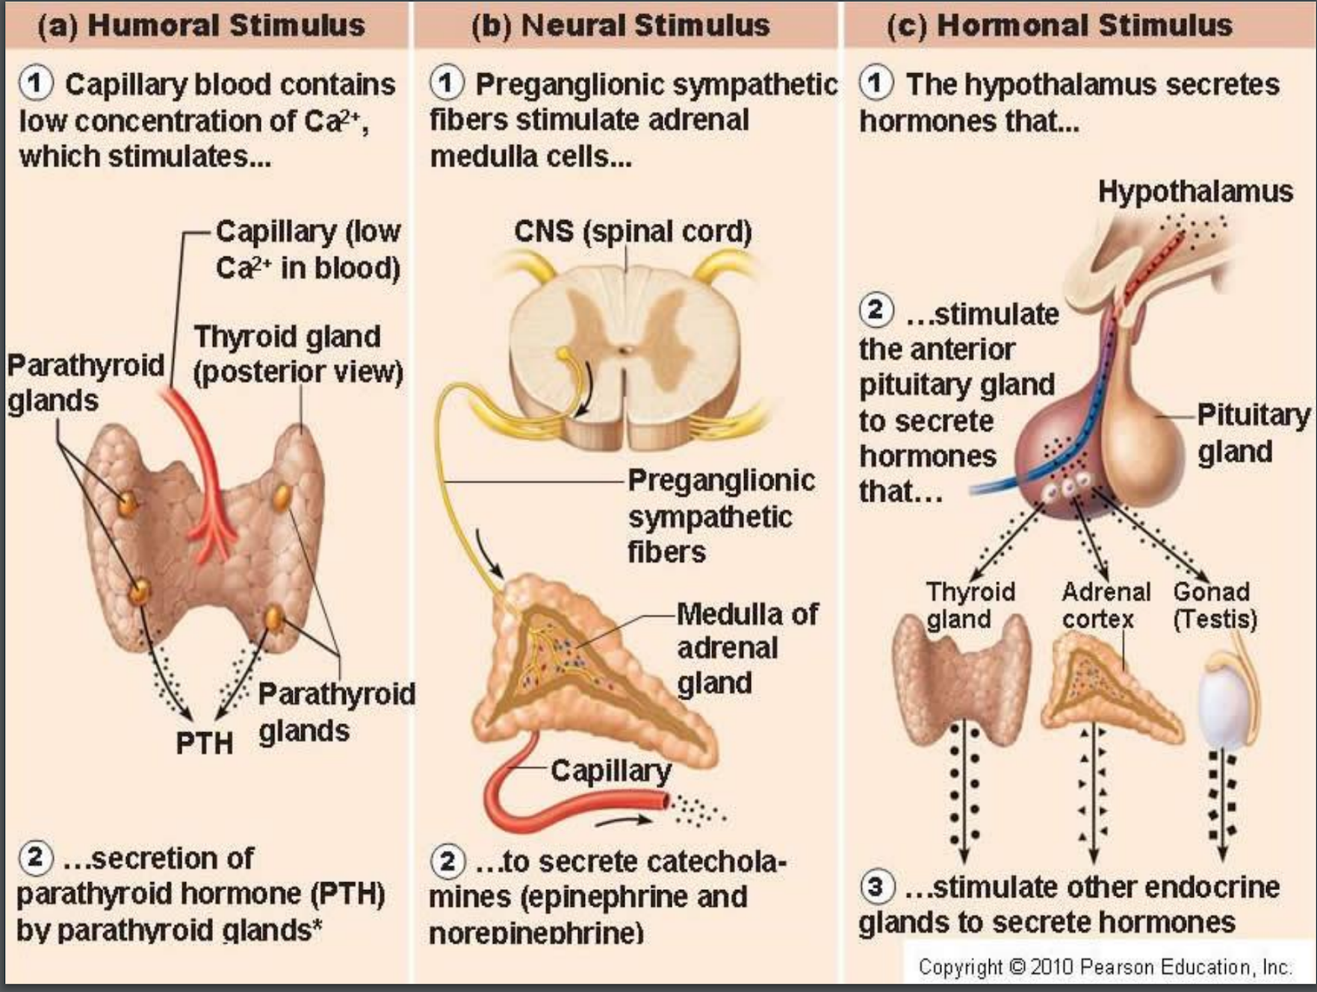
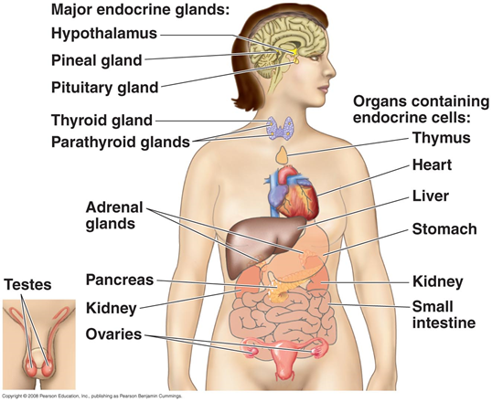
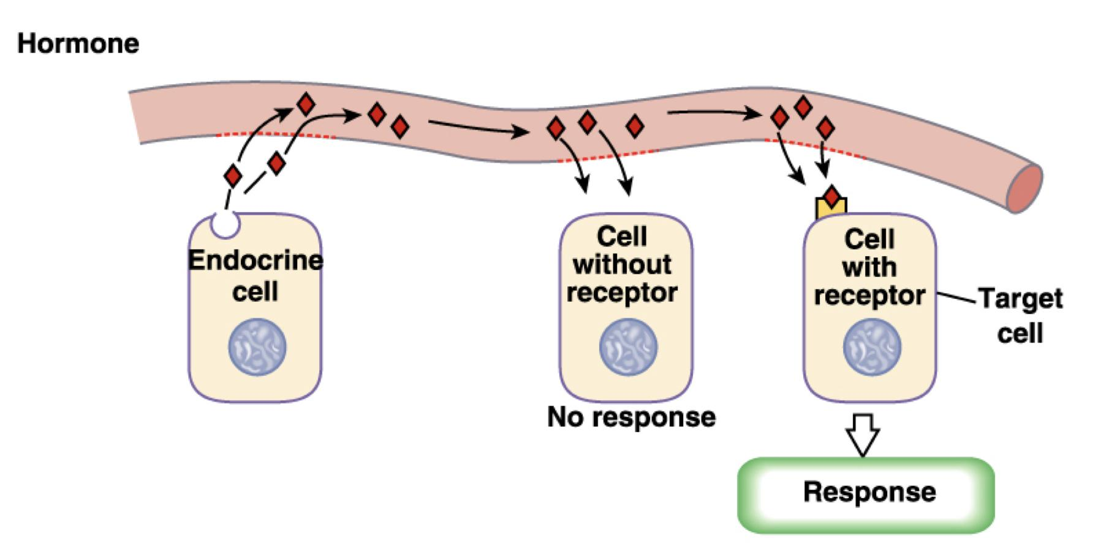
2
INTRODUCTION TO THE ENDOCRINE PHYSIOLOGY
Lecture One
Figure 1-6 Stimuli for hormonal secretion.
Figure 1-4 Neural stimuli for hormonal secretion, the adrenal medulla medulla, unlike neurons, secrete four times as much epinephrine than norepinephrine.
Figure 1-5 Hormonal stimuli for hormonal secretion. Will be explained later in-depth in upcoming lectures.
Figure 1-3 Humoral stimuli for hormonal secretion. Will be explained later in-depth in upcoming lectures.
Endocrine Glands and Key Roles of Hormones
The multiple hormone systems play a key role in regulating almost all body functions:
Metabolism (thyroxine)
Growth and development (Growth hormone)
Water and electrolyte balance (ADH)
Reproduction (FSH, LH and sex hormones)
Behavior (Oxytocin, increases during hugging and orgasmic activities)
Figure 1-7 Shows endocrine glands, the key endocrine glands are: (1) Pituitary, (2) pancreas, (3) testes, (4) ovaries, (5) adrenals, (6) thyroid, (7) parathyroid, (8) placenta.
Receptor Types and How Hormones Exert Their Effects
What are target cells? Target cells refer to cells that contain specific receptors (binding sites) for a particular hormone.
Receptors: Hormonal receptors are large proteins.
2000-100,000 receptors/cell.
Receptors are usually highly specific for a single hormone.
Receptor Locations:
Cytosolic or Nuclear: Lipophilic ligand enters cell, often activates gene, and slower response.
Cytosolic: Steroid hormones
Nuclear: Thyroid hormones
2. On the Surface of Cell Membrane: Lipophobic ligand can't enter cell, outer surface receptor and faster response.
Peptides, proteins and catecholamines.
Mechanism of Action
Hormone-receptor interaction (1st messenger)
Conformational changes
From here most hormones cause:
3. Enzyme activation
4. Release of the second messenger
5. All hormones: effects on cellular function
Figure 1-8

Slide 4
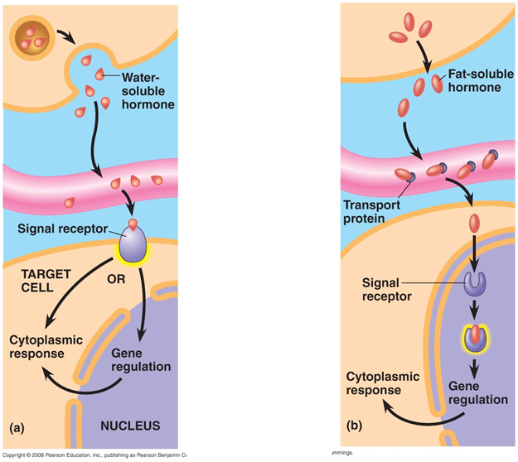
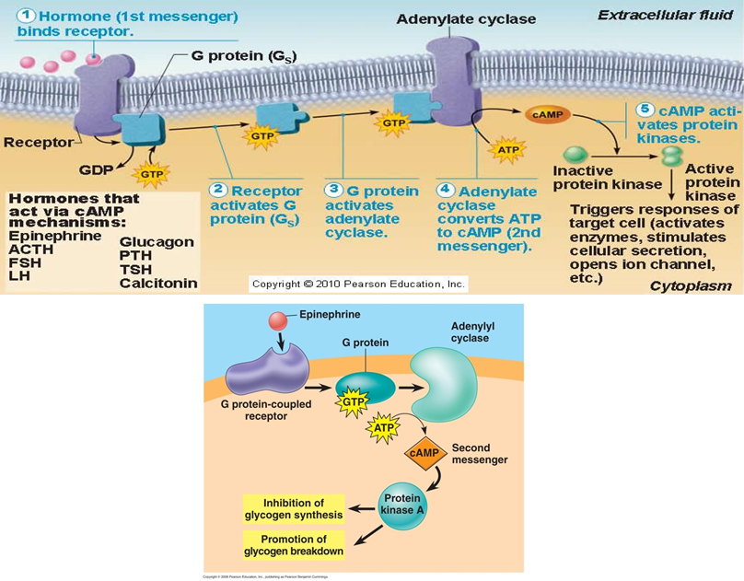
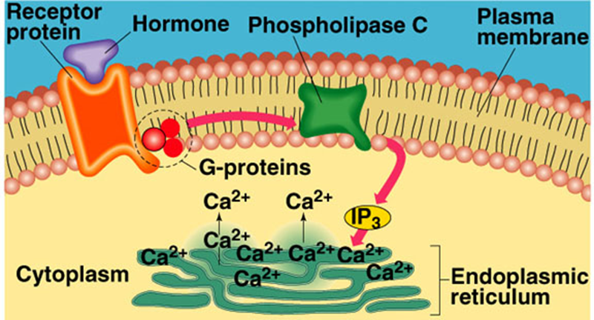
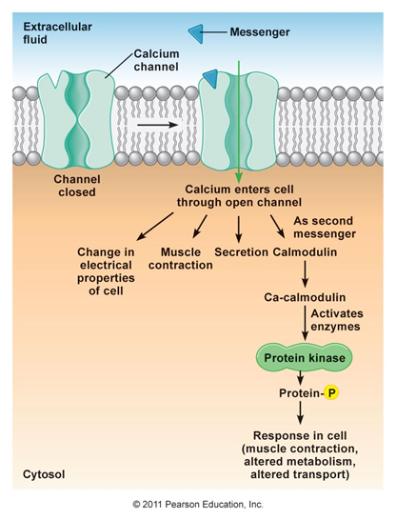
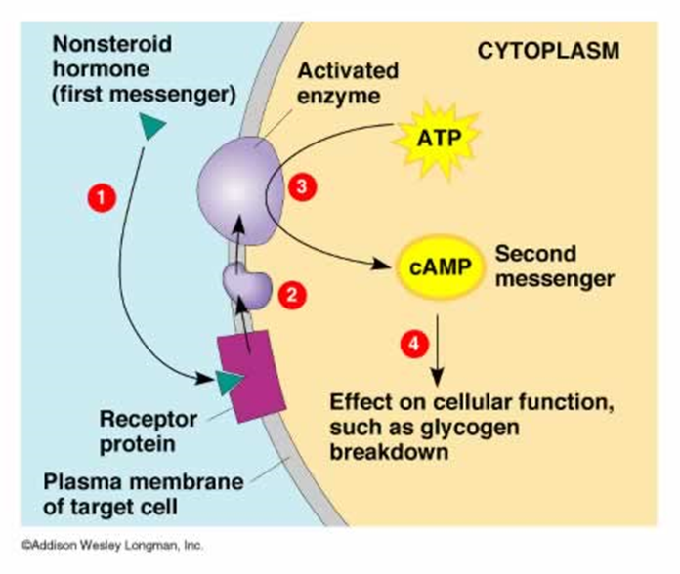
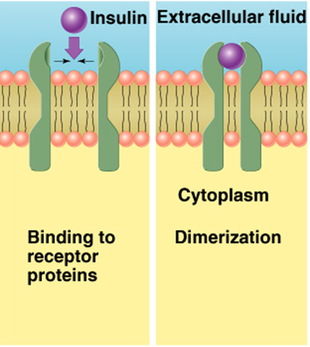
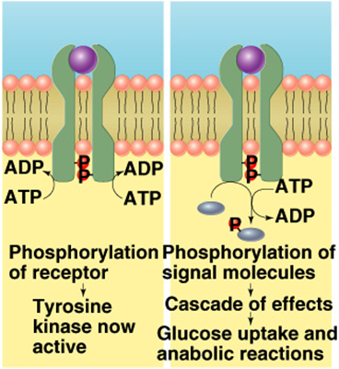
3
INTRODUCTION TO THE ENDOCRINE PHYSIOLOGY
Lecture One
Transport of Hormones
Water soluble hormones: hydrophilic (peptides & catecholamines) dissolved in plasma.
Fat soluble hormones: hydrophobic (steroids and thyroid hormones) transported bound to plasma proteins (90%),
binding to proteins helps to
Provide reservoirs
Slow hormones clearance
Figure 1-9
Peptide and Protein Hormones (Pituitary, pancreatic and parathyroid hormones)
Synthesis
Mechanism of Action | Figure 1-13: 2nd Messenger Systems of Peptide and Protein Hormones: (a) Adenylate Cyclase-cAMP, (b) Phospholipase C-IP3/DAG (c) Calcium-calmodulin complex, (d) Tyrosine Kinase System
Figure 1-11 Example of protein hormone, insulin.
Figure 1-10 Synthesized as preprohormone → post-translational modification to prohormone → then hormone.
In other words: The gene hormone is transcripted into mRNA → translated in the ribosomes into the hormone with an extra amino acid sequence that serves as a “docking peptide” → attach to ER, the hormone plus the docking peptide are called “preprohormones” → docking peptide is chopped off → preprohormone enters the ER as a prohormone (there are still some remaining amino acids that keeps the hormone inactive) → these extra amino acids are cleaved in golgi apparatus, and then the hormone along with the chopped off peptide are released into ECF.
Figure 1-12
Peptide hormone exert their effect through 2nd messenger systems.
Adenylate Cyclase-cAMP
(b) Phospholipase C-IP3/DAG: Binding of hormone: Hormone binds → Alpha subunit of G-protein detaches → Activates PLC → Cleaves a phospholipid in cell membrane (PIP2) into DAG and IP3 → IP3 releases calcium from mitochondria and sER, DAG activates protein kinase C → Cell effects.
(c) Calcium-calmodulin complex
(d) Tyrosine Kinase System:
Used by insulin & many growth factors to cause cellular effects.
Surface receptor is tyrosine kinase: consists of two units that form active dimer when insulin binds.
Activated tyrosine kinase phosphorylates signaling molecules
Induction of hormone/growth factor effects
The receptor consists of an extracellular domain that acts as a binding site for the hormone, and a catalytic (enzymatic) domain in the cytoplasm. Upon hormone binding, a conformational change activates the cytoplasmic domain.

Slide 5
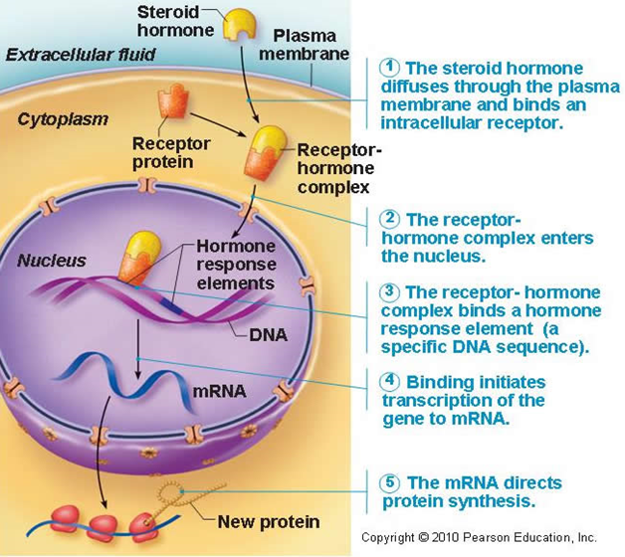
4
INTRODUCTION TO THE ENDOCRINE PHYSIOLOGY
Lecture One
Steroid Hormones (Adrenal cortex, placenta, ovaries and testes)
Synthesis | Derived from cholesterol (lipophilic) Cross membranes (no storage) On-demand synthesis (SER) Usually bound to carrier proteins
Mechanism of Action
Figure 1-14 Hormone response element, is a DNA segment on which the receptor-hormone complex will bind to adhere to the DNA. The complex acts as a transcription factor to initiate gene transcription, and therefore protein synthesis.
Figure 1-15
Amine Hormones (Tyrosine-derived: Thyroid hormones, catecholamines. Tryptophan-derived: melatonin)
Synthesis | Tryptophan-derived: Melatonin Tyrosine-derived: Catecholamines Behave like peptide hormones¹ Tyrosine-derived: Thyroid hormones Behave like steroid hormones¹
Mechanism of Action | Catecholamines: same as peptide hormones Thyroid hormones act via nuclear receptors.
Figure 1-16 Mainly for your knowledge only.
Figure 1-17
FOOTNOTES
Tyrosine-derived hormones include catecholamines, they resemble peptide hormones as they are dissolved in plasma and act via cell surface receptors. Similarly, thyroid hormones are transported via plasma proteins and act intracellularly, but through nuclear receptors rather than cytoplasmic.

Slide 6
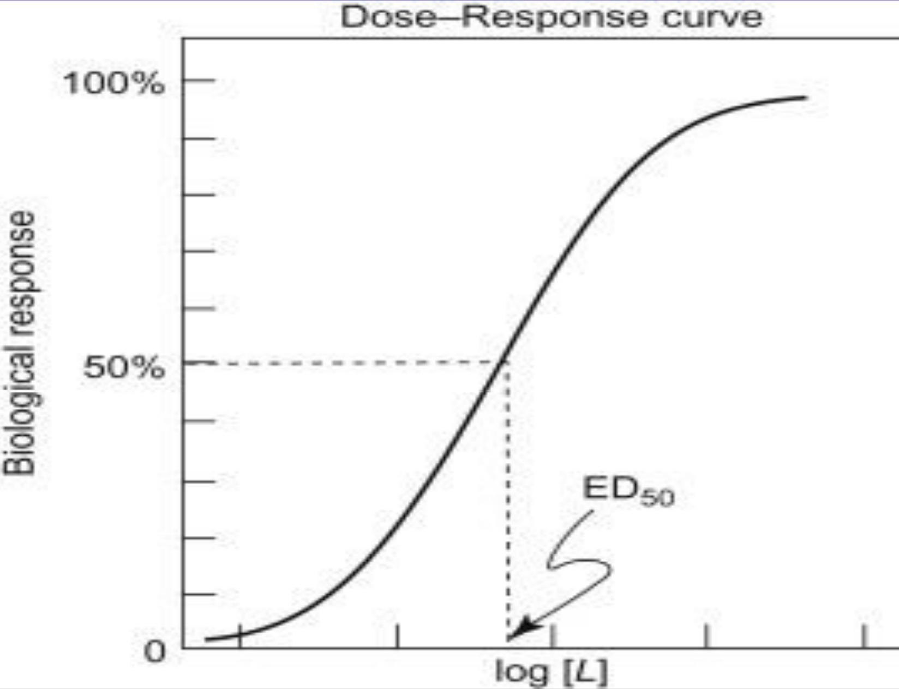
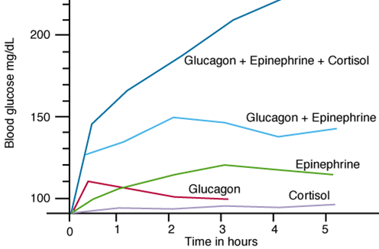
5
INTRODUCTION TO THE ENDOCRINE PHYSIOLOGY
Lecture One
Regulation of Hormones and Their Receptors
Receptors does not remain constant
Inactivated or destroyed
Reactivated or manufactured
Downregulation
Increase hormone concentration leads to decrease in the number of active receptors.
Most peptide hormones have pulsatile secretion which prevents downregulation¹
Decrease synthesis, increased degradation, or Inactivation of receptors. Example: triiodothyronine (T3)
Upregulation
The hormone induces greater than normal formation of a receptor or intracellular signaling proteins.
Increase synthesis, decreased degradation, receptor activation. Example: prolactin.
Figure 1-18 Summary of mechanism of actions.
Receptor Regulation
Dose-response relationship: Describes how the concentration of a particular hormone relates to its physiological effect.
Sensitivity: Refers to the responsiveness of a particular cells to a hormonal stimulus due to the presence of receptors.
Number: Numbers of receptors on a particular cell that responds to a specific hormone.
Affinity: Refers to the affinity of a receptor to its particular ligand (hormone).
Interaction of Hormones at Target Cells
Figure 1-19
Permissiveness: One hormone allows another hormone to have its full effect. (Especially during growth)(this occurs through upregulation of the receptors or the intracellular enzymes required for the action of another hormone)
Thyroid hormone have permissive effect on growth hormone action.
Deficiency of thyroid hormone in infants leads to dwarfism.
Thyroid hormone have permissive effect on epinephrine through upregulation of beta-2 receptors, partially why hyperthyroidism causes excessive sympathetic stimulation.
Synergism: Combined action of hormones is more than just additive (the combined effects are greater than if the effects of the individual hormones are measured separately)
Glucagon, cortisol and epinephrine
Antagonism: Antagonistic hormones have opposing physiological actions
Hormone B diminishes the effect of hormone A
(Glucagon, insulin)(Calcitonin, parathyroid hormone)
Figure 1-20
Clearance of Hormones
Two factors control the concentration of a hormone in the blood:
The rate of its secretion
The rate of its removal and inactivation (metabolic clearance)
Hormones are cleared by:
Metabolic destruction by tissues through enzymes
Excretion by the liver into bile
Excretion by the kidney into urine
Binding with tissues
Clearance of protein- bound hormones is slower than clearance of peptide hormones (dissolved hormones).
FOOTNOTES
Meaning that the hormonal secretion varies at different times during a 24 hour cycle.For example, growth hormone secretion increases during the early hours of sleep then decreases later on. In fact, as much as 75% of GH secretion occurs during sleep.

Slide 7
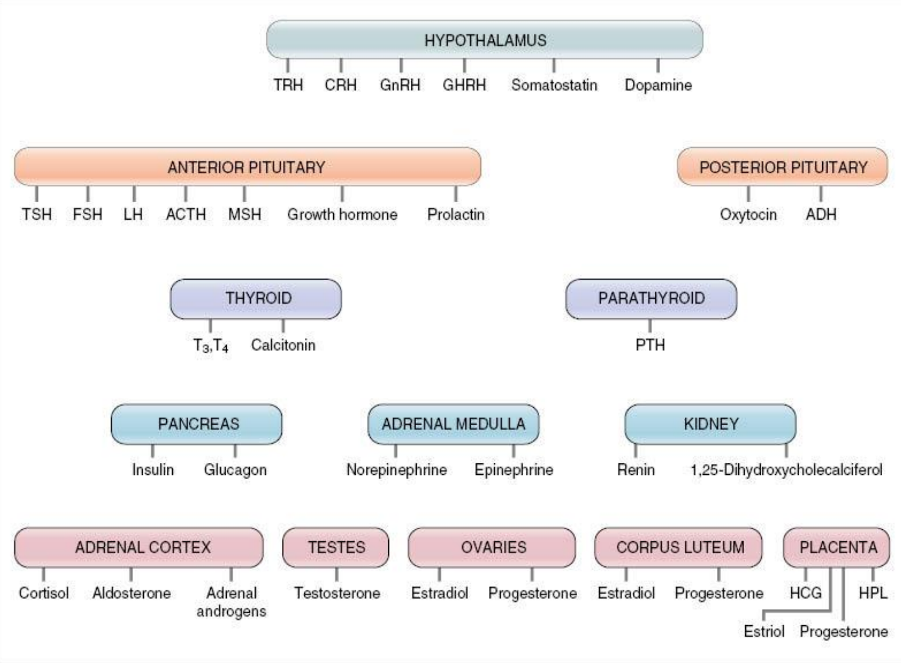
6
INTRODUCTION TO THE ENDOCRINE PHYSIOLOGY
Lecture One
Figure 1-21 For upcoming lectures.

Slide 8
A relationship in which one hormone augments the effects of another hormone, primarily by upregulating receptors:
Synergism
Permissiveness
Antagonism
Co-agonist synergy
2. The removal of the docking peptide of preprohormones occurs during:
Uptake by endoplasmic reticulum
Golgi apparatus
In the mitochondria
Ribosomes
3. The term “neuroendocrine” refers to:
A neuron secreting chemical substances across a synaptic cleft
A neuron secreting chemical substances into the bloodstream
A gland secreting its hormones across into the bloodstream
Chemical substances secreted by neurons that act on the same neurons producing them.
4. Insulin is an example of:
A steroid hormone
Protein hormone
Amine hormone
Tyrosine-derived hormone
5. In Phospholipase C-IP3/DAG, the protein that cleaves phospholipase is:
G protein
G protein-linked receptor
DAG
Protease C
ANSWER KEY: B, A, B, B, A

Slide 9
Nayef Alsaber, Hameed M. Humaid
FEMALE PHYSIOLOGY CO-LEADERS
Maha Alnahdi, Taif Alshammari
MALE PHYSIOLOGY CO-LEADERS
Nayef Alsaber, Hameed M. Humaid
REFERENCES
Guyton and Hall Textbook of Medical Physiology
Ganong’s Review of Medical Physiology

