Slide 1
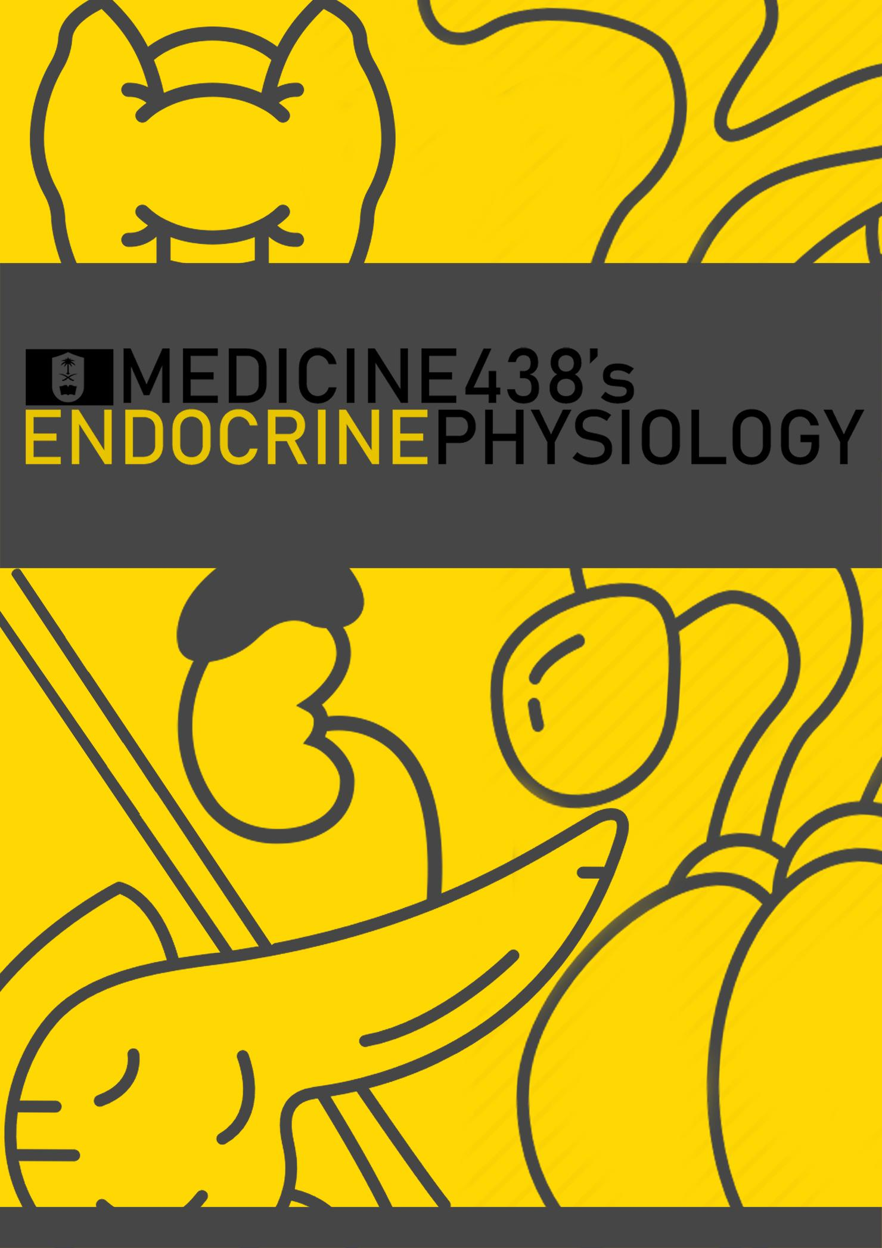
LECTURE II: Hypothalamo-Pituitary Axis and Regulatory Mechanisms
EDITING FILE
IMPORTANT
MALE SLIDES
EXTRA
FEMALE SLIDES
LECTURER’S NOTES

Slide 2
1
HYPOTHALAMO-PITUITARY AXIS AND REGULATORY MECHANISMS
Lecture Two
OBJECTIVES
Structure of pituitary gland:
Anterior pituitary cell types and hormones.
Posterior pituitary cell types and hormones.
Hypothalamic control of pituitary gland:
Hypothalamo-hypophysial portal system.
Hypothalamo-hypophysial tract.
Feedback mechanisms:
Positive feedback.
Negative feedback.
Structure of Pituitary Gland
Pituitary gland is a 1cm gland that weigh 0.5-1g controlled by Hypothalamus and consist of two lobes:
Anterior (Adenohypophysis) lobe that originates from Rathke’s pouch (pharyngeal epithelium).
Posterior (Neurohypophysis) lobe that originates from hypothalamus (Which explains the presence of glial-type cells).
Infundibulum.
Anterior pituitary contains 5 cell types:
Somatotrops produce Growth Hormone (GH) and represent 40% of anterior pituitary lobe cells.
Corticotrops produce Adrenocorticotropic Hormone (ACTH) and represent 20% of anterior pituitary lobe cells.
Thyrotropes produce Thyroid Stimulating Hormone (TSH).
Gonadotropes produce Luteinizing Hormone (LH) & Follicle Stimulating Hormone (FSH).
Lactotrops produce Prolactin (PRL).
Figure 2-1
Figure 2-2 shows relation with optic chiasm
Figure 2-3
Dark Area on the left shows more vascularity (anterior pituitary).
Light area on the right shows less vascularity and have more nerves (posterior pituitary).
Hypothalamic Control of Pituitary Secretions
Almost all secretions by the pituitary are controlled by either:
Hormonal secretion of hypothalamus (Anterior pituitary).
Nervous signals from hypothalamus (Posterior pituitary).
Hypothalamic-Pituitary Axis coordinate Thyroid gland, adrenal gland & reproductive gland. It also control growth, milk production and osmoregulation.
Figure 2-4
Feedback Mechanism
Negative feedback¹: Release of hormone A stimulates the release of hormone B. Hormone B inhibits the release of hormone A.
Positive feedback² : Release of hormone A stimulates the release of hormone B. Hormone B stimulates further release of hormone A.
FOOTNOTES
Negative feedback is usually the predominant controlling mechanism, that is, conditions or products resulting from action of hormone on target tissue tend to inhibit further secretion of the hormone to prevent oversecretion. For example, GH causes release of somatomedins from liver that inhibit further release of GH to maintain homeostasis.
In few cases, the conditions or products resulting from the action of hormone on target tissues results in further release of hormone, but eventually, all positive feedback reverts to negative feedback to maintain homeostasis, like in Figure 2-16.

Slide 3
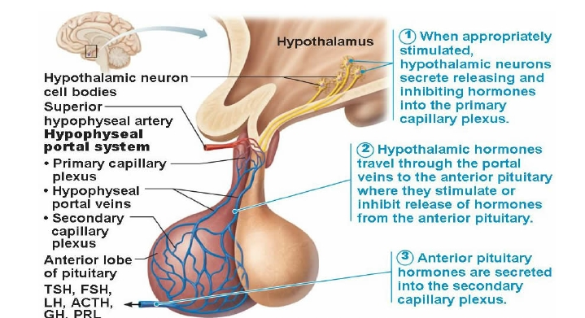
2
HYPOTHALAMO-PITUITARY AXIS AND REGULATORY MECHANISMS
Lecture Two
Figure 2-5
Figure 2-6
Negative Feedback Mechanism (Long And Short Loop Reflexes)
Long-loop feedback means that the hormone feeds back all the way to the hypothalamo-pituitary axis.
Short-loop feedback means that the anterior pituitary hormone feeds back on the hypothalamus to inhibit secretion of hypothalamic-releasing hormone.
Ultrashort-loop feedback in which the hypothalamic hormone inhibits its own secretion.
Note: Feedback is considered a short loop only when hormones of anterior pituitary inhibit the hypothalamus.
Figure 2-7
Control of Anterior Pituitary (Adenohypophysis) By Hypothalamus
Special neurons in the hypothalamus synthesize and secrete the hypothalamic releasing and inhibitory hormones that control secretion of anterior pituitary.
Neurons send their nerve fibers to the median eminence (extension of hypothalamic tissue into the pituitary stalk).
Hormones are secreted to the tissue fluids, absorbed into the Hypothalamic-Hypophysial Portal System and transported to the sinuses of the anterior pituitary.
Anterior pituitary gland is connected to hypothalamus by portal system called (Hypothalamic-Hypophysial Portal Vessels)
Figure 2-8 4th step is the release to circulation.
Figure 2-9 What type of secretion is it? neuroendocrine

Slide 4
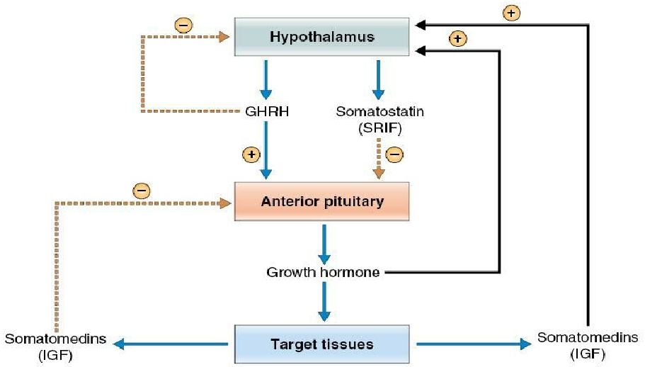
3
HYPOTHALAMO-PITUITARY AXIS AND REGULATORY MECHANISMS
Lecture Two
Hypothalamic Releasing And Inhibiting Hormones
Growth hormone releasing hormone
(GHRH)
Growth hormone inhibiting hormone
(GHIH)
Thyrotropin-releasing hormone (TRH)
Corticotropin-releasing hormone (CRH)
Gonadotropin -releasing hormone
(GnRH)
Prolactin inhibitory hormone (PIH)
GHRH Stimulates release of Growth Hormone.
GHIH inhibit release of Growth Hormone.
Figure 2-11 Growth hormone secretion is regulated by negative feedback (see Fig 2-7). Three feedback loops including both long and short loops are involved.
(1) GHRH inhibits its own secretion from the hypothalamus via an ultrashort-loop feedback.
(2) Somatomedins, which are byproducts of the growth hormone action on target tissues, inhibit secretion of growth hormone by the anterior pituitary.
(3) Both growth hormone and somatomedins stimulate the secretion of somatostatin by the hypothalamus.
The overall effect of this third loop is inhibitory (i.e., negative feedback) because somatostatin inhibits growth hormone secretion by the anterior pituitary.
Figure 2-10
Hypothalamic Releasing And Inhibiting Hormones
Growth hormone releasing hormone
(GHRH)
Growth hormone inhibiting hormone
(GHIH)
Thyrotropin-releasing hormone (TRH)
Corticotropin-releasing hormone (CRH)
Gonadotropin -releasing hormone
(GnRH)
Prolactin inhibitory hormone (PIH)
Stimulates release of Thyroid Stimulating Hormone (TSH).
Figure 2-13
TRH is secreted by the hypothalamus and acts on the thyrotrophs of the anterior pituitary to cause secretion of TSH. TSH then acts on the thyroid gland to stimulate the synthesis and secretion of thyroid hormones.
The thyroid hormones secretion will cause a negative feedback on the anterior pituitary to inhibit further secretion of TSH.
Figure 2-12 T3 is The active form of T4, Thus it mediates the inhibition of TRH & TSH.

Slide 5
4
HYPOTHALAMO-PITUITARY AXIS AND REGULATORY MECHANISMS
Lecture Two
Hypothalamic Releasing And Inhibiting Hormones
Growth hormone releasing hormone
(GHRH)
Growth hormone inhibiting hormone
(GHIH)
Thyrotropin-releasing hormone (TRH)
Corticotropin-releasing hormone (CRH)
Gonadotropin -releasing hormone
(GnRH)
Prolactin inhibitory hormone (PIH)
Stimulates release of Adrenocorticotropin Hormone (ACTH).
Figure 2-15
CRH is secreted by the hypothalamus and acts on the corticotrophs of the anterior pituitary to cause secretion of ACTH. In turn, ACTH acts on the cells of the adrenal cortex to stimulate the synthesis and secretion of adrenocortical hormones.
It’s a long loop negative feedback.
Figure 2-14
Hypothalamic Releasing And Inhibiting Hormones
Growth hormone releasing hormone
(GHRH)
Growth hormone inhibiting hormone
(GHIH)
Thyrotropin-releasing hormone (TRH)
Corticotropin-releasing hormone (CRH)
Gonadotropin -releasing hormone
(GnRH)
Prolactin inhibitory hormone (PIH)
causes release of two gonadotropic hormones:
Luteinizing (LH).
Follicle-stimulating hormone (FSH)
Figure 2-16 why does estrogen at times cause GnRH to be increased in day 12-14 of ovulation as opposed to negative feedback in the remaining days? Simply in these days there is gonna be a higher estrogen concentration which will cause a switch in the feedback mechanism from negative to positive, the reasons for this are not clear.
Figure 2-17 Sertoli and leydig are types of cells present in testis
Figure 2-18 Long loop negative feedback mechanism “sex steroids”

Slide 6
5
HYPOTHALAMO-PITUITARY AXIS AND REGULATORY MECHANISMS
Lecture Two
Hypothalamic Releasing And Inhibiting Hormones
Growth hormone releasing hormone
(GHRH)
Growth hormone inhibiting hormone
(GHIH)
Thyrotropin-releasing hormone (TRH)
Corticotropin-releasing hormone (CRH)
Gonadotropin -releasing hormone
(GnRH)
Prolactin inhibitory hormone (PIH)
Also called Dopamine.
Inhibit secretion of Prolactin.
1
Figure 2-19 There are two regulatory pathways from the hypothalamus, one inhibitory (via dopamine, which acts by decreasing cAMP levels) and the other stimulatory (via TRH). In persons who are not pregnant or lactating, prolactin secretion is tonically inhibited by dopamine (prolactin-inhibiting factor [PIF]) from the hypothalamus. In other words, the inhibitory effect of dopamine dominates and overrides the stimulatory effect of TRH in normal conditions.
2
Figure 2-20
Control of Posterior Pituitary (Neurohypophysis) By Hypothalamus
Hormones synthesized in the supraoptic nuclei (Antidiuretic hormone, ADH) it synthesizes (1\6 of total oxytocin) and paraventricular secretes (1\6 of ADH) and paraventricular nuclei (Oxytocin) of the hypothalamus and released in posterior pituitary.
Figure 2-21
Figure 2-22
Figure 2-23 Magnocellular neurons in paraventricular and supraoptic nuclei secrete oxytocin and vasopressin directly into capillaries in the posterior lobe.

Slide 7
6
HYPOTHALAMO-PITUITARY AXIS AND REGULATORY MECHANISMS
Lecture Two
Clinical Application
What will happen if pituitary gland is removed from its normal position and transplanted to other part of the body?
Release of all hormones will stop.
Release of some hormones will decrease to very low levels.
Release of some hormones will increase.
Answer: both the 2nd and 3rd answer are correct, Prolactin is the only hormone that will not be inhibited and thus it’ll increase.
Summary of Hypothalamic Control of Pituitary Gland
Figure 2-24
Figure 2-25
Summary of Anterior Pituitary Hormones
Hormone | Target Tissue | Principal Actions | Regulation Of Secretion
ACH (Adrenocorticotropic Hormone) | Adrenal cortex | Stimulate secretion of glucocorticoids | Stimulated by CRH (corticotropin-releasing hormone) Inhibited by glucocorticoids
TSH(thyroid-stimulating Hormone) | Thyroid gland | Stimulate secretion of thyroid hormones | Stimulated by TRH (thyrotropin-releasing hormone) inhibited by thyroid hormone
GH(Growth Hormone) | Most tissues | Promotes protein synthesis and growth , lipolysis and increased blood glucose | Inhibited by somatostatin Stimulated by growth hormone-releasing hormone
FSH(follicle-stimulating Hormone) | Gonads | Promotes gamete production and stimulates estrogen production in females | Stimulated by GnRH(gonadotropin-releasing hormone) inhibited by sex steroids and inhibin
PRL(prolactin) | Mammary glands and other sex accessory organs | Promote milk production in lactating females , additional actions in other organs | Inhibited by PIH(prolactin-inhibiting Hormone)
LH(luteinizing Hormone) | Gonads | Stimulates sex hormone secretion , ovulation and corpus luteum formation in females , stimulation of testosterone secretion in males. | Stimulated by GnRH , Inhibited by sex steroids

Slide 8
Which of the following hormones originates in the anterior pituitary?
Growth hormone-releasing hormone.
Somatostatin.
Oxytocin.
Thyroid-stimulating hormone.
2. The two hormones released from the neurohypophysis are actually manufactured in which of the following?
Paraventricular and supraoptic nuclei of the hypothalamus.
Hypophyseal portal vein.
Pars intermedia.
Adenophysis.
3. When the anterior pituitary hormone feeds back on the hypothalamus to inhibit secretion of hypothalamic-releasing hormone this called:
Positive feedback.
Short-loop feedback.
Long-loop feedback.
Ultra-short feedback.
4. In males which hormone stimulates Sertoli cells to produce androgen binding globulin (ABG)?
Oxytocin.
FSH.
LH.
GnRH.
5. For milk to pass from the nipple of the mother into the mouth of the nursing infant, what must occur?
Oxytocin secretion from the posterior pituitary must take place.
The baby’s mouth must develop a strong negative pressure over the nipple.
Myoepithelial cells must relax.
Prolactin levels must fall.
ANSWER KEY: D, A, B, B, A

Slide 9
Taif Alshammari
FEMALE PHYSIOLOGY CO-LEADERS
Maha Alnahdi, Taif Alshammari
MALE PHYSIOLOGY CO-LEADERS
Nayef Alsaber, Hameed M. Humaid
REFERENCES
Guyton and Hall Textbook of Medical Physiology
Ganong’s Review of Medical Physiology

