Slide 1
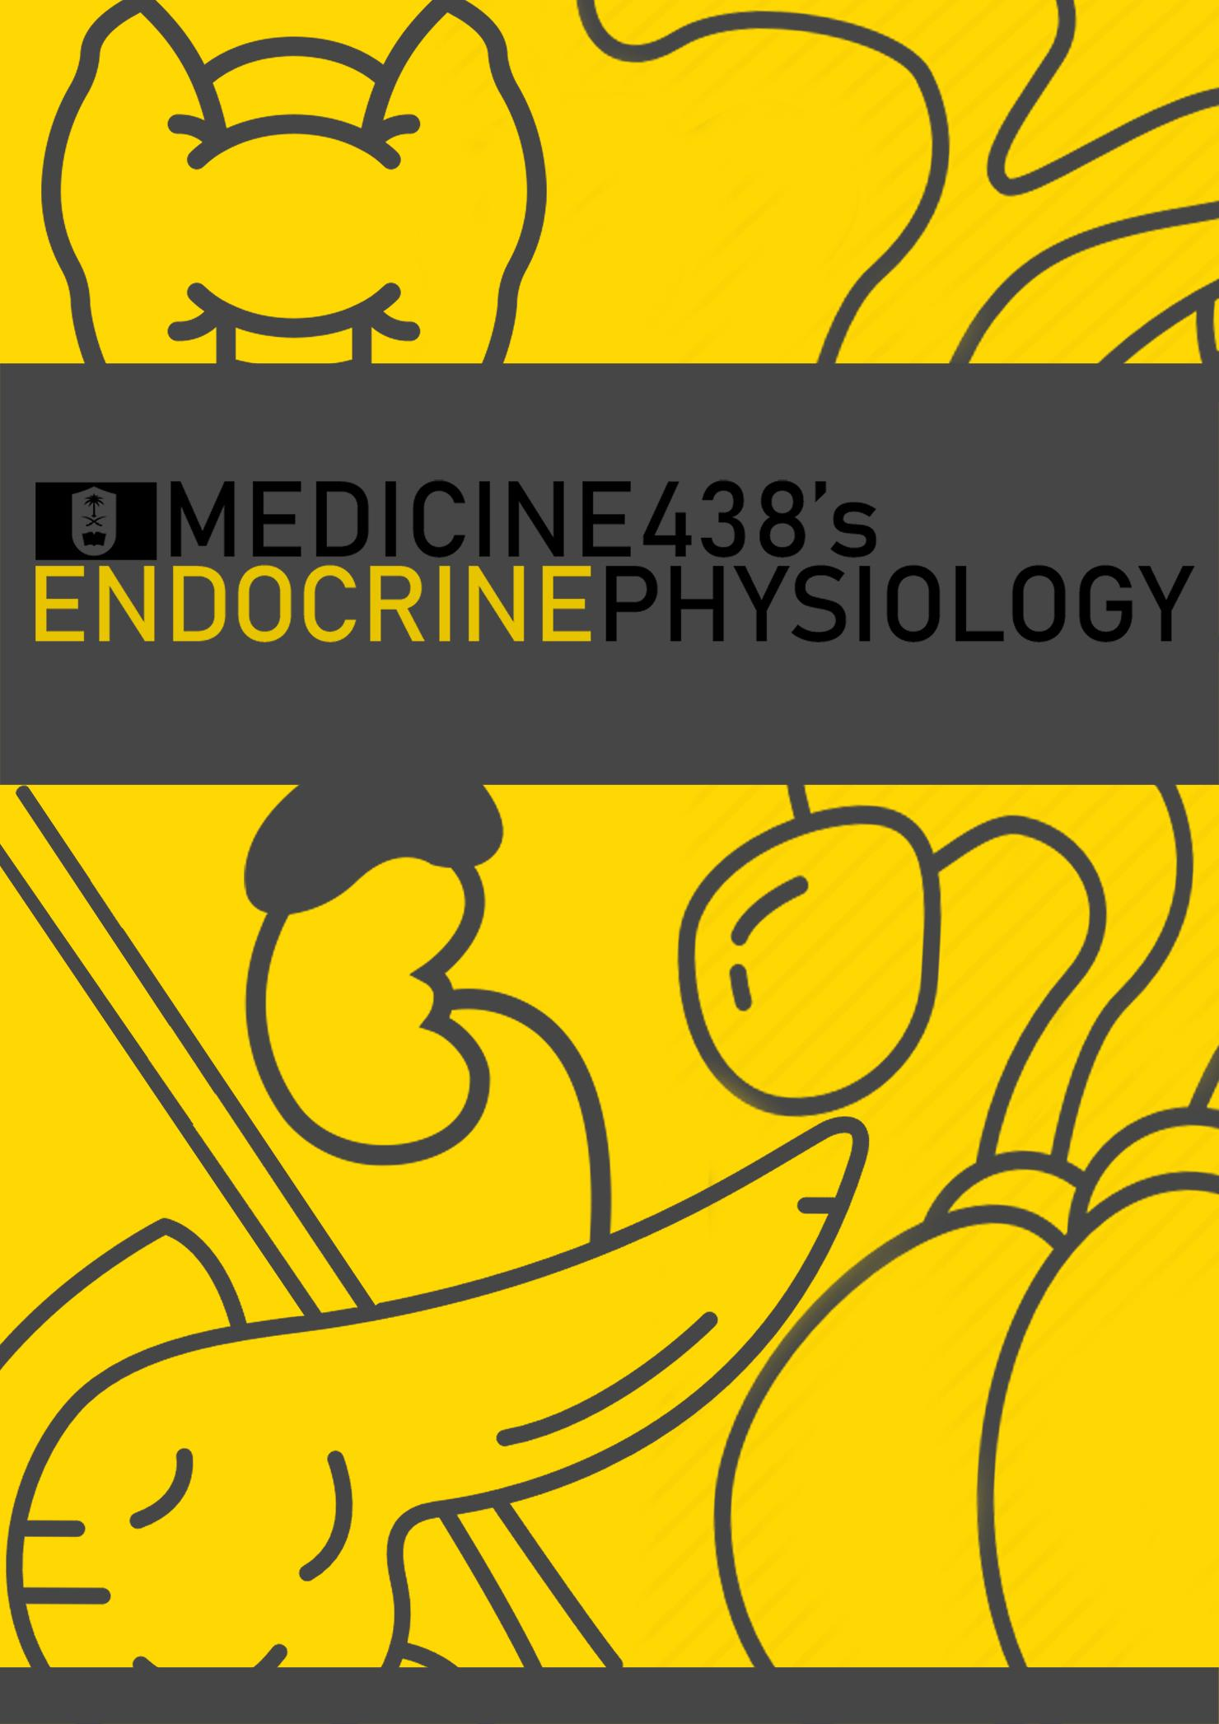
LECTURE III & IV: Anterior Pituitary Gland (Part I & II)
EDITING FILE
IMPORTANT
MALE SLIDES
EXTRA
FEMALE SLIDES
LECTURER’S NOTES

Slide 2
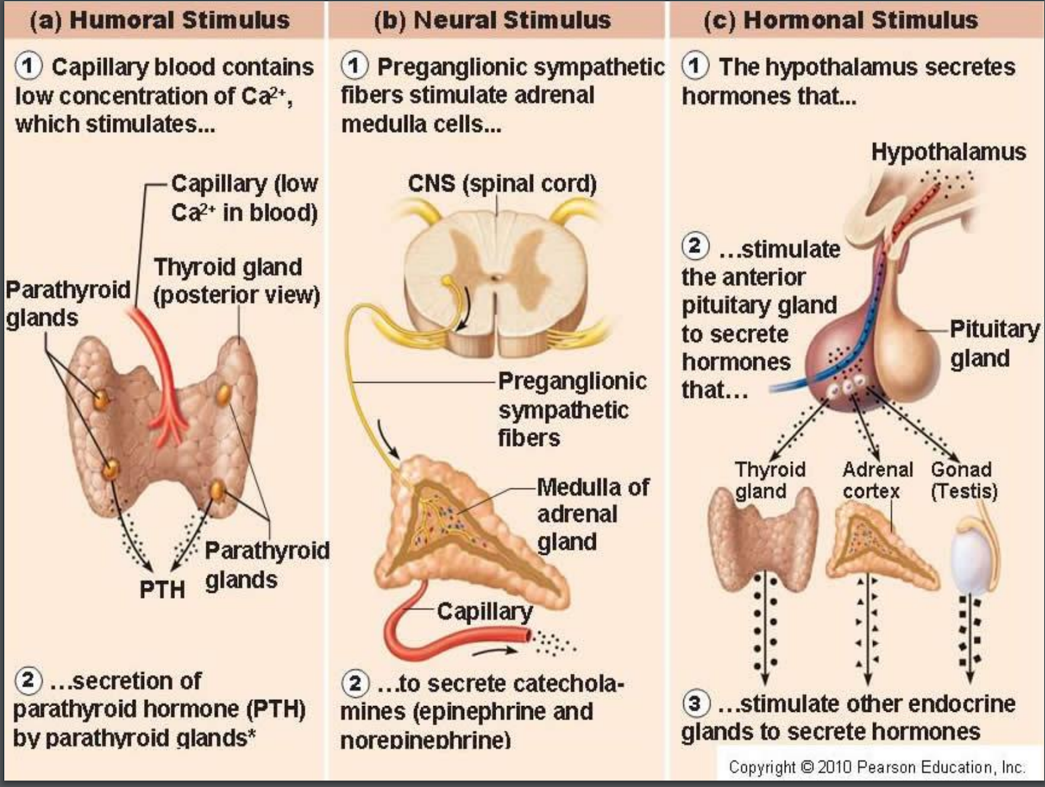
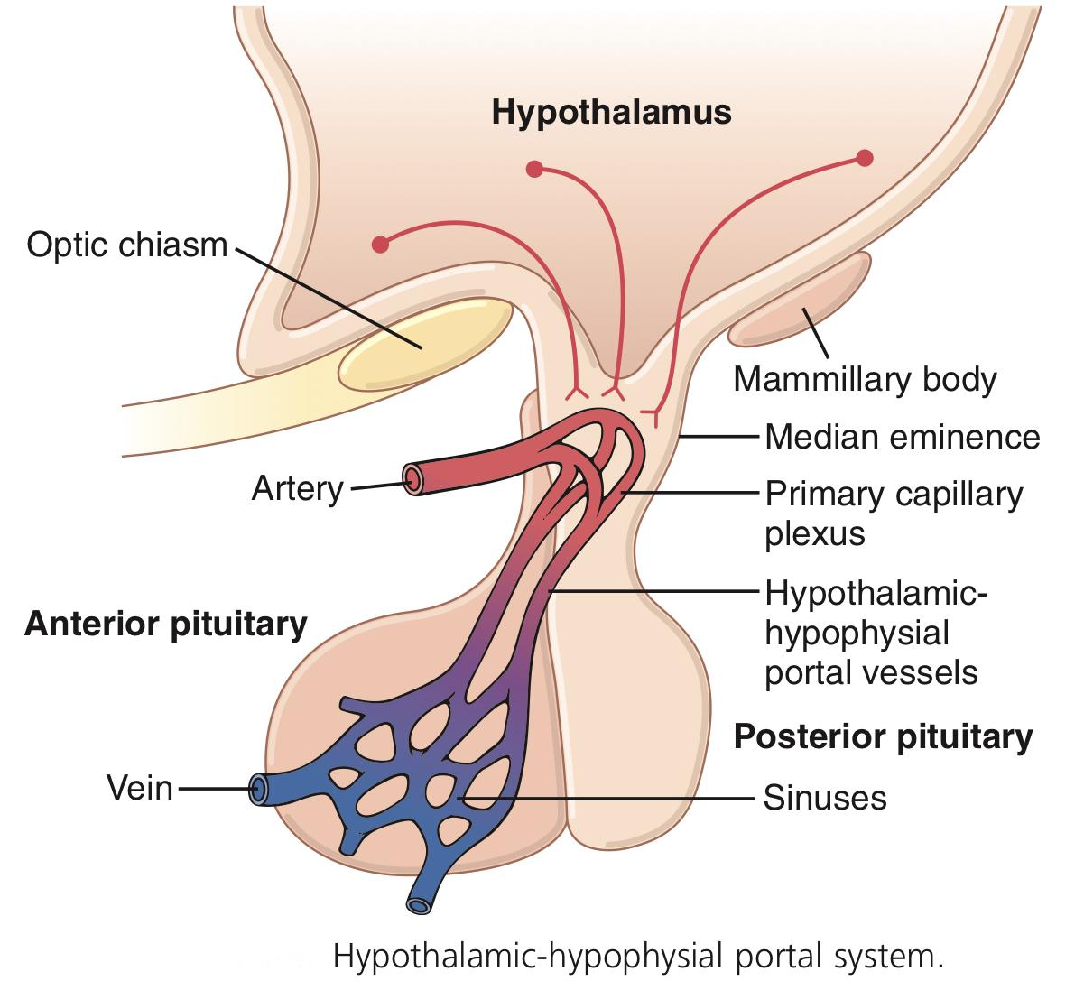
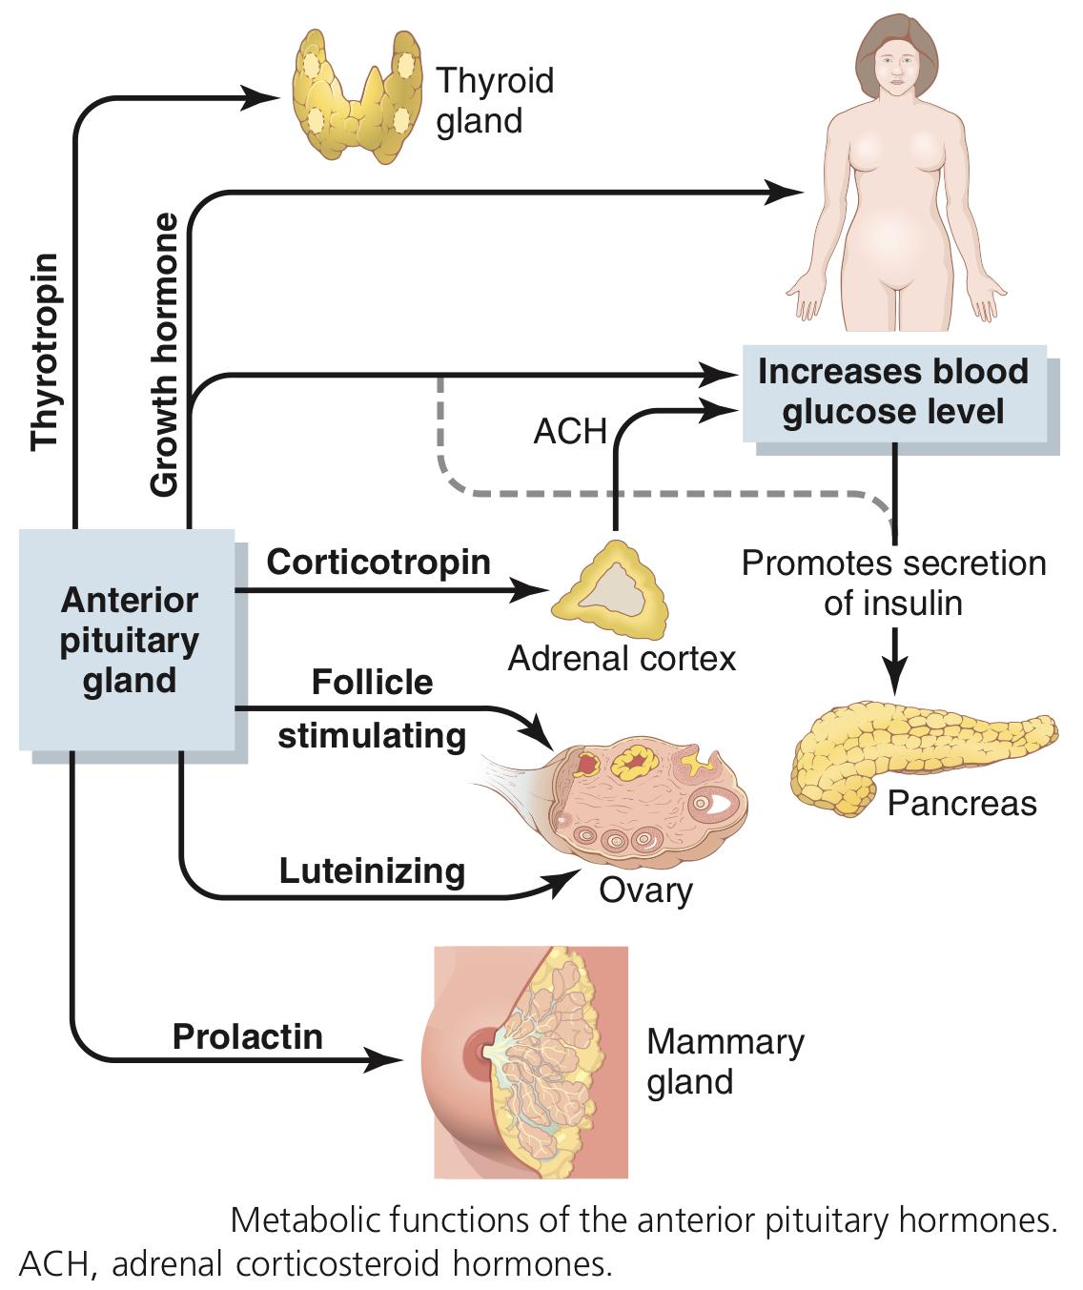
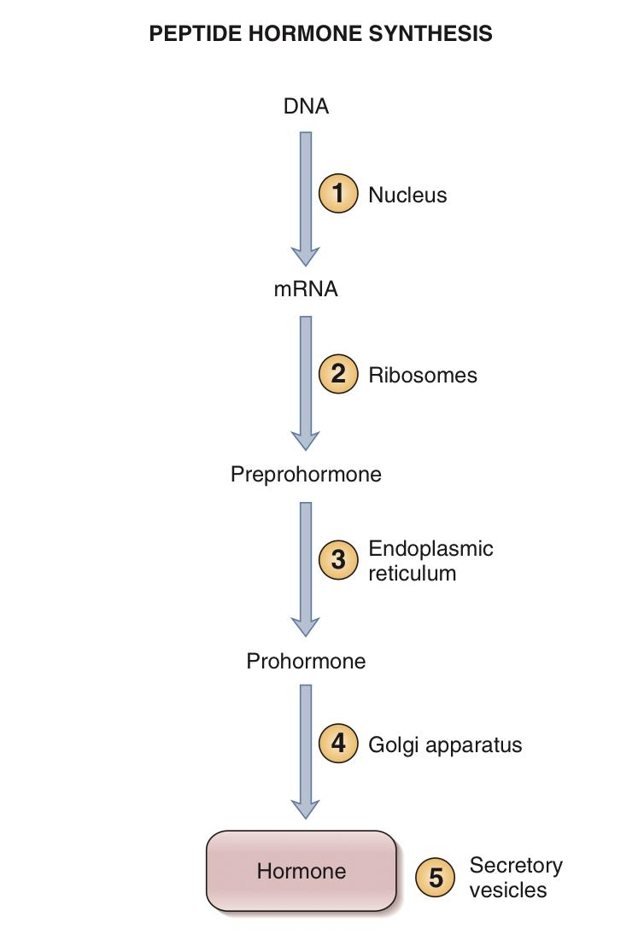
Growth Hormone (Somatotropic Hormone or Somatotropin)
1
ANTERIOR PITUITARY GLAND
Lecture Three
OBJECTIVES
Anterior pituitary hormones ( GH, Prolactin, TSH, FSH, LH, ACTH)
Describe actions of Anterior Pituitary hormones
Mechanism of action of hormones
Hormone receptors, down-regulation and up-regulation
Intracellular signaling
Second messenger mechanism
Know conditions related to hypo or hyper secretion of Anterior Pituitary hormones
Growth Hormone
Physiological functions
Regulation of GH secretion
Feedback mechanism
Factors controlling secretion
Prolactin
Physiological functions
Regulation of prolactin secretion
Stimuli for Hormonal Secretion
Anterior Pituitary Gland (Adenohypophysis)
It is connected to hypothalamus by portal system: “hypothalamic-hypophysial portal vessels”.
Figure 3-1
Figure 3-2
Anterior Pituitary Hormones
Pituitary hormones are classified as peptide hormones.
Six major hormones are secreted by the anterior lobe of the pituitary:
Growth hormone¹: promotes growth of the entire body by affecting protein formation, cell multiplication, and cell differentiation.
Prolactin: promotes mammary gland development and milk production.
Adrenocorticotropin (corticotropin): controls the secretion of some of the adrenocortical hormones, which affect metabolism of glucose, proteins, and fats.
Thyroid-stimulating hormone (thyrotropin): controls the secretion rate of thyroxine and triiodothyronine by the thyroid gland.
Two separate gonadotropic hormones, control growth of the ovaries and testes, as well as their hormonal and reproductive activities:
Follicle-stimulating hormone
Luteinizing hormone
Figure 3-3
Synthesized and secreted by somatotrophs in the anterior pituitary.
The synthesis of growth hormone is stimulated by GHRH & inhibited by Somatostatin (also known as somatotropin release–inhibiting factor [SRIF]).
It is a small protein molecule that contains 191 amino acids.
It has a molecular weight of 22,000.
Figure 3-4 Steps involved in the synthesis of peptide hormones.
FOOTNOTES
All hormones secreted by the anterior pituitary glands function to act on other glands (e.g. prolactin on mammary gland), except GH, which acts directly on tissues.

Slide 3
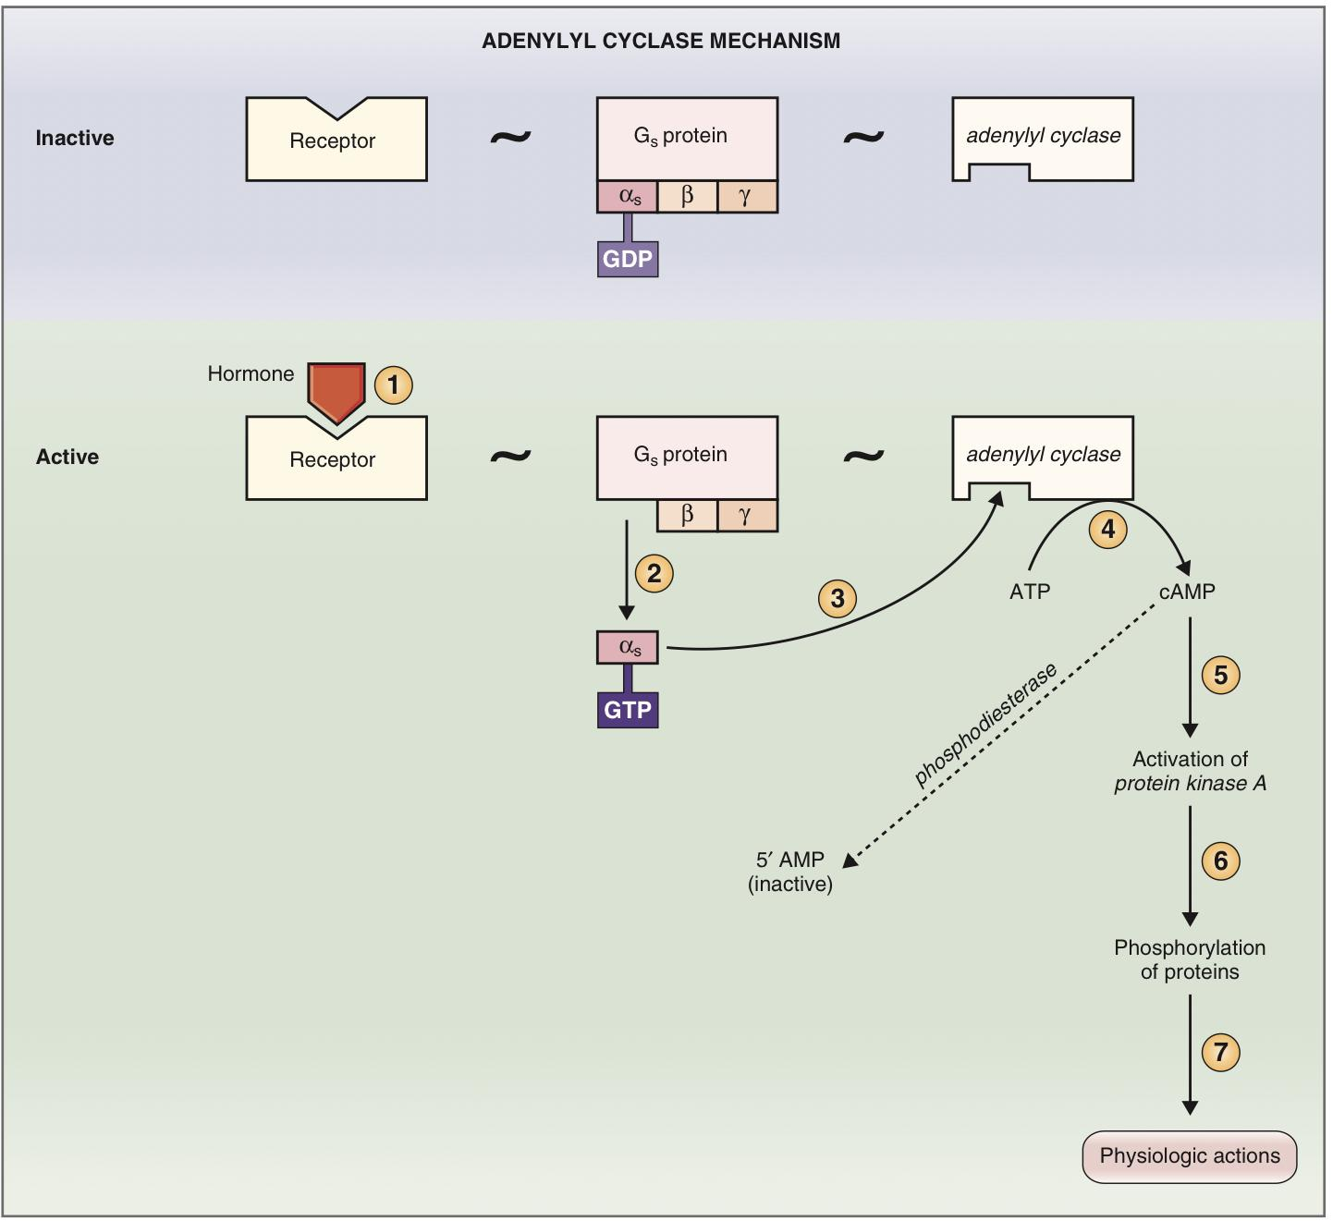
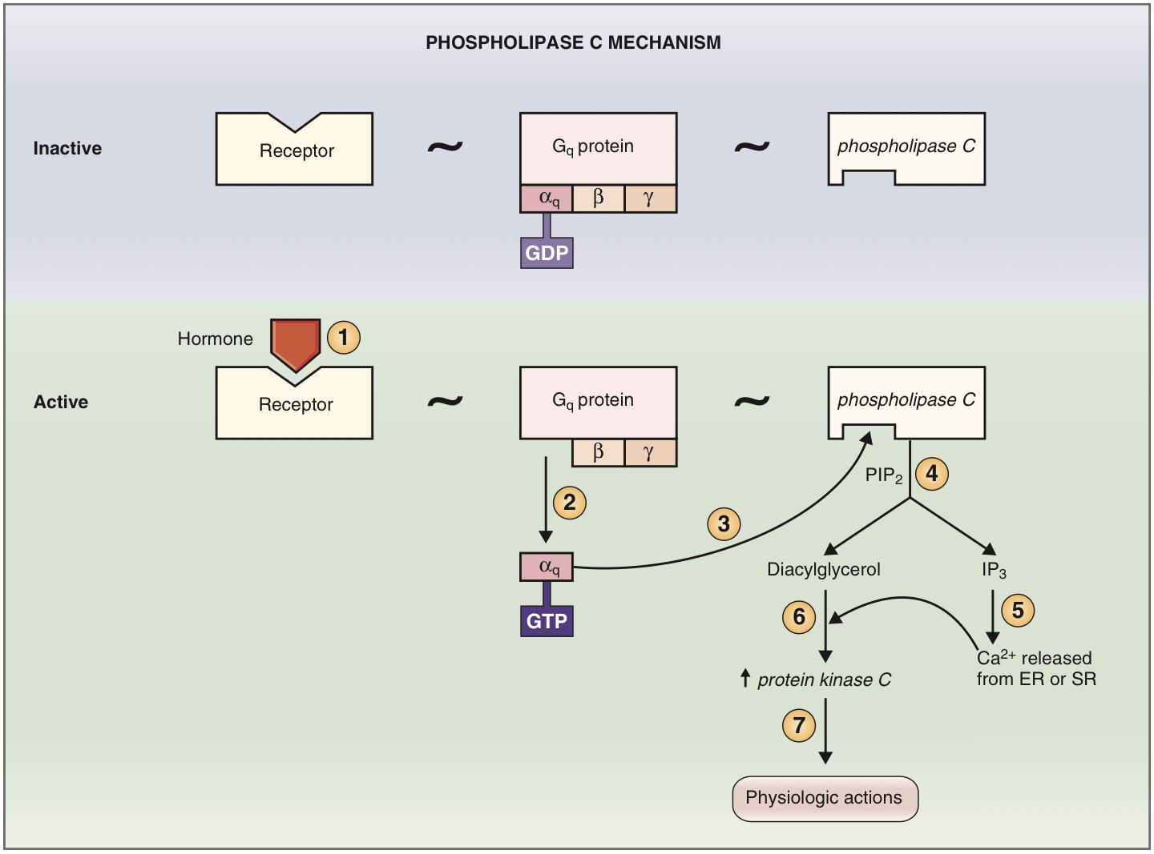
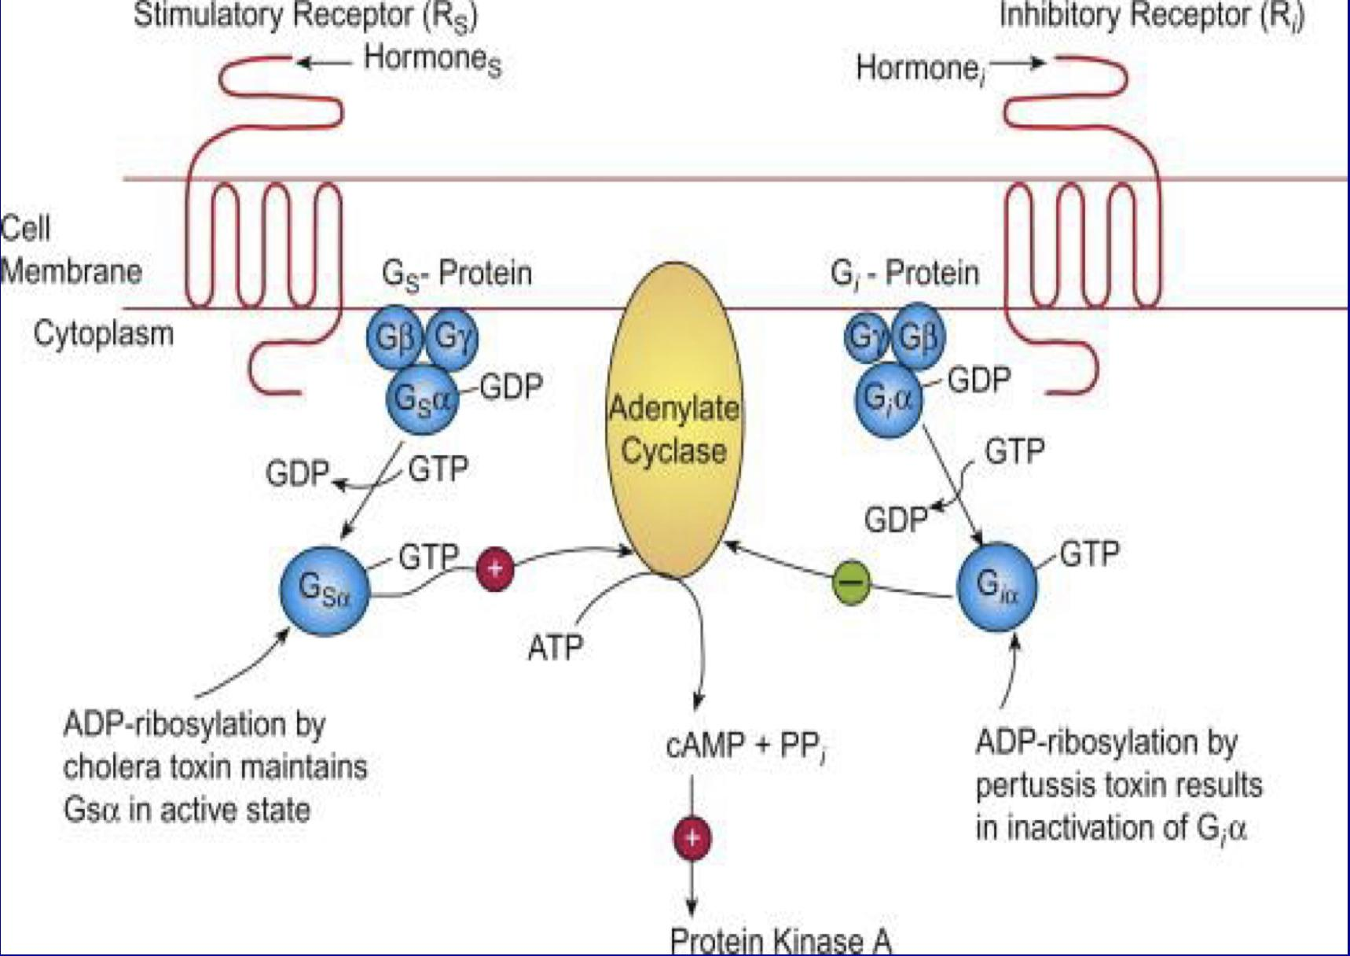
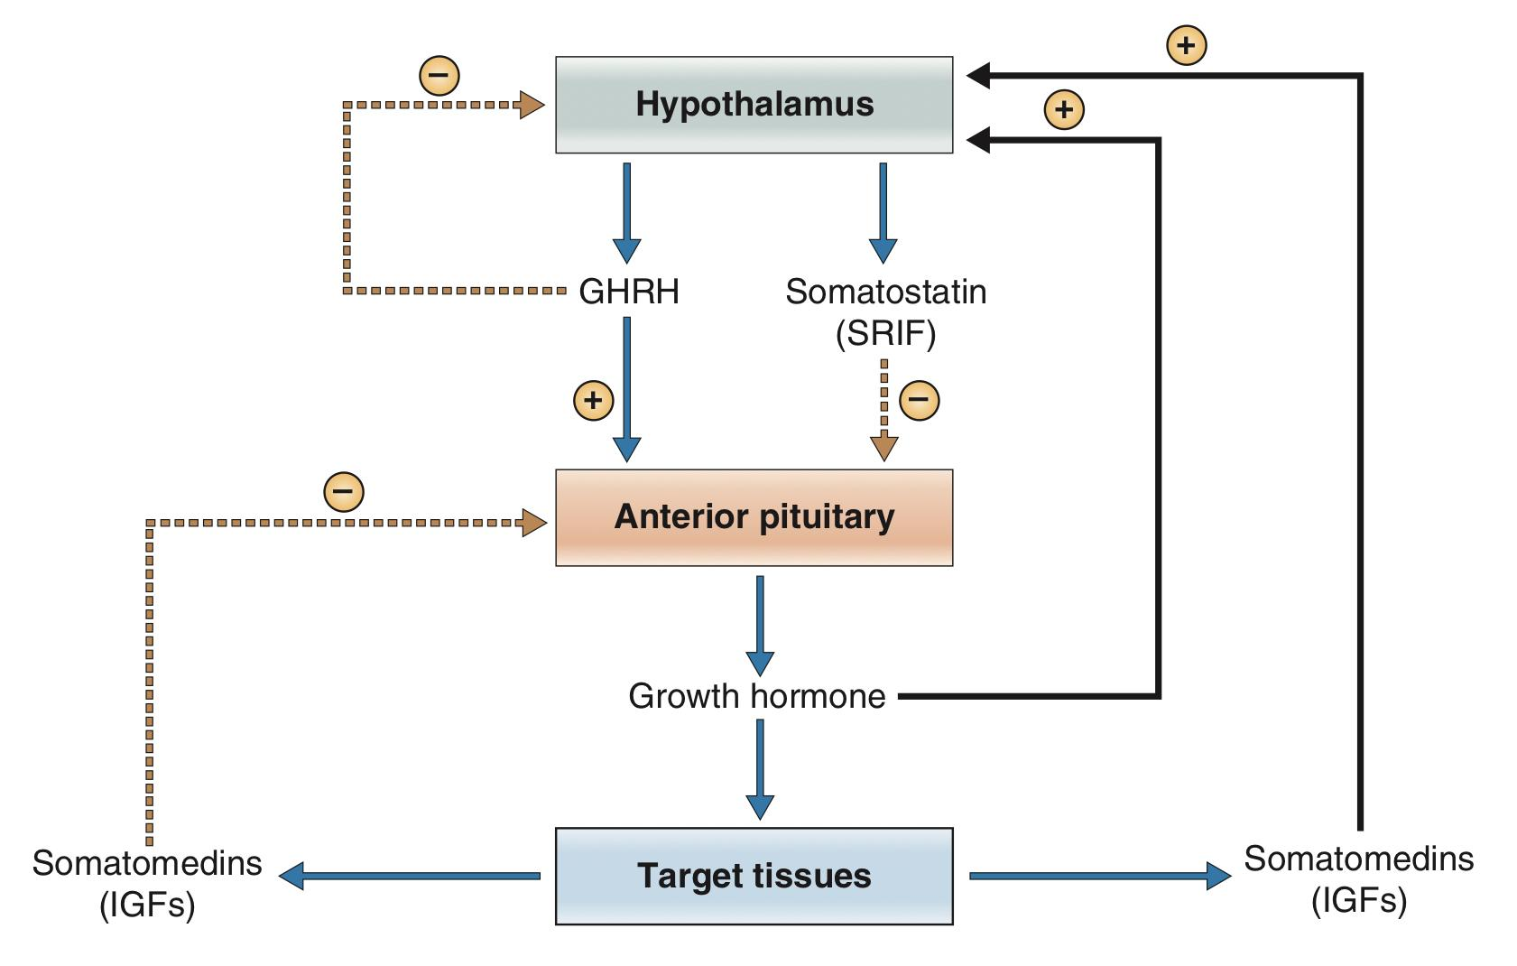
2
ANTERIOR PITUITARY GLAND
Lecture Three
Regulation of Growth Hormone Secretion
GHRH → binds to a Gs-protein coupled receptor → activates either adenylyl cyclase or phospholipase C mechanisms → cAMP & IP3/Ca → secretion and synthesis of growth hormone.
Somatostatin (SRIF) → binds to a Gi-protein coupled receptor → inhibits generation of cAMP → Decrease secretion.
Recall from the 1st lecture that peptide hormone exert their effect through 2nd messenger systems, which include:
(a) Adenylate Cyclase-cAMP mechanism, (b) Phospholipase C-IP3/DAG, (c) Tyrosine Kinase System.
Remember that G proteins can be either stimulatory or inhibitory and are called, accordingly, Gs or Gi. Stimulatory or inhibitory activity resides in the α subunit (α_{s} or α_{i}). Thus when GTP is bound to the α_{s} subunit of a G_{s} protein, the G_{s} protein stimulates the effector enzyme (e.g., adenylyl cyclase). When GTP is bound to the α_{i} subunit of a G_{i} protein, the G_{i} protein inhibits the effector enzyme.
Figure 3-5 Adenylyl Cyclase Mechanism:
In this example, the hormone utilizes a Gs protein (rather than a Gi protein).
1. Hormone binds which produces two changes:
GDP is released from the α_{s} subunit and is replaced by GTP
α_{s} subunit of Gs protein detaches
2. The α_{s}-GTP complex activates adenylyl cyclase.
Activated adenylyl cyclase converts ATP to cAMP (2nd messenger).
3. cAMP activates protein kinase A which phosphorylates intracellular proteins and produces the final physiologic actions.
4. Intracellular cAMP is degraded to an inactive metabolite (5′ AMP), by the enzyme phosphodiesterase, thereby turning off the action of the second messenger.
Figure 3-6 Phospholipase C-IP3/DAG Mechanism:
This mechanism involves utilizing a Gq protein.
1. Hormone binds which produces two changes:
GDP is released from the α_{q} subunit and is replaced by GTP
α_{q} subunit of Gq protein detaches
2. The α_{q}-GTP complex activates phospholipase C.
Activated phospholipase C Cleaves (PIP₂) into DAG and IP₃
3. IP₃ releases calcium from mitochondria and sER. Calcium & DAG activate protein kinase C which phosphorylates intracellular proteins and produces the final physiologic actions.
Figure 3-7 Somatostatin binds to its own membrane receptor, which is coupled to adenylyl cyclase by a Gi protein, inhibiting the generation of cAMP and decreasing growth hormone secretion.
Figure 3-8 Regulation of growth hormone secretion

Slide 4
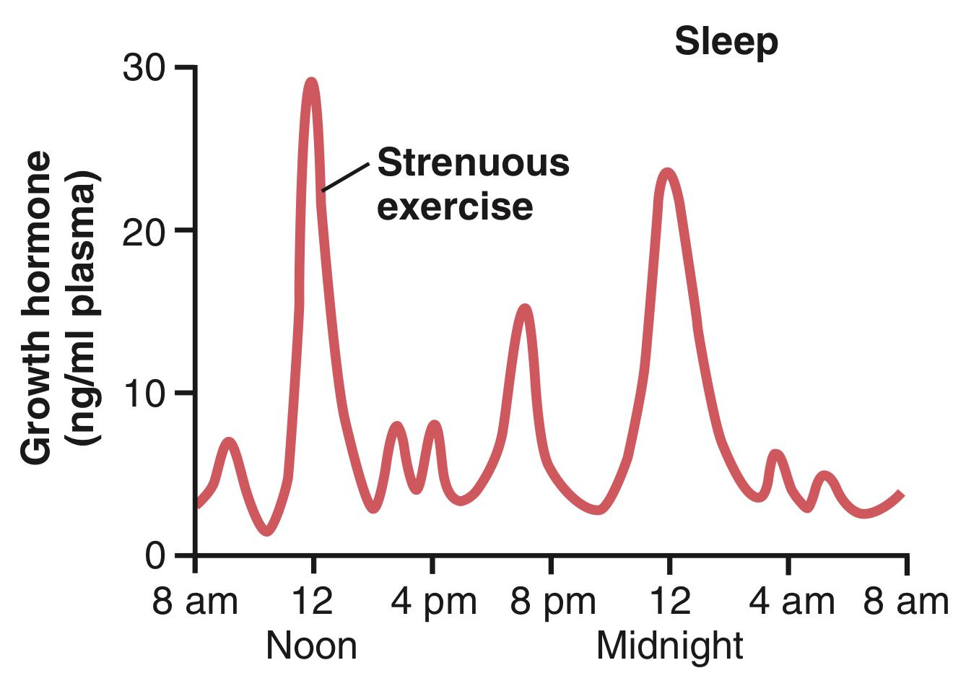
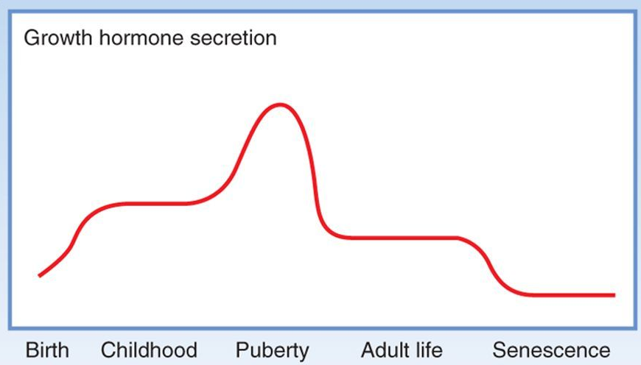
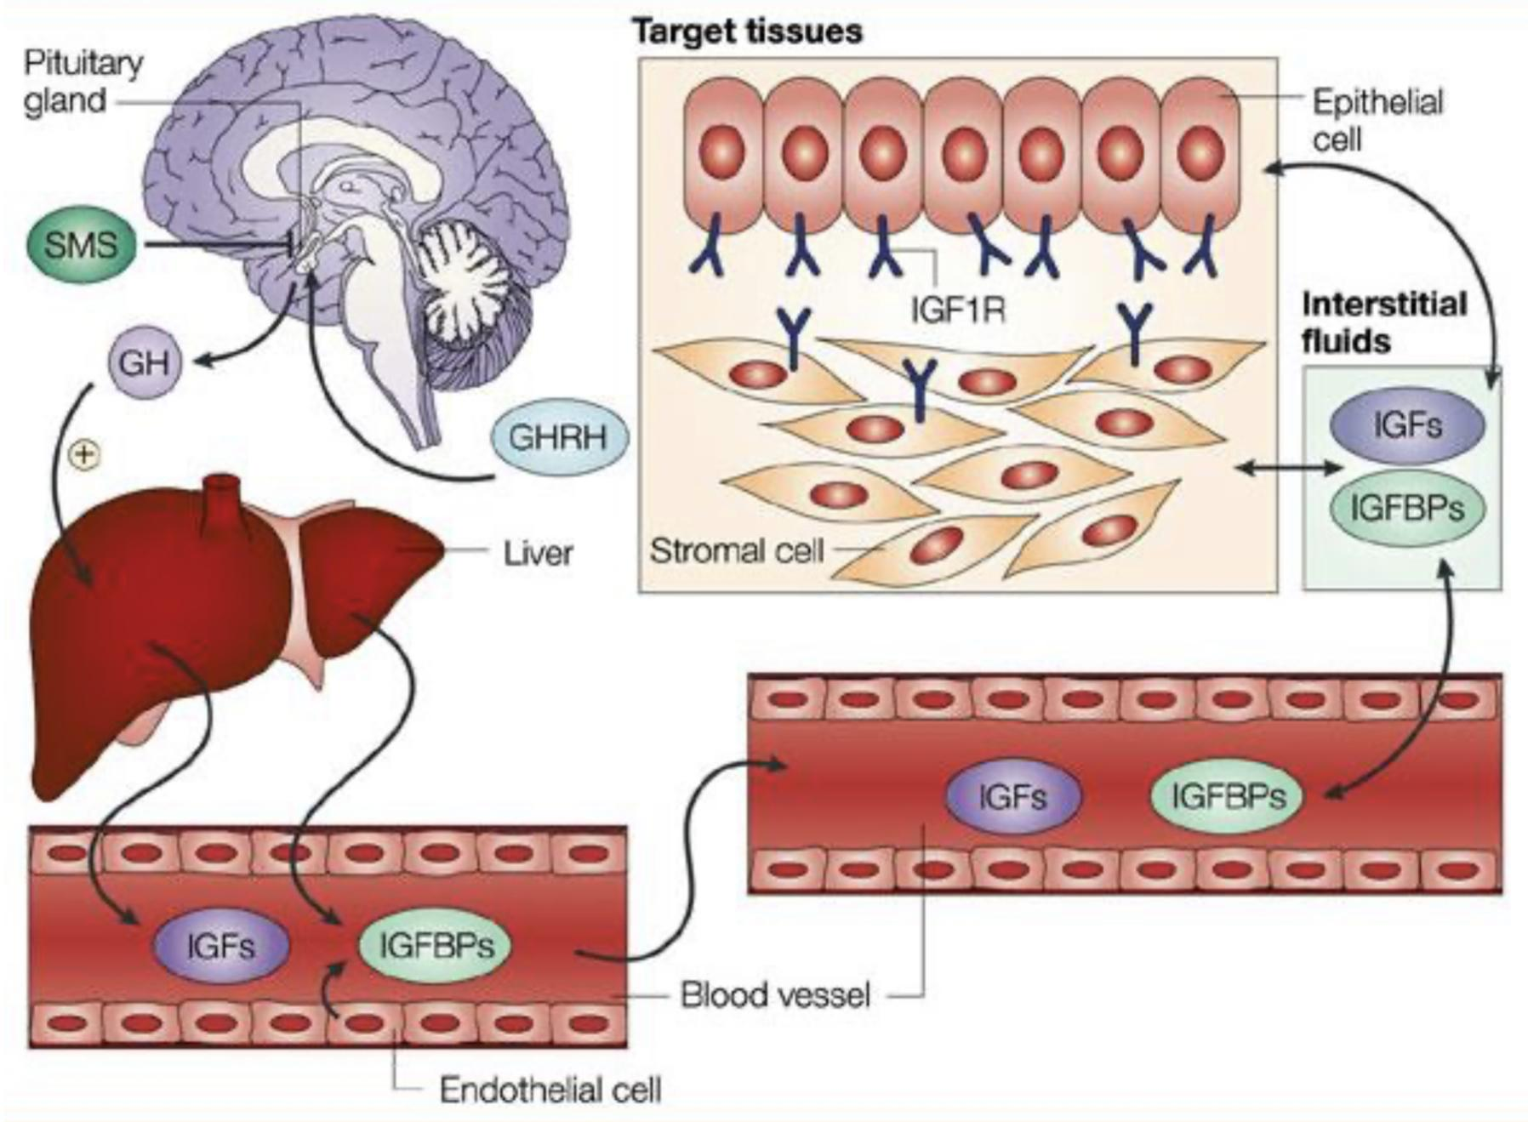
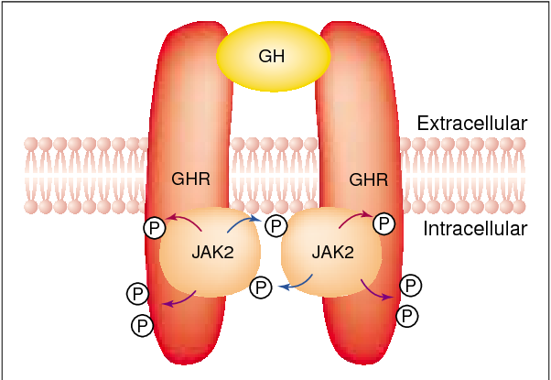
3
ANTERIOR PITUITARY GLAND
Lecture Three
Regulation of Growth Hormone Secretion
Growth hormone is secreted in a pulsatile pattern, with bursts of secretion occurring approximately every 2 hours.
Growth hormone secretory rates are not constant over a lifetime.
It increases steadily from birth into early childhood.
During childhood, secretion remains relatively stable.
At puberty, there is an enormous secretory burst, induced in females by estrogen and in males by testosterone. The high pubertal levels are responsible for the growth spurt of puberty.
After puberty, the rate of growth hormone secretion declines to a stable level.
Finally, in senescence, growth hormone secretory rates decline to their lowest levels.
Typical variations in growth hormone secretion throughout the day, demonstrating the especially powerful effect of strenuous exercise and also the high rate of growth hormone secretion that occurs during the first few hours of deep sleep.
Figure 3-9
Figure 3-10
Mechanism of Action
Indirect Effect (Somatomedins) | Direct Effect (GH)
Mediated indirectly through the production of somatomedins (or insulin-like growth factors [IGFs]¹) in the liver. The most important of the somatomedins is somatomedin C or IGF-1, It has a molecular weight of 4500-7500. More potent. | Target tissues: Skeletal muscles, liver and adipose tissue. Mediated by tyrosine kinase–associated receptors.
FOOTNOTES
It’s called IGFs because many of the somatomedin effects on growth are similar to the effects of insulin on growth. Including its effect on amino acid transport.

Slide 5
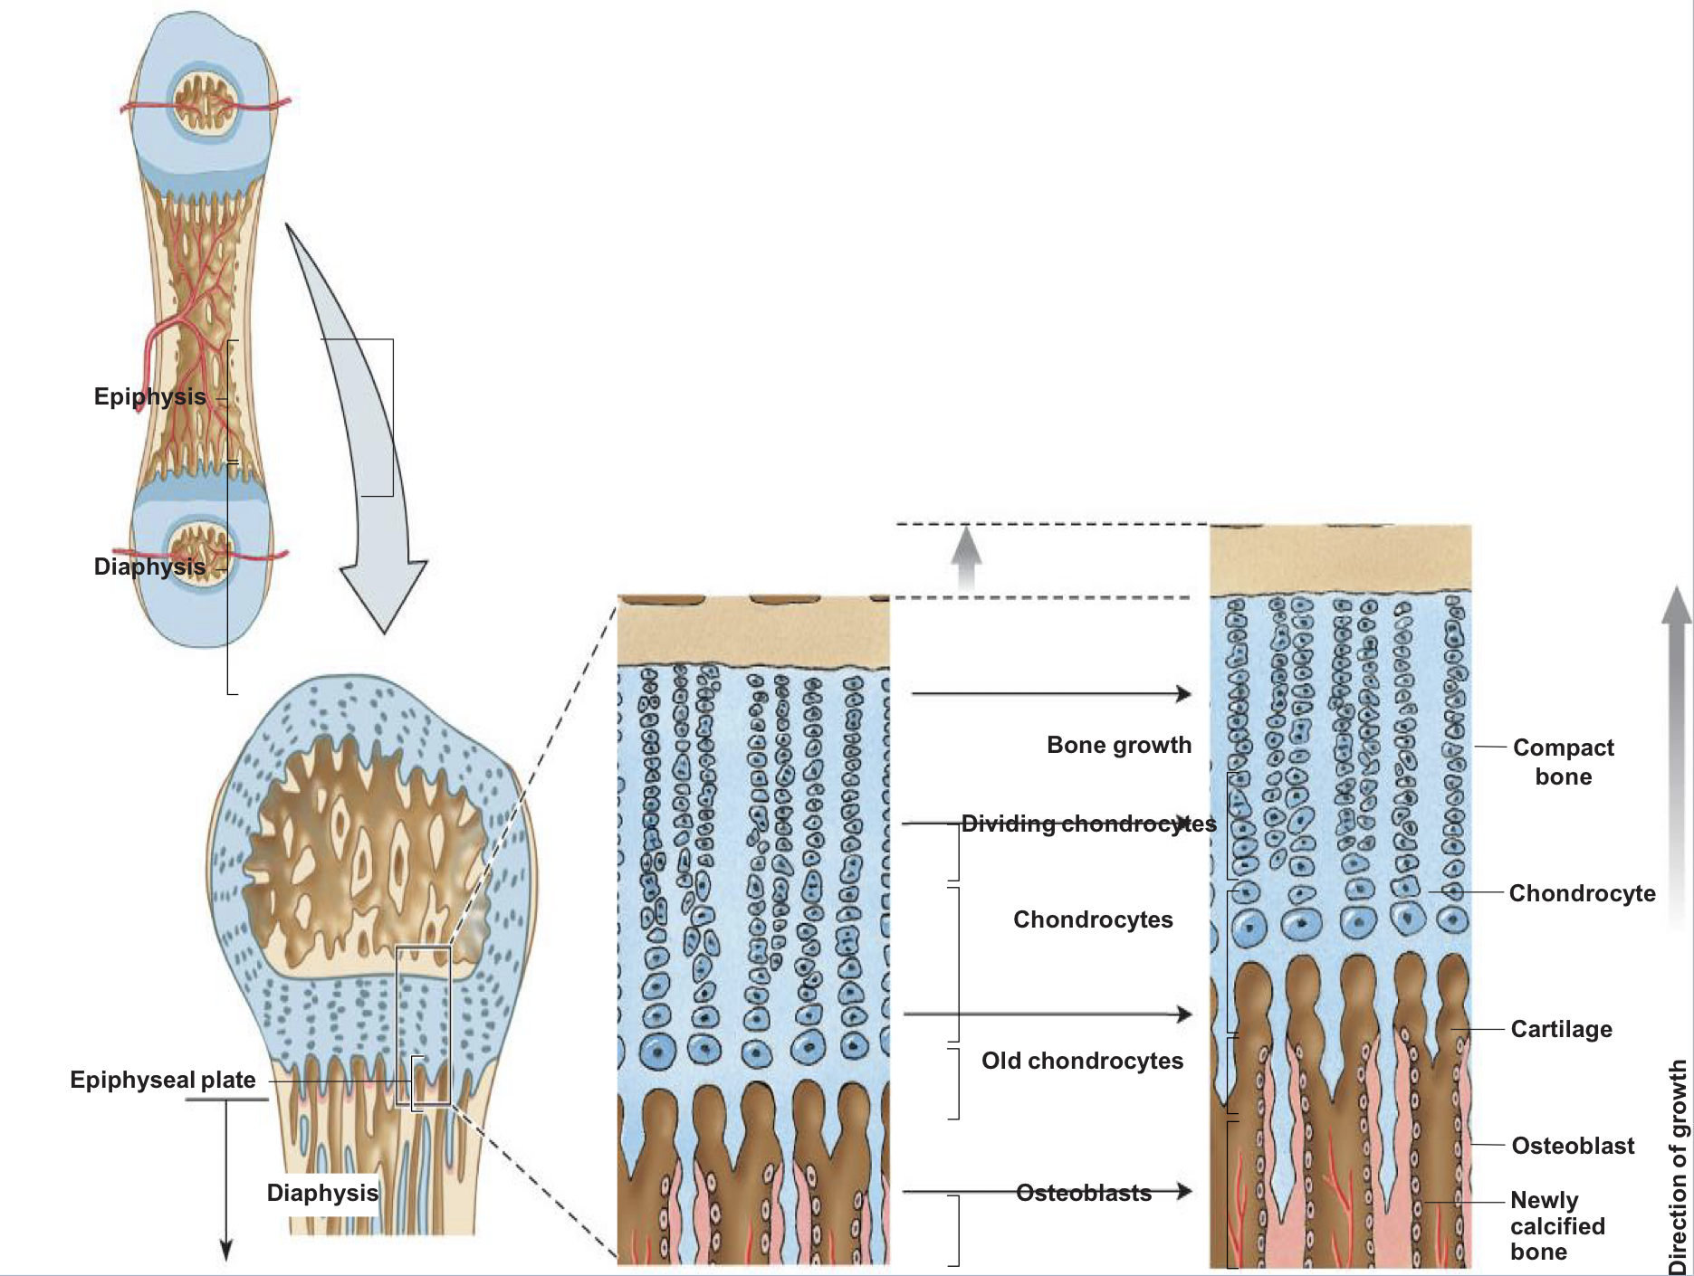
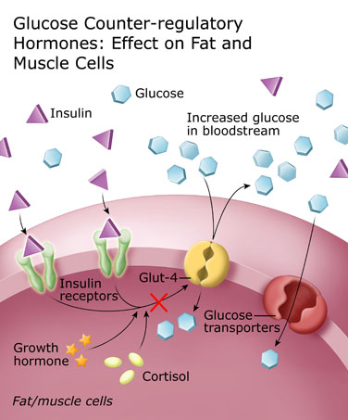
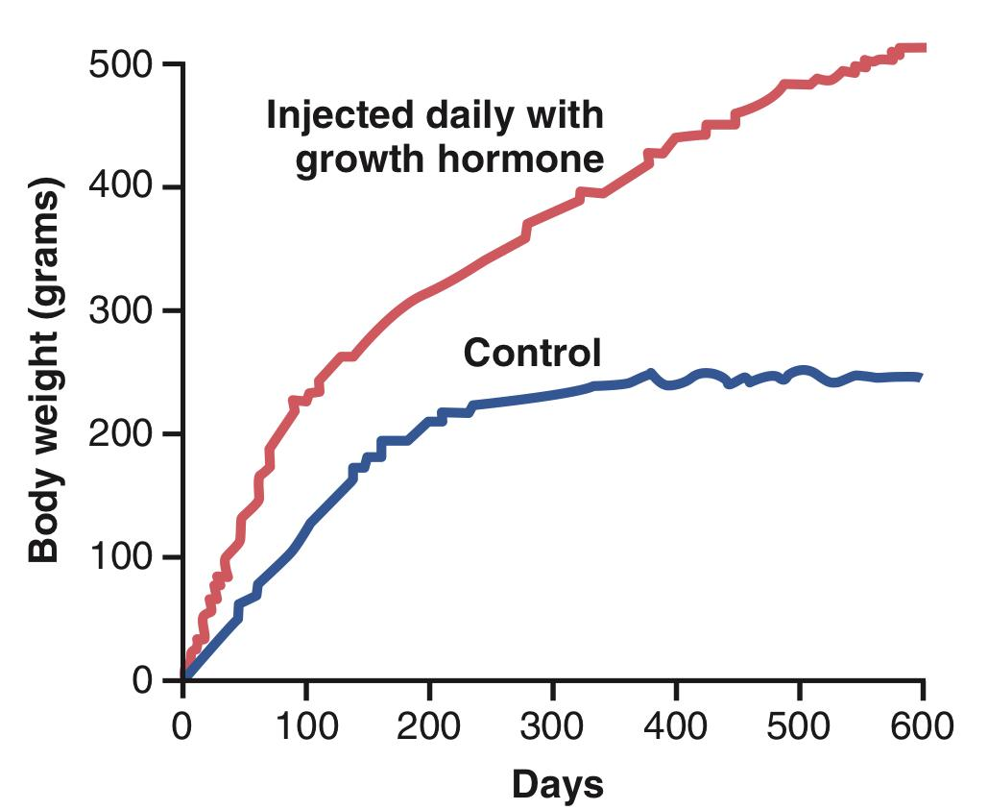
4
ANTERIOR PITUITARY GLAND
Lecture Three
Functions of Growth Hormone
Long Term Effect | Short Term Metabolic Effects
Promotion of growth: ↑ cellular sizes & ↑ mitosis ↑ tissue growth & organ size Indirect effect: Depends on somatomedin ‘insulin– like growth factor [IGF-I & II] secreted by the liver, which is responsible for effect of GH on bone & cartilage growth and increase the synthesis of protein in skeletal muscles. | Protein metabolism (Anabolic): Increase rate of protein synthesis in all cells through: Increase amino acids transport into cells. Increased nuclear transcription of DNA to form RNA. Enhancement of RNA translation to cause protein synthesis. Decrease protein catabolism “protein sparer”. (because fatty acids are used as an energy source instead of proteins) Increases lean body mass.
1. Linear growth of long bones: Long bones grow in length at epiphyseal cartilages, causing deposition of new cartilage (↑collagen synthesis) followed by its conversion into bone. When bony fusion occurs between shaft & epiphysis at each end, no further lengthening of long bone occur. | Fat metabolism (Catabolic): Increase mobilization of free fatty acids from adipose tissue stores. Conversion of fatty acids to acetyl CoA to provide energy.¹
2. Deposition of New Bone: Increase cell proliferation on surfaces of older bone & in some bone cavities. It also increase the thickness of bones. Occurs in membranous bones (flat bone), e.g. jaw and skull bones. | CHO metabolism (Hyperglycemic): Decreases glucose uptake by tissues (skeletal muscles and fat). Decreases the rate of glucose utilization throughout the body (fat is the alternative of glucose for energy). Increases glucose production by the liver (↑ gluconeogenesis) Increases Insulin resistance (↑FFA²) “Diabetogenic”.
Other effects of growth hormone: Increases calcium absorption from GIT (stimulates activation of Vit. D by kidney) Strengthens and increases the mineralization of bone Retention of Na+ and K+ (through activation of RAAS, mechanisms are not clear) Increases muscle mass (increased protein synthesis) Stimulates the growth of all internal organs excluding the brain Contributes to the maintenance and function of pancreatic islets Stimulates the immune system (stimulates maturation of myeloid progenitors)
Figure 3-11
Figure 3-12
Figure 3-13 GH prevents the activation of Glut-4 by insulin, which stops the transport of glucose from blood into cells.
Figure 3-14 Comparison of weight gain of a rat injected daily with growth hormone with that of a normal littermate.
FOOTNOTES
Diabetogenicity mechanism: Growth hormone causes an increase in plasma free fatty acids, these fatty acids can act on inflammatory cells to cause the release of inflammatory mediators such as (TNF-alpha, IL-1 and IL-6), in turn, these cytokines can act on body tissues to antagonize the effect of insulin. This mechanism is also mainly responsible for the increased incidence of diabetes in obese individuals.
Fat must be converted to Acetyl-CoA to enter Krebs cycle, this conversion also results in the formation of ketone bodies, thus a person with GH excess may suffer from ketoacidosis or diabetic ketoacidosis.

Slide 6
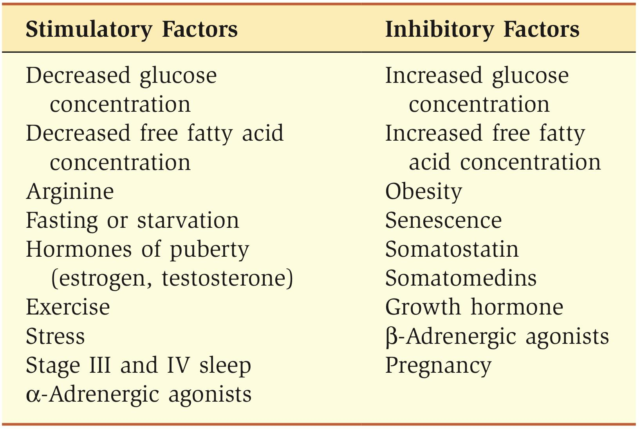
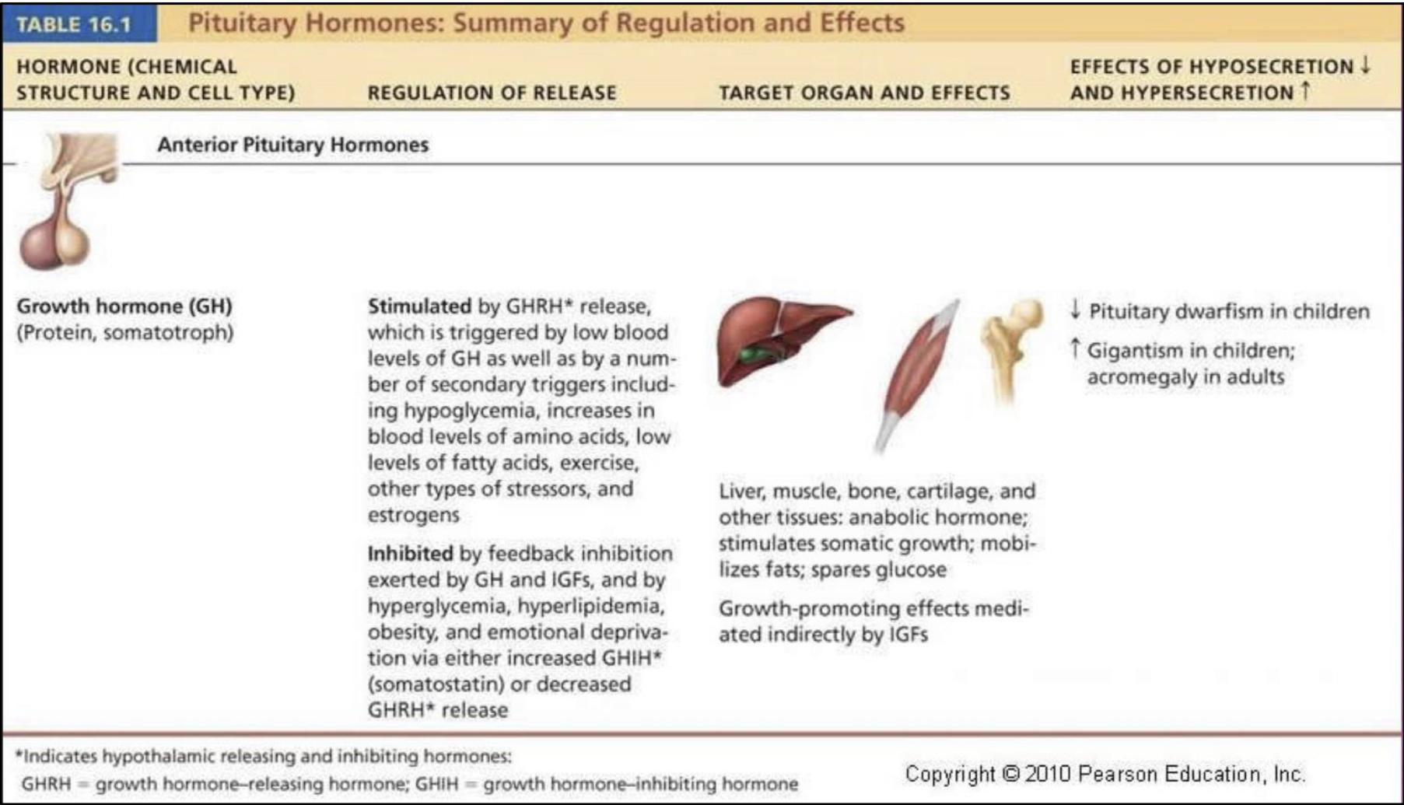
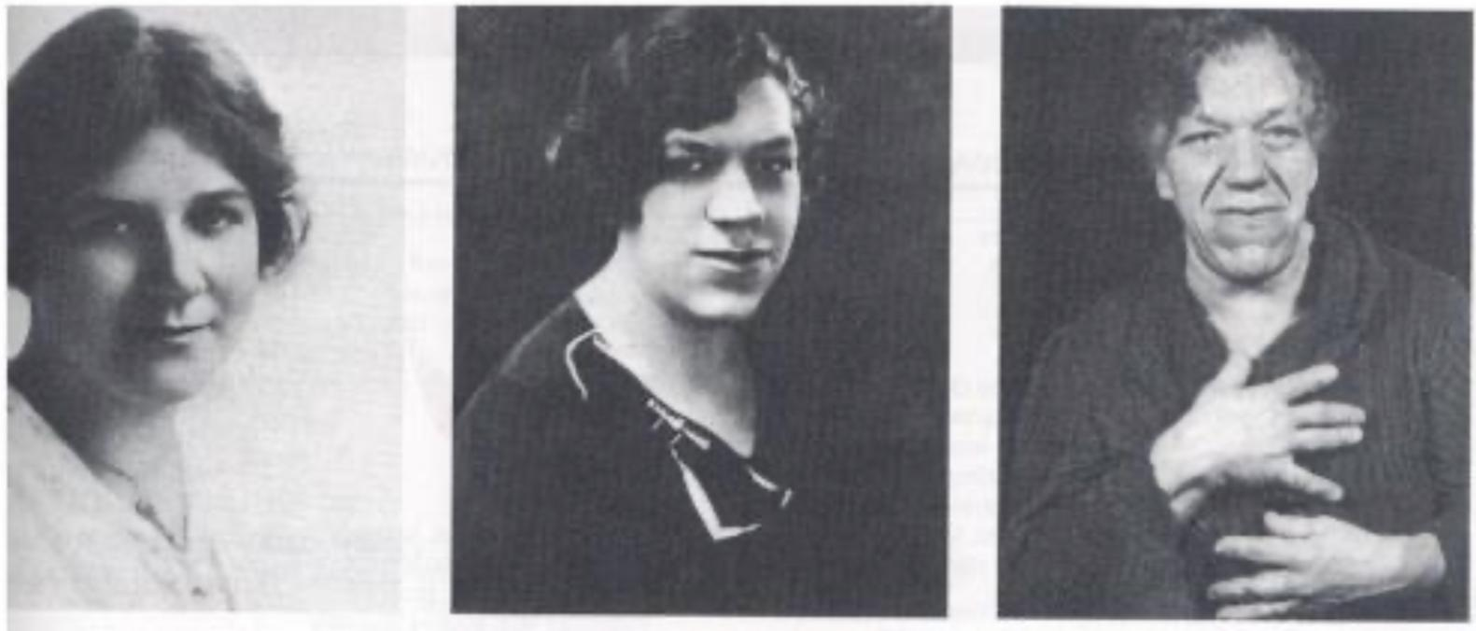
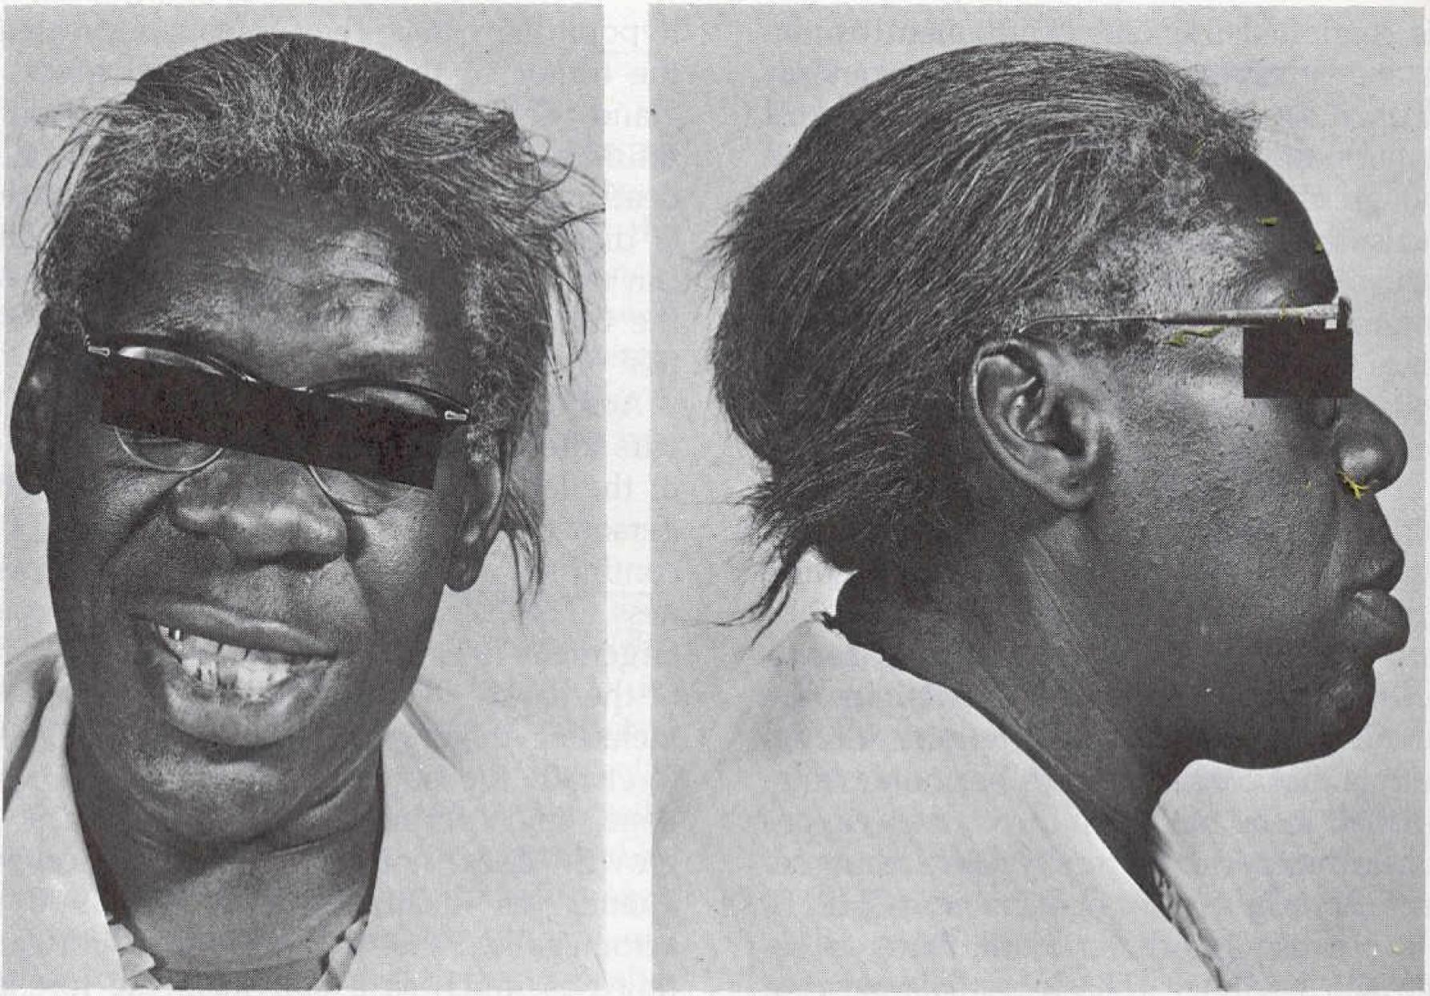
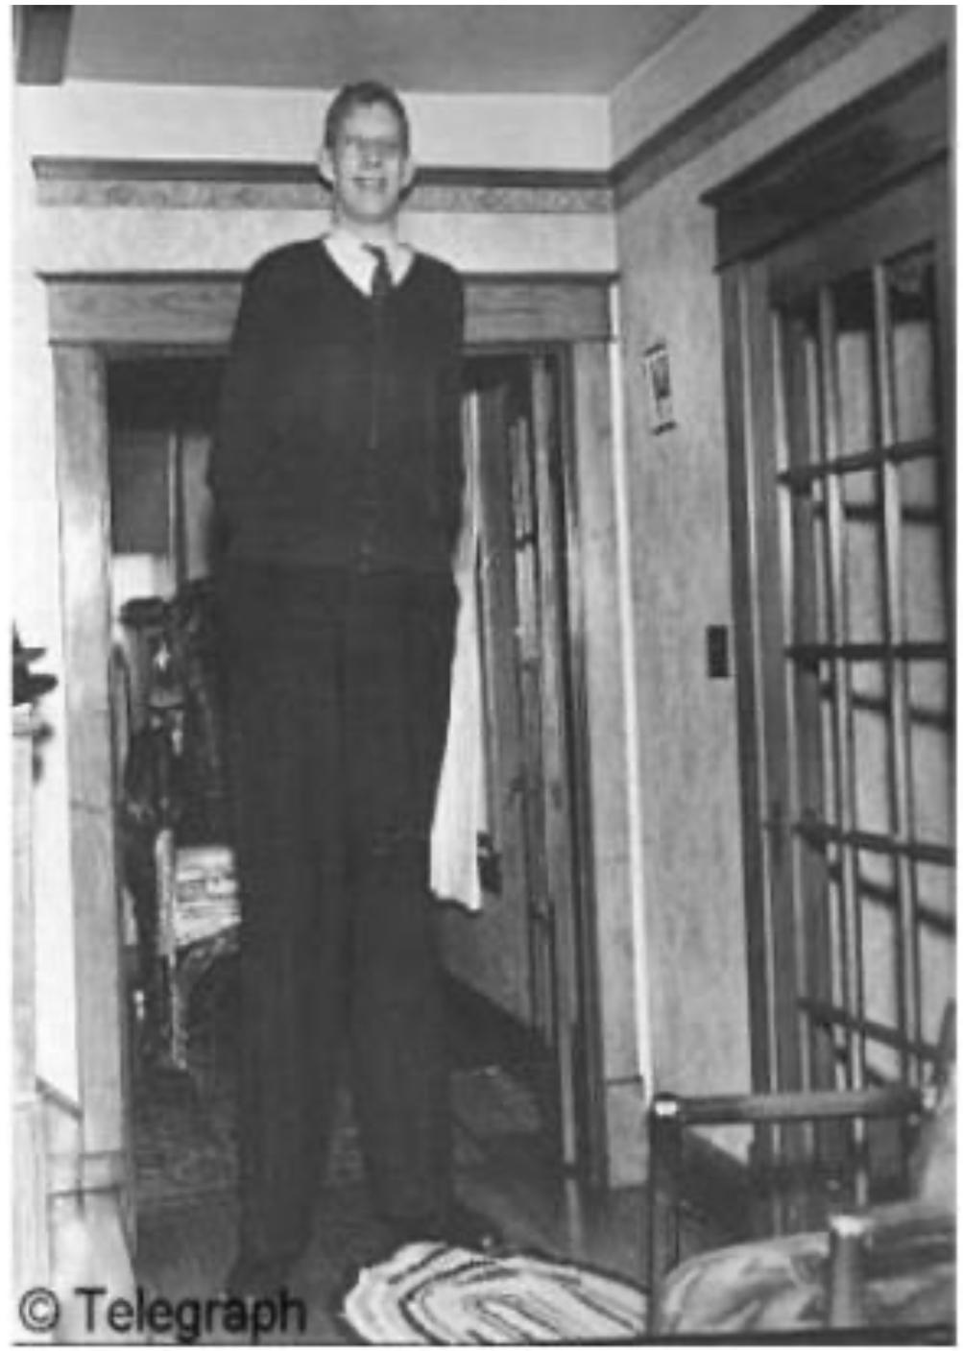
5
ANTERIOR PITUITARY GLAND
Lecture Three
Control of Growth Hormone Secretion
Stimulating Factors:
The hypothalamus: GHRH
Hypoglycemia (fasting)
Muscular exercise (increased glucose consumption)
Intake of protein or amino acids (after meals).
During sleep (more in children)
Stress conditions, e.g. trauma or emotions¹
Ghrelin (stomach) (released during hunger)
Inhibiting Factors:
The hypothalamus: GHIH (somatostatin)
Hyperglycemia (glucose intake)
Increased free fatty acid concentrations
Figure 3-15 Factors Affecting Growth Hormone Secretion
Figure 3-16
Abnormalities (Decreased GH secretion)
Dwarfism
Abnormalities (Increased GH secretion)
In adults
In children
Acromegaly
Gigantism
Soft tissue continue to grow in thickness (e.g. skin, tongue, liver & kidneys)
Enlargement of bones of hands & feet.
Enlargement of membranous bones including cranium, nose, forehead bones, & supraorbital ridges.
Protrusion of lower jaw.
Hunched back (kyphosis, enlargement of vertebrae).
Hyperglycemia (diabetes).
Treated by Octreotide.
Height increases as it occurs before epiphyseal fusion of long bones with their shafts.
Hyperglycemia (diabetes).
Octreotide.
FOOTNOTES
Hypothalamus is connected to the limbic system, therefore the hypothalamus computes the person’s emotional responses and randomly or accordingly fires off hormones that stimulate the secretion of pituitary hormones.

Slide 7
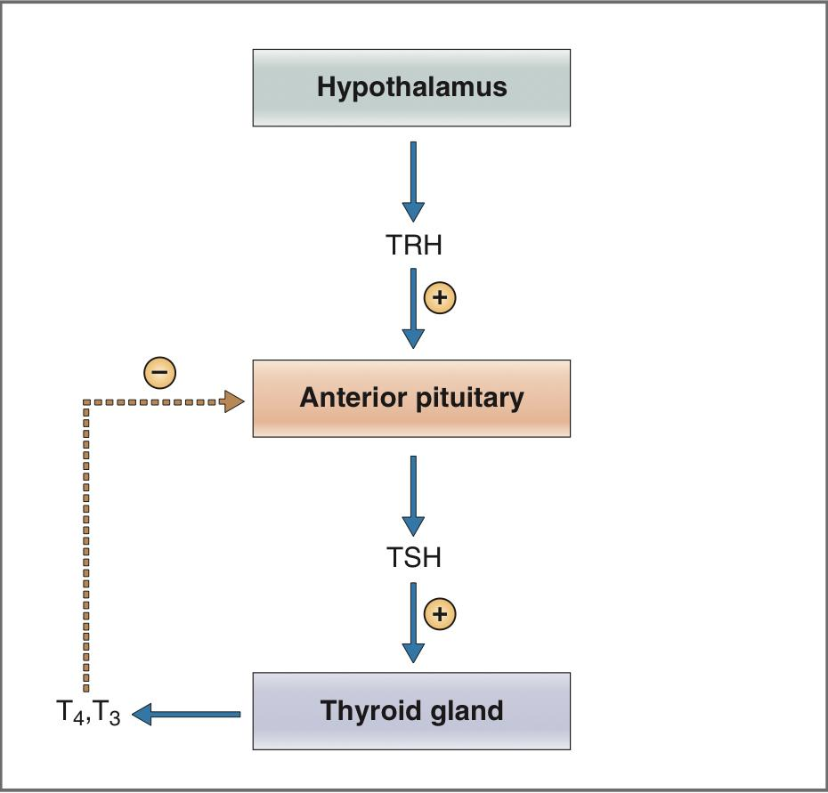
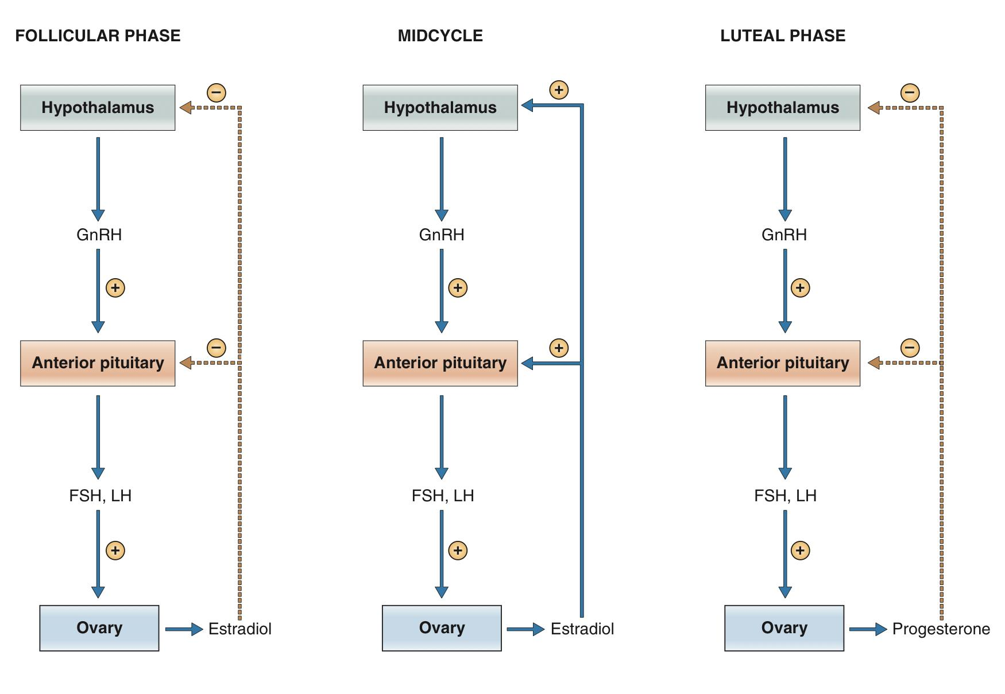
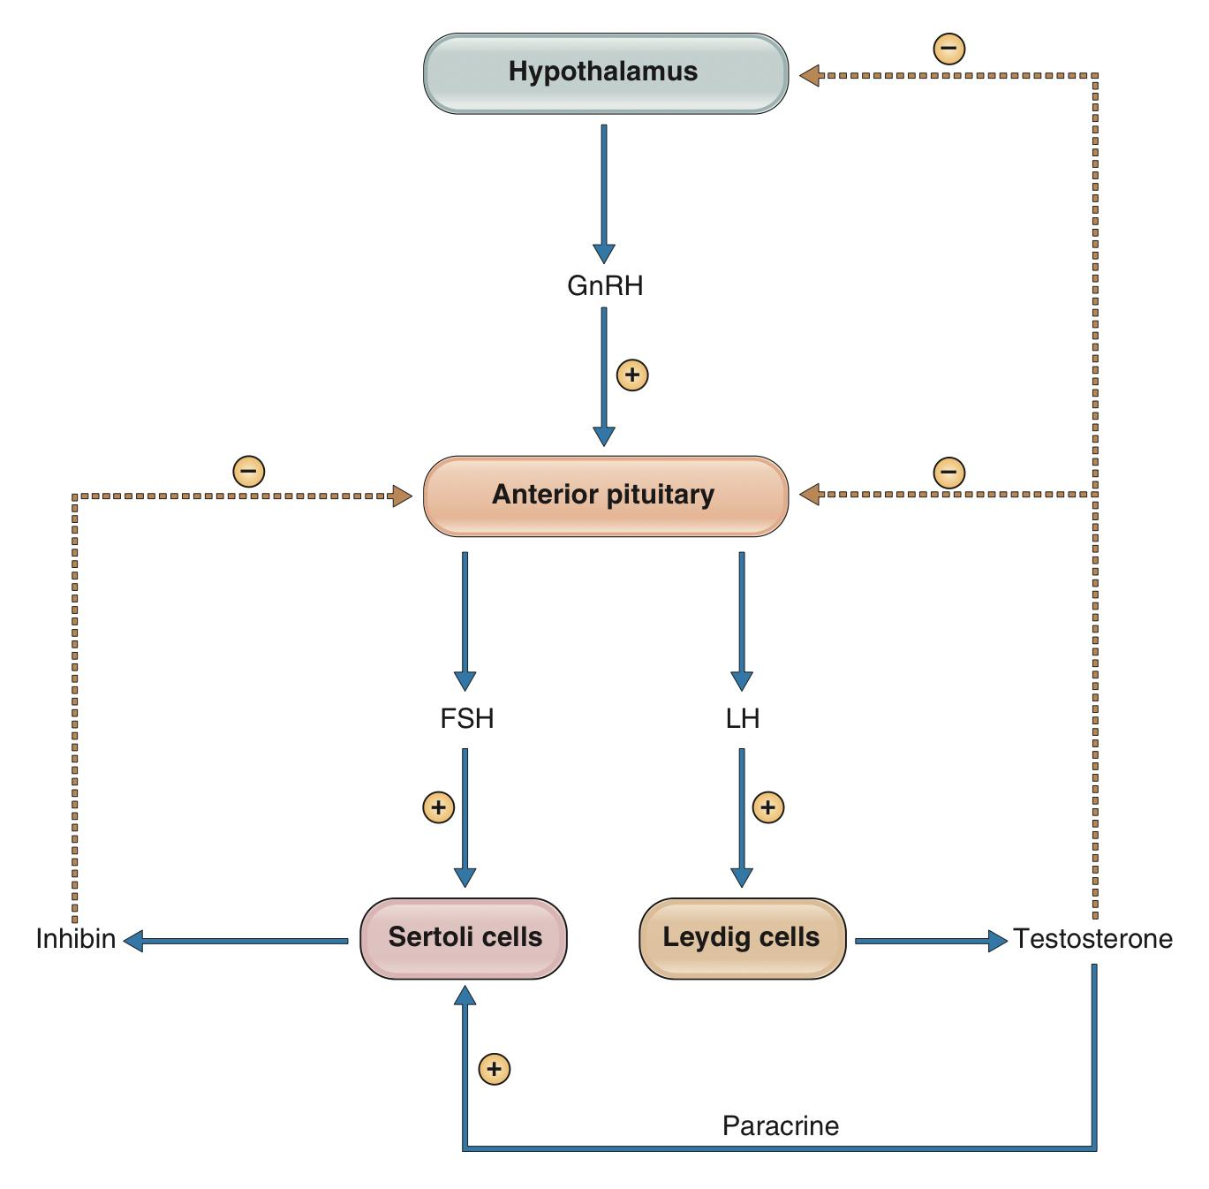
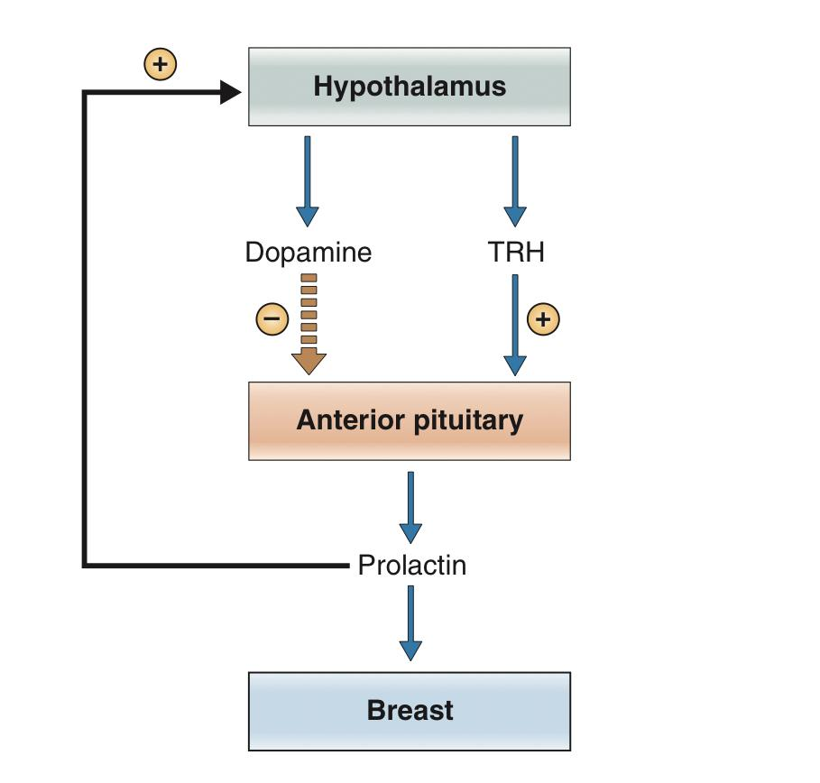
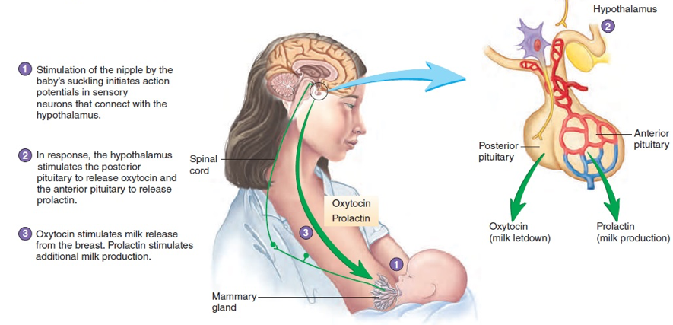
6
ANTERIOR PITUITARY GLAND
Lecture Three and Four
TSH, FSH, and LH are all glycoproteins
Each hormone consists of two subunits, α and β.
The α subunits of TSH, FSH, and LH are identical and are synthesized from the same mRNA.
The β subunits for each hormone are different and therefore confer the biologic specificity.
The placental hormone human chorionic gonadotropin (HCG) is structurally related to the TSH-FSH-LH family.
Thyroid-Stimulating Hormone
Synthesized by Thyrotrophs (5%)
It is a glycoprotein, consists of two subunits (α and β)
Related to LH and FSH.
Actions:
Increased synthesis and secretion of thyroid hormone.
Trophic effect (size)
Abnormalities:
Hyperthyroidism
Hypothyroidism
Figure 3-17 Regulation of thyroid hormone secretion.
Follicle-Stimulating Hormone (FSH) & Luteinizing Hormone (LH)
Synthesized by Gonadotrophs (15%)
It is a glycoprotein, consists of two subunits (α and β)
Related to TSH.
FSH: promotes gamete production & stimulates estrogen production in females.
LH: stimulates sex hormone secretion; ovulation and corpus luteum formation in females; stimulates testosterone secretion in males.
Figure 3-18 Control of follicle-stimulating hormone (FSH) and luteinizing hormone (LH) secretion in females during the menstrual cycle.
Figure 3-19 Control of gonadotropin-releasing hormone (GnRH), follicle-stimulating hormone (FSH), and luteinizing hormone (LH) secretion in males.
LECTURE IV: Anterior Pituitary Gland Part II
Prolactin
Synthesized by lactotrophs (15%)
Chemically, prolactin is related to growth hormone, having 198 amino acids.
The major function of prolactin is milk production.
Prolactin release is inhibited by PIH (dopamine).
In persons who are not pregnant or lactating, prolactin secretion is tonically inhibited by dopamine.
Suckling response inhibits PIH release leading to increase prolactin release.
Figure 4-1 Regulation of prolactin secretion.
Figure 4-2
Figure 4-3

Slide 8
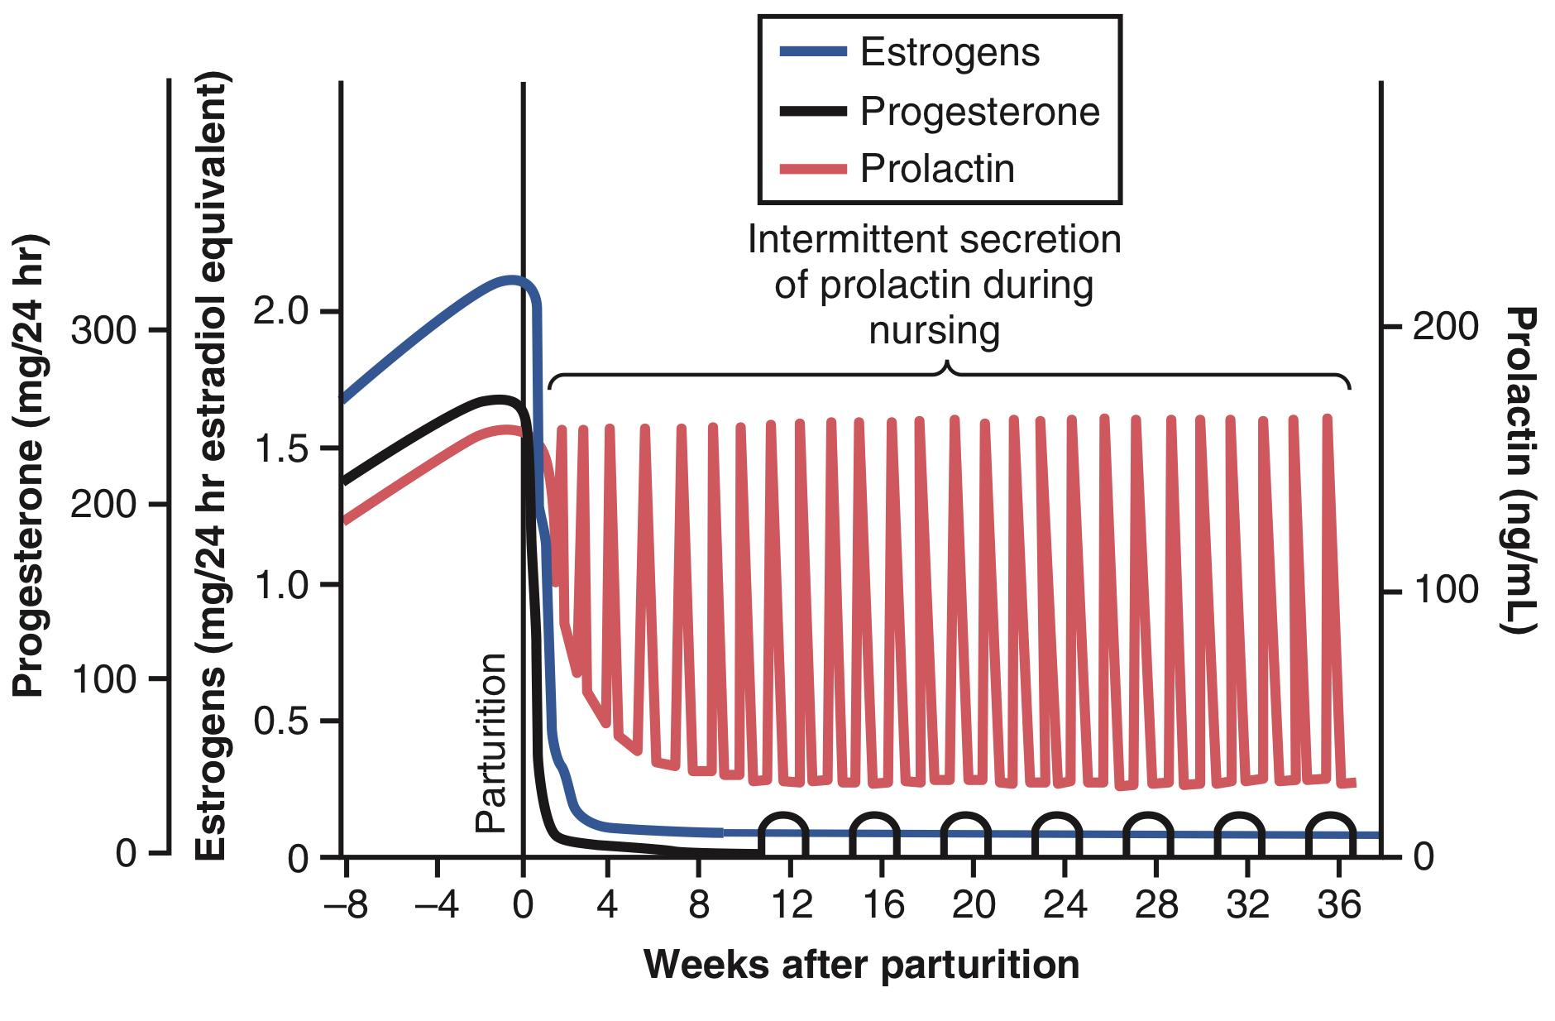
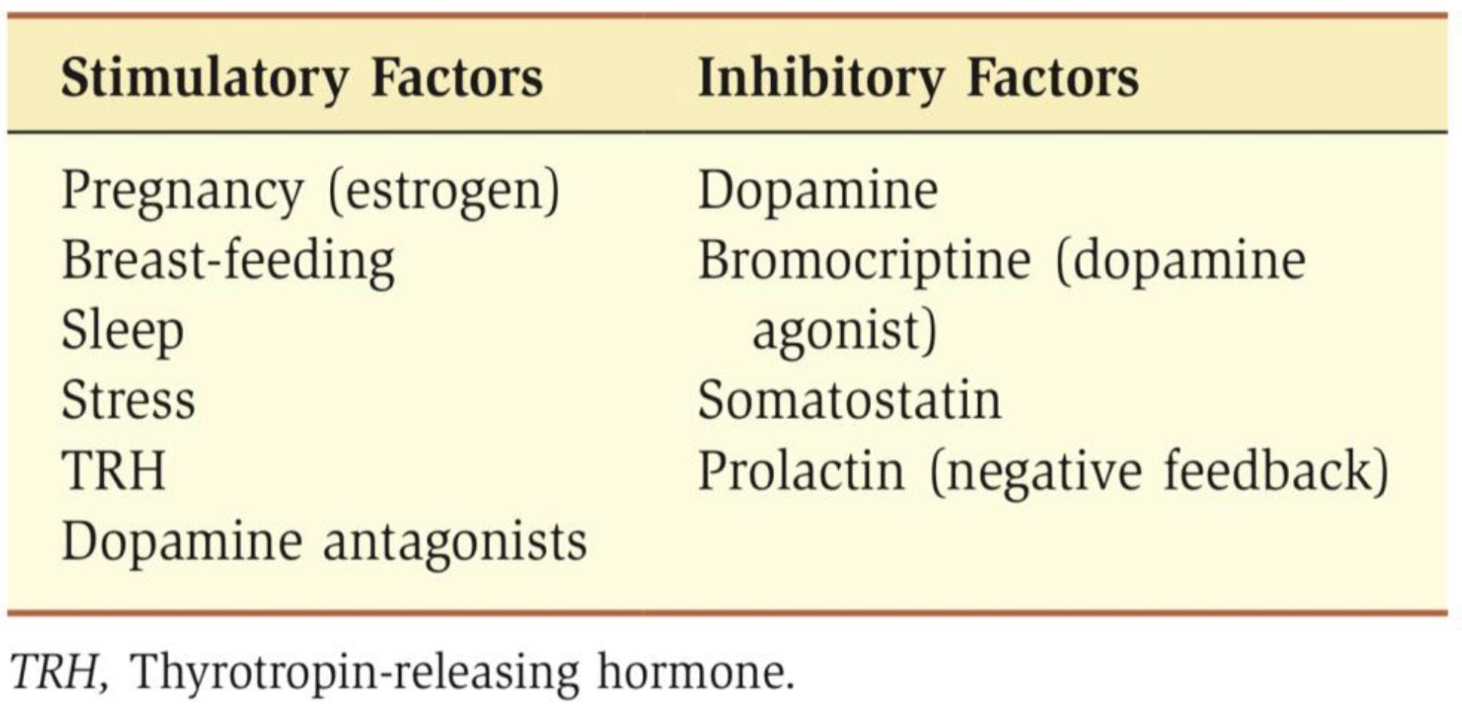
7
ANTERIOR PITUITARY GLAND
Lecture Four
Sources of Dopamine
1. Dopaminergic neuron in the hypothalamus (major).
2. Dopaminergic neuron in the posterior pituitary gland.
3. Non lactotrophs cells of the anterior pituitary gland (very small amount).
Functions of Prolactin
Prolactin Effect on Breast:
Increases mRNA
Breast development (with estrogen and progesterone).
Lactogenesis¹:
increases production of lactalbumin, lipid and casein.
Parturition²
Other Effects of Prolactin:
Dopamine:
Stimulates the secretion of dopamine in median eminence (inhibits its own secretion)
Inhibition of ovulation³:
Inhibits the synthesis and release of gonadotropin-releasing hormone (GnRH).
Inhibition of ovulation account for the decreased fertility during breastfeeding.
In males with high prolactin levels (e.g., due to a prolactinoma), there is a parallel inhibitory effect on GnRH secretion and spermatogenesis, resulting in infertility.
Control of Prolactin Secretion
PIH (Dopamine) inhibit its secretion
Exercise increases PRL secretion
Surgical & psychological stress increases PRL secretion
Stimulation of the nipple increases PRL secretion
During Sleep Prolactin level rises
During pregnancy prolactin level rises
TRH increases PRL secretion
Abnormalities
Prolactin deficiency.
Failure to lactate.
Prolactin excess.
Galactorrhea.
Infertility.
Treated by Bromocriptine.
Figure 4-5 After the birth of the baby, the basal level of prolactin secretion returns to the nonpregnant level during the next few weeks. However, each time the mother nurses her baby, nervous signals from the nipples to the hypothalamus cause a 10 to 20-fold surge in prolactin secretion that lasts for about 1 hour. This prolactin acts on the mother’s breasts to keep the mammary glands secreting milk into the alveoli for the subsequent nursing periods. If this prolactin surge is absent or blocked as a result of hypothalamic or pituitary damage or if nursing does not continue, the breasts lose their ability to produce milk within 1 week or so. However, milk production can continue for several years if the child continues to suckle, although the rate of milk formation normally decreases considerably after 7 to 9 months.
Figure 4-4 Factors Affecting Prolactin Secretion
FOOTNOTES
Interestingly, pregnancy does not have to occur for lactation to be possible; if there is sufficient stimulation of the nipple, prolactin is secreted and milk is produced.
Although prolactin levels are high during pregnancy, lactation does not occur because the high levels of estrogen and progesterone down-regulate prolactin receptors in the breast and block the action of prolactin. At parturition, estrogen and progesterone levels drop precipitously and their inhibitory actions cease. Prolactin can then stimulate lactogenesis, and lactation can occur.
The reason seems to be that the same nervous signals from the breasts to the hypothalamus that cause prolactin secretion during suckling, inhibit secretion of GnRH.

Slide 9
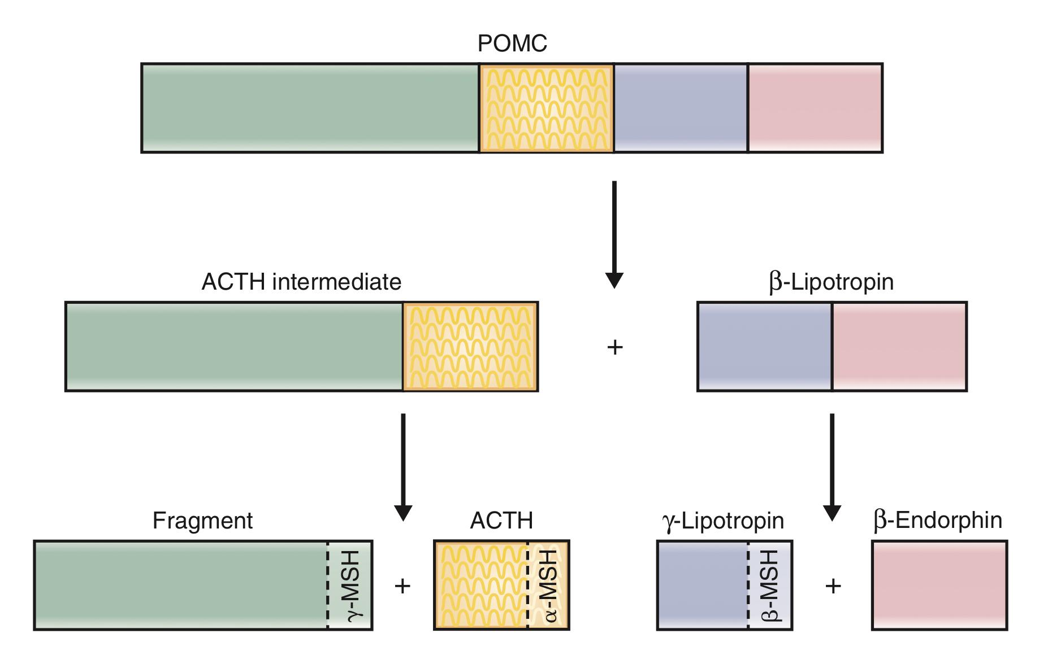
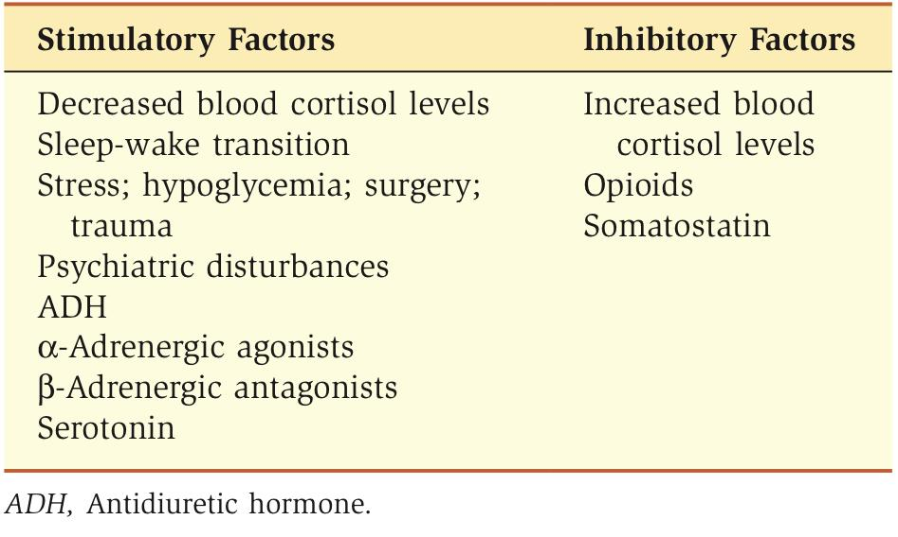
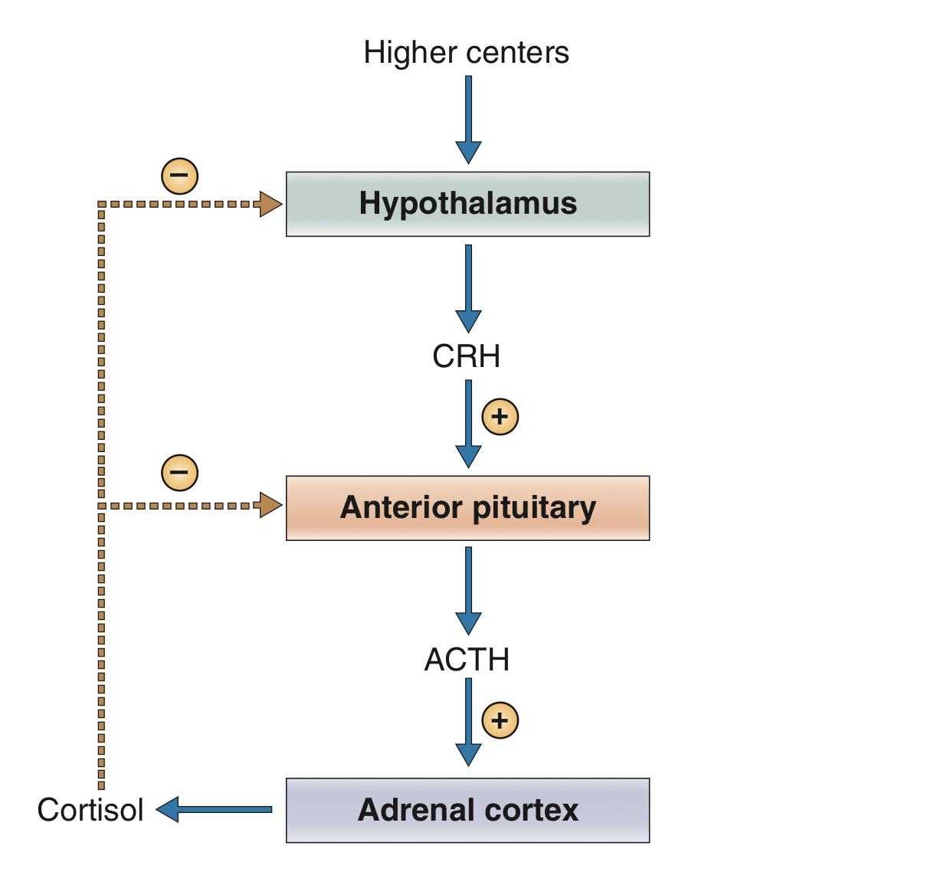
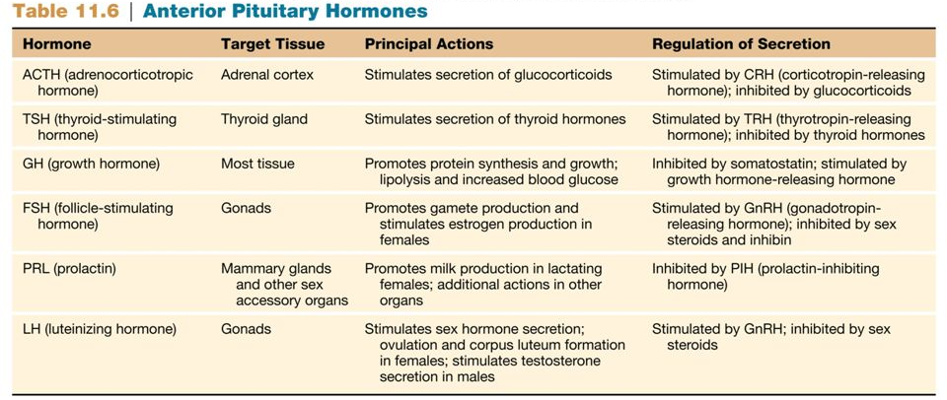
8
ANTERIOR PITUITARY GLAND
Lecture Four
Adrenocorticotropic hormone (ACTH)
The ACTH family is derived from a single precursor, pro-opiomelanocortin (POMC).
ACTH family includes ACTH, γ- and β-lipotropin, β-endorphin, and melanocyte-stimulating hormone (MSH)¹.
Synthesized by Corticotrophs (15%)
Stimulate synthesis and secretion of adrenocortical hormones.
Figure 4-6 The hormones derived from pro-opiomelanocortin (POMC).
Figure 4-7 Factors affecting ACTH secretion.
Figure 4-8 Regulation of cortisol secretion.
Summary
FOOTNOTES
ACTH is the only hormone in this family with well-established physiologic actions in humans. β-Endorphin is an endogenous opiate.

Slide 10
Which of the following increases secretion of GH?
Senescence
Insulin-like growth factor-1 (IGF-1)
Somatostatin
Hypoglycemia
Which anterior pituitary hormone plays a major role in the regulation of a nonendocrine target gland?
ACTH
TSH
Prolactin
FSH
Why is milk produced by a woman only after delivery, not before?
Levels of LH and FSH are too low during pregnancy to support milk production
High levels of progesterone and estrogen during pregnancy suppress milk production
The alveolar cells of the breast do not reach maturity until after delivery
High levels of oxytocin are required for milk production to begin, and oxytocin is not secreted until the baby stimulates the nipple
GH secretion would most likely be suppressed under which condition?
Acute hyperglycemia
Deep sleep
Gigantism
Exercise
Which of the following conditions or hormones would most likely increase GH secretion?
Hyperglycemia
Exercise
Aging
Somatomedin
ANSWER KEY: D, C, B, A, B

Slide 11
Lipolytic effect of growth hormone is suppressed by
Glucose administration
Fasting
Stress
Hypoglycemia
Growth hormone increases the
Absorption of calcium from GIT
Excretion of sodium by kidney
Excretion of potassium by kidney
Excretion of magnesium by kidney
Growth hormone secretion is inhibited by
Glucagon
Estrogen
Androgens
Growth hormone
Growth hormone has all of the following effects on the protein metabolism except
Increased protein synthesis
Increased amino acid level in blood
Decreased protein catabolism
Increased nuclear transcription of DNA to form RNA
The effect of growth hormone on fat metabolism includes all of the following except
Breakdown of stored fat
Decreased conversion of fatty acids to acetyl CoA
Increased free fatty acid level in blood
Increase mobilization of free fatty acids from adipose tissue stores
ANSWER KEY: A, A, D, B, B

Slide 12
Maha Alnahdi
FEMALE PHYSIOLOGY CO-LEADERS
Maha Alnahdi, Taif Alshammari
MALE PHYSIOLOGY CO-LEADERS
Nayef Alsaber, Hameed M. Humaid
REFERENCES
Guyton and Hall Textbook of Medical Physiology
Ganong’s Review of Medical Physiology

