Slide 1
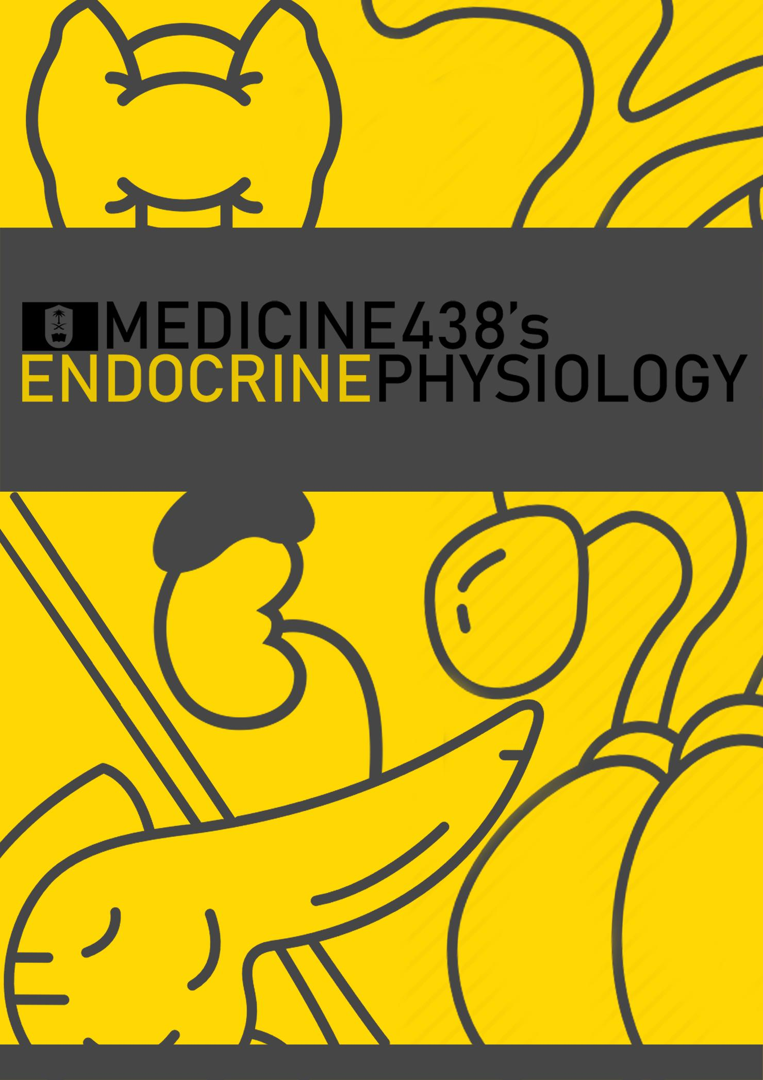
LECTURE V: Posterior Pituitary Gland
EDITING FILE
IMPORTANT
MALE SLIDES
EXTRA
FEMALE SLIDES
LECTURER’S NOTES

Slide 2
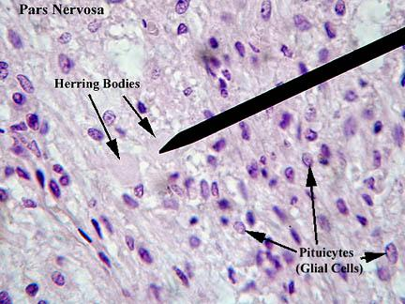
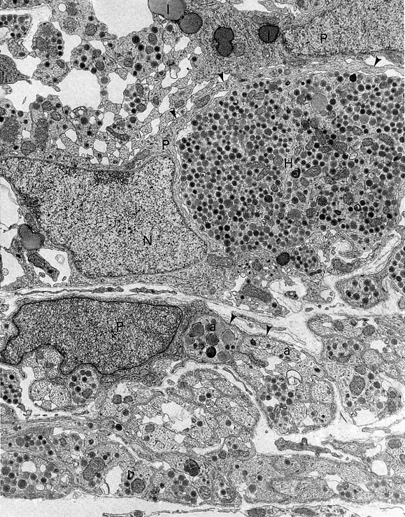
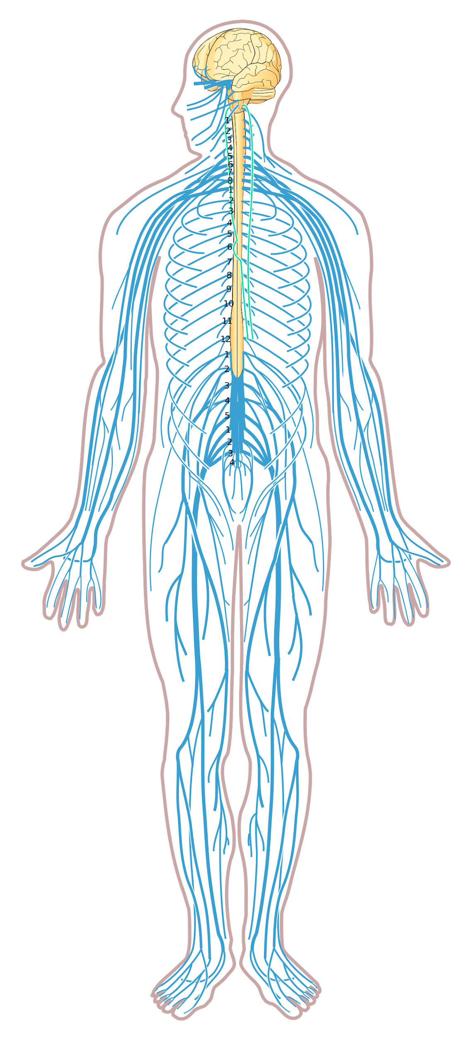
1
POSTERIOR PITUITARY GLAND
Lecture Five
OBJECTIVES
Describe the posterior pituitary relationship with the hypothalamus(hypothalamic control).
List the target organs and functional effects and Control of secretion of oxytocin.
Name the stimuli for oxytocin release in relation to its reproductive and lactation functions.
List the target cells for vasopressin and explain why vasopressin is also known as antidiuretic hormone.
Describe the stimuli and mechanisms that control vasopressin secretion.
Identify disease states caused by a) over-secretion, and b) under-secretion of vasopressin and list the principle symptoms of each.
Posterior Pituitary Gland
Does not synthesize hormones
Synthesize in the supraoptic and paraventricular nuclei of the hypothalamus ¹
Consists of axon terminals of hypothalamic neurons
Secretions of the posterior pituitary are controlled by Nervous signals from hypothalamus
Figure 5-1
Pituicytes Function
They are glial cells of the posterior pituitary,
They’re NOT a simple glial cells. They have spots, when hormone demand or not needed the pituicytes engulf or completely surround neurosecretory axons.
It forms physical and chemical barrier between nerve terminal and blood vessels
Amplify auto receptor negative feedback ²
Figure 5-2
Figure 5-3
By satisfaction (Autoregulation)
Synthesis of ADH
Synthesized as pre-prohormone and processed into a nonapeptide (nine amino acids).
Synthesized in the cell bodies of hypothalamic neurons (supraoptic nucleus)¹
Stored in the neurohypophysis
(posterior pituitary)
Receptors of ADH (Vasopressin)
V1A
V1B
V2
Mediate vasoconstriction
Found in the liver (glycogenolysis)
Unique to anterior pituitary
Mediate increased ACTH secretion. There can be hyperpigmentation (dark skin) b/c of the stimulatory effect of ACTH precursor molecule on melanocytes.
Located in the principle cells in distal convoluted tubule and collecting ducts in the kidneys
FOOTNOTES
ADH is mainly secreted from the Supraoptic Nucleus, while 1/6th of the total secretion comes from the Paraventricular Nucleus.
Pituicytes envelope the axons when conditions are unfavorable, and is reduced when when secretion is increased either by osmotic stim, or in lactation.

Slide 3
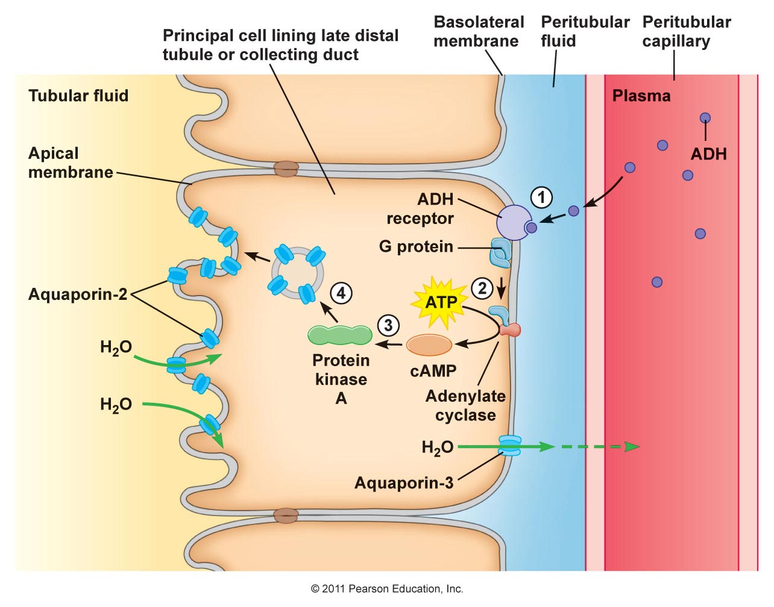
2
POSTERIOR PITUITARY GLAND
Lecture Five
Mechanism of Action of ADH
01
ADH binds to V2 receptors on the peritubular (serosal) surface of cells (principle cells¹) of the distal convoluted tubules and medullary collecting ducts ².
02
This binding Cause some changes in adenylate cycles leads to activate it to release cAMP
03
Via adenylate cyclase/cAMP induces production and insertion of aquaporin2 into the luminal membrane and enhances permeability of cell to water.
04
Increased membrane permeability to water permits back diffusion of solute- free water, resulting in increased urine osmolality (concentrates urine).
Figure 5-4
The single most important function of adh is to conserve body water by reducing urine output.
Secretion of ADH
Osmotic stimuli
If plasma osmolality is directly increased by administration of solutes, such as sodium, cause ADH release.
Conversely, substances that enter cells rapidly, such as urea, do not change osmotic equilibrium and thus do not stimulate ADH release.
ADH secretion is very sensitive to changes in osmolality.
Changes of 1-2% result in increased ADH secretion.
Non-osmotic stimuli
Hypovolemia is perceived by “pressure receptors” carotid and aortic baroreceptors, and stretch receptors in left atrium³ and pulmonary veins.
Normally, pressure receptors tonically inhibit ADH release.
Decrease in blood pressure induces ADH secretion by reducing input from pressure receptors.
The reduced neural input to baroreceptors relieves the source of tonic inhibition on
hypothalamic cells that secrete ADH.
Sensitivity to baroreceptors is less than osmoreceptors– senses 15 to 25% change in volume.
FOOTNOTES
Principle cells are the main Na reabsorbing cells, and the site of action for aldosterone(secretion of K). While intercalated cells play a major role in acid-base regulation, and are of two types: type A: eliminates H while reabsorbing Bicarbonate in acidosis, type B: secrete bicarbonate into lumen while reabsorbing hydrogen ions In alkalosis.
CD are impermeable to water in the absence of ADH. 3. Produced ANP is an antagonist to angiotensin pathway(decrease bp) by inhibiting ADH, Ald and renin.

Slide 4
3
POSTERIOR PITUITARY GLAND
Lecture Five
Control of ADH Release
Osmotic Pressure | Blood Volume
Osmoreceptors mediated Osmoreceptors in hypothalamus | Baroreceptors mediated (vagus nerve) Baroreceptors in carotid artery, aortic arch and left atrium
increase osmotic pressure increase ADH secretion | high blood pressure decrease ADH secretion
Low osmotic pressure decrease ADH secretion | Decrease in blood pressure increases ADH secretion
Direct relationship | Inverse relationship
Control of ADH Release
Characteristics of Receptors | Osmoreceptors | Baroreceptors
Location | Anterolateral hypothalamus | Carotid sinus, aortic arch, pulmonary veins & atria
Value measured | Plasma osmolality | Circulating volume
ADH release stimulated by | Activation of receptor | Suppression of receptor
Change required for action | 1% above 280 mOsm/kg | 15-25% decrease
Regulating amount of ADH | Small (antidiuretics) | Large (vasoconstriction)
Override other | No | Yes
As it reabsorbs water and vasoconstricts in higher conc.
Other Stimuli That Affect Release of ADH Secretion
Decrease Its Secretion
Increase Its Secretion
alcohol
Nausea
Pain
Stress
Fear
Trauma
Emotional stress
Surgical stress

Slide 5
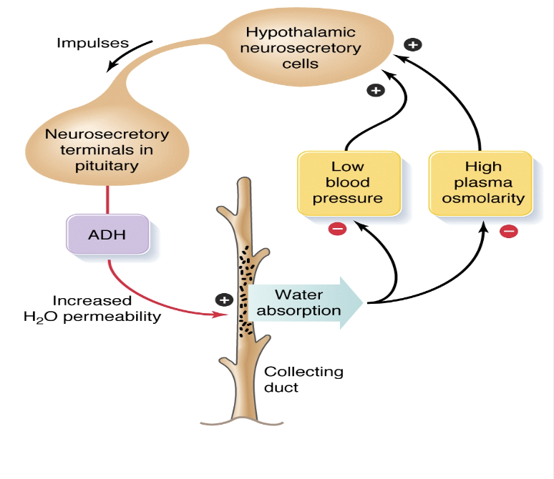
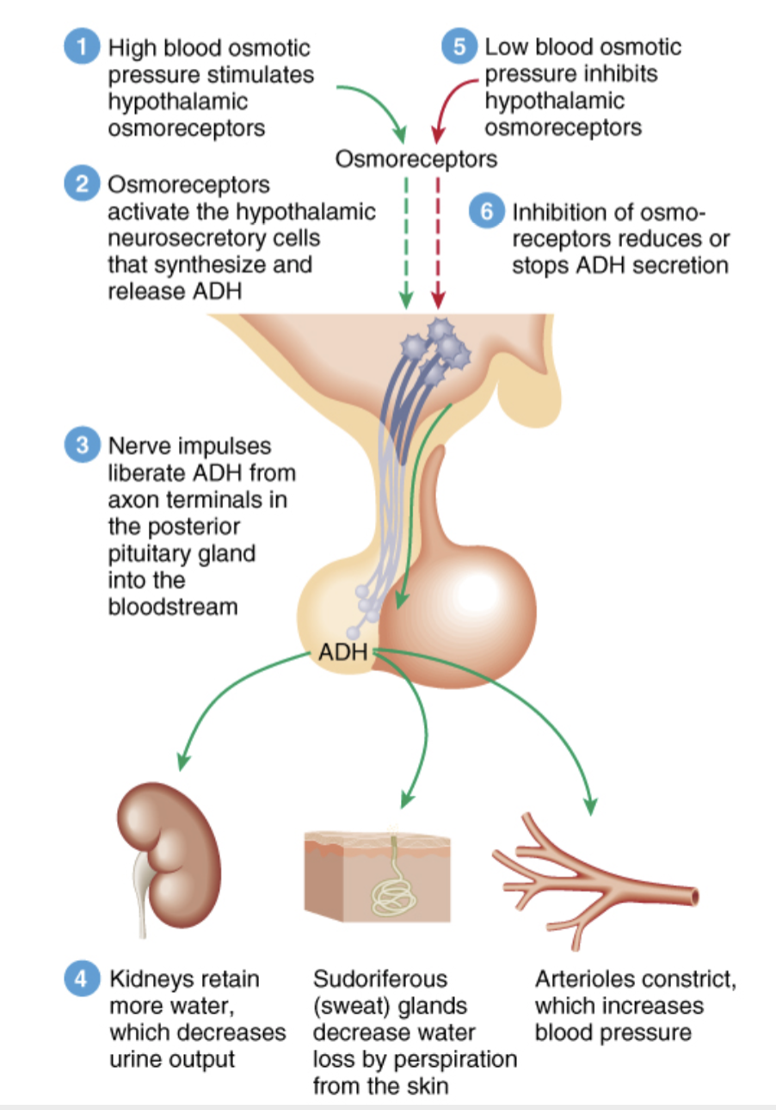
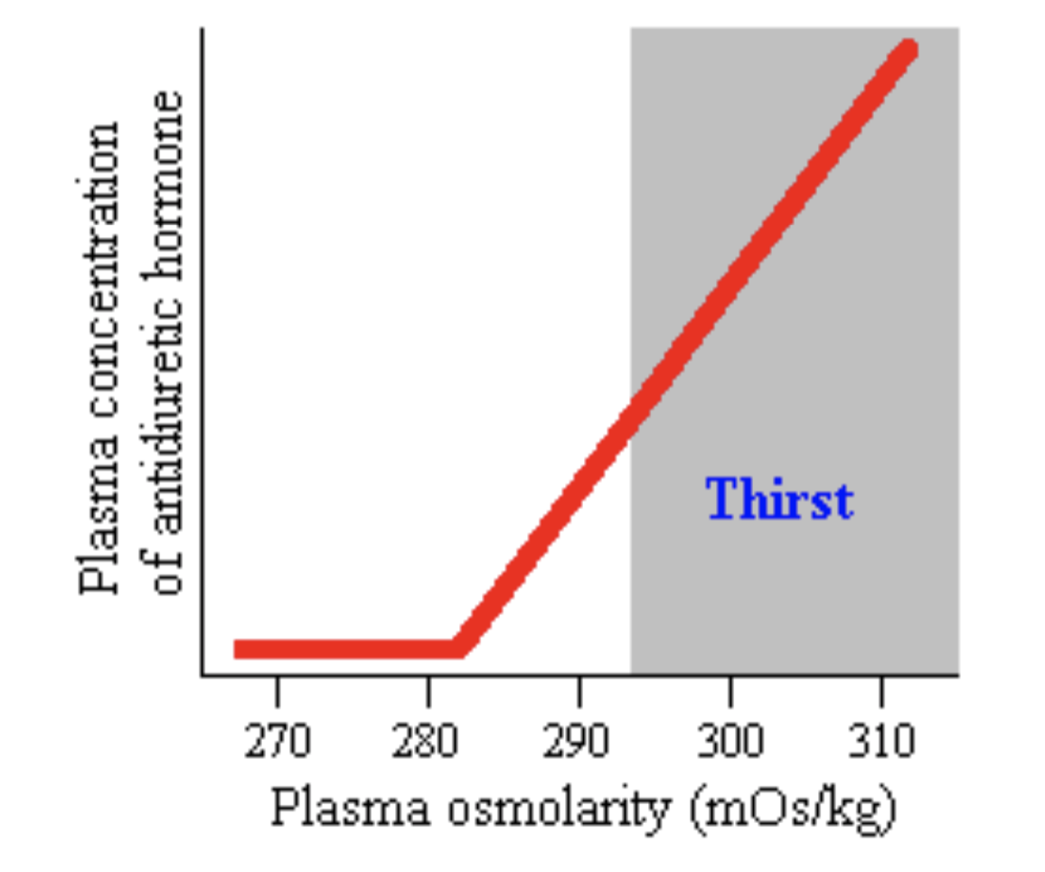
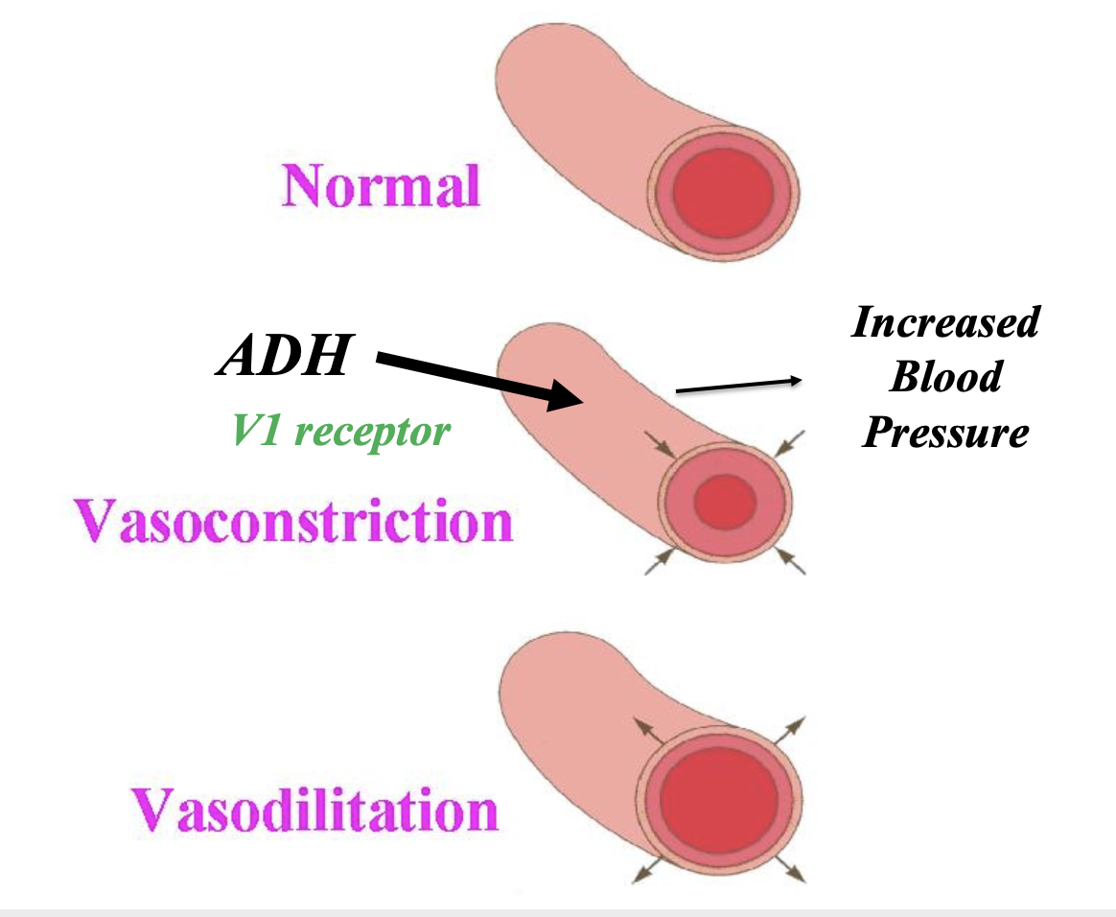
4
POSTERIOR PITUITARY GLAND
Lecture Five
Function/Regulation of ADH (vasopressin)
Hypothalamus receives feedback from:
Osmoreceptors
Aortic arch
Carotid baroreceptors,
Atrial stretch receptors.
Any increase in osmolality or decrease in blood volume will stimulate ADH secretion from posterior pituitary.
In regulation of ADH
Figure 5-5
Dehydration cause the releases of ADH
Overhydration inhibits the releases of ADH
Figure 5-6
Angiotensin II
V1 receptor
Figure 5-7 Plasma Osmolarity stimulates both ADH release and thirst via osmoreceptors
Figure 5-8 ADH effect on blood vessels
ADH Disorders
1
2
3
Central (Neurogenic) Diabetes Insipidus
Failure of hypothalamus or neuro -hypophysis to synthesized or secrete ADH
Nephrogenic Diabetes Insipidus
Failure of kidney to respond to ADH
Syndrome of inappropriate antidiuretic hormone (SIADH)
Diabetes Insipidus (DI)
DI is a disorder resulting from deficiency of antidiuretic hormone (ADH) or its action and is characterized by the passage of copious amounts of dilute urine.
Central DI is due to failure of producing adequate ADH.
Nephrogenic DI results when the renal tubules of the kidneys fail to respond to circulating ADH.
The resulting renal concentration defect leads to the loss of large volumes of dilute urine. This causes cellular and extracellular dehydration and hypernatremia.
It must be differentiated from other polyuric states such as primary polydipsia & osmotic diuresis.

Slide 6
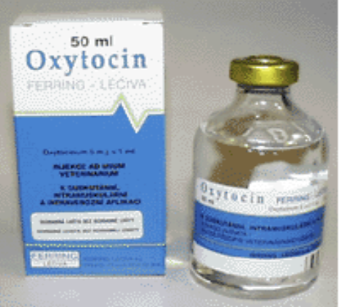
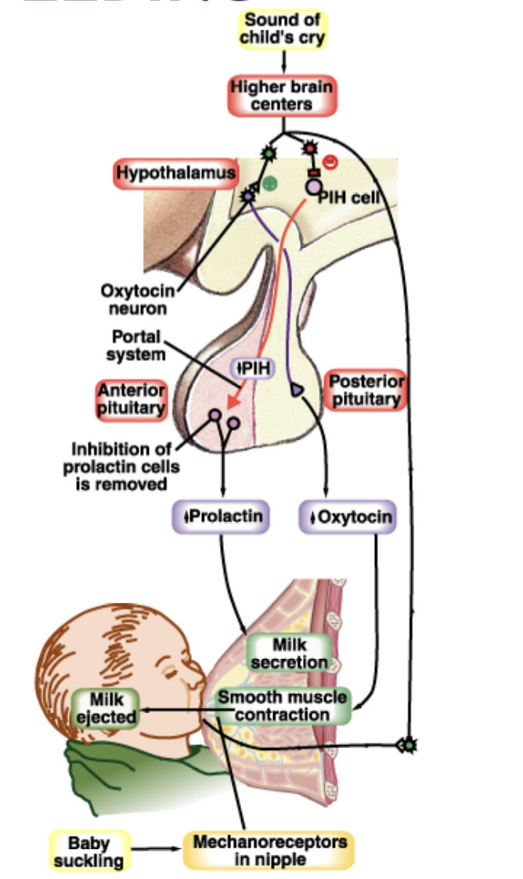
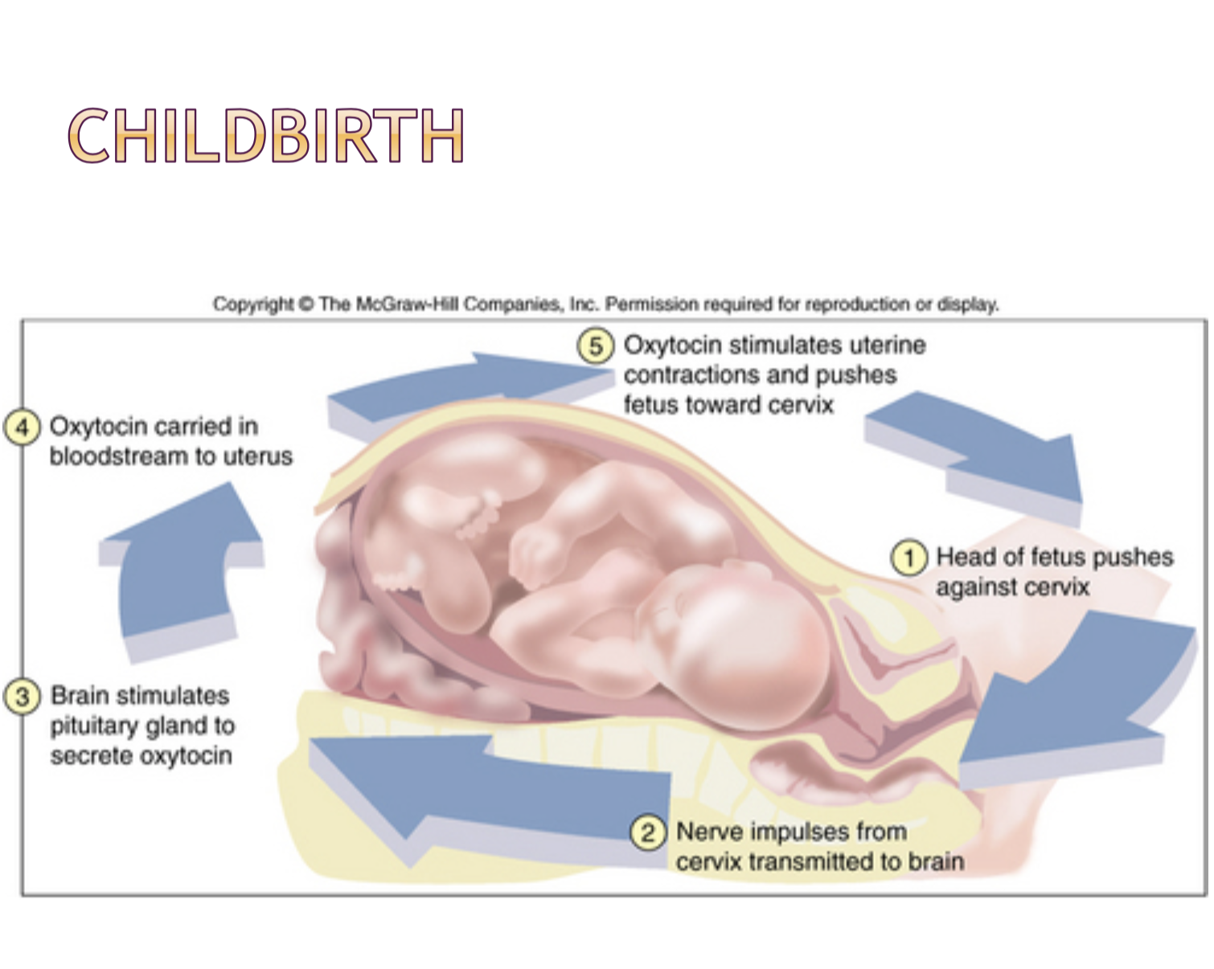
5
POSTERIOR PITUITARY GLAND
Lecture Five
Treatment of DI
High dose of Desmopressin (DDAVP): synthetic analog superior to native AVP due to:
Longer duration of action (8-10h vs 2-3h)
More potent
Antidiuretic activity is 3000x its pressor activity.
Treatment of Nephrogenic DI
Correction of underlying cause.
Provision of adequate fluids & calorie.
Low sodium intake & diuretics.
Synthesis of Oxytocin
Synthesized in the cell bodies of hypothalamic neurons (paraventricular nucleus)¹
Stored in posterior pituitary
Figure 5-9, during delivery, an I.M. Injection of Oxytocin is given to push the placenta out after child birth, so no complications occur.
Functions of Oxytocin
01
Oxytocin is a strong stimulant for uterine contraction
02
Regulated by positive feedback mechanism
03
Which leads to increased intensity of uterine smooth muscle (myometrium) contraction ending in birth (parturition)
04
Breastfeeding:
Contracts the myoepithelial cells of the alveoli, which triggers milk ejection (letdown reflex) (classic neuroendocrine reflex)²
Figure 5-10, the cry of any child could be a trigger.
05
Increase contraction of smooth muscle of vas deferens, helping in ejaculation process ³
Figure 5-11
FOOTNOTES
Oxytocin is mainly secreted from the Paraventricular Nucleus , as only 1/6th of the total secretion comes from the Supraoptic Nucleus.
A neuroendocrine reflex is a reflex in which a nervous signal causes the release of hormones into blood.
Oxytocin acts on non-pregnant uterus to facilitate sperm transport to uterine tube where fertilization normally occurs. As well as increase contraction of vas deferens, propelling sperm toward the urethra.

Slide 7
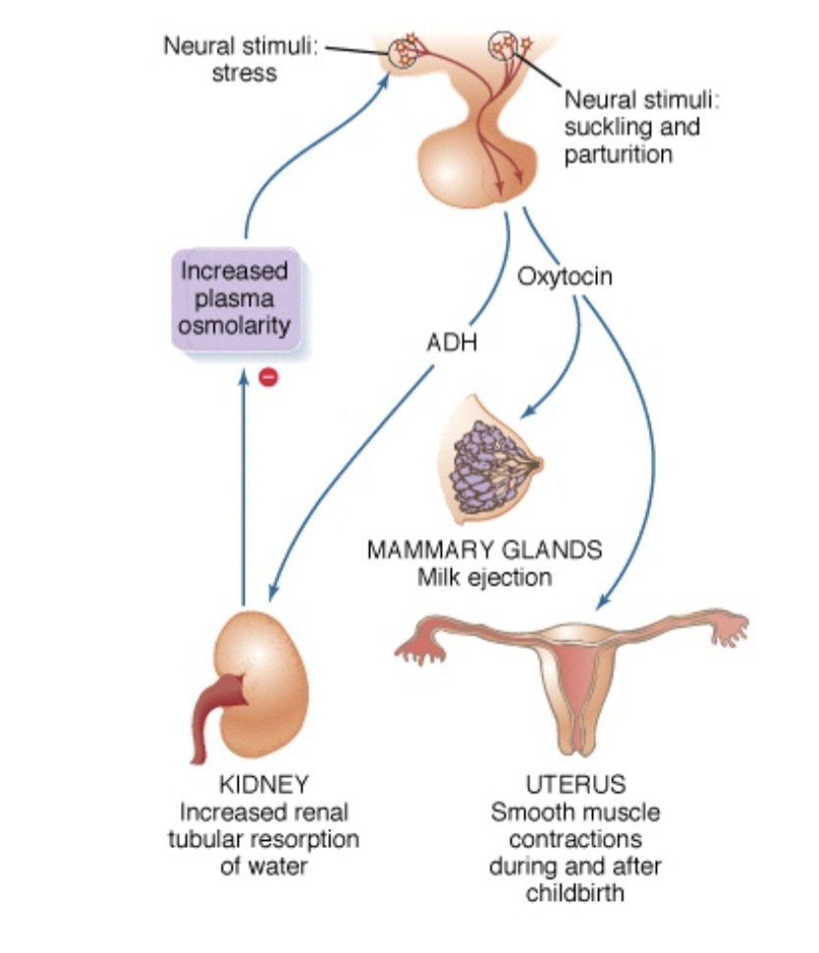
6
POSTERIOR PITUITARY GLAND
Lecture Five
Control of Oxytocin Release
Other Stimuli That Control Release of Oxytocin
Inhibition
Increased in
alcohol
emotion
Ejaculation in males
Hugging
Touching
Orgasm
Stress
Contraction of vas deferens
Oxytocin and Autism
Autistics have significantly lower plasma oxytocin compared to non-autistics.
Elevated oxytocin was associated with higher scores on social & developmental measures for non-autistic children.
Summary of Posterior Pituitary Hormones Actions
Figure 5-12
Figure 5-13

Slide 8
Which of the following is the function of oxytocin?
Increase metabolic rate
Increase cortisol levels
Inhibit synthesis of prostaglandin
Stimulate uterine contraction
Osmoreceptors are located in:
Carotid sinus
Anterolateral hypothalamus
Pulmonary veins
Aortic arch
Failure of kidney to respond to ADH is
Diabetes mellitus
Central diabetes insipidus
Nephrogenic diabetes insipidus
SIADH
For milk to flow from the nipple of the mother into the mouth of the nursing infant, what must occur?
Myoepithelial cells must relax
Prolactin levels must fall
Oxytocin secretion from the posterior pituitary must take place
All the above
Actions of oxytocin includes all the following except
Contraction of pregnant uterus
Synthesis of milk
Ejection of milk
Contraction of vas deferens
Release of which hormone is an example of neuroendocrine secretion?
GH
Cortisol
Oxytocin
Prolactin
ANSWER KEY: D, B, C, C, B, C

Slide 9
Elaf Almusahel, Shahad Althaqeb
Reviewed by: Nujud Alabdullatif
FEMALE PHYSIOLOGY CO-LEADERS
Maha Alnahdi, Taif Alshammari
MALE PHYSIOLOGY CO-LEADERS
Nayef Alsaber, Hameed M. Humaid
REFERENCES
Guyton and Hall Textbook of Medical Physiology
Ganong’s Review of Medical Physiology

