Slide 1
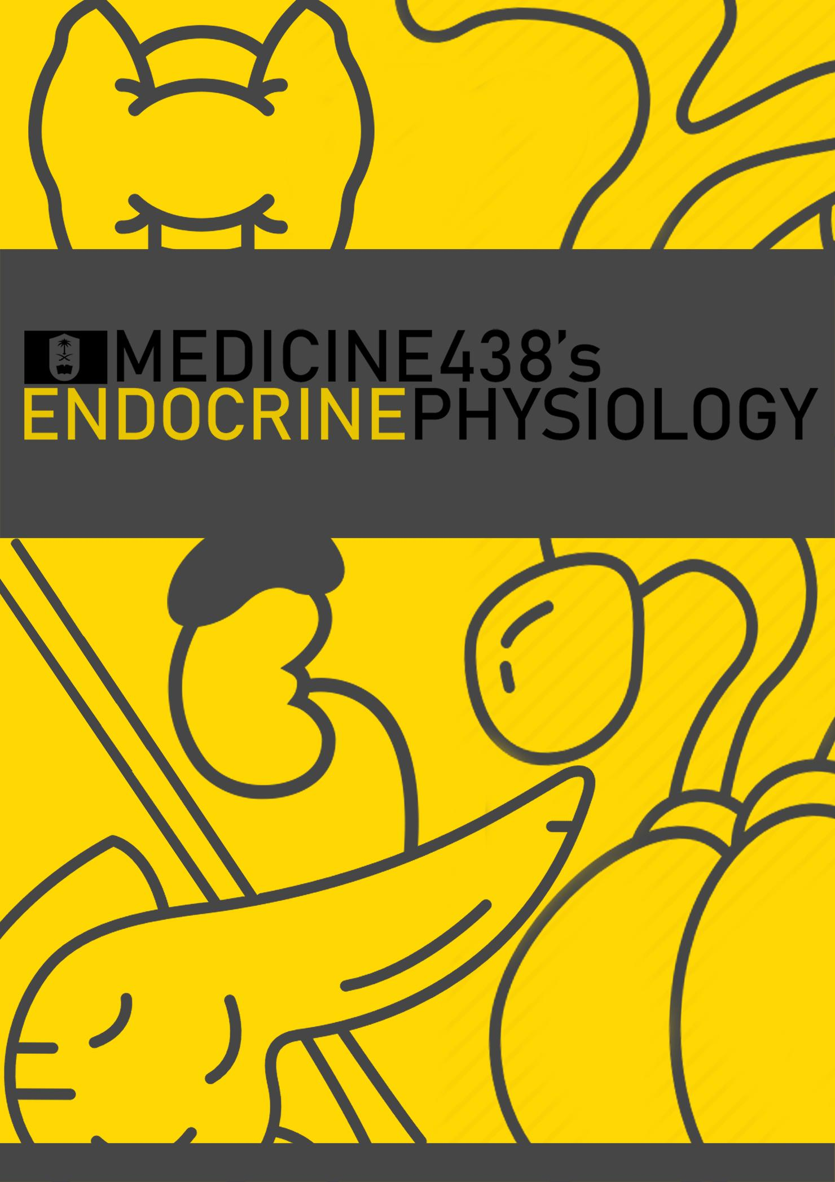
LECTURE VI and VII: Physiology and Disorders of Thyroid Gland
EDITING FILE
IMPORTANT
MALE SLIDES
EXTRA
FEMALE SLIDES
LECTURER’S NOTES

Slide 2
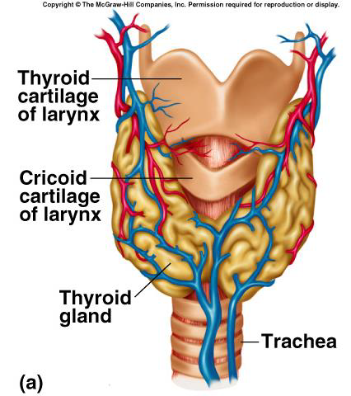
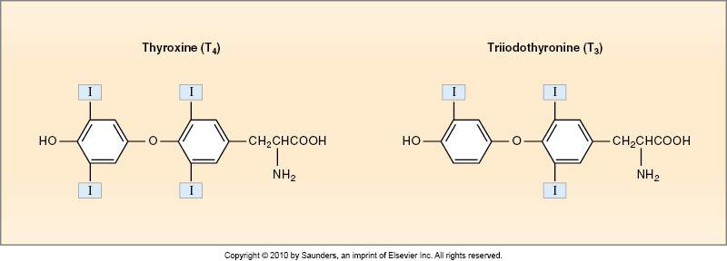
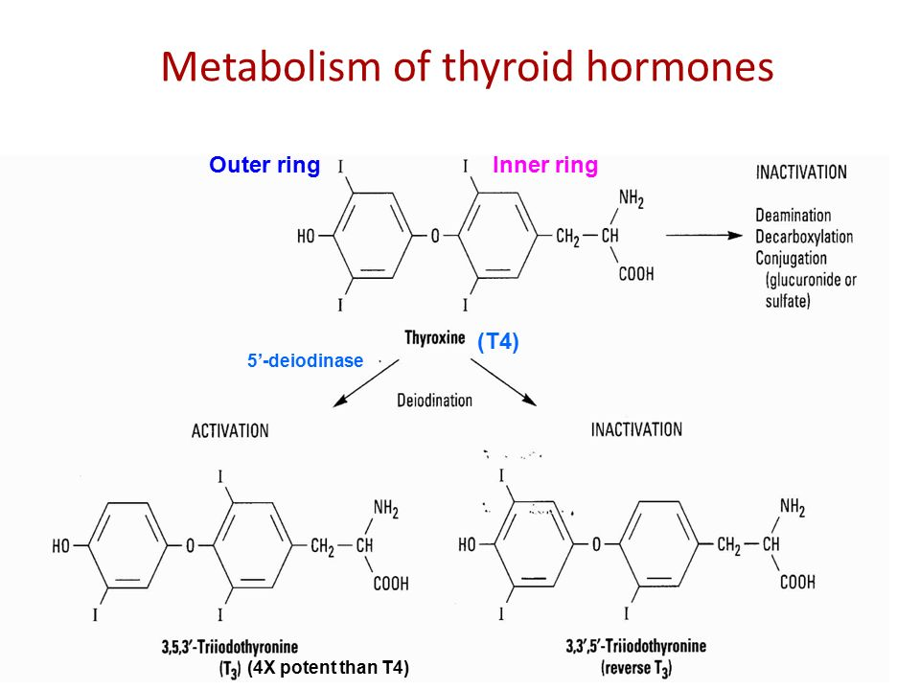
1
PHYSIOLOGY OF THE THYROID GLAND
Lecture Six
OBJECTIVES
List thyroid gland hormones.
Describe the synthesis of the thyroid hormones.
Describe the release and the actions of the thyroid hormones.
Describe the negative feedback mechanism (control).
Overview
The thyroid gland is the first recognized endocrine gland.
It is located below the larynx on either sides and anterior to the trachea.
It weighs 20 grams in adults.
The Hormones Of The Thyroid
Figure 6-1
Triiodothyronine “T3” (10%).
Thyroxine/ tetraiodothyronine “T4” (90%).
Reverse T3 (Figure 6-3)
Calcitonin (by parafollicular cells, for calcium homeostasis)
Figure 6-2
Figure 6-3
The Three Unique Features Of The Thyroid Gland (important)
Contains a large amount of iodine, which is supplied through the diet (1mg/week)(50mg/year, ⅕ absorbed by thyroid for synthesis, ⅘ excreted by kidney)
The synthesis of the hormones is partially intracellular and partially extracellular.
Thyroxine “T4” is the major product (90%).
FOOTNOTES
Footnotes
Reverse T3: An inactivated product caused by deiodination of T4 at the inner ring (Figure 6-3) rather than the outer ring, deiodination of the outer ring of T4 produces T3 (active). This can occur both at thyroid or tissue level. Since the same enzyme is expressed also by the thyroid.

Slide 3
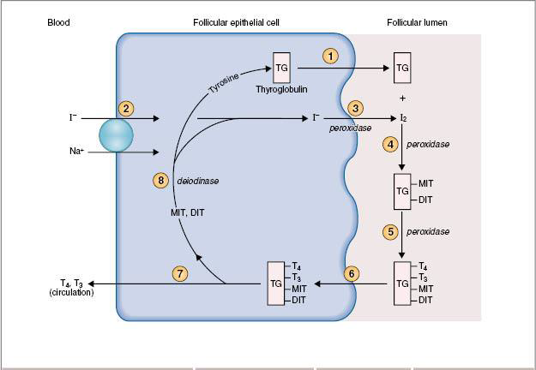
2
PHYSIOLOGY OF THE THYROID GLAND
Lecture Six
The Steps Of The Hormone Biosynthesis In Thyroid Gland
1
Thyroglobulin Formation And Transport
Contains 140 tyrosine residues.
It’s formed and secreted by the rER and the golgi apparatus of the follicular cells.
2
Iodide Pump or Trap
Iodide is the ion form of iodine present in the blood, its concentration within the follicular cells is much higher than the circulation 30 to 250 times.
For this reason we need secondary active transport for it to enter the follicular cell, which is stimulated by TSH.
Wolff-Chaikoff effect¹: A reduction in thyroid hormone levels caused by administration of a
large amount of iodine)
3
Oxidation of Iodide to Iodine²
By thyroid peroxidase, and it takes place nearby or attached to the apical membrane.
4
Organification of Thyroglobulin³
The binding of iodine with thyroglobulin, which is catalyzed by thyroid peroxidase,
Remain attached to it until the gland is stimulated to secrete, there are 2 types:
Monoiodotyrosine (MIT)
Diiodotyrosine (DIT)
5
Coupling Reaction
Merging DIT + DIT to form thyroxine (T4)(faster)
Merging DIT + MIT to form triiodothyronine (T3)
This reaction is catalyzed by thyroid peroxidase, and the products will be stored as colloid within the follicular lumen which will be sufficient for 2-3 months.
6
Endocytosis of thyroglobulin from the follicular lumen into the follicular cells.
By pinocytosis, follicular cells extend projections which form “pinocytic vesicles” that surround thyroglobulin, and takes it up into the cell.
7
Fusion Of Lysosomes Immediately With The Vesicles.
8
Hydrolysis of the peptide bonds
to release DIT, MIT, T4, and T3 from the thyroglobulin.
9
Delivery of T4 and T3 to the systemic circulation.
Figure 6-4
10
Deiodination Of DIT And MIT By Thyroid Deiodinase (Recycling)
Note that this is a different deiodinase from the one that converts T4 to T3 or rT3 in the periphery or within the thyroid. The enzyme for the latter reaction is catalyzed by 5-iodinase (common name)
FOOTNOTES
Footnotes
Wolff-Chaikoff effect: it’s the inhibition of the iodide transport, thus inhibiting the formation of hormones due to elevated iodide in the blood as an evolutionary protective mechanism to prevent the development of hyperthyroidism.
Iodide is one iodide atom (I⁻), Iodine is two iodide atoms bonded by covalent bonds (I₂). Only oxidized forms (I⁰, I₃⁻) can be used for synthesis.
Iodine is inorganic, its binding with thyroglobulin (organic) is thus termed organification.

Slide 4
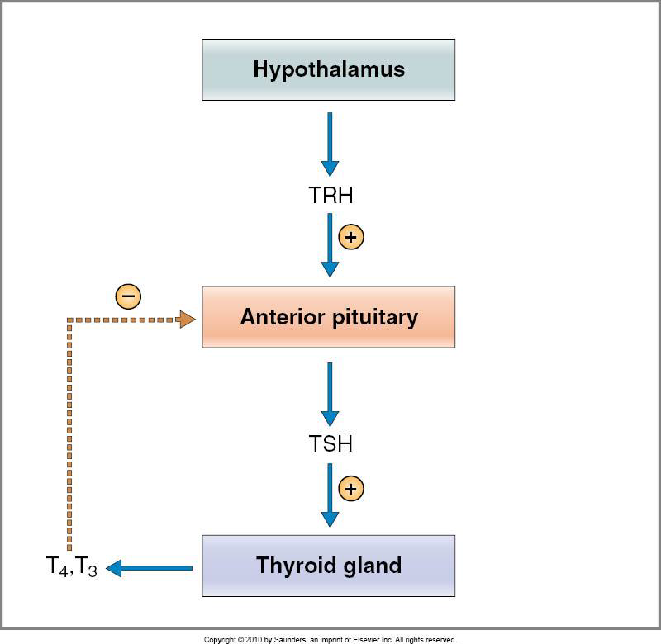
3
PHYSIOLOGY OF THE THYROID GLAND
Lecture Six
Thyroid Hormone Within The Circulation
There are two types:
Unbound: Small amount. (0.03% of T4, 0.3% of T3).
Bound: >99% is bound.
70%-80% bound to thyroxine-binding globulin (TBG), which is synthesised by the liver.
The reminder is bound to albumin and prealbumin.
The bound type could be affected by physiological and pathological factors:-
Liver disease: ↓TBG → ↑free level of T3&T4 → inhibition of thyroid secretion.
Pregnancy: ↑estrogen → ↑TBG → ↓free level of T3&T4 → stimulation of thyroid secretion.
Transient hypothyroidism or hyperthyroidism might be observed in both cases.
Release Of T4 & T3 To The Tissues
The release is slow because of the high affinity of the plasma binding proteins:
½ of T4 in the blood is released every 6 days.
½ of T3 in the blood is released every one day.
Readily diffuse through membranes, and are stored within the target tissues.
Before binding to the nuclear receptors, 90% of T4 is converted to T3 by the enzyme 5-iodinase.
In the nucleus, T3 mainly binds to thyroid hormone receptor and influence transcription of genes. (nuclear receptors have higher affinity for T3)
The mechanism of the T3 action:
T3 + nuclear receptor → T3-receptor complex → activation of thyroid regulating element on DNA → DNA transcription → formation of mRNA → translation of mRNA → specific protein synthesis.
It’s important to note that all the subsequent effects occur as a result of gene transcription and the formation of new proteins that participate in signaling cascades that cause these effects.
Regulation Of Hormone Secretion
They are regulated by the hypothalamic-pituitary axis, through:-
Thyrotropin-releasing hormone (TRH):
It’s a tripeptide that is secreted by the paraventricular nuclei of the hypothalamus.
Acts on the thyrotrophs of the anterior pituitary, leading to transcription and secretion of TSH.
Thyroid stimulating hormone (TSH):
It’s a glycoprotein that is secreted by the anterior pituitary, which regulates the growth and secretion of the thyroid gland (trophic effect).
Figure 6-5

Slide 5
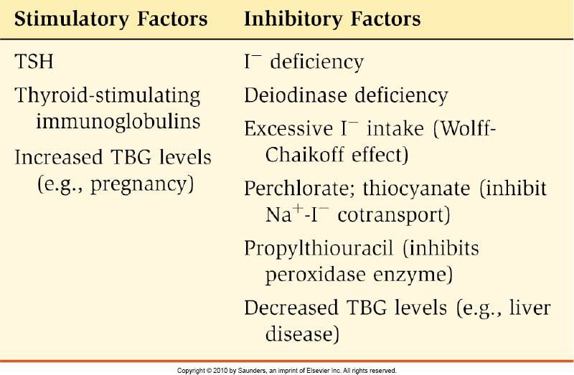
4
PHYSIOLOGY OF THE THYROID GLAND
Lecture Six
Actions of TSH
Increase proteolysis of the thyroglobulin.
Increase pump activity.
Increase iodination.
Increase coupling reactions.
Trophic effect.
TSH secretion starts early at 11-13 of the gestational weeks
The mechanism of the signalling :-
TSH + receptor → activation of adenylyl cyclase via Gs protein → ↑cAMP → activation of protein kinase → multiple phosphorylation → secretion and thyroid growth.
Figure 6-6
ACTIONS OF THE THYROID HORMONES
Actions On The Basal Metabolic Rate (BMR)
It’s the energy required under basal condition, which is the state of mental and physical rest (12-18 hours after a meal).
Complete lack of the thyroid hormones → ↓40-50% in BMR.
Extreme increase of thyroid hormones → ↑60-100% in BMR.
Thyroid hormones increase number and size of mitochondria in almost all cells, thus increasing ATP formation and use.
Actions On Metabolism
Effect on carbohydrate metabolism:-
Increase glucose uptake by cells.
Increase glycogenolysis.
Increase gluconeogenesis.
Increase absorption from the GIT.
All effects result from the increased metabolism (increased mitochondria) and specific gene transcription for glucose metabolizers.
Effects on fat metabolism:-
Increase lipolysis.
Decrease plasma cholesterol by increasing expression of LDL receptors and causing increase loss in feces. (hypothyroidism associated with atherosclerosis)
Increase oxidation of free fatty acids.

Slide 6
5
PHYSIOLOGY OF THE THYROID GLAND
Lecture Six
Effect on protein metabolism:-
Overall effect is catabolic leading to decrease in muscle mass.
Metabolic effects are due to the induction of metabolic enzymes:-
Cytochrome oxidase (mitochondrial)
NADPH cytochrome C reductase. (mitochondrial)
Alpha-glycerophosphate dehydrogenase. (mitochondrial)
Increase transcription of malic enzyme (Generates NADPH as a byproduct)
Increase transcription of proteolytic enzymes
Actions on the CVS
Increase heart rate (increase cardiac output up to 60%).
Increase stroke volume.
Decrease peripheral resistance.
The end result is increased delivery of oxygenated blood to the tissues, these effects can happen in two different ways:-
The thyroid hormones potentiate the effect of catecholamines in the circulation, which will lead to the activation of 𝞫-adrenergic receptors.
Direct induction of:
Myocardial 𝞫-adrenergic receptors.
Sarcoplasmic reticulum Ca⁺² ATPase. (SERCA)
Increase alpha-myosin transcription (Contractile protein, T3 decreases transcription of beta-myosin “weaker form” and increases transcription of alpha-myosin “stronger form”)
Actions on the CNS
In fetal and postnatal life:
Thyroid hormones are essential for CNS maturation, so prenatal decrease of it might lead to irreversible mental retardation.
Early screening is essential to introduce hormone replacement.
In adults:-
Increased thyroid secretion:
Hyperexcitability. (discussed later)
Irritability. (discussed later)
Decreased thyroid secretion:
Slow movement. (discussed later)
Impaired memory. (discussed later)
Decreased mental capacity.

Slide 7
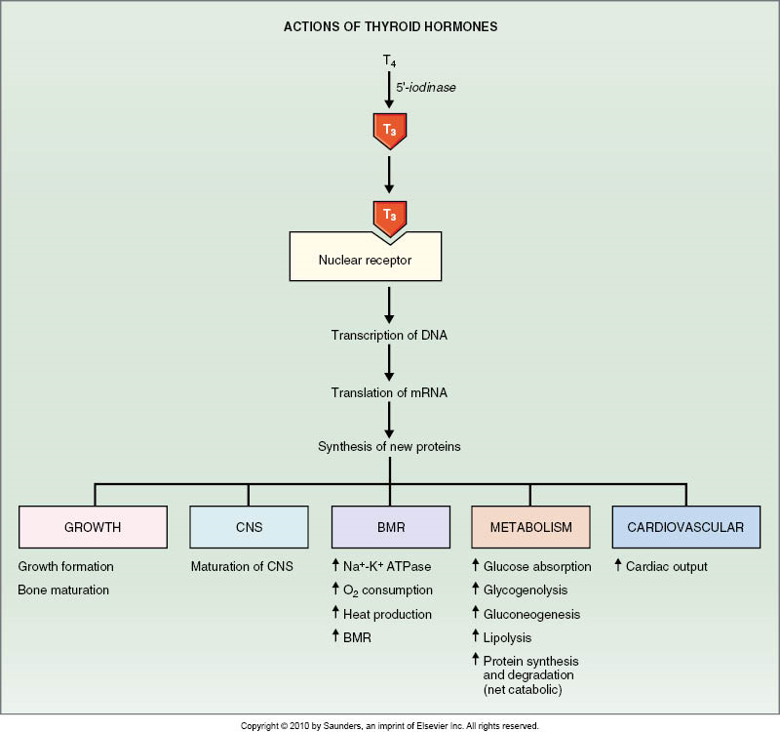
6
PHYSIOLOGY OF THE THYROID GLAND
Lecture Six
Actions On The Autonomic Nervous System
Produced by the same actions of catecholamines via 𝞫-adrenergic receptors, including: (both synergism due to similar effects and permissiveness due to potentiation of adrenergic receptors)
Increased BMR.
Increased heat production.¹
Increased heart rate.
Increased stroke volume
For example, the beta-blocker propranolol is used in hyperthyroidism treatment.
Actions on Bones
Promote bone formation.
Promote ossification.
Promote fusion of bone plate.
Promote bone maturation.
Actions on Respiration
Increase ventilation rate (Increased metabolism → Increased CO₂ → Stimulation of respiratory centers to increase ventilation to exhale CO₂)
Increase dissociation of oxygen from hemoglobin by increasing red blood cell 2,3-DPG (2,3 diphosphoglycerate)(Direct effect on RBCs)
Actions on GIT
Increase appetite and food intake.
Increase secretion of digestive juices.
Increase GIT motility:
Excess secretion of the hormone will lead to diarrhea.
Lack of secretion of the hormone will lead to constipation.
Figure 6-7
FOOTNOTES
Footnotes
By activating sympathetics, leading to increased lipolysis by brown adipose tissue, and eventually thermogenesis through heat loss if protons in ETC pass through uncoupling proteins rather than ATPase. Remember that the main goal of Krebs and ETC is to pump protons across a membrane, their passage back into the matrix through ATPase generates ATP.

Slide 8
7
HYPERTHYROIDISM & HYPOTHYROIDISM
Lecture Seven
OBJECTIVES
Describe pathophysiology behind the causes of hyper-hypothyroidism.
Describe pathophysiology behind the signs and symptoms of hyper & hypothyroidism.
List the treatment
Hyperthyroidism (Overactivity of the thyroid gland) Five to ten times increase in secretion Two to three times increase in size
Causes | Graves’ Disease (95% of cases of hyperthyroidism) An autoimmune disorder characterized by thyroid-stimulating immunoglobulin.¹ Thyroid tumor (95% benign, 5% malignant) History of head and neck irradiation and family history Exogenous T4 and T3 Excess TSH secretion Disease of the hypothalamus (TRH) Diseases of pituitary (TSH)
Signs and Symptoms
Diagnosis and Investigation | Serum T3, T4 and TSH measurement: In primary hyperthyroidism: High T3, T4 and low TSH . In secondary hyperthyroidism: High T3, T4 and high TSH.
Treatment | Medical therapy: Propylthiouracil: Start monthly with 3-4 monthly monitoring. Inhibits thyroid peroxidase Radioactive iodine⁴ Surgery: Subtotal thyroidectomy Indications: Relapse after medical treatment. Drug intolerance Cosmetic Suspected malignancy
Women:Men ratio (8:1)
Goiter (95%)
Skin
Smooth, warm (heat intolerant)
Moist skin, night sweating.
Musculoskeletal: Muscle atrophy.
Neurological
Tremor.²
Enhanced reflexes²
Irritability.
5. Gonads: Menstrual cycle disturbance
6. Renal: Increased GRF .
7. Cardiovascular
Increase heart rate
Increase stroke volume
Arrhythmias
Hypertension
8. G.I tract
Weight loss, increased appetite
Diarrhea.
9. Exophthalmos³
- Anxious staring expression.
- Protrusion of eyeballs.
- This can cause extreme protrusion with stretching of the optic nerve, resulting in visual defects. Due to edema and wasting of extraocular muscles. ²
FOOTNOTES
They have a prolonged effect on the thyroid gland lasting up to 12 hours, in contrast, TSH’s stimulating effect last for little more than an hour. The proposed mechanism for the development of antibodies is the release of sequestered antigens (a mechanism for autoimmunity)
Due to increased neuronal activity, this includes faster depolarization (increased transcription of Na/K-ATPase, resulting in a reactive neuron. The cerebellum and basal ganglia are affected, resulting in prolonged neuronal synapses leading to tremors.
In Graves’ disease, there are usually autoantibodies that cause destruction of extraocular muscles, also, autoreactive T-cells recognize ocular antigens that bear similarity to thyroid antigens, this causes infiltration of T-cells, release of cytokines which activate fibroblasts to to deposit extracellular matrix with the end result being edema and protrusion of the eyeball.
Radioactive iodine is composed of iodine atoms that are unstable due to unstable nucleus. This is further explained in pharmacology lectures.

Slide 9
8
HYPERTHYROIDISM & HYPOTHYROIDISM
Lecture Seven
Hypothyroidism Under activity of the thyroid gland
Causes | 1. Inherited Abnormalities Of Thyroid Hormone Synthesis Peroxidase defect Iodide trapping defect Thyroglobulin defect (deficient coupling and/or proteolysis) 2. Endemic colloid Goiter before table salt ↓Iodide → ↓Hormone formation → ↑TSH →↑Thyroglobulin→ ↑Size (>10 times) 3. Idiopathic Non-Toxic Colloid Goiter Iodine intake is normal Inﬂammation → ↑Cell damage → ↓Hormone secretion → ↑TSH→ ↑Activity of normal cells→ ↑Thyroglobulin → ↑Size 4. Gland destruction (surgery). 5- Pituitary or hypothalamic disease or tumor.
Signs and Symptoms
Diagnosis and Investigation | Serum T3, T4 and TSH measurement: Primary hypothyroidism: Low T3, Low T4 and high TSH Secondary hypothyroidism: Low T3, Low T4 and low TSH
Treatment | L- thyroxine Starting dose is 25-50 µg. Increase to 200 µg at 2-4 weeks period. The first response seen is the weight loss.
More in women, peak incidence: 30-60 years
Skin
Dry skin.
Cold intolerance
Musculoskeletal
Increased muscle bulk
Delayed skeletal growth
Muscle sluggishness
Slow relaxation after contraction¹
Neurological²
Slow movement
Impaired memory
Decrease mental capacity
Remal: Decreased glomerular filtration rate.
5. Cardiovascular
Decreased heart rate
Decreased stroke volume
Increased risk for atherosclerosis
6. G.I tract
Constipation
Increase weight.
7. Myxoedema
An edematous appearance throughout the body.
8. Gonads
Loss of libido.
Menstrual cycle disturbance.
Cretinism
Extreme hypothyroidism during infancy and childhood (failure of growth).
Causes: 1) Congenital lack of thyroid gland (Congenital Cretinism).
2) Genetic deﬁciency leading to failure to produce hormone.
3) Lack of Iodine in the diet (Endemic Cretinism).
Symptoms: (1) Infant is normal at birth but abnormality appears within weeks. (2) Protruding tongue. (3) Dwarf with short limbs. (4) Mental retardation. (5) Often umbilical hernia. (6) delayed growth of permanent teeth.
Treatment: Changes are irreversible unless treatment is given early in life.
FOOTNOTES
Related to deep tendon reflexes, alteration in Calcium-ATPase activity of skeletal muscles.
Due to decreased activity of reticular activating system, which is activated during increased sympathetic activity and by thyroid hormones.

Slide 10
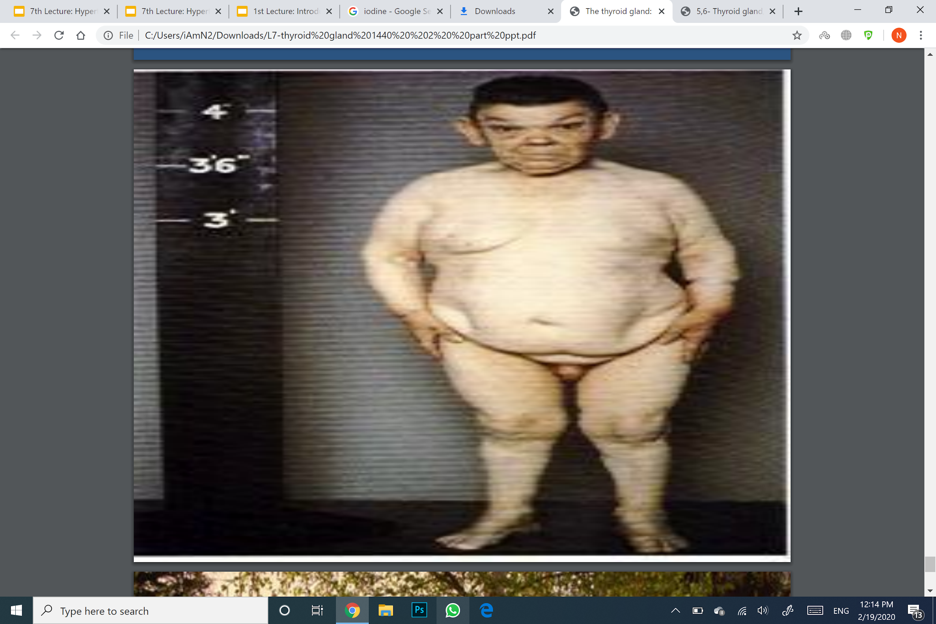
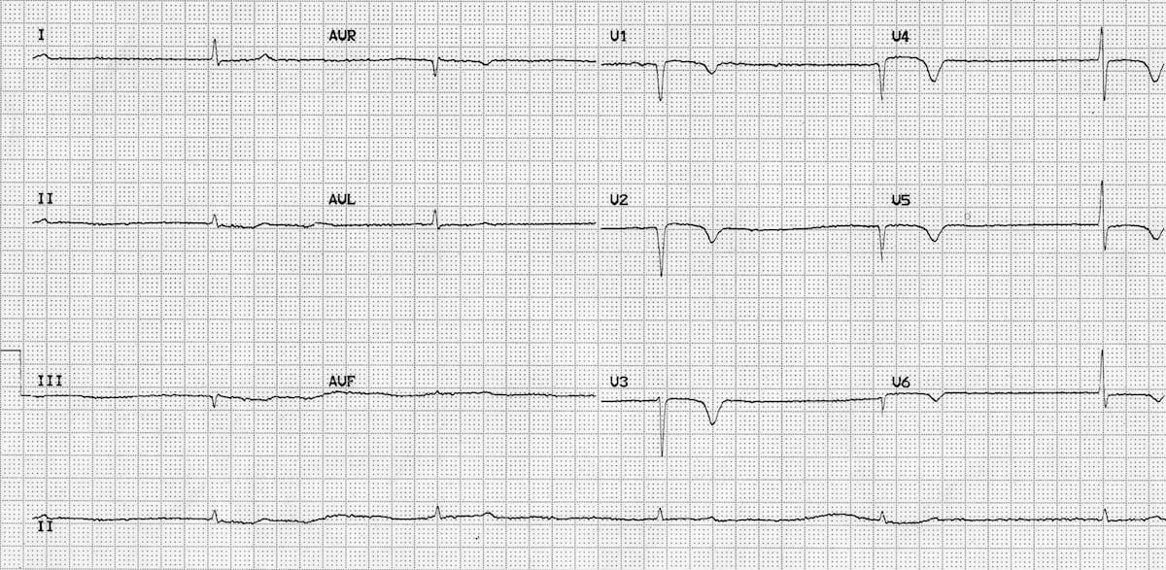
9
HYPERTHYROIDISM & HYPOTHYROIDISM
Lecture Seven
Further Readings (Extracurricular)
Hypertension occurs in both settings of thyroid (hypo / hyper) -thyroidism.
in Hyperthyroidism:
It’s Systolic Hypertension (more pressure exerted as heart ejects blood) why?
Increase transcription of myocardial proteins (myosin, Ca-ATPase (recall that calcium is essential for myocardial contraction)
Activation of sympathetic nervous system which activates RAAS (constriction of afferent arteriole, trapping of blood).
Lid lag is due to the sympathetic overstimulation of the levator palpebrae superioris (extraocular muscle, elevates upper eyelid)
Exophthalmos: In Graves’ disease, there are usually autoantibodies that cause destruction of extraocular muscles, also, autoreactive T-cells recognize ocular antigens that bear similarity to thyroid antigens, this causes infiltration of T-cells, release of cytokines which activate fibroblasts to deposit extracellular matrix with the end result being edema and protrusion of the eyeball.
Tremors are due to increased neuronal activity, this includes faster depolarization (increased transcription of Na/K-ATPase, resulting in a reactive neuron. The cerebellum and basal ganglia are affected, resulting in prolonged neuronal synapses leading to tremors.
Figure 7-1 Showing hyperthyroidism due to graves disease.
While in Hypothyroidism:
It’s Diastolic Hypertension (more pressure as the heart relaxes, suggesting an arterial source) why?
Increased peripheral resistance
decreased GFR (trapping of more blood).
increased cholesterol.
Recall that dwarfism is also caused by Growth hormone deficiency, but unlike cretinism, the patient with low GH maintains their mental capabilities:)
(Could be a differential diagnosis)
Atherosclerosis, lack of thyroid hormone increases quantity of blood cholesterol (diminished liver excretion)—recall from previous lecture that this is due to decrease of LDL receptor expression on liver.
Figure 7-2 Hypothyroidism, the depressed appearance of hypothyroid patients can be mistakenly recognized as depression, therefore measurement of thyroid hormones is important for such cases.
Figure 7-3 Cretinism, symptoms are: (1) Infant is normal at birth but abnormality appears within weeks. (2) Protruding tongue. (3) Dwarf with short limbs. (4) Mental retardation. (5) Often umbilical hernia. (6) delayed growth of permanent teeth.
Figure 7-4 Low voltage QRS complex in electrocardiogram (remember voltage represents strength of the action potential, and hence, contraction), due to:
Decreased sympathetic outflow (normally sympathetic system increases cardiac output by 30%)
Decreased synthesis of proteins in cardiomyocytes (such as myosin, upregulated by tyrosine)

Slide 11
What enzyme catalyzes the coupling reactions?
Peroxidase
5-iodase
NADPH
A & B
2. Which of the following is a cardiac action of the thyroid hormone?
Slow movement
Decreased cardiac output by 60%
Increase heart rate
Increase peripheral resistance
3. How will long-standing liver disease affect thyroid function?
It won’t affect it
It will stimulate it
It will inhibit it
Same as pregnancy
4. Fatima, a 45-year-old mother to five children paid a visit to an endocrinologist. She had been sweating heavily, and she spends too much time in the kitchen and eats while keeping the door to the fridge open. She had been eating in a much more excessive manner than usual, with more visits to the toilet due to diarrhea. Which of the following disorders best correlates with Fatima’s behavior?
Hyperthyroidism
Hypothyroidism
Prolactinemia
Cushing’s syndrome
5. Huda, a 35-year-old epidemiologist, was accompanied to a psychiatry clinic by her husband. She spends too much time sleeping, and often remains for long periods in bed with constant feeling of tiredness, she covers herself with three blankets. Despite her decreased appetite she suffers from weight gain and her husband thinks she is depressed. He started bringing her food to her bed, but more often, it remains untouched. The psychologists advised Huda to visit a fellow endocrinologist. What is your interpretation of the psychologist’s suggestion?
Huda’s symptoms are consistent with diabetes
Huda’s symptoms are consistent with hypothyroidism
Huda’s symptoms are consistent with hyperthyroidism
Huda’s symptoms are consistent with prolactinemia
ANSWER KEY: A, C, C, A, B

Slide 12
Meshari Alzeer, Rakan Alfifi, Musfer Alqahtani
Co-editor: Njoud Alabdullatif
FEMALE PHYSIOLOGY CO-LEADERS
Maha Alnahdi, Taif Alshammari
MALE PHYSIOLOGY CO-LEADERS
Nayef Alsaber, Hameed M. Humaid
REFERENCES
Guyton and Hall Textbook of Medical Physiology
Ganong’s Review of Medical Physiology

