Slide 1
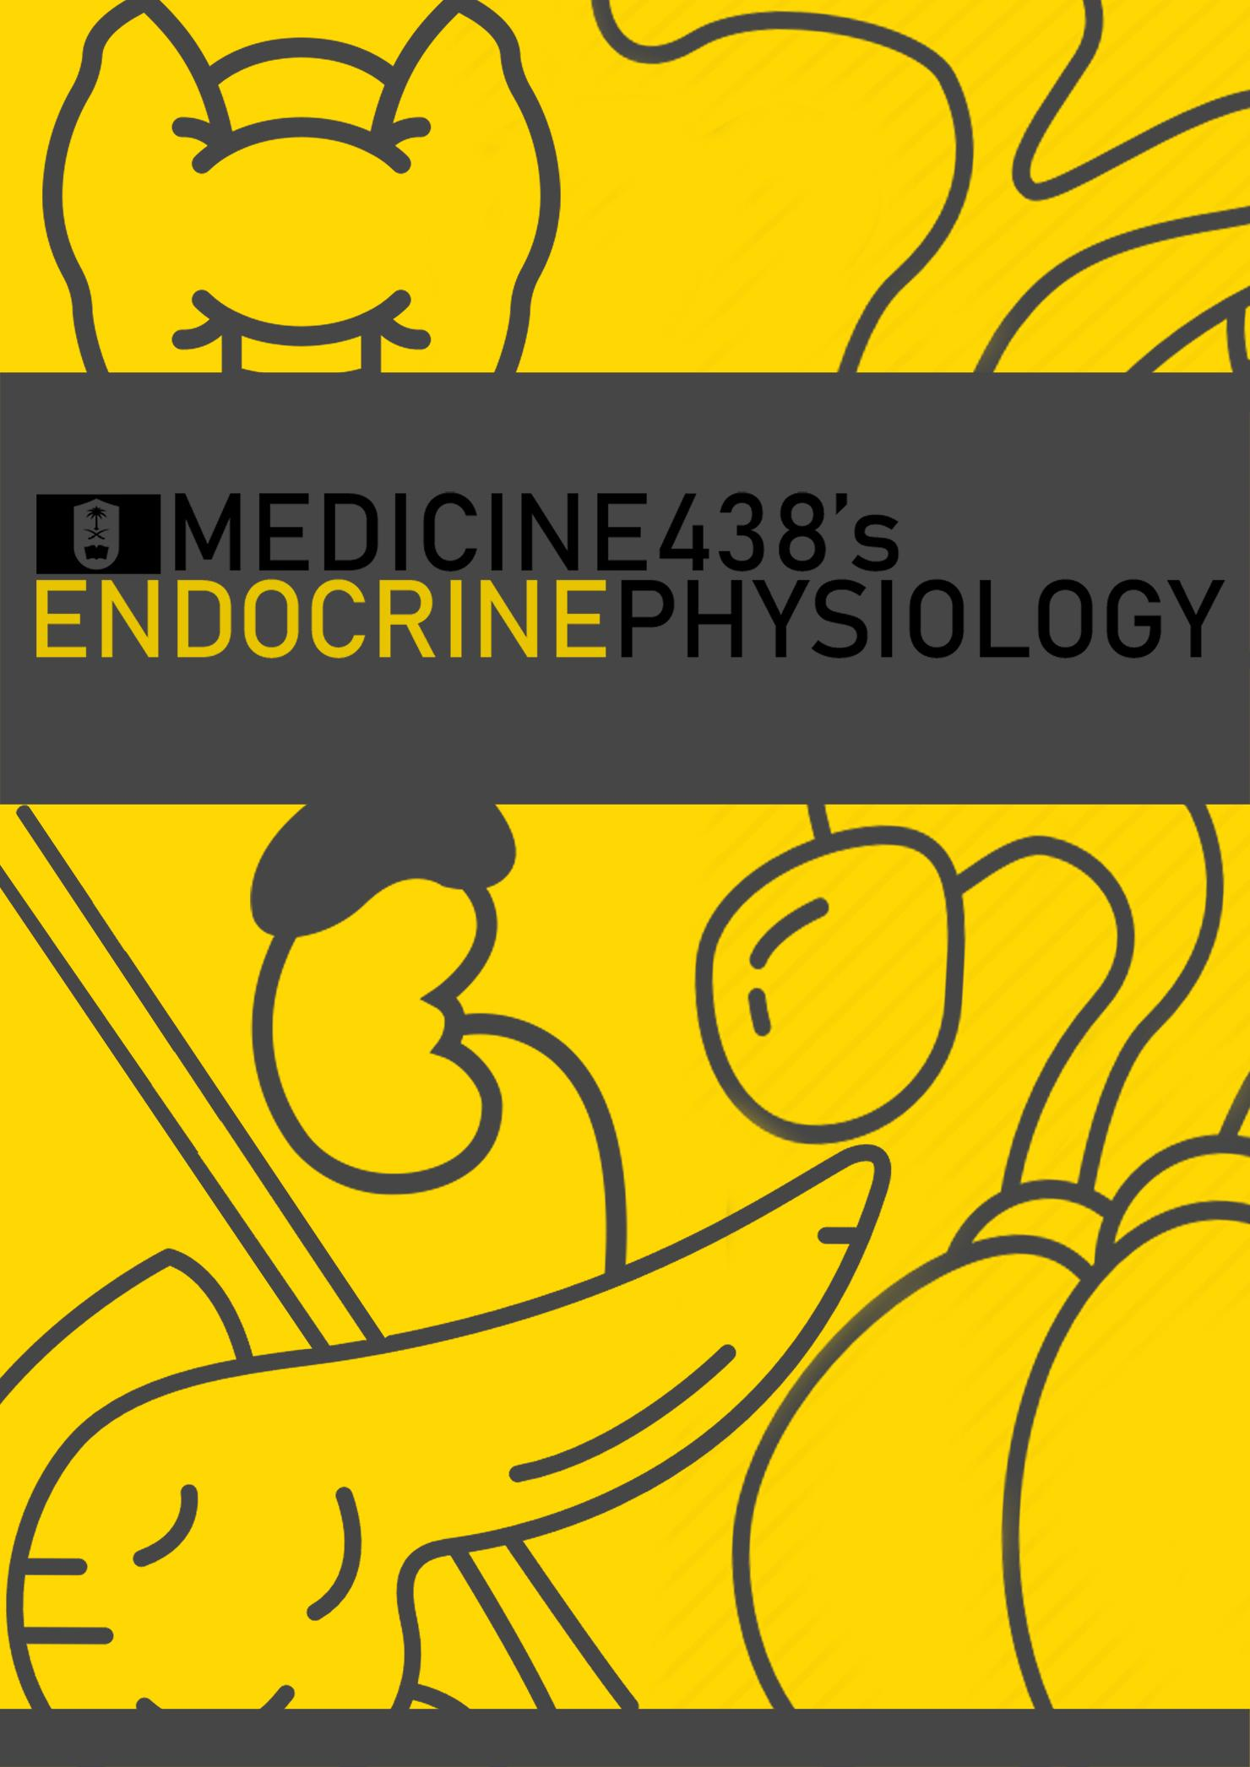
LECTURE VIII & IX: Calcium Homeostasis & Hypo and Hyperparathyroidism
EDITING FILE
IMPORTANT
MALE SLIDES
EXTRA
FEMALE SLIDES
LECTURER’S NOTES

Slide 2
1
CALCIUM HOMEOSTASIS
Lecture Eight
OBJECTIVES
List the functions of calcium
Identify the normal range of dietary calcium and phosphate intake.
Describe calcium metabolism
Describe physiology of bone
Understand and explain hormonal regulation of calcium metabolism
- Parathyroid hormone
- Calcitonin
- Vitamine D3
Distribution of Calcium in Body
 | Calcium | Phosphorus
Total body content Relative tissue distribution (% of total body content) | 1,300 g | 600 g
Bones & teeth | 99% | 86%
ECF | 0.1% | 0.08%
ICF | 1.0% | 14%
99% Bones
& Teeth
1% ICF
(Endoplasmic
Reticulum)
0.1% ECF
Table 8-1
Distribution of Calcium in ECF/Plasma
1% stored in cells, 0.1% is in ECF, and around 99% is stored in bones.
Total plasma Ca²⁺ : 9-10.5 mg/dl = 5 mEq/L = 2.5 mmol/L
Non diffusible Ca²⁺ = 41%
Diffusible Ca²⁺ = 59%
50%
1.2 mmol/L
9%
0.2 mmol/L
41%
1 mmol/L
Ionized Ca²⁺
(Diffusible and is the physiologically active form)
Ca²⁺ complexed to anions
(Diffusible)
Protein-bound Ca²⁺
(Non diffusible)
FOOTNOTES
1. Anion-bound calcium: is not ionized, and has a neutral charge, such as calcium bicabonate, calcium citrate, and calcium phosphate.

Slide 3
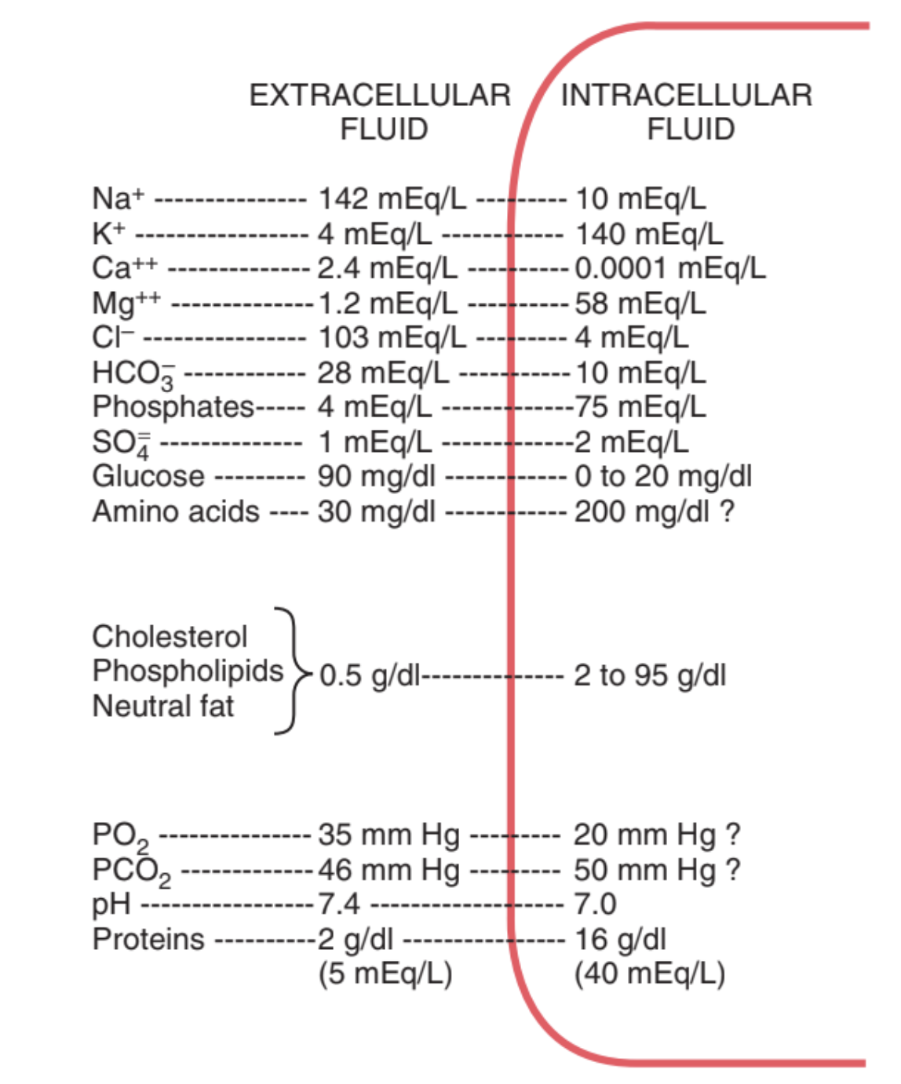
2
CALCIUM HOMEOSTASIS
Lecture Eight
Protein-bound Calcium
Most of this calcium is bound to Albumin and much smaller fraction is bound to Globulin.
Binding of calcium to Albumin is pH-dependent.
Acute respiratory alkalosis increases calcium protein thereby decreases ionized calcium level.¹
Competition between Ca²⁺ and H⁺ on albumin binding:
Alkalosis → Low ionized Ca²⁺ (Less hydrogen ions, less competition and consequently more protein binding)
Acidosis → High ionized Ca²⁺ (More hydrogen ions, more competition and consequently less protein binding)
Figure 8-1
Physiological Importance of Calcium
Calcium salts in the bone provide structural integrity of the skeleton.
Calcium ions in extracellular and cellular fluids is essential for normal function of the following biochemical processes:
Enzymatic regulation
Blood coagulation
01
02
03
04
Hormonal secretion &
Second messenger
Neuromuscular excitability
Calcium Sources
Absorption
Daily Requirements
Poor abs.
Dairy
Infants and adults: 12.5-25 mmol/day
Pregnancy, lactation and after menopause: 25-35 mmol/day
Duodenum: active transport
small intestine: concentration gradient
Milk
Fish
FOOTNOTES
1. Symptoms of tetany appear at higher total calcium levels if the patient hyperventilates(decreased pCO2), thus increases plasma pH(becomes more alkaline). Thus decreasing hydrogen ions concentration, and increasing protein-bound calcium. Net result is decreased ionized calcium (the physiologically active form) leading to tetany.

Slide 4
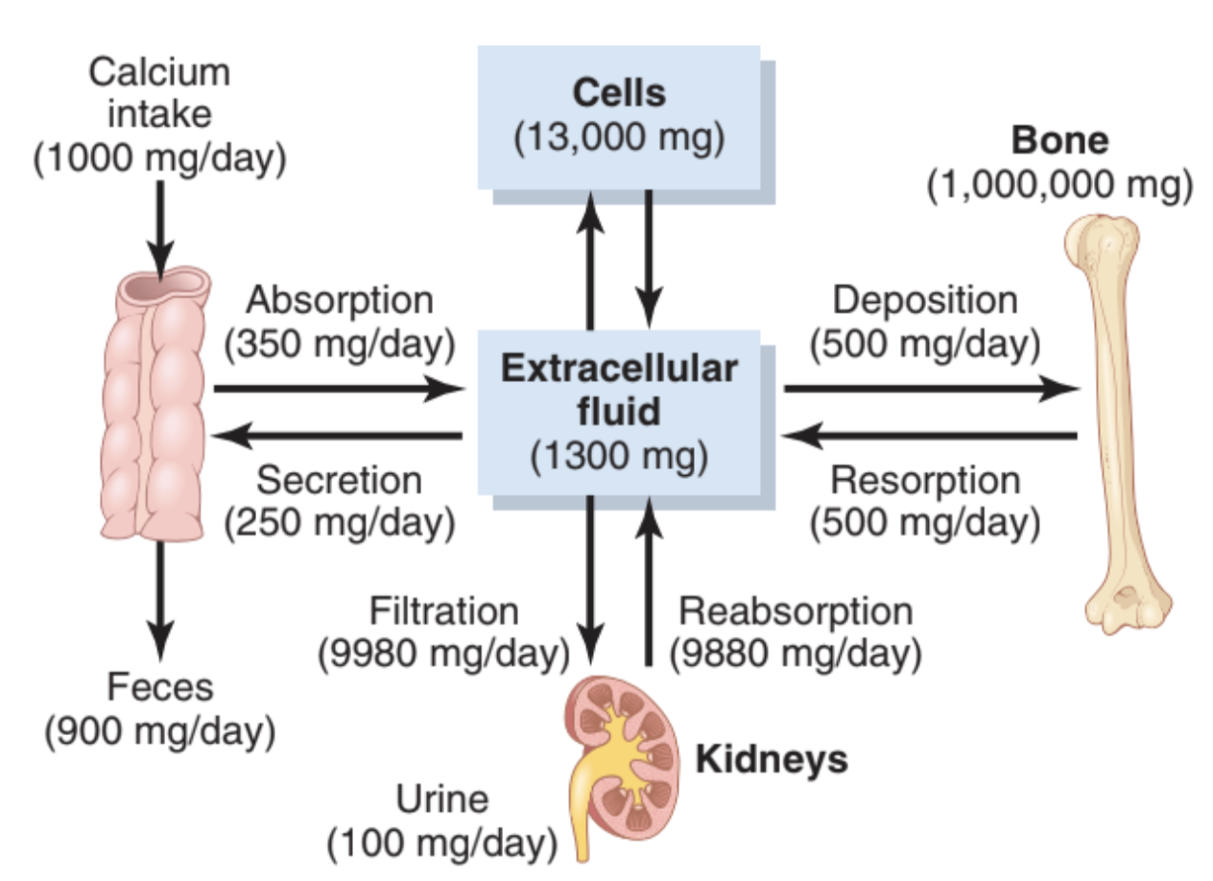
3
CALCIUM HOMEOSTASIS
Lecture Eight
Calcium Metabolism in an Adult Human
Calcium concentration is well-regulated, that is, if large amounts of calcium were injected intravenously calcium concentration will rise to very high levels, however within one hour-or-so the levels will return to normal.
Calcium is poorly absorbed without the actions of vitamin D.
Normal calcium intake from diet is 1000mg/day, vitamin D promotes the absorption of about 35% of calcium (around 350mg/daily) the remaining is unabsorbed and excreted.
A regulated, relatively constant amount of calcium is secreted by the intestines in digestive juices for whatever purpose (around 250mg/daily)
About 100mg.day of calcium is then excreted by the kidney into the urine, thus maintaining calcium levels within the homeostatic range. (excretion equal to intake)
The kidney filters ionized and anion-bound calcium (protein-bound is too large), 90% is freely reabsorbed, PTH regulates the absorption of the remaining 10%, so that when PTH level drops in hypercalcemic states, more calcium is excreted. Which helps to maintain homeostasis.
It’s worth noting that the bones act as a reservoir for calcium, and that cells contain 10 times as much calcium as ECF, while bones harbor around 99% of total body calcium.
Figure 8-2
Phosphate
Phosphate plasma concentration is around 4 mg/dL.
Phosphorous is an essential mineral necessary: for ATP and cAMP second messenger systems.
Forms:
1. Ionized (diffusible) → around 50%
2. Un-ionized (non-diffusible) and protein-bound → 50%
Calcium is tightly regulated with Phosphorus in the body. Although extracellular fluid phosphate concentration is not nearly as well regulated as calcium concentration, phosphate serves several important functions and is controlled by many of the same factors that regulate calcium.
Phosphorus is the element itself (P), whereas phosphate is a phosphorus atom coupled to four oxygen atoms (charged, conjugate base of phosphoric acid) (PO₄⁻³), phosphoric acid is (H3PO4)
Regulation of Calcium Level
Non-Hormonal mechanisms: Can rapidly buffer small changes in plasma concentrations of free Calcium.
Hormonal mechanisms: Provide high-capacity, long-term regulation of plasma Calcium and Phosphate concentrations.
[Ca²⁺] < 9-10.5 mg/dl → Tetany + seizures + excitation of the nervous system ¹
[Ca²⁺] > 9-10.5 mg/dl → Renal stones + depression of the nervous system
Bone Cells
Osteoblasts
Osteocytes
Osteoclasts
-Bone forming cells
-Osteoblasts surrounded by calcified matrix
-Bone eroding Cell (resorping)
FOOTNOTES
1. When the ECF concentration of calcium ions falls below the normal level, the nervous system becomes progressively more excitable because hypocalcemia causes increased neuronal membrane permeability to sodium ions Calcium binds to ion channels, creating a positive charge that repels incoming sodium, this is the basis of tetany, calcium binds to ACh receptors (Ligand-gated ion channels) and repels the entry of sodium. This is acceptable in normal levels, but in hypocalcemia large amounts of sodium enter spontaneously causing tetany. When calcium levels are high the opposite happens, weak muscle contractions in hypercalcemia can even affect GIT motility causing constipation.

Slide 5
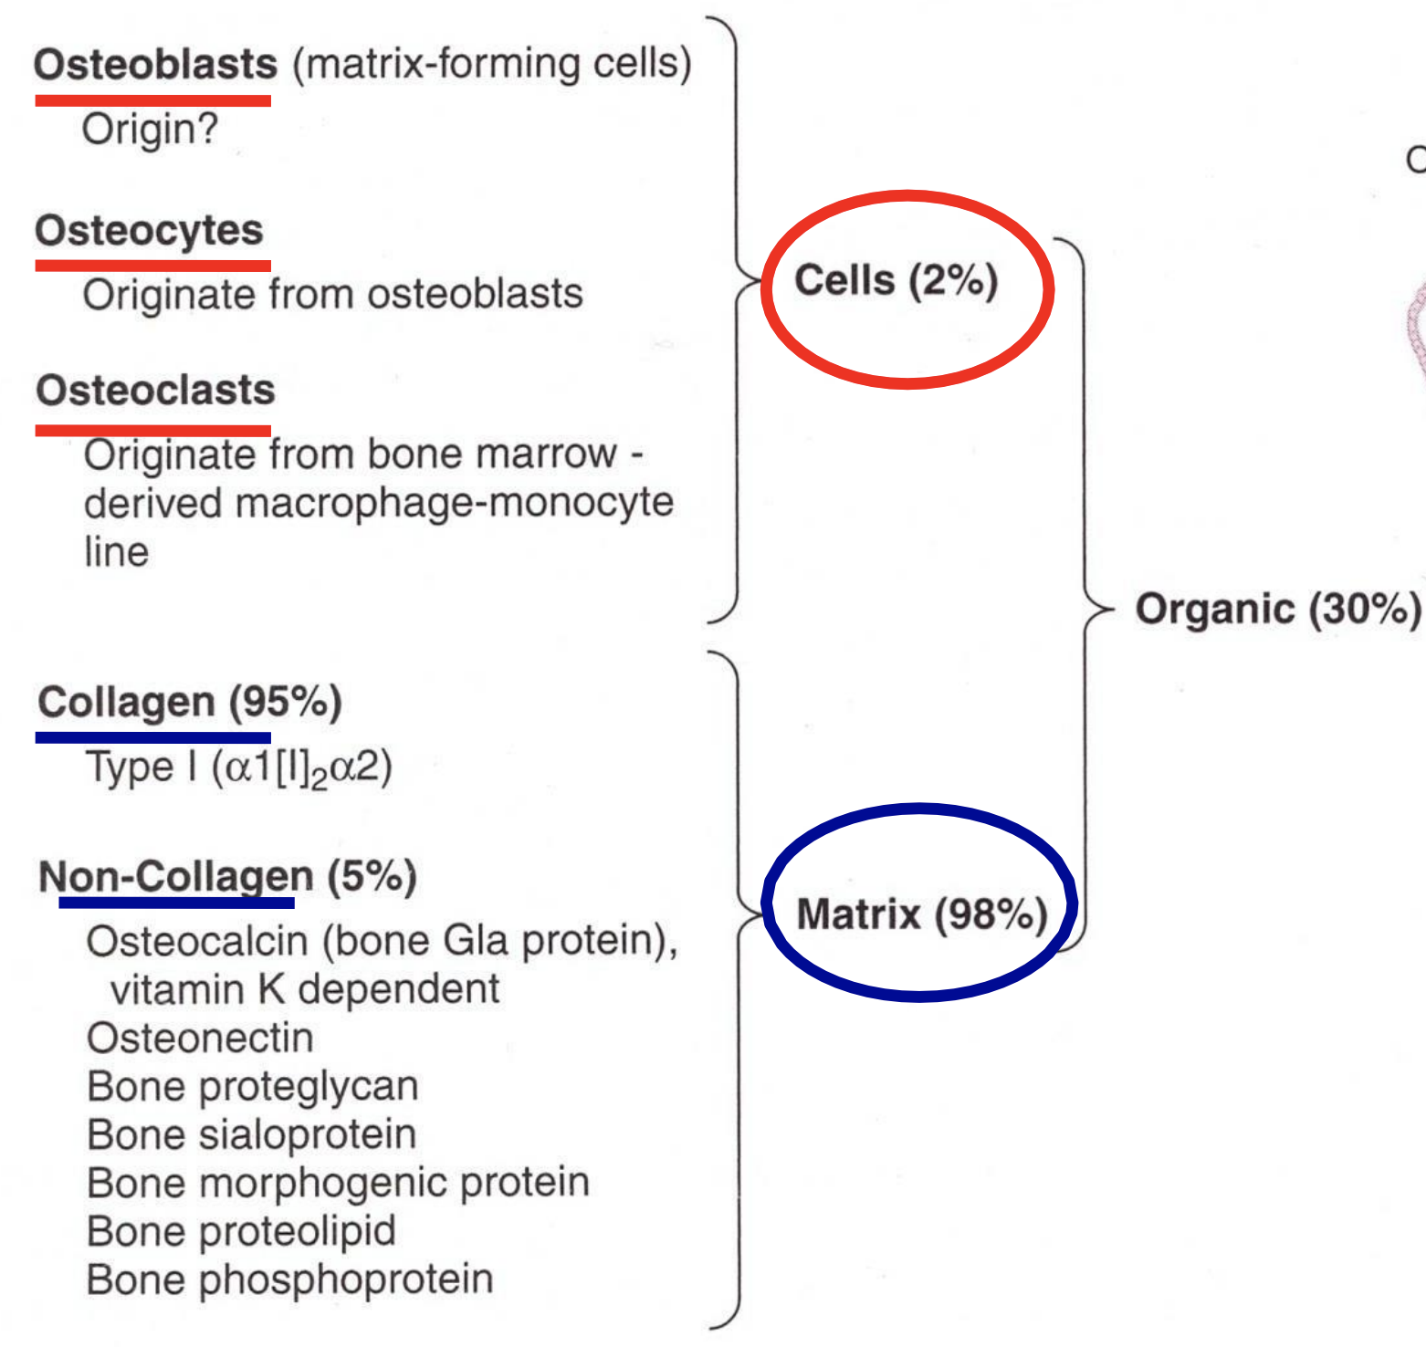
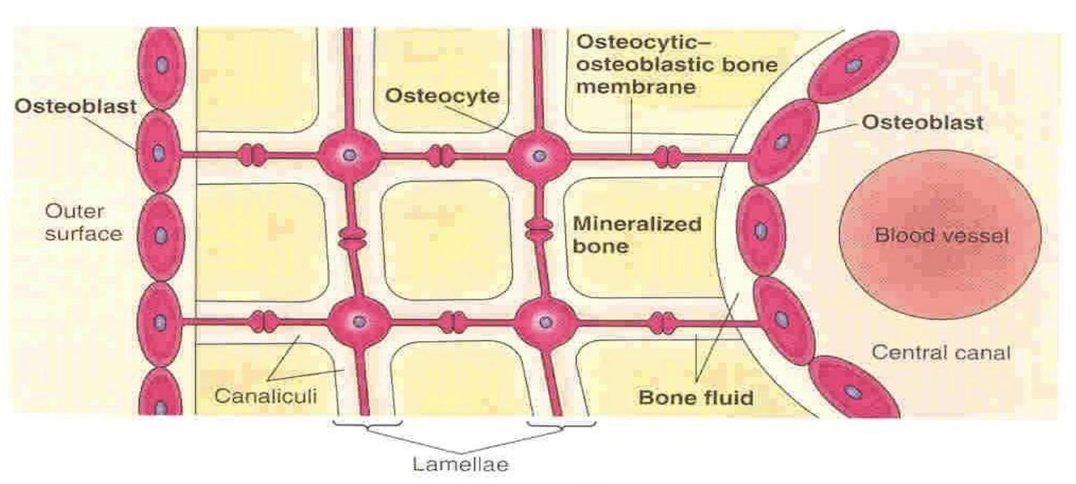
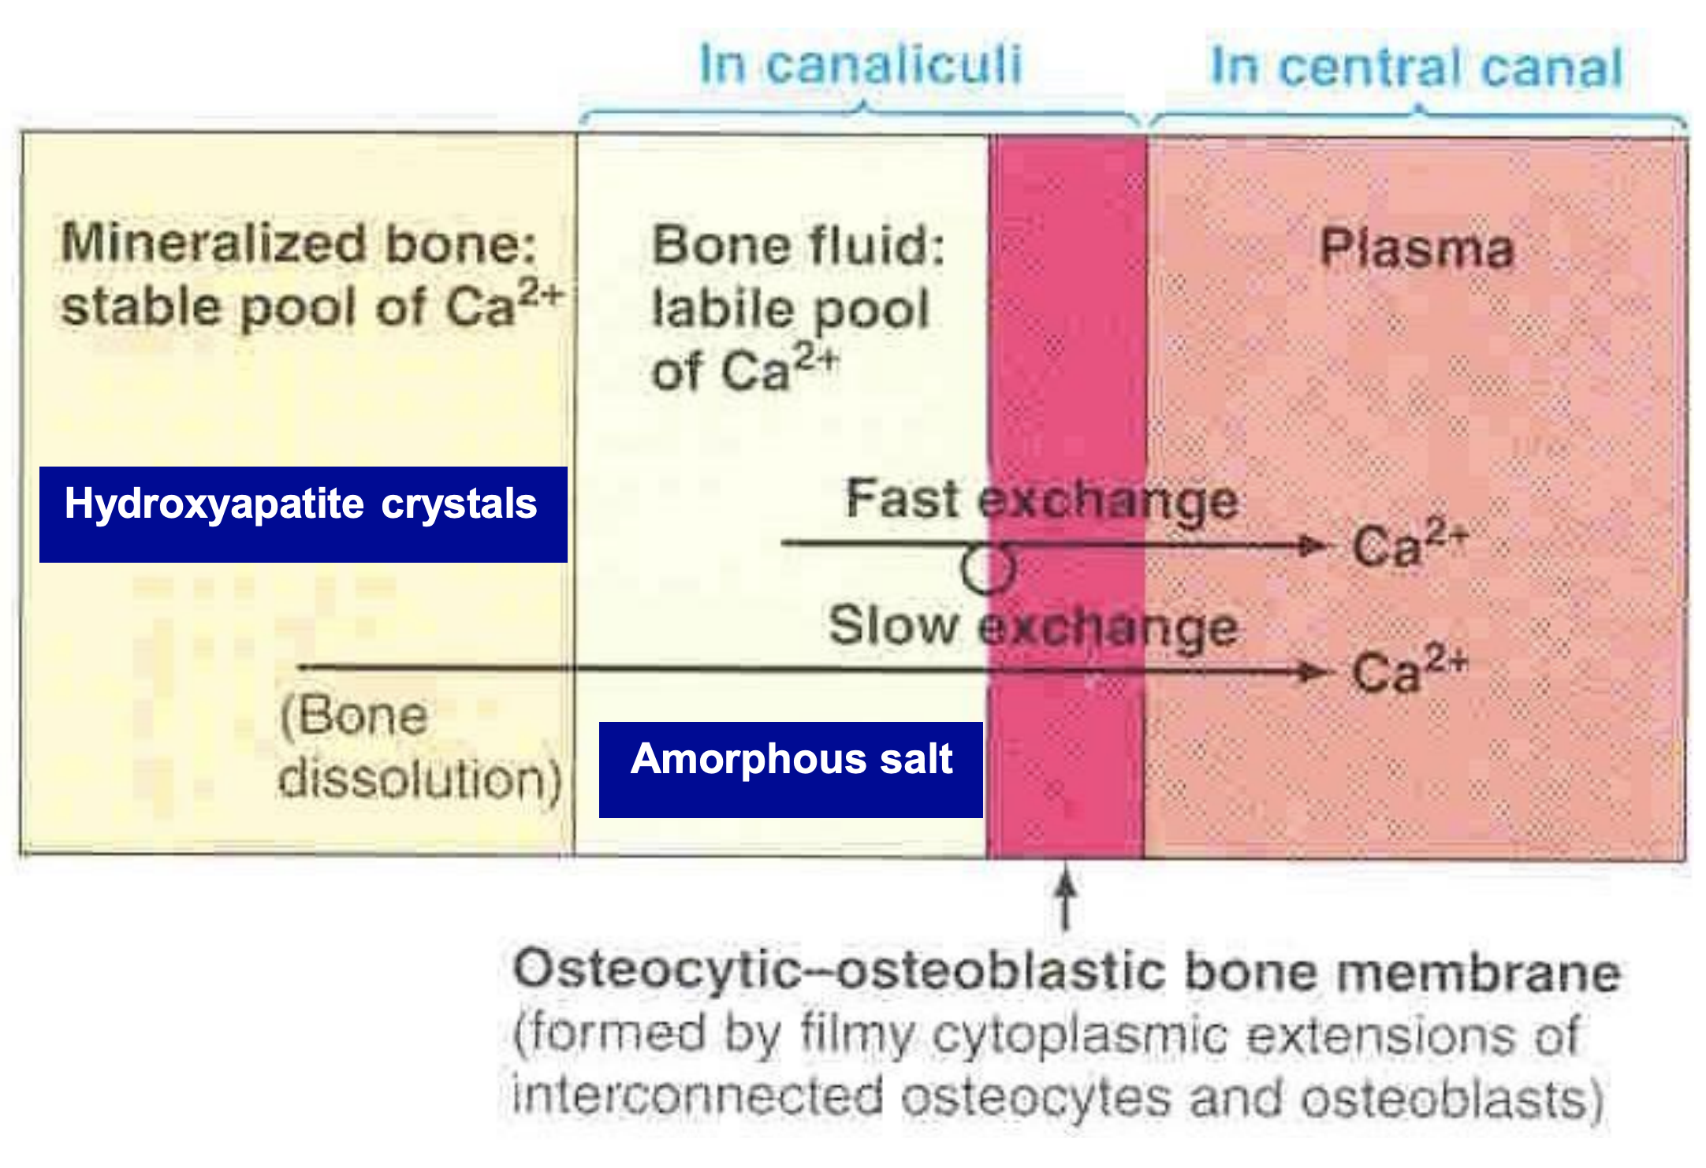
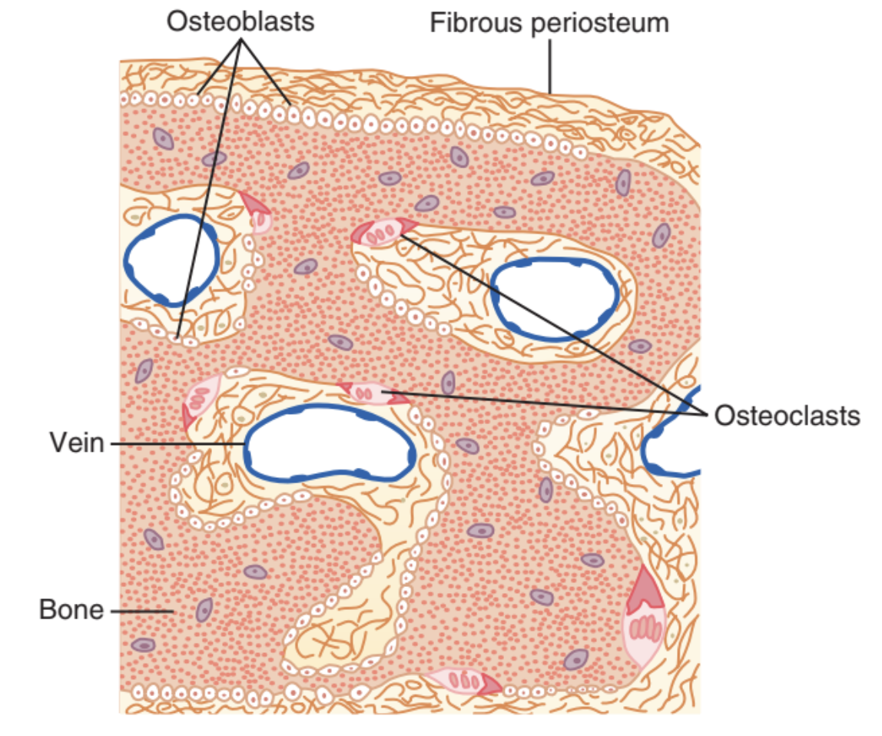
4
CALCIUM HOMEOSTASIS
Lecture Eight
Bone Composition
Organic Matrix (Tensile Force)(30%):
1. Collagen Fibers → 95%
2. Ground Substance: ECF and Proteoglycans → 5%
Bone Salts (Compressional Force)(70%):
1. Salts of Calcium and Phosphate in the form of Hydroxyapatite crystals Ca₁₀(PO₄)₆(OH)₂ → 99%
2. Mg, Na, K, Carbonate ions.
3. Amorphous salts: exchangeable calcium that plays a role in the rapid regulation of ionized Calcium level in ECF. Always in equilibrium with Calcium in ECF.
0.4-1% of total bone Ca²⁺.
Figure 8-4 shows that the bone contains a type of exchangeable calcium in a form of readily mobilizable salt (Amorphous salts) that is always in equilibrium with calcium ions in the ECF. These calcium salts, unlike hydroxyapatite are highly soluble and in contact with the ECF (through osteocytes, discussed in page 7), so that when calcium level drops, these salts can quickly re-establish equilibrium. Osteocytes are provided with pumps to move this calcium.
Figure 8-3
Figure 8-4
Remodeling of Bone
Bone is continually being deposited by osteoblasts, and it’s continually being resorbed where osteoclasts are active.
Figure 8-5
Hormonal Regulation of Calcium
01
02
03
Parathyroid hormone
Vit D
Calcitonin
FOOTNOTES
Tensile Force: Is the force required to pull-down or tear an elastic material, an example of this is the tearing up of a rope when pulled in high strength. Bone is provided with this force by collagen, which is why Vit. C deficiency can cause brittle bones.
Compressional Force: Is basically the force applied on an object that causes it to break, fracture or be squashed.

Slide 6
5
CALCIUM HOMEOSTASIS
Lecture Eight
Vitamin D (1,25 Dihydroxycholecalciferol)
Vitamin D is a prohormone that must undergo two successive hydroxylation reactions to become the active form known as 1,25-dihydroxyvitamin D or calcitriol.
It is formed in the skin from (7- dehydrocholesterol) by Ultraviolet B light.
Then stored in the liver
Converted in the liver to 25- Hydroxycholecalciferol
Feedback control limits concentration¹
Converted to the active form in the kidney: (parathyroid hormone (PTH) stimulates 1α hydroxylase which makes 1,25- Dihydroxycholecalciferol (calcitriol)
Under the feedback control of (PTH)
Sunlight
(Ultraviolet
B light).
1𝛼-Hydroxylase
Kidney
1,25-Dihydroxycholecalciferol
aka 25-Dihydroxyvitamin D₃
Skin
7-Dehydrocholesterol
25-hydroxycholecalciferol
aka 25-hydroxyvitamin D₃
Cholecalciferol (Vit D₃)
Liver
Dietary intake:
Vit D₃ → Fish and Meat
Vit D₂ → Supplements
Vitamin D Effects:
Takes a couple of days to fully develop response.
Vitamin D in the form of 1,25 Dihydroxycholecalciferol increases calcium blood level by:
Kidney: ↑ Renal Ca²⁺ and PO₄³⁻ reabsorption (weak effect)²
Bone: Works with PTH to cause calcium absorption from bone.
Intestine: Promotes intestinal absorption of Ca²⁺ and PO₄³⁻ by increasing the formation of calcium binding protein, calcium stimulated ATPase and alkaline phosphatase and related facilitated transport.
Stimulates differentiation of immune cells.³
FOOTNOTES
Meaning that 25-hydroxycholecalciferol (final product of liver metabolism before kidney activation) inhibits further conversion of cholecalciferol by the liver, This is important because 25-hydroxycholecalciferol has a short half-life, in contrast, cholecalciferol has a longer half-life up to months. So this inhibition allows more storage.
Difference between absorption and reabsorption: Main absorption of food occurs in the intestines, however absorbed substances can be filtered through the kidney and then be absorbed a second time, hence why we call it reabsorption.
Vitamin D acts on nuclear receptors, causing gene transcription and hence protein synthesis. And this is why it can stimulate differentiation of many cells, since differentiation depends on the expression of genes.

Slide 7
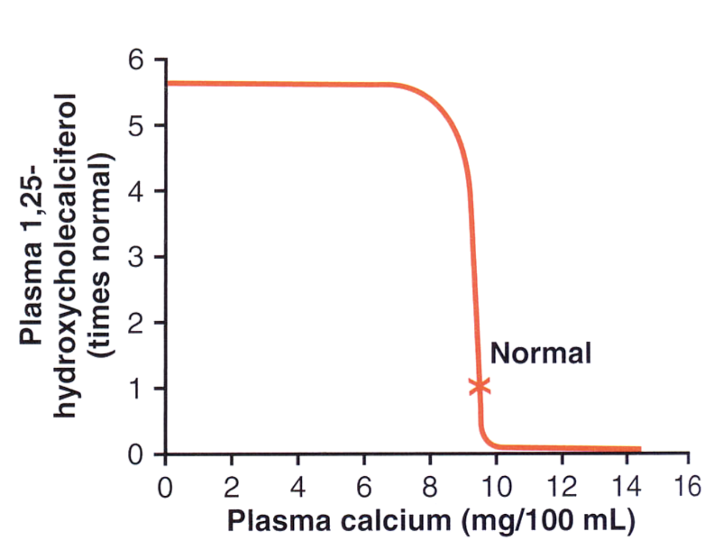
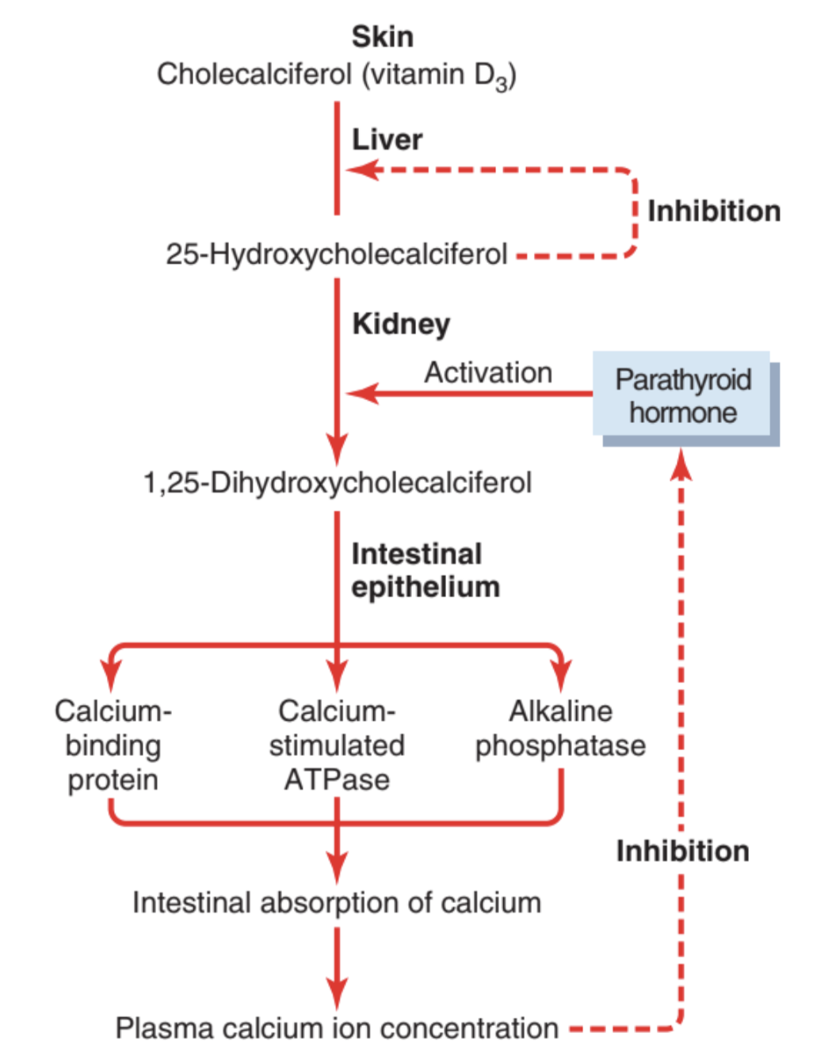
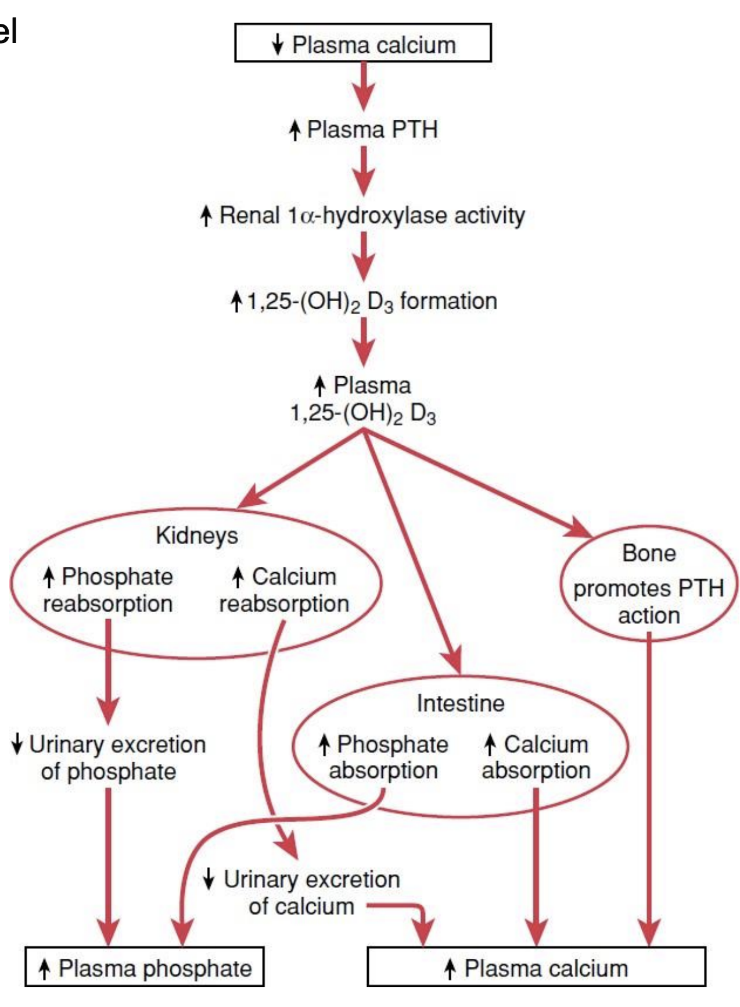
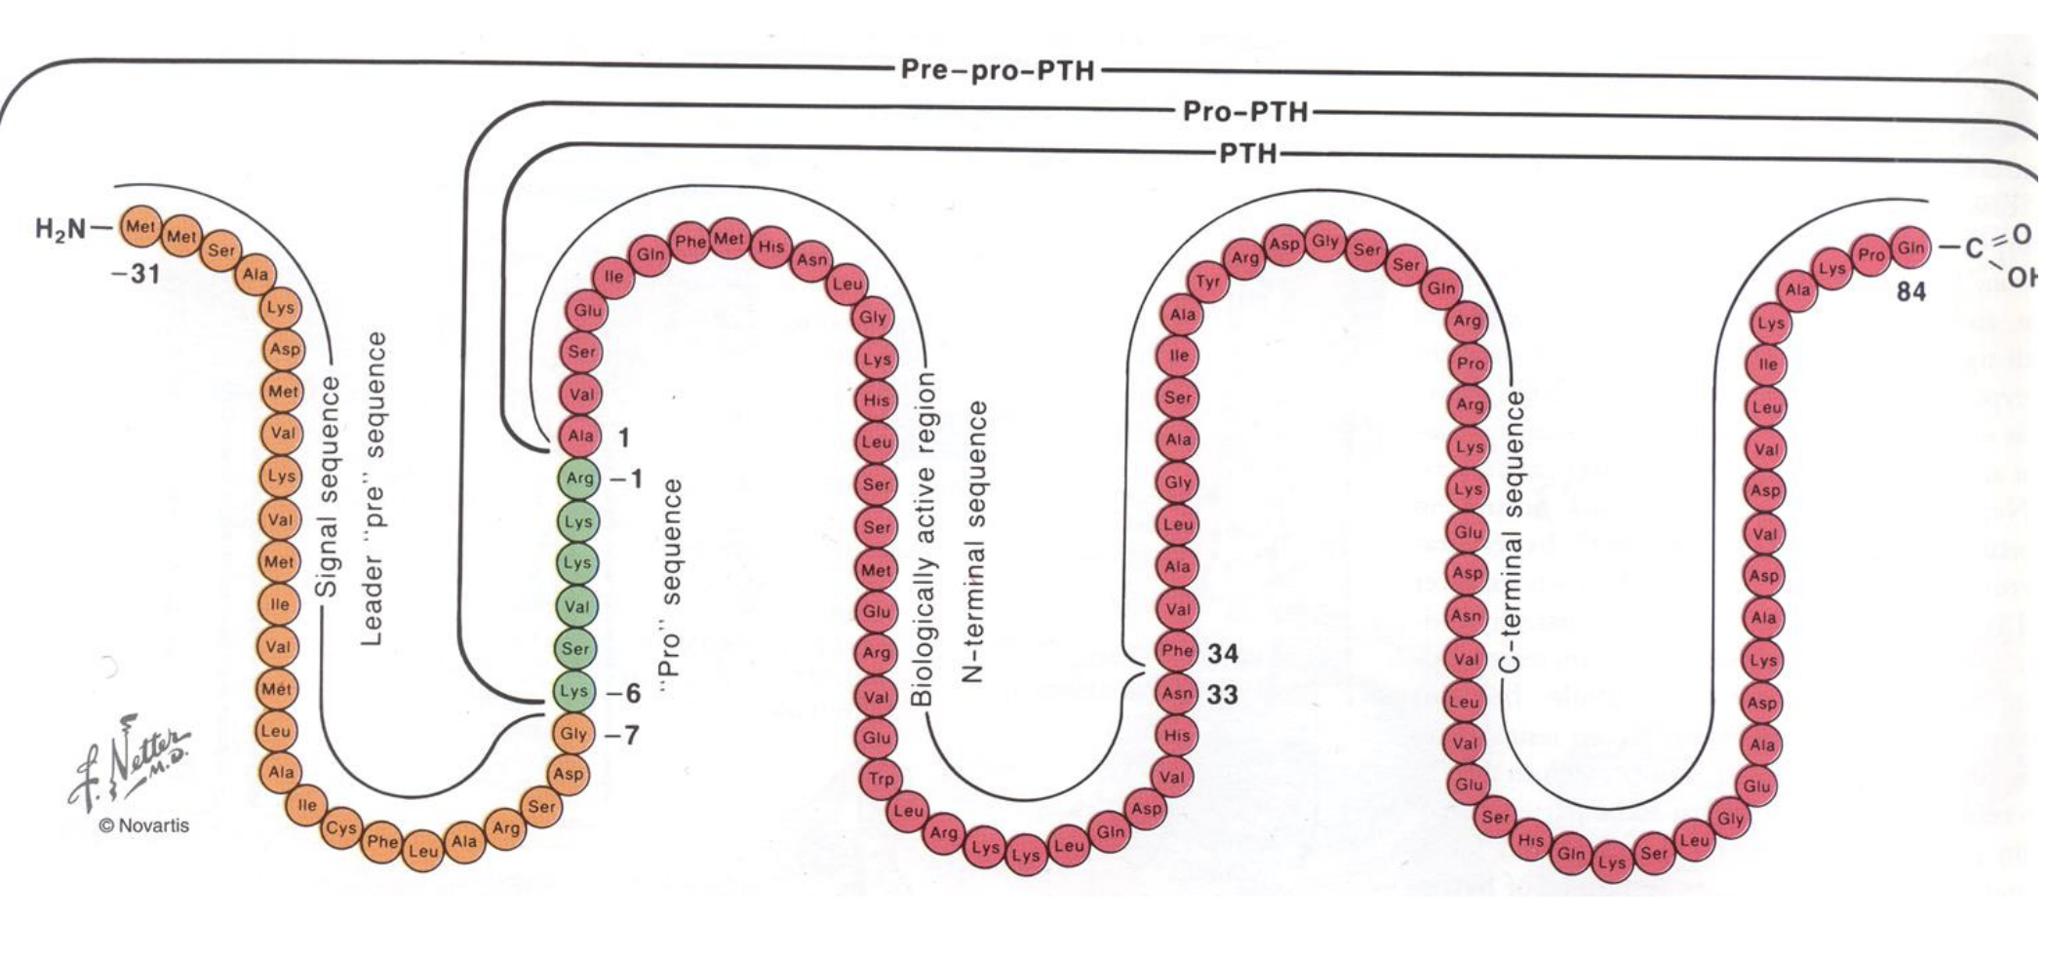
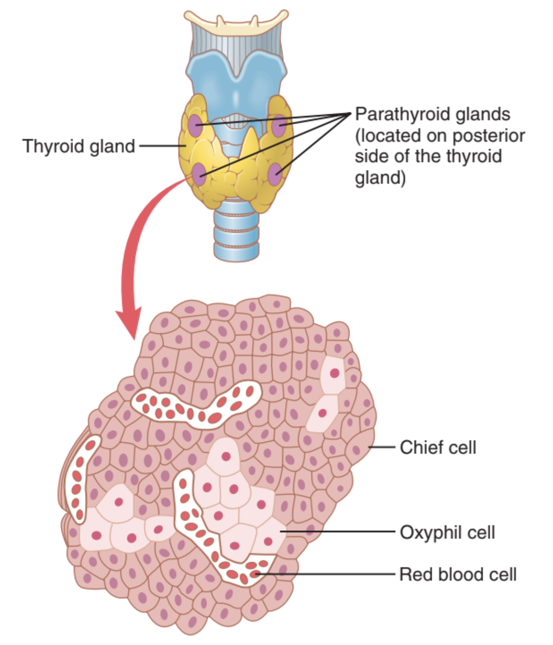
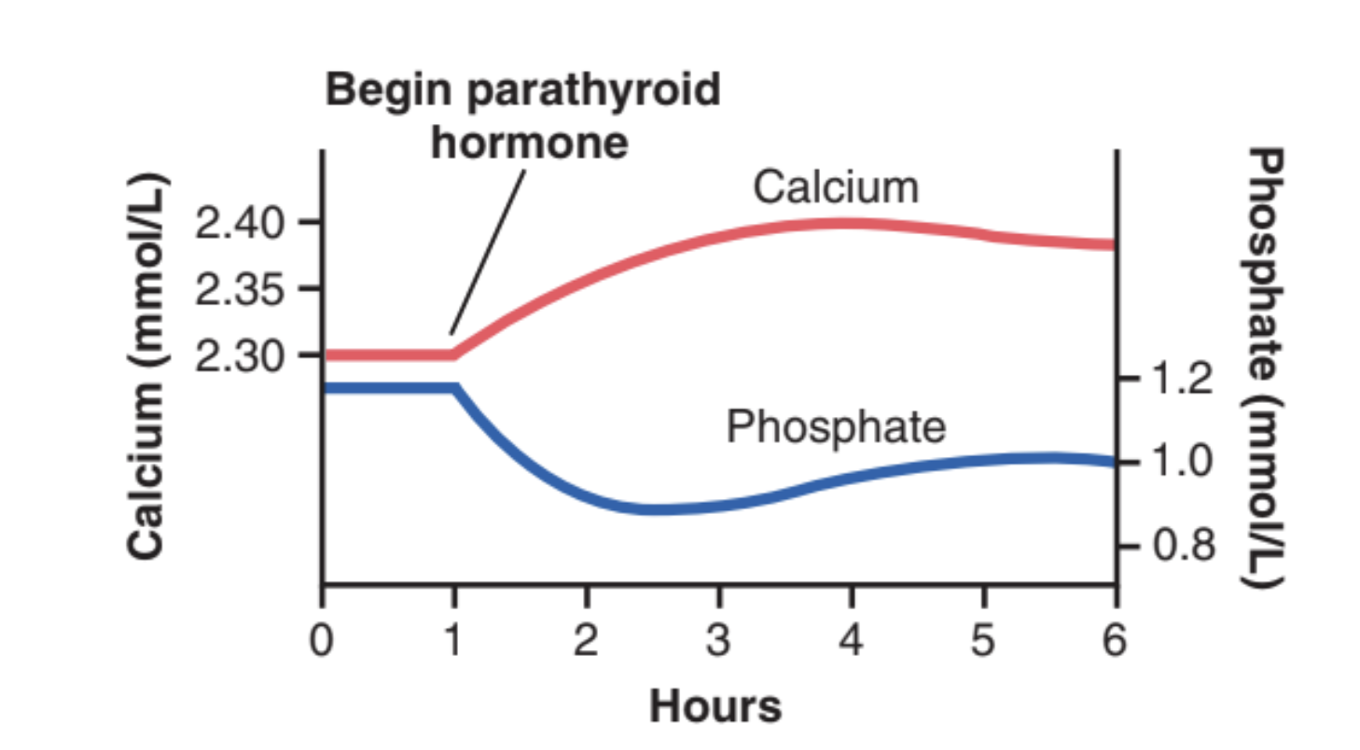
6
CALCIUM HOMEOSTASIS
Lecture Eight
Effects of Vitamin D on Bone & Its Relation to Parathyroid Hormone Activity
Vitamin D in smaller quantities :
- Promotes bone calcification (by ↑ calcium and phosphate absorption from the intestine and enhances the mineralization of bone).
The administration of extreme quantities of vitamin D:
- causes absorption of bone by:
1. Facilitating PTH action on bones 2. Number & activity of osteoclasts.
Control of Vitamin D
Stimulation of renal 1𝛼-Hydroxylase occurs by:
Low Calcium ions
Prolactin
PTH
Figure 8-8
Effect of plasma calcium concentration on the plasma concentration of 1,25-dihydroxycholecalciferol.
This figure shows that a slight decrease in calcium concentration below normal causes increased formation of activated vitamin D, which in turn leads to greatly increased absorption of calcium from the intestine.
Figure 8-6
Figure 8-7
Figure 8-9
Parathyroid Hormone (PTH)
Figure 8-10
Source: Chief (principal) cells of parathyroid gland
Polypeptide hormone: (84 aa)
Molecular Weight: 9500
Half Life: 10 min
Mechanism of action: acts via 2nd messenger mechanism utilizing G-protein coupled receptor and cAMP
Effect (Rapid -minutes- response to reduced calcium):
- Increase plasma Calcium level
- Decrease Phosphate level
Figure 8-11
Approximate changes in calcium and phosphate concentrations during the first 5 hours of PTH infusion at a moderate rate.
Even though PTH stimulates phosphate absorption from bone, the effect on PTH on phosphate excretion is far greater, leading to a decreased phosphate concentration.

Slide 8
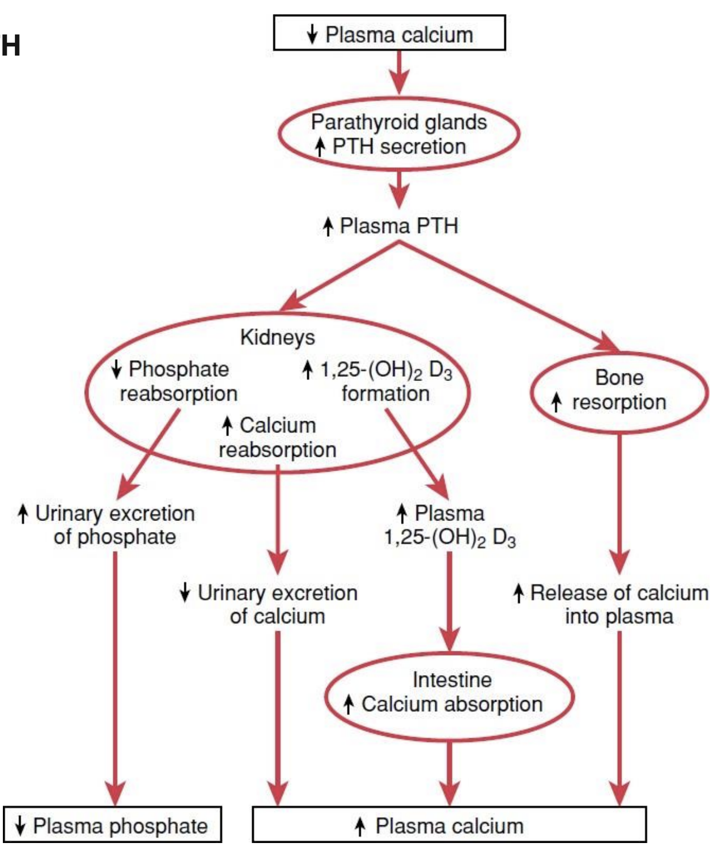
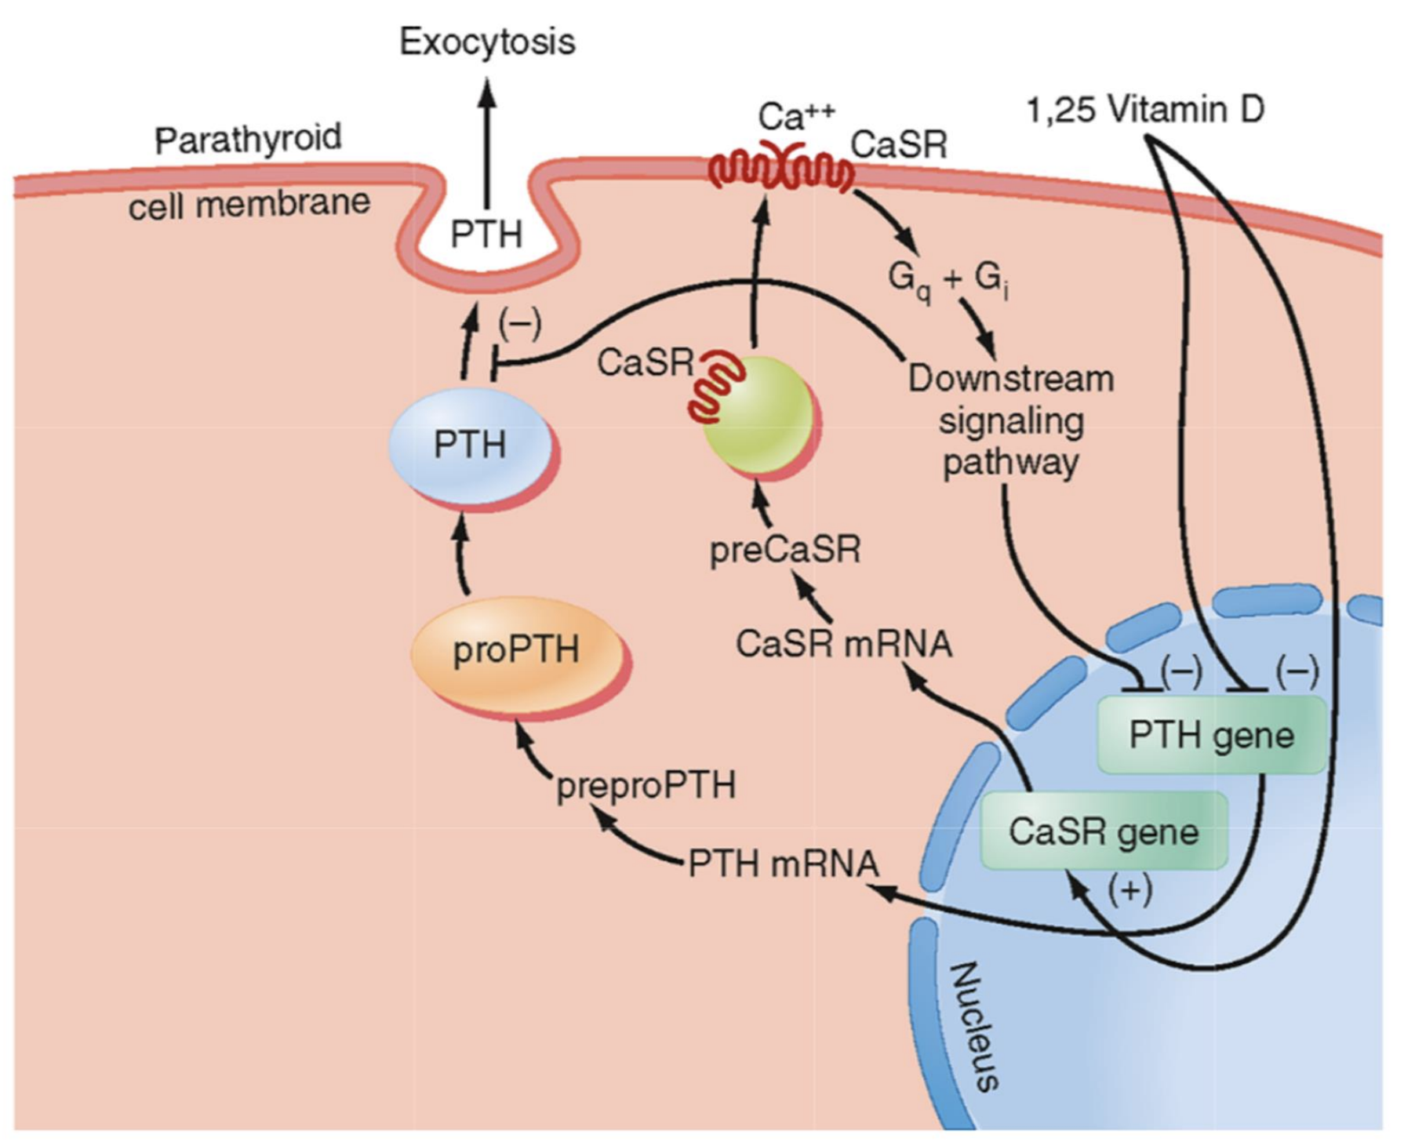
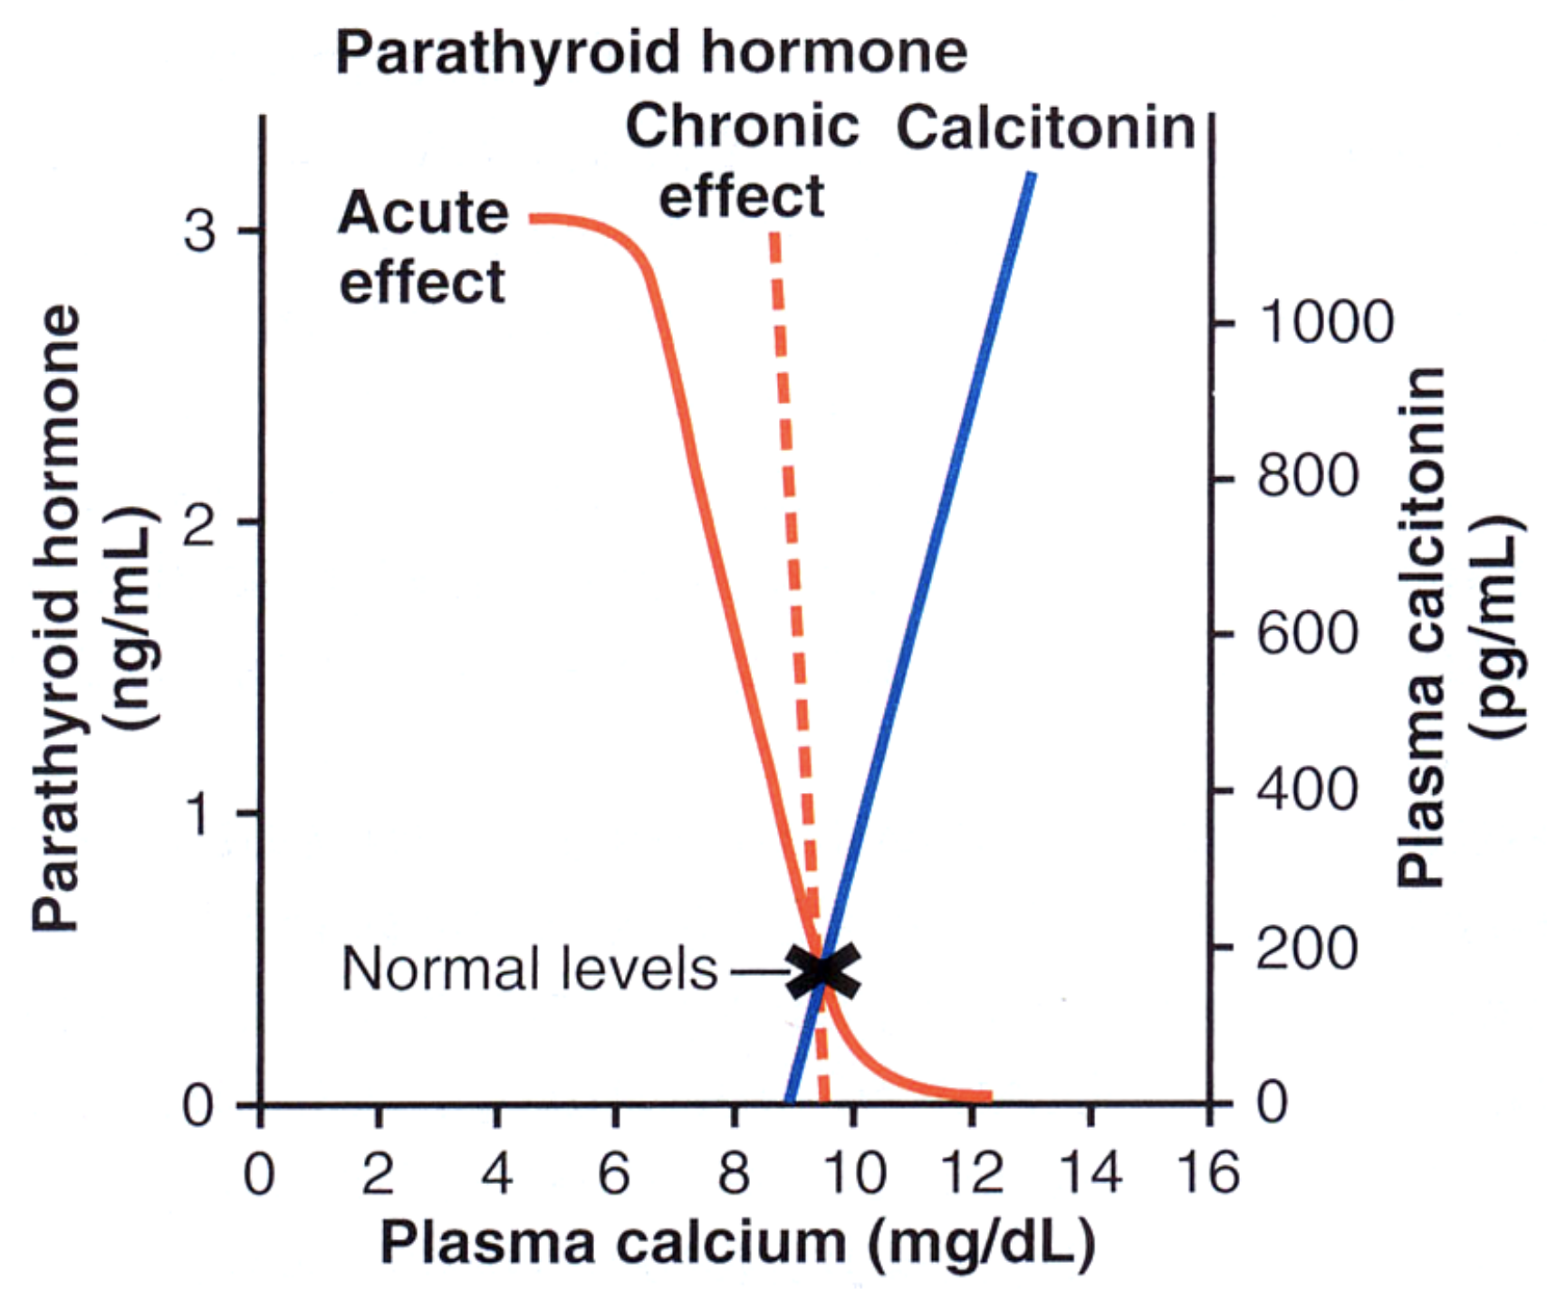
7
CALCIUM HOMEOSTASIS
Lecture Eight
Parathyroid Hormone (PTH)
PTH acts on (mainly kidneys, bone and intestine):
1. ↓ Phosphate reabsorption from the proximal convoluted tubules (phosphaturic action). Leading to:
↑ Phosphate excretion in the urine and
↓ plasma phosphate concentration.
2. ↑ Ca²⁺ & Mg ions reabsorption from the distal convoluted tubules, collection ducts and ascending loop of Henle, decreasing its excretion to prevent bone deterioration.
3. ↑ Formation of 1,25 vit D₃ in the kidney.
Increase calcium & phosphate resorption from the bone via:
1. New osteoclasts² are formed and existing osteoclasts are activated (days to weeks) to digest bone and release calcium and phosphate.
(Stimulated indirectly by osteoblasts which express RANKL that binds to RANK on osteoclasts leading to their activation)
2. Depression of osteoblastic activity Existing osteocytes¹ stimulated (minutes to hours) to transport calcium – calcium pumps.
↑ absorption of calcium and phosphate indirectly through stimulating the formation of
1,25 – (OH)₂ -D₃ in kidney
Effect of Calcium level on PTH
Figure 8-12
Figure 8-13 Showing the sensitivity of parathyroid cells to calcium concentration. Calcium binds to specific receptors (Calcium-Sensing Receptors) and activates cascades that inhibits the transcription of PTH gene.
Vitamin D also acts through nuclear receptors and potentiates the action of calcium both directly and indirectly by increasing calcium receptors.
Decreased activation of calcium receptors will lead to more secretion of PTH.
This is how the parathyroids sense calcium levels.
Figure 8-14
Figure 8-14 Note that the secretion of PTH increases markedly below approx. 10mg/dl.
Chronic decrease over weeks can cause extreme increase in PTH secretion and clinically will manifest as hypertrophy of parathyroids.
Acute decrease of calcium concentration will cause marked increase in PTH secretion, starting within minutes.
Calcitonin plays a minor role, it decreases calcium concentration when it increases around 10% the normal leveL
However, the action of calcitonin is limited, as soon as plasma calcium level reaches 10 mg/dl, the effect of calcitonin is overridden by the more powerful PTH.
FOOTNOTES
Osteocytes can absorb calcium from bones, this happens in the following manner: Osteocytes are present on bone surfaces, and are connected to each other forming an “osteocytic membrane system”, this membrane is separated from bony surfaces by bone fluid which contains exchangeable calcium (very soluble), and is in direct contact with ECF from the other side. These osteocytes are provided with calcium pumps that are activated by PTH. This pump transports calcium from bone fluid to ECF. This is responsible for the rapid increase in calcium concentration.
In contrast, osteoclasts take longer to be activated, and digest bone itself rather than relying on exchangeable calcium.

Slide 9
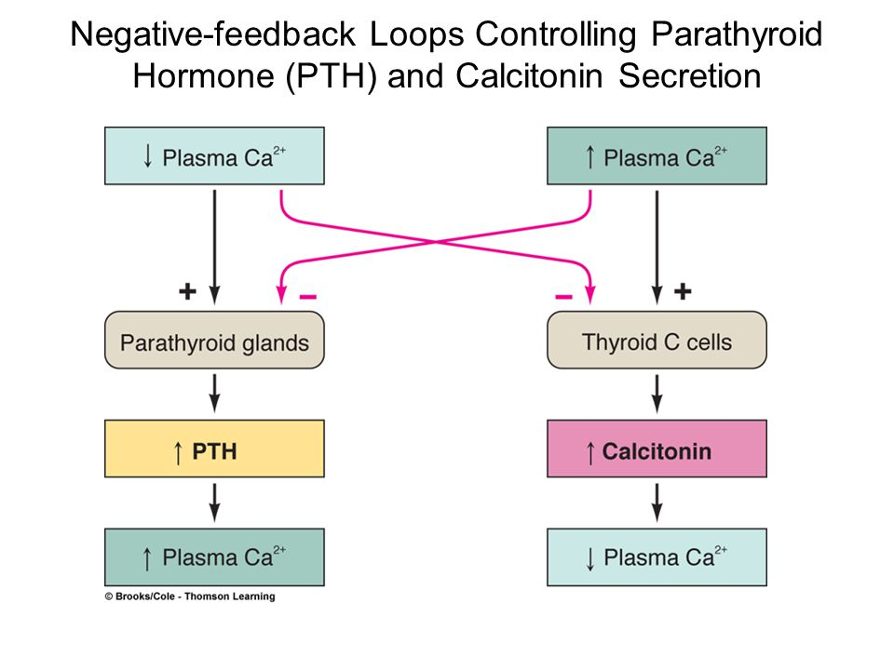
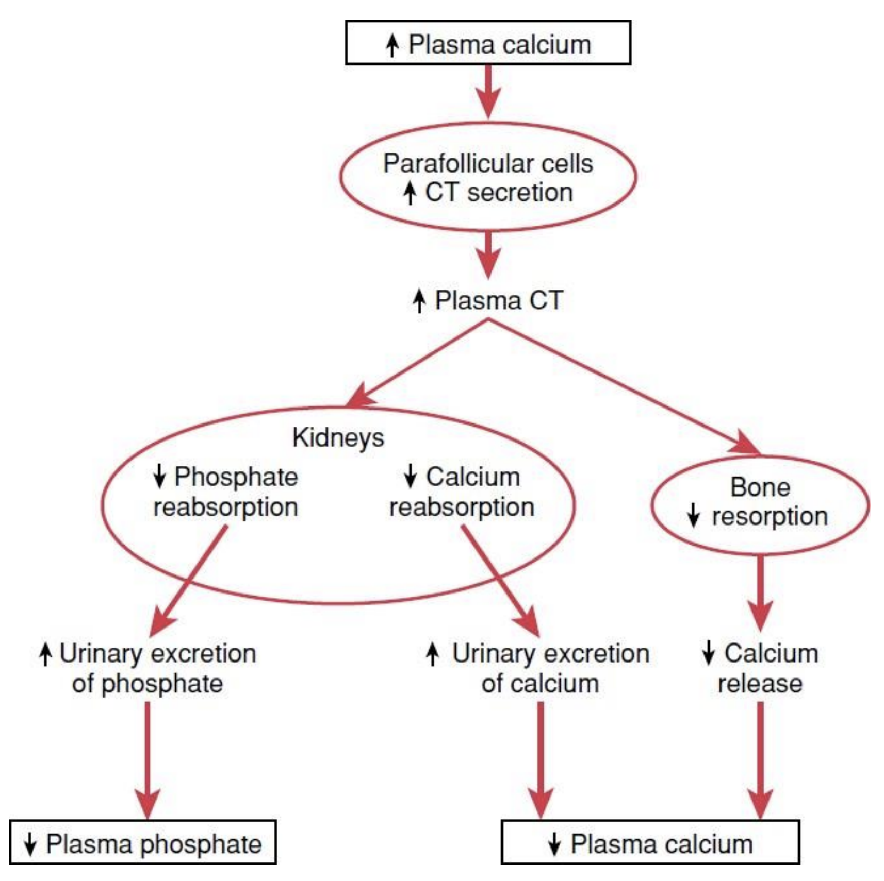
8
CALCIUM HOMEOSTASIS
Lecture Eight
Calcitonin
Source: Secreted by the parafollicular cells (C cells) of the thyroid gland.
Nature: 32 amino acid peptide.
Stimulus for secretion: Increased plasma calcium concentration.
Function:
- Decrease blood Ca²⁺ level very rapidly within minutes.
- Opposite effect to PTH.
Acts on:
↓↓ Ca²⁺ reabsorption
↑↑ Ca²⁺ excretion (in addition to phosphate)
Has weak effect on kidney and intestine.
↑ Ca²⁺ deposition of bone
Inhibits bone resorption:
inhibition of osteoclasts
↓ formation of new. osteoclasts (Osteoclast decrease causes osteoblast decrease).
Effect of Calcium level on Calcitonin
Figure 8-15
Figure 8-16
Figure 8-17

Slide 10
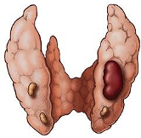
9
HYPO AND HYPERPARATHYROIDISM
Lecture Nine
Disorders
Hypercalcemia
Hypocalcemia
Vitamin D deficiency
osteoporosis
Common causes of Hypercalcemia:
PTH mediated
Primary hyperparathyroidism
Affects approximately 100,000 patients a year (in the US).
Prevalence: 0.1 to 0.3% of the general population.
More common in women (1:500) than in men (1:2000).
Patients with single adenoma (~90%): minimally invasive surgery.
Non-PTH mediated
Parathyroid hormone–related peptide (PTHrP): certain tumors secrete high levels of PTHrP, which causes hypercalcemia of malignancy.
Vitamin D intoxication, granulomatous disorders¹, osteolytic bone metastases², malignancy
Medications: Thiazide diuretics³
Clinical manifestations of Hypercalcemia:
Nausea,vomiting, Anorexia, weight loss, constipation
Confusion, stupor, coma, Impaired concentration and memory Depression
Reduced neuromuscular excitability and muscle weakness (calcium blocks sodium channels and inhibits depolarization), Lethargy and Fatigue, Proximal muscle weakness
Cardiac arrhythmias, Vascular calcification
Kidney stones
Treatment of Hypercalcemia(severe):
Indications for therapy:
Symptoms of hypercalcemia
Plasma [Ca] >14 mg/dl
Principles of therapy:
Expand ECF volume to dilute Ca2+ conc.
Increase urinary calcium excretion
Decrease bone resorption
NS(normal saline) bolus to restore volume; then 100 – 200 ml/hr
Bisphosphonates (onset 24-48 hrs)
Calcitonin 4 – 8 IU q6-8 hrs (onset immediate, resistance develops in 24-48 hrs)
Surgery for adenoma
Figure 9-1 Tumor of parathyroid gland.
Hyperparathyroidism
The disorder is characterized by hypercalcemia, hypercalciuria, hypophosphatemia, and hyperphosphaturia.
Parathyroid hormone causes phosphaturia and a decrease in serum phosphate , Calcium rises and it is also secreted in the urine⁴.
Most common complication are renal stones made of calcium phosphate (Stone chemistries: calcium, phosphate, urate).
Most serious complication is the deposition of calcium in the kidney tubules resulting in impaired renal function.
FOOTNOTES
Footnotes
due to dysregulated production of Calcitriol by activated macrophages trapped in pulmonary alveoli and granulomatous inflammation.
Prostaglandins arising from tumor itself (such as prostaglandin E2) cause this erosive effect.
Thiazides (antiHTN) blocks NaCl transporter. Lower sodium lvls facilitate calcium/sodium exchange, Increasing it’s resorption as a result.
PTH increases reabsorption of Ca2+ but hypercalciuria accompanies it. WHY? Well, the increase in the load of filtered calcium overwhelms the effect of reabsorption:(

Slide 11
10
HYPO AND HYPERPARATHYROIDISM
Lecture Nine
Causes of Hyperparathyroidism
Primary¹
Secondary (normo- or hypocalcemia)
Adenoma (90%)
Multiple gland enlargement (10%)
Familial hyperparathyroidism²
Carcinoma (<1%)
Familial benign hypercalcemia (FBH)²
Chronic renal failure (↓ 1,25 (OH) – D3 synthesis) , vitamin D deficiency.
Low calcium diet
Pregnancy, lactation.
Rickets
Osteomalacia
causes
causes
Manifestations:
Hypercalcemia (↑ Ca²⁺)
Hypophosphatemia (↓PO₄³⁻), Hyperphosphaturia.
Hypercalciuria
Calcium containing stones in kidney (calcium phosphate stones most common
Demineralisation of bone: multiple bone cysts (osteitis fibrosa cystica)
Easily broken bones
↑ Alkaline phosphatase³
CNS & Peripheral nervous system depression
Muscle weakness
Constipation, Abdominal pain
Peptic ulcer
Decrease appetite
Depressed relaxation of the heart during systole.
Parathyroid poisoning: Precipitation of calcium in soft tissues occur when Ca²⁺ > 17 mg/dl leading to death.
(due to ↓ Ca²⁺ in ECF → ↑ PTH → ↑ Ca²⁺)
In secondary hyperparathyroidism the cause usually leaves the gland intact, like vitamin D deficiency, which as we remember helps in calcium absorption (without it only trace amounts will be ansorbed), therefore initially the patients present with hypocalcemia and hyperphosphatemia. As we know, vitamin D inhibits the release of PTH (Figure 8-13). So it’s deficiency will lead to excess PTH. Eventually compensation will happen.
Compensatory Manifestations:
Hypercalcemia (↑ Ca²⁺)
Hypophosphatemia (↓PO₄³⁻)
Hypercalciuria
Demineralisation of bone: multiple bone cysts (osteitis fibrosa cystica)
Calcium containing stones in kidney
Precipitation of calcium in soft tissues occur when Ca²⁺ > 17 mg/dl.
Secondary (compensatory)
Primary¹
Wolff’s Law:
“Use it, or lose it”
States that bone in a healthy person or animal will
adapt to the loads under which it is placed. If loading on a
particular bone increases, the bone will remodel itself over
time to become stronger to resist that sort of loading.
The remodeling of bone in response to loading is achieved via mechanical stress.
Prolonged immobilization might lead to bone resorption and increased calcium plasma levels.
Figure 9-2 Demineralization of bone leading to multiple bone cysts (osteitis fibrosa cystica).
FOOTNOTES
Footnotes
In primary hyperparathyroidism the problem is in the parathyroid gland itself, the cause ordinarily is a tumor of one of the parathyroid glands; such tumors occur much more frequently in women than in men or children, mainly because pregnancy and lactation stimulate the parathyroid glands and therefore predispose to the development of such a tumor.
FBH is caused by an abnormal set-point for PTH secretion in the calcium sensing receptor (CASR)— we need more Ca2+for the CaSR to sense. Whereas in familial hyperparathyroidism, the body requires higher amounts of PTH to maintain normal Ca2+ lvls.
Osteoblastic activity in the bones also increases to make up for the bone loss(in a vain attempt). And secrete large quantities of alkaline phosphatase.

Slide 12
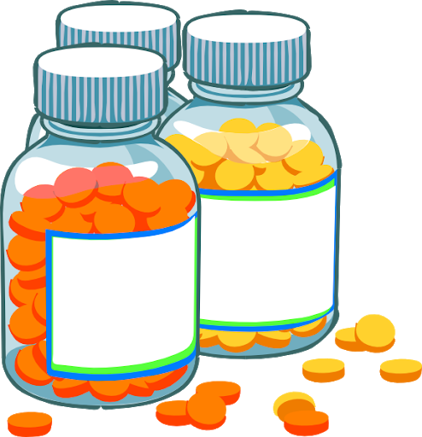
11
HYPO AND HYPERPARATHYROIDISM
Lecture Nine
disorders
hypercalcemia
hypocalcemia
Vitamin D deficiency
osteoporosis
Causes of hypocalcemia:
Hypoparathyroidism
Surgical (thyroid, parathyroid surgery)
Autoimmune
Magnesium deficiency¹
PTH resistance (pseudohypoparathyroidism): Normal PTH levels but deficient receptors
Vitamin D deficiency
Vitamin D resistance
Lack of 1α hydroxylase, no vit D3 activation
Other: renal failure, pancreatitis, tumor lysis.
Hypoparathyroidism
Paresthesia (Tingling in the lips, fingers, and toes)
Delayed cardiac repolarization with prolongation of the QT interval
Positive Chvostek’s sign (facial muscle twitch)
Positive Trousseau’s sign (carpal spasm)
Tetany (can be overt or latent)
Muscle cramps and pain in the face, hands, legs, and feet.
Dry hair, brittle nails, and dry, coarse skin
Cataracts on the eyes
Malformations of the teeth, including weakened tooth enamel.
Loss of memory, Headaches²
neuromuscular irritability, numbness, anxiety, carpopedal spasms².
Hypocalcemia, hyperphosphatemia .
Severe Hypocalcemia is followed by convulsions, stridor (Laryngospasm, stridor and apneas (main cause of death in neonates), dystonia, and depression.
signs/Symptoms due to hypocalcemia
Treatment of Hypoparathyroidism: Calcium carbonate and vitamin D supplements³.
Positive Chvostek's sign (facial muscle twitch)
Positive Trousseau’s sign(carpal/carpopedal spasm)
It refers to an abnormal reaction to the stimulation of the facial nerve.
When the facial nerve is tapped at the angle of the jaw (masseter muscle) as it emerge from the parotid gland in front of the ear, the facial muscles on the same side of the face will contract momentarily (typically a twitch of the nose or lips) because of hypocalcemia.
is facial nerve irritability/spasms elicited by tapping the nerve.
A blood pressure cuff is placed around the arm and inflated to a pressure greater than the systolic blood pressure and held in place for 3 minutes ,This will occlude the brachial artery.
In the absence of blood flow, the patient's hypocalcemia and subsequent neuromuscular irritability will induce spasm of the muscles of the hand and forearm.
The wrist and metacarpophalangeal joints flex.(check figure 9-4 )
FOOTNOTES
Footnotes
CaSRs of the parathyroid senses low Ca, and increase PTH secretion. But it also detects Mg -as it has the same charge as Ca- Therefore when magnesium levels are low, PTH secretion is increased. But in severe magnesium deficiency a bizarre reaction happens and PTH secretion actually decreases! The mechanisms for this are not clear.
Read Extracurricular Reading Number 5 for further explanation.
PTH is occasionally used to treat hypopara­thyroidism. However, hypoparathyroidism is usually not treated with PTH because this hormone is expensive, its effect lasts for a few hours at most, and the tendency of the body to develop antibodies against it makes it progressively less and less effective.

Slide 13
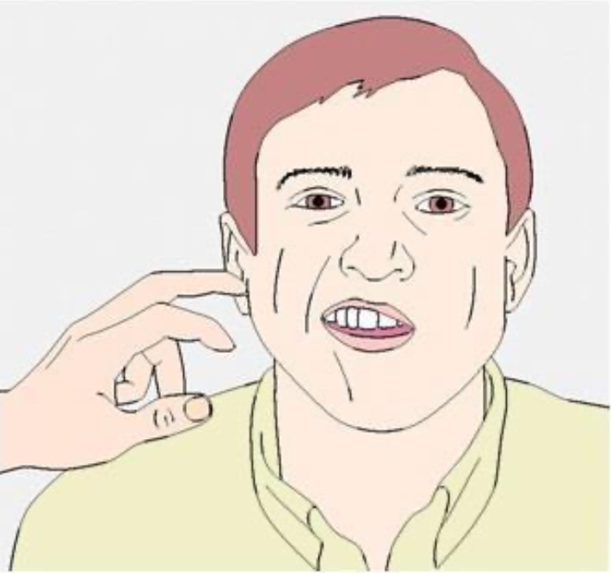
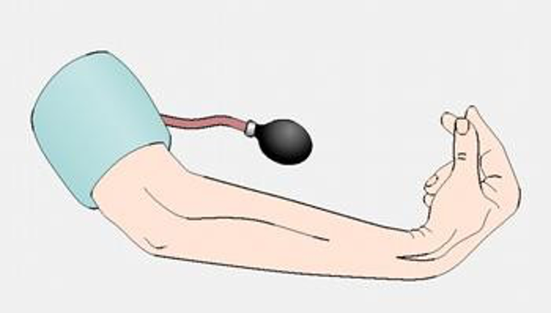
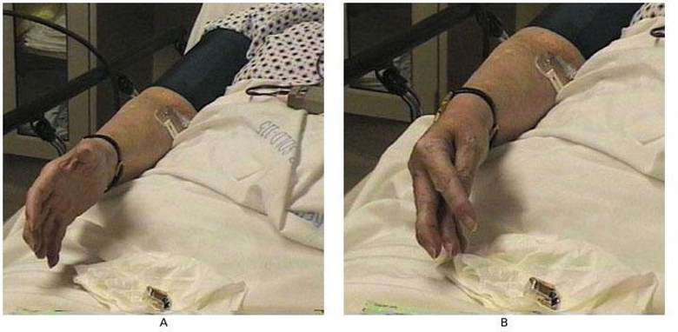
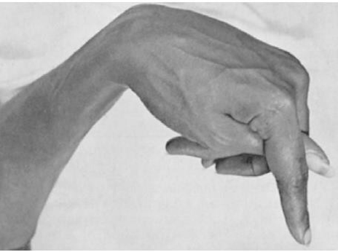
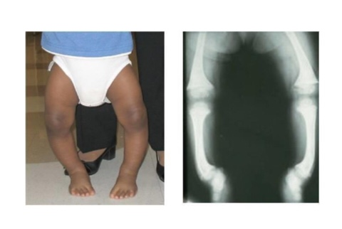
12
HYPO AND HYPERPARATHYROIDISM
Lecture Nine
Figure 9-4 Carpal spasms occur. (metacarpophalangeal and wrist joints are flexed, fingers are adducted) (due to enhanced neuromuscular excitability)
Figure 9-4 When an occlusion of brachial artery with a blood pressure cuff
Figure 9-3 , Chvostek's sign
disorders
hypercalcemia
hypocalcemia
Vitamin D deficiency
osteoporosis
Rickets
Normal formation of the collagen matrix
BUT
Incomplete mineralization (poor calcification)
Soft bones clinically: bone deformity (rickets)
Rickets (In children)
Cause | Occur
lack of vitamin D leading to calcium/phosphate deficiency in ECF | In the spring
Features | Treatment
Low plasma calcium and phosphate Weak bones Tetany | supplying adequate calcium and phosphate in the diet and, administering large amounts of vitamin D.
Tetany in Rickets
Early stage:
No tetany
(PTH stimulate osteoclastic absorption of bone)
ECF Calcium level is normal
When the bones finally become exhausted of calcium:
Calcium level falls rapidly.
blood level of calcium falls below 7 mg/dl :
→ signs of tetany: (positive Chvostek's sign)
→Death: tetanic respiratory spasm

Slide 14
13
HYPO AND HYPERPARATHYROIDISM
Lecture Nine
Osteomalacia
Osteomalacia: demineralization (poor calcification) of preexisting bones which leads to more susceptibility to fractures.
Adult rickets: Rare serious deficiencies of both vitamin D and calcium occasionally occur as a result of steatorrhea (failure to absorb fat).
Poor absorption of vitamin D and calcium
Almost never proceeds to the stage of tetany but often is a cause of severe bone disability
Osteomalacia (Renal Rickets)
It is a type of Osteomalacia due to prolonged kidney disease
Failure of the damaged kidney to form calcitriol.
disorders
hypercalcemia
hypocalcemia
Vitamin D deficiency
osteoporosis
Inadequate bone matrix and minerals.
Osteoporosis is the most common of all bone diseases in adults, especially in old age.
Results from equal loss of both organic bone matrix and minerals resulting in loss of total bone mass and strength.
The cause of the diminished bone:
the osteoblastic activity in the bone is usually less than normal so the rate of bone osteoid deposition is depressed.
excess osteoclastic activity.
Causes of osteoporosis
1
2
3
4
5
6
lack of physical stress
Malnutrition
lack of vitamin C
postmenopausal lack of estrogen¹
Cushing’s syndrome
Old age
Old age
FOOTNOTES
Footnotes
Estrogens prevent osteoporosis by inhibiting the stimulatory effects of certain cytokines on osteoclasts. Recall that Insulin increases bone formation, and there is bone loss in untreated diabetes.

Slide 15
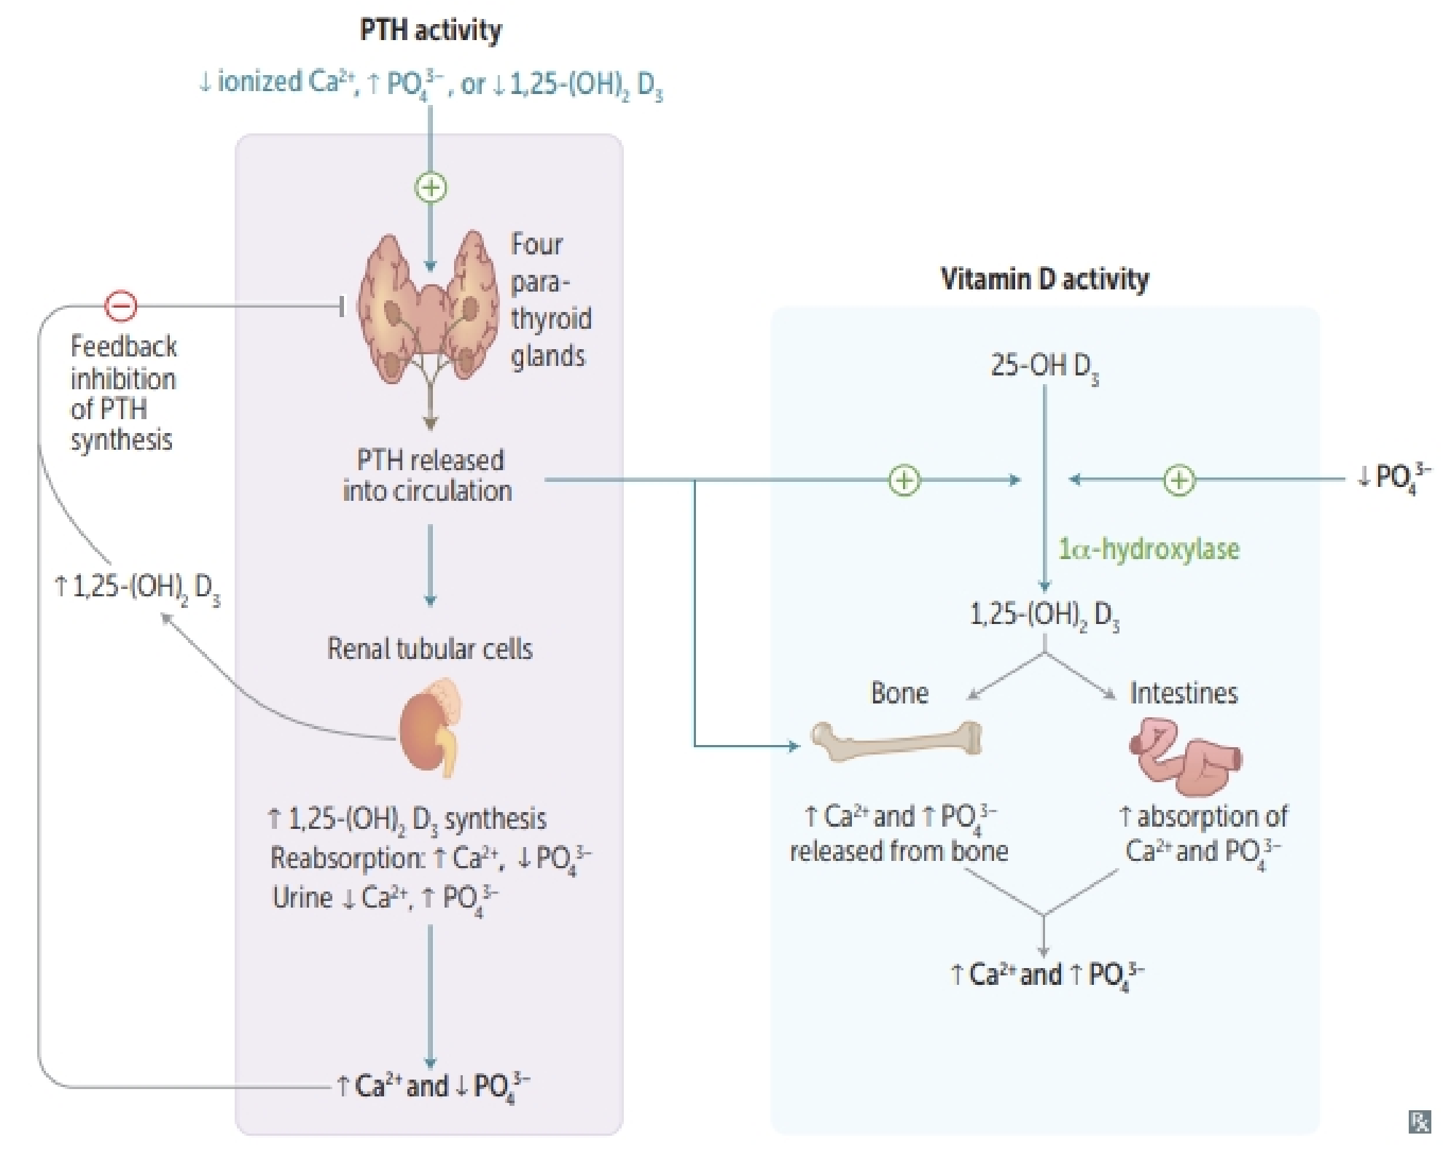
14
CALCIUM HOMEOSTASIS
Lecture Eight
SUMMARY
SUMMARY
Calcium
Plasma Ca²⁺ exists in three forms:
Ionized/free (50%, active form)
Bound to albumin (41%)
Bound to anions (9%)
Alkalosis → Low ionized Ca²⁺ → ↑ PTH secretion
Acidosis → High ionized Ca²⁺ → ↓ PTH secretion
Parathyroid Hormone
Source: Parathyroid gland
Function:
Increase bone resorption of calcium and phosphate
Increase calcium reabsorption from the distal convoluted tubules
Decrease Phosphate reabsorption from the proximal convoluted tubules
Increases the production of 1,25 – (OH)₂ D₃ by stimulating kidney 1𝛼-Hydroxylase
Regulation: ↓ serum calcium or ↑ serum phosphate → PTH secretion
Calcitonin
Source: parafollicular cells (C cells) of the thyroid gland
Function:
Decrease bone resorption of calcium (Calcitonin opposes actions of PTH)
Regulation: ↑ serum calcium → Calcitonin secretion

Slide 16
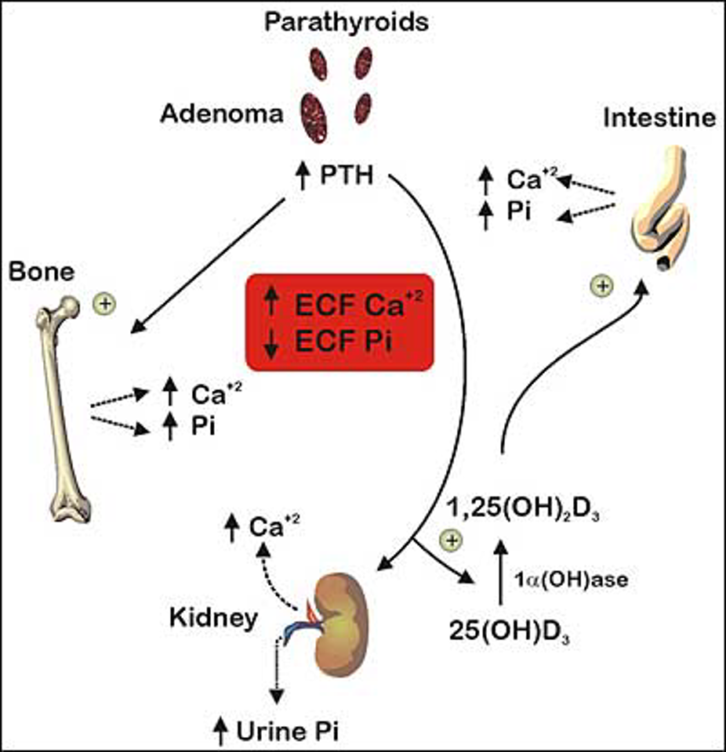
15
HYPO AND HYPERPARATHYROIDISM
Lecture Nine
SUMMARY
Total body calcium
Approximately 1000 grams
Bone (99%)
Non-bone (1%)
Crystalline form (99%)
Bone fluid
Extracellular
Intracellular
Blood stream
Interstitial fluid
Hormone | Actions
VITAMIN D | Calcium ↑ Absorption from Bone ↓ Renal Excretion ↑ Absorption from GIT Phosphate ↑ Absorption from Bone Renal Excretion
PARATHORMONE | Calcium ↑ Absorption from Bone ↓ Renal Excretion Phosphate ↑ Absorption from Bone ↑ Renal Excretion
CALCITONIN | Immediate effect: ↓ Osteoclastic Activity Prolonged Effect: ↓ Formation of new Osteoclasts ↓ Calcium ↓ Phosphate
Figure 9- 5
Rickets | Osteomalacia | Osteoporosis
lack of vitamin D leading to calcium/phosphate deficiency in ECF. Normal formation of the collagen matrix but incomplete mineralization Low plasma calcium and phosphate Weak bones Tetany | serious deficiencies of both vitamin D and calcium occasionally occur as a result of steatorrhea (failure to absorb fat) demineralization (poor calcification) of preexisting bones which leads to more susceptibility to fractures. | Inadequate bone matrix and minerals. Results from equal loss of both organic bone matrix and minerals resulting in loss of total bone mass and strength.

Slide 17
16
HYPO AND HYPERPARATHYROIDISM
Lecture Nine
Further Readings (Extracurricular)
# | Hyperparathyroidism Manifestations | Interpretation
1 | Hypercalcemia (↑ Ca²⁺) | due to ↑ osteoclastic activity (bone resorption)
2 | Hypophosphatemia (↓PO₄³⁻) | due to ↑ phosphate renal excretion
3 | Hypercalciuria | Increased calcium levels
3 | Demineralisation of bone: multiple bone cysts (osteitis fibrosa cystica) | in severe hyperparathyroidism, the osteoclastic > osteoblastic leading to multiple fracture from minor trauma. Radiographs of the bone typically show extensive decalcification and cystic areas filled with osteoclasts in the form of giant cell osteoclast “tumors.”
4 | Easily broken bones | ↓ Calcium/phosphate (loss of compressional force)
5 | CNS & Peripheral nervous system depression | When the level of calcium in the body fluids rises above normal, the nervous system becomes depressed and reflex activities of the central nervous system are sluggish. Also, increased calcium ion concen­tration decreases the QT interval of the heart and causes lack of appetite and constipation, probably because of depressed contractility of the muscle walls of the gastro­intestinal tract.
 | Muscle weakness
 | Constipation, Abdominal pain
 | Decrease appetite
 | Depressed relaxation of the heart during systole.
6 | Calcium containing stones in kidney | Excess calcium and phosphate re/absorbed in hyperparathyroidism must be excreted by the kidneys, leading to increased conc. in urine. As a result, crystals of calcium phosphate tend to precipitate forming stones. Also, calcium oxalate stones develop because even normal levels of oxalate cause calcium precipitation at high calcium levels.
7 | Parathyroid poisoning: Precipitation of calcium in soft tissues occur when Ca²⁺ > 17 mg/dl leading to death. | Extreme quantities of PTH → rapid ↑ Ca²⁺ , ↑ PO₄³⁻→ supersaturation of body fluids with → calcium phosphate (CaHPO₄) crystals begin to deposit in the alveoli of the lungs, the tubules of the kidneys, the thyroid gland, the acid­ producing area of the stomach mucosa, and the walls of the arteries throughout the body within a few days.
 | Hypoparathyroidism Manifestations | Interpretation
 | Tetany | When the ECF concentration of calcium ions falls below normal, the nervous system becomes progressively more excitable because this phe­nomenon causes increased neuronal membrane permeability to sodium ions, allowing easy initiation of action potentials that peripheral nerves begin to discharge spontaneously­, initiating trains of nerve impulses that pass to the peripheral skeletal muscles to elicit tetanic muscle con­traction. And also occasionally causes seizures.
 | Neuromuscular excitability
 | Seizures
Clinical Note: insulin increases bone formation. How? By simulating osteoblast differentiation, in order to produce Osteocalcin (a vit K dependent calcium-binding protein) which would ultimately lead to more insulin production. In untreated diabetes, a significant bone loss occurs—increase risk fracture.

Slide 18
PTH directly:
Controls the rate of 25-hydroxycholicalciferol formation.
Controls the rate of formation of calcium-binding protein.
Controls the rate of formation of 1,25-dihydroxycholicalciferol.
2. Which of the following increases the rate of excretion of calcium by the
kidney?
A decrease in calcitonin concentration in the plasma.
A decrease in the plasma level of PTH.
An increase in phosphate ion concentration in the plasma.
3. Which of the following stimulates the secretion of PTH?
An increase in extracellular calcium ion activity above the normal value.
An increase in calcitonin concentration.
None of the above .
4. The function of which of the following is increased by an elevated
parathyroid hormone concentration?
Osteoclasts.
Hepatic formation of 25-hydroxycholecalciferol.
Phosphate reabsorptive pathways in the renal tubules.
5. The stimulus for 1𝛼-Hydroxylase is?
Low calcium ions.
Prolactin and PTH.
All of the above.
6. Which one of the following is a manifestation of Hypoparathyroidism:
Hypercalcemia.
Incresed alkaline phosphate.
Tetany.
7. How to test for Chvostek’s sign:
Arresting blood flow to the forearm
Using a sphygmomanometer
Tapping the facial nerve at the jaw angle.
7. Which of the following is true about the early stage of tetany in rickets:
Calcium level increases .
Calcium level falls rapidly.
ECF Calcium level is normal.
SAQ:
Mention the effects of vitamin D on kidneys, bone and intestines:
Kidney: ↑ Renal Ca²⁺ and PO₄³⁻ absorption. Bone: calcium absorption from bone. Intestine: Promotes intestinal absorption of Ca²⁺ and PO₄³⁻
Briefly explain the hormonal mechanisms involved in the regulation of calcium:
PTH: Kidney: ↓ Phosphate reabsorption ↑ Phosphate excretion + ↑ Ca²⁺ reabsorption + ↑ Formation of 1,25 vit D₃ in the kidney.
Bone: Increases calcium & phosphate resorption from the bone by forming new osteoclasts, activating existing osteoclasts and depressing osteoblasts. Intestine: ↑ absorption of calcium and phosphate indirectly through stimulating the formation of 1,25 – (OH)₂ -D₃ in kidney.
Vit D: answered in Q1
Calcitonin: Kidney: ↓ Ca²⁺ reabsorption ↑ Ca²⁺ excretion Bone:↑ Ca²⁺ deposition of bone and Inhibits bone resorption.
ANSWER KEY: C, B, C, A, C, C, C, C

Slide 19
Nouf Alshammari, Amirah Al-Zahrani, Norah alharbi
Co-editor: Njoud Alabdullatif
FEMALE PHYSIOLOGY CO-LEADERS
Maha Alnahdi, Taif Alshammari
MALE PHYSIOLOGY CO-LEADERS
Nayef Alsaber, Hameed M. Humaid
REFERENCES
Guyton and Hall Textbook of Medical Physiology
Ganong’s Review of Medical Physiology

