Slide 1
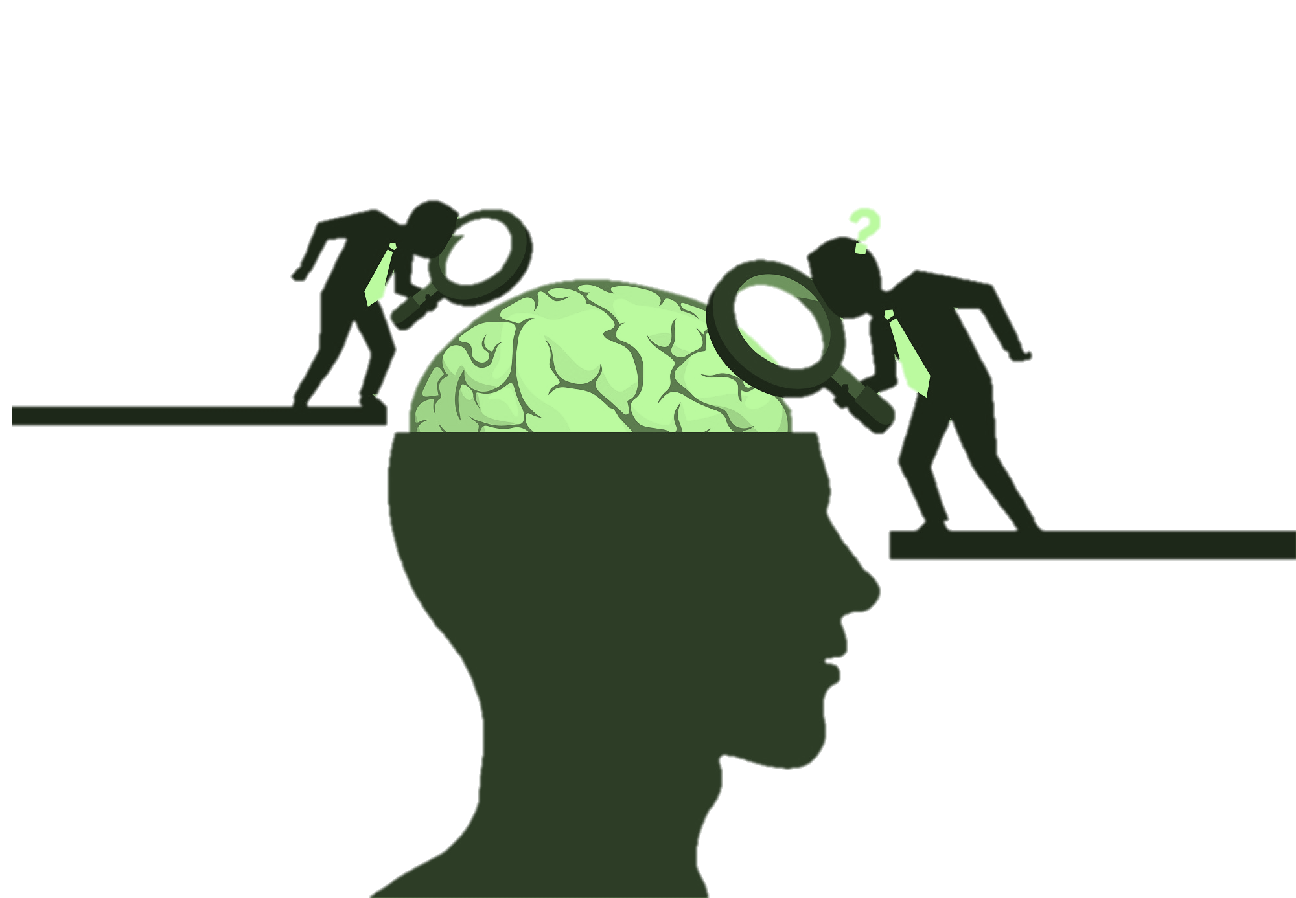
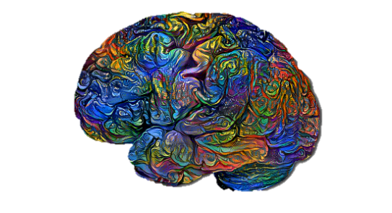
Coping with Diabetes Mellitus in Adolescence
{. . وَمَا تَوْفِيقِي إِلَّا بِاللَّهِ. . }
Objective | Color index
Difficulties among adolescent with DM type 1 Sources of stressors for them. Types of coping. How to help. | Black : Main content. Gray : Notes. Red : important.
Editing File
Team Leaders
Njoud Alali Abdullah shadid
For the record, This lecture was published during COVID19 outbreak

Slide 2
introduction
Adolescence can be a difficult period of life. The need to become more independent, to create an identity and to adopt a new lifestyle can influence the way that adolescents with diabetes cope with their disease
The freedom to makes one’s own choices about lifestyle is seen as important in this age group. Taking increasing responsibility for diabetes self-care is part of the process
adolescence
and sources of stress
Early adolescence
Mid-adolescence
Late adolescence
-(11-14 yrs.)
Am I normal?
- (14-16 yrs.)
- Independence
- self image
- (17-older yrs.)
- Future oriented
- intimacy
- career goals
Types of Diabetes Mellitus
Type 1 | Type 2
Insulin dependent DM 5-10% Childhood Facts about Type I patients: 80%, Unhygienic administer 58% , Wrong dose 77%, Glucose level (Test/interpret) 75% , Foods ( type / regular ) | Non Insulin dependent DM increased about 4 folds (last 30yrs) 8.5 % Age – usually more then 18 years
Treatment Lifestyle •Active •Weight •Drugs •Early diagnosis •Insulin Vs. OH •Blood pressure control •Blood lipid control
Psychosocial Factors and Diabetes (important) its play an important role in the course of illness
Stress sometimes changes a latent case of diabetes into an active one.
Psychological factors may precipitate the onset of diabetes and influence the timing of symptoms presentation
It has been established that there is an excess of life events in the few months preceding the onset of the condition particularly in older children & adolescents.
Psychological dysfunction may cause recurrence of acute diabetic episode specially in adolescents.
Life experience and emotional factors can have an important bearing on the course of diabetes.
Diabetes and Comorbidity
Psychological morbidity appears to be from 10 – 30 % with chronic illnesses.
Diabetes mellitus is co-morbid with : most commonly Anxiety disorders then depression
Other co-morbid behavioral & psychological problems:
-Anger - Adjustment disorders - Social withdrawal- Acute organic brain syndrome - Low self esteem
- Behavioral problems - Eating disorders

Slide 3
Difficulties that they face
Diet restriction. Always the same food and diet
Frequent blood testing & injections.
Dependency on family. (difficulty in developing independence) (most important)
Isolation from peers. And their relationships with peers
Physical limitations. They feel they can’t play and workout.
Parents can’t differentiate between Common anxiety Symptoms of temperament AND hypoglycemia.
body image issues
Sources of stress in DM
The illness itself.
Illness-specific stressor such as:
Disease-related pain.
Medical procedures
Stress related to admission.
Extreme self control ( diet)
Psychological stress
Difficult to alter lifestyle behaviors
Pressure to eat
Medical information seen as advisory
Asymptomatic ( thinks he doesn’t have the disease )
What factors affect types of adjustment ?
Personal strength & interpersonal skills.
Child temperament
family influences on coping
Peer group influences on coping
Feelings and attitudes about how they cope
Quality of life and how this affected coping
Personal meaning of illness
Fear for the future and how this affected coping.
Effects of stress
There are negative impact of everyday stressors on health , immune and circulatory system
Other effects :
Children & adolescents with diabetes show an increased rate of learning problems.
Cognitive impairment on intelligence scales have been noticed.
School absence.
The majority of school personnel has inadequate understanding of diabetes and its management.
Coping
It is The process of managing stressors (internal and external ).
Coping of adolescents with chronic illness focus on coping with illness itself
Types
Additive ( main ) effect model which focus on well-being regardless amount of stress.
Interactive model : coping moderates the impact of stressor to varying degree depends on severity of stressor.
5 Stage
Denial
Anger
Bargaining
Depression
Acceptance
How to help
Parent support.
Cognitive coping ( understand how the insulin help to grow stronger )
Behavioral coping ( minimize the experience of being deprived from popular food ..)
Coping with Symptoms of Depression.
Psychosocial Aspects of Management
Most of youngsters with diabetes and their families will cope well with the social and psychological stresses imposed by the illness.
Education
When to refer the patient to a child and adolescent psychiatrist?
School counseling
Individual psychotherapy
Family counseling
Managing psychiatric disorders

Slide 4
Quiz
Very important notes you can skip all the lecture and read this only it’s enough
in the course of illness psychological factor is very important
anxiety is the most common psychiatric disorder associated with DM, depression is the second
Dependency is the most common difficulty they face
Best way of coping is coping with the disease itself
Answers Key!
1.D 2.C 3.D 4.C 5.B 6.C
Which one of the following a DM patient face?
Frequent blood testing
Diet restriction
Peers Isolation
All Choices
2) Psychological morbidity appears to range from?
1-5%
20-50%
10-30%
3-4%
3) What is the best way of coping in a child with type 1 diabetes?
Diet restriction
Bargaining
Parent counseling
Coping with illness itself
4): What is the most common disorder associated with diabetes in adolescents?
Schizophrenia
Depression
Anxiety
Anorexia nervosa
5) Sources Of Stress And Worries In Mid-Adolescence?
Career goal
Self image
Future oriented
Intimacy
6) which one of the following Psychosocial Factors is TRUE in regards to Diabetes ?
Stress does not changes a latent case of diabetes into an active one.
no relation between Psychological factors and the onset of diabetes
May cause recurrence of acute diabetic episode
Life experience and emotional factors are not important
Good luck!

