Slide 1
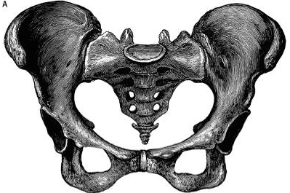
ANATOMY OF THE PELVIS

Slide 2
OBJECTIVES
At the end of the lecture, students should be able to:
Describe the anatomy of the pelvic wall, bones, joints & muscles.
Describe the boundaries and subdivisions of the pelvis.
Differentiate the different types of the female pelvis.
Describe the pelvic floor.
Describe the components & function of the pelvic diaphragm.
List the arterial & nerve supply
List the lymph & venous drainage of the pelvis.

Slide 3
The bony pelvis is composed of four bones:
Two hip bones, which form the anterior and lateral walls.
Sacrum and coccyx, which form the posterior wall.
These 4 bones are connected by 4 joints and lined by 4 muscles.
The bony pelvis with its joints and muscles form a strong basin-shaped structure (with multiple foramina),
The pelvis contains and protects the lower parts of the alimentary & urinary tracts & internal organs of reproduction.

Slide 4
FOUR JOINTS
1- Anteriorly:
Symphysis pubis (cartilaginous joint).
2- Posteriolateraly:
Two Sacroiliac joints. (Synovial joins)
3- Posteriorly:
Sacrococcygeal joint (cartilaginous),

Slide 5
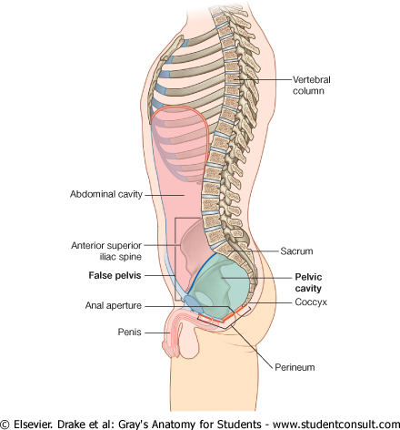
The pelvis is divided into two parts by the pelvic brim.
Above the brim is the False or greater pelvis, which is part of the abdominal cavity.
Below the brim is the True or lesser pelvis.
Pelvic brim
The False pelvis is bounded by:
Posteriorly:
Lumbar vertebrae.
Laterally:
Iliac fossae and the iliacus muscle.
Anteriorly:
Lower part of the anterior abdominal wall.
It supports the abdominal contents.

Slide 6
The True pelvis has:
An Inlet.
An Outlet.
A Cavity:
The cavity is a short, curved canal, with a shallow anterior wall and a deeper posterior wall.
It lies between the inlet and the outlet.

Slide 7
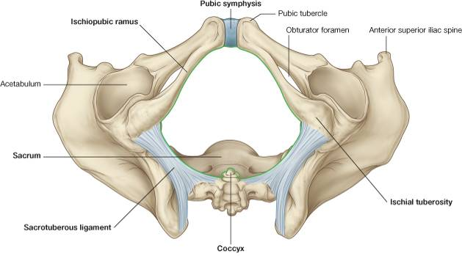
PELVIC INLET
PELVIC OUTLET
Anteriorly: Symphysis pubis.
Posteriorly: Promontory of sacrum, ala of sacrum.
Laterally: Ileopectineal (arcuate) lines.
Anteriorly: Symphysis pubis.
Posteriorly : Coccyx,
Anterolaterally: ischiopubic ramus
Posterolaterally: Sacrotuberous ligament,

Slide 8
FEMALE
MALE
In female the Sacrum is usually wider and shorter.
Also, the Angle of the pubic arch is wider.
The promontory and the ischial spines are less projecting.

Slide 9
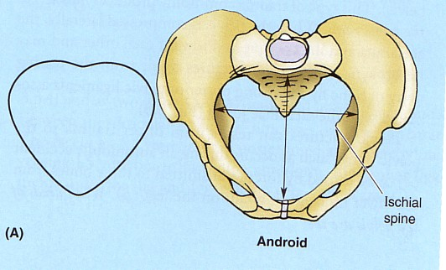
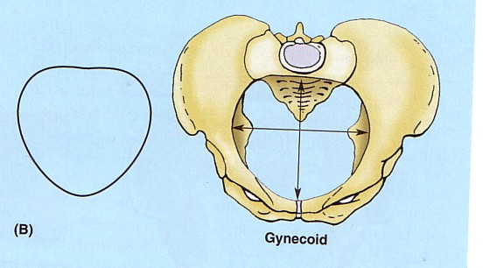
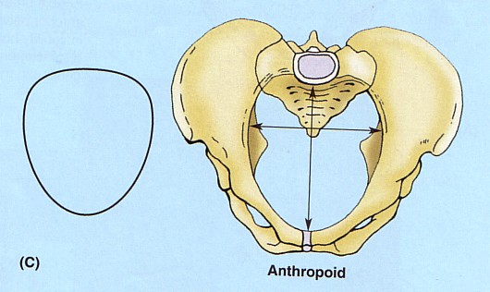
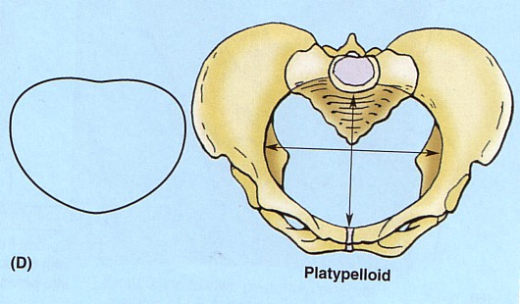
Types of Female Bony Pelvis
Information of the shape and dimensions of the female pelvis is of great importance for obstetrics, because it is the bony canal through which the child passes during birth.

Slide 10
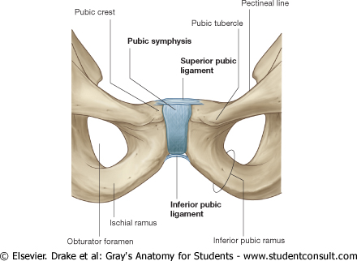
The pelvis has 4 walls:
Anterior.
Posterior.
Lateral.
Inferior or floor.
The walls are formed by bones and ligaments that are lined with muscles covered with fascia and parietal peritoneum.
Pelvic walls
ANTERIOR PELVIC WALL
It is the shallowest wall and is formed by the posterior surfaces of the bodies of the pubic bones, the pubic rami, and the symphysis pubis.

Slide 11
POSTERIOR PELVIC WALL
It is large and formed by sacrum, coccyx , piriformis muscles and their covering of parietal pelvic fascia.

Slide 12
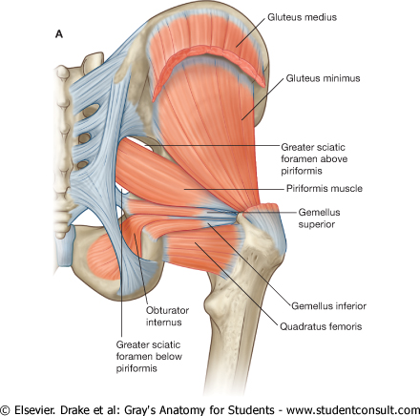
Piriformis
Origin: Pelvic surface of the middle 3 sacral vertebrae.
It leaves the pelvis through the greater sciatic foramen.
Insertion: Greater trochanter of the femur.
Action: Lateral rotator of the femur at the hip joint.
Nerve supply: Sacral plexus.

Slide 13
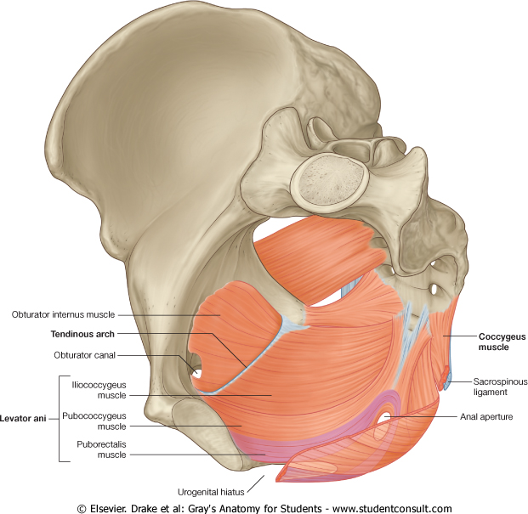
LATERAL PELVIC WALL
It is formed by:
1- Part of the hip bone below the pelvic inlet,
2- Obturator internus and its covering fascia & the obturator fascia.
3- Sacrotuberous ligament.
4- Sacrospinous ligament.

Slide 14
Obturator Internus
Origin: Inner surface of the obturator membrane and the hip bone.
Insertion: It leaves the pelvis through the lesser sciatic foramen to be inserted into the greater trochanter of the femur.
Action: Lateral rotator of the femur at the hip joint.
Nerve supply: Nerve to obturator internus.

Slide 15
INFERIOR PELVIC WALL, OR PELVIC FLOOR
Basin-like structure which supports the pelvic viscera and is formed by the pelvic diaphragm.
It stretches across the true pelvis and divides it into:
Main (true) pelvic cavity above, which contains the pelvic viscera, &
Perineum below which carries the external genital organs.

Slide 16
PELVIC DIAPHRAGM
It is formed by the levator ani and the coccygeus muscles and their covering fasciae.
It is incomplete anteriorly to allow passage of the urethra in males and urethra and vagina in females.

Slide 17
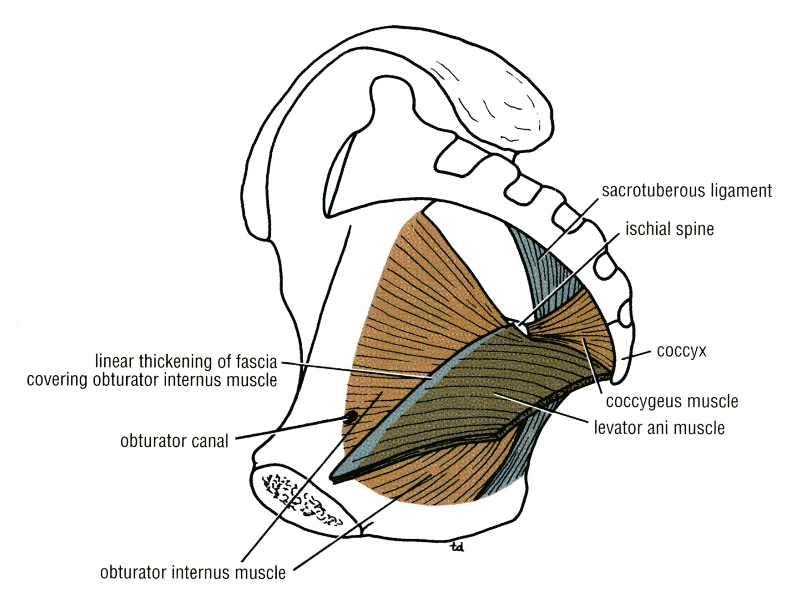
LEVATORES ANI MUSCLES
It is a wide thin sheet-like muscle .
ORIGIN:
Back of the body of the pubis
Tendinous arch of the obturator fascia
Spine of the ischium.

Slide 18
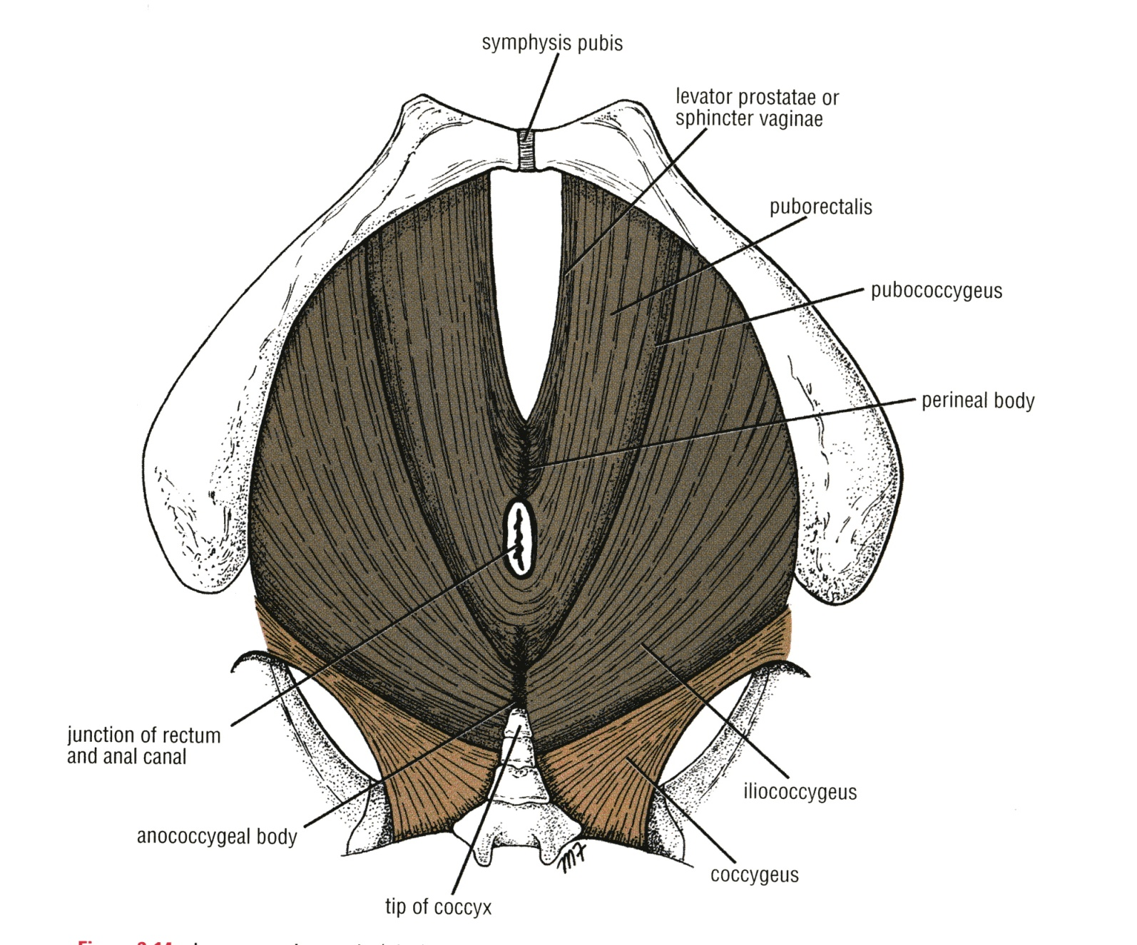
Its fibers are divided into 3 parts:
1- Pubococcygeus.
2- Puborectalis.
3-Ilioiococcygeus.

Slide 19
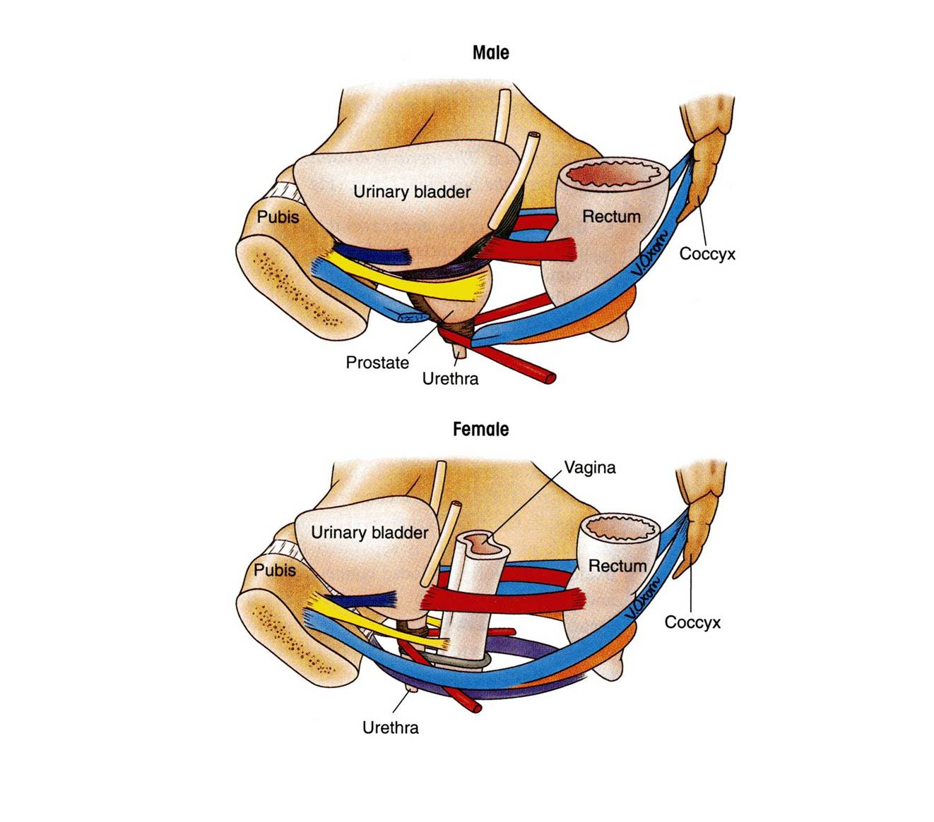
LEVATORES ANI MUSCLES - ANTERIOR FIBERS
1- Pubococcygeus.
originates from the posterior surface of the body of the pubis
inserted into the perineal body (and coccyx.
supports the prostate (or constricts the vagina)
stabilizes the perineal body
forms a sling around the prostate or the vagina
levator prostatae
sphincter vaginae

Slide 20
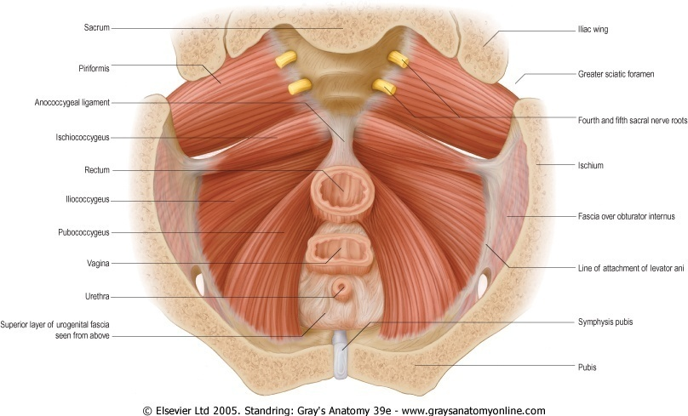
LEVATORES ANI MUSCLES Intermediate Part (The puborectalis )
forms a sling around the recto-anal Junction.
It has a very important role in maintaining fecal continence.

Slide 21
posterior part Iliococcygeus
inserted into the anococcygeal body and the coccyx

Slide 22
Nerve supply to levator ani:
1. perineal branch of the fourth sacral nerve
2. perineal branch of the pudendal nerve.
Actions of levator ani:
The muscles of the two sides form an efficient muscular sling that supports and maintains the pelvic viscera in position.
They resist the rise in intra pelvic pressure during the straining and expulsive efforts of the abdominal muscles (as in coughing).
3. They have a very important role in maintaining fecal continence.
4. They serve as a vaginal sphincter in the female.

Slide 23
COCCYGEUS MUSCLE
small triangular muscle.
Origin:
Ischial spine.
Insertion: Lower end of sacrum and coccyx
Action:
Assist the levator ani in supporting the pelvic viscera
Nerve supply: branches of the 4th and 5th sacral nerves

Slide 24
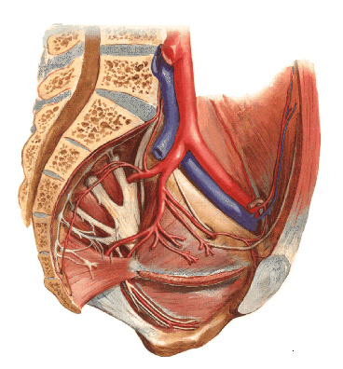
Arteries of the Pelvis
(I) Internal iliac artery(IIA):
One of the 2 terminal branch of the Common iliac artery.
Arises in front of the sacroiliac joint
It descends downward & backwards over the pelvic inlet.
It divides at the upper border of the greater sciatic foramen into:
Anterior & Posterior divisions.
Posterior division Supplies:
Posterior abdominal wall.
Posterior pelvic wall.
Gluteal region.
Anterior division supplies:
1. Gluteal region.
2. Perineum.
3. Pelvic viscera.
4. Medial (adductor) region of thigh
5.The fetus (through the umbilical arteries).
IIA

Slide 25
Parietal Branches
Iliolumbar
Obturator
From posterior division:
Iliolumbar artery.
Lateral sacral arteries (2 branches.)
Superior gluteal artery.
From anterior division:
Obturator artery.
Inferior Gluteal artery.
Lateral sacral
Superior gluteal
Inferior Gluteal

Slide 26
Visceral Branches (all from anterior division)
Umbilical artery :
Gives the superior vesical artery: The distal part of this artery fibrosed and forms the Medial Umbilical Ligament.
Inferior Vesical artery in male or vaginal in femal:
In the male it supplies, the Prostate and the Seminal Vesicles.
It also gives the artery of the Vas Deferens.
Middle rectal artery
Internal pudendal artery
It is the main arterial supply to the perineum.
Umbilical
Internal pudendal
superior vesical

Slide 27
Visceral Branches (in Female)
Vaginal artery:
Replaces the inferior vesical artery.
Uterine artery:.
Crosses the Ureter superiorly and supplies the uterus & uterine tubes.
(II) Ovarian artery:
Arises from the abdominal aorta.

Slide 28
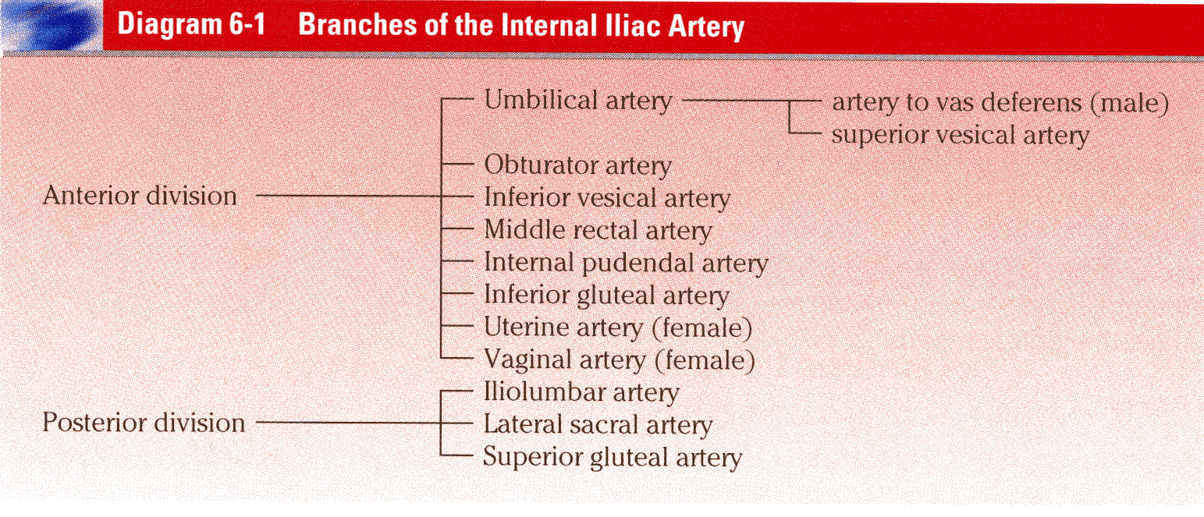
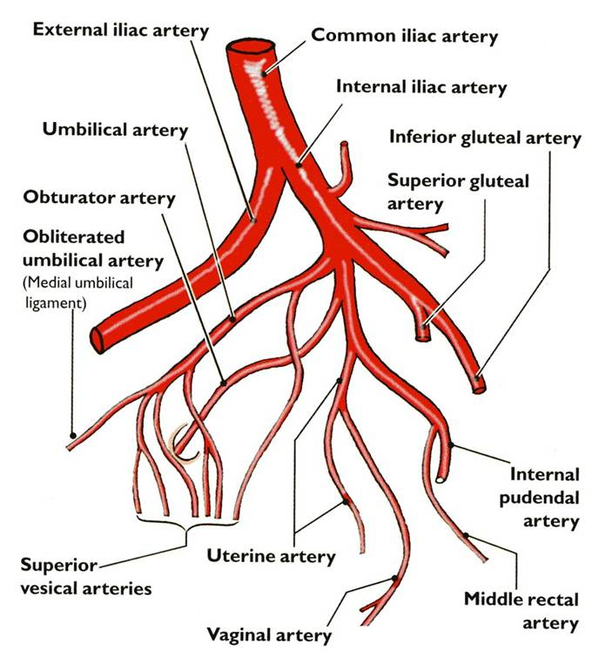
IN BRIEF…

Slide 29
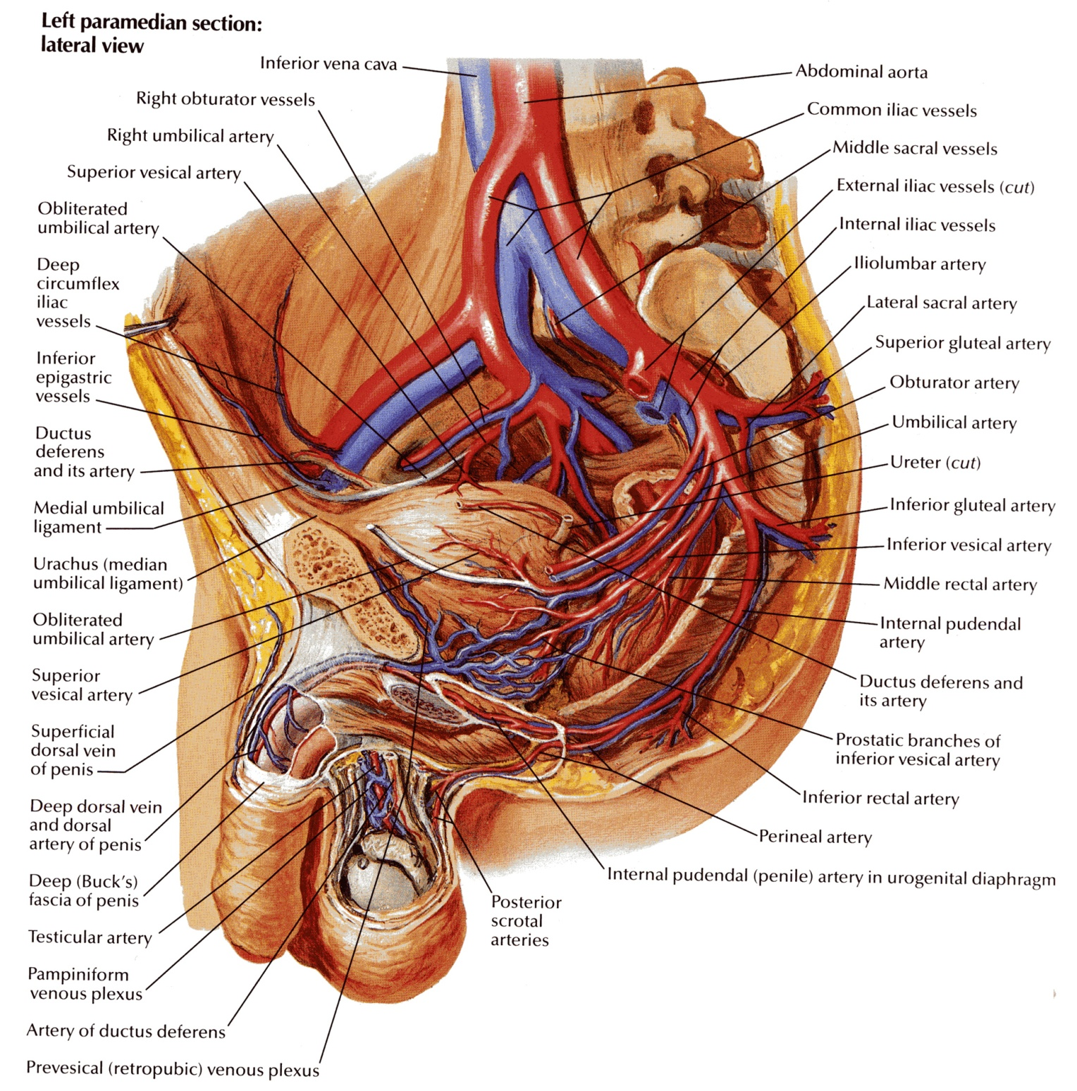
Venous Drainage
INTERNAL ILIAC VEINS
It collect tributaries corresponding to the branches of the internal iliac artery.
joins the external iliac vein in front of the sacroiliac joint to form the common iliac vein
Ovarian vein:
Right vein drains into IVC
Left vein drains into left renal Vein.

Slide 30
LYMPHATICS OF THE PELVIS
The lymph nodes and vessels are arranged in a chain along the main blood vessels.
Thus, there are external iliac nodes, internal iliac nodes, and common iliac nodes.
lymph from Common iliac nodes & the (Ovaries, uterine tubes & fundus of uterus) passes to Lateral aortic (paraortic) nodes.

Slide 31
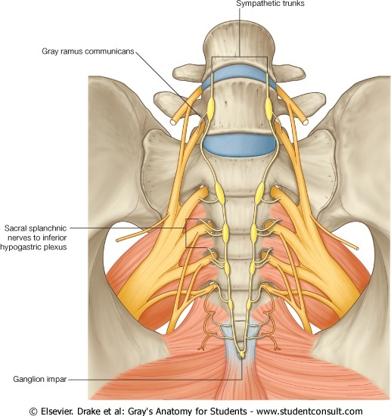
Nerve Supply
Somatic:
Sacral plexus
Autonomic:
Sympathetic:
Pelvic part of sympathetic trunk:The 2 sympathetic trunks unite inferiorly in front of the coccyx and form a single ganglion (Ganglion Impar).
II- Superior & Inferior
Hypogastric plexuses
Parasympathetic:
Pelvic splanchnic nerves (From S 2 , 3 & 4)

Slide 32
Thank You

