Slide 1
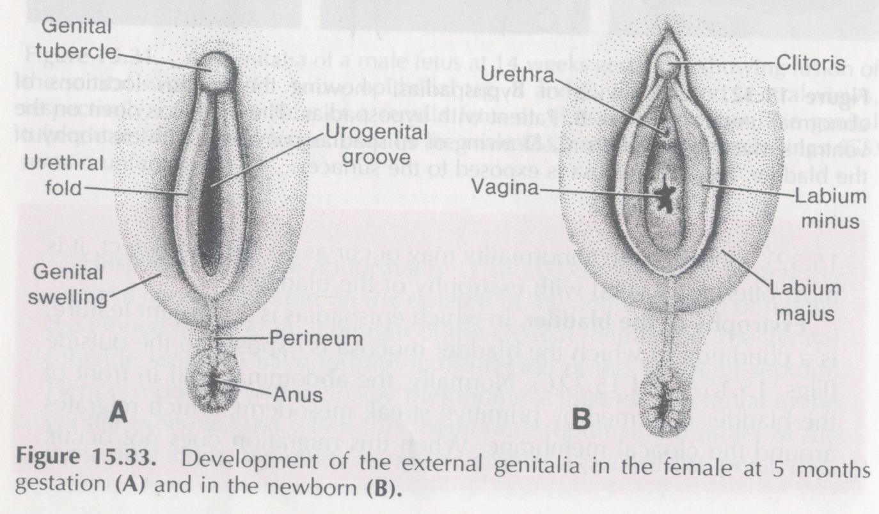
Development of Female Genital System
Prof. Musaad Al-Fayez
Dr.Jamila EL-Medany

Slide 2
OVARY
Primitive sex cords dissociate into irregular cell cluster.
Later they will disappear and are replaced by vascular stroma forming ovarian medulla.
Surface epithelium of the female gonad proliferates.
In 7th week they give rise to 2nd generation of cords called “cortical cords”.

Slide 3
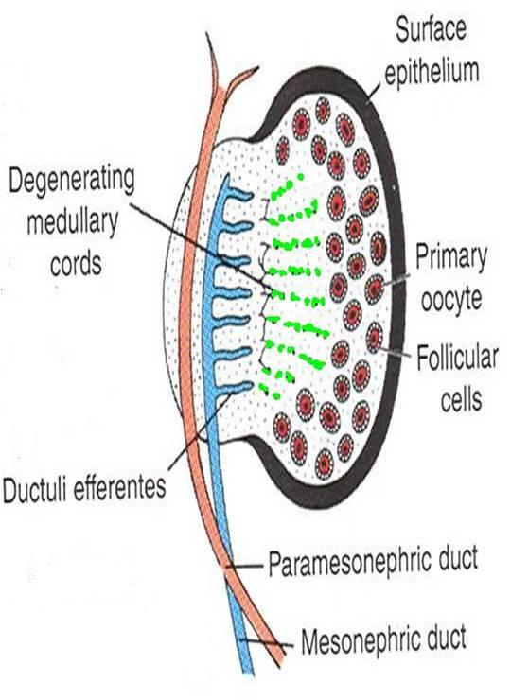
OVARY
The cortical cords penetrate the underlying mesenchyme.
In 4th month these cords split into isolated cell clusters which surrounding one or more primitive germ cells, (GC).
GC will develop into oogonia and the surrounding epithelial cells form the follicular cells.

Slide 5
GENITAL DUCTS
Two pairs of genital ducts develop in both sexes:
1.Mesonephric (Wolffian) ducts and
2. Paramesonephric (Mullerian) ducts.

Slide 6
GENITAL DUCTS
In female embryos, mesonephric ducts regress while the paramesonephric ducts develop into:
Uterus,
Uterine tubes and
Upper vagina.

Slide 7
Genital duct in the female
Paramesonephric ducts develop into the main genital ducts of the female.
Initially, 3 parts can be recognized in each duct:
A vertical cranial portion (1) which opens into abdominal cavity.
A horizontal part that crosses anterior to the mesonephric duct, (2).
1
1
2
3
2
3

Slide 8
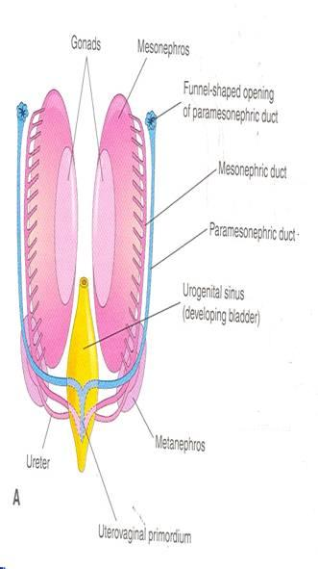
Genital duct in the female
A caudal vertical (3) part that fuses with its partner from the opposite side.
(1 & 2) develop into the uterine tubes.
The fused parts (3) give rise to body and cervix of the uterus.
Mesenchyme will form the myometrium & perimetrium of the uterus.

Slide 9
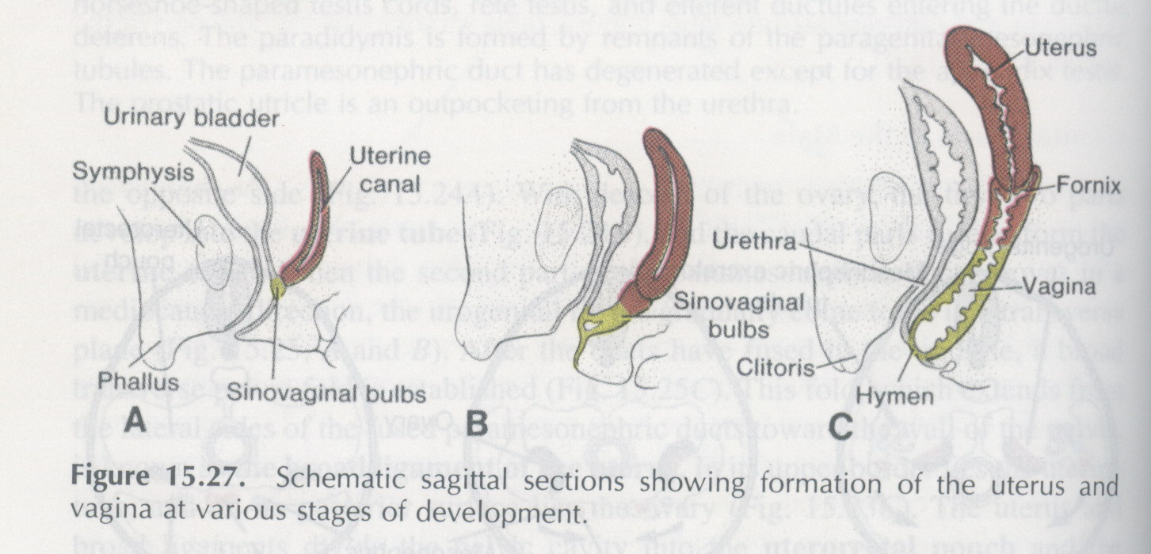
Vagina
After solid tip of paramesonephric ducts reaches the urogenital sinus, 2 solid evagination grow out.
These evagination (sinovaginal bulbs), proliferate and form vaginal plate.
By the 5th week the outgrowth is entirely canalized.

