Slide 1
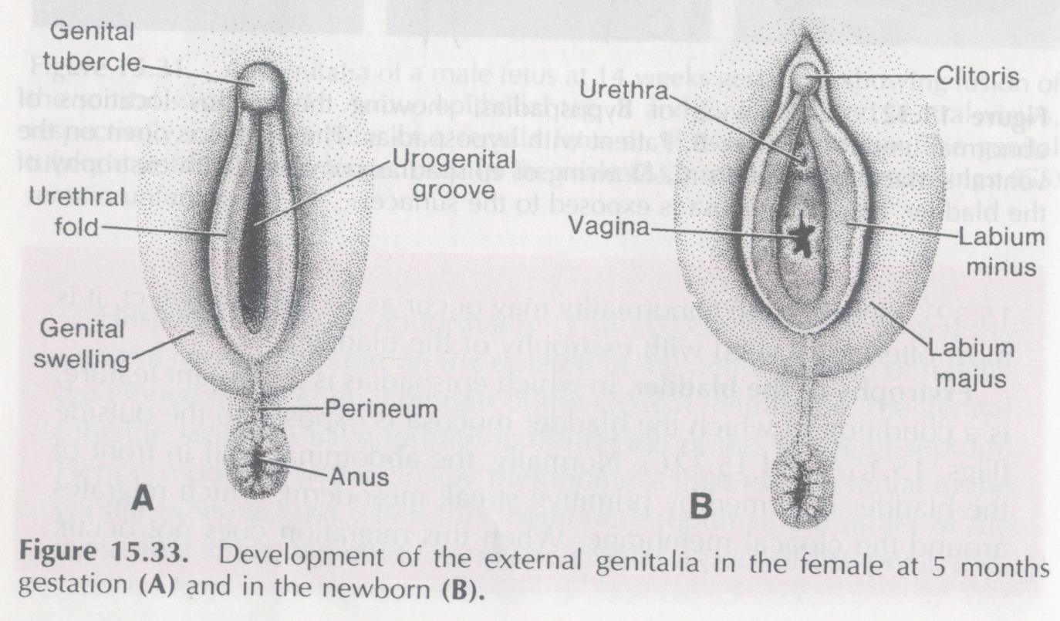
Development of Female Genital System
Prof. Musaad Al-Fayez
Dr.Jamila EL-Medany

Slide 2
Objectives
By the end of the lecture, you should be able to:
Describe the development of gonads (indifferent & different).
Describe the development of the female gonad (ovary) and the internal genital organs (uterus, uterine tubes and vagina).
Describe the development of the external genitalia.
List the main congenital anomalies of female genital system.

Slide 3
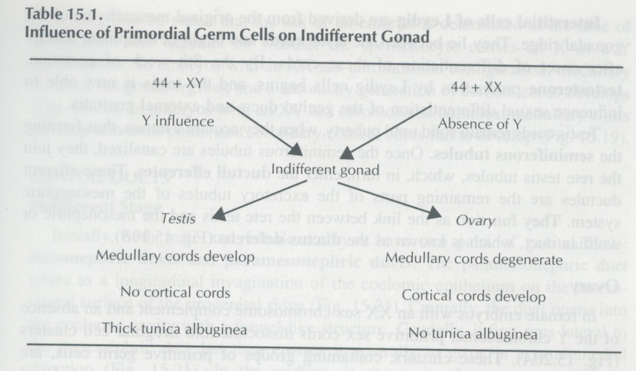
Development of Genital System
Y chromosome.
Testis-determining factor (TDF) gene.
TDF = Male.
No TDF = Female.

Slide 4
Gonads
Sex of the embryo is determined genetically at the time of fertilization.
Gonads do not acquire male or female morphological characteristics until the 7th week of development.

Slide 5
Gonads
Genital system are developed from two longitudinal ridges of mesoderm which run down the entire length of the dorsal body wall.
These ridges are called urogenital ridges.
The medial region of this ridge differentiates into the genital ridge where the gonads develop.

Slide 7
Gonads
The gonads begin to develop during the 5th week in the genital ridge.
First the gonads are undifferentiated and have a cortex and a medulla.

Slide 8
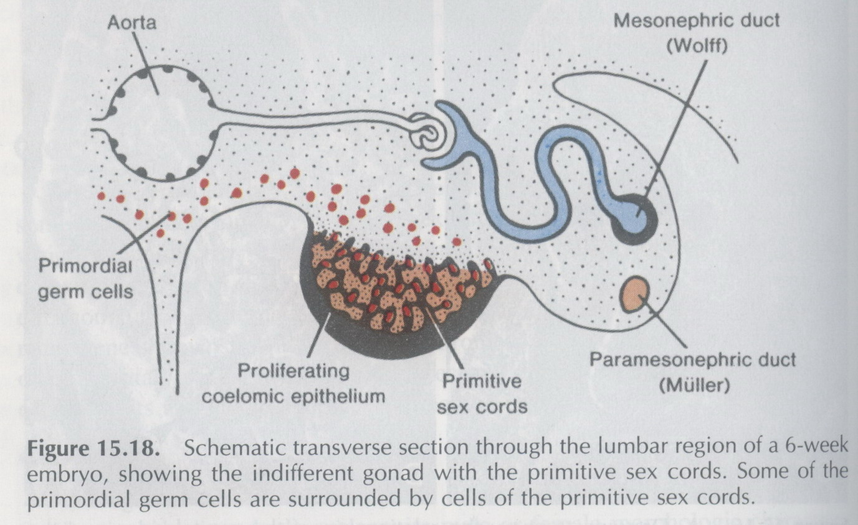
Gonads
In embryos with an XX chromosome complex, the cortex normally differentiates into an ovary, and the medulla regresses.
In embryos with an XY complex, the medulla differentiates into a testis and the cortex regresses.

Slide 9
Gonads
Large primitive cells, called primordial sex cells formed in the yolk sac during the 4th week.
They migrate along the dorsal mesentery of the hindgut to the genital ridges where they become incorporated into the developing gonads.

