Slide 1
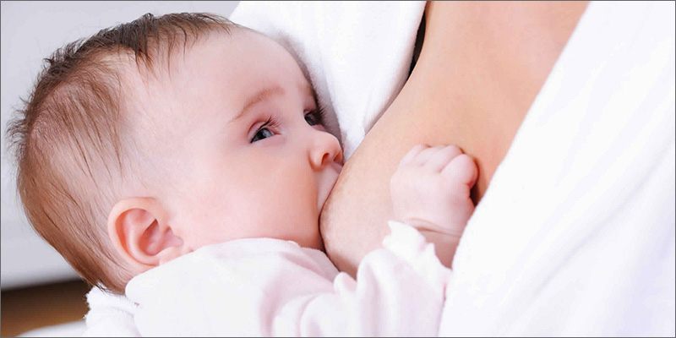
BREASTFEEDING
BY: RUBANA BAABBAD
CONSULTANT NEONATOLOGIST
INTERNATIONAL BOARD OF LACTATION CONSULTANT EXAMINERS

Slide 2
contents
Introduction
Breastfeeding definitions
Breast milk contents
Advantages of breastfeeding
Preparation of the prospective mother
Establishing and maintaining the milk supply
Technique of breastfeeding
Expression of breast milk
Contraindications

Slide 3
قال الحق تبارك وتعالى: (وَالْوَالِدَاتُ يُرْضِعْنَ أَوْلَادَهُنَّ حَوْلَيْنِ كَامِلَيْنِ لِمَنْ أَرَادَ أَنْ يُتِمَّ الرَّضَاعَةَ) [البقرة :233 ].

Slide 4
ان كلمة الرضاعة والفصال ومشتقاتهما قد تكررت في القرآن الكريم أربع عشرة مرة في سبع سور وثماني آيات كريمات

Slide 5
ت | اسم السورة | رقم الآية | الكلمة
1. | سورة البقرة | 233 | يرضعن، الرضاعة، فصالاً، تسترضعوا
2. | سورة النساء | 23 | أرضعنكم، الرضاعة
3. | سورة الحج | 2 | مرضعة، أرضعت
4. | سورة القصص | 7،12 | ارضعيه، المراضع
5. | سورة لقمان | 14 | وفصاله
6. | سورة الاحقاف | 15 | وفصاله
7. | سورة الطلاق | 6 | ارضعن، فسترضع

Slide 6
introduction
Breastfeeding is the normal feeding for infants during the first months of life which can ‘t be replicated .
It contains over 200 known component.
Breast milk bring both nutritive& non nutritive signals to the neonate .

Slide 7
HUMAN MILK UNIQUE COMPOSITION
Exclusive human milk feeding for the first 6 mon. of life, with continued breastfeeding for 2 years of life is the normative standard for infant feeding because of Its unique nutritive composition and non nutritive bioactive factors that promote survival and healthy development.

Slide 8
CONT.
Human milk composition is dynamic, and varies within a feeding, diurnally, over lactation, and between mothers and populations.
Influences on compositional differences include maternal and environmental factors and the expression and management of milk (e.g. Storage and pasteurization)

Slide 9
Nutritional component of human milk
Macronutrients :varies within mothers and across lactation but is remarkably conserved across populations despite variations in maternal nutritional status.
differs between preterm and term milk, with preterm milk tending to be higher in protein and fat .
It contain fat ,carbohydrate, proteins
menirals,

Slide 10
Micronutrients
many micronutrients vary in human milk depending on maternal diet and body stores .
including vitamins A, B1, B2, B6, B12, D, and iodine.
. Regardless of maternal diet, Vitamin K is extremely low in human milk and thus, the American Academy of Pediatrics recommends an injection of this vitamin to avoid hemorrhagic disease of the newborn
. Vitamin D also occurs in low quantity in human milk, particularly with low maternal exposure to sunshine.

Slide 11
Bioactive factor including:
living cells (macrophages and stem cells)
anti-infectious
anti-inflammatory agents
growth factors
Prebiotics
Probiotics
vitamins,hormons, enzymes complements,
lysozymes , immunoglobulins
cytokines
mucins

Slide 12
Breast milk under microscopy

Slide 13
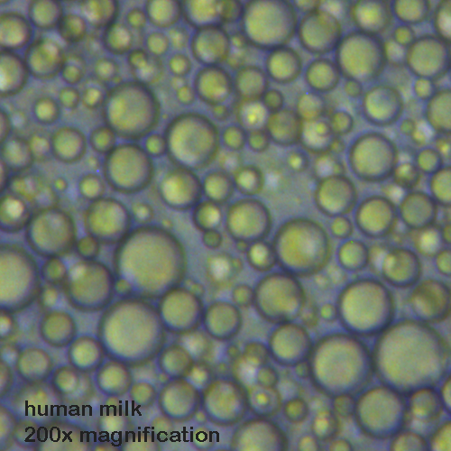
Comparison of microscopic picture

Slide 14
Colostrum vs. breast milk

Slide 15
colostrum
Colostrum, the yellowish, sticky breast milk produced at the end of pregnancy, is recommended by WHO as the perfect food for the newborn, and feeding should be initiated within the first hour after birth.

Slide 16
colostrum
Colostrum The often yellow and sometimes clear fluid that is released by a new mother’s breasts before her breast milk comes in.
This fluid has often been referred to as “liquid gold” and it resembles blood more than it does milk as it contains protective white blood cells capable of attacking harmful bacteria. and it also acts to “seal” the inside of the baby’s intestines thus preventing the invasion of bacteria. Colostrum is an ideal first food for baby as it is high in protein and low in sugar and fat, thus making it easy to digest.

Slide 17
colostrum
Is the first fluid produced after delivery up to 3-5 days and some times longer in premature delivery and with maternal obesity.
The colostrum
----primary functions is immunological and trophic

Slide 18
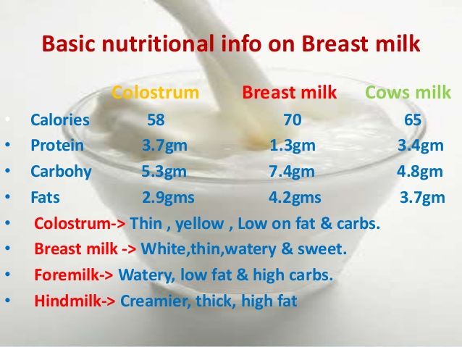

Slide 19
Colostrum in comparison to transitional and mature milk
Higher in
Lower in
Rich in immunological components(s. IgA, lactoferrin,leukocytes, developmental factors such as epidermal growth factors.
Na
Cl
Mg
Low volume
lactose
Potassium
calcium

Slide 20
BIOACTIVE COMPONENTS AND THEIR SOURCES
defined as elements that “affect biological processes or substrates and hence have an impact on body function or condition and ultimately health”.
Bioactive components in human milk come from a variety of sources;
produced and secreted by the mammary epithelium,
produced by cells carried within the milk,
drawn from maternal serum and carried across the mammary epithelium by receptor-mediated transport.

Slide 21
Sources of mother milk immune factors

Slide 22
BIOACTIVE FACTORS
recognition of potent, bioactive human milk factors indicates the importance of preserving their biologic activity, to the extent possible, through the process of milk collection, storage, and pasteurization.

Slide 23
IMMUNOLOGICAL FACTORS
Transfer of living protection and programming: Cells of human milk
Human milk contains a variety of cells, including macrophages, T cells, stem cells, and lymphocytes.
Communication between cells: Cytokines and chemokines
Cytokines are multi-functional peptides that act in autocrine/paracrine fashion.
Chemokines are a special class of chemotactic cytokines that induce movement of other cells.

Slide 24
Cont.
Finally, recognition of the unique mechanisms by which human milk protects and enhances development provides models for new preventive and therapeutic approaches in medicine.
Many of these factors act synergistically, such that consumption of human milk is superior to supplementation with individual factors or their combinations.

Slide 25
Breastfeeding Definitions
Exclusive breastfeeding (Breast milk (including milk expressed or from a wet nurse)
Predominant breast milk :Breast milk (including milk expressed or from a wet nurse) as the predominant source of nourishment
Complementary feeding; Breast milk (including milk expressed or from a wet nurse) and solid or semi-solid foods
May include anything else: any food or liquid including non-human milk and formula

Slide 26
Cont.
Breastfeeding: Breast milk (including milk expressed or from a wet nurse) and solid or semi-solid foods ,may include anything else: any food or liquid including non-human milk and formula
Bottle-feeding: Any liquid (including breast milk) or semi-solid food from a bottle with nipple/teat may include anything else: any food or liquid including non-human milk and formula

Slide 27
WHO recommendation
Breastfeeding is the normal way of providing young infants with the nutrients they need for healthy growth and development. Virtually all mothers can breastfeed, provided they have accurate information, and the support of their family, the health care system and society at large.
Exclusive breastfeeding is recommended up to 6 months of age, with continued breastfeeding along with appropriate complementary foods up to two years of age or beyond.

Slide 28
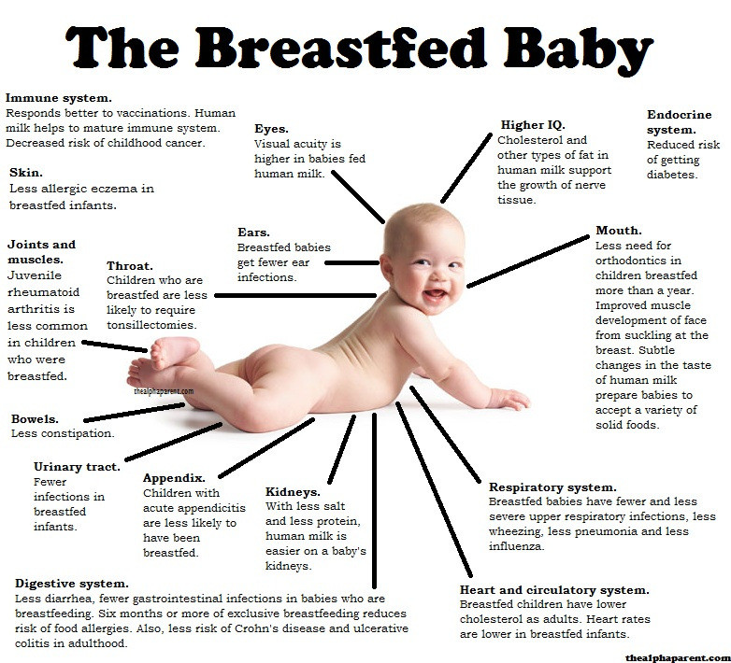

Slide 29
Benefits of breastfeeding for mothers
Helps the uterus to regress to its size before pregnancy.
Losing accumulated fat during pregnancy.
Empowerment
Decrease risk of osteoporosis
Improve blood sugar control for diabetics
Decrease the incidence of high cholesterol ,diabetes ,breast, cervical,ovarian,uterine cancers, less chance for gallstone formation and rheumatoid arthritis
Bonding ,decrease post partum depression

Slide 30
Advantages of breastfeeding
Superior health outcomes in breastfed infant
Protection during breastfeeding | Protection after weaning in early childhood | Protection later in childhood
Gastrointestinal and respiratory infections | Gastrointestinal and respiratory infections | Obesity
Urinary infections | Wheezing | Types I and II diabetes
Sepsis and meningitis | Celiac disease | Leukemia/lyphomas
Atopic dermatitis | Growth faltering | Crohn disease
Food allergies | Cognition | Cognition
Wheezing | Visual acuity | Strong, secured personality
Necrotizing enterocolitis
Celiac diseas
Growth faltering
Visual acuity

Slide 31
Preparation of the prospective mother
Most women are physically capable of breastfeeding, provided the receive sufficient encouragement and are protected from discouraging experiences and comments while the secretion of breast milk is becoming established.
Physical Factors: leading to a good breastfeeding include: good health, having enough rest, freedom of worry, treatment of any disease, and adequate nutrition.
Retracted & inverted nipples.

Slide 32
A retracted nipple is a nipple that turns inward instead of outward, except when stimulated. This type of nipple is sometimes referred to as an inverted nipple. ... Some experts
make a distinction between retracted and inverted nipples, referring to a retracted nipple as one that lies flat against the breast, rather than indenting in.

Slide 33
Hoffman technique
The Hoffman technique for drawing out inverted nipples has been in use since the 1950s. To try it:
Place your thumbs on either side of your nipple. Be sure to place them at the base of the nipple, not the outside of the areola.
Press firmly into your breast tissue.
While still pressing down, gently pull your thumbs away from each other.
Move your thumbs all around the nipple and repeat.

Slide 34
Establishing and maintaining the milk supply
The most satisfactory stimulus to the secretion of human milk is regular and complete emptying of the breast; milk production is reduced when the secreted milk is not drained.
The breastfeeding should begin as soon after delivery as the condition of the mother and the baby permits, preferably within the first hour.

Slide 35
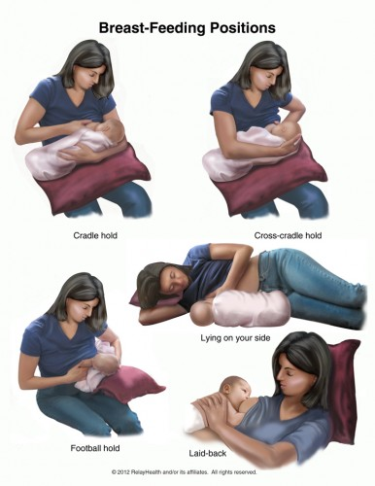
Breastfeeding position

Slide 36
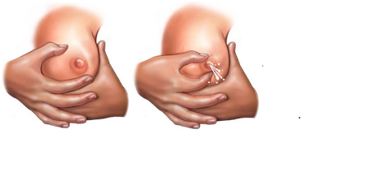
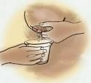
Manual expression of breast milk

Slide 37
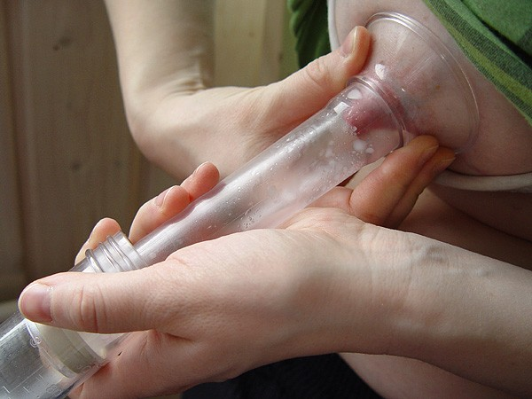
Expression of breastmilk

Slide 38
Contraindications
It is important to look at the entities that put the mother or infant at significant risk and are not remedial.
Infectious Diseases:
Life – threatening illnesses in the mother:
Medications:

Slide 39
Correct latching

