Slide 1
Pathology of Cervix
Dr. Maria A. Arafah
Associate Professor – Department of Pathology

Slide 2
Objectives
Some common benign conditions and infections
Understand the concepts of dysplasia and intraepithelial neoplasia in the female genital tract and the role of a cervical screening program.
Know the incidence, risk factors, clinical presentation, pathological features and prognosis of cervical squamous cell carcinoma.

Slide 3
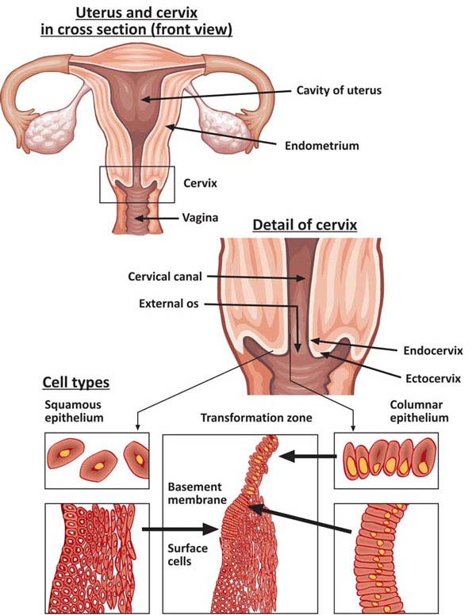
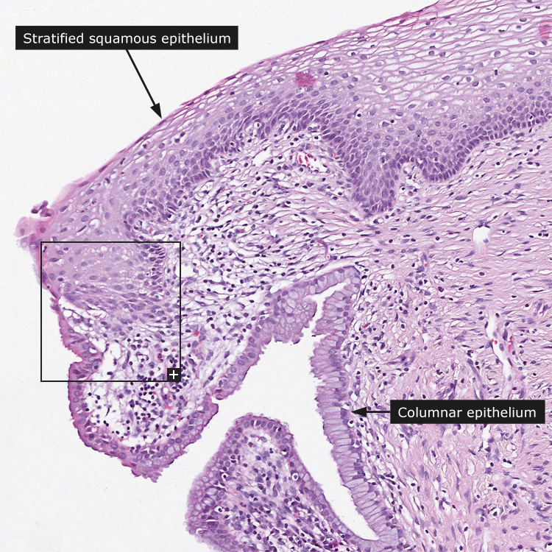
Introduction

Slide 4
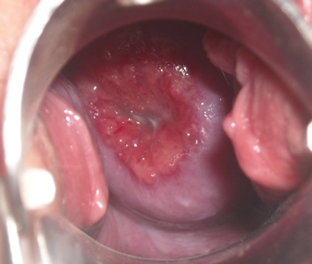
Cervical Ectropion (Erosions)
It occurs when the squamous epithelium is replaced by columnar epithelium, grossly resulting in an erythematous area.
It is a typical response to a variety of stimuli including hormones, chronic irritation and inflammation (chronic cervicitis).
It is benign and has no malignant potential.

Slide 5
Squamous Metaplasia
In this condition, the columnar cells are replaced by squamous cells.
It is seen in the cervix at the squamo-columnar junction.
Squamous metaplastic epithelium is the area most affected by HPV infection and the area where dysplasia and malignant transformation starts, however, the squamous metaplastic epithelium is benign and by itself not considered premalignant.

Slide 6
Cervical Polyp
This is a small pedunculated mass.
Most polyps originate from the endocervix (endocervical polyps) and few from the ectocervix (ectocervical polyps).
They are not true neoplasms.
The lesion is characterized by an overgrowth of benign cervical stroma covered by cervical epithelium:
The epithelium covering the polyp can be columnar or stratified squamous or sometimes both.
The stroma is made up of fibrous tissue with thick-walled blood vessels and inflammatory cells.

Slide 7
Cervical Polyp

Slide 8
Cervical Polyp

Slide 9
Noninfectious Nonspecific Cervicitis
It is an inflammation of the cervix caused by chemical (e.g. douche) or mechanical (e.g. tampon, diaphragm) irritation. It can be acute or chronic.
Clinically, it is often asymptomatic but the cervix appears red and swollen.
Histologically, inflammatory cells are seen (neutrophils, plasma cells and lymphocytes). Squamous metaplasia is also common in chronic cervicitis.

Slide 10
Infectious Cervicitis
It can be caused by various organisms e.g. Staphylococci, Enterococci, Gardnerella Vaginalis, Trichomonas Vaginalis, Candida Albicans and Chlamydia Trachomatis and HPV.
They most often involves the endocervix.
They may be asymptomatic or manifest as vaginal discharge or itching.

Slide 11
Candidiasis (Moniliasis)
It is a common infection caused by Candida Albicans, a normal component of the vaginal flora.
It involves the cervix and vagina.
It is associated with diabetes mellitis, pregnancy, antibiotic therapy, oral contraceptive use and immunosuppression.
It is characterized by white patchy mucosal lesions with thick curdy white discharge and vulvovaginal pruritis. Ulcers may develop.

Slide 12
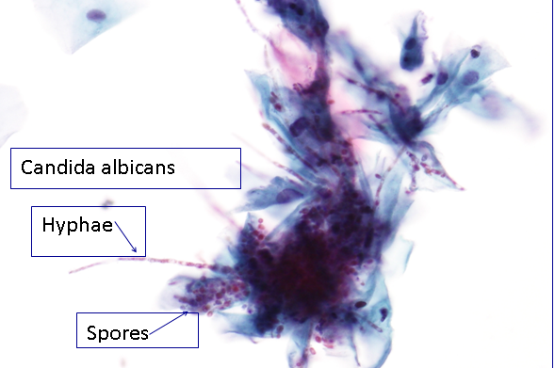
Candidiasis
Cytology smears show fungal colonies in the form of spores and branching pseudohyphae on the cervical epithelium. Chronic inflammatory cells are present.

Slide 13
Trichomoniasis
It is caused by a unicellular flagellated protozoan called Trichomonas Vaginalis.
It is a sexually transmitted disease that involves the vagina and cervix.
Clinically, a greenish-yellow frothy and foul smelling vaginal discharge is seen with painful urination, vulvovaginal itching or irritation and dyspareunia.

Slide 14
Trichomoniasis
Pap smear (cytology):
The organism can be identified in Pap smear slides in a background of inflammatory cells.
They can also be visualized by examination of a saline wet preparation in which the motile trophozoites are seen.

Slide 15
Trichomoniasis

Slide 16
Chlamydia Trachomatis Cervicitis
Chlamydia Trachomatis is an obligate, gram-negative intracellular pathogen.
Chlamydial cervicitis is the most common sexually transmitted disease in developed countries. It may coexist with Neisseria Gonorrhoeae infection.
It is a frequent cause of pelvic inflammatory disease and a condition known as lymphogranuloma venereum.
Clinically, it is often asymptomatic. In symptomatic cases there is a mucopurulent cervical discharge with a reddened, congested and edematous cervix. It may be associated with urethritis.

Slide 17
Herpes Simplex Virus Infection
HSV type 2 infection accounts for the majority of genital herpes cases and it is spread by a sexual contact.
It produces vesicles and ulcers that can involve the cervix, vagina, vulva, urethra and perianal skin.
Pap smears show multinucleated cells with intranuclear “Cowdry type” viral inclusions (nuclei have ground glass appearance due to the accumulation of viral particles).

Slide 18
Herpes Simplex Virus Infection

Slide 19
Human Papilloma Virus Infection
HPV infection is common with over 20 serotypes that infect the female genital areas and cause a variety of different lesions depending on the serotypes.
Clinical behavior:
HPV infection causes koilocytic atypia in the cervical squamous epithelium.
HPV infection is associated with increased risk of subsequent cervical cancer.

Slide 20
Human Papilloma Virus Infection
HPV infection may cause any of the following depending on the HPV serotype:
Condyloma: It is usually caused by HPV serotypes 6 and 11. It develops in the squamous epithelium of the ectocervix. The lesions may be flat or exophytic (called exophytic condyloma acuminatum).
Low grade dysplasia: It is usually caused by "low risk" HPV serotypes, 6 and 11.
High grade dysplasia: It is caused by "high risk” HPV (types 16 and 18) and “moderate risk” HPV (types 31, 33 and 35).

Slide 21
Koilocytes
Koilocytes are squamous epithelial cells that have undergone structural changes due to an infection by HPV. They show koilocytosis or koilocytic atypia which is the following cellular changes:
Nuclear enlargement
Irregular nuclear membrane
Nuclear hyperchromasia
Perinuclear halo (clear area around the nucleus)

Slide 22
Koilocytes

Slide 23
Cervical Cancer
The most common cervical cancer is squamous cell carcinoma. Other types are adenocarcinoma, neuroendocrine carcinoma, etc.
Cervical carcinoma used to be a major cause of cancer-related death in women.
Nowadays there is a dramatic improvement in the management of this disease because of the early diagnosis and therefore early treatment. As a result, deaths due to cervical cancer are decreasing. The early diagnosis is due to the use of a screening method/program called the PAP screening test.
The wide use of PAP screening program has lowered the incidence of invasive cancer and deaths.

Slide 24
Cervical Cancer
All invasive squamous cell carcinomas arise from non invasive pre-cancerous cervical squamous epithelium called cervical intraepithelial neoplasia (CIN) or squamous intraepithelial lesions (SIL).
Not all cases of CIN/SIL progress to invasive cancer and some cases of CIN/SIL may spontaneously regress.
Cases of high grade CIN/SIL have a higher risk of progression to cancer. High grade CIN/SIL are associated with high-risk HPV serotypes.
Timely detection and diagnosis of CIN/SIL is essential in preventing the development of invasive carcinoma.

Slide 25
Cervical Cancer
CIN lesions may begin as low grade CIN and progress to high grade CIN, or they might start straight away as high grade CIN.
On the basis of histology, pre-cancer lesions are graded as follows:
CIN I: Mild dysplasia
CIN II: Moderate dysplasia
CIN III: Severe dysplasia and carcinoma in situ (CIS).

Slide 26
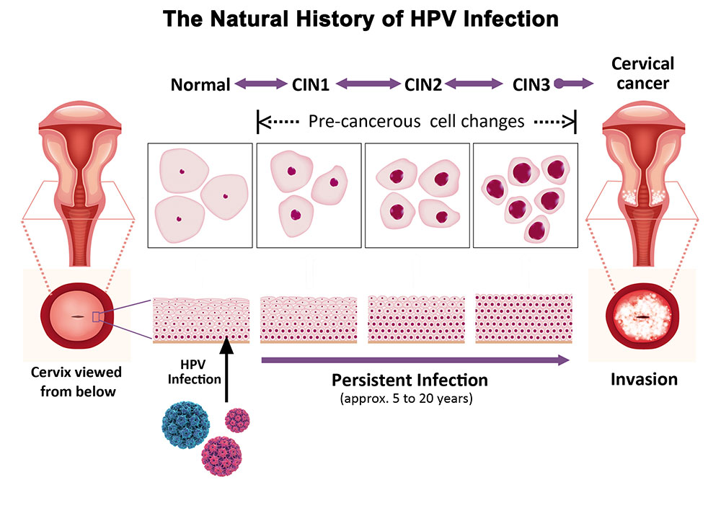

Slide 27
Cervical Cancer
Normal
CIN 1 (LSIL)

Slide 28
Cervical Cancer
CIN 2 (HSIL)
CIN 3 (HSIL)

Slide 29
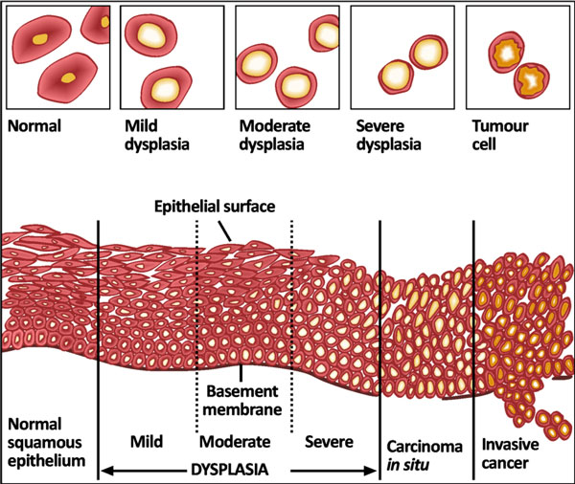
Cervical Cancer

Slide 30
Pap Screening Test: Cytology Screening For Precancerous Lesions
Cytologic examination can detect precancerous squamous intraepithelial lesions long before any abnormality can be seen grossly, using the PAP screening test.
PAP test is the cytologic examination of the cells of cervix. The cervix is examined and the cells lining the cervical wall at the transformation zone are scrapped off (sampled) with a spatula and then transferred onto a slide, processed, stained (Papanicolaou stain) and then examined under a light microscope to look for squamous intraepithelial lesions (SIL) and a diagnosis is made.
This screening test should be done on all women usually from the age of 21 years and onwards.

Slide 31
Pap Screening Test: Cytology Screening For Precancerous Lesions
The terminology used in Pap smears is squamous intraepithelial lesions (SIL). SILs are divided into low grade and high grade SIL.
In cytology smear report these are few of the possible diagnoses:
Normal cells/ Negative for squamous intraepithelial lesion
Low Grade SIL = LSIL (= CIN1/mild dysplasia on histology)
High Grade SIL = HSIL (= CIN2 and CIN3/ moderate to severe dysplasia on histology)
About 1 to 5% of low grade SIL become invasive squamous cell carcinomas
About 6 to74% of high grade SIL become invasive squamous cell carcinomas

Slide 32
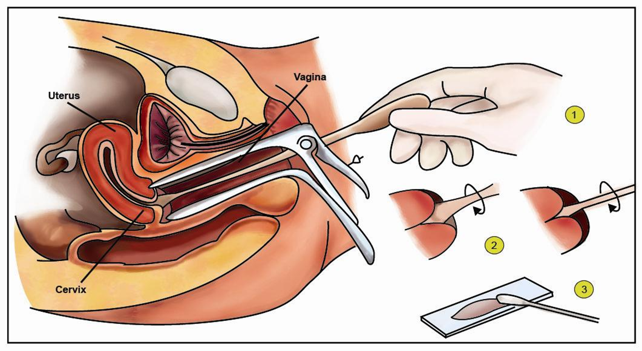
Pap Screening Test: Cytology Screening For Precancerous Lesions

Slide 33
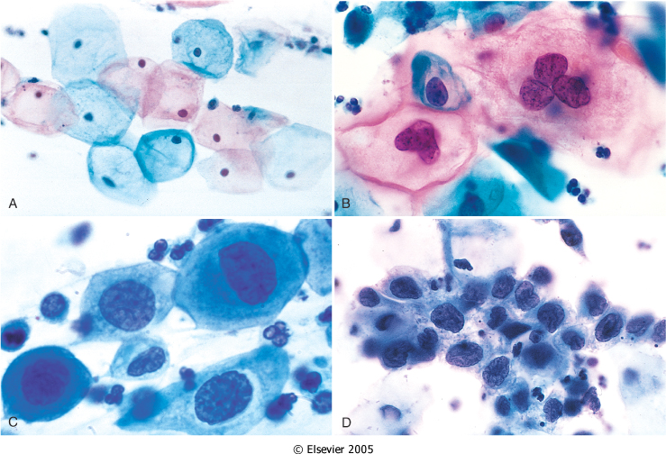
Pap Screening Test: Cytology Screening For Precancerous Lesions
The cytology of CIN as seen on the Pap smear.
The cytoplasmic staining in superficial cells (A&B) may be either red or blue.
A. Normal exfoliated superficial squamous epithelial cells.
B. CIN I/ low grade SIL
C. CIN II/ high grade SIL.
D. CIN III/ high grade SIL.
Note the reduction in cytoplasm and the increase in the nucleus to cytoplasm ratio, which occurs as the grade of the lesion increases. This reflects the progressive loss of cellular differentiation on the surface of the lesions from which these cells are exfoliated.

Slide 34
Pap Screening Test: Cytology Screening For Precancerous Lesions
Women with SIL/CIN have no visible signs or symptoms and it is difficult to diagnose SIL/CIN without a Pap smear/exam.
Therefore regular Pap exams should be done on all women to detect HPV infection early.
An HPV DNA in-situ hybridization (ISH) test, called the Diegene Hybrid Capture test, is done to identify the serotype of the HPV. This test will determine whether a patient carries high or low risk strains of the virus. HPV DNA screening test should not be used before the age of 30 if the Pap test is normal.

Slide 35
Pap Screening Test: Cytology Screening For Precancerous Lesions
General rules of Pap screening are:
Pap smear should start by the age of 21.
For women between age 21 to 29: pap test should be done every 3 years
For women between age 30 to 64 : there are 2 possibilities
Either do only Pap test once every 3 years
Or do two tests (co-testing) at the same time → the Pap test + DNA in-situ hybridization HPV testing, every 5 years.

Slide 36
Risk Factors of CIN
Early age at first intercourse
Multiple sexual partners
A male partner with multiple previous sexual partners
Persistent infection by high risk papillomaviruses
Low socioeconomic groups
Rare among virgins and multiple pregnancies

Slide 37
Causes of CIN
The HPV is the number one cause for abnormal cells of the cervix.
HPV is a skin virus, which results in warts, flat warts, genital warts (condylomas), planter warts, and precancerous lesions.
HPV can be detected in 85-90% of pre-cancer lesions.
High risk types HPV: 16, 18, 31, 33, 35, 39, 45, 52, 56, 58, and 59.
Low risk types HPV: 6, 11, 42, 44. These types result in condylomas.

Slide 38
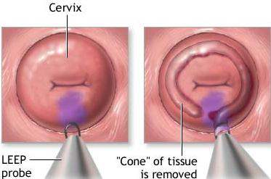
Treatment of CIN
Laser or cone biopsy is the most effective method of managing patients with high grade SIL for cancer prevention.

Slide 39
Invasive Cervical Cancer
About 75-90% of invasive cancers are squamous cell carcinomas.
The remainder are adenocarcinomas, mixed adenosquamous carcinomas (20%) and small cell neuroendocrine carcinomas.
The reduction in incidence in western countries is due to Papanicolaou screening tests.

Slide 40
Invasive Cervical Cancer
The tumors may be invisible or present as an exophytic mass.
Cervical carcinomas are graded from 1 to 3 (i.e. well, moderately and poorly differentiated) based on cellular differentiation and staged from 1 to 4 depending on the clinical spread.

Slide 41
Invasive Cervical Cancer

Slide 42
Invasive Cervical Cancer
Squamous cell carcinomas typically arise from pre-cancer CIN/SIL lesions at the transformation zone.
Squamous cell carcinoma has a peak incidence at the age of about 45 years, some 10 to 15 years after detection of precursor SIL.
Nowadays, due to the Pap screening test, many of cervical cancers are diagnosed in early stages, and majority are diagnosed in the pre-invasive CIN/SIL phase.
Advanced cases of squamous cell carcinoma are seen in women who either have never had a Pap smear or have waited many years since the last Pap smear.

Slide 43
Clinical Features
The early stages of cervical cancer may be completely asymptomatic.
On colposcopic examination, the cervix shows a mosaic vascular pattern and the lesions appear as white patches after the application of acetic acid to cervix.
Vaginal bleeding, contact bleeding, cervical mass, dyspareunia.
In advanced disease, metastases may be present in the abdomen, lungs or elsewhere.
Symptoms of advanced cervical cancer may include: loss of appetite, weight loss, fatigue, pelvic pain, back pain, leg pain, swollen legs, heavy bleeding from the vagina, bone fractures, and/or (rarely) leakage of urine or feces from the vagina.

Slide 44
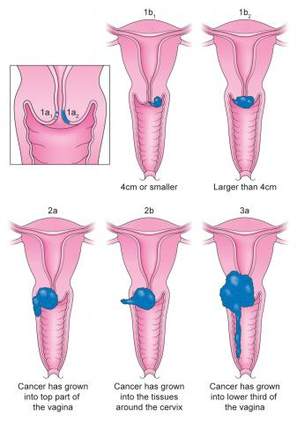
Staging
0- Carcinoma in Situ
1- Confined to the cervix
2- Extension beyond the cervix without extension to the lower third of Vagina or Pelvic Wall
3- Extension to the pelvic wall and/or lower third of the vagina
4- Extends to adjacent organs

Slide 45
Treatment
The primary treatment is hysterectomy and lymph node dissection; small microinvasive carcinomas may be treated with cone biopsy.
Radiation and chemotherapy are also of benefit in instances where surgery alone is not curative.

Slide 46
Reference
Kumar V, Abbas AK, Aster JC. Robbins Basic Pathology. 10th ed. Elsevier; 2018. Philadelphia, PA.

Slide 47
Thank You
End of Lecture

