Slide 1
Breast Pathology
Amany Fathaddin
Reference: Robbins & Cotran Pathology and Rubin’s Pathology

Slide 2
Pathology of benign breast diseases

Slide 3
Objectives
Pathology of benign breast diseases.
At the end of this lecture, the student should be able to:
Know the ways that benign breast conditions can clinically present.
Know the common inflammatory conditions of breast
Understand the pathology of fibrocystic change.
Know the common benign breast tumours with special emphasis on fibroadenoma and phyllodes tumour.
Know the risk of subsequent breast cancer in women with diagnosed benign breast tissue.

Slide 4
Clinical Presentation of Breast Diseases
Pain (mastalgia or mastodynia) is a common symptom often related to menses, possibly due to cyclic edema and swelling. Pain localized in a specific area is usually caused by a ruptured cyst or trauma to adipose tissue (fat necrosis). Almost all painful masses are benign, but for unknown reasons a small fraction of cancers (about 10%) cause pain.
Inflammation causes an edematous and erythematous breast. It is rare and is most often caused by infections, which only occur with any frequency during lactation and breastfeeding. An important mimic of inflammation is “inflammatory” breast carcinoma
Nipple discharge may be normal when small in quantity and bilateral. The most common benign lesion producing a nipple discharge is a papilloma arising in the large ducts below the nipple . Discharges that are spontaneous, unilateral, and bloody are of greatest concern for malignancy.

Slide 5
Clinical Presentation of Breast Diseases
4) Lumpiness, or a diffuse nodularity throughout the breast, is usually a result of normal glandular tissue. When pronounced, imaging studies may help to determine whether a discrete mass is present.
5) Palpable masses: can arise from proliferations of stromal cells or epithelial cells and are generally detected when they are 2 to 3 cm in size .
Most (~95%) are benign; these tend to be round to oval and to have circumscribed borders. In contrast, malignant tumors usually invade across tissue planes and have irregular borders. However, because some cancers grow deceptively as circumscribed masses, all palpable masses require evaluation.
6) Gynecomastia is the only common breast symptom in males. There is an increase in both stroma and epithelial cells resulting from an imbalance between estrogens, which stimulate breast tissue, and androgens, which counteract these effects.

Slide 6
Mammographic screening
was introduced in the 1980s as a means to detect early, nonpalpable asymptomatic breast carcinomas before metastatic spread has occurred. Mammography has met this promise, as the average size of invasive carcinomas detected by mammography is about 1 cm (significantly smaller than cancers identified by palpation), and only 15% will have metastasized to regional lymph nodes at the time of diagnosis
Densities(mass): Most tumors appear radiologically denser than the normal breast. Fibroadenomas, cysts etc. can also present as densities.
Calcifications: Calcium gets deposited in secretions, necrotic debris, or hyalinized stroma. It can be seen in benign and malignant conditions
Calcifications in malignancy are usually small, irregular, numerous, and clustered.
Ductal carcinoma in situ (DCIS) is most commonly detected as mammographic calcifications. Mammographic screening has increased the diagnosis of DCIS.
Mamographic screening is generally recommended to start after age 40.

Slide 7
Breast lesions
Inflammatory lesions
    Acute mastitis: staph infection most common
    Periductal mastitis
    Mammary duct ectasia means dilated ducts disease
    Fat necrosis is usually due to mechanical trauma, surgical or otherwise
    Lymphocytic mastopathy (sclerosing lymphocytic lobulitis) seen in diabetics
    Granulomatous mastitis sarcoid, TB, etc., but mostly idiopathic
Benign epithelial lesions
    Non proliferative breast changes (fibrocystic changes)
    Proliferative breast disease without atypia
    Proliferative breast disease with atypia /Atypical hyperplasia
Carcinoma in situ
    DCIS
    LCIS
Invasive carcinoma
    Ductal carcinoma
    Lobular carcinoma
Others/stromal tumors e.g. fibroadenoma, phyllodes tumors, sarcomas etc.

Slide 9
INFLAMMATORY PROCESSES
Inflammatory diseases of the breast are rare and may be caused by infections, autoimmune disease, or foreign body–type reactions.
Symptoms include erythema and edema, often accompanied by pain and focal tenderness.
Because inflammatory diseases are rare, the possibility that the symptoms are caused by inflammatory carcinoma should always be considered .
The only infectious agent to cause breast disease with any frequency is Staphylococcus aureus, which typically gains entry via fissures in nipple skin during the first weeks of breastfeeding. The invading organisms may lead to the formation of “lactational abscesses,” collections of neutrophils and associated bacteria in fibroadipose tissue.
If untreated, tissue necrosis may lead to the appearance of fistula tracks opening onto the skin.
Most cases are treated adequately with antibiotics and continued expression of milk. Rarely, surgical incision and drainage is required

Slide 10
Benign epithelial lesions of breast are divided into 3 basic types
Non proliferative breast changes (fibrocystic changes)
Proliferative breast disease without atypia
Proliferative breast disease with atypia (Atypical hyperplasia)

Slide 11
1- Non proliferative Breast Changes (Fibrocystic Change/disease)
Most common disorder of the breast. Age: 20-55yrs, decreases progressively after menopause.
The cause is not known. Thought to be caused by hormonal imbalances.
No increased risk for cancer
Histology: consists of three major morphologic changes:
cysts, fibrosis, and adenosis.
It is termed “nonproliferative” because the lesions contain single layers of epithelial cells.
The most common nonproliferative breast lesions are simple cysts lined by a layer of luminal cells that often undergo apocrine metaplasia The apocrine secretions may calcify and be detected by mammography.
When cysts rupture, chronic inflammation and fibrosis in response to the spilled debris may produce palpable nodularity of the breast (so-called “fibrocystic changes”).

Slide 12
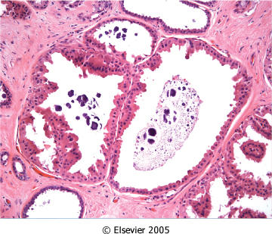
Figure 23-7 Apocrine cysts. Cells with round nuclei and abundant granular eosinophilic cytoplasm, resembling the cells of normal apocrine sweat glands, line the walls of a cluster of small cysts. Secretory debris, frequently with calcifications, is often present. Groups of cysts are common findings associated with clustered mammographic calcifications.
Downloaded from: Robbins & Cotran Pathologic Basis of Disease (on 11 November 2007 08:05 PM)
© 2007 Elsevier

Slide 13
© 2007 Elsevier

Slide 14
2- Proliferative Disease without Atypia
Rarely form palpable masses
Detected as small mammographic densities.
Incidental finding
Risk for cancer is 1.5 – 2 times normal
The following entities are included in this category:
  Epithelial hyperplasia
  Sclerosing adenosis
  Complex sclerosing lesions/radial scar
  Papillomas
  Proliferative variant of fibrocystic disease.

Slide 15
2- Proliferative Disease without Atypia contd…
Epithelial Hyperplasia (usual epithelial hyperplasia).
Normal breast has a 2 layers of cells (epithelial and myoepithelial cells). Epithelial hyperplasia is defined as the presence of more than 2 layers.
Hyperplasia can range from mild, moderate to severe/florid.
Both epithelial and myoepithelial cells proliferate.
It can be seen in the ducts and the lobules.

Slide 16
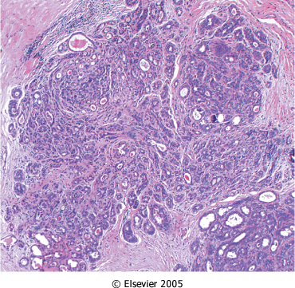
2- Proliferative Disease without Atypia contd…
Sclerosing Adenosis.
Commonly seen as an incidental microscopic finding but may occasionally present as a palpable mass that is mistaken clinically for cancer.
Calcification is commonly seen in the lesion, so even on mammography it can mimic cancer.
Microscopically: adenosis and stromal fibrosis in the lobule which leads to compression and distortion of the lobule.

Slide 17
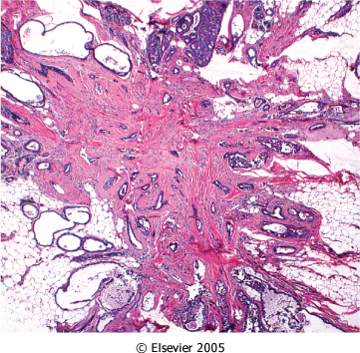
2- Proliferative Disease without Atypia contd…
Complex Sclerosing Lesion (Radial Scar).
Radial scars are stellate lesions characterized by a central nidus of entrapped glands in a hyalinized stroma
They typically present as an irregular mammographic density and closely mimic an invasive carcinoma both mammographically and grossly.
The word "scar" refers to the morphologic appearance, and not a prior inflammation, trauma or surgery.
There is a central nidus consisting of small tubules entrapped in a densely fibrotic stroma surrounded by radiating arms of epithelium with varying degrees of cyst formation and hyperplasia.

Slide 18
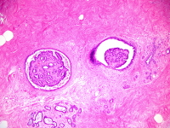
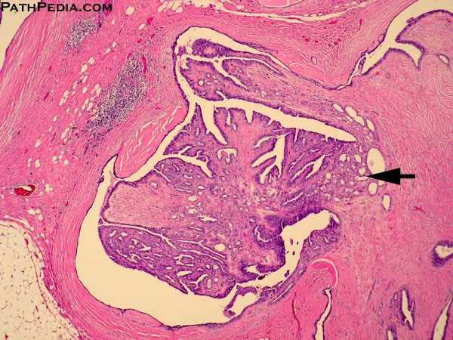
2- Proliferative Disease without Atypia contd…
Papillomas
Is a papillary tumor that arises from the ductal epithelium. It is more common in the large lactiferous ducts (present in the central part of the breast at the nipple) but can also occur in the small ducts
Large duct papillomas (central papillomas): usually solitary and situated in the lactiferous duct at the nipple. Patients present with bloody nipple discharge .
Small duct papillomas: commonly multiple and located deeper within the ductal system. Small duct papillomas have been shown to increase the risk of subsequent carcinoma.

Slide 19
3- Proliferative breast disease with atypia (Atypical hyperplasia)
Risk for cancer is 4-5 times normal
Atypical hyperplasia is a cellular proliferation resembling ductal carcinoma in situ (DCIS) or lobular carcinoma in situ (LCIS) but lacking sufficient qualitative or quantitative features for a diagnosis of carcinoma in situ.
Include two entities
    Atypical ductal hyperplasia
    Atypical lobular hyperplasia
Atypical hyperplasia has some of the architectural and cytologic features of carcinoma in situ but lack the complete criteria for that diagnosis and is categorized as ductal or lobular in type

Slide 20
Pathologic lesion | Relative risk of development of invasive carcinoma | comments
NONPROLIFERATIVE BREAST CHANGES (Fibrocystic changes) | do not have an increased risk. | Fibrocystic disease
PROLIFERATIVE DISEASE WITHOUT ATYPIA | 1.5 to 2 times normal | Epithelial hyperplasia Sclerosing adenosis Complex sclerosing lesions/radial scar Papillomas Proliferative fibrocystic disease.
PROLIFERATIVE DISEASE WITH ATYPIA | 4.0 to 5.0 times normal | ADH ALD
CARCINOMA IN SITU | 8.0 to 10.0 times normal | DCIS LCIS

Slide 21
Stromal Tumors
Tumors derived from intralobular stroma are comprised of both stromal cells and epithelial cells (i.e., they are “biphasic”), as the neoplastic proliferation of specialized lobular fibroblasts also stimulates reactive proliferation of lobular epithelial cells.
Two types: fibroadenoma and phyllodes tumors
Lesions of interlobular stroma are monophasic (only comprised of mesenchymal cells) and include benign soft tissue tumors found elsewhere in the body, such as hemangiomas and lipomas.
The only malignancy derived from interlobular stromal cells of note is angiosarcoma , which may arise in the breast after local radiotherapy. The morphologies of these lesions are described elsewhere

Slide 22
Fibroadenoma (FA)
The most common benign tumor of the female breast.
Any age, most common before age 30
Classic presentation: firm, mobile lump.
It may increase in size during pregnancy. It may stop growing and regress after menopause.
The tumor is usually solitary but may be multiple and involve both breasts.
The tumor is completely benign. FA are almost never malignant.

Slide 23
FA
Grossly: spherical nodules, sharply demarcated and circumscribed from the surrounding breast tissue and so is freely movable and can be shelled out. Size vary (1cm to 10 cm in diameter). Cut surface: pearl-white and whorled.
Histology: tumor is composed of a mixture of ducts and fibrous connective tissue
Treatment: lumpectomy (only the lump is removed)

Slide 24
Phyllodes tumors
Phyllodes tumors can occur at any age, but most present in the 40s and 50s
These tumors are much less common than fibroadenomas
Most present as large palpable masses (usually 3 to 4 cm in diameter)
They are fibro-epthelial tumors, have a leaf like pattern(“phyllodes” (Greek for “leaflike”) and a cellular stroma.
Phyllodes tumors are classified as:
Benign phyllodes tumors: most (75%) phyllodes tumors are benign.
Low-grade phyllodes tumors: they tend to recur locally and a rarely metastasize.
High-grade phyllodes tumors: are uncommon and they behave aggressively with frequent local recurrences and can have distant metastases to lung, bone, CNS.

Slide 26
Breast cancer

Slide 27
Objectives
Breast cancer.
At the end of this lecture, the student should be able to:
Know the risk factors for the development of breast cancer.
Know the classification of breast cancer.
Understand the behavior and spread of breast cancer.
Know the prognostic indicators of breast carcinoma

Slide 28
Breast Carcinoma
Breast carcinoma is the most common malignancy of women globally (excluding nonmelanoma skin cancer) and causes the majority of cancer deaths in women.
The lifetime risk of breast cancer is 1 in 8 for women living to age 90 in the United States.
Since the mid-1980s the mortality rate has dropped from 30% to less than 20%. The decrease is attributed to both improved screening, which detects some cancers before they have metastasized, and more effective systemic treatment

Slide 29
Almost all breast malignancies are adenocarcinomas (>95%). In the most clinically useful classification system, breast cancers are divided based on the expression of hormone receptors—estrogen receptor (ER) and progesterone receptor (PR)—and the expression of the human epidermal growth factor receptor 2 (HER2, also known as ERBB2), into three major groups:
• ER positive (HER2 negative; 50%–65% of cancers)
• HER2 positive (ER positive or negative; 10%–20% of cancers)
• Triple negative (ER, PR, and HER2 negative; 10%–20% of cancers)

Slide 30
These three groups show striking differences in patient characteristics, pathologic features, treatment response, metastatic patterns, time to relapse, and outcome . Within each group are additional histologic subtypes

Slide 32
An alternative classification system with substantial overlap relies on gene expression profiling. This system, which is currently used mainly in the context of clinical research, divides breast cancers into four major types:
• Luminal A. The majority are lower-grade ER-positive cancers that are HER2 negative
• Luminal B. The majority are higher-grade ER-positive cancers that may be HER2 positive
• HER2-enriched. The majority overexpress HER2 and do not express ER
• Basal-like. The majority by gene expression profiling resemble basally located myoepithelial cells and are ER-negative, HER2-negative

Slide 34
Epidemiology and Risk Factors
Age and Gender. Breast cancer is rare in women younger than age 25, but increases in incidence rapidly after age 30 ; 75% of women with breast cancer are older than 50 years of age, and only 5% are younger than 40. The incidence in men is only 1% of that in women.
Family History of Breast Cancer. The greatest risk is for individuals with multiple affected first-degree relatives with early-onset breast cancer. In most families, it is thought that various combinations of low penetrance, “weak” cancer genes are responsible for increased risk. However, approximately 5% to 10% of breast cancers occur in persons who inherit highly penetrant germline mutations in tumor suppressor genes . For these individuals, the lifetime risk of breast cancer may be greater than 90%.
Geographic Factors. Significant differences in the incidence and mortality rates of breast cancer have been reported in various countries. The risk is significantly higher in the Americas and Europe than in Asia and Africa. Diet, reproductive patterns, and breastfeeding practices are thought to be involved. In line with this, breast cancer rates appear to be rising in parts of the world that are adopting Western habits

Slide 35
Epidemiology and Risk Factors
Race/Ethnicity. The highest rate of breast cancer is in women of European descent, largely because of a higher incidence of ER-positive cancers. Hispanic and African American women tend to develop cancer at a younger age and are more likely to develop aggressive tumors. Such disparities are thought to result from a combination of differences in genetics, social factors, and access to health care and are an area of intense study.
Reproductive History. Early age of menarche, nulliparity, absence of breastfeeding, and older age at first pregnancy are all associated with increased risk, probably because each increases the exposure of “at-risk” breast epithelial cells to estrogenic stimulation.
Ionizing Radiation. Radiation to the chest increases the risk of breast cancer if exposure occurs while the breast is still developing. For example, breast cancer develops in 25% to 30% of women who underwent irradiation for Hodgkin lymphoma in their teens and 20s, but the risk for women treated later in life is not elevated.
Other Risk Factors. Postmenopausal obesity, postmenopausal hormone replacement, mammographic density, and alcohol consumption also have been implicated as risk factors. The risk associated with obesity probably is due to exposure of the breast to estrogen produced by adipose tissue. In keeping with this, obesity is only associated with an increased risk of tumors that express ER.

Slide 36
The most common location of tumors within the breast is in the upper outer quadrant (50%), followed by the central portion (20%). About 4% of women with breast cancer have bilateral primary tumors or sequential lesions in the same breast.
Breast cancers are classified morphologically according to whether they have penetrated the basement membrane.
Those that remain within this boundary are termed in situ carcinomas, and those that have spread beyond it are designated invasive carcinomas.
In this classification, the main forms of breast carcinoma are as follows:
A. Noninvasive 1. Ductal carcinoma in situ
2. Lobular carcinoma in situ
B. Invasive 1. Invasive ductal carcinoma (includes all carcinomas that are not of a special type)—70% to 80%
2. Invasive lobular carcinoma— ~10% to 15%
3. Carcinoma with medullary features— ~5%
4. Mucinous carcinoma (colloid carcinoma) — ~5%
5. Tubular carcinoma— ~5%
6. Other types

Slide 37
Noninvasive (in Situ) Carcinoma

Slide 38
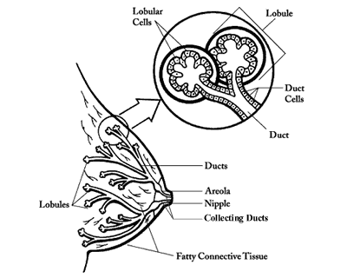
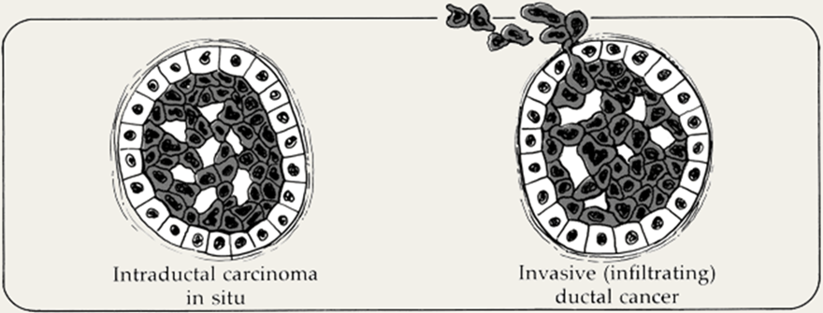

Carcinoma in situ
This is epithelial proliferation that is still
confined to the TDLU, By definition, both “respect” the basement membrane and do not invade into stroma or lymphovascular channels
There are two subtypes:
Ductal carcinoma in situ (DCIS) or intraductal carcinoma
2) Lobular carcinoma in situ

Slide 40

Ductal Carcinoma In Situ (DCIS)
DCIS is the non-invasive proliferation of malignant cells within the duct system without breaching the underlying basement membrane
They have a very high risk of development of subsequent invasive carcinoma.
DCIS has a wide variety of histologic appearances, including solid, comedo, cribriform, papillary, micropapillary, and “clinging” types.
Nuclear appearances range from bland and monotonous (low nuclear grade) to pleomorphic (high nuclear grade).
The distinctive comedo subtype is characterized by extensive central necrosis, which produces toothpastelike necrotic tissue.
http://www.dslrf.org/images/f12_02.gif

Slide 41
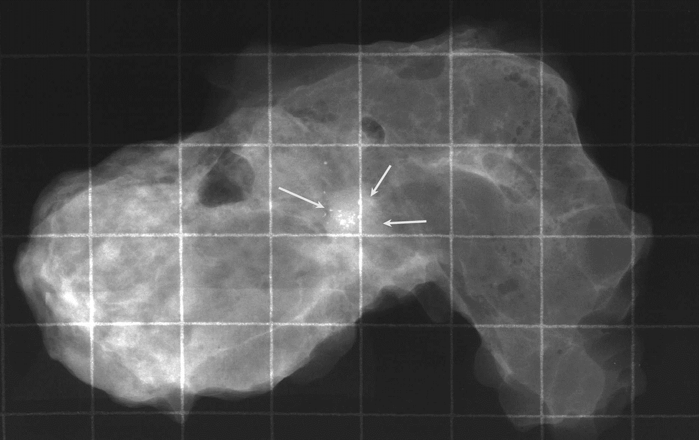
DCIS( Ductal Carcinoma In Situ)
Calcifications frequently are associated with DCI resulting from calcification of necrotic debris or secretory material.
DCIS constitutes only 5% of breast cancers in unscreened populations but up to 30% in screened populations, largely because of the ability of mammography to detect calcifications.
Current treatment strategies for DCIS use surgery and irradiation to eradicate the lesion.
Treatment with anti-estrogenic agents such as tamoxifen also is used to decrease the risk of recurrence of ER-positive DCIS. The prognosis is excellent, with greater than 97% long-term survival.
If untreated, DCIS progresses to invasive cancer in roughly one-third of cases, usually in the same breast and quadrant as the earlier DCIS
Microcalcification of DCIS

Slide 42
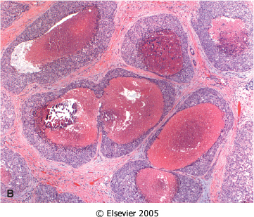
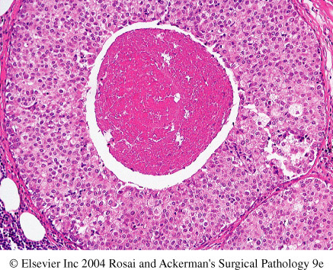
Comedo DCIS: is characterized by large central zones of necrosis with calcified debris

Slide 43
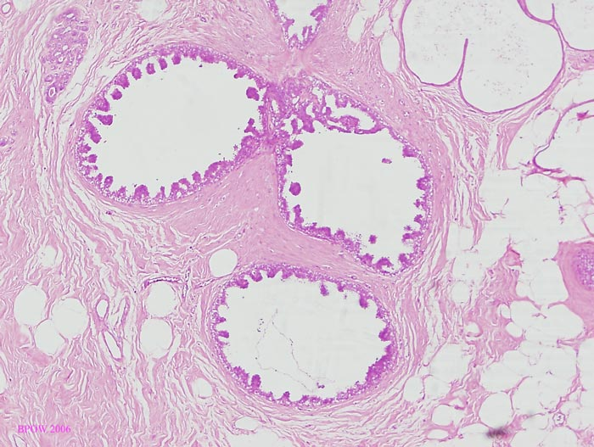
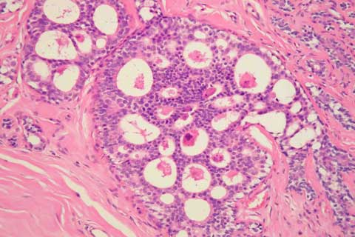
DCIS
Micropapillary DCIS.
Cribriform DCIS comprises cells forming round, regular ("cookie cutter") spaces. The lumens are often filled with calcifying secretory material.
http://www.breastpathology.info/Carcinoma%20in%20situ.html#images

Slide 44
Paget disease
Paget disease of the nipple is caused by the extension of DCIS up the lactiferous ducts and into the contiguous skin of the nipple, producing a unilateral crusting exudate over the nipple and areolar skin. Paget disease of the nipple stems from in situ extension of an underlying carcinoma.
The prognosis of the carcinoma of origin is affected by the presence of Paget disease and is determined by other factors

Slide 45
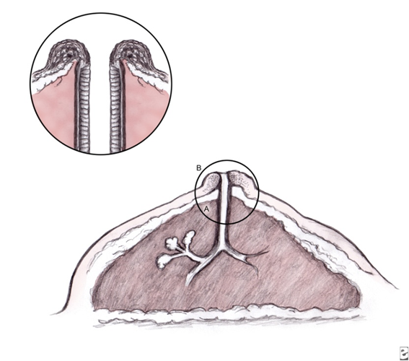
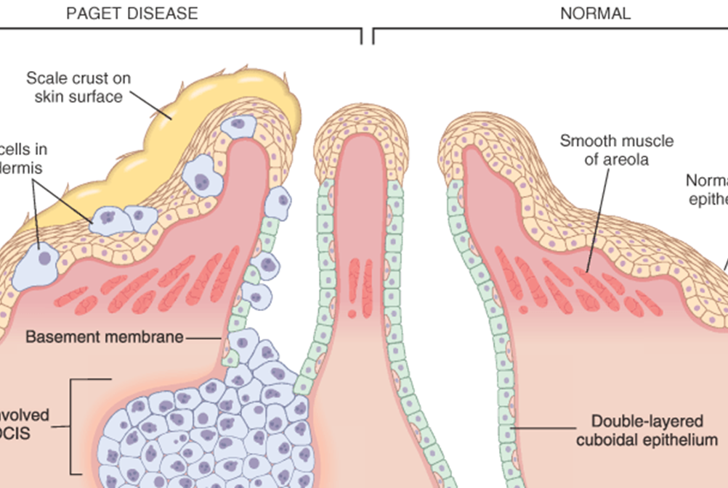
Paget’s Disease
http://img.medscape.com/pi/emed/ckb/dermatology/1048885-1101235-854tn.jpg
Paget's disease of the breast is a rare type of breast cancer that is characterized by a red, scaly eczematous lesion on the nipple and surrounding areola.

Slide 46
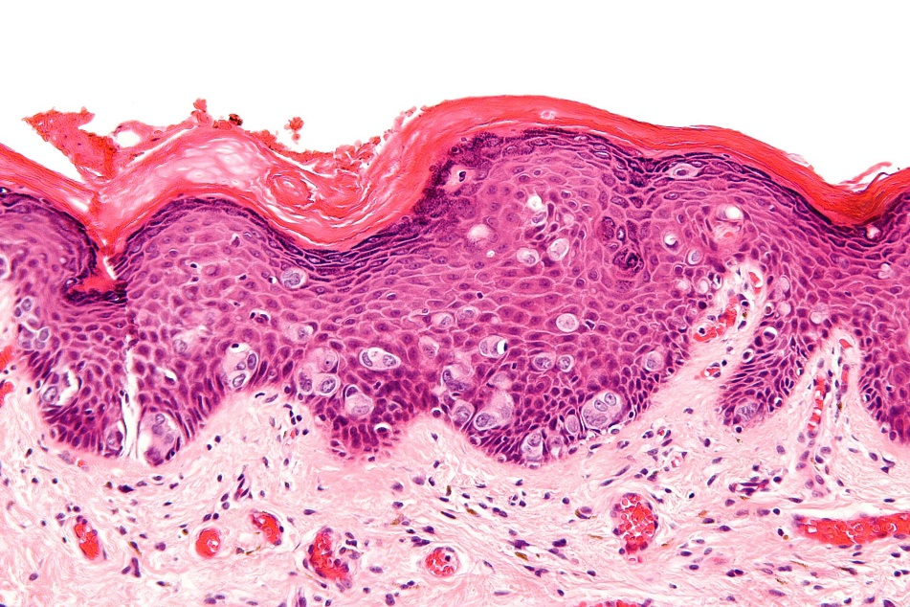
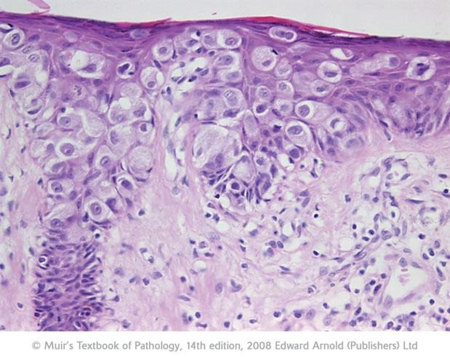
Pagets disease
The histologic hallmark of Paget’s disease of the nipple is the infiltration of the epidermis by large neoplastic ductal cells with abundant cytoplasm, pleomorphic nuclei and prominent nucleoli.
Paget cells extend from DCIS within the ductal system into nipple skin without crossing the basement membrane
"Extramammary Paget disease - high mag" by Nephron - Own work. Licensed under CC BY-SA 3.0 via Wikimedia Commons - http://commons.wikimedia.org/wiki/

Slide 47
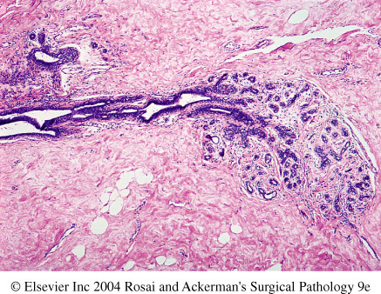
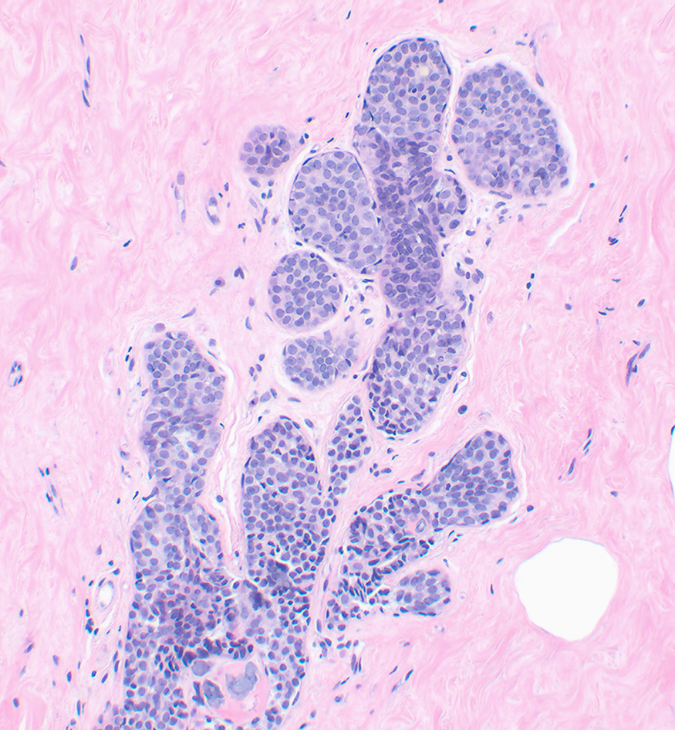
Lobular Carcinoma in Situ (LCIS)
NORMAL
LCIS has a uniform appearance. The cells are monomorphic, have bland, round nuclei, and are found in loosely cohesive clusters within the lobules
LCIS is virtually always an incidental finding because, unlike DCIS, it is only rarely associated with calcifications.
Approximately one-third of women with LCIS eventually develop invasive carcinoma.
Unlike DCIS, invasive carcinomas following a diagnosis of LCIS may arise in either breast 2/3 in the same breast and 1/3 in the contralateral breast.
Thus, LCIS is both a marker of an increased risk of carcinoma in both breasts and a direct precursor of some cancers.
Current treatment options include close clinical and radiologic follow-up, chemoprevention with tamoxifen or, less commonly, bilateral prophylactic mastectomy.
LCIS

Slide 48
INVASIVE BREAST CARCINOMA

Slide 49
Invasive Breast Carcinoma: Classification
Invasive breast carcinoma is tumor that has extended across them
basement membrane. This permits access to lymphatics and vessels and
Therefore the potential to metastasize. Invasive breast carcinoma is
subdivided into:
1. Invasive ductal carcinoma (includes all carcinomas that are not of a special type)—70% to 80%
2. Invasive lobular carcinoma— ~10% to 15%
3. Carcinoma with medullary features ~5%
4. Mucinous carcinoma (colloid carcinoma) ~5%
5. Tubular carcinoma ~5%
6. Other types

Slide 50
Invasive Ductal Carcinoma, NOS
Invasive ductal carcinoma is a term used for all carcinomas that cannot be subclassified into one of the specialized types
A majority (70%–80%) of cancers falls into this group. This type of cancer usually is associated with DCIS.
About 50% to 65% of ductal carcinomas are ER positive, 20% are HER2 positive, and 15% are negative for both ER and HER2

Slide 51
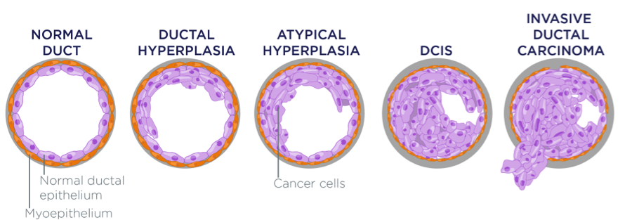
Invasive Ductal Carcinoma
http://aegiscreative.com/wp-content/uploads/2014/01/Figure-2.png

Slide 52
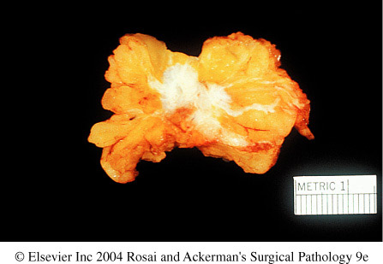
Invasive Ductal Carcinoma, NOS: gross
Grossly: tumor is firm, hard, with an irregular border.
Cut surface: gritty and shows irregular margins with stellate infiltration (sometimes it can be soft and well demarcated) and in the center there are small foci of chalky white stroma and occasionally calcifications

Slide 53
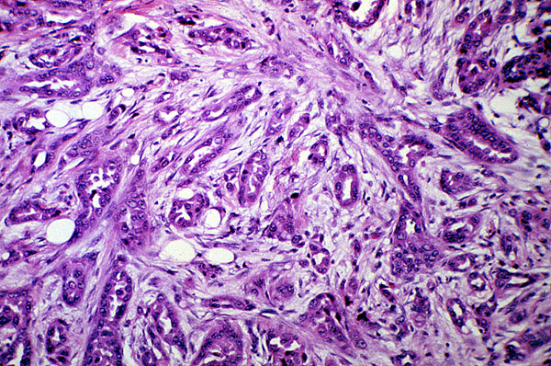
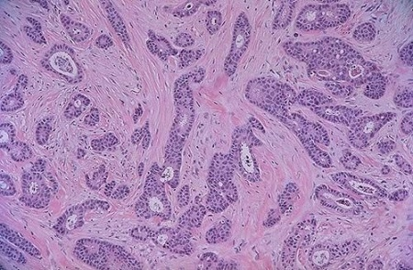
Invasive Ductal Carcinoma, NOS: histology
Histology: the tumor cells are large and pleomorphic usually within a dense stroma. They are adenocarcinomas and so they show glandular formation but can also be arranged in cords or sheets of cells.
The tumors range from well differentiated to moderate or poorly differentiated.
Carcinomas associated with a large amount of DCIS require large excisions with wide margins to reduce local recurrences

Slide 54
Invasive Lobular Carcinoma
It is the second most common type of invasive breast cancer
The tumor may occur alone or in combination with ductal carcinoma.
It tends to be bilateral and multicentric.
The pattern of metastasis of lobular carcinoma is unique among breast cancers, as they frequently spread to cerebrospinal fluid, serosal surfaces, gastrointestinal tract, ovary, uterus, and bone marrow. Almost all lobular carcinomas express hormone receptors, whereas HER2 overexpression is rare. Carcinomas
The amount of stromal reaction to the tumor varies from marked fibroblastic (desmoplastic) response to little reaction and therefore the presentation varies from a discrete mass to a subtle, diffuse indurated area. Most are firm to hard with irregular margins
Histology: single infiltrating malignant cells, forming a line often one cell width (called as indian file pattern). No tubules or papillary formation.

Slide 55
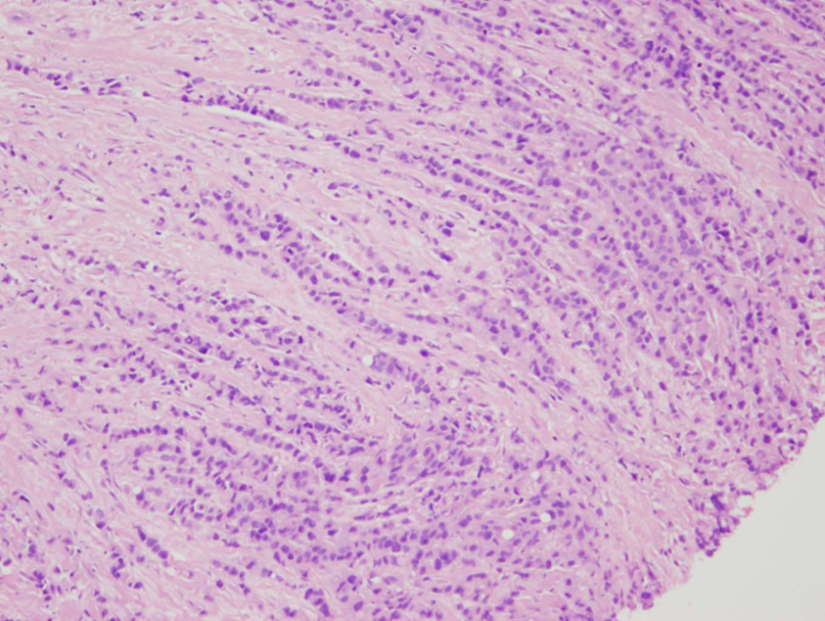
Invasive Lobular Carcinoma
infiltrating cells that are morphologically similar to the tumor cells seen in LCIS; indeed, two-thirds of the cases are associated with LCIS.
The cells invade stroma individually and often are aligned in “single-file”
Although most manifest as palpable masses or mammographic densities, a significant subgroup invade without producing a desmoplastic response; such tumors may be clinically occult and difficult to detect by imaging

Slide 56
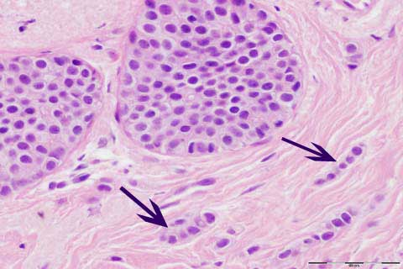
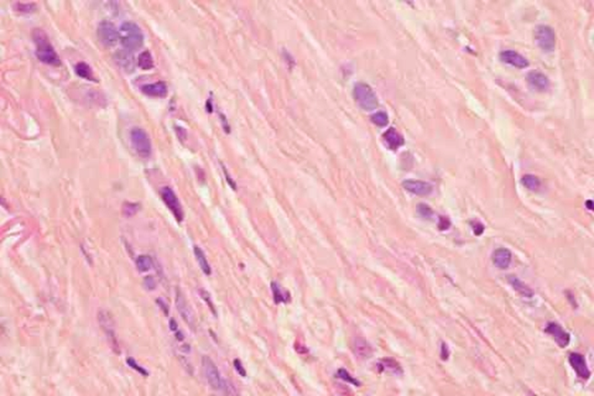
Invasive lobular carcinoma with area of lobular carcinoma in situ also
http://www.breastpathology.info/Special%20Types.html
http://www.breastpathology.info/Special%20Types.html

Slide 57
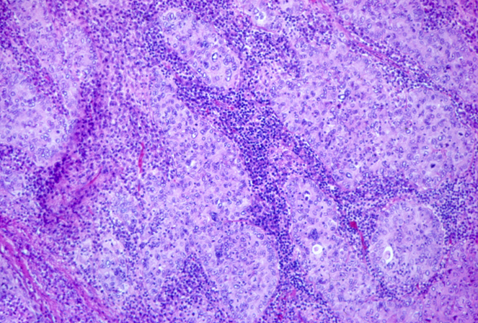
Carcinomas with medullary features
Carcinomas with medullary features are a special type of triple-negative cancer comprising about 5% of all breast cancers.
These carcinomas typically grow as rounded masses that can be difficult to distinguish from benign tumors on imaging
They consist of sheets of large anaplastic cells associated with pronounced lymphocytic infiltrates composed predominantly of T cells
The presence of lymphocytes is associated with a favorable prognosis, at least in part due to a better response to chemotherapy compared to poorly differentiated carcinomas without lymphoid infiltrates.
This type of carcinoma is seen frequently in women with germline BRCA1 mutations, but most women with these carcinomas are not carriers
http://tgmouse.ucdavis.edu/JENSEN-MAMM2000/BRCA-3/BRCA-3.HTML

Slide 58
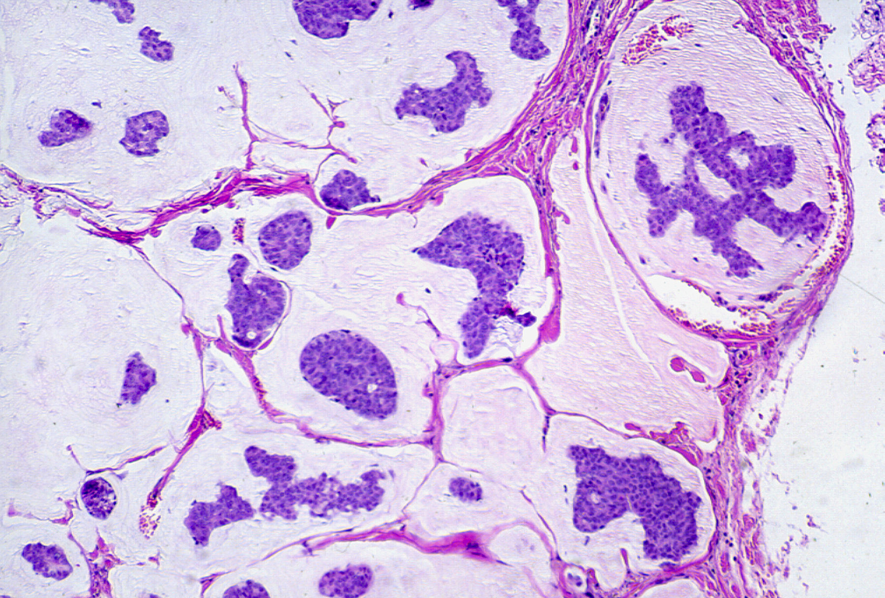
Colloid Carcinoma/ Mucinous carcinoma
Mucinous (colloid) carcinoma is an ER-positive/HER2negative tumor that produces abundant amounts of extracellular mucin.
The tumors usually are soft and gelatinous because of the presence of mucin pools that create an expansile circumscribed mass.
http://tgmouse.ucdavis.edu/JENSEN-MAMM2000/BRCA-3/BRCA-3.HTML

Slide 59
Tubular carcinoma
Tubular carcinoma is another type of ER-positive/HER2negative cancer and is almost always detected on mammography as a small irregular mass.
The tumor cells are arranged in well formed tubules and have low-grade nuclei.
Lymph node metastases are rare, and the prognosis is excellent.

Slide 60
Inflammatory carcinoma
Inflammatory carcinoma is defined by its clinical presentation, rather than a specific morphology.
Patients present with a swollen erythematous breast without a palpable mass. The underlying invasive carcinoma is generally poorly differentiated and diffusely infiltrates and obstructs dermal lymphatic spaces, causing the “inflamed” appearance; true inflammation is absent.
Many of these tumors metastasize to distant sites; the overall 5-year survival is less than 50%, and understandably even lower in those with metastatic disease at diagnosis.
About half express ER and 40% to 60% overexpress HER2

Slide 61
All types of invasive breast carcinoma are assigned a grade from 1 (low-grade) to 3 (high-grade) based on nuclear pleomorphism, tubule formation, and proliferation.
Low-grade nuclei are similar in appearance to the nuclei of normal cells. High-grade nuclei are enlarged and have irregular nuclear contours .
Most low-grade carcinomas form well-defined tubules and may be difficult to distinguish from benign lesions, whereas high-grade carcinomas lose this capacity and invade as solid sheets or single cells.
Proliferation is evaluated by counting mitotic figures.

Slide 62
Clinical Presentation
In unscreened population, Most breast cancers are detected as a palpable mass by the affected patient. Such carcinomas are almost all invasive and are typically at least 2 to 3 cm in size.
At least half of these cancers will already have spread to regional lymph nodes.
In older screened populations approximately 60% of breast cancers are discovered before symptoms are present. About 20% are in situ carcinomas. Invasive carcinomas detected by screening in older women are 1 to 2 cm in size and only 15% will have metastasized to lymph nodes

Slide 63
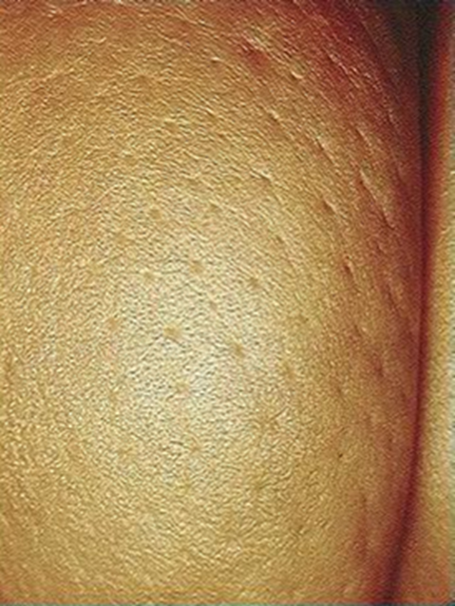
Lymphatics may become involved and the lymphatic drainage of that area and the overlying skin gets blocked causing lymphedema and thickening of the skin, a change referred to as peau d'orange.
When the tumor involves the central portion of the breast, retraction of the nipple may develop.

Slide 64
The clinical outcome for a woman with breast cancer can be predicted based on the molecular and morphologic features of the cancer and its stage at the time of diagnosis.
Factors that influence outcome include the following:
• Biologic type. The biologic type of cancer is evaluated by a combination of histologic appearance, grade (including proliferative rate), expression of hormone receptors, and expression of HER2.
Proliferation is evaluated by mitotic count and is closely tied to responsiveness to cytotoxic chemotherapy
Expression of estrogen or progesterone receptors predicts response to anti-estrogen therapy. The growth of hormone receptor–positive cancers can be inhibited for many years with therapy and it is possible for patients to survive for long periods with distant metastases. However, resistance often eventually develops—in some cancers because of mutations in the gene for ER.
In contrast, there is no targeted therapy available for triple-negative cancers, which are treated with chemotherapy.
Overexpression of HER2 is seen in about 20% of breast cancers. HER2 remains one of the best-characterized examples of an effective therapy that is directed against a tumor-specific molecular lesion

Slide 65
RNA expression profiling is a newer method of subclassifying cancers.
• Tumor stage. “Stage” is a measure of the extent of tumor at the time of diagnosis and is important for all biologic types of carcinoma.
It is based on features of the primary tumor (T), involvement of regional lymph nodes (N), and the presence of distant metastases (M)
The AJCC/UICC staging system, used in the United States and Europe, classifies tumors as T1, T2, and T3 based on the tumor size, whereas T4 tumors have ulceration of the skin, involvement of the deep muscles of the chest wall, or are clinically diagnosed as inflammatory carcinoma.
The majority of cancers first metastasize to regional nodes, and nodal involvement is a very strong prognostic factor. Lymphatic drainage goes to one or two sentinel lymph nodes in the axilla in most patients. If these nodes are not involved, the remaining axillary nodes are usually free of carcinoma. Sentinel node biopsy has become the standard for assessing nodal involvement, replacing more extensive lymph node dissections, which are associated with significant morbidity.
Distant metastases (M) are only detected in 5% of newly diagnosed women.

Slide 66
Stage 0 is CIS, which is associated with survival rates greater than 95%.
Stage I includes women with smaller cancers and nodes either free of carcinoma or with only very small micrometastases. Survival is ~86% at 10 years.
Carcinomas are classified as Stage II either because of larger tumor size or because of up to three positive nodes. Survival declines to ~71% at Stage II.
Stage III is the group of locally advanced cancers defined by large size, involvement of skin or chest wall, or by four or more positive nodes. Only ~54% of patients survive 10 years.
Stage IV is reserved for patients with distant metastases, and survival is very poor (~11%).

Slide 67
SUMMARY BREAST CARCINOMA
• The lifetime risk of developing breast cancer for an American woman is 1 in 8.
• A majority (75%) of breast cancers are diagnosed after the age of 50.
• The major risk factors for developing breast cancer are related to hormonal factors and inherited susceptibility.
• About 12% of all breast cancers are caused by identified germline mutations; BRCA1 and BRCA2 genes account for one-half of the cases associated with single-gene mutations.
• DCIS is a precursor to invasive ductal carcinoma and is most often found on mammographic screening as calcifications. When carcinoma develops in a woman with a previous diagnosis of untreated DCIS, it is usually is an invasive ductal carcinoma in the same breast.
• LCIS is both a marker of increased risk and a precursor lesion. When carcinoma develops in a woman with a previous diagnosis of LCIS, two-thirds are in the same breast and one-third is in the contralateral breast.
• Invasive carcinomas are classified according to histologic type and biologic type: ER-positive/HER2-negative, HER2-positive, and ER/PR/HER2-negative (triple-negative
The biologic types of cancer have important differences in patient characteristics, grade, mutation profile, metastatic pattern, response to therapy, time to recurrence, and prognosis.
• Prognosis is dependent on the biologic type of tumor, stage, and the availability of treatment modalities

Slide 68
Reference: Robbins & Cotran Pathology and Rubin’s Pathology

