Slide 1
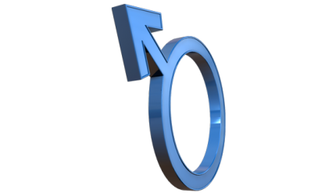
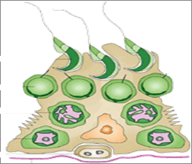
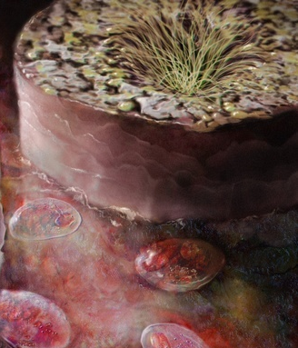
DRUGS USED IN
MALE INFERTILITY

Slide 2
DRUGS USED IN
MALE INFERTILITY
ILOs
By the end of this lecture you will be able to:
Define male infertility
Recognize regulations contributing to male fertility & dysregulations leading to infertility
Classify hormonal & non-hormonal therapies used in male infertility whether being empirical or specific.
Expand on the mechanism of action, indications, preparations, side effects, contraindications & interactions of most hormonal therapies
Highlight some potentialities of non-hormonal
therapies

Slide 3
MALE INFERTILITY
Definition
Inability of a male to achieve conception in a fertile woman after one year of frequent unprotected intercourse.
Prevalence
Infertility has traditionally been thought of as a woman's problem. However, about one out of every three cases of infertility is due to the man alone
INFERTILITY vs IMPOTENCE – What is the difference?

Slide 4
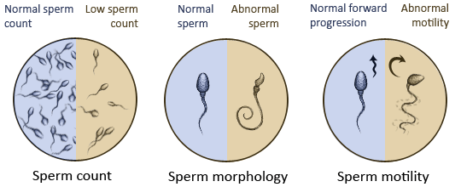
In male infertility, the semen analysis is abnormal:
Count is low (oligospermia)
Sperms are absent in the ejaculate (azoospermia)
Sperm motility is seriously affected (asthenospermia).
Sperms are totally immobile or dead (necrospermia)

Slide 5
Causes of Male Infertility
1. Idiopathic (causes unknown).
2. Pre- testicular causes (poor hormonal support & poor general
health) including:
Hypogonadism; Drugs; alcohol; Tobacco; Strenuous riding (bicycle
& horse riding); Medications (chemotherapy; anabolic steroids).
3. Testicular causes (testes produce semen of low quantity and/or
poor quality): Age; Malaria; Testicular cancer;
Idiopathic (unexplained sperm deficiencies).
4. Post- testicular causes (conditions that affect male genital
system after sperm production):
Vas deferens obstruction; Infection, e.g. prostatitis, T.B;
Ejaculatory duct obstruction; Impotence.

Slide 6
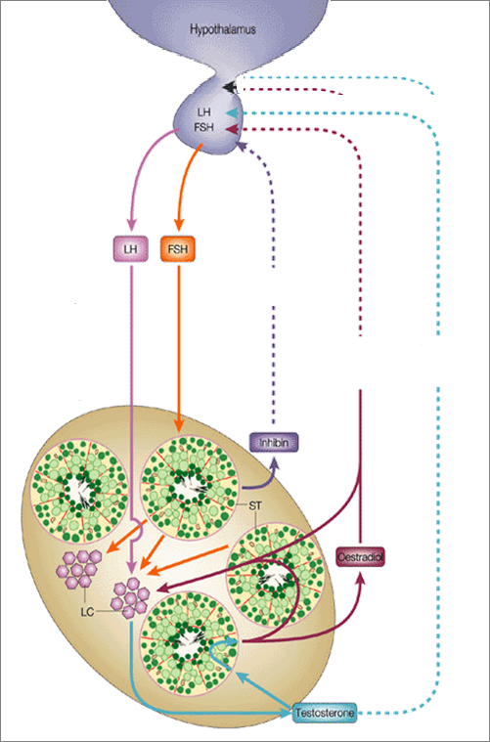
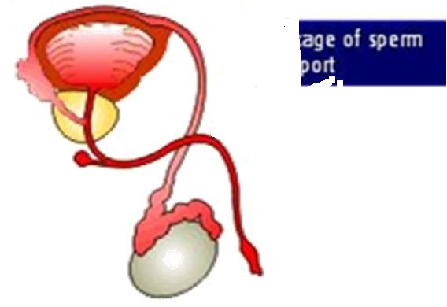
HYPOTHALAMUS
Pulsatile Secretion
GnRH
3. Problems of Sperm Transport
GnHs
POST-TESTICULAR
LH
FSH
-ve
-ve
Initiation & Maintenance of spermatogenesis
-ve
+ve
PRE-TESTICULAR
Inhibin
4. Problem in Erection & Ejaculation
Estradiol
+ve
1. Problems related to Hormone Production
5DHT
2. Problems related to Sperm Production
TESTOSTERONE
TESTICULAR
LHTestosterone Pulsatile
(chronic LH  makes testis refractory)
MALE INFERTILITY

Slide 7
Needs 3 ms. before semen quality changes
DRUG TREATMENT OF MALE INFERTILITY
HORMONAL THERAPY
NON-HORMONAL THERAPY
SPECIFIC
EMPERICAL
EMPERICAL
SPECIFIC
Hyperprolactinaemia DA₂₋ Agonists
Hypothyroidism Thyroxine
Congenital Adrenal Hyperplasia  Glucocorticoids excess
Erectile Dysfunction PDE 5 inhibitors,e.g. sildenafil (viagra) , vardenafil (levitra) , tadalafil (cialis)
Premature Ejaculation SSRIs (e.g. prozac)
Infection of testes, prostate &UT Antibiotics
Idiopathic Androgens, Antiestrogen, GnH(FSH)
Euogonadotrophic Hypogonadism  (T only) Antiestrogens (SERMs & Aromatase Is)
Hypogonadotrophic hypogonadism  2^{ndry} Hypogonadism ( Hypothalamo-Pituitary )
(T &  FSH / LH )
Pulsatile GnRH, hCG, hMG, Androgens, Clomiphene
Kallikrein
Antioxidants; e.g.vit E, vit.c
Zinc Supplements
Folic acid
L-Carnitine
Hypergonadotrophic Hypogonadism (Testicular dysfunction)  1^{ry} Hypogonadism (T &LH ) Assisted Reproduction ( no treatment )

Slide 8
Drugs Used in the Treatment of Male infertility
Testosterone and synthetic androgens
Anti-estrogens
- SERMs-clomiphene, tamoxifen
- Aromatase inhibitors:
Anastrazole
3. GnRH
4. GnH together with hcG
5. Non- hormonal therapy

Slide 9
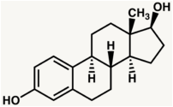
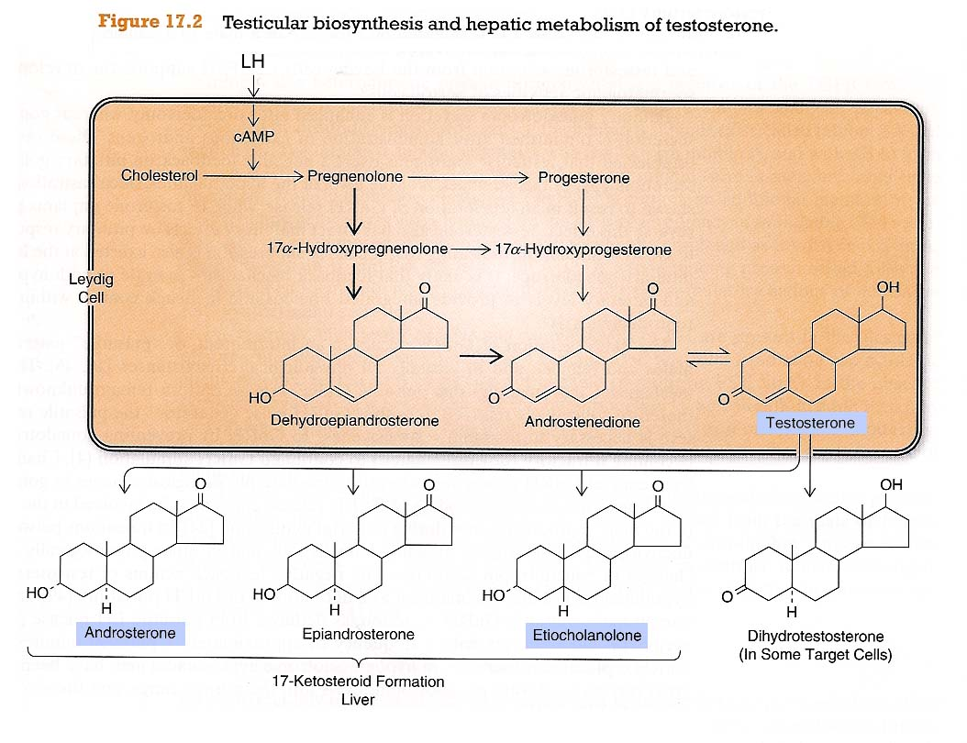
1.Testesterone
> in brain, bone, liver, adipose t.
AROMATASE
Estradiol
> in accessory sex organs
5-α-REDUCTASE
Leydig C
DHT
TESTOSTERONE
Principle male sex hormone produced in testis(> 95%), small amount in adrenals. It follows a circadian patternin early morning & in evening

Slide 10
Mechanism of action of testosterone
A. (prostate, seminal vesicles converted by α-reductase to DHT
B. Bones and Brain
Testesterone is metabolized to estradiol by c-p450 aromatase.
Bones: estradiol accelerates maturation of cartilage into bone leading to closure of the epiphyses & conclusion of growth.
Brain: estradiol serves as the most important feedback signal to the hypothalamus(esp. affecting LH secretion).

Slide 11
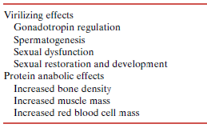
Pharmacological effects of Testesterone
Testesterone has virilizing and anabolic effects
○ Testosterone & Synthetic Androgens
Anabolic Steroids
Not used in infertility

Slide 12
Kinetics of Testesterone
Ineffective orally(inactivated by 1st pass met.) I.M or S.C.
Skin patch & gels…. are also available
Binds to Sex Hormone Binding Globulin [SHBG]
t1/2 = 10 –20 min
Inactivated in the liver.; 90% of metabolites excreted in urine.
Disadvantages: Rapidly absorbed, rapidly metabolized (Short duration of action).
Synthetic Androgens
Less rapidly metabolized & more lipid soluble ►increasing its duration of action.
Derived from Testosterone
Esters; proprionate, enanthate, cypionate in oil for IM; every 2-3 weeks
Other derivatives as Fluoxymesterone, Methyltestosterone, Danazol  given Orally; daily
Derived from DHT; Mesterolone  given Orally; daily

Slide 13
Adverse effects of Androgens
Excess androgens (if taken > 6 wks) can cause impotence, decreased spermatogenesis & gynecomastia.
Alteration in serum lipid profile: HDL & LDL, hence, risk of premature coronary heart disease.
Salt & water retention leading to edema.
Hepatic dysfunction; AST levels,alkaline phosphatase,  bilirubin & cholestatic jaundice.
Hepatic carcinoma (long term use)
Behavioral changes; physiologic dependence,↑ aggressiveness, psychotic symptoms
Polycythemia (increase # of RBC)  risk of clotting.
Premature closing of epiphysis of the long bones.
Reduction of testicular size

Slide 14
1. ANDROGENS
INDICATIONS
As Testesterone Replacement Therapy(TRT)
Therapy for androgen deficiency in adult male infertility.
In delayed puberty with hypogonadism
 give androgen slow & spaced for fear of
premature fusion of epiphyses  short stature.

Slide 15
Contraindications
Testesterone
Male patients with cancer of breast or prostate
Severe renal & cardiac disease → predispose to edema
Psychiatric disorders
Hypercoagulable states
Polycythemia
Interactions
+ corticosteroids  oedema
+ warfarin  metabolism   bleeding
+ insulin or oral hypoglycemics  hypoglycemia
+ propranolol   propranolol clearance  efficacy
Mesterolone
More safely given in  testosterone or in 2ndry hypogonadism.
Why ???
1. Not aromatized into estrogens no –ve of GnHs  encourages natural testosterone production spermatogenesis is enhanced
2. Unlike other oral synthetic androgens it is not hepatotoxic.

Slide 16
2. Antiestrogens
Because estrogens  –ve feedback on hypothalamus  GnRH pulse frequency & pituitary responsiveness to GnRH , so antiestrogens  Gn RH & improve its pituitary response.
2.a. SERMs
Tamoxifen, Clomiphene
Tamoxifen
Clomiphene
Both drugs can induce libido & bad temper in men
2.b. Aromatase Inhibitors
Anastrozole
Blocks conversion of testosterone to estrogen within the hypothalamus
- All are used for inducing spermatogenesis in oligozoospermia ( count is low)
- Given as daily dose over a period of 1–6 months.
- Best to improve sperm count & motility with good pregnancy rates

Slide 17
3. GnRH
Used in hypothalamic dysfunctionandrogenization & spermatogenesis
Given as Pulsatile GnRH therapy (4-8 ug subcut every 2 hours) using a portable pump.
Exogenous excess of GnRH  down-regulation of pituitary GnRH receptors &  LH responsiveness.
ADRs; Headache, depression, generalized weakness, pain , gynecomastia and osteoporosis.
4. GnHs
Used in 2ndry hypogonadism (FSH or both FSH or LH absent)  spermatogenesis
GnHs replacement must be combined; hCG (IM.2 ms.) followed by hCG + hMG (IM. 6 -12 ms).
ADRs; Headache, local swelling (injection site), nausea, flushing, depression, gynecomastia, precocious puberty.

Slide 18
5.Non-HORMONAL THERAPY
Sometimes is very promising, to improve sperm quality and quantity.
Antioxidants
Protect sperm from oxidative damage (e.g. vit E,C)
KALLIKREIN
Has proteolytic activity, cleaving kininogen to kinins important for sperm motility.
FOLIC ACID
Plays a role in RNA and DNA synthesis during spermatogenesis & has antioxidant properties.
ZINC
Plays an important role in testicular development, sperm production & sperm motility.
L-CARNITINE
Is important for sperm maturation.

