Slide 1


DRUGS USED FOR THE TREATMENT OF SYPHILIS
& GONORRHEA
Human Papillomavirus
_ HPV _ Nucleus
Health-AZ_{P}O_{ro}n_{f}A.u_{H}E_{a}lJ_{n}H_{a}k_{n Hagar}

Slide 2

At the end of lectures, the students should
List the drugs used in the treatment of syphilis & gonorrhea.
Describe the mechanism of action and adverse effects of each drug.
Describe the contraindications of drugs used
Describe the recommended regimens used for the treatment of syphilis & gonorrhea
Know the alternative treatments in allergic patients.

Slide 3
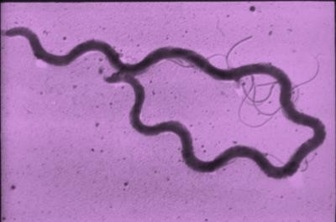
Sexually transmitted disease
Caused by Treponema pallidum
a spiral-shaped, Gram-negative highly mobile bacterium
· T. pallidum enters the body via skin and mucous membranes through abrasions during sexual contact or blood transfusion or placental transfer from a pregnant woman to her fetus.

Slide 4
The signs and symptoms of syphilis vary depending upon stage of disease.
Disease progresses in stages (primary, secondary, latent, and tertiary).
May become chronic without treatment

Slide 5

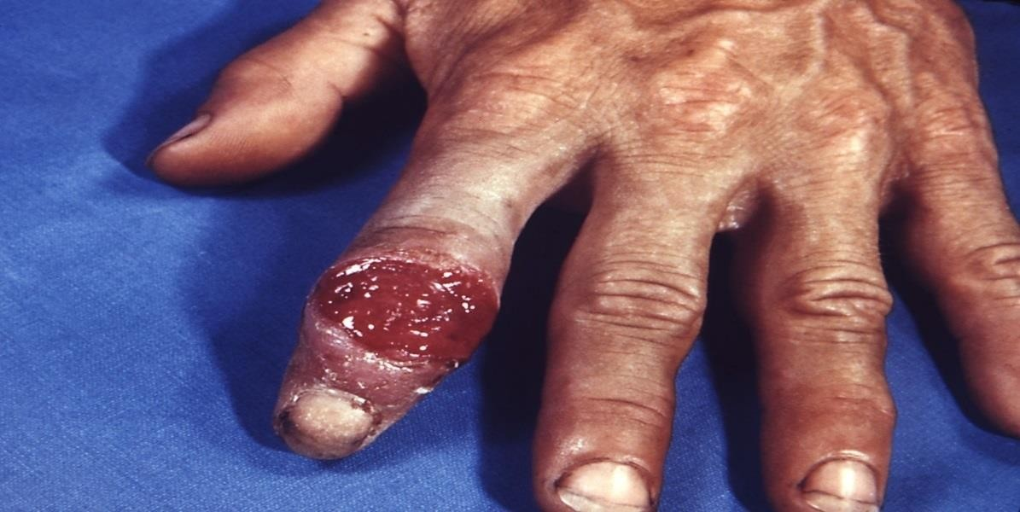
· Painless skin ulceration (a chancre)

Slide 6

· Diffuse skin rash & mucous membranes lesions

Slide 7
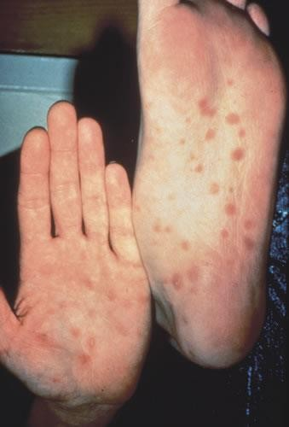
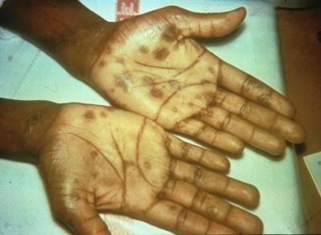
Source: Seattle STD/HIV Prevention Training Center at the University of Washington, UW HSCER Slide Bank
Source: CDC/NCHSTP/Division of STD
Prevention, STD Clinical Slides

Slide 8




































In latent syphilis there are little to no symptoms which can last for years.
70% may have NO SYMPTOMS

Slide 9
Approximately 30% of untreated patients progress to the tertiary stage within 1 to 20 years.
Rare because of the widespread use of antibiotics.
Manifestations as cardiovascular syphilis (syphilitic aortitis and an aortic aneurysm).

Slide 10
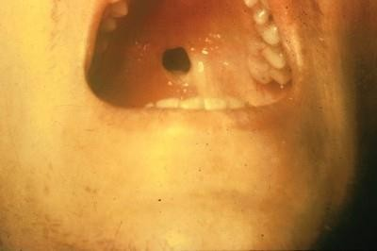
If a woman is pregnant and has symptomatic or asymptomatic early syphilis, disseminating organisms may pass through the placenta to infect the fetus.
Perforation of Palate

Slide 11
Penicillins***
Penicillin G
Procaine Penicillin G
Benzathine Penicillin G
Tetracyclines e.g. doxycycline
Macrolides e.g. azithromycin
Cephalosporins
  Ceftriaxone
  Cefixime

Slide 12
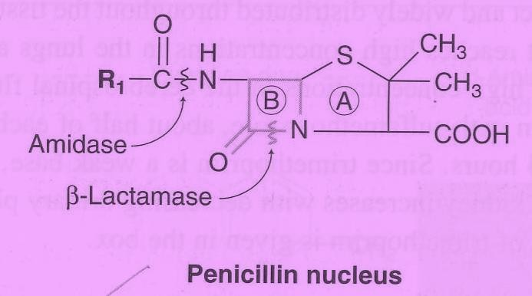
β-Lactam Antibiotics
Mechanism of action
◆ Inhibits bacterial cell wall synthesis through inhibition of transpeptidase enzyme required for crosslinks .
◆ Bactericidal

Slide 13
Benzylpenicillin (penicillin G)
Procaine penicillin G
benzathine penicillin G

Slide 14
Penicillin G
Short duration of action, given i.v.
Procaine penicillin G
Given i.m. - delayed absorption.
Long acting
Benzathine penicillin G
Given i.m. - Delayed absorption.
Long acting, 2.4 million units is given once.

Slide 15
All these penicillin preparations are:
Acid unstable
Penicillinase sensitive (β-lactamase sensitive)
Not metabolized
Excreted unchanged in urine through acid tubular secretion.
Renal failure prolong duration of action.

Slide 16
Hypersensitivity
Convulsions with high doses or in renal failure
Super infections

Slide 17

Macrolides e.g. Azithromycin
Tetracyclines e.g. doxycycline
Cephalosprins
Ceftriaxone – cefixime

Slide 18
Inhibit bacterial protein synthesis by reversibly binding to 30 S bacterial ribosomal subunits.
· Bacteriostatic.

Slide 19
Doxycycline
Given orally
· Well absorbed orally
Long acting
100 mg BID daily for 14 days.

Slide 20
Nausea, vomiting ,diarrhea & epigastric pain (given with food)
Brown discoloration of teeth in children
Deformity or growth inhibition of bones in children.
Hepatic toxicity ( prolonged therapy with high dose).
Vertigo
Superinfections.

Slide 21
Pregnancy
Breast feeding
Children (below 10 yrs)
21

Slide 22

Inhibits bacterial protein synthesis by binding to bacterial 50S ribosomal subunits.

Slide 23
Acid stable
Penetrates into most tissues except CSF
Half life : 2-4 days
Once daily oral dose
· Should be given 1hour before or 2 hours after meals
No effect on cytochrome P450

Slide 24

GIT upset: Nausea, vomiting, abdominal pain & diarrhea.
Allergic reactions: urticaria, mild skin rashes.

Slide 25
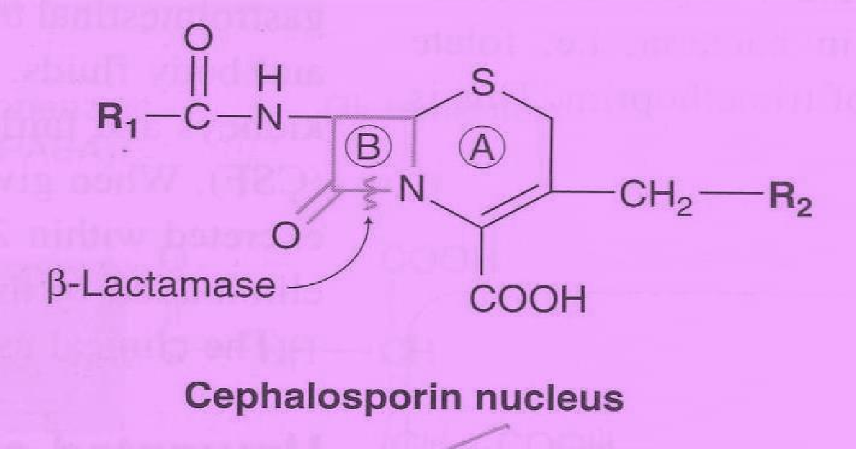
Inhibit bacterial cell wall synthesis
· Bactericidal

Slide 26
Ceftriaxone
Third generation cephalosporins
Given parenterally (i.v.)
Eliminated via biliary excretion
Long Half-life

Slide 27
Hypersensitivity reactions
1
Thrombophlebitis
2
Superinfections
3
Diarrhea
4

Slide 28
Early syphilis | WHO GUIDELINES FOR THE Treatment of Treponema pallidum (syphilis)
Adults (primary, secondary and early latent syphilis of not more than two years’ duration) | benzathine penicillin G 2.4 million units once I.M.
 | procaine penicillin G 1.2 million units I.M. for 10–14 days If penicillin is not allowed due to allergy, use
 | Doxycycline 100 mg twice daily orally for 14 days or Ceftriaxone 1 g IM once daily for 10–14 days or, Azithromycin 2 g once orally.
Pregnant woman | benzathine penicillin G 2.4 million units once I.M. procaine penicillin G 1.2 million units I.M. for 10–14 days If penicillin is not allowed due to allergy, use Erythromycin 500 mg orally four times daily for 14 days Ceftriaxone 1 g IM once daily for 10–14 days or, Azithromycin 2 g once orally.

Slide 29
Late syphilis | WHO GUIDELINES FOR THE Treatment of Treponema pallidum (syphilis)
Adults (infection of more than two years’ duration without evidence of treponemal infection) | benzathine penicillin G 2.4 million units nits I.M. once weekly for three consecutive weeks.
 | procaine penicillin G 1.2 million units I.M. for 20 days If penicillin is not allowed due to allergy, use
 | Doxycycline 100 mg twice daily orally for 30 days or
Pregnant woman | benzathine penicillin G 2.4 million units nits I.M. once weekly for three consecutive weeks. procaine penicillin G 1.2 million units I.M. for 20 days If penicillin is not allowed due to allergy, use Penicillin desensitization Erythromycin 500 mg orally four times daily for 30 days Ceftriaxone 1 g IM once daily for 10–14 days or, Azithromycin 2 g once orally.

Slide 30
Congenital syphilis
WHO GUIDELINES FOR THE Treatment
of Treponema pallidum (syphilis)
In infants with confirmed congenital syphilis
or infants who are or clinically normal,
but whose mothers
had untreated syphilis
Aqueous benzyl penicillin ( I.V.)
100 000–150 000 U/kg/day for 10–15 days
Procaine penicillin (I.M.)
50 000 U/kg/day single dose for 10–15 days

Slide 31


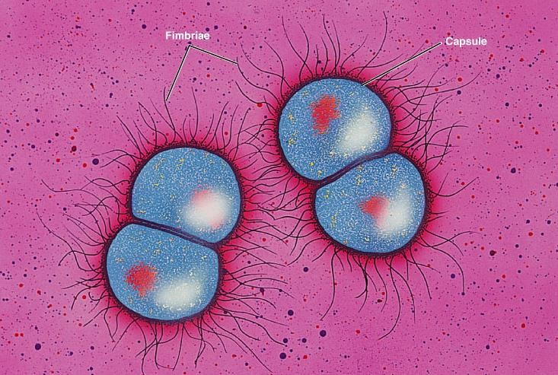
GONORRHEA
Caused by, Neisseria gonorrhea,
Pus producing bacteria
Gram –ve cocci

Slide 32
GONORRHEA
Transmitted during sexual contact with affected person.
Many people have no symptoms.
Men may have burning with urination, discharge from the penis or testicular pain.
Women may have burning with
urination, vaginal discharge, vaginal bleeding between periods, or pelvic pain.

Slide 33




3rd generation Cephalosporins***
e.g. Ceftriaxone, Cefixime
Fluoroquinolones**
e.g. Ciprofloxacin
Spectinomycin

Slide 34





Uncomplicated gonorrheal infections 3rd generation cephalosporins
500mg ceftriaxone, I.M. or 400 mg of cefixime, po
Typically given in combination with
a single dose of azithromycin(1gm, po) or doxycycline(100 mg BID, p.O.) for 7
days.

Slide 35
Single oral dose of : Ciprofloxacin(500 mg) Ofloxacin(400 mg)

Slide 36
All are bactericidal
Inhibit DNA synthesis by inhibiting DNA gyrase enzyme (required for DNA supercoiling).

Slide 37
GIT: Nausea , vomiting & diarrhea
CNS: Headache & dizziness
May damage growing cartilage and cause
arthropathy.
Phototoxicity, avoid excessive sunlight

Slide 38
Pregnancy
Nursing mothers
Children under 18 years

Slide 39









Slide 40

Inhibits protein synthesis by binding to 30 S ribosomal subunits.
· Is given 2 g, i.m, once.

Slide 41
Pain at site of injection
Fever
Nephrotoxicity (not common).

Slide 42




If left untreated, it can spread through blood stream into:
EYE
Joints
Heart valves
Brain

Slide 43


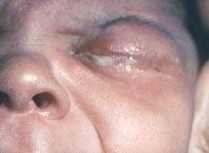
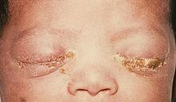
It can also spread from a mother to a child during birth.
Newborn eye infections conjunctivitis, may lead to blindness

Slide 44
WHO guidelines suggest one of the following options for topical application to both eyes immediately after birth:
Silver nitrate 1% solution or
Erythromycin 0.5% eye ointment or
Tetracycline hydrochloride 1% eye ointment or
Povidone iodine 2.5% solution (water-based) or
Chloramphenicol 1% eye ointment

Slide 45
· It has germicidal effects due to precipitation of bacterial proteins by liberated silver ions.
Put into conjunctival sac once immediately after birth (no later than 1 h after birth )

Slide 46

0.5% ointment for treatment & prevention of corneal & conjunctival infections.
Put into conjunctival sac immediately after birth (no later than 1 hr after delivery )

