Slide 1
Lecture 1 Hypothalamic and pituitary gonadal axis
Dr. Laila Al Dokhi
Assistant Professor
Department of Physiology

Slide 2
Objectives
By the end of this lecture, you should be able to:
Characterize hypothalamic pituitary relationship
Name the hypophysiotropic hormones and outline the effects that each has on anterior pituitary function
Name anterior pituitary gonadotropic hormones and outline the effects that each has on the gonads
Describe the negative and positive feedback mechanisms in the hypothalamic-pituitary-gonadal axis and their importance in the control of reproductive function
Keywords: hypophysiotropic hormones, gonadotropic hormones, androgens, estrogens

Slide 3
What is a hormone?

Slide 4
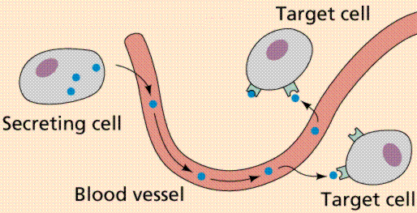
Definition of hormone

Slide 5
Small group activity
How hypothalamus controls anterior pituitary?
What are the hormones secreted by anterior pituitary?
How hypothalamus controls posterior pituitary?
What are the hormones secreted by posterior pituitary?

Slide 6
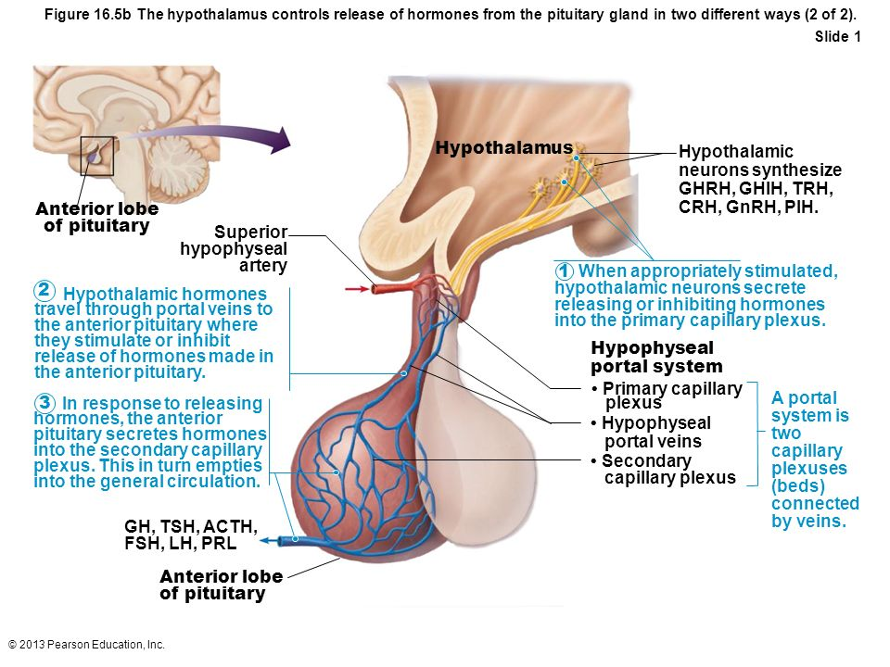
Connection between Hypothalamus and anterior pituitary gland
Hypothalamic-hypophysial portal vessels

Slide 7
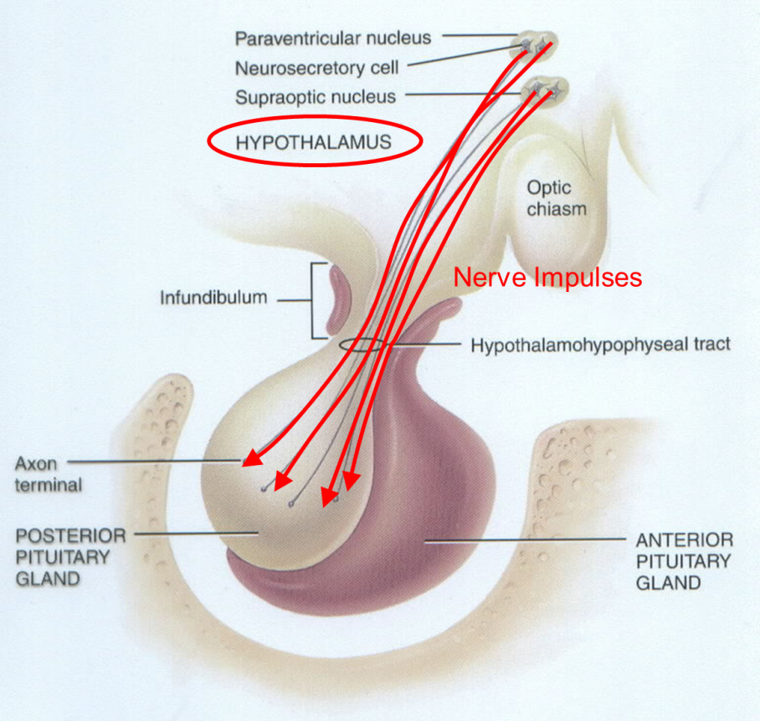
Connection between the hypothalamus and Posterior pituitary gland
Hypothalamohypophysial tract between the hypothalamic neuclei (supraoptic and paraventricular nuclei) and posterior pituitary gland
(neural connection)

Slide 8
The anterior pituitary secretes six hormones:
Adrenocorticotropic hormone (corticotrophin, ACTH)
Thyroid-stimulating hormone (thyrotropin, TSH)
Growth hormone (GH)
Follicle-stimulating hormone (FSH)
Luteinizing hormone (LH)
Prolactin (PRL)

Slide 9
Control of male sexual functions by hypothalamic & anterior pituitary hormones :
GnRH :
A peptide secreted by the arcuate nuclei of the hypothalamus
Stimulate anterior pituitary gland to release gonadotropins (LH and FSH).
GnRH is secreted intermittently for few minutes every 1 to 3 hrs.
Secretion of LH by the anterior pituitary is also cyclical following the pulsatile release of GnRH.

Slide 10
Regulation of Testosterone production by LH:
Testosterone is secreted by leydig cells, in the interstitium of the testis, by LH stimulation from the AP and
Its release is directly proportional to the amount of LH.
Mature leydig cells are found in a child’s testis few weeks after birth & then disappear until puberty when it appear again.

Slide 11
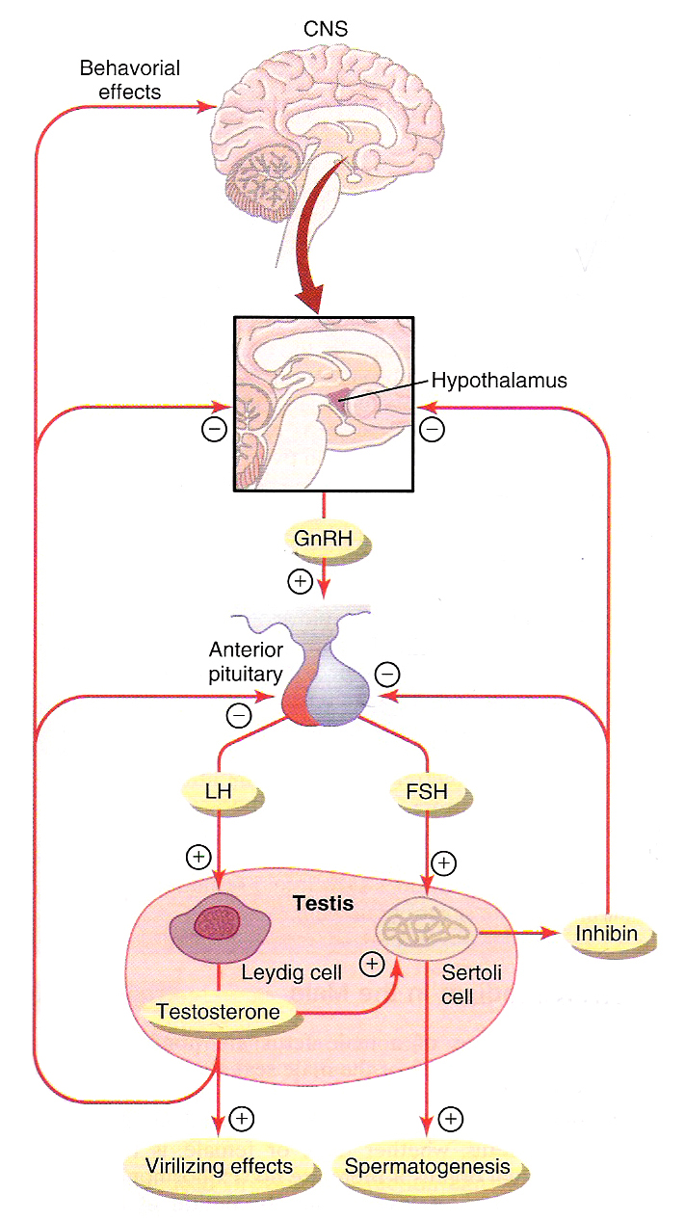
Negative feedback control of testosterone
LH stimulate Testosterone secretion by the testis
Testosterone inhibit the secretion of LH.
Most of the inhibitory effect result from direct inhibition of GnRH release from the hypothalamus
Inhibition of GnRH leads to decrease secretion of both LH & FSH.

Slide 12
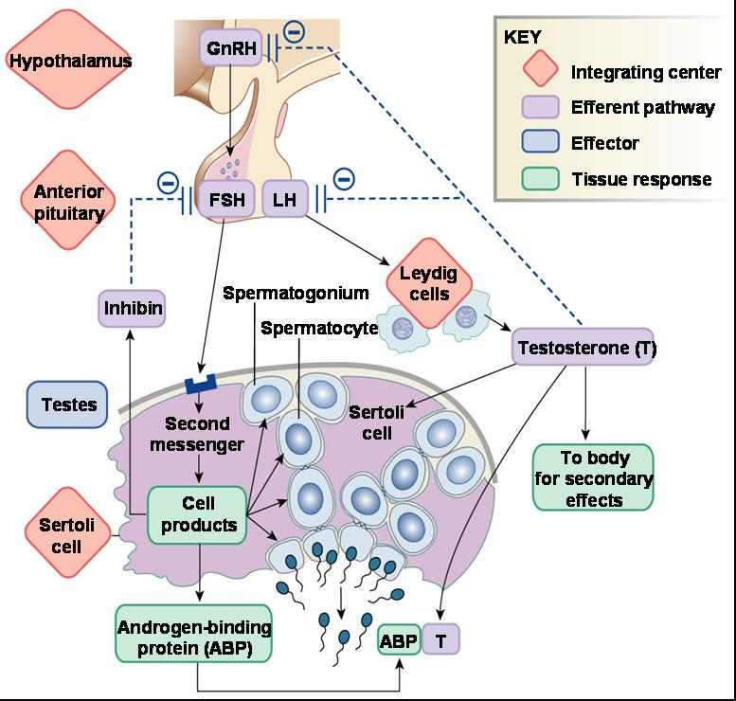
Regulation of spermatogenesis by FSH and testosterone
FSH binds with specific FSH receptors attached to the sertoli cell in the seminiferous tubules, which causes these cells to grow & secrete spermatogenic substances.
Also testosterone & dihydrotestosterone diffuses into the seminiferous tubules from the leydig cells affect the spermatogenesis,
So both FSH & testosterone are necessary to initiate spermatogenesis.

Slide 13
Negative feedback control of seminiferous tubule activity Role of the hormone inhibin:
When the seminiferous tubules fail to produce sperm the secretion of FSH from the AP increases.
Conversely, when spermatogenesis proceeds rapidly pituitary secretion of FSH diminishes.
This is due to the secretion of inhibin hormone from the sertoli cells which strongly inhibit the AP- FSH
Inhibin has slight inhibitory effect on the hypothalamus to inhibit GnRH secretion.

Slide 14
Regulation of the female monthly rhythm Interplay between the ovarian and hypothalamic-pituitary hormones:
Hypothalamic centers for release of GnRH:
The neural activity that causes release of GnRH occurs in the mediobasal hypothalamus, in the arcuate nuclei which regulate most of the female sexual activity.
Secretion of AP hormone is controlled by “releasing hormones”
GnRH is secreted in pulses lasting 5-25 minutes every 1-2 hrs.
The pulsatile release of GnRH cause intermittent output of LH secretion about every 90 minutes.

Slide 15
Follicular phase
After menstruation the level of FSH & LH increases
Mainly FSH accelerates growth of few follicles (6-12 follicles).
The growing follicle secrets increasing amounts of estrogen

Slide 17
Negative feedback effects of estrogen and progesterone
Estrogen in small amounts has strong effect to inhibit the production of LH & FSH.
This inhibitory effect of estrogen is increased when progesterone is available.
This inhibitory effects more on the AP directly & to lesser extent on the hypothalamus to inhibit the secretion of GnRH.
Hormone inhibin from the corpus luteum inhibits FSH & LH secretion:
The hormone inhibin secreted by the granulosa cells of the ovarian corpus luteum inhibit the secretion of FSH & to lesser extent LH.

Slide 18
Positive feedback effect of estrogen before ovulation – the pre-ovulatory LH surge:
AP secretes increased amount of LH for 1-2 days before ovulation.
FSH surge is much smaller in the pre-ovulatory than LH surge.
The possible causes of LH secretion could be:
Estrogen has special positive feedback effect of stimulating pituitary secretion of LH & to a lesser extent FSH
The granulosa cells of the follicle begin to secrete small increasing amount of progesterone about 1 day before ovulation which stimulate LH secretion

Slide 19
Feedback oscillation of the hypothalamic-pituitary-ovarian system:
Postovulatory secretion of the ovarian hormones, and depression of the pituitary gonadotropins:
During the postovulatory phase the corpus luteum secrete large quantities of both progesterone ,estrogen & inhibin
Which all together cause negative feedback effect on AP & hypothalamus to inhibit both FSH & LH secretion.
(lowest level 3-4 days before the onset of menstruation)

Slide 20
Follicular growth phase :-
2 -3 days before menstruation, corpus luteum regress & secretion of estrogen, progesterone & inhibin decrease.
This decrease remove the negative feedback effect on AP hormones.
Therefore a day after menstruation FSH secretion begins to increase (2 folds) while LH secretion is low.
These hormones causes growth of a new follicle.
During the first 11 to 12 days of the follicular growth the rate of secretion of FSH & LH decrease due to the negative feedback effect of estrogen on the AP.

Slide 21
https://youtu.be/2_owp8kNMus

